Slide 1
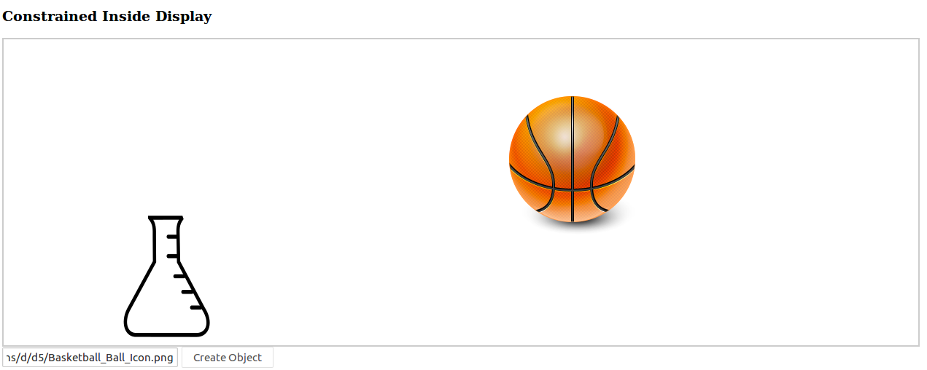
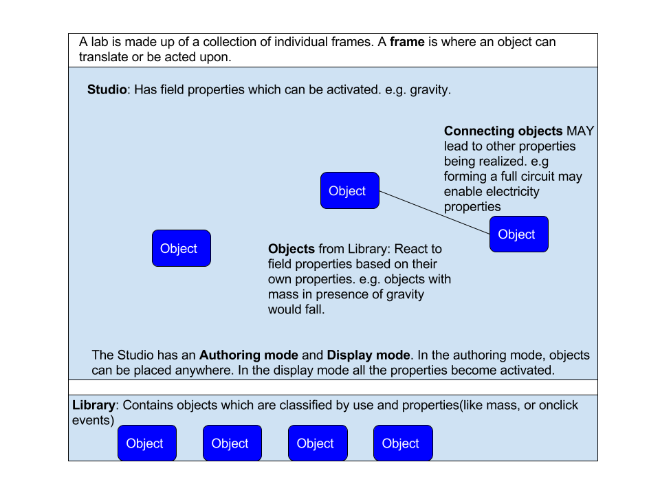

Lab Authoring Tools for Virtual Labs
AIM
To create a set of tools so that anybody with an idea for an online lab should be able to create one. It should be interactive and user friendly, making use of a library of objects with pre-determined and customizable properties
METHODS
With a strong requirements mindset, we looked through many industrially used modeling and experimentation tools. Most are too complex and have a high learning curve. In addition they give a level of precision which is not required by us.
We came up with a programming model to be followed during the development of these tools:
INTRODUCTION
Currently there exists many online lab experiments where students learn and interact with a site to learn various concepts. The problem is that most of these experiments are manually coded in javascript(before flash as well). There is a lack of easily accessible tools for a person who has an idea for an interactive lab but lacks the necessary expertise to create one. To go about building such a tool, a survey of existing tools availabile in the industry (and their corresponding standards) needed to be done.
RESULTS
We did a comparative study on many modeling related tools present in the industry.
Following our own programming model and developing, we are able to place images / objects onto a screen and place them in any location we want to.
CONCLUSIONS
Further development needs to be done in this area however it is quite promising. The survey has led to potential for integrating our programming model with other tools.
The progress so far can be used in other projects which have a strong requirement for finding an easier way to place and manipulate objects on a screen.
Projit Bandyopadhyay

