Slide 1
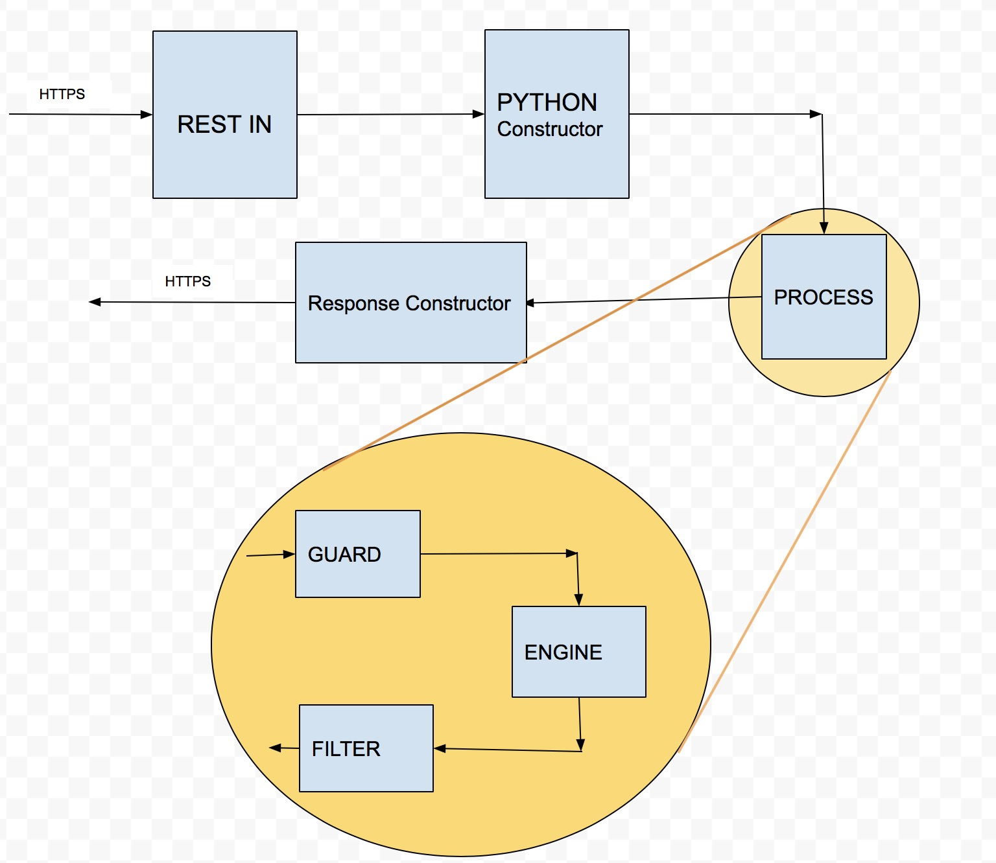
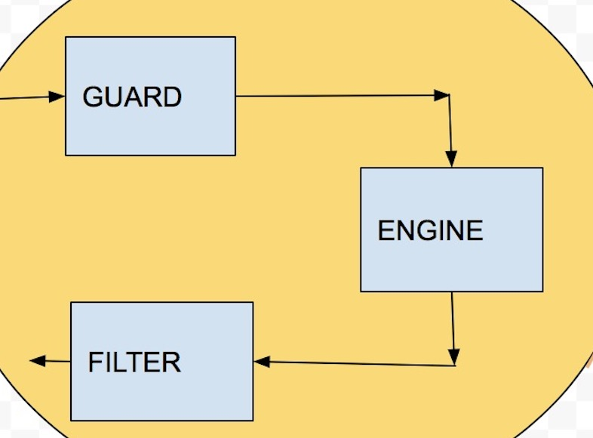
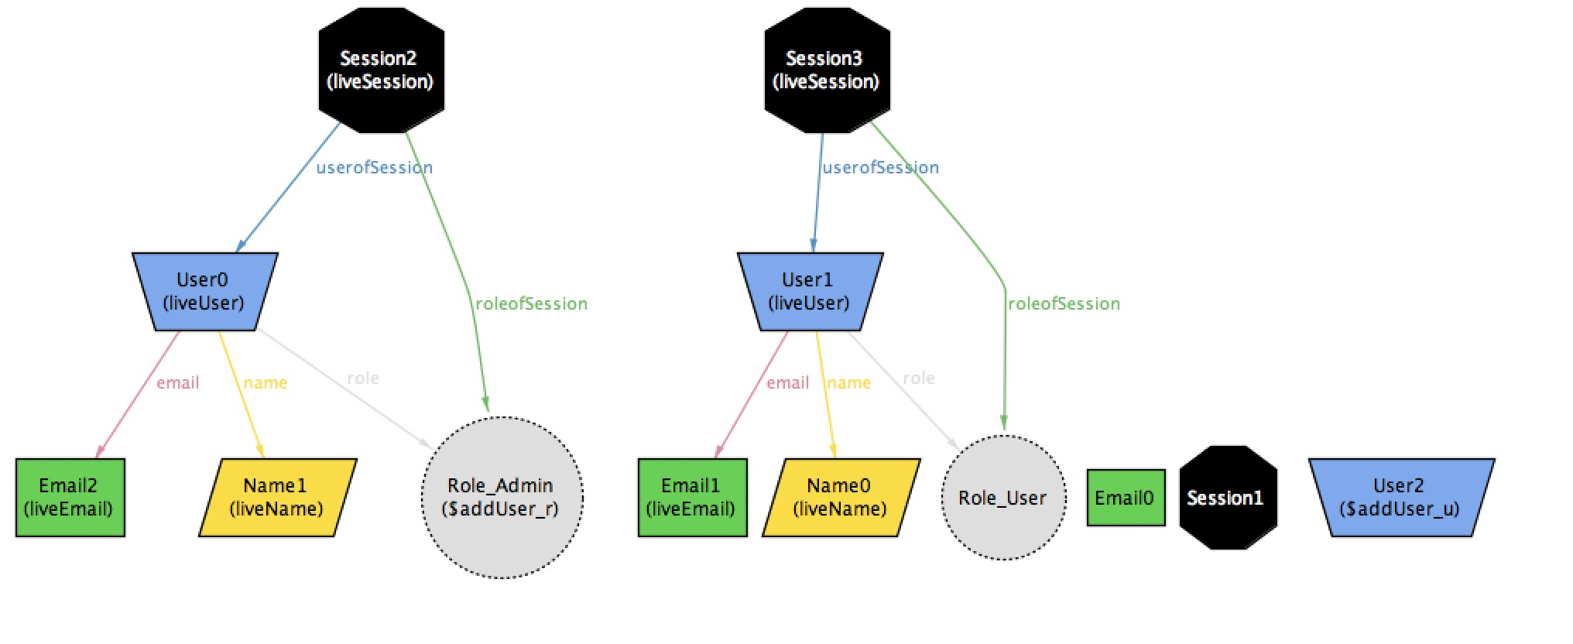
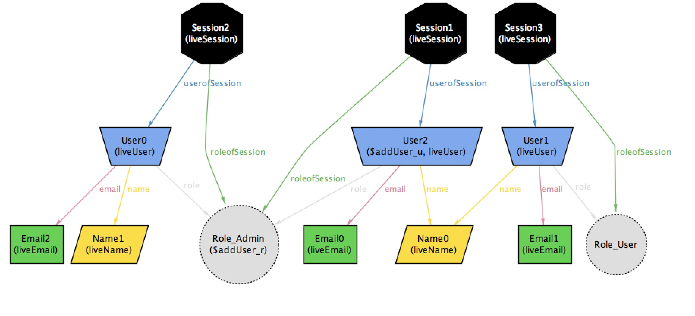
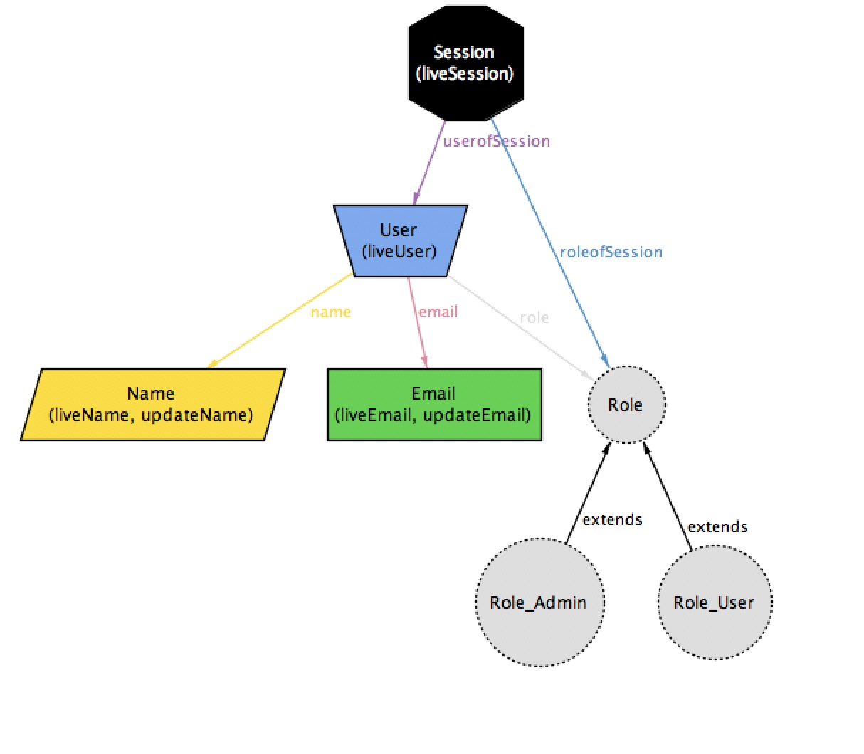
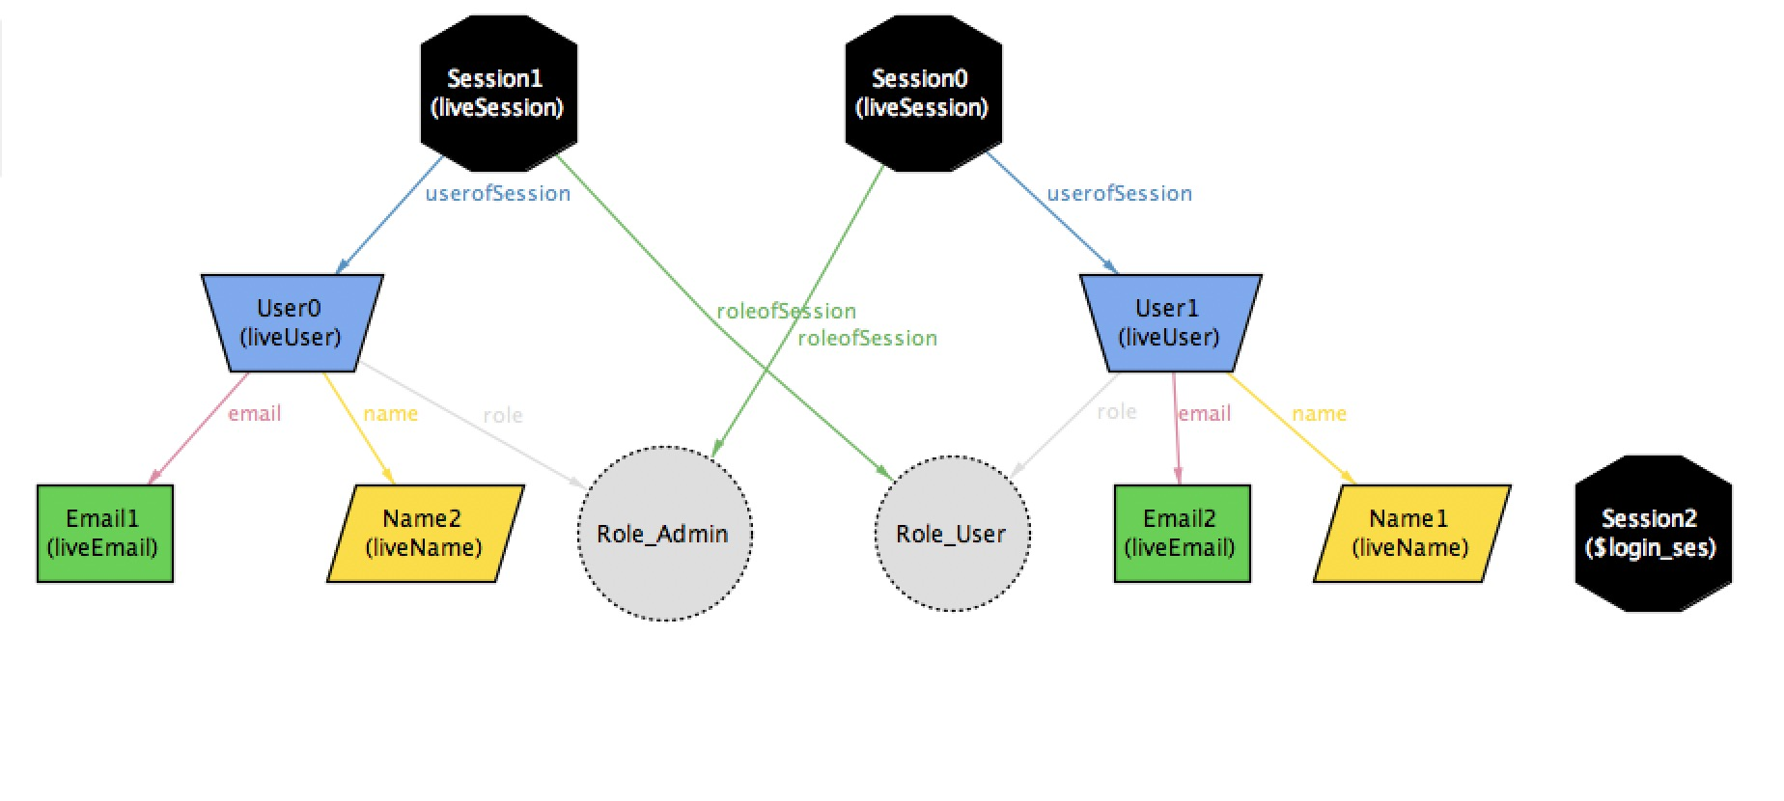
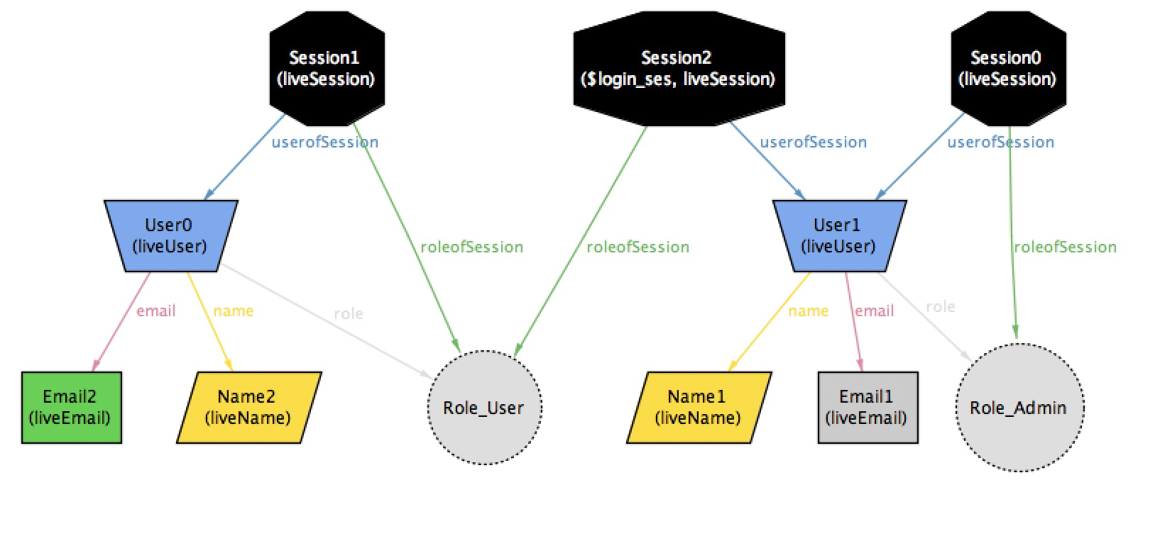
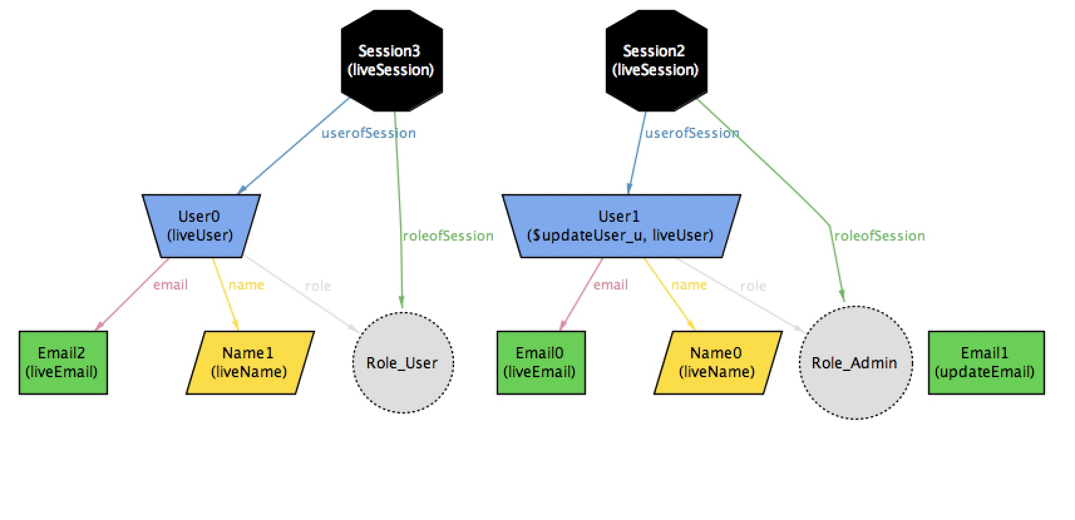
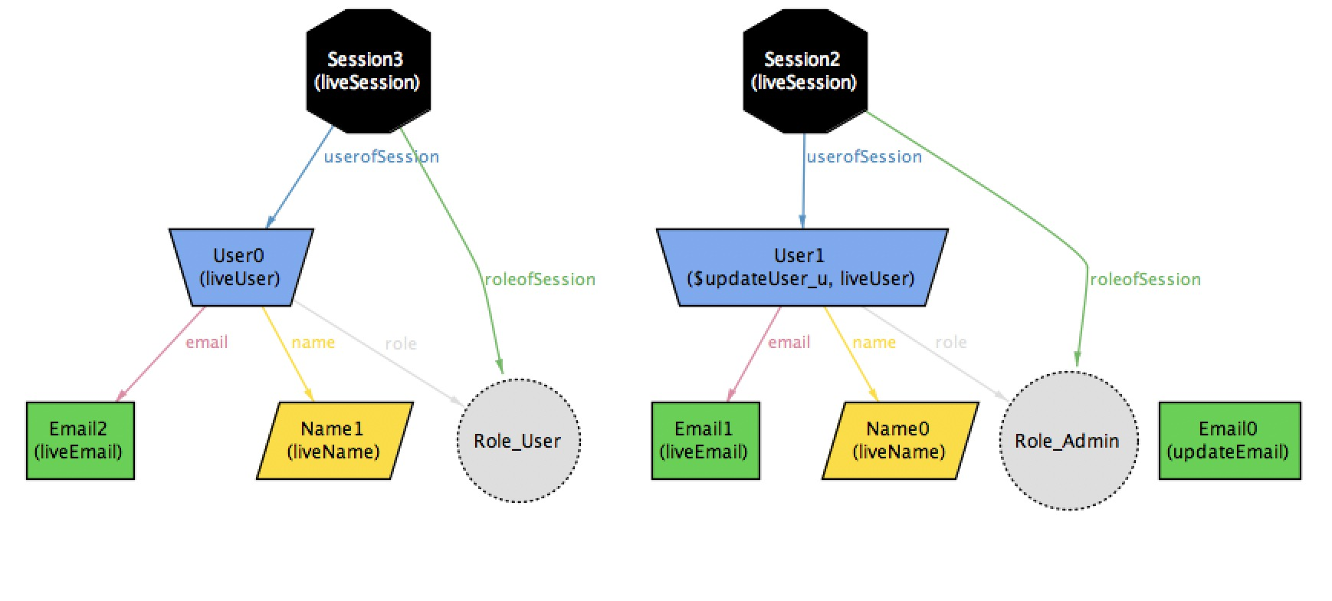
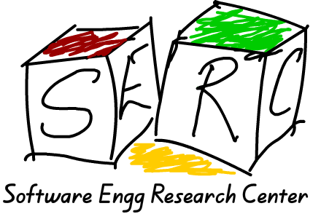
Alloy and web-app-short-course
AIM
To show the advantages of modelling during the development of an application.
More emphasis on the requirements.
To remove the bugs directly during development process rather than during the production of the app.
To show that modular development helps in pipelining and automation.
METHODS
Routing: All the operations in the app follow a workflow, i.e, an instruction is generated from the REST API and sent to the components.The app has 2 components,
Guard:This does all the checks
such as type check, auth check
and state check depending
upon the type of instruction.
Engine :This does the
operations on the entities and
returns the result.
Alloy Model
Add user: This example shows user being added by the admin in system.
before the user is added after the user is added
User Login : This example shows user login inside of the system.
before the user is logged in after the user is logged in
Update user: This example shows user credentials being updated by the admin in system.
before user is updated after user is updated
MODULAR DEVELOPMENT
Modular development is a technique which is
used to break down our app into independent
modules which can perform a task.We combine
all such modules in a certain order(i.e, we
generate a workflow) to get a certain
operation done.
workflow of the app
INTRODUCTION
Alloy and formal methods of web development :
This Web-application is a simple user directory.It allows users have role, name, email.This app has many functionalities such as add, update, delete show users etc,.It is written in python.
Alloy is a tool for relational modelling which uses expressive login based notations.
We used alloy to show
the various constrains
that a application model
faces while designing it.
eg.1.Can users have same
name or email?.2.How
many roles a user can
have? -The Alloy Analyzer generated metamodel
of the app showing the relations of all the
entities in the app
Motivation to model our app in a specification language(like Alloy) is that it helps us in checking the correctness of our data-model before actually writing the real code.Also, the client may ask us to add new requirements or constraints and there is a necessity to check whether the new constraints don’t break the constraints of the previously present requirements.
RESULTS
Completed all the necessary routes(12 routes) and their tests (totally 114 tests)in the web-app-short-course.
The routes are successfully built modularly.
Relational modelling helped us in defining a better database for the app and also helped in achieving the requirements without any bugs.
CONCLUSIONS
Our work shows how using a specification language to model our app helps us in understanding the requirements better.
Modelling in Alloy and modular development helps in automating the process of developing an application by giving some inputs and requirements.
Modular development helps in achieving pipelining as each module is independent and can be used according to the operation.
Developers name: Anirudh Reddy, Shubh Maheshwari
Mentors : Professor Venkatesh Choppella, Thirumal Ravula

