Slide 1
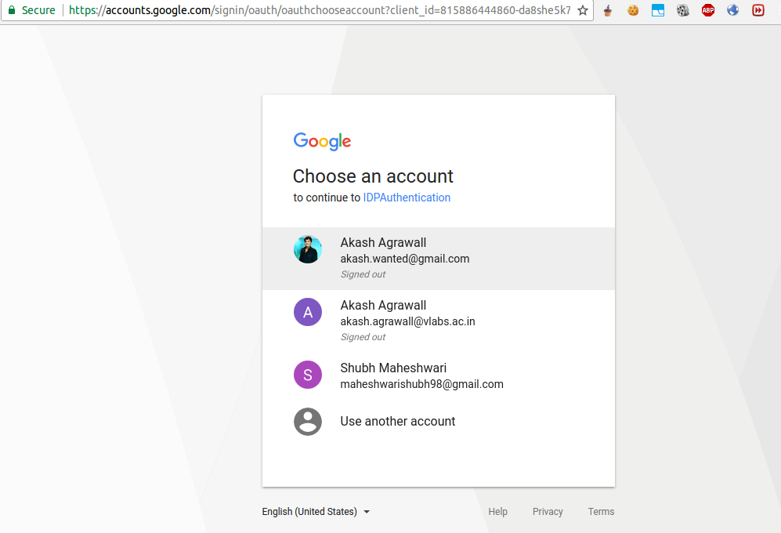
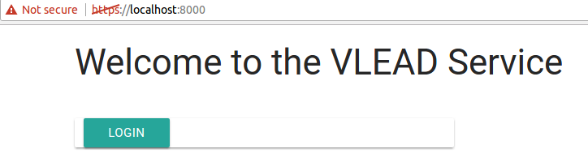
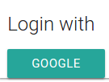
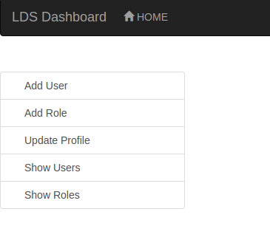

Authentication and Authorization Between VLabs Services
AIM
VLabs follows a microservice architectural style to increase modularity and allow for scaling and requires authorization / authentication between servers. We needed to survey industrial standards and build a model of for the interactions required. The model authentication system should support Single-Sign in principle.
Phase 2
We have done an implementation of the oauth service model using an Oauth Server, a client server and LDS dashboard, an existing VLEAD microservice.
METHODS
In our model the following endpoints exist:
Login with Google:
The user is redirected from the microservice to Oauth Server. Using Google Sign-On, the user is authenticated by Google.
After Authentication:
Users credentials are available at the check_login() end point of the oauth service.
Logout:
Oauth server logs out user of all the microservices.
Service 1
Service 2
Oauth Server
INTRODUCTION
We are trying to make an oauth service using Google as a Single Sign-On followed by common authorization for all the services
The Project could be split up into two phases:
1. Surveying and Research
2. Implemenntation
Phase 1
We needed to survey current industrial standards according to our requirements and look for for possible solutions.
RESULTS
After analysis of various standards, we decided to use an approach encorporating the Oauth protocol.
We have incorporated the oauth model with LDS dashboard and Google sign-on.
CONCLUSIONS
Decided that we should use an Oauth protocol based system to provide both authentication(via user flow) and authorization between services(server flow).
To secure and maintain the microservices, we must apply a layer of proxy and handle all the requests through an API gateway.It would be this gateway which would also incorporate of Oauth.
Developers:
Projit Bandyopadhyay,
Shubh Maheshwari

