Slide 1
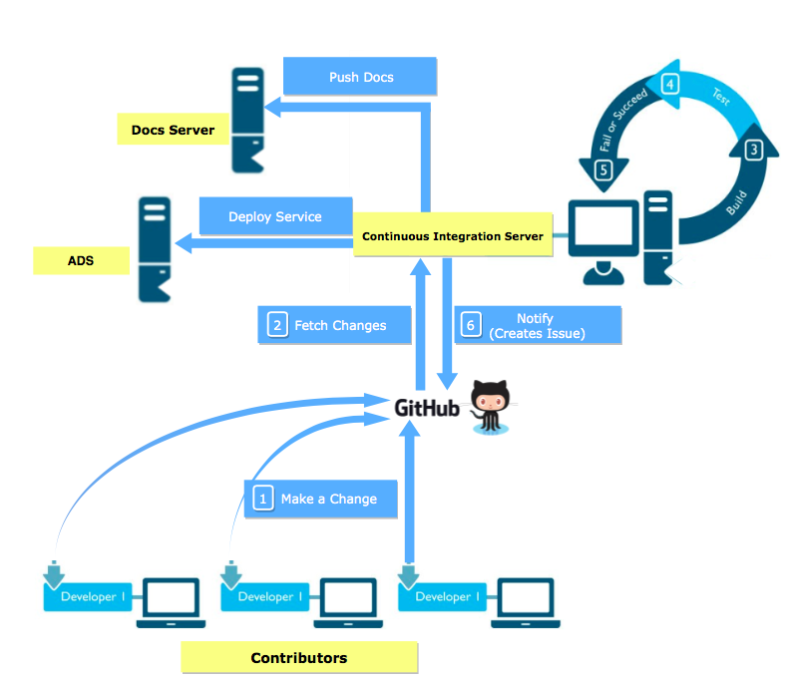

CONTINUOUS INTEGRATION
AIM
To ensure evolution of software and solicit contribution from folks across the world, continuous integration is to be built around each lab/service of VLEAD/Virtual-Labs organisations. A cycle for integration should involve building the code, running the tests suite, notifying the users and deployment.
METHODOLOGY
Our basis of the whole implementation was to build a micro-service which could be scaled over time with the requirement. One of the best ways to implement a micro-service is using flask in python. The continuous integration service was provided in the form of APIs to the contributors/developers. The functionality provided by Github web-hooks were exploited to invoke these APIs whenever a change was made to the repo. The JSON payload sent by these webhooks were used to extract information from about the repository to carry on further processing involved in the continuous integration process(Building, testing, notification, etc). Apart from this certain shell scripts were used to align the notification process to our requirement. Similar APIs were built using flask to pipeline this continuous integration process with the current auto deployment process which would deploy the application in the production environment after the successful build and tests. Security issues were also dealt with by making this service exclusive to only repositories part of Virtual-Labs and VLEAD(this is configurable as per the requirement). This service is hosted using NGINX and G-Unicorn along with the already running services.
INTRODUCTION
Continuous integration is a DevOps software development practice where developers regularly merge their code changes into a central repository, after which automated builds and tests are run. Continuous integration most often refers to the build or integration stage of the software release process and entails both an automation component (e.g. a CI or build service) and a cultural component (e.g. learning to integrate frequently). The key goals of continuous integration are to find and address bugs quicker, improve software quality, and reduce the time it takes to validate and release new software updates.
A lab is currently defined as a set of related experiments and is a web application. Each lab is a repository on github. In the past, developers would work in isolation and only attempt to merge their changes to the master branch once their work was completed. This batched process made merging accumulated code changes difficult and time-consuming. This is compounded when small bugs accumulate for a long time without correction.
With continuous integration, developers from around the world can contribute to Virtual Labs. The continuous integration service detects commits to the shared repository, and automatically builds and runs unit tests on the new code changes to immediately surface any functional or integration errors.
RESULTS
The service was hosted in the testing environment. Unit test cases and integration tests created during the development ran successfully. Further one of the existing services from VLEAD were taken and tested with our continuous integration service. Our Service was able to provide it’s functionality without any issues.
CONCLUSIONS
Micro-services is a great way to cater the need of our requirements and offer a simple solution.Instead of relying on heavy industry existing continuous integration service like Jenkins or Travis which wasn’t able to satisfy all our complete set of functional requirements we were able to provide by developing our own micro-service for it.
Developers name: Srikar, Savar, Sripathi.

