Slide 1
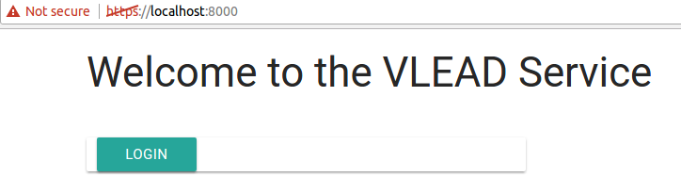
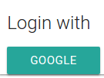
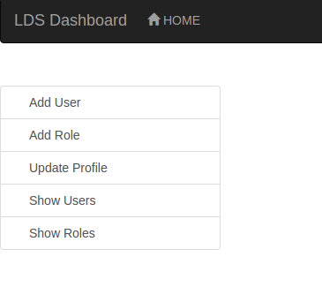
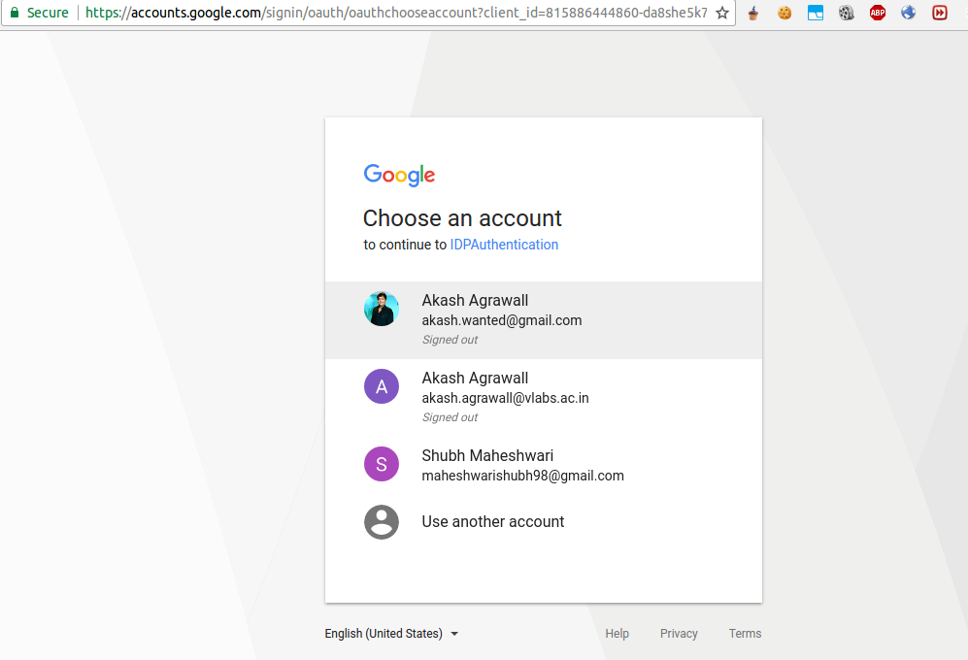

Authentication and Authorization Between Services
AIM
VLabs follows a microservice acrchitectural style to increase modularity and allow for scaling. With different services sitting on different servers authorization in between is required. An authentication system allowing for Single-Sign On is also needed.
Phase 2
We have done an implementation of the oauth service model using an Oauth Server, a client server and LDS dashboard, an existing VLEAD microservice.
METHODS
1. In our Oauth Model the user opens one of the microservices and tries to login into VLEAD
Authentication with Google:
The user is redirected to our microservice. Using Google Sign-On, the user is authenticated by Google.
After Authentication:
Now the users credentials are available at the check_login() end point of the oauth service.
Logout:
User is logged out of all the microservice
INTRODUCTION
We are trying to make an oauth service using Google as a Single Sign-On followed by common authorization for all the microservices
The Project could be split up into two phases:
1. Surveying and Research
2. Implemenntation
Phase 1
We needed to survey current industrial standards according to our requirements and look for for possible solutions.
RESULTS
Phase 1
After analysis of various standards, we decided to use an approach encorporating the Oauth protocol.
CONCLUSIONS
Phase 1
Decided that we should use an Oauth protocol based system to provide both authentication(via user flow) and authorization between services(server flow).
Projit Bandyopadhyay,
Shubh Maheshwari

