Slide 1
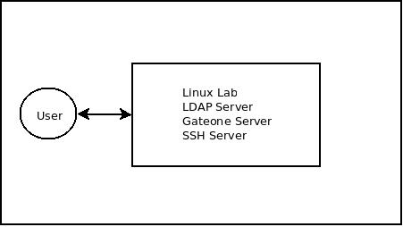

Hosting Linux-lab based on web-based interactive terminal
METHODS
This lab is a combination of many servers put together to achive the desired goal.
Here is the list of the servers and brief info about each of them :-
1. L.D.A.P server :- Lightweight Directory Access Protocol (LDAP) is a standard protocol designed to manage and access hierarchical directory information over a network. In linux lab, it is used as a centralized authentication system.
2. Gateone server :- Gateone is an open source, web-based terminal emulator with a powerful plugin system. In linux lab, gateone is used to run a terminal application on user’s browser.
3. SSH server :- As gateone server is an amazing SSH client. So, here SSH is used with gateone server to server the purpose of the lab.
AIM
The aim of this lab is to build a interactive web-based terminal. This interaction is not just to see the output of executed command on browser but to hover over the command outputs to see the info about that command i.e what are the arguments? and how many are them?.
Moreover, one can also see what that command does and how it can be used with different flag just by hovering over that command. It will use javascript framework over the gateone to achive this.
INTRODUCTION
Linux-Lab is a tool for learning command-line interface in an innovative way. The main motive behind this lab is to save time and learn efficientely as usually it takes a good deal of time and experience to learn command-line. With this lab, one can learn linux without damaging his system as this lab uses web-based terminal. One can learn linux without actually installing any
Linux-operating system.
For many CSE related virtual labs, it is a fundamental requirement to provide a way for the user to interact with a computer. This interaction could be the execution of system command to observe the output, the execution of a program to see the result or the execution of a program by an evaluation mechanism. It is desirable to make this interaction imitate a real system interaction as closely as possible. Hence, providing a terminal emulator on the user’s browser while taking care of security considerations would be a good solution.
RESULTS
Linux lab is ready to be integrated with virtual labs, with some security features to be implemented :-
1. Capthca in register.
2. Restricting user root privileges.
Moreover, the idea of javascript framework on gateone for hovering over the command outputs to get info is still to be implemented.
CONCLUSIONS
It is a lot easier to learn linux command line interface in this way. It gives opportunity to users for experimenting on web-based terminal which they can’t do on their systems.
It is lot easier to get info about commands just by hovering rather than exploring man-pages.
Developers name: Nikhil Bansal, Yogesh agrawal
Mentor : Venkatesh choppella

