Slide 1
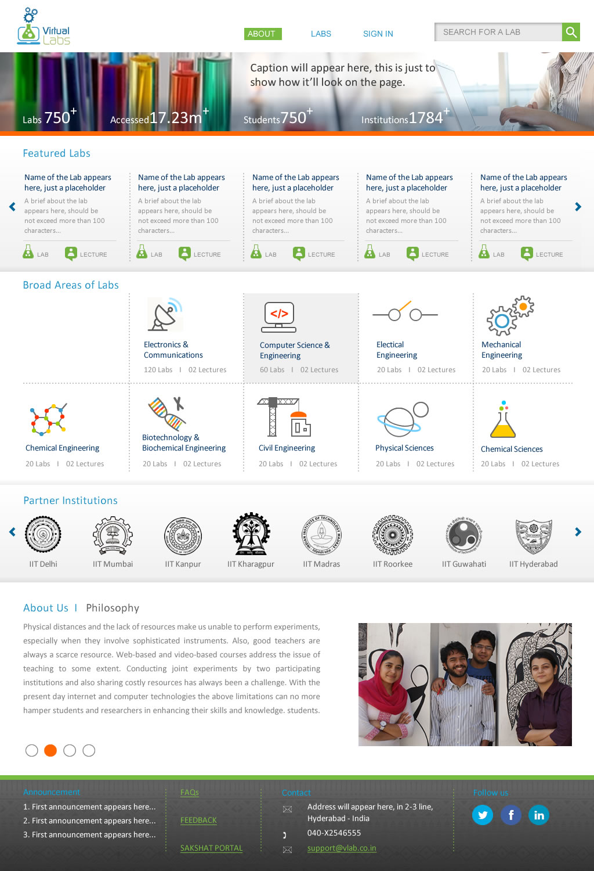
Here we will show 1 lab from each domain. A brief write-up about the lab, and the corresponding link to experiments and NPTEL lectures. Please refer to the attached Excel Sheet called (Features Labs)
Replace “Broad Areas of Labs” with
“Disciplines and Domains”
Clicking a discipline will take the user to the next page.
Clicking a partner institution will take the user to the list of labs (as in the current website. For example: clicking on IIT Delhi, will take the user to http://vlab.co.in/institute_detail.php?ins=001
We will have different photographs for the 4 tabs.
The content for each tab is given in Slide 3.

Slide 2
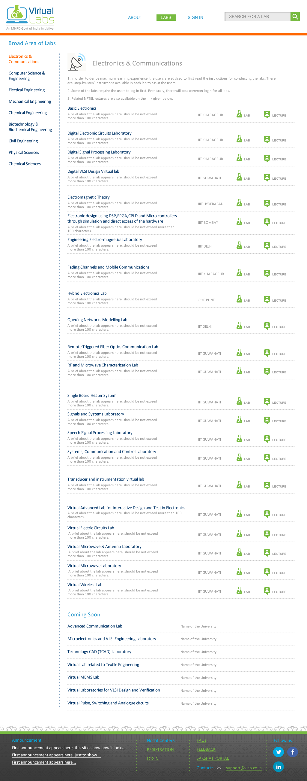
Similar page should come up for all the Disciplines listed here.

Slide 3
Tab 1
About Us | Virtual Labs
With 150 labs and about 1500 experiments across multiple disciplines developed by the leading , Virtual Labs is one of the largest educational initiatives in the world.
These labs, developed by faculties from the top technical institutes of the country, address the issue of lack of good laboratory facilities, as well as trained teachers, by making remote and simulation-based experimentation possible through the Internet.

Slide 4
Tab 2
About Us | Objectives
To provide remote-access to Labs in various disciplines of Science and Engineering for students at the undergraduate level, post graduate level and research scholars.
To arouse curiosity in students and help them learn basic and advanced concepts through remote experimentation.
To provide a complete Learning Management System around the Virtual Labs to provide students access to web-resources, video-lectures, animated demonstrations and self-evaluation.
To provide remote access to costly equipment and resources, which are otherwise available to limited number of users due to constraints of time and physical locations.

Slide 5
Tab 3
About Us | Philosophy
Often, physical distances and lack of sophisticated laboratory equipment make it difficult for students to perform experiments. Also, good teachers are always a scarce resource. While web-based and video-based courses address the issue of teaching, remote experimentation overcomes the problem of access to costly laboratory equipment.
Web-enabled remote experiments ensures that costly instruments and equipment are shared with fellow researchers to the extent possible.
Today most equipment has a computer interface for control and data storage. Internet-based experimentation permits use of resources such as knowledge, software, and data available on the web effectively.

Slide 6
Tab 4
About Us | Key Features
Virtual Labs offers various types of experiments for students to perform online.
Modeling or simulating the physical phenomenon by a set of equations to yield the result of a particular experiment.
Remotely triggering an experiment in an actual lab and providing the student the result of the experiment through a computer interface. This would entail carrying out the actual lab experiment remotely.
Accompanying audio and video streaming of an actual lab experiment and equipment.

Slide 7
Tab 4
About Us | Key Features
Virtual Labs offers various types of experiments for students to perform online.
Modeling or simulating the physical phenomenon by a set of equations to yield the result of a particular experiment.
Remotely triggering an experiment in an actual lab and providing the student the result of the experiment through a computer interface. This would entail carrying out the actual lab experiment remotely.
Accompanying audio and video streaming of an actual lab experiment and equipment.

Slide 8
Tab 4
About Us | Key Features
Virtual Labs offers various types of experiments for students to perform online.
Modeling or simulating the physical phenomenon by a set of equations to yield the result of a particular experiment.
Remotely triggering an experiment in an actual lab and providing the student the result of the experiment through a computer interface. This would entail carrying out the actual lab experiment remotely.
Accompanying audio and video streaming of an actual lab experiment and equipment.

