Slide 1
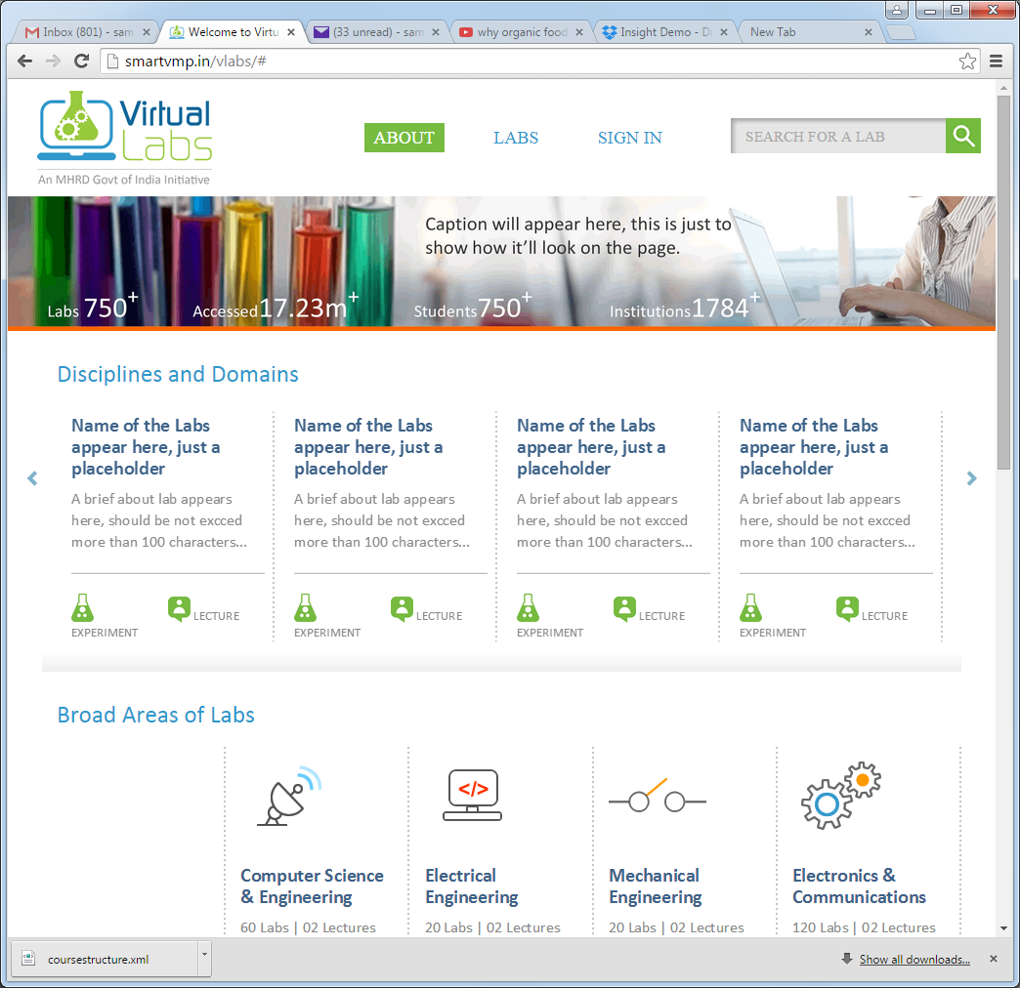
Refer to the Content-landing-pages_July10.ppt for all content changes
Example: The first title should be Featured Labs
Example: This title should be Disciplines and Domains

Slide 2
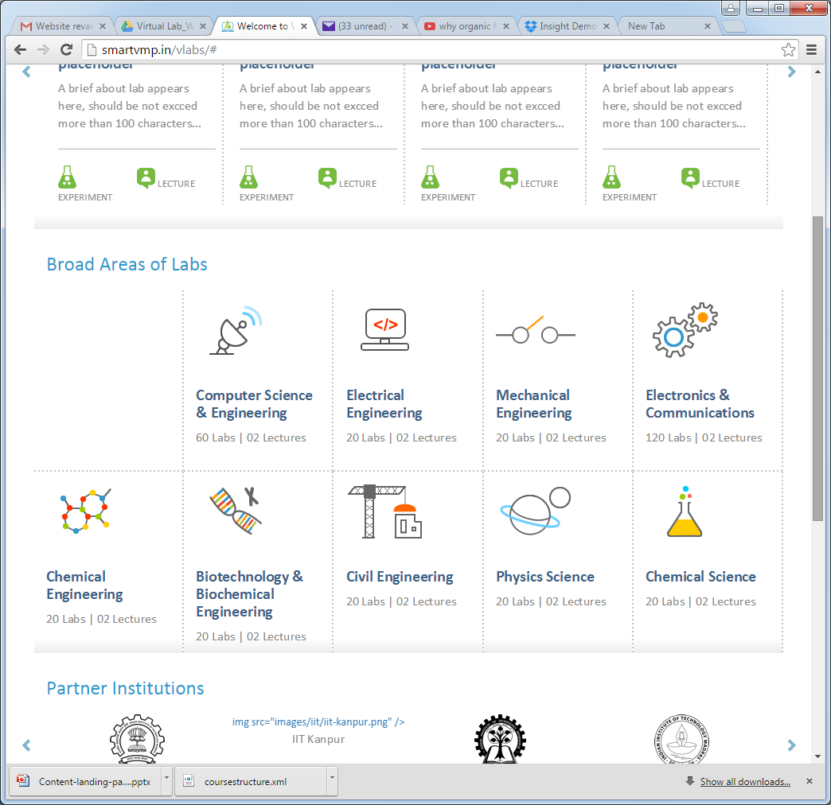
All these labels for icons under Broad Areas of Labs . Refer to the Fireworks files provided.

Slide 3
About Labs and SIGN: font should be Calibri, 15, #2C99CD
SEARCH FOR LAB: font should be Calibri, 15, #666666
Use hover image: for Search icon: icon_search_over
Geeta to provide caption and numbers for Labs, Accessed, Students
This image looks really pixelated, the original seems to be fine. I work at 1920 resolution, Geeta, do you also see the same problem.
Vikram, do you want me to provide high resolution image?
Lab and Lecture, have provide hover images for both icons
Experiment should be in the same line of the icon and (like Lecture)
Grey line: 1 pixel, #CCCCCC
All divider (shadow) should be from left end upto the right end of the page area; it gets cut abruptly.

Slide 4
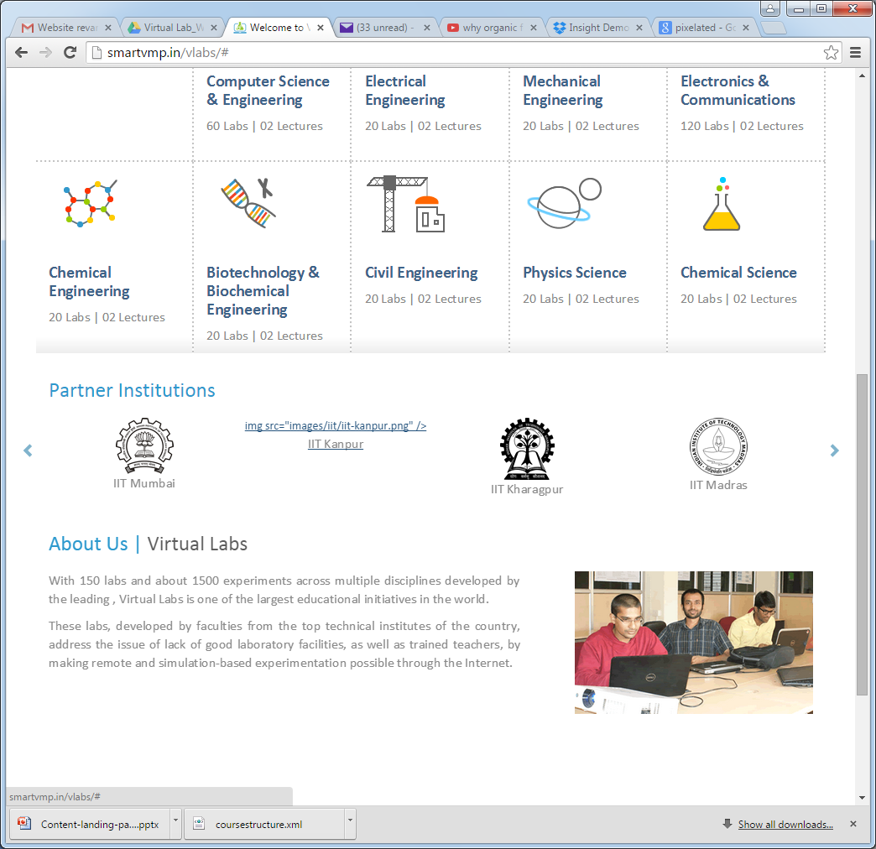

Geeta, someone from VLEAD will need to provide the numbers for Labs and Lectures for each of the domain.
Can we reduce the gap between logos so that more number of universities are visible at a time? Same grid as used for the domains above.
IIT Kanput image appears to be missing, it’s there in the google drive folder.
IIT Hyd Image is wrong, this is the image to be used. Can you check all the images once again.
Each logo needs to be linked to the respective institutions’s page

Slide 5
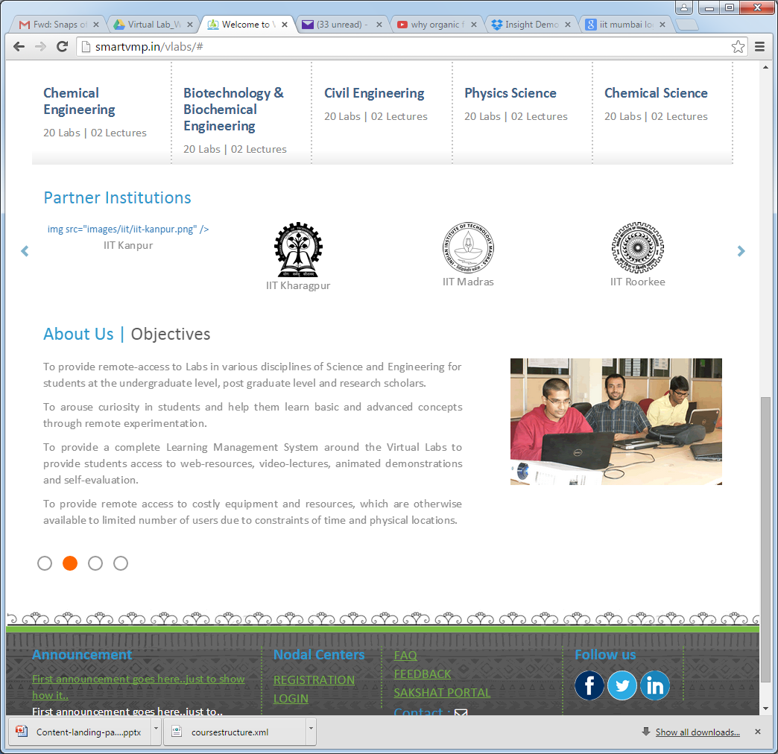
Sampada to provide images for each of the tabs.
Objectives, Features are supposed to be numbered.
Geeta, Philosophy can appear as paragraphs, right?
All links at the bottom of the page need to be linked to respective pages/popups

