Slide 1
Webpage Optimization
Testing Framework

Slide 2
Analysis of Web Page Content
Optimizing Critical rendering path
To improve speed of the web page
Reduce Network Bandwidth
Minimize HTTP request for each web page

Slide 3
Tools we used for analysis and Optimizing
Yslow
  To analyze webpages w.r.t Best Practices.
  It
Pagespeed
  To optimize webpages based on report obtained from Yslow

Slide 4
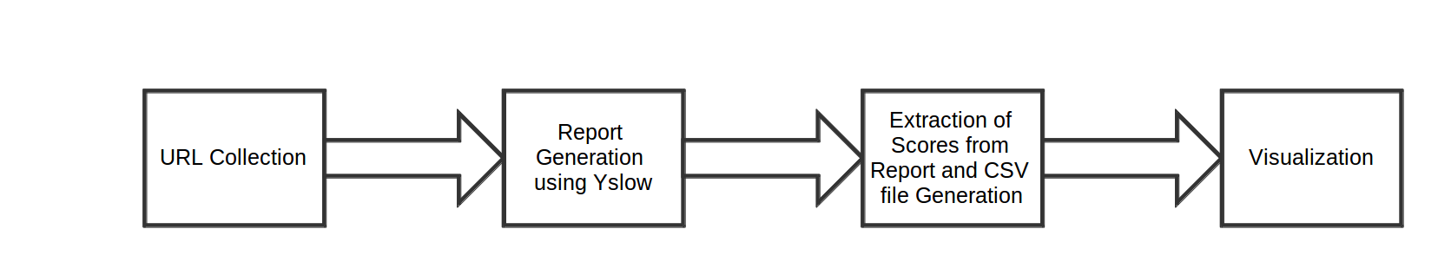
Approach to visualize

Slide 5
How we did?
Collected url using crawler
Wrote scripts to generate reports
Wrote scripts to find scores for webpages and made csv file

Slide 6
Analysis for
5000 webpages of www.vlab.co.in

Slide 7
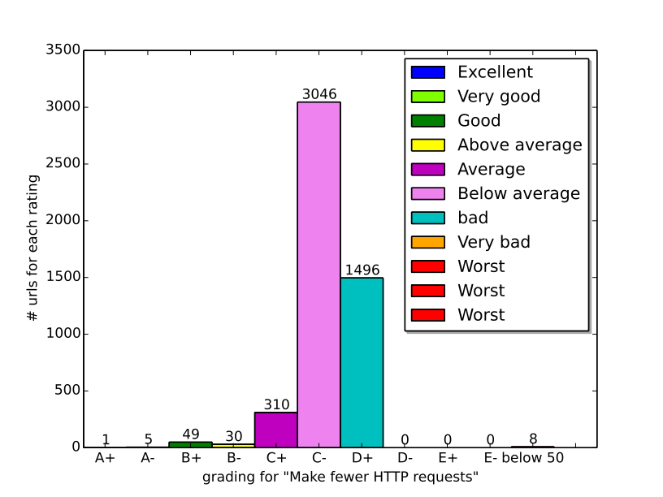
Make fewer http requests

Slide 8
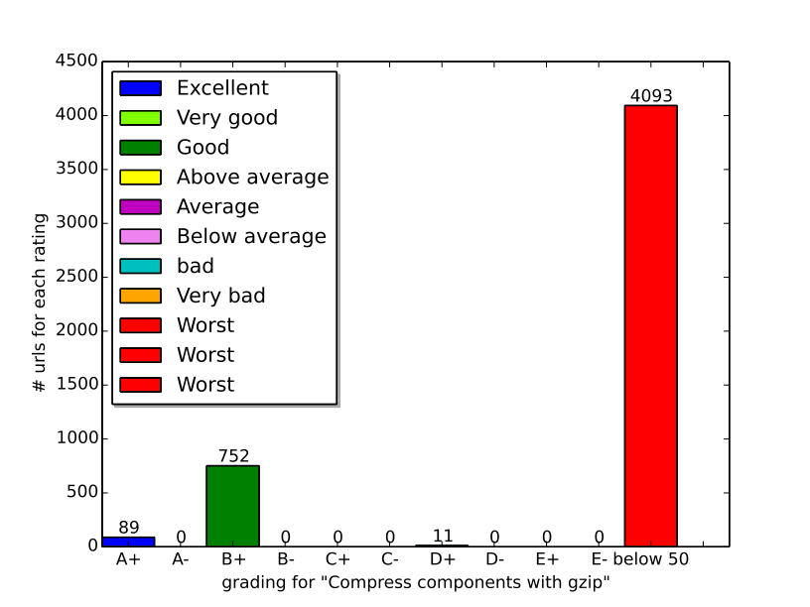
Compress components with gzip

Slide 9
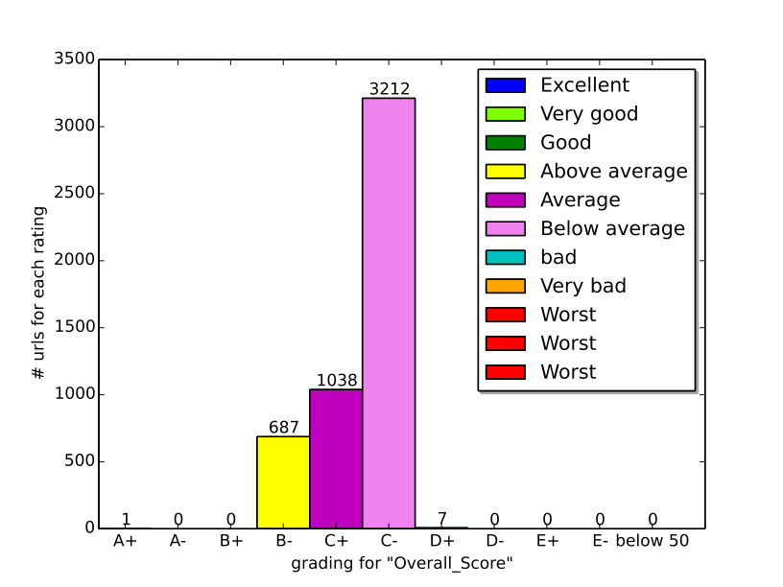
Overall Score

Slide 10
Analysis for webpages of
www.virtual-labs.co.in

Slide 11
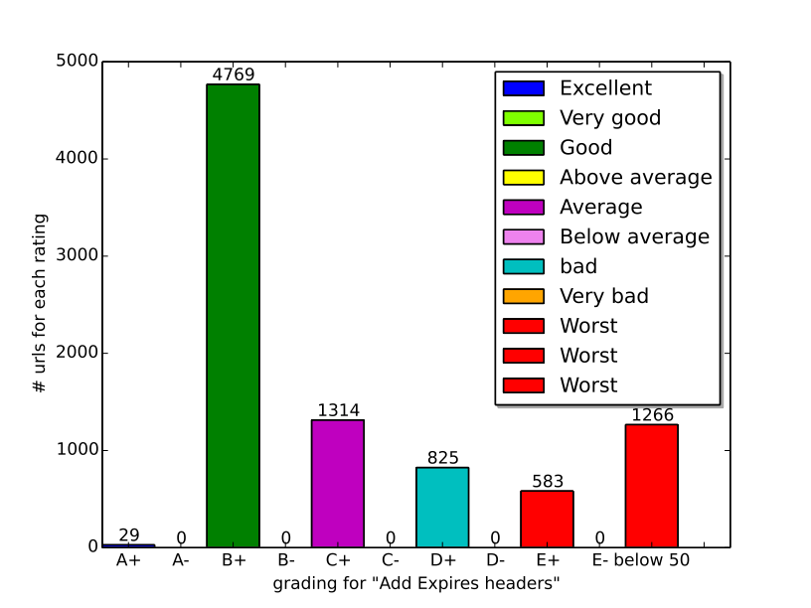
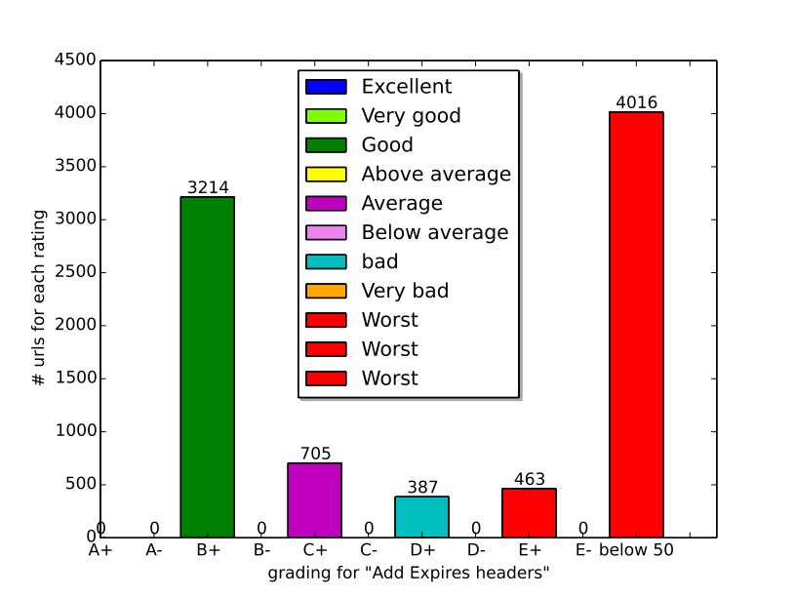
Add expires

Slide 12
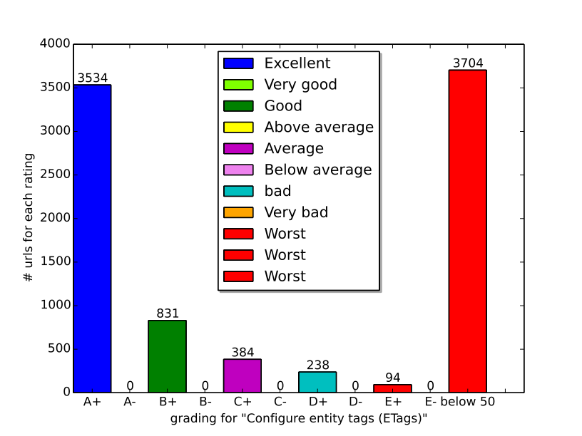
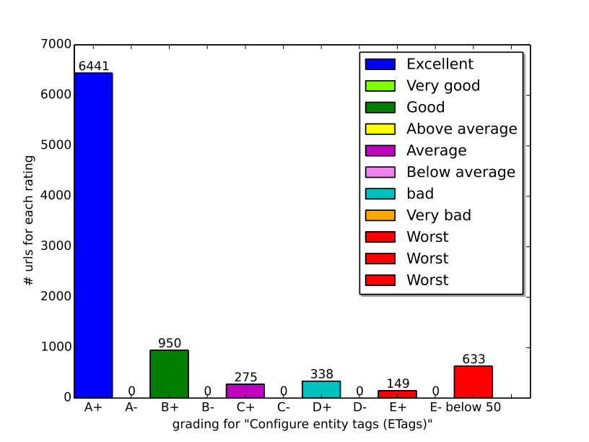
E-tags

Slide 13
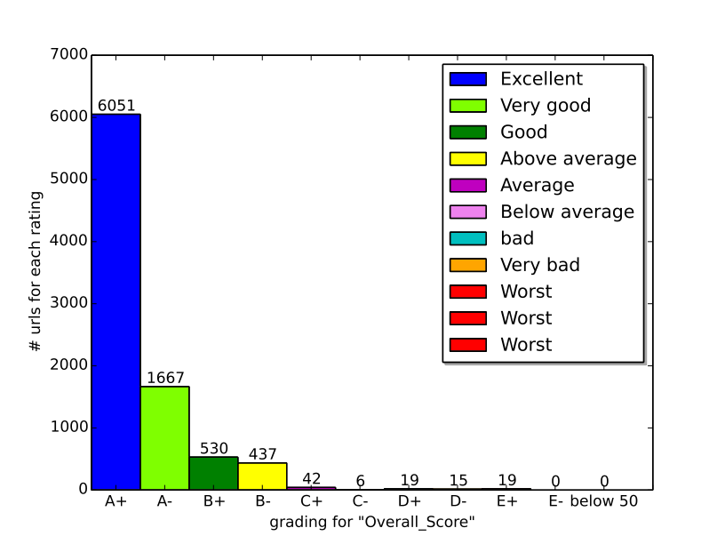
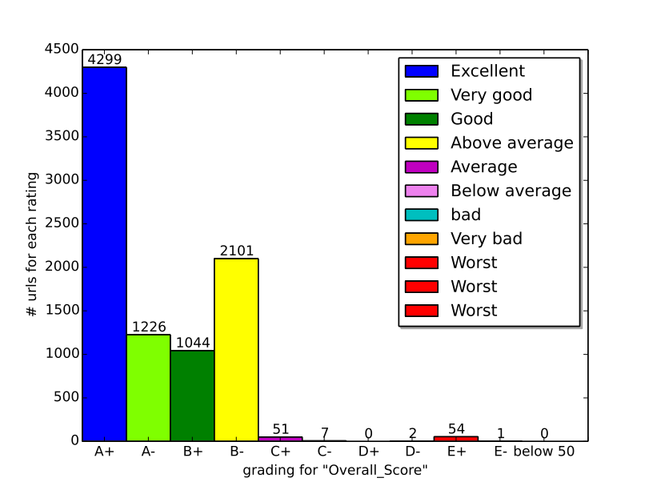
Overall score

