Slide 1
Automated Framework for Analysis and Optimization of WebPages of Vlabs
Team:- Jatin,Utkarsh and Prateek

Slide 2
Major Task
Exploring yslow
Generating report for urls in virtual-labs using yslow
Analyzing report and using it for pagespeed.
Exploring pagespeed

Slide 3
Tools and Technologies
Yahoo Yslow
Google Mod_pagespeed
Shell Scripting
Matplotlib-for plotting graphs.

Slide 4
Why Web-page Optimization?
Improves rendering speed
Improves user experience
Saves network bandwidth
Reduce no. of http requests.

Slide 5
Yslow.js
Runs on Phantomjs.
It is headless WebKit with JavaScript API.

Slide 6
How yslow works
crawls the DOM
Read information about each component.
Analyzes it and genarates score for each rule
And then calculate overall score

Slide 7
Yahoo Best Practices
Make fewer HTTP requests | Remove duplicate JS and CSS
Use a CDN | Configure ETags
Avoid empty src or href | Make Ajax cacheable
Add an Expires header | Use GET for AJAX requests
Compress components | Reduce the Number of DOM elements
Put CSS at top | No 404s
Put Javascript at the bottom | Reduce Cookie Size
Avoid CSS expression | Use Cookie-free Domains
Make JS and CSS external | Make favicon Small and Cacheable
Reduce DNS lookups | Avoid filters
Minify JS and CSS | Don't Scale Images in HTML
Avoid redirects

Slide 8
Rule | Weight | Points | Configs | Score Computation
Make fewer HTTP requests | 8 | js = 3 css = 4 css images = 3 | max js = 3 max css = 2 max css images = 6 | (N JS - 3) * 3 (N CSS - 2) * 4 (N CSS images - 6) * 3
Use a CDN | 6 | 10 | patterns = CDN hostname RegExp patterns types = js, css, image, cssimage, flash, favicon | N RegExp mismatches * 10 (ignores /favicon.ico)
Avoid empty src or href | 30 | 100 | how far = 172800s (2 days) types = js, css, image, cssimage, flash, favicon | N empty src <img> * 100 N empty src <script> * 100 N empty href <link rel="stylesheet"> * 100
Add Expires headers | 10 | 11 | min file size = 500 bytes types = doc, iframe, xhr, js, css | N (unexpired or expiring in < 2 days of any type) * 11

Slide 9
Rule | Weight | Points | Configs | Score Computation
Compress components with GZip | 8 | 11 | min file size = 500 bytes types = doc, iframe, xhr, js, css | N (uncompressed or file size < 500b of any type) * 11
Put CSS at top | 4 | 10 | - | 1 + N CSS link tag on BODY * 10
Put JavaScript at bottom | 4 | 5 | - | N JS on HEAD * 5 ignores injected, defered and async JS
Reduce DNS lookups | 3 | 5 | max domains = 4 | N domains > 4 AND (N domains - 4) * 5

Slide 10
Rule | Weight | Points | Configs | Score Computation
Minify JavaScript and CSS | 4 | 10 | types = js, css | N (unminified JS or CSS external or inline) * 10
Avoid URL redirects | 4 | 10 | - | N redirects * 10
Remove duplicate JavaScript and CSS | 4 | 5 | types = js, css | N (duplicated JS or CSS) * 5
Configure ETags | 2 | 11 | types = js, css, image, cssimage, flash, favicon | N bad etag of any type * 11
Avoid HTTP 404 (Not Found) error | 4 | 5 | types = js, css, image, cssimage, flash, favicon, xhr | N 404 * 5
Do not scale images in HTML | 3 | 5 | - | N (images scaled down width or height) * 5
Make favicon small and cacheable | 2 | 5 | size = 2000b min cache time = 3600s | Favicon 404 not found = 5 Favicon size > 2000b = 5 No favicon expiration or expiration < 3600s = 5

Slide 11
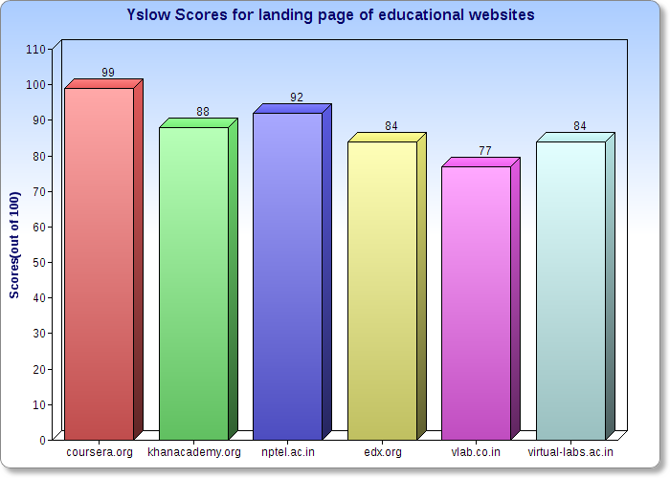

Slide 12
Analysis of yslow report on virtual labs urls

Slide 13
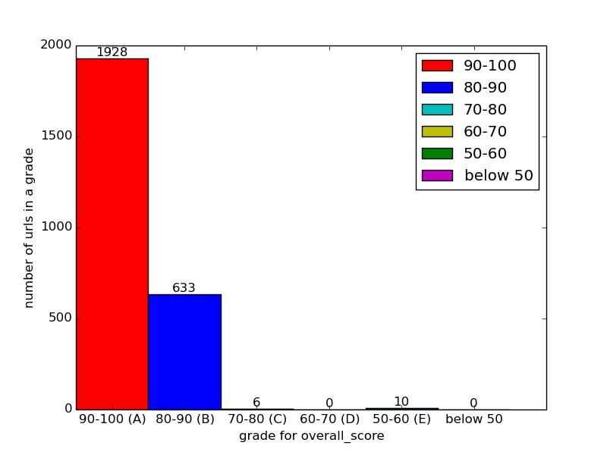
Overall score

Slide 14
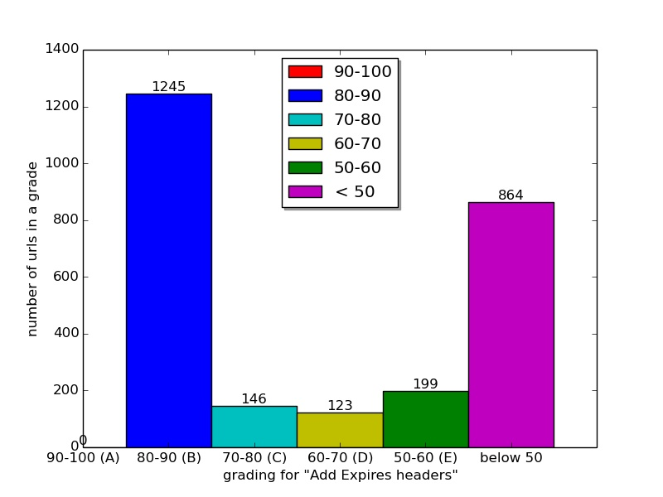
Add expires headers

Slide 15
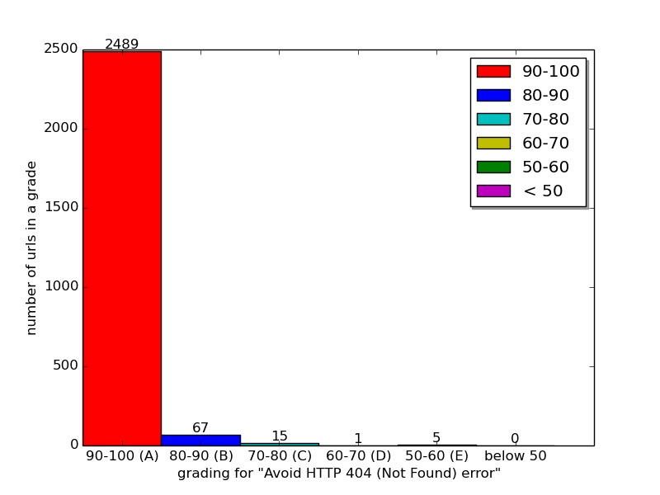
Avoid HTTP 404 error

Slide 16
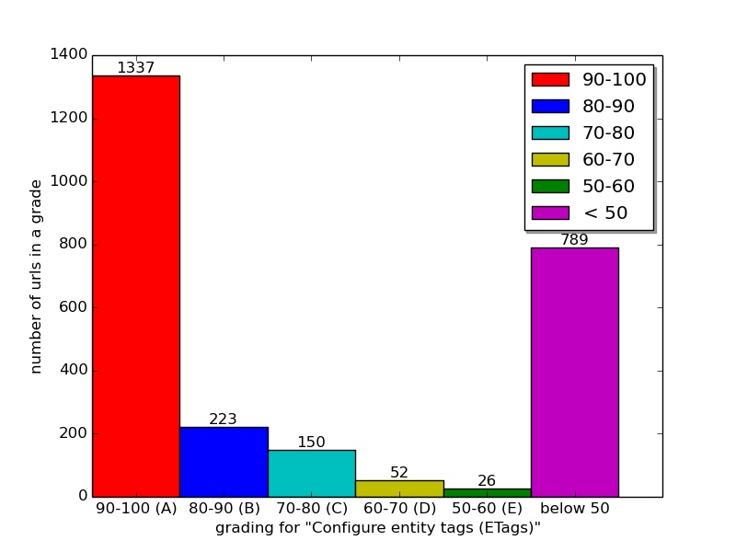
Configure e-tags

Slide 17
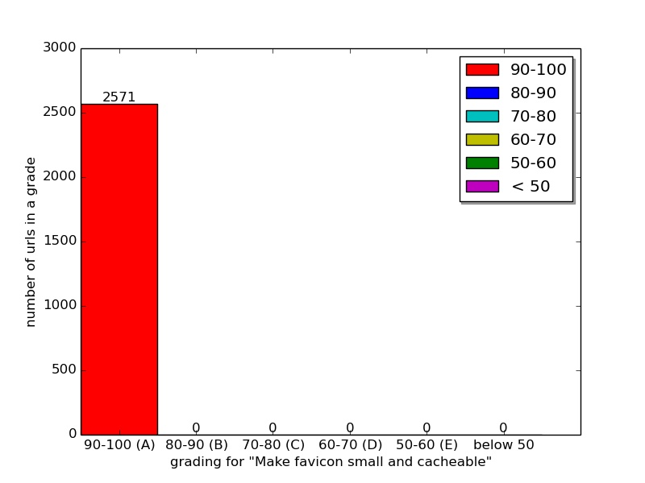
Make favicon small

Slide 18
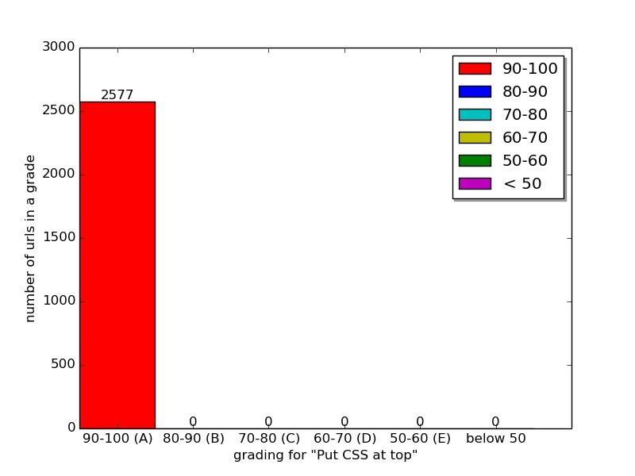
Put CSS at top

Slide 19

Compress components with Gzip

Slide 20
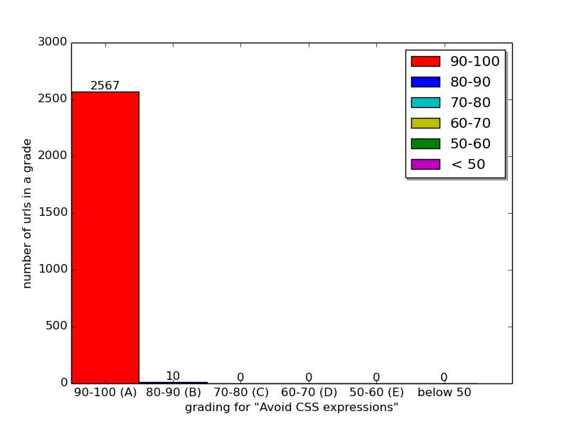
Avoid css expressions

Slide 21

Make fewer http requests

Slide 22

Put javascript at bottom

Slide 23

Avoid url redirects

Slide 24
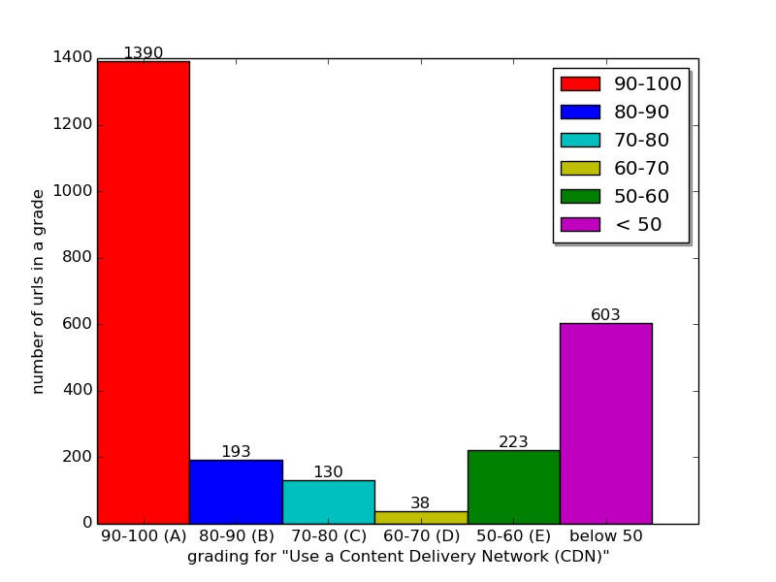
Use a CDNs

Slide 25
Problem?
Yslow only analyzes web page and give suggestions.
So we need some tool to optimize it automatically.
Pagespeed caters to our need
Google pagespeed follows yahoo best practices
So we can use yslow reports to use pagespeed.

Slide 26
Mod_Pagespeed
An Open-source web server module
Speeds up any site
Reduces load time
Analyse and Optimize websites
Identify and enforce best web practices

Slide 27
Pagespeed features
Automatic website and asset optimization
Latest web optimization techniques
40+ configurable optimization filters
Free, open-source, and frequently updated
Deployed by individual sites, hosting providers, CDNs

Slide 28
Filters
It is a set of C++ classes.
It automatically optimizes web pages
It rewrites the web content dynamically
There are around 40+ filters included in module.

Slide 29
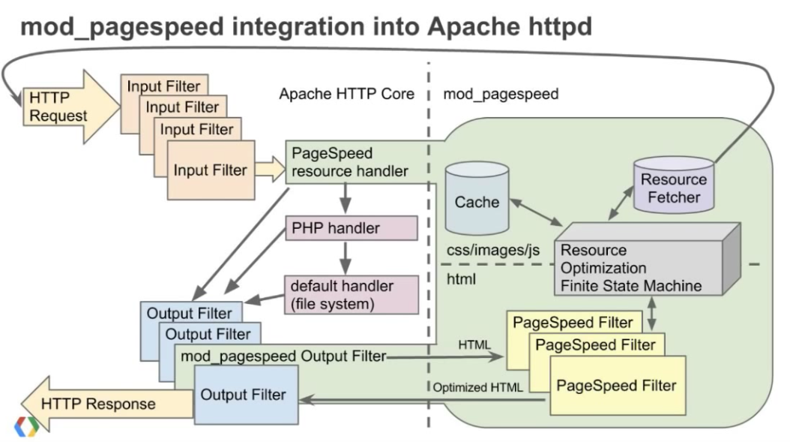
Working

Slide 30
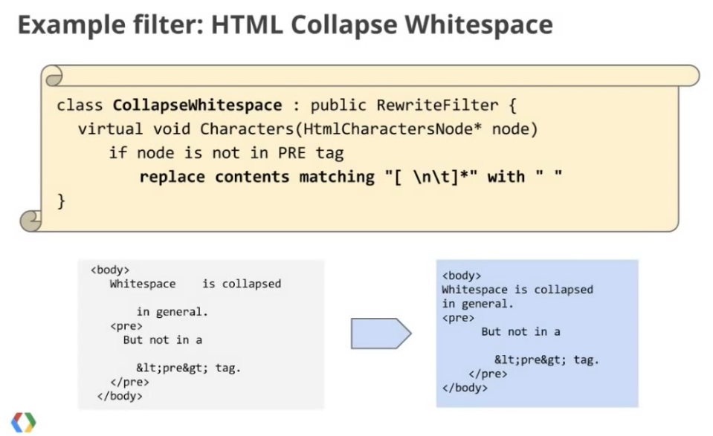
Filters

Slide 31
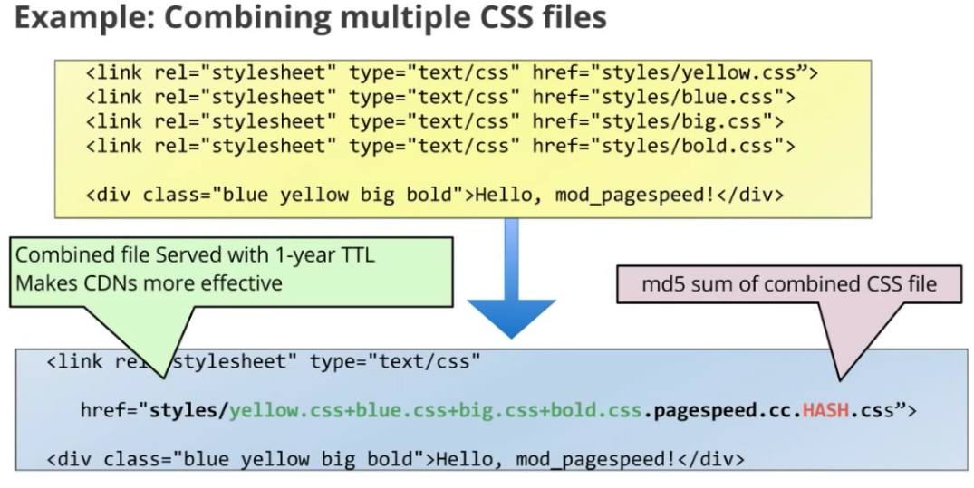
.

Slide 32
Filters
add_head | convert_png_to_jpeg
combine_heads | insert_image_dimensions
outline_css | inline_images
outline_javascript | recompress_images
move_css_above_scripts | convert_gif_to_png
move_css_to_head | resize_images
combine_css | inline_preview_images
rewrite_css | collapse_whitespaces
rewrite_javascript | extend_catche
inline_javascript | extend_catche_css/scripts
include_js_sourcemaps | lazyload_images
local_storage_catch | add_instrumentation
rewrite_images | Sprite_images
Convert jpeg_to_progressive | trim_urls

Slide 33
Risks
Only core filters are by-default on
Some filters are risky.
For eg.add_deferjavascript:
<script>document.write('<div>')</script>
<span></span>
<script>document.write('</div>')</script>

Slide 34
Experiment with pagespeed on Biomedical and Signal Processing Lab (Bio16) and
VLSI Lab(Cse14) on localhost.

Slide 35
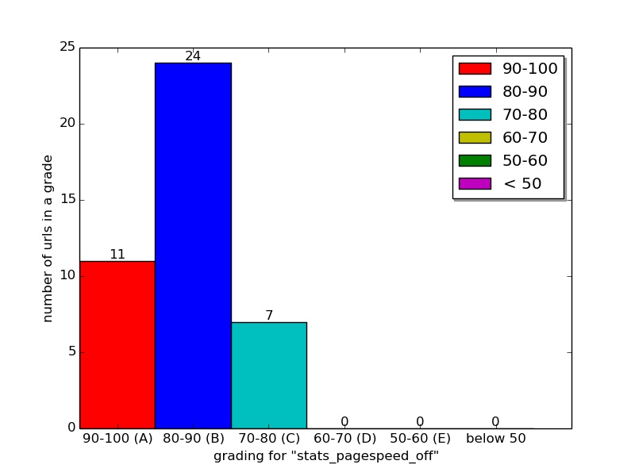
No Pagespeed

Slide 36
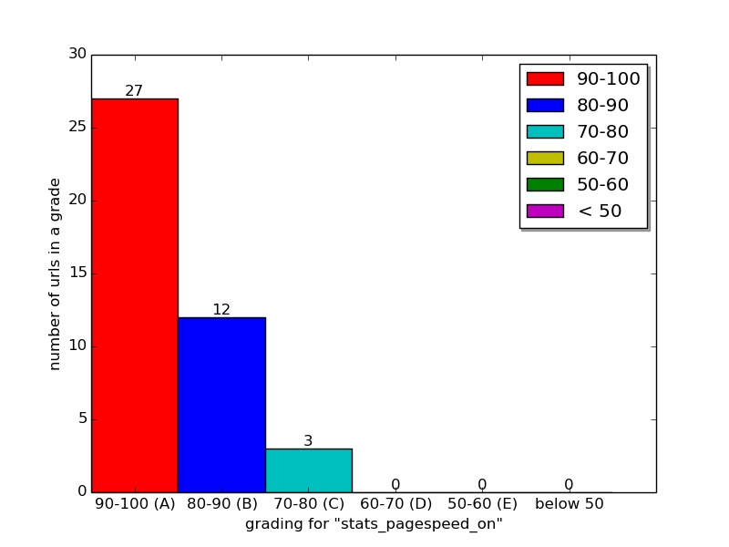
Pagespeed with default filters on

Slide 37
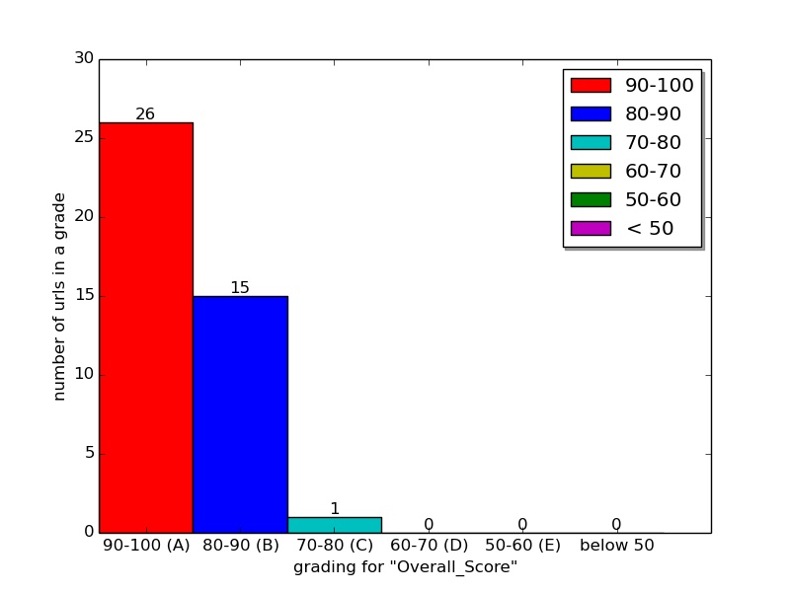
Pagespeed with more filters on

