Slide 1
Identifying Differences Between
Sequencing Data Sets
Vladimír Macko
Mgr. Tomáš Vinař, PhD

Slide 2
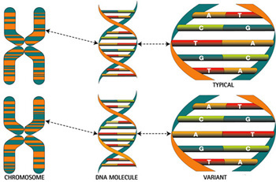

Slide 3
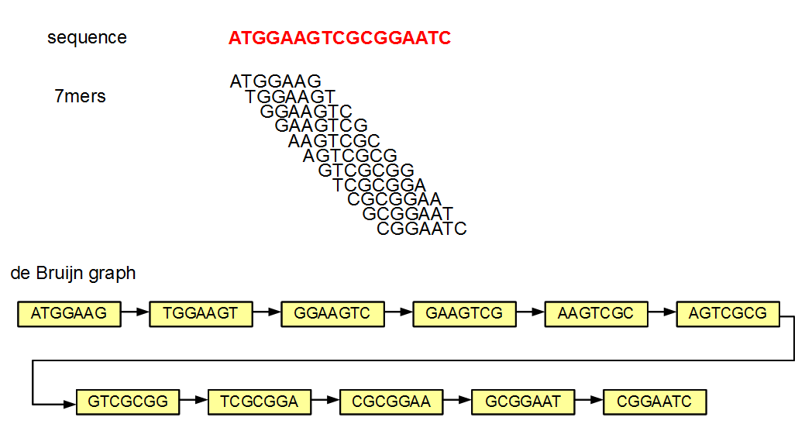
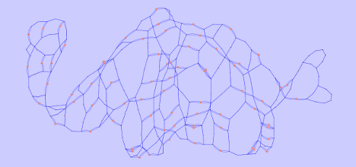

Slide 4
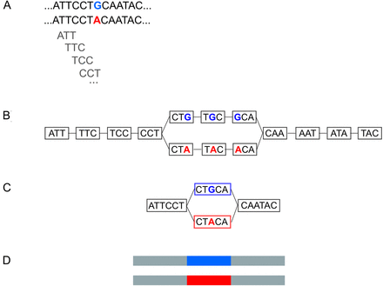

Slide 5
Overview
Introduction
1 Problem statement and related work
  Biological motivation
  Genome sequencing
  Genome alignment and assembly
  Problem statement
  Related work
    Bidirected de Bruijn graph
    Bubble calling
    Variant Calling
    Probabilistic model for sequence assembly
    Indexing techniques
    A*
2 Proposed probabilistic approach
3 Catchy name for our tool that will be implemented
  Implementation problems
  Data
    Variant simulation
    Read simulation
    Paired read simulation
    Real data
  Metrics
  Benchmarks
    Genome alignments
    Without paired reads
    With paired reads
  Results
  Future improvements
4 Discussion

Slide 6
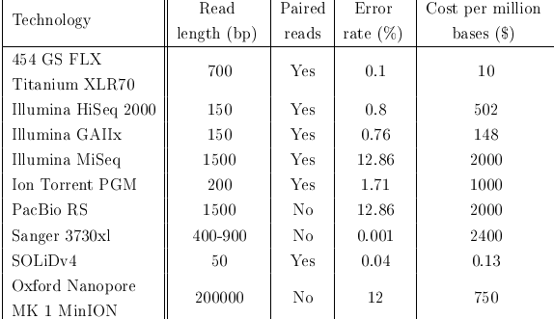
Sequencing
Overview of technologies

Slide 7
Genome assembly
Based on heuristics
Paired reads are usually used only during post-processing

Slide 8
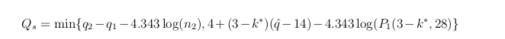
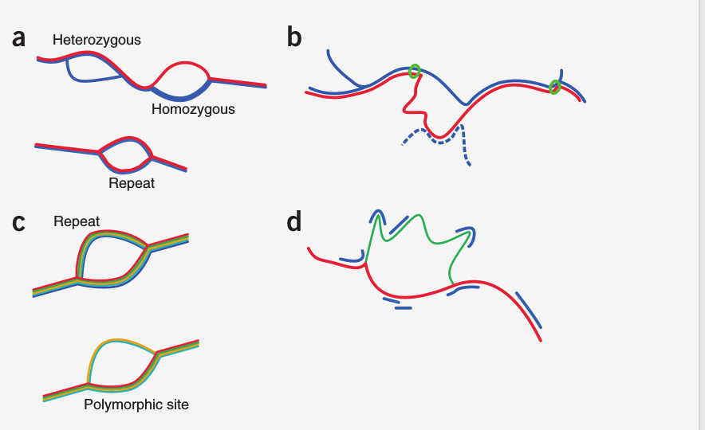
Variant Calling
Heng Li,
  Not De Novo
Zamin Iqbal, Mario Caccamo
  No use of paired reads
  Basically bubble enumeration

Slide 9
Bubble calling
Enumeration is NP-hard
  Chung-Lun Li, S.Thomas McCormick
Polynomial delayed algorithm
  Sacomoto

Slide 10
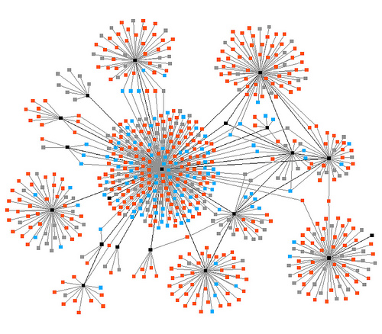
Indexing techniques
K-ANNS with hierarchical navigable small world
Logarithmic complexity

