Slide 1
Firefly Training

Slide 2
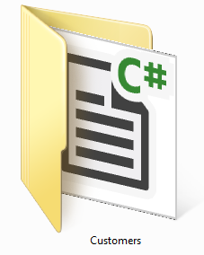
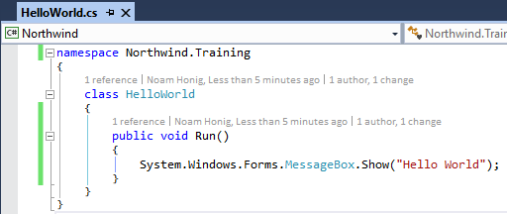
The C# (csharp) Language
C# is case sensitive
Every execution statement ends with a ;
The code is organized in classes
Classes have members (Methods, fields, properties, events etc…)
Classes are organized in namespaces (like folders)

Slide 3
Access Modifiers
Access modifiers are keywords used to specify the declared accessibility of a member or a type. It determines which code can use this class or method. There are four access modifiers:
private – only visible to code within class and inner classes
protected – also visible to code within class that inherit from this class
Internal – visible to any code within my assembly (dll/exe)
public – visible to any code
Defaults:
Classes are “internal”
Members (methods, fields etc…) and inner classes are “private”

Slide 4
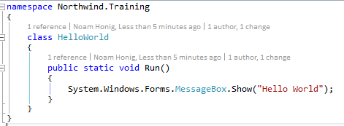
Identifying Code elements
Let’s identity the different parts of the call to the MessageBox Show method:
Namespace
Class
Arguments
Method

Slide 5
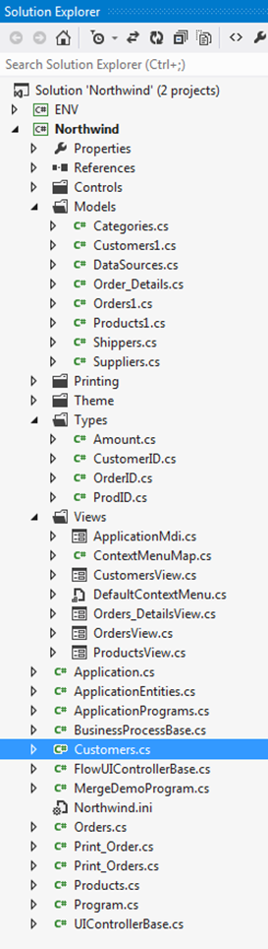
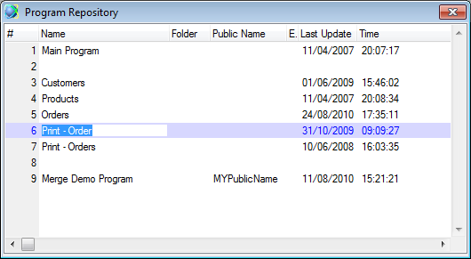
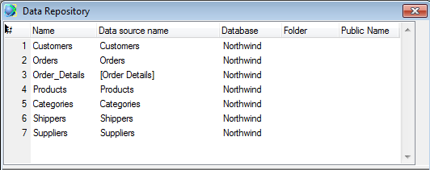
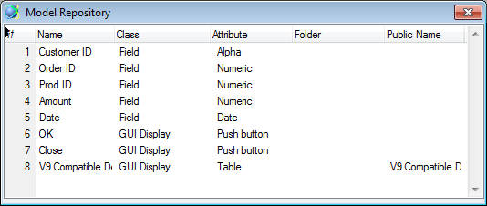
.NET Project Structure
Tables become classes in the Models namespace
.NET
The UI of the programs is converted to forms in the Views namespace
Magic
Each program is converted to a class in the resulting .NET project
Field Models, become classes in the Types namespace

Slide 6
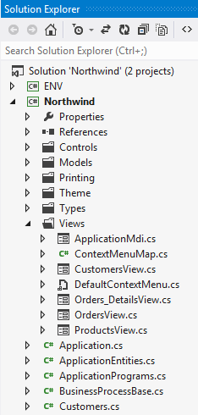
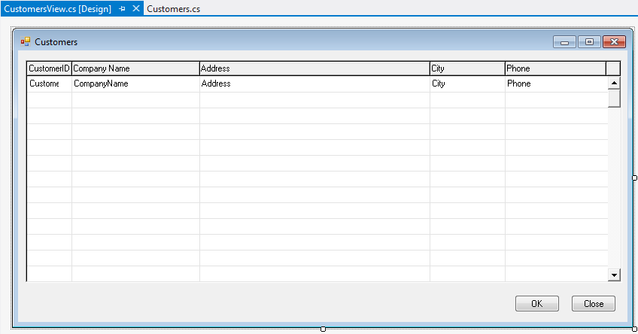

Online Tasks
Partitioned to separate business logic code from UI code
Logic code, goes into a class that inherits from the UIController class, and controls the UI interactions.
UI Code, goes into the Views namespace, and is designed using Visual Studio’s Form Designer.

Slide 7

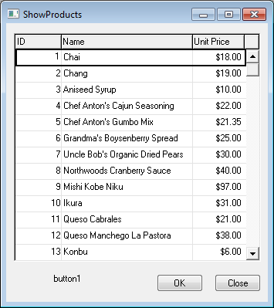
UIController Diagram
Controller
View (UI)
Data
+
Logic Code (OnEnterRow,OnEnd…)
Code Behind
Designer code
reference
_controller
+
Event handlers
Auto generated

Slide 8
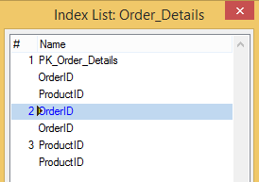
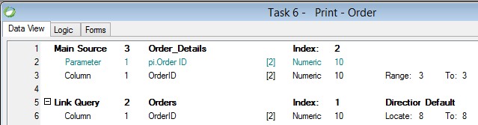
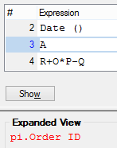
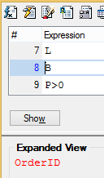
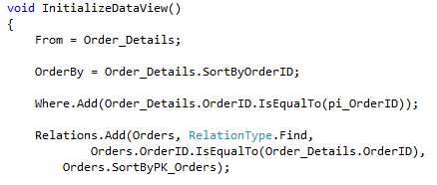

UIController
Magic
.NET

Slide 9
Task Circle of Life
Constructor
Define the DataView
Construct the task
Run Method:
Base.Execute();
OnLoad
All the task settings are set
Filter is determined and fixed
OnStart
Rows are fetched from the database
Specific row is loaded, and bound values are evaluated
OnEnterRow
OnLeaveRow
OnSavingRow
OnEnd
Only for rows that were changed
OnUnLoad
Specific row is saved
IO and DB Relase

Slide 10
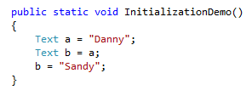
Initialization Demo - Text
Danny
a
Sandy
b

Slide 11
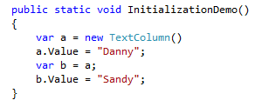
Initialization Demo - Column
Danny
Column
a
Value
Sandy
b

Slide 12
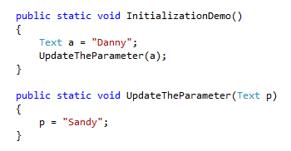
Initialization Demo – Text parameter
Danny
a
Danny
Sandy
p

Slide 13
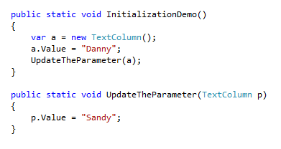
Initialization Demo - Column parameter
Danny
Column
a
Value
Sandy
P

