Slide 1
FEDERAL THRIFT SAVINGS PLAN
LIFECYCLE FUND ASSET ALLOCATION
OCTOBER 2014
Annie Bruneau
Jay Love
Andrew Scheufele

Slide 2
Contents
Overview
Capital Market Assumptions and Efficient Frontier
Stochastic Modeling
  Demographic Assumptions
  Glide Path Analysis
Modeling Results – 2030 Fund
Summary and Recommendations

Slide 3
TSP Goals for Lifecycle Fund Development
To construct customized lifecycle funds that are:
composed of the TSP Core Funds
a series of evolving targeted maturity funds that become more conservative as the set “maturity date”¹ approaches
able to accommodate daily cash flows and minimize transaction costs
easily communicated and understood by participants
a convenient and automatic way for participants to diversify their investment account
¹The target maturity date is the date the participant expects to begin withdrawing money from his or her account. This date may or may not be the date the participant retires from his or her agency or even the date the participant stops working.

Slide 4
Plan Characteristics
In arriving at its fund structure recommendations, Mercer considered:
TSP participant demographic information. We assumed that the participants were members of FERS and based our projections on typical account balances and contribution patterns for the targeted group for each Lifecycle Fund
Plan-level financial information including the volume and pattern of daily cash movements
Underlying composition and management of each of the five Core Funds, including the unique aspects of the G Fund:
  Returns equivalent to long government bond yields
  No default risk

Slide 5
Overview
The purpose of this study is to review the current asset allocations of the lifecycle funds of the Federal Retirement Thrift Savings Plan
Key objectives and metrics:
  Provide opportunity to achieve sufficient retirement income for career FERS employees
    Metrics: Range of account balances and replacement ratios
  Provide capital preservation for participants as they approach retirement
    Metric: Likelihood of loss in final two years before retirement
  Limit likelihood of running out of assets in retirement
    Metric: Expected account drawdown age

Slide 6
Executive Summary
A review of the analysis and metrics highlights the following:
Adding equity along the glide path improves projected account balances, but adds to capital preservation risk at retirement
Increasing international equity weight has relatively small positive impact given the current EAFE benchmark for the I Fund
Current slight overweight position in small cap equity (S Fund) less favorable than prior years; outcomes in line with market weight allocation
Given the rise in rates built into the assumptions, G Fund continues to outperform F Fund in short term
Replacement ratios, in combination with Social Security and the defined benefit program, likely to meet the commonly suggested targets (i.e. 70-80% of earnings) for career employees

Slide 7
FEDERAL RETIREMENT THRIFT SAVINGS PLAN: Mean-Variance and Efficient Frontier Analysis

Slide 8
Mercer Capital Market Assumptions
We conducted our analysis using capital market assumptions over a 20-year time horizon:
  Real economic growth is 2.7%
  Inflation is 2.5%
  For equities, the table below breaks down the components for our equity assumptions.
 | C Fund | S Fund | I Fund
Inflation | 2.5% | 2.5% | 2.0%
Real Earnings Growth | 2.5% | 4.3% | 1.7%
Dividend/Income | 2.7% | 1.5% | 3.0%
P/E Expansion(Contraction) | -1.1% | -1.4% | 0.0%
Currency Drag | 0.0% | 0.0% | 1.1%
Total | 6.6% | 6.9% | 7.8%

Slide 9
Applying Capital Market Assumptions:
Using our capital market assumptions and statistical modeling, we calculated expected risk and return for each of the five core funds.
We also need to set the correlation assumptions – very important in determining the diversification benefits. Correlation tells how much the markets move together (high correlation), whether they are independent (low correlation), or even inversely related (negative correlation).
 | Geometric Return | Standard Deviation | Interest and Dividend Income
C Fund: Large Cap Equity | 6.6% | 18.1% | 1.91%
S Fund: Small Cap Equity | 6.9% | 22.1% | 1.32%
I Fund: International Equity | 7.8% | 20.5% | 3.00%
F Fund: Broad Market Fixed Inc | 4.3% | 5.3% | 2.22%
G Fund: Government Yields | 4.5% | 1.2% | 2.25%
 | C Fund | S Fund | I Fund | F Fund | G Fund
C Fund | 1.00
S Fund | 0.91 | 1.00
I Fund | 0.77 | 0.72 | 1.00
F Fund | 0.11 | 0.10 | 0.03 | 1.00
G Fund | 0.00 | 0.00 | 0.00 | -0.10 | 1.00

Slide 10
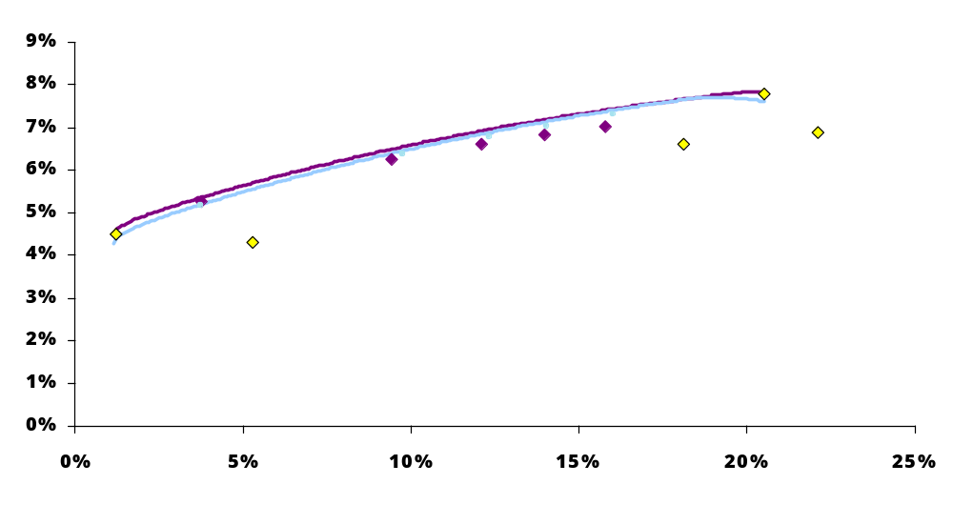
Position of Lifecycle Funds on the Efficient Frontier: Including 2013 and 2014
Expected Geometric Return
I Fund
C Fund
S Fund
F Fund
G Fund
2013 Study and L Funds
2014 Study and L Funds (July 2014 Portfolios)
Risk (Standard Deviation)

Slide 11
STOCHASTIC MODELING

Slide 12
Stochastic Modeling
We projected inflation, economic growth, salary growth, corporate profits, P/E ratios, interest rates and exchange rates and used these results to compute capital market returns.
We also had special states of the world to accommodate these regimes:
  Normal Growth: Above average growth with modest inflation
  Recession: Negative economic growth, low inflation
  Stagflation: Low economic growth, high inflation (6%)
  Inflationary Growth: Above average growth with high inflation
  Ideal Growth: Very high growth with very low inflation
  Credit crunch: Severely negative growth, deflation
  High Inflation: Inflation moves to 10%, growth slumps

Slide 13
Model Outcomes
Incorporate demographic assumptions
Project investment outcomes by using stochastic analysis (1,000 simulations) of:
  Economic factors
      Inflation, growth, interest rates, salary growth, capital market returns
  Typical behavior of participants by age group
      Participants increase contributions over time
      Participants retire at approximately age 61
  Change in asset allocation over time as the Lifecycle fund becomes more conservative

Slide 14
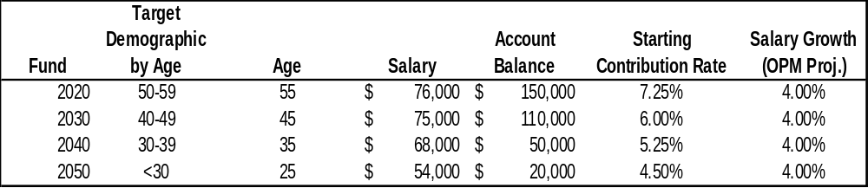
Demographic Inputs Derived From OPM Data Match
Three year federal wage freeze through 2013. Salary growth rate of 4% is based on OPM long term assumption of 1.5% real wage growth and assumed inflation rate of 2.5%.
Average salary and account balances are based on data from 2012 rolled forward
Estimated contribution rate based on age-range averages across all FERS employees in 2013

Slide 15
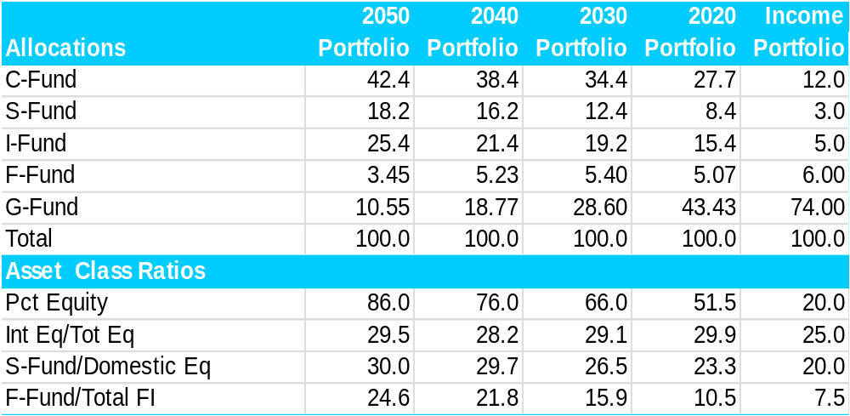
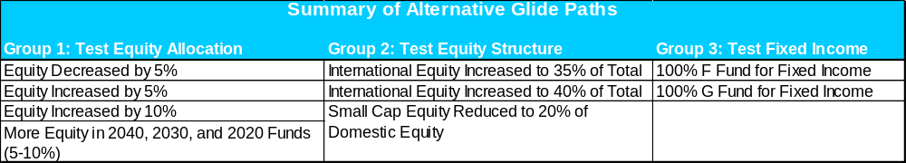
Glide Paths Considered: 2014 Study
Current glide path (allocations as of July 2014)
Alternative glide paths reviewed in three groups

Slide 16
Modeling Results Example: 2030 Fund

Slide 17
2030 Fund Results
For purposes of this illustration, we selected a representative career FERS participant with entry age 37 and retirement at age 61. Results for a 2030 Lifecycle Fund investor -- 45 yr. old FERS employee with approximately 8 years of tenure, a $110,000 account balance, and currently earning $75,000/yr. Assumed real wage growth is 1.5%/yr. and inflation is 2.5%.
 |  |  | Current Glide Path | More Equity 2040 - 2020 | Increase International Equity to 40%
Median Account Balance at 2030 (real $) |  |  | $412,650 | $419,465 | $416,531
5th Pct Account Balance at 2030 (real $) |  |  | $326,263 | $327,227 | $328,409
TSP Median Replacement Ratio at 2030 |  |  | 26% | 26% | 26%
TSP 5th Pct Replacement Ratio at 2030 |  |  | 19% | 19% | 19%
Total FERS Median Replacement Ratio* at 2030 |  |  | 72% | 72% | 72%
Total FERS 5th Pct Replacement Ratio* at 2030 |  |  | 64% | 64% | 64%
Probability of Decline over Final 2 Yrs. |  |  | 7.70% | 8.50% | 8.20%
Assume post-retirement spending is 80% of final inflation adjusted salary.
Probability account depleted - age 80 |  |  | 63.20% | 62.60% | 62.70%
Probability account depleted - age 90 |  |  | 94.40% | 94.60% | 94.10%
* includes estimated replacement from Social Security (22% to 23%) and FERS defined benefit (24%)

Slide 18
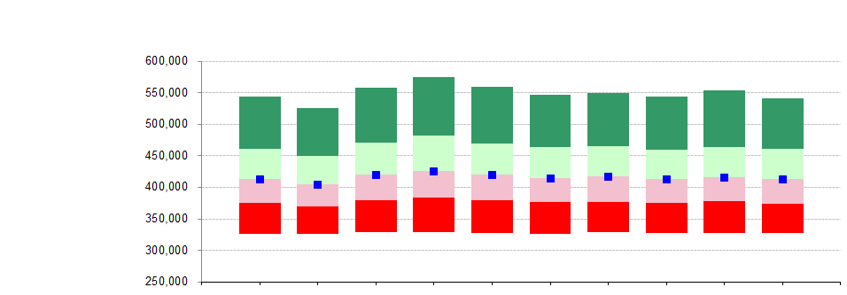
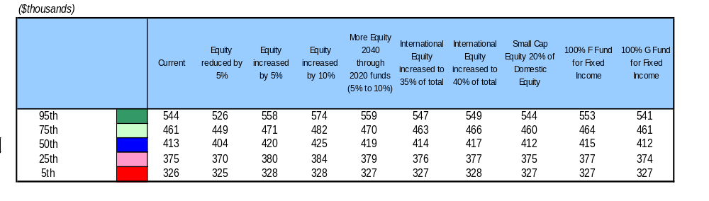
Summary of Real (Inflation-Adjusted) Account Balances at Maturity:
2030 Fund
Range of Real Account Balances
Assumptions:
Age: 45
Salary: 75,000
Account Balance: 110,000
Deferral Rate: 6.00%
Higher equity allocations provide improvement in account balances across range of outcomes

Slide 19
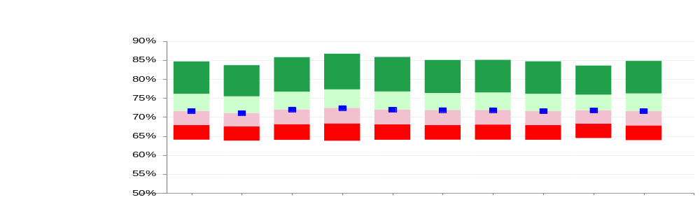
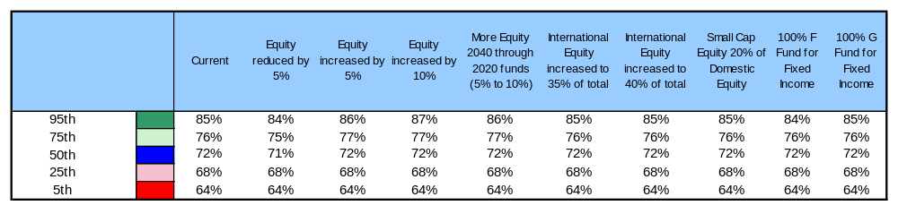
Summary of Replacement Ratios at Maturity: 2030 Fund
Range of Replacement Ratios
Replacement ratio measures the percentage of final salary than can be replaced in retirement assuming an average life expectancy (based on annuity pricing)
Overall, replacement ratio outcomes are similar across the range of alternatives
Additional equity tends to increase expected replacement ratios for optimistic scenarios

Slide 20
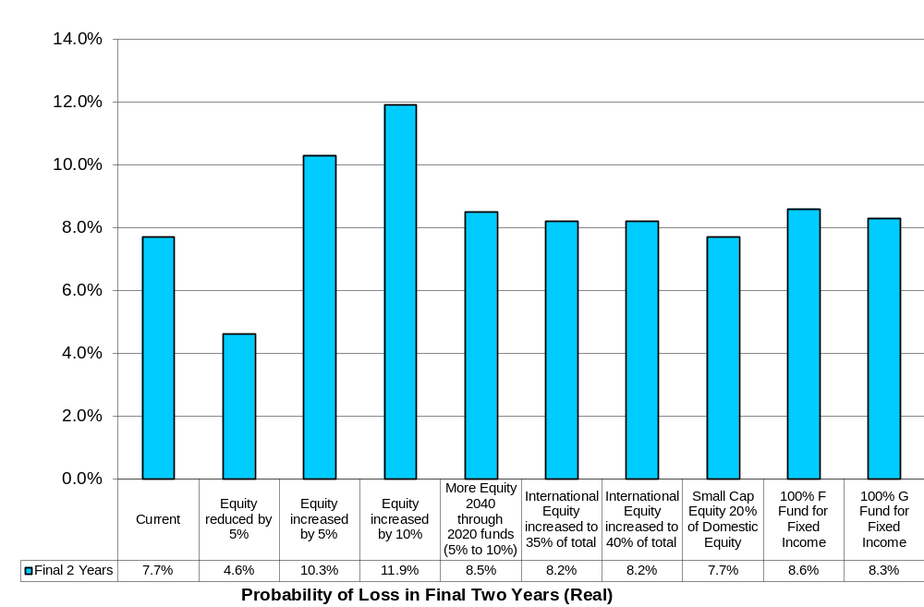
Probability of Decline in Account Balance In Final Two Years Before Maturity, In Real (Inflation-Adjusted) Terms: 2030 Fund
This measure is influenced by the size of account balance as well as the size of the contributions
Lower equity glide paths reduce the probability of a decline in account balances, while the higher equity glide paths increase the probability of decline

Slide 21
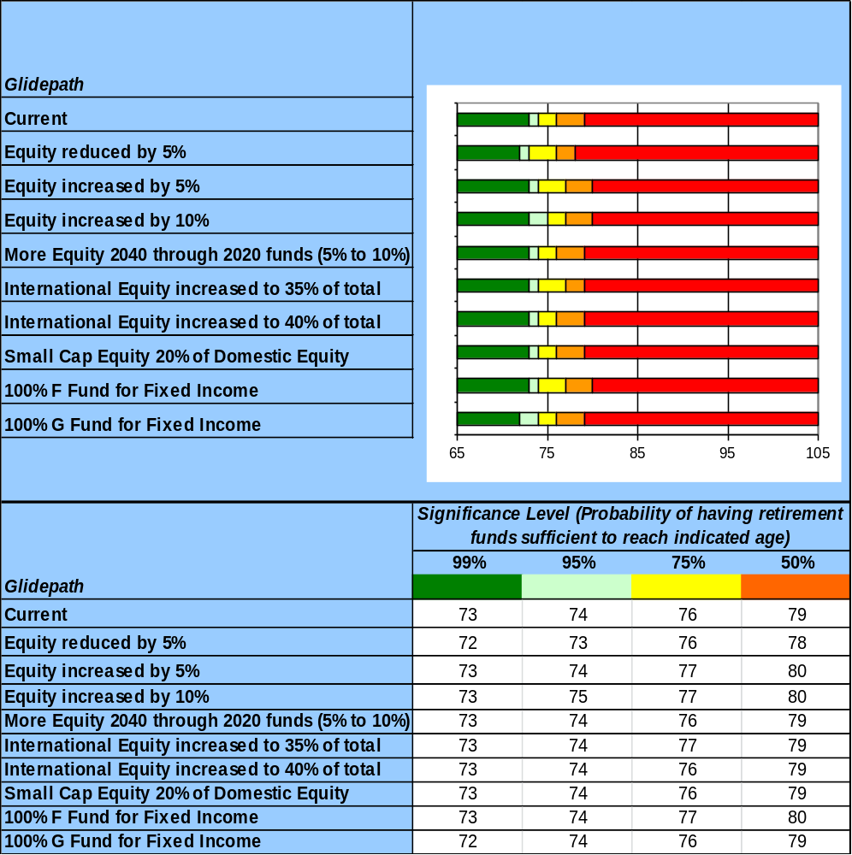
Expected Account Depletion Ages: 2030 Fund
Projected Age DC Fund Drawdown Reaches Zero
Assumes retirement spending budget of 80% of final pay at retirement
Under median outcome, account expected to last 18 years post-retirement
1% chance of depleting DC assets within 12 years post-retirement with current glide path
Outcomes improve slightly with higher equity allocation and with 100% F Fund for fixed income

Slide 22
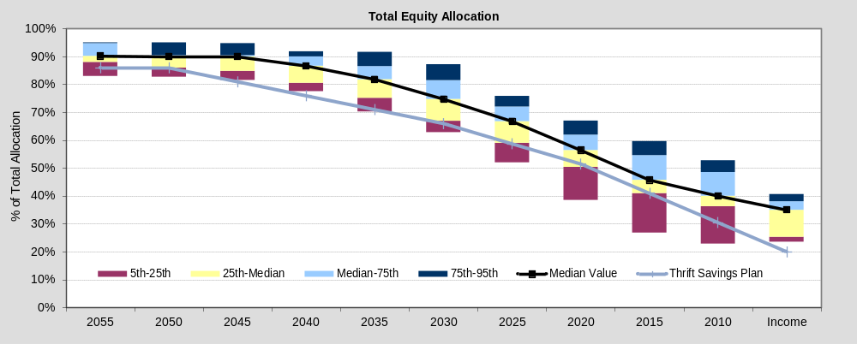
Equity Allocation: Comparison to Mercer Survey
Some TDF providers have increased the equity allocation in their glidepath over the last year.

Slide 23
Recommendations

Slide 24
Recommendations
Retirement outcomes are similar across glide path alternatives studied
Relatively conservative approach provides participants with good opportunity to meet retirement objectives
No compelling need for change to existing allocations

Slide 25
Appendix
Alternative Glide Paths
Market Survey

Slide 26
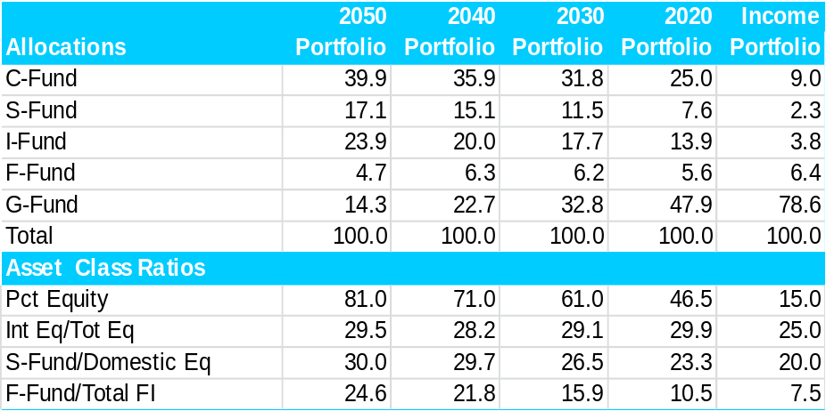

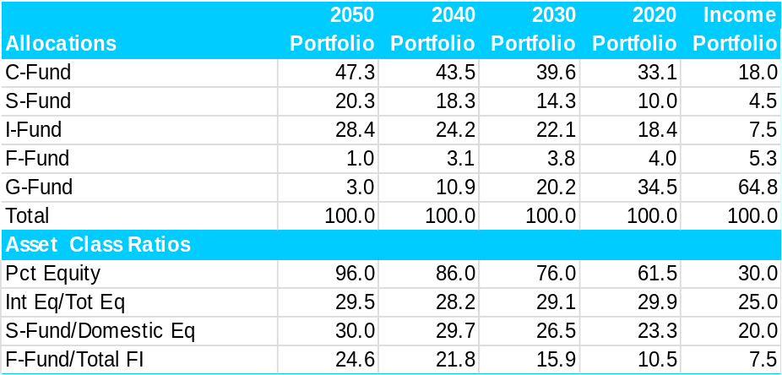

Current Asset Allocation of Alternative Glide Paths
Decrease Equity 5%
Increase Equity 5%
Increase Equity 10%
More Equity 2040 - 2020

Slide 27
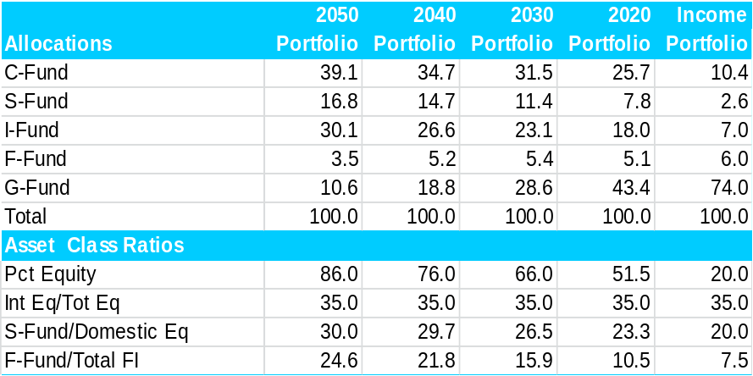


Current Asset Allocation of Alternative Glide Paths
International Equity Increased to 35% of Total Equity
International Equity Increased to 40% of Total Equity
Small Cap Equity to 20% of Domestic Equity

Slide 28
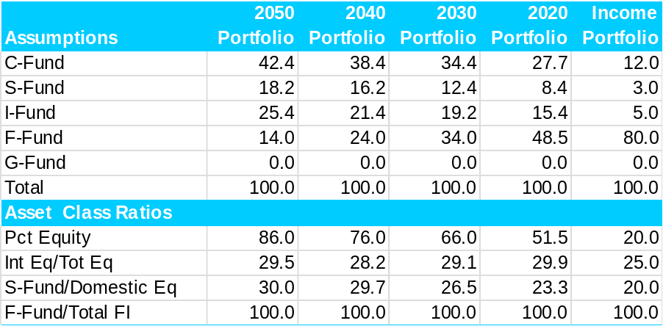
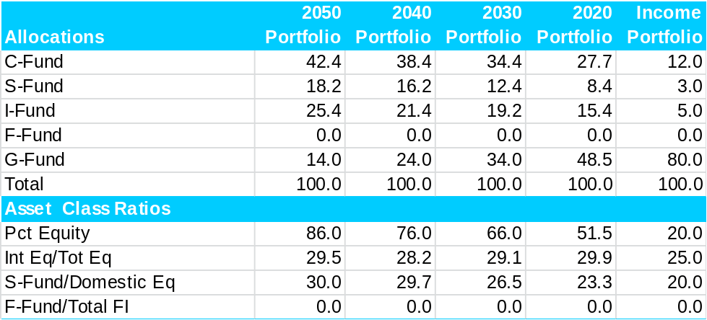
Current Asset Allocation of Alternative Glide Paths
100% F Fund for Fixed Income
100% G Fund for Fixed Income

Slide 29
Summary of Quarterly Market Survey
Mercer performs a quarterly survey of Target Date Fund providers
The survey covers 36 Target Date Fund families from 20 providers
The Thrift Savings Plan asset allocation is somewhat conservative relative to the survey median
  Lower equity allocations than median across glide path
The split of international equity vs. total equity is in line with the survey median (approximately 30% of total equity)
  For most providers, the international equity allocation includes some emerging markets exposure

Slide 30

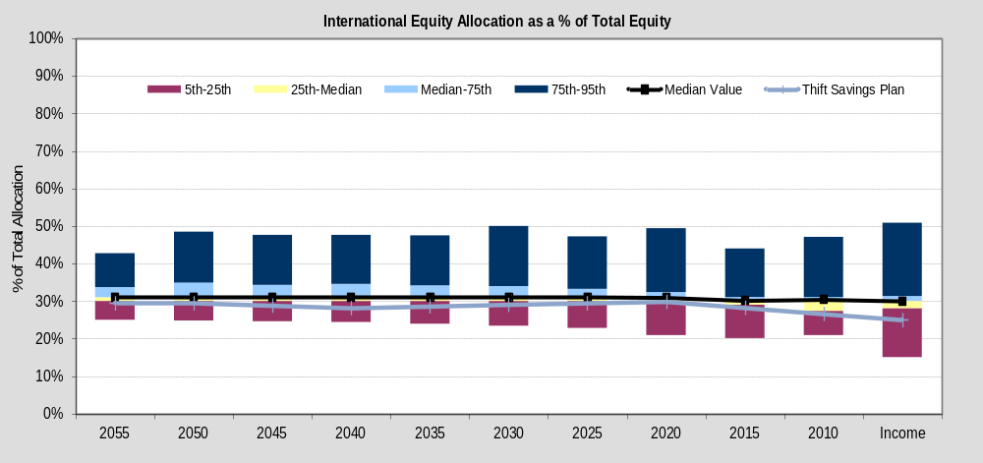
International Equity Allocation: Comparison to Mercer Survey

Slide 31
Important Notices
References to Mercer shall be construed to include Mercer LLC and/or its associated companies.
© 2014 Mercer LLC. All rights reserved.
This contains confidential and proprietary information of Mercer and is intended for the exclusive use of the parties to whom it was provided by Mercer. Its content may not be modified, sold or otherwise provided, in whole or in part, to any other person or entity, without Mercer’s prior written permission.
The findings, ratings and/or opinions expressed herein are the intellectual property of Mercer and are subject to change without notice. They are not intended to convey any guarantees as to the future performance of the investment products, asset classes or capital markets discussed. Past performance does not guarantee future results. Mercer’s ratings do not constitute individualized investment advice.
Information contained herein has been obtained from a range of third party sources. While the information is believed to be reliable, Mercer has not sought to verify it independently. As such, Mercer makes no representations or warranties as to the accuracy of the information presented and takes no responsibility or liability (including for indirect, consequential or incidental damages), for any error, omission or inaccuracy in the data supplied by any third party.
This does not constitute an offer or a solicitation of an offer to buy or sell securities, commodities and/or any other financial instruments or products or constitute a solicitation on behalf of any of the investment managers, their affiliates, products or strategies that Mercer may evaluate or recommend.
For the most recent approved ratings of an investment strategy, and a fuller explanation of their meanings, contact your Mercer representative.
For Mercer’s conflict of interest disclosures, contact your Mercer representative or see www.mercer.com/conflictsofinterest.
Mercer universes: Mercer’s universes are intended to provide collective samples of strategies that best allow for robust peer group comparisons over a chosen timeframe. Mercer does not assert that the peer groups are wholly representative of and applicable to all strategies available to investors.
The value of your investments can go down as well as up, and you may not get back the amount you have invested. Investments denominated in a foreign currency will fluctuate with the value of the currency. Certain investments, such as securities issued by small capitalization, foreign and emerging market issuers, real property, and illiquid, leveraged or high-yield funds, carry additional risks that should be considered before choosing an investment manager or making an investment decision.
Returns for periods greater than one year are annualized. Returns are calculated gross of investment management fees, unless noted as net of fees.
Style analysis graph time periods may differ reflecting the length of performance history available.
Notes:
4

Slide 32
Important Notices - continued
The information contained in this document (including any attachments) is not intended by Mercer to be used, and it cannot be used, for the purpose of avoiding penalties under the Internal Revenue Code that may be imposed on the taxpayer.
Mercer’s capital market assumptions are based on the professional judgment of experienced investment consultants and economists and rely on historical experience, economic theory, and our assessment of future developments in the capital markets. Our process for setting asset class expected returns begins with earnings growth and current yields. Equity return assumptions are set by adding a risk premium over bonds. Volatility and correlation assumptions are based more directly on historical experience, except in cases in which the market environment has clearly changed.
Mercer believes that as opportunities in the capital markets change, so do the expected returns for asset classes. A key factor in our process is the level of interest rates, as they combine the market’s expectations of inflation and economic growth. In general, as interest rates rise, our expected returns will rise; as interest rates decline, our expected returns will decline. This runs counter to the realized returns as interest rates change and is part of the difference between ex ante and ex post results.
When interest rates change, we may change our assumptions. However, we are cautious about making changes. We have designed our assumptions to be strategic in nature, so they will typically not be adjusted to short-term market spikes. We use our judgment to determine whether interest rate moves are sustainable. In practice, we continuously review our assumptions and work to refine our methodology as we gain additional information relating to the capital markets, but we do not anticipate changes every time interest rates rise in 25 or 50 basis point increments.
Services provided by Mercer Investment Consulting, Inc.
Notes:
4

Slide 33


