Slide 1
GitHub, Student (updated 12/15/21)
These Slides Will Answer the Following Questions:
What is GitHub?
How do I use GitHub?
How do I create Private Repository?
How do I use GitBash and desktop version?

Slide 2

What is GitHub?
GitHub is a version control system that (VCS) that lets users save their code online, track changes of their code (versions), and collaborate with others on a particular project. A version control system records changes to files over time and let’s users review this changes later.

Slide 3


Git vs. GitHub
It was built off of Git which is also a VCS; however, Git only uses the command line tool when making changes to a project. GitHub allows users to make changes online, using the command tool (GitBash or the terminal), and in GitHub Desktop.
vs

Slide 4
GitHub Terms
Repository is where all files are stored for a particular project. Each project has its own repository where multiple versions and branches are created and tracked.
Branches are the versions of a user’s code inside a repository that is created without altering original state of the project (usually the master branch).
Master branch is created once a repository is created and can store all versions of a project when branches merge into it.
Cloning allows for the online repository to be downloaded locally on a user’s computer.

Slide 5
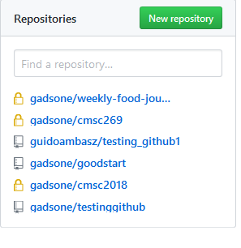
Public vs. Private Repositories
Public repositories are projects are visible to the entire GitHub community is great for collaborating with users all over the world. Private repositories, however, are only visible to the user that creates it unless they decide to add collaborators are on the project. Repositories that have lock represent private while the public repositories have an open source symbol.

Slide 6
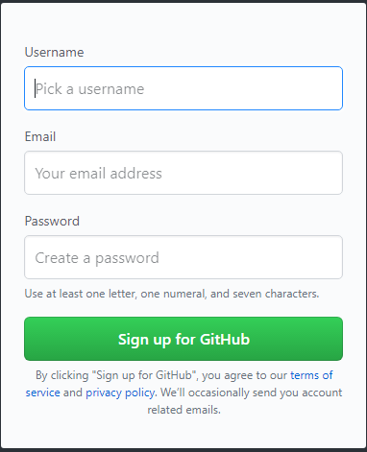
Create a GitHub Account
Create your GitHub account using your Montgomery College Email (MYMCID@montgomerycollege.edu):
https://github.com/
With a valid student email, you are able to create private repositories for free.

Slide 7
Request a discount
After signing up for github go to https://education.github.com to request a free 2 year discount. GitHub is a open source software that allows users to create multiple public repositories, but users need to request a discount for unlimited private repositories. This is free with student verification!
Follow the next steps to activate student development pack.
NOTE:- This may take 0-5 business days

Slide 8
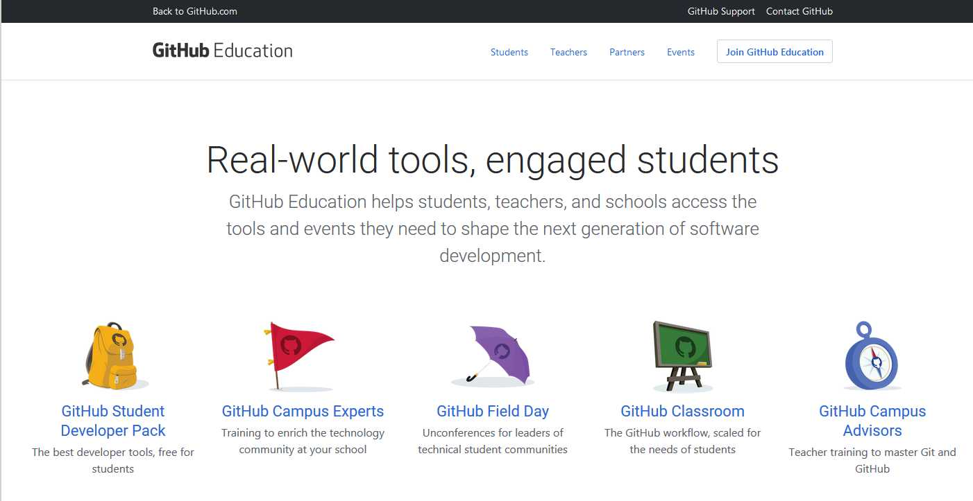

Slide 9
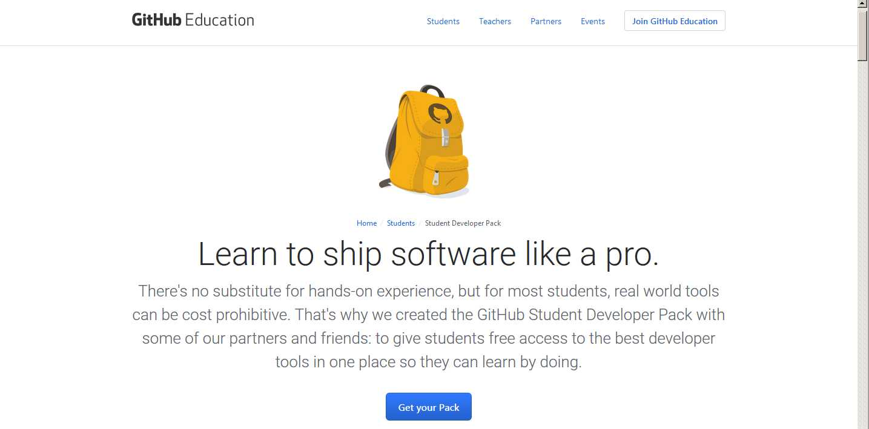

Slide 10
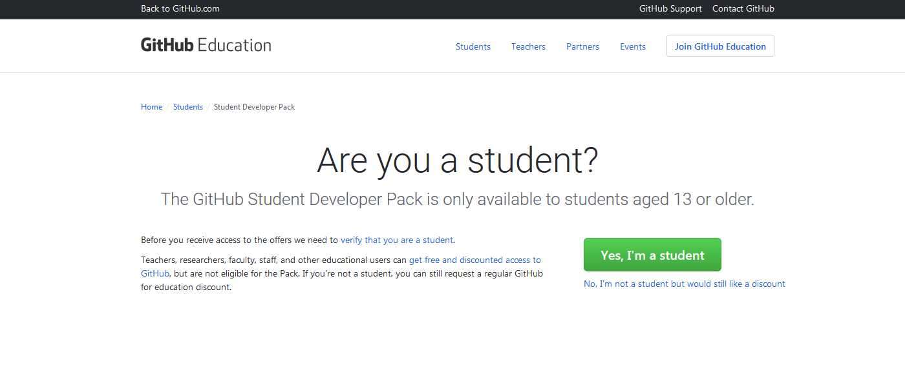

Slide 11
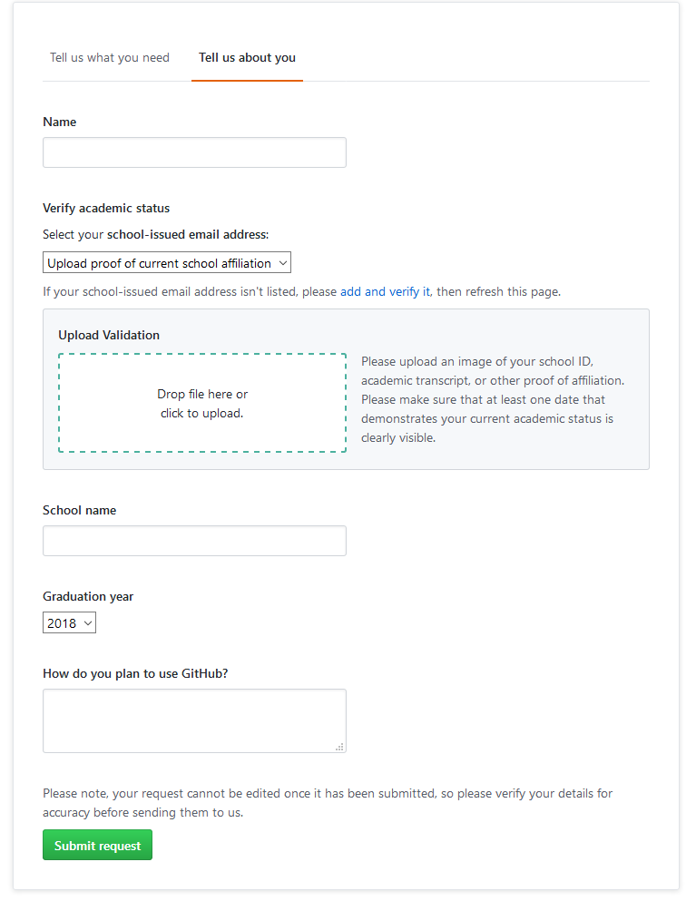
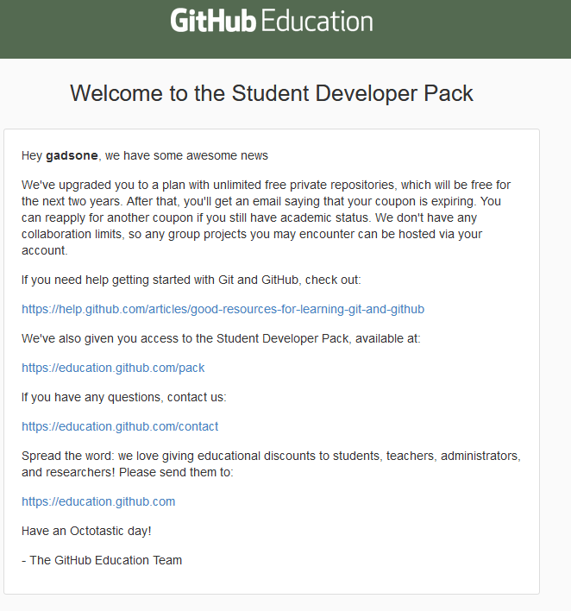
Check college email to see when you have leveled up to student pack.
Fill in the information as seen and submit your request.
gadsone

Slide 12
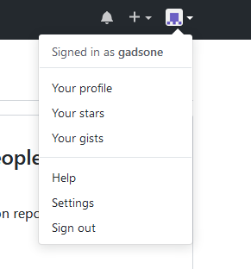
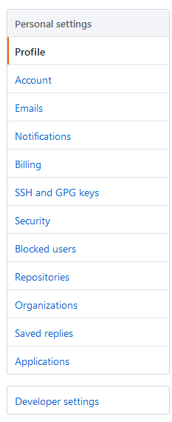
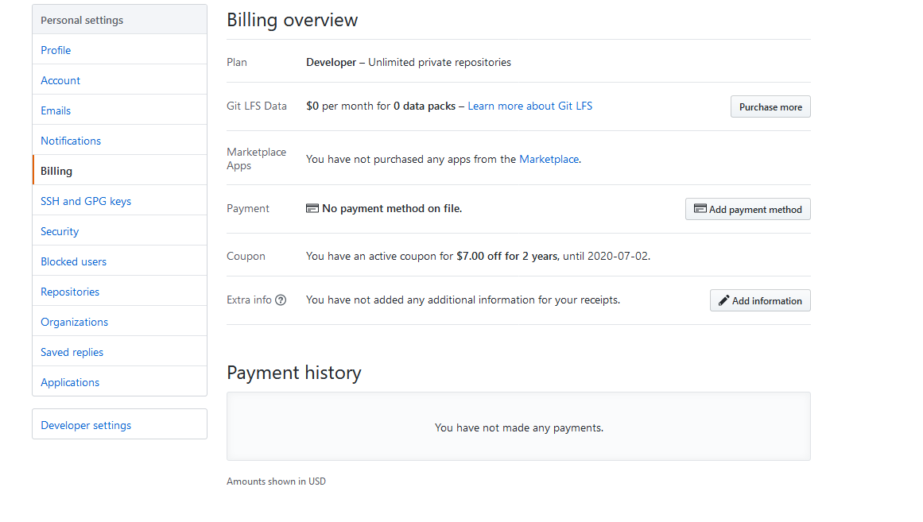
After submitting your request go to the billings tab on github and you should see your coupon.

Slide 13
Repository
A software repository, colloquially known as a "repo" for short, is a storage location from which software packages may be retrieved and installed on a computer.
If you have the student developer activated and confirmed, you can create hidden/private repository else you can make only make a public visible repository for free.

Slide 14
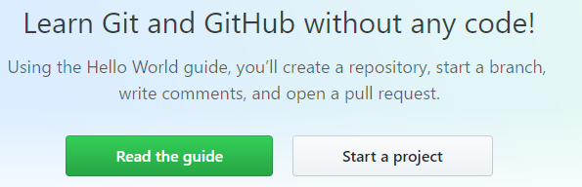
Let’s Create a Repository
Click on Start a Project to create a repository.
After naming your repository, choose the private option for your repository.

Slide 15
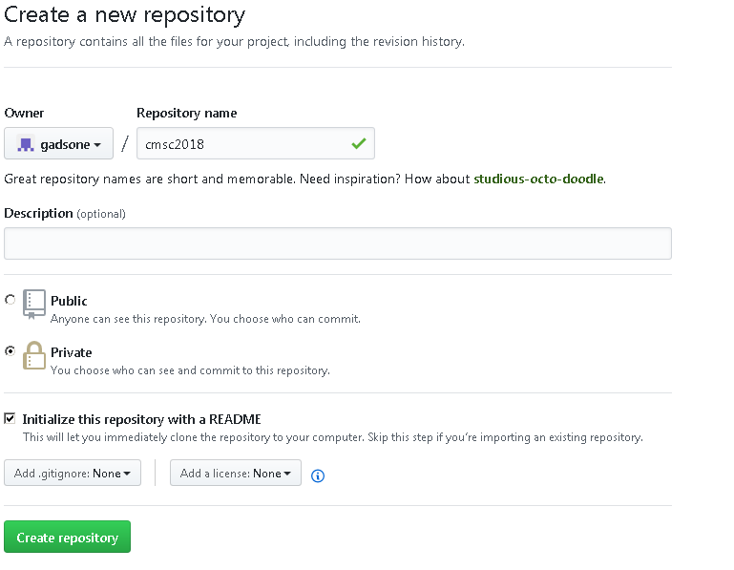
Name repository and select either public or private. Next, check initialize README box. Then, click “create repository”

Slide 16
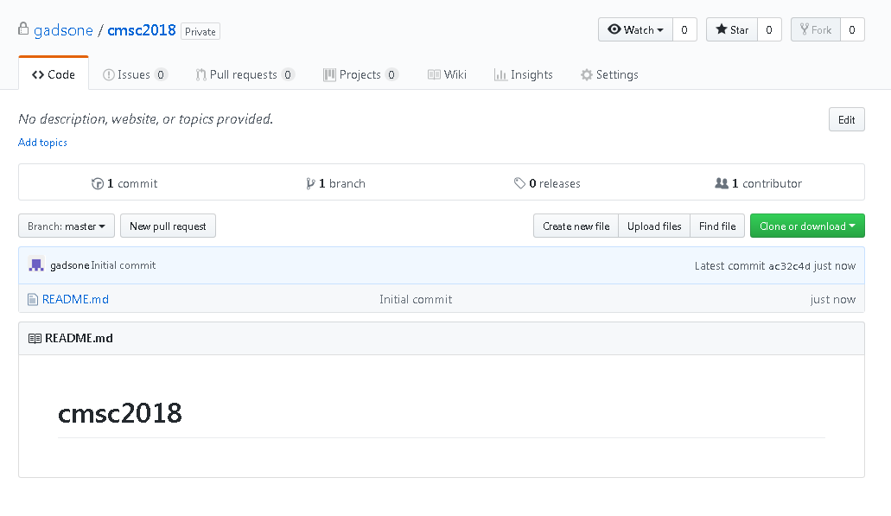
You have successfully created a repository. You can now add files and invite others.

Slide 17
You have successfully created a repository. You can now add files and invite others. Add a Folder: To create a new folder in a repository, click “create a new file.” Type your new folder’s name in the area where you would write the file name, and at the end of the file name type a “/” to initialize it as a folder. After this you can create a new file in the folder. Then upload files from the desktop. Git doesn't store empty folders. You can also create new folders by simply dragging and dropping a folder with files to your repository on GitHub and then uploading them. If you want the folder you’re uploading to be inside a specific sub-folder, be sure to click on and enter that sub-folder before uploading your files. Deleting files in a repository You can delete an individual file in your repository or an entire directory, including all the files in the directory. If you try to delete a file or directory in a repository that you don’t have to write permissions to, we'll fork the project to your user account and help you send a pull request to the original repository after you commit your change. For more information, see "About pull requests." If the file or directory you deleted contains sensitive data, the data will still be available in the repository's Git history. To completely remove the file from GitHub, you must remove the file from your repository's history. For more information, see "Removing sensitive data from a repository."

Slide 18


Deleting a file Browse to the file in your repository that you want to delete. At the top of the file, click . At the bottom of the page, type a short, meaningful commit message that describes the change you made to the file. You can attribute the commit to more than one author in the commit message. For more information, see "Creating a commit with multiple co-authors." Deleting a directory Browse to the directory in your repository that you want to delete. At the top-right corner, click ,, then click Delete directory. At the bottom of the page, type a short, meaningful commit message that describes the change you made to the file. You can attribute the commit to more than one author in the commit message. For more information, see "Creating a commit with multiple co-authors."

Slide 19
Interactions with the repo
Web:
Simple and limited manageability of the repo
Desktop GUI:
Still very simple but intermediate manageability of the repo (Recommended)
Terminal:
Advance manageability of the repo, however there is an learning curve

Slide 20
Download GitHub Desktop
Download GitHub desktop to manage your workflow for Windows and macOS.
https://desktop.github.com/
Then complete the following installation steps:

Slide 21
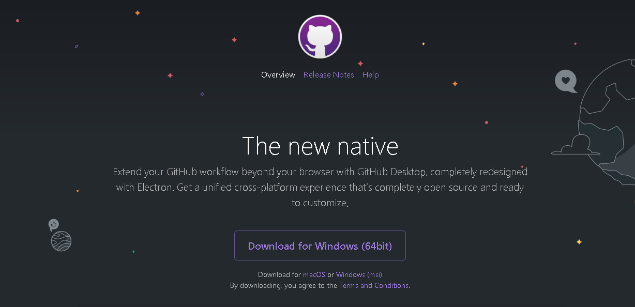
Download the 64-bit version for Windows or macOS.

Slide 22
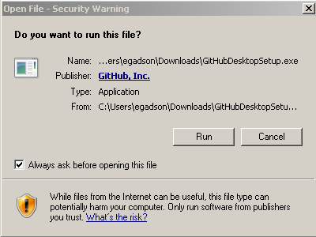
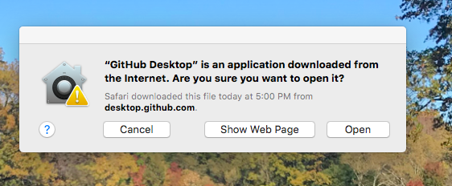
Run GitHub Desktop for Windows or macOS

Slide 23
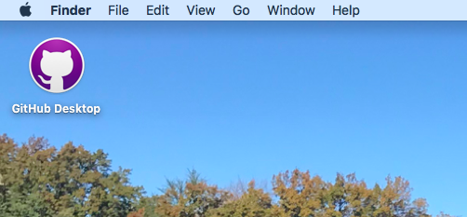
In macOS, open the GitHub desktop application.

Slide 24
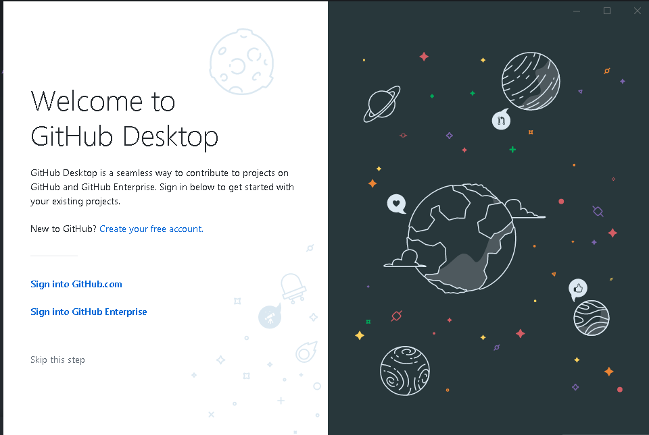
Select “Sign into GitHub.com” for both Windows and macOS

Slide 25
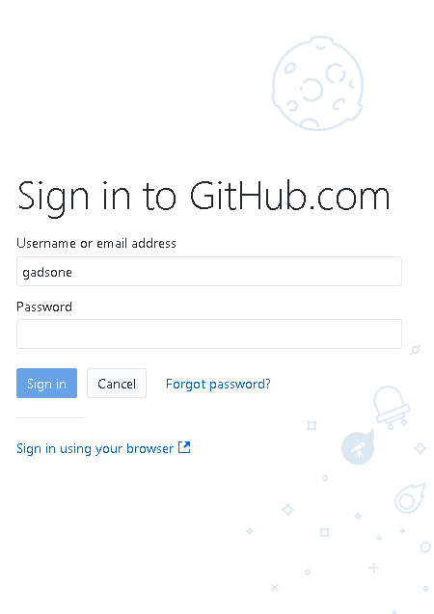
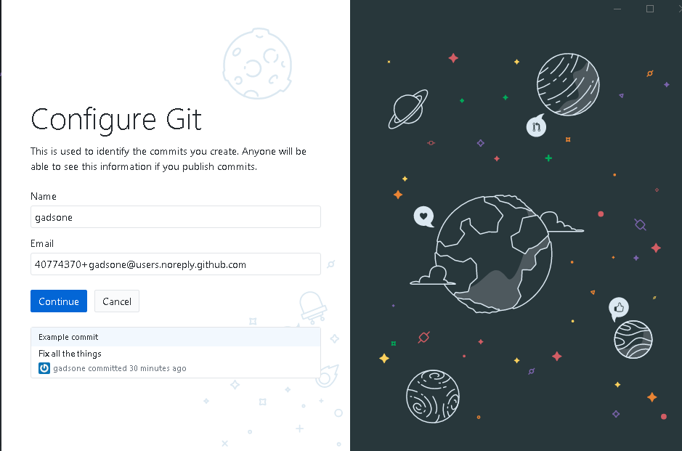
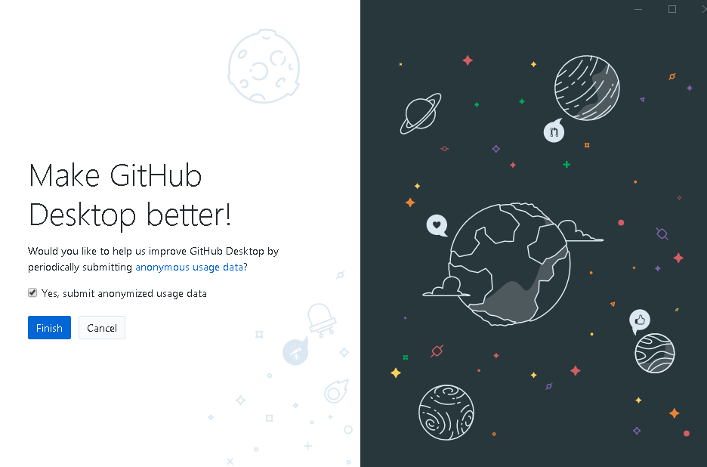
Login to GitHub Desktop

Slide 26
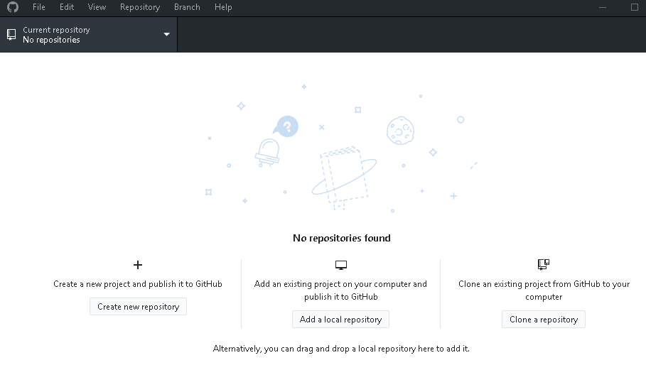
Choose Repository
Select “Add a Local Repository” to clone a repository from GitHub.com. You can also create a repository and clone one from your computer.

Slide 27
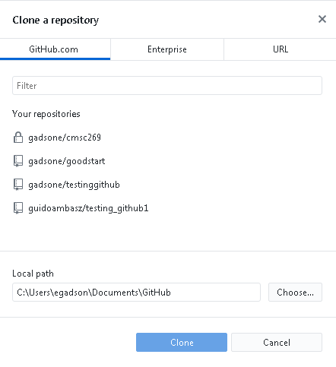
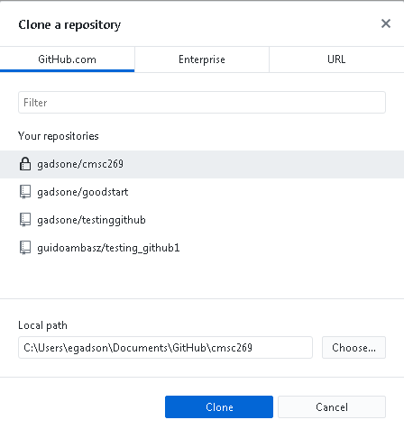
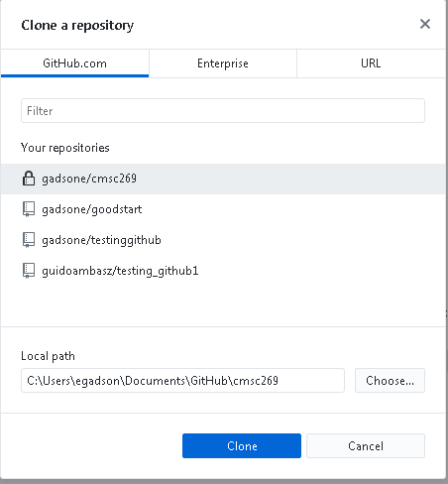
Select a repository from GitHub.com
Choose local path on your computer
Select “Clone”

Slide 28
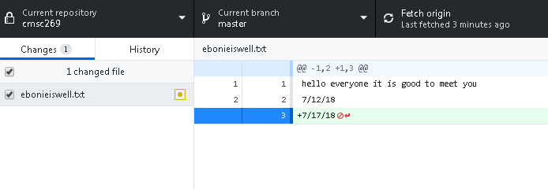
How to Use GitHub Desktop
Click “fetch origin” to git pull (all information from GitHub.com
Locate folder where your repository is located and add or change files. (Remember local path on your computer )

Slide 29
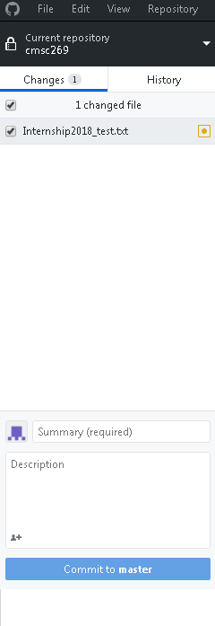

Files added/changes will show under “Changes” tab.
Add a summary of what was changed (a message)
You can add a description but it is not necessary
Click “Commit to [branch]”
Select “Push Origin” to push changes to GitHub.com

Slide 30
References & Quick Links
Educational Resources for Students: https://education.github.com/pack , https://education.github.com/
GitHub: https://github.com/
GitBash: https://git-scm.com/download/win
GitHub Desktop: https://desktop.github.com/
GitHub Golassary: https://help.github.com/articles/github-glossary/
GitHub Youtube Channel: https://www.youtube.com/user/GitHubGuides
GitHub Add a Folder: https://github.community/t/add-a-folder/2304
GitHub Deleting Files in a repository:
https://docs.github.com/en/repositories/working-with-files/managing-files/deleting-files-in-a-repository

Slide 31


The End

