Slide 1
EXIGENCE
DRONES HAVE TURNED TOWARD CIVILIANS
SCALE
~4,000%
increase in drone attacks in conflict from 2020 to 2024
19,704 attacks in 2024 alone
450+ armed groups have used drones, not just nations
COST
~$360
A Ukrainian FPV drone, vs. ~$7M for an early-2000s military drone
A Predator was saved for high-value targets
Cheap drones are expendable and make it easier to mass-deploy them without repercussions
TARGETING
#1
Drones became the most common attack on Ukraine’s civilians in 2025
Sudan: 880+ civilians killed in early 2026, in hospitals, markets and camps
308 Hits on health care targets in 2024, up from just 10 in 2022
For people below, ordinary movement (to work, to market, to a clinic) becomes a risk to calculate.
CIVIC/ACLED via Just Security · ACLED (2025–26) · Vector · AP via WTOP · Arab News (2026) · Insecurity Insight
04
Notes:
The big picture: drones used to be a narrow counterterrorism tool, used by a few states against a few chosen targets. Three things changed. Scale: CIVIC’s reading of ACLED data puts the rise at about 4,000% from 2020 to 2024. Be honest that Ukraine drives much of that, but more than 450 armed groups have now used drones, so this is not one war. Cost: the important number is not the drop itself but what it does to targeting. When a drone costs a few hundred dollars, it becomes rational to spend one on a single person. Targeting: in 2025, drone attacks on Ukrainian civilians outnumbered every other type of attack on civilians for the first time; in Sudan a UN official said the targets show intent to spread terror. Land the last line slowly: this is what it means to live under drones now.

Slide 2
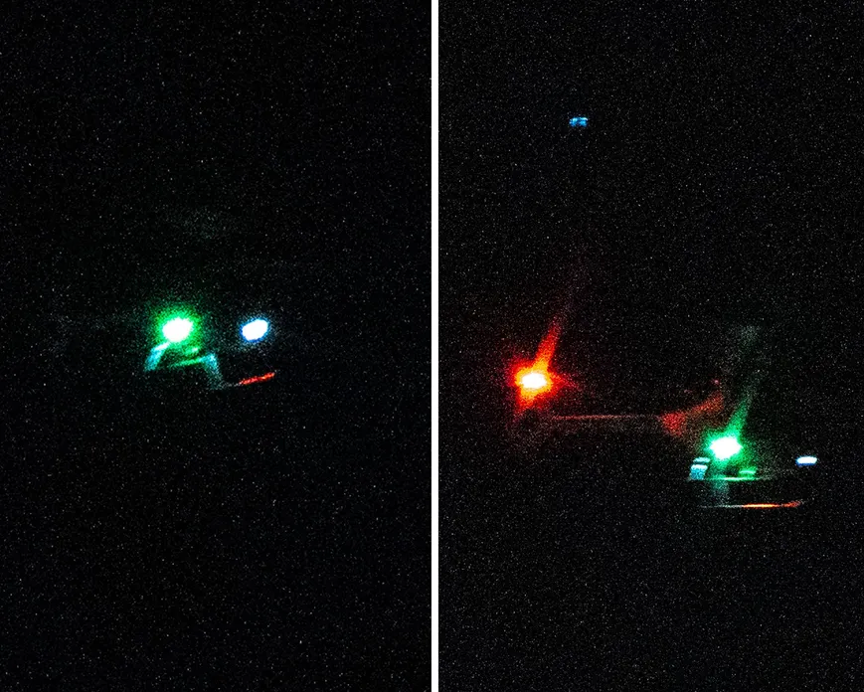
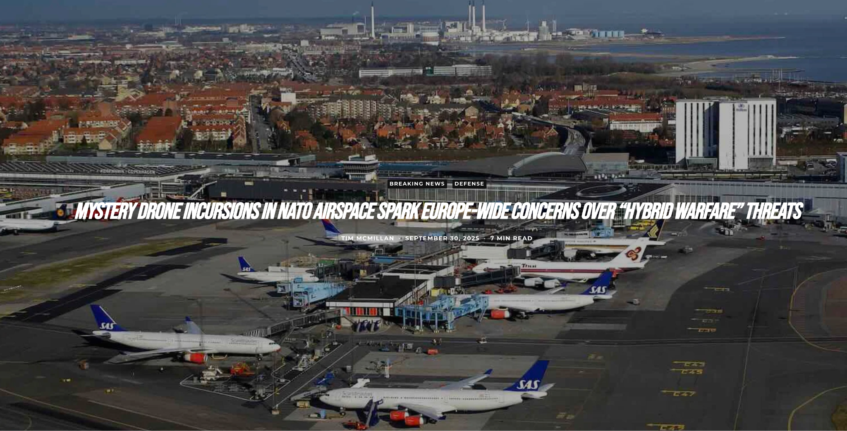
EXIGENCE
FEAR PERSISTS EVEN IN TIMES OF PEACE
New Jersey in 2024
A few people’s posts about “drone sightings” led to 5,000+ tips to the FBI and temporary flight bans in New Jersey, even though the drones were later reported to be FAA-approved.
Europe in Fall 2025
Unidentified drones caused airports to be shut down in Copenhagen, Oslo, Munich, and Brussels. Analysis guesses they were used to build anxiety and erode trust in government protection.
Everyday skies
US police drone use has nearly tripled since 2020, and a 2025 executive order moves routine beyond-sight flights toward normal.
Residents don’t trust that drones are good/bad, even if the government says so. The ambiguity of the aircraft raises concerns and social media doesn’t help.
USA Today via AOL (2024) · Intl. Airport Review (2025) · The Debrief (2025) · Deseret News · EO 14307 (2025)
05
Notes:
In late 2024, Americans were gripped with the mystery of what seemed at first like an invasion of drones over New Jersey and other East Coast states. One year later, some of that mystery has been explained, but questions linger about exactly what happened.
It all started in November 2024 with reports of possible drones flying near the Picatinny Arsenal military research center in Morris County, New Jersey. More sightings at the facility were reported in the following weeks. Soon, Americans in other East Coast states and even politicians claimed to have seen drones.
Reports of drone sightings surged in November and December, prompting government agencies to investigate and politicians to demand answers. Speculation swirled about what or who could be behind the sightings. Were they sent by a foreign enemy? Were they a sign of the U.S. government spying on civilians? Were they even drones at all, or were people seeing things that weren't there?
yet uncertainty alone caused weeks of anxiety, and many residents stayed unconvinced. Europe shows the same effect produced on purpose; analysts argue such flights aim to erode trust that the state can protect people.

Slide 3
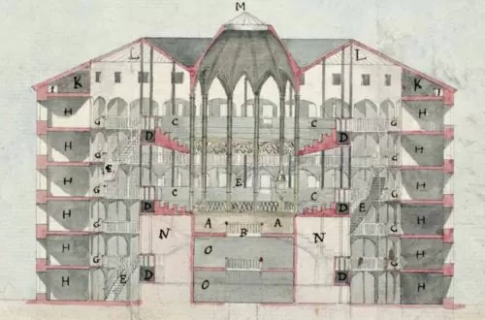
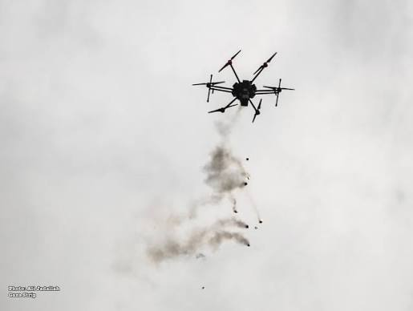
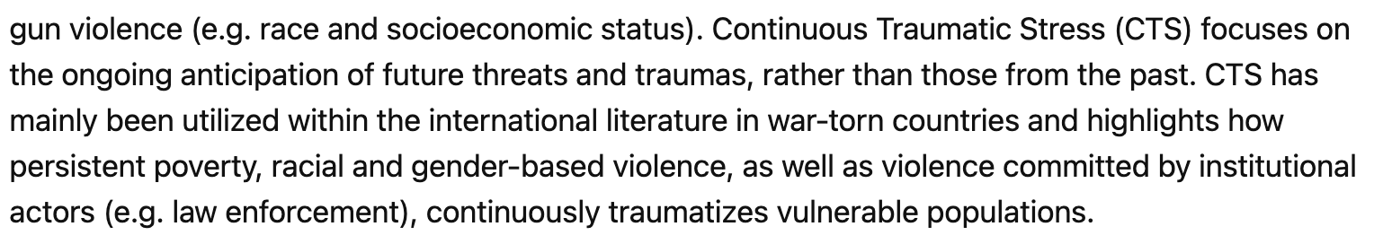
HOW THE HARM WORKS
CARNEGIE MELLON · FALL 2026
Continuous Traumatic Stress, Fear of the Unknown, and the Panopticon Effect
Framework adapted from Hijazi et al. (2019), Current Psychology · Stanford & NYU (2012)
06
Notes:
This is the causal chain we test in the case studies. Hijazi et al. (2019) note that surveillance occurs far more often than strikes, and that signature strikes make ordinary behavior itself look suspicious, so people cannot protect themselves by being “innocent.” The last step is where psychological harm becomes social and economic harm.

