Slide 2
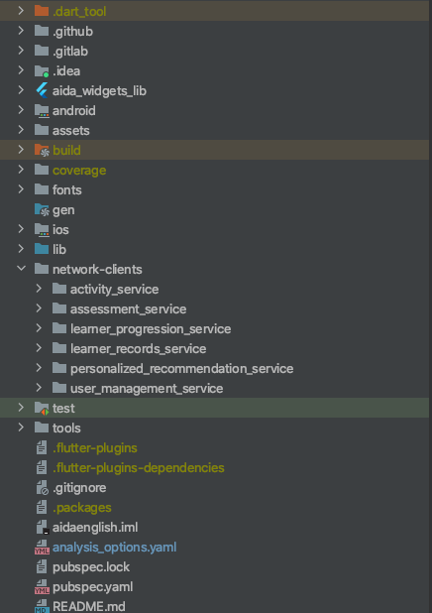
Common Widgets

Slide 3
Common Widgets
Network Clients

Slide 4
Common Widgets
Network Clients
Unit Tests for main module

