Slide 1
Big Data Application in Biomedical Research and Health Care
Prof.Dr.H. Hami OZ
Citation: Luo et al. Big Data Application in Biomedical Research and Health Care:
A Literature Review. Biomedical Informatics Insights 2016:8 1–10 doi: 10.4137/BII.S31559.

Slide 2
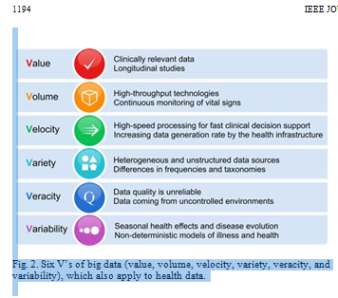

Slide 3
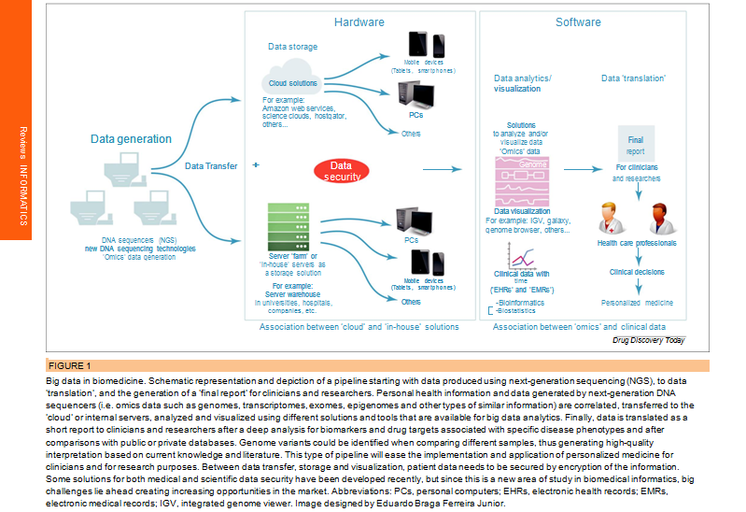

Slide 4
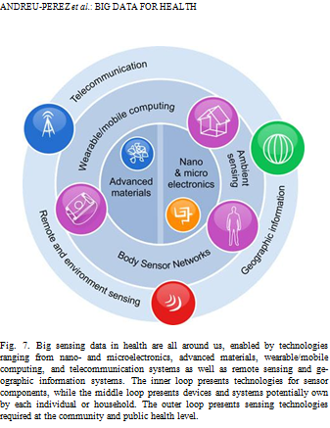

Slide 5
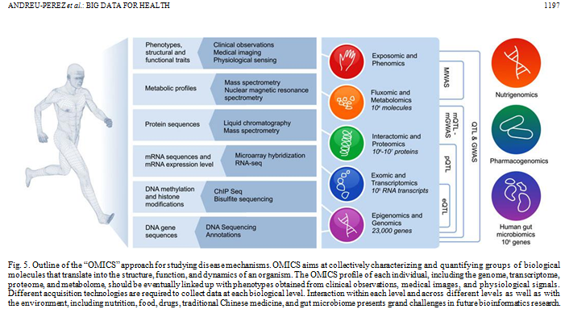

Slide 6
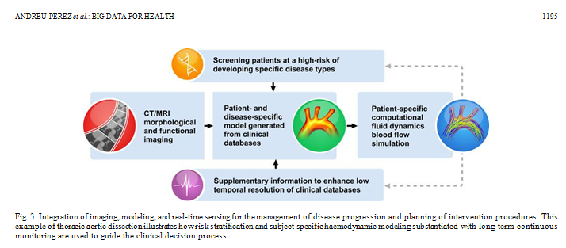

Slide 7
Volume of data
ProteomicsDB ⁸ covers 92% (18,097 of 19,629) of known human genes that are annotated in the Swiss-Prot database.
ProteomicsDB has a data volume of 5.17 TB

Slide 8
Volume of data
Data from millions of patients have already been collected and stored in an electronic format, and these accumulated data could potentially enhance health-care services and increase research opportunities.^{10,11}
Visible Human Project, which has archived 39 GB of female datasets.¹²

Slide 9
variety of data types and structures.
For example, sequencing technologies produce “omics” data systematically at almost all levels of cellular components, from genomics, proteomics, and metabo-lomics to protein interaction and phenomics.¹³
Much of the data that are unstructured¹⁴ (eg, notes from EHRs,^{15,16} clinical trial results,^{17,18} medical images,¹⁹ and medical sensors) provide many opportunities and a unique challenge to formulate new investigations.

Slide 10
velocity
refers to producing and processing data.
The new generation of sequencing technologies enables the production of billions of DNA sequence data each day at a relatively low cost.
Because faster speeds are required for gene sequencing,^{1,20} big data technologies will be tailored to match the speed of producing data, as is required to process them

Slide 11
Veracity
Veracity is important for big data as, for example, personal health records may contain typographical errors, abbreviations, and cryptic notes.
Ambulatory measurements are sometimes taken within less reliable, uncontrolled environments compared to clinical data, which are collected by trained practi-tioners.
The use of spontaneous unmanaged data, such as those from social media, can lead to wrong predictions as the data context is not always known.
Furthermore, sources are of-ten biased toward those young, internet savvy, and expressive online.

Slide 12
value
Last but not least, real value to both patients and healthcare systems can only be realized if challenges to analyze big data can be addressed in a coherent fashion.
It should be noted that many of the underlying principles of big data have been explored by the research community for years in other domains.
Nevertheless, new theories and approaches are needed for analyzing big health data.
The total projected healthcare spending in the UK by 2021 will make 6.4% of the gross domestic product (GDP) whilst the total projected healthcare share of the GDP in the United States is expected to reach 19.9% by 2022 [4].

Slide 13
Big Data Technologies
In most of the cases reported, we found multiple technologies that were used together, such as ­artificial intelligence (AI), along with Hadoop®,²⁴ and data mining tools.

Slide 14
Parallel computing
In recent years, novel parallel computing models, such as MapReduce²⁵ by Google, have been proposed for a new big data infrastructure.
More recently, an open-source MapReduce package called Hadoop²⁴ was released by Apache for distributed data management.
The Hadoop Distributed File System (HDFS) supports concurrent data access to clustered machines.
Hadoop-based services can also be viewed as cloud-computing platforms, which allow for centralized data storage as well as remote access across the Internet.

Slide 15
cloud computing
cloud computing is a novel model for sharing con-figurable computational resources over the network²⁶ and can serve as an infrastructure, platform, and/or software for providing an integrated solution

Slide 16
Big Data Applications
Bioinformatics applications
This section classifies big data technologies/tools into four categories:
(1) data storage and retrieval,
(2) error identification,
(3) data analysis, and
(4) platform integration deployment

Slide 17
Data storage and retrieval.
Nowadays, a sequencing machine can produce millions of short DNA sequencing data during one run.
The sequencing data need to be mapped to specific reference genomes in order to be used for additional analysis, such as genotype and expression variation ­analysis.
CloudBurst³⁰ is a parallel computing model that facilitates the genome mapping process.
CloudBurst parallelizes the short-read mapping process to improve the scalability of reading large sequencing dat

Slide 18
CloudBurst³⁰
The CloudBurst model was evaluated using a 25-core cluster, and the results indicate that the speed to process seven million short-reads was almost 24 times faster than a single-core machine.
The CloudBurst team have developed­ new tools based on CloudBurst to support­
­biomedical research, such as
Contrail³¹ for assembling large genomes and
Crossbow³² for identifying single nucleotide
polymorphisms (SNPs) from sequencing­ data.

Slide 19
DistMap³³
DistMap³³ is a toolkit for distributed short-read mapping on a Hadoop cluster.
DistMap aims to increase the support of different types of mappers to cover a wider range of sequenc-ing applications.
The nine supported mapper types include BWA, Bowtie, Bowtie2, GSNAP, SOAP, STAR, Bismark, BSMAP, and TopHat.
A mapping workflow is integrated into DistMap, which can be operated with simple commands.
For example, an evaluation test was done using a 13-node cluster, making it an effective application for mapping short-read data. The BWA mapper can perform 500 million read pairs (247 GB) in about six hours using DistMap, which is 13 times faster than a single-node mapper.

Slide 20
SeqWare³
SeqWare³⁴ is a query engine built on the Apache HBase³⁵ database to help bioinformatics researchers access large-scale whole-genome datasets.
The SeqWare team created an interactive interface to integrate genome browsers and tools. In a prototyping analysis, the U87MG and 1102GBM tumor databases were loaded, and the team used this engine to compare the Berkeley DB and HBase back end for loading and export-ing variant data capabilities.
The results show that the ­Berkeley DB solution is faster when reading 6M variants, while the HBase solution is faster when reading more than 6M variants.

Slide 21
Read Annotation Pipeline®³⁶
The Read Annotation Pipeline®³⁶ by the DNA Data Bank of Japan (DDBJ) is a cloud-based pipeline for high-throughput analysis of next-generation sequencing data.
DDBJ initiated this cloud-computing system to support sequencing analysis.
It offers a user-friendly interface to process sequencing data-sets, which supports two levels of analysis:
(1) the basic-level tools accept FASTQ format data and preprocess them to trim low-quality bases and
(2) during the second analysis, the data are mapped to genome references or assembled on supercomputers.
This pipeline uses the Galaxy interface for advanced analysis, such as SNP detection, RNA-sequencing (RNA-seq) analysis, and ChIP-seq analysis. In a benchmark testing, DDBJ finished mapping 34.7 million sequencing reads to a 383-MB reference genome in 6.5 hours.

Slide 22
Hydra³⁷
Hydra³⁷ is a scalable proteomic search engine that uses the Hadoop-distributed computing framework.
Hydra is a software package for processing large peptide and spectra databases, implementing a distributed computing environ-ment that supports the scalable searching of massive amounts of spectrometry data.
The proteomic search in Hydra is divided into two steps:
(1) generating a peptide database and
(2) scoring the spectra and retrieving the data.
The system is capable of performing 27 billion peptide scorings in about 40 minutes on a 43-node Hadoop cluster.

Slide 23
Error identification
Error identification. A number of tools have been devel-oped to identify errors in sequencing data;
SAMQA³⁸ identifies such errors and ensures that large-scale genomic data meet the minimum quality standards. Originally built for the National Institutes of Health Cancer Genome Atlas to automatically identify and report errors, SAMQA includes a set of technical tests to find data abnormalities (eg, sequence alignment/map­ [SAM] format error, invalid CIGAR value) that contain empty reads.
A comparison of Hadoop, which was tested on a cluster, with SAMQA, which was tested on a single-core server, shows that the Hadoop cluster processed a 23-GB sample nearly 80 times faster (18.25 hours).

Slide 24
ART
ART ³⁹ provides simulation data for sequencing analysis­ for three major sequencing platforms:
454 Sequencing™, Illumina,­ and SOLiD.
ART has built-in profiles of read error and read length and can identify three types of sequencing errors: base substitutions, insertions, and deletions.

Slide 25
CloudRS⁴⁰
CloudRS⁴⁰ is an error- correction algorithm of high-throughput sequencing data based on a parallel, scalable framework.
This method is developed based on the RS algorithm.⁴¹ The CloudRS team evaluated the system on six different datasets using the GAGE benchmarks,⁴² and the results show that CloudRS has a higher precision rate compared with the Reptile⁴³ method.

Slide 26
Data analysis
In addition to the described frameworks and toolkits for sequencing data analysis, the Genome Analysis Toolkit (GATK)^{20,44} is a MapReduce-based programing framework designed to support large-scale DNA sequence analysis.
GATK supports many data formats, including SAM files, binary alignment/map (BAM), HapMap, and dbSNP.
With GATK, “traversal” modules prepare and read sequencing data into the system and thus provide associated references to the data, such as ordering data by loci.
The “walker” module consumes the data and provides analytics outcomes. GATK has been used in the Cancer Genome Atlas and 1000 Genomes Projects.

Slide 27
ArrayExpress Archive of Functional Genomics
The ArrayExpress Archive of Functional Genomics data repository^{45,46} is an international collaboration for integrating high-throughput genomics data.
The repository contains 30,000 experiments and more than one million assays.
About 80% of the data were extracted from the GEO data repository, and the rest 20% were directly submitted to ArrayExpress by its users.
Each day, the platform is visited by more than 1,000 different users, and more than 50 GB of data are downloaded.
The platform also connects with R and GenomeSpace to support data transition and analysis.

Slide 28
BlueSNP
BlueSNP ⁴⁷ is an R package for genome-wide associa-tion studies (GWAS) analysis, focusing on statistical tests (eg, P-value) to find intensive associations between large geno-type–phenotype datasets.
BlueSNP operates on the Hadoop platform, which reduces barriers and improves the efficiency of running GWAS analyses on clustered machines.
On a 40-node cluster, BlueSNP analyzed 1,000 phenotypes on 10⁶ SNPs in 10⁴ individuals within 34 minutes.

Slide 29
Myrna⁴⁸
Myrna⁴⁸ is a cloud-based computing pipeline that calculates the differences of gene expression in large RNA-seq datasets.
RNA-seq data are m-sequencing reads derived from mRNA molecules.
Myrna supports several functions for RNA-seq analysis, including reads alignment, normalization, and statistical modeling in an integrated pipeline.
Myrna returns differential expression of genes into the form of P-value and q-value.
This system was tested on the Amazon Elastic Compute Cloud (Amazon EC2) using 1.1 billion RNA-seq reads, and the results show that Myrna can process data in less than two hours; the cost of the test task was around $66

Slide 30
Eoulsan package⁴⁹
The Eoulsan package⁴⁹ implanted a pipeline for analyzing the differential transcript expressions, including data imports from sequencer reads, data mapping to reference genomes, alignment filters, transcription expression calculations, expression normalizations using edgeR, and detection of differential expressions.
Eoulsan can be run under three modes: stand-alone, local cluster, and cloud on Amazon Elastic MapReduce.
Eoulsan­ was tested on Amazon EC2 using eight mouse samples­ of 188 million reads. The cost for processing the data was $18–$66, and the total time ranged from 109 to 822 minutes.

Slide 31
SparkSeq⁵⁰
SparkSeq⁵⁰ is a fast, scalable, cloud-ready software pack-age for interactive genomic data analysis with nucleotide pre-cision.
SparkSeq provides interactive queries for RNA/DNA studies, and the project is implemented on Apache Spark using the Hadoop-BAM library for processing bioinformatics files.

Slide 32
Platform integration deployment
Platform integration deployment. The use of big data platforms usually requires a strong grasp of distributed computing and networking knowledge.
To help biomedical researchers embrace big data technology, novel methods are needed to integrate existing big data technologies with user-friendly operations.
The following systems have been developed to help achieve this goal.

Slide 33
SeqPig⁵¹
SeqPig⁵¹ reduces the need for bioinformaticians to obtain the technological skills needed to use MapReduce.
The SeqPig project extends the Apache Pig scripts to provide feature-rich sequence processing functions.
With the help of Hadoop-BAM,⁵² SeqPig solves the problem of reading large BAM files to feed analysis applications.
SeqPig supports commonly used sequencing formats, such as FASTQ , SAM, BAM, and QSeq.
It further sustains commonly used processing tools, such as Pileup, base frequency count, read coverage, and distribution.

Slide 34
CloVR
Current bioinformatics platform also incorporates a virtual machine. CloVR⁵³ is a sequencing analysis package that is distributed through a virtual machine.
By reducing the technical barriers for analyzing large sequencing datasets, CloVR supports both local desktop and cloud systems to enable high-throughput data processing.
Several automated bioinformatics workflows/pipelines are integrated into the virtual machine, including whole-genome, metagenome, and 16S rRNA-sequencing analysis.

Slide 35
CloVR
The CloVR team tested the portability of the system on a local machine (4 CPU, 8 GB RAM) and on the Amazon EC2 cloud platform (80 CPU), and the results show that CloVR is portable on both platforms, while the EC2 instance runs about five times faster.
Similarly, CloudBio­ Linux⁵⁴ is a virtual machine solution that provides more than 135 bioinformatics packages for sequencing analysis, includ-ing preconfigured tools (eg, GATK, Bowtie, Velvet, FASTX) and programing libraries (eg, BioJava, R, Bioconductor).

Slide 36
CloudDOE
CloudDOE is a software package that provides a simple interface for deploying the Hadoop cloud because the Hadoop platform is often too complex for scientists without computer science expertise and/or similar technical skills.
CloudDOE⁵⁵ is a user-friendly tool for analyzing high-throughput sequencing data with MapReduce, encapsulating the complicated procedures for configuring the Hadoop cloud for bioinformatics researchers.
Several packages are integrated with the CloudDOE package (CloudBurst, CloudBrush, and CloudRS), and its operation is further simplified by wizards and graphic user interfaces.

Slide 37
Clinical informatics applications
Clinical informatics focuses on the application of information technology in the health-care domain. It includes
activity-based research,
analysis of relationship between patient main diagnosis (MD) and underlying cause of death (UCD),
and storage of data from EHRs and other sources (eg, electrophysiological [such as EEG] data).

Slide 38
Clinical informatics applications
In this section, we classified big data technolo-gies/tools into four categories:
(1) data storage and retrieval,
(2) interactive data retrieval for data sharing,
(3) data security, and
(4) data analysis.
Compared with bioinformatics, clini-cal informatics does not offer many tools for error identifica-tion but pays more attention to data-sharing and data security issues.
Its data analysis method is very different from bioin-formatics, as clinical informatics works with both structured and unstructured data, develops specific ontologies, and uses natural language processing extensively.

Slide 39
Data storage and retrieval.
Data storage and retrieval. It is critical to discuss the ways in which big data techniques (eg, Hadoop, NoSQL database) are used for storing EHRs.
The efficient storage of data is especially important when working with clinical real-time stream data.⁵⁶ Dutta et al evaluated the potential of using Hadoop and HBase³⁵ as data warehouses for storing EEG data and discussed their high-performance characteristics. Jin et al.⁵⁷ analyzed the potential of using Hadoop HDFS and HBase for distributed EHRs.

Slide 40
Data storage and retrieval.
Cloudwave, uses Hadoop-based data processing modules to store clinical data, and by leveraging the processing power of Hadoop, they developed a web-based interface for real-time data visualization and retrieval.
The Cloudwave team evaluated a dataset of 77-GB EEG signal data and compared Cloudwave with a stand-alone system; the results show that Cloudwave processed five EEG studies in 1 minute, while the stand-alone system took more than 20 minutes.

Slide 41
NoSQL
Compared with a traditional relational database that handles structured data well, the novel NoSQL is a great prospect for storing unstructured data.
It combines both relational and multidimensional technologies with NoSQL repositories to enable data mining techniques and provide flexibility and speed in data ­processing.

Slide 42
NoSQL
A prototype system for storing clinical signal data, where the time series data of clinical sensors are stored within HBase in a way that the row key serves as the time stamp of a single value, and the column stores patient physiological values that correspond with the row key time stamp.
To improve the accessibility and read-ability of the HBase data schema, the metadata are stored in MongoDB,⁶² which is a document-based NoSQL database.
Google Web Toolkit is incorporated into the system to visual-ize the clinical signal data.

Slide 43
Interactive data retrieval for data sharing
Interactive data retrieval for data sharing. Interactive medi­cal information retrieval is expected to play an important role in sharing medical knowledge and integrating data.
To handle huge amounts of online heart disease data analyses in China, Wang et al.⁶⁸ used a hybrid XML database and the Hadoop/HBase infrastructure to design the “Clinical Data Managing and Analyzing System.”

Slide 44
Data security.
MedCloud , a model that leverages the Hadoop eco-system to consider compliance issues with HIPAA when accessing patient data.
Home-Diagnosis, a cloud-based framework to address challenges with privacy protection, ensure highly concurrent and scalable medical record retrieval, and conduct data analysis in a self-caring setting.
To solve these major challenges, a Lucene-based dis-tributed search cluster was used in Home -Diagnosis, while a Hadoop cluster was employed to speed up the process overall.

Slide 45
Data analysis
Data analysis. Predicting disease risk and progression over time can be very useful for clinical decision support, and building computational models for clinical prediction requires a complex pipeline.
PARAMO as a predictive modeling platform for analyzing electronic health data.
PARAMO supports the generation and reuse of a clinical data analysis pipeline for different modeling purposes.
To efficiently process parallel tasks, PARAMO supports ­MapReduce, which analyzes data for an immense amount of medical data that can be processed in a reasonable time.

Slide 46
PARAMO
Medical terminology ontologies (eg, ICD, UMLS) were inte-grated into the PARAMO system, and the analysis was tested on a set of EHR data from 5,000 to 300,000 patients using a Hadoop cluster; the concurrent task varies from 10 to 160. Results show that on this large dataset, 160 concurrent tasks are 72 times faster than running on 10 concurrent tasks.

Slide 47
Imaging informatics applications.
In this section, we classified big data technologies/tools into three categories:
(1) data storage and retrieval,
(2) data sharing, and
(3) data analysis..

Slide 48
Data storage and retrieval
Imaging informatics is pre-dominantly used for improving the efficiency of image processing workflows, such as storage, retrieval, and interoperation.
PACS are popular for delivering images to local display work-stations, which is accomplished primarily through DICOM protocols in radiology departments.
Many web-based medical applications have been developed to access PACS, and greater use of big data technology has been improving their performance

Slide 49
Data storage and retrieval
A massive Hadoop-based was developed medical image retrieval system that extracted the characteristics of medical images using a Brushlet transform and a local binary pattern algorithm.
Then, the HDFS stored the image features, followed by the imple-mentation of MapReduce.

Slide 50
Data and workflow sharing
PACS primarily provide image data archiving and analysis workflow at single sites.
Radiology groups operating under a disparate delivery model (ie, different services offered by different vendors to complete a single radiology task) face significant challenges in a data-sharing infrastructure.

Slide 51
Super­ PACS,
Super­ PACS, a system that enables a radiology group that serves multiple sites and has disparate PACS, RIS, reporting, and other relevant IT systems to view these sites virtually from one site and to use one virtual desktop to efficiently complete all radiology work and reporting.
SuperPACS provides two approaches:
(1) the federated approach, in which all patient data stay local, and
(2) the consolidated approach, in which the data are stored centrally by a single agent

Slide 52
Super­ PACS
The agent is able to
(1) provide an interface for DICOM, HL7, HTTP, and XDS standard and nonstandardized data;
(2) synchronize metadata on local PACS and RIS;
(3) cache images and data received from local PACS, RIS, any input tool, or another agent;
(4) archive image data with compression and multitier storage, backup, disaster recovery, and image and data life­ cycle management;
(5) provide­ worklists, folders, routing logic, and mechanisms for image and nonimage data;
(6) distribute image data through a web server, including compres-sion and streaming; and
(7) access local and remote data from a SuperPACS web client.

Slide 53
Data analysis.
Data analysis. Seeking to overcome the challenges brought by large -scale (terabytes or petabytes) data derived from path-ological images,
Hadoop-GIS, an effi-cient and cost-effective parallel system. Here, GIS refers to spatially derived data management applications, which enable real-time spatial queries with the Real-time Spatial Query Engine, and integrates both MapReduce-based spatial query processing and Hive-based feature query processing.

Slide 54
Hadoop-GIS
The Hadoop-GIS system also offers an easier SQL-like declarative query language that is supported by Hive.
In the performance study,
(1) a small-sized cluster for prototype tests and
(2) a medium-sized cluster for scalability tests on real-world data were used.
The results show that Hadoop-GIS increased query efficiency and decreased loading and query time.

Slide 55
Hadoop-GIS
Hadoop was used to establish a cluster of computing nodes and MapReduce to speed up the process.
Three cases of use were analyzed:
(1) parameter opti-mization for lung texture classification using support vector machines (SVMs),
(2) content-based medical image indexing, and
(3) three-dimensional directional wavelet analysis for solid texture classification.
Test results in a parallel grid search for optimal SVM parameters showed that using concurrent map tasks reduced the total runtime from 50 hours to 9 hours 15 minutes – a significant improvement in computing effi-ciency while maintaining a good classification performance.

Slide 56
Public health information
public health has three core functions:
(1)assessment,
(2) policy development, and
(3) assurance.
Assessment primarily involves collecting and analyzing data to track and monitor public health status, thereby providing evidence for decision making and policy development.
Assurance is used to validate whether the services offered by health institutions have achieved their initial target goals for increasing public health outcomes;

Slide 57
Public health information
This section focuses on four areas:
(1) infectious disease surveillance,
(2) population health man-agement,
(3) mental health management, and
(4) chronic dis-ease management.

Slide 58
Infectious disease surveillance
Using big data for global infectious disease surveillance.
A system was developed that provides real-time risk monitoring on map, pointing out that machine learning and crowdsourcing have opened new possibilities for devel-oping a continually updated atlas for disease monitoring.
Online social media combined with epidemiological information is a valuable new data source for facilitating public health surveillance.
The use of social media for disease monitoring was demonstrated in which 553,186,016 tweets were collected and extracted more than 9,800 with HIV risk-related keywords (eg, sexual behaviors and drug use) and geographic annotations.
There is a significant positive correlation (P , 0.01) between HIV-related tweets and HIV cases based on prevalence analysis, illustrating the importance of social media

Slide 59
Population health management
The independent association of patient MD and UCD was analyzed.
The MD was identified by ICD10 code, while the UCD was extracted from a death registry.
If MD and UCD were different events, then those events were found to be independent.
Using health insur-ance data, information from 421,460 deceased patients was extracted from 2008 to 2009.
The results show that 8.5% of inhospital deaths and 19.5% of out-of-hospital deaths were independent events and that independent death was more common in elderly patients.
The results demonstrate that large-scale data analysis can be used to effectively analyze the association of medical events.

Slide 60
Mental health management
Messages posted on social media could be used to screen for and potentially detect depression.
Their analysis is based on previous research of the association between depressive dis-orders and repetitive thoughts/ruminating behavior.
Big data analytics tools play an important role in their work by ­mining hidden behavioral and emotional patterns in messages, or “tweets,” posted on Twitter.
Within these tweets, a disease-related emotion pattern, which is a previously hidden symptom may be detected .
Future research could delve deeper into the conversations of the depressed users to understand more about their hidden emotions and sentiments.
The effectiveness of their model against a dataset of 89,840 patients were analyzed, and the results show that they can achieve an overall accuracy of 82.35% for all conditions.

Slide 61
Successful applications of personalized medicine in cancer
Successful applications of personalized medicine in cancer include three drugs that have been identified and used in specific groups of patients.
Patients with melanoma and the BRAF muta-tion V600E can be treated with dabrafenib [52],
patients with breast cancer and the amplification or overexpression of the gene encoding Her2/Neu can be treated with a targeted therapy using trastuzumab [53]
and different types of tumor that contain the fusion protein BCR-ABL can be treated with imatinib [54].

Slide 62
Chronic disease management
­Cardiovascular Health in Ambulatory Care Research Team (CANHEART), a unique, population-based ­observational research initiative aimed at measuring and improving cardio-vascular health and the quality of ambulatory cardiovascular­ care provided in Ontario, Canada.
It included data from 9.8 ­million Ontario adults aged $20 years.
Data were assembled by linking multiple databases, such as electronic surveys, health administration, clinical, laboratory, drug, and electronic medical record databases using encoded personal identifiers.
Follow-up clinical events were collected through record link-ages to comprehensive hospitalization, emergency department, and vital statistics administrative databases.

Slide 63
Conclusion
(1) integrating different sources of information enables clinicians to depict a new view of patient care processes that consider a patient’s holistic health status, from genome to behavior;
(2) the avail-ability of novel mobile health technologies facilitates real-time data gathering with more accuracy;
(3) the implementation of distributed platforms enables data archiving and analysis, which will further be developed for decision support; and
(4) the inclusion of geographical and environmental informa-tion may further increase the ability to interpret gathered data and extract new knowledge.

Slide 64
Conclusion
While big data holds significant promise for improving
health care, there are several common challenges facing­ all the four fields in using big data technology; the most significant problem is the integration of various databases.
For example, the VHA’s database, VISTA, is not a single system; it is a set of 128 interlinked systems.
This becomes even more complicated when databases contain different data types (eg, integrating an imaging database or a laboratory test results database into existing systems), thereby limiting a system’s ability to make queries against all databases to acquire all patient data.
The lack of standardization for laboratory protocols and values­ also creates challenges for data integration.

Slide 65
Conclusion
For example, image data can suffer from technological batch effects when they come from different laboratories under different proto-cols.
Efforts are made to normalize data when there is a batch effect; this may be easier for image data, but it is intrinsically more difficult to normalize laboratory test data.
Security­ and privacy concerns also remain as hurdles to big data integra-tion and usage in all the four fields, and thus, secure platforms­ with better communication standards and protocols are greatly needed.

Slide 66
Example of companies and institutions that provide solutions to generate, interperet and visualize combined omics and health clinical data

Slide 67
Examples of companies and institutions that provide solutions to generate, interpret and visualize combined omics and health clinical data
Company or institution | Type of solution | Website
Appistry | High-performance big data platform that combines self-organizing computational | http://www.appistry.com
 | storage with optimized and distributed high-performance computing to provide secure,
 | HIPAA-complaint accurate on-demand analysis of omics data in association with clinical
 | information
Beijing Genome Institute | This solution serves as a solid foundation for large-scale bioinformatics processing. The | http://www.genomics.cn/en
 | computing platform is an integrated service comprising versatile software and powerful
 | hardware applied to life sciences
CLC Bio | Utilizes proprietary algorithms, based on published methods, to accelerate successfully | http://www.clcbio.com
 | data calculations to achieve remarkable improvements in big data analytics
Context Matters | Provides a comprehensive tool that empowers pharmaceutical and biotechnology | http://www.contextmattersinc.com
 | companies to make better strategic decisions using web-based applications, and
 | easy-to-use interface and visualization tools to deal with complex data sets
DNAnexus | Provides solutions for NGS by using cloud computing infrastructure with scalable | http://www.dnanexus.com
 | systems and advanced bioinformatics in a web-based platform to solve data
 | management and the challenges in analysis that are common in unified systems.
Genome International | Genome International Corporation (GIC) is a research-driven company that provides | http://www.genome.com
Corporation | innovative bioinformatics products and custom research solutions for corporate,
 | government, and academic laboratories in life sciences
GNS Healthcare | A big data analytics company that has developed a scalable approach to deal with big | http://www.gnshealthcare.com
 | data solutions that could be applied across the healthcare industry
NextBio | Big data technology that enables users to integrate and interpret systematically public | http://www.nextbio.com
 | and proprietary molecular data and clinical information from individual patients,
 | population studies and model organisms applying omics data in useful ways both in
 | research and in the clinic
Pathfinder | Develops customized software applications, providing solutions in different sectors, | http://www.pathfindersoftware.com
 | including healthcare and omics, offering technologies that enable business
 | breakthroughs and competitive advantages
Reviews INFORMATICS

Slide 68
Examples of big corporations offering solutions and pipelines to store, analyze and deal with complex biomedical information
Company | Solution(s) | Website
Amazon Web Services | Provides the necessary computing environment, including CPUs, storage, | http://aws.amazon.com
 | memory (RAM), networking, and operating system, for a hardware
 | infrastructure as a service in the biomedical and scientific fields
Cisco Healthcare Solutions | Offers different types of solution for the life sciences, including specific | http://www.cisco.com/web/strategy/
 | hardware and cloud computing for reliable and highly secure health data | healthcare/index.html
 | communication and sharing across the healthcare community
DELL Healthcare Solutions | Connects researchers to the right technology and processes to create | http://www.dell.com/Learn/us/en/70/
 | information-driven healthcare and accelerate innovation in life sciences | healthcare-solutions?c=us&l=en&s=hea
 | with electronic medical record (EMR) solutions
GE Healthcare Life Sciences | Provides expertise and tools for a wide range of applications, including basic | http://www3.gehealthcare.com/en/
 | research of cells and proteins, drug discovery research, as well as tools to | Global_Gateway
 | support large-scale manufacturing of biopharmaceuticals
IBM Healthcare and | Provides healthcare solutions, technology and consulting that enable | http://www-935.ibm.com/industries/
Life Sciences | organizations to achieve greater efficiency within their operations, and | healthcare
 | to collaborate to improve outcomes and integrate with new partners for
 | a more sustainable, personalized and patient-centric system
Intel Healthcare | Currently builds frameworks with governments, healthcare organizations, | http://www.intel.com/healthcare
 | and technology innovators worldwide to build the health IT tools and
 | services of tomorrow by combining different types of health information
Microsoft Life Sciences | Provides innovative, world-class technologies to help customers nurture | http://www.microsoft.com/health/en-us/
 | innovation, improve decision-making and streamline operations | solutions/Pages/life-sciences.aspx
Oracle Life Sciences | Delivers key functionalities built for pharmaceutical, biotechnology, clinical | http://www.oracle.com/us/industries/
 | and medical device enterprises. Oracle maximizes the chances of | life-sciences/overview/index.html
 | discovering and bringing to market products that will help in treating
 | specific diseases

Slide 69
Examples of companies that offer personalized genetics and omics solutions
Company | Applications and/or services | Website
23andme | A DNA analysis service providing information and educational tools for individuals to | http://www.23andme.com
 | learn and explore their DNA through personal genomics
Counsyl | Offers tests for gene mutations and variations in more than 100 inherited rare genetic | http://www.counsyl.com
 | disorders using a DNA biochip designed specifically to test for these disorders
Foundation Medicine | A molecular information company at the forefront of bringing comprehensive cancer | http://www.foundationmedicine.com
 | genomic analytics to routine clinical care
Knome | Analyzes whole-genome data using software-based tests to examine and compare | http://www.knome.com
 | simultaneously many genes, gene networks and genomes as well as integrate other
 | forms of molecular and nonmolecular data
Pathway Genomics | Incorporates customized and scientifically validated technologies to generate | http://www.pathway.com
 | personalized reports, which address a variety of medical issues, including an
 | individual’s propensity to develop certain diseases
Personalis | A genome-scale diagnostics services company pioneering genome-guided medicine | http://www.personalis.com
 | focused on producing the most accurate genetic sequence data from each sample,
 | using data analytics and proprietary content to draw accurate and reliable biomedical
 | interpretations

Slide 70
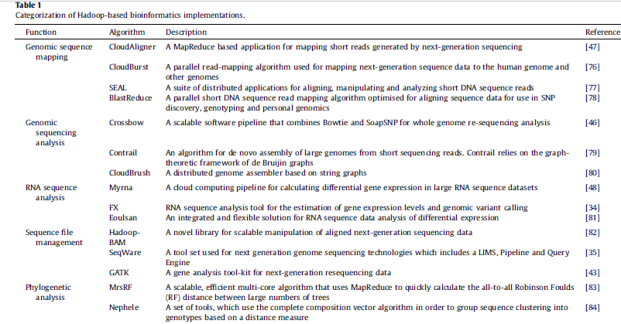
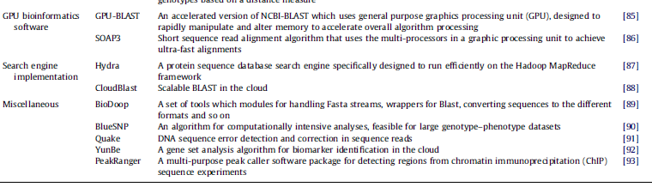

Slide 71
Thank you

