Slide 1


VLIZ R Code Club 6

Slide 2
Today’s agenda
Event/Project updates:
Tracking the users of VLIZ data systems
Training – tutorials
R Shiny – Make your own shiny app
R Shiny – How to put your personal Shiny app online
R Shiny – Best practices of shiny apps – by IT
R Shiny – how to add your published shiny app to a website
New Projects
The R Code Club newsletter!
Tips & Tricks
Create reproducible examples with reprex
Read the source code with lookup

Slide 3
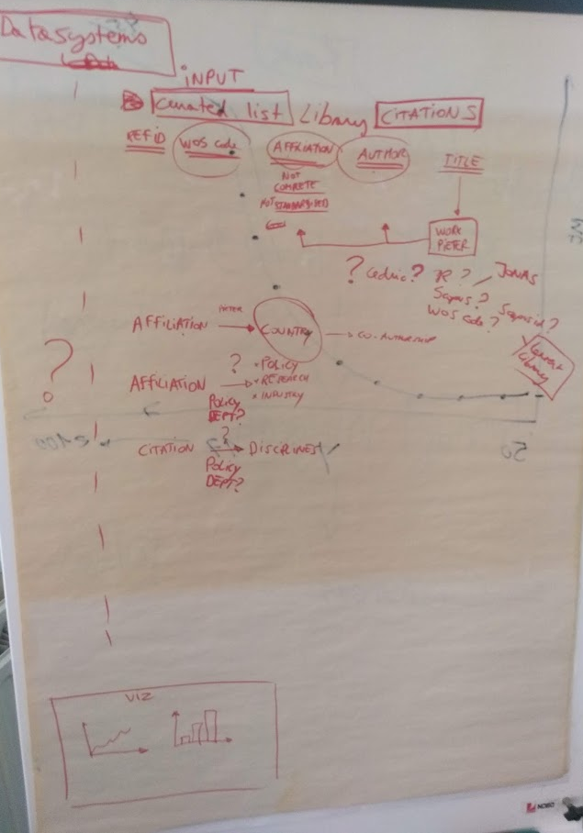
Measuring the citation impact of our data systems
Data Centre
Policy
Library
-> interdisciplinary!

Slide 4
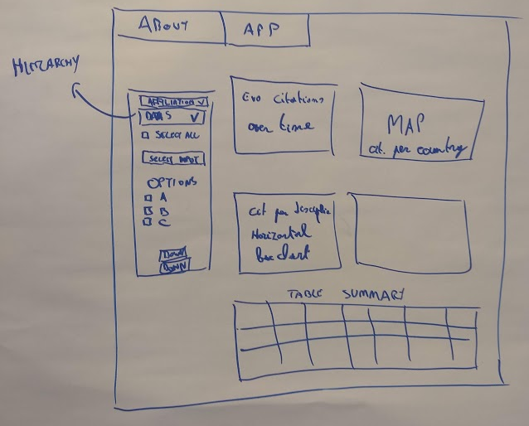
Measuring the citation impact of our data systems

Slide 5
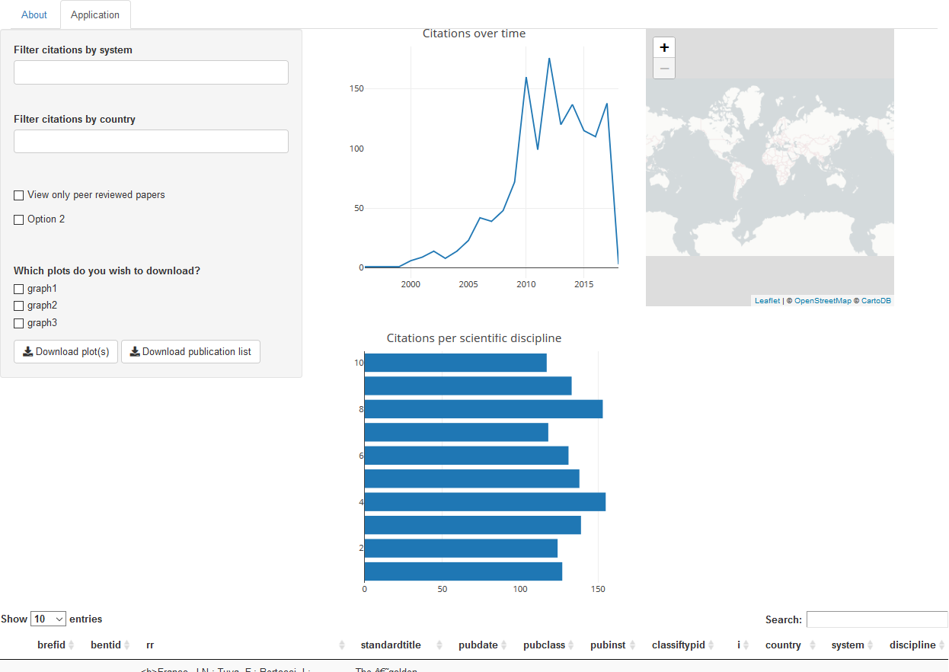
Measuring the citation impact of our data systems
Code + Shiny Application:
https://gitlab.vliz.be/datac/rshiny/citation-impact

Slide 6
Measuring the citation impact of our data systems
So far the good side…
… with a dummy dataset
Still to do:
Enriching the metadata of our citations:
Affiliations
Country
Discipline
Impact of citation?
Other indices?
https://docs.google.com/spreadsheets/d/1ZlYcKDdP98XH3f4FhD2nPZJ28z27QW7AcaT_s3x_rt8/edit#gid=0

Slide 7
Measuring the citation impact of our data systems
Still to do:
What is the price for an ‘extended’ api?
How to make an ‘Relative citation index’ chart
Meet again?

Slide 8
R Shiny

Slide 9
How to make your own shiny app
User interface = ui
Define input
Define output
Background calculations = server
Do crazy stuff with input
Calculate output
Reactive content:
Every time an input changes:
server recalculates
Sends info to output

Slide 10
How to make your own shiny app
https://github.com/rstudio/shiny-examples
if (!require('shiny')) install.packages("shiny")
shiny::runGitHub("shiny-examples", "rstudio", subdir = "001-hello“)
shiny::runGitHub("shiny-examples", "rstudio", subdir = "003-reactivity")
https://shiny.rstudio.com/tutorial/

Slide 11
How to publish your own shiny app

Slide 12
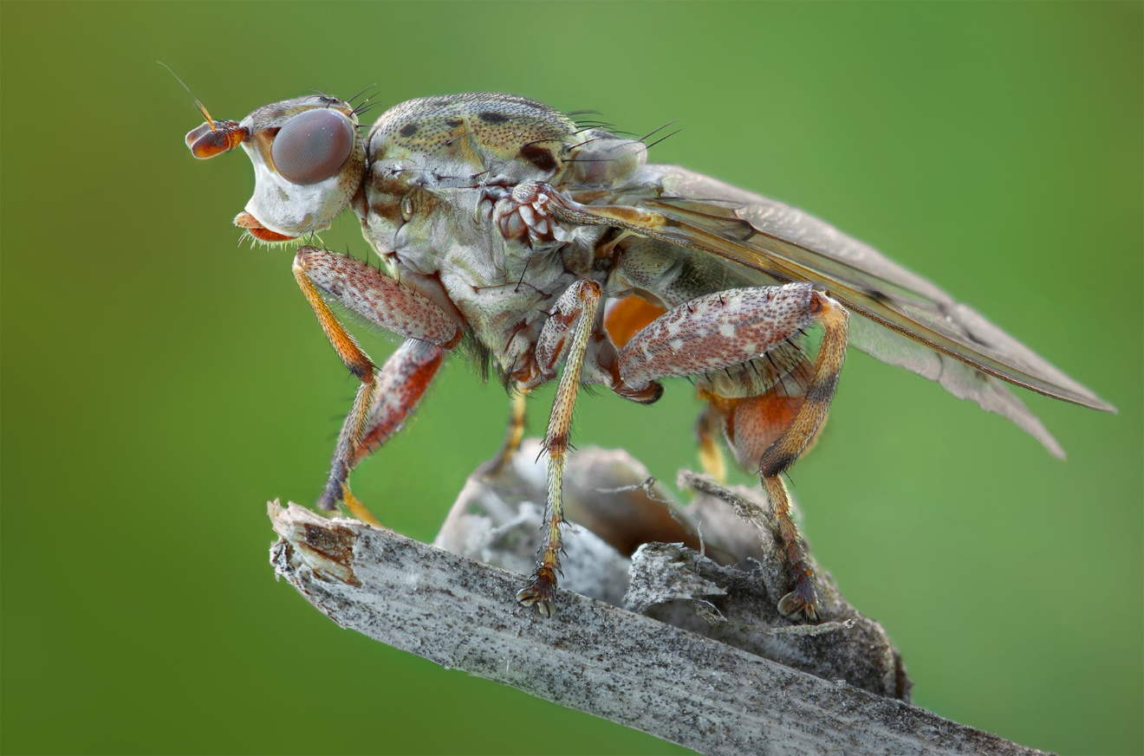
JONAS MORTELMANS’ SHINY APP
Shinyapps
Notes:
Slakkendodende vliegen
Larven parasiteren slakken
Sterke connectie met gastheer
572 soorten op de wereld
72 in belgie

Slide 13
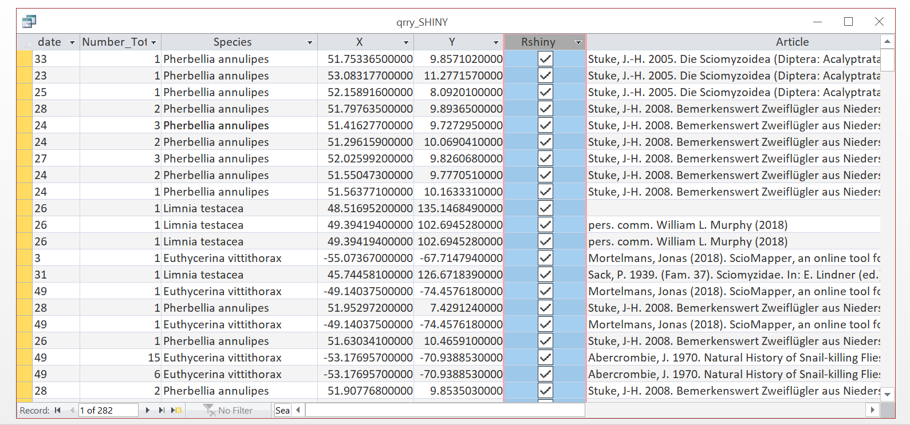
Notes:
Ik heb eigen databank in acces voor het bijhouden van waarnemingen

Slide 14
Access database (>60.000 records of flies!)
Species distribution (where?)
Species occurence (when?)
Collector details (who caught it? where is the specimen)
Source (literature? own observations? Collections?)
Is it OK if I show this record online (no legal issues)
Notes:
Essentials:
Coordinaten
Datum
Source (gekopieerd uit literatuur, eigen observatie, collecties?)
En ook: mag ik dat specifiek record zonder problmeen online tonen (bvb in veel gevallen kan ik dat niet, als ik de waarnemingen van een online observatieplatform kopieerde bvb)

Slide 15
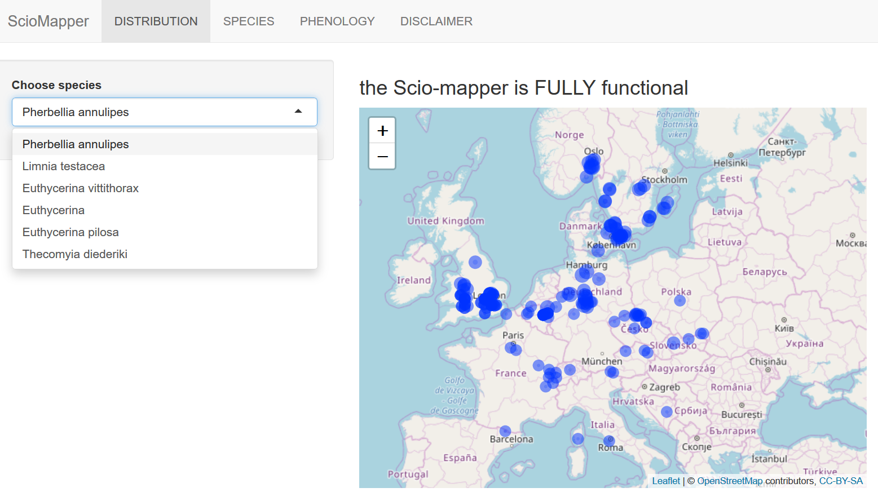
https://sciomyzidae.shinyapps.io/sciomapper/
Notes:
All this information is shown on my rhsiny app
A distribution tab: you can select a ceratin species, and obserbations will be plotted on dynamic map!
Only one species a a time for now

Slide 16
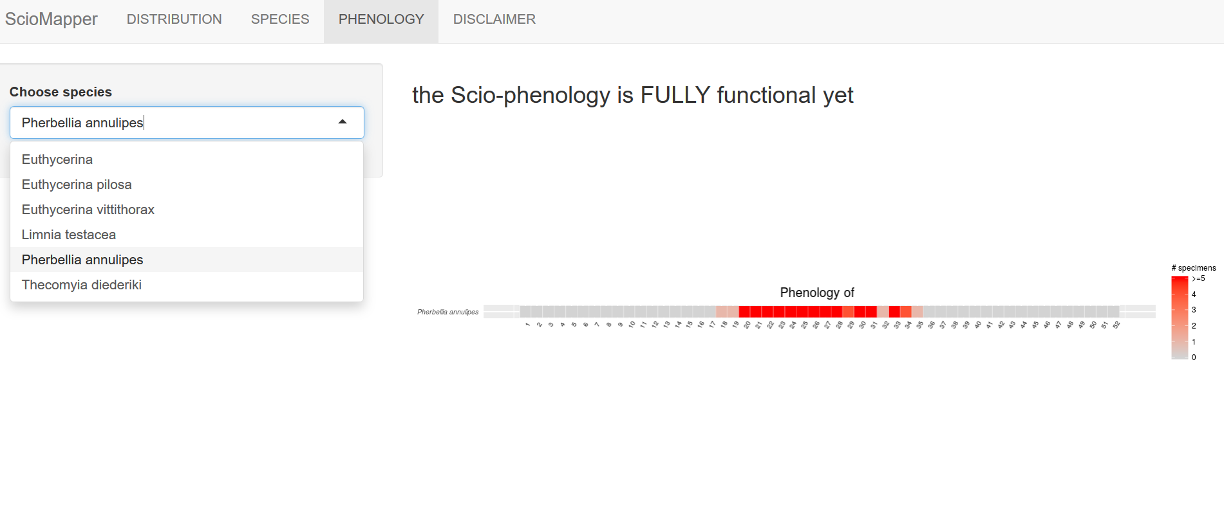
Notes:
All this information is shown on my rhsiny app
The phenology is automatically plotted too
One species at a time
Easy to see when a certain species is flying in the year.. In this example I need to go from week 20 to 28 to look for the species
Other tabs are not working yet

Slide 17

Basics of an R-shiny App
Ui.R file
Deals with graphics, tables, maps, colour, scales, user panels…
server.R file
Shiny::RunApp()
ui <- fluidPage()
server <- function(input, output) {}
shinyApp(ui = ui, server = server)

Slide 18
How to get one running (‘online manual’)
Sign up at https://www.shinyapps.io/
5 packages (up to 300 dollar/year)
I have the free package (it works only 25 hours a month! But its FREE)
Three steps
Library(Rsconnect)
The rsconnect package enables you to deploy and manage your Shiny applications directly from your R console.
Authorize R and shinyapps.io to connect
Via a simple token
Deploy!
Rsconnect::deployApp(‘pathtoyourapp’)

Slide 19
How to get one running (‘own experience’)
HORROR!!

Slide 20
How to get one running (‘own experience’)
No, joke, it’s OK just follow the manual

Slide 21
How to get one running (‘own experience’)
Load in data from SQL library(RODBC)
Prepare UI and server codes (make sure they work local)
Library(Rsconnect)
Authorize R and shinyapps.io to connect
Deploy!
Library(RODBC)
channel <- odbcConnectAccess2007(testdb)
df<-sqlFetch(channel, "qrry_SHINY_species")
write.csv(df, 'data_taxonmatch.csv')
Rsconnect::deployApp(‘pathtoyourapp’)

Slide 22
Tips and Tricks

Slide 23
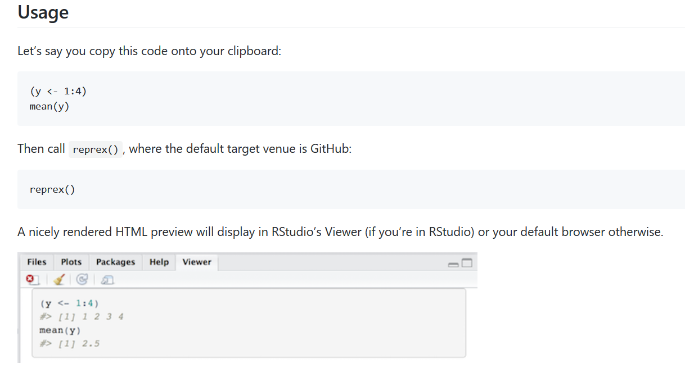
Making a clean reproducible example
https://reprex.tidyverse.org/
install.packages(‘reprex’)
library(reprex)

Slide 24
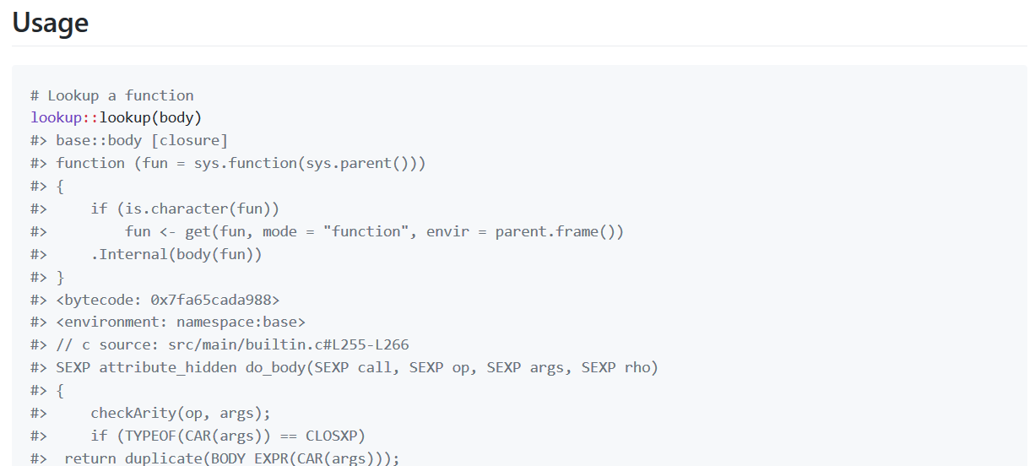
Looking up the source
https://github.com/jimhester/lookup
#install.packages("devtools")
devtools::install_github("jimhester/lookup")

Slide 25
Next meeting
Friday 8 November 2019, in the Marmara
Topic:
Data wrangling with dplyr
Warming stripes in R
… ? Open for suggestions!

