Slide 1

©willywonka

Slide 2
DPLYR
~ Dataset apply’r

Slide 3
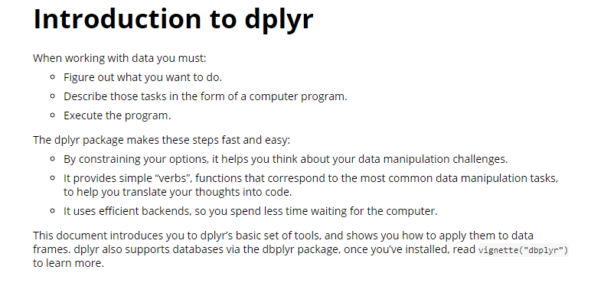
WHY?? What R-studio says:
Notes:
More simple, faster

Slide 4
WHY?? TIBBLE, better than dataframe
Never changes input typ (dataframe: StringsAsFactor: FALSE)
Doesn’t change a variable name
Subset is always a tibble. Subset of a dataframe: df or vector

Slide 5
https://cran.rstudio.com/web/packages/tibble/vignettes/tibble.html
https://www.datacamp.com/courses/data-manipulation-with-dplyr-in-r
https://www.datacamp.com/courses/joining-data-with-dplyr-in-r

