Slide 1
General Education Renaissance
Comprehensive Survey Results

Slide 2
Table of Contents
Academic Leader Survey Results 3
Academic Leader – AI Section 14
Alumni Survey Results 18
Alumni – AI Section 27
Employer Survey Results 34
Employer – AI Section 42
Faculty Survey Results 46
Faculty – AI Section 58

Slide 3
Academic Leader Survey Results
Program deans, associate deans, chairs, and associate chairs April 14—May 1, 2026

Slide 4
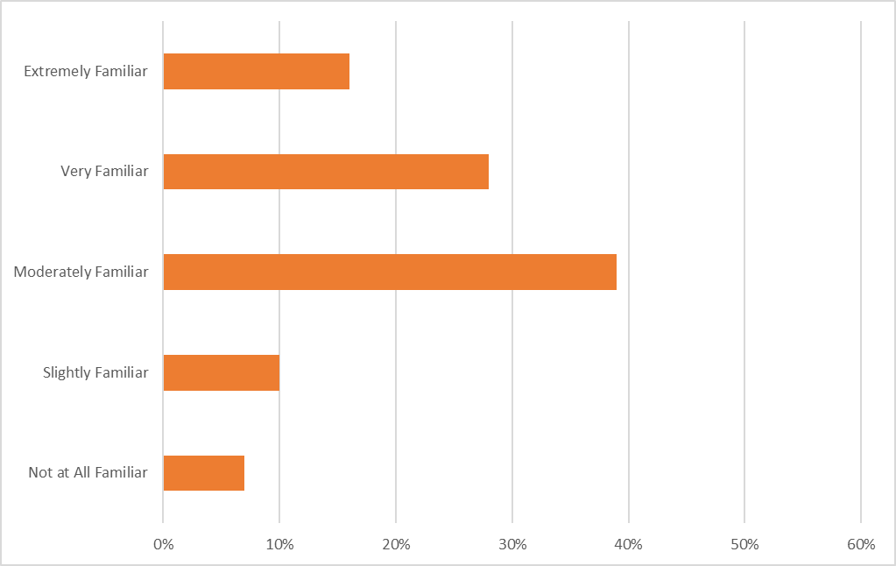
How familiar are you with SCAD's general education learning outcomes?
Extremely Familiar | 16%
Very Familiar | 28%
Moderately Familiar | 39%
Slightly Familiar | 10%
Not at All Familiar | 7%

Slide 5
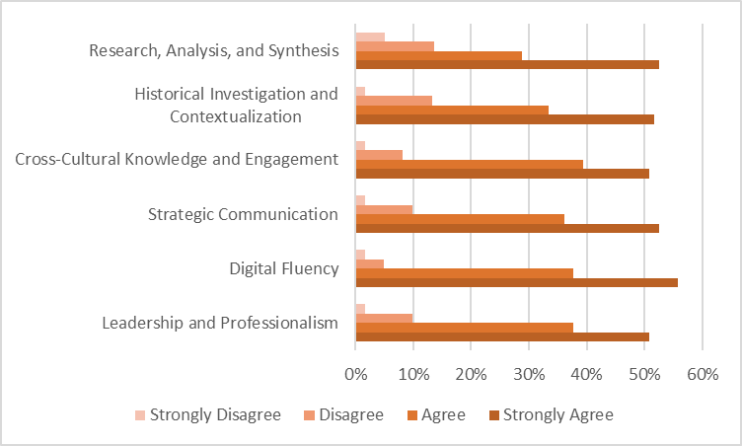
The following six outcomes are the formal general education outcomes that have been taught and assessed at SCAD since the 2017-18 academic year.
To what extent do you agree that each current general education outcome adequately prepares students for their future careers?
 | SA | A | D | SD
Research, Analysis, and Synthesis | 53% | 29% | 14% | 5%
Historical Investigation and Contextualization | 52% | 33% | 13% | 2%
Cross-Cultural Knowledge and Engagement | 51% | 39% | 8% | 2%
Strategic Communication | 52% | 36% | 10% | 2%
Digital Fluency | 56% | 38% | 5% | 2%
Leadership and Professionalism | 51% | 38% | 10% | 2%

Slide 6
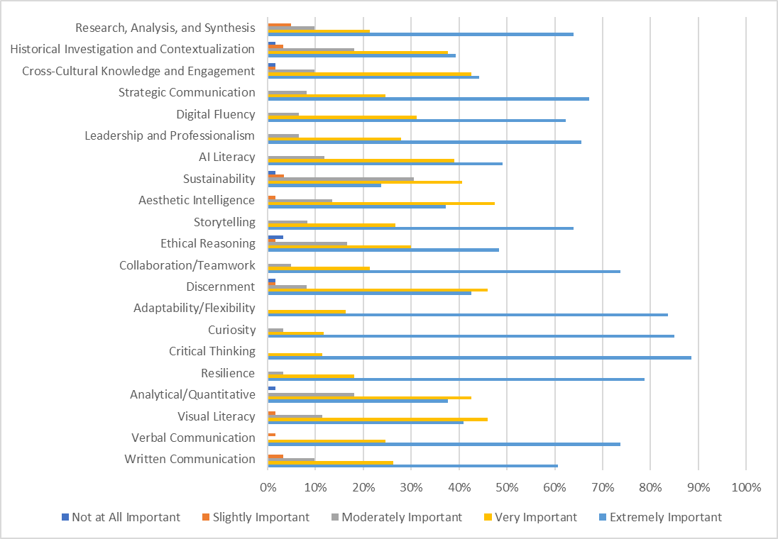
How important are each of the following competencies for students' career success after graduation?
Top Six Competencies | Extremely Important
Collaboration/Teamwork | 74%
Adaptability/Flexibility | 84%
Curiosity | 85%
Critical Thinking | 89%
Resilience | 79%
Verbal Communication | 74%

Slide 7
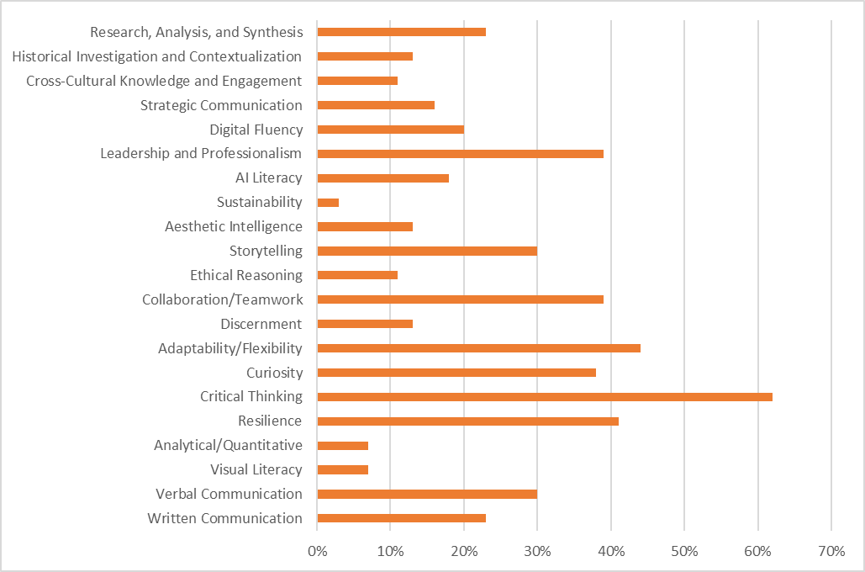
If you could only prioritize FIVE competencies from the list above, which would be most critical for our students' career success?
Top Six Competencies
Leadership and Professionalism | 39%
Collaboration/Teamwork | 39%
Adaptability/Flexibility | 44%
Curiosity | 38%
Critical Thinking | 62%
Resilience | 41%
These skills were consistently prioritized by respondents.
Skills in bold were rated Extremely Important in the previous question.

Slide 8
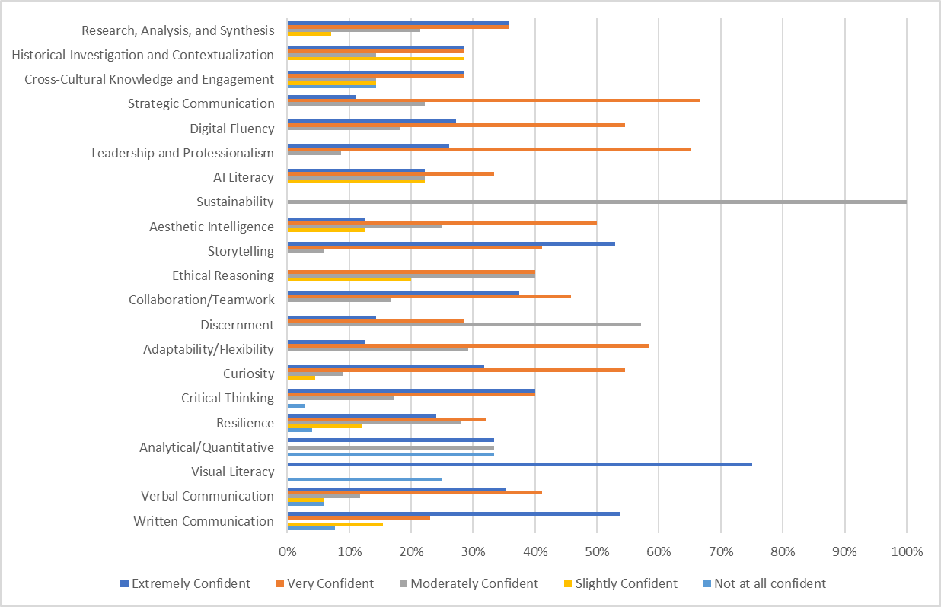
To ensure the mastery of critical skills, it is the duty of all faculty to develop and reinforce general education outcomes in their coursework.
Based on the top five skills/competencies you selected, how confident are you in your faculty's ability to intentionally develop each of the following competencies in students through their coursework?
 | EC | VC | MC | SC | NAC
Leadership and Professionalism | 26% | 65% | 9% | 0% | 0%
Collaboration/ Teamwork | 38% | 46% | 17% | 0% | 0%
Adaptability/ Flexibility | 13% | 58% | 29% | 0% | 0%
Curiosity | 32% | 55% | 9% | 5% | 0%
Critical Thinking | 40% | 40% | 17% | 0% | 3%
Resilience | 24% | 32% | 28% | 12% | 4%

Slide 9
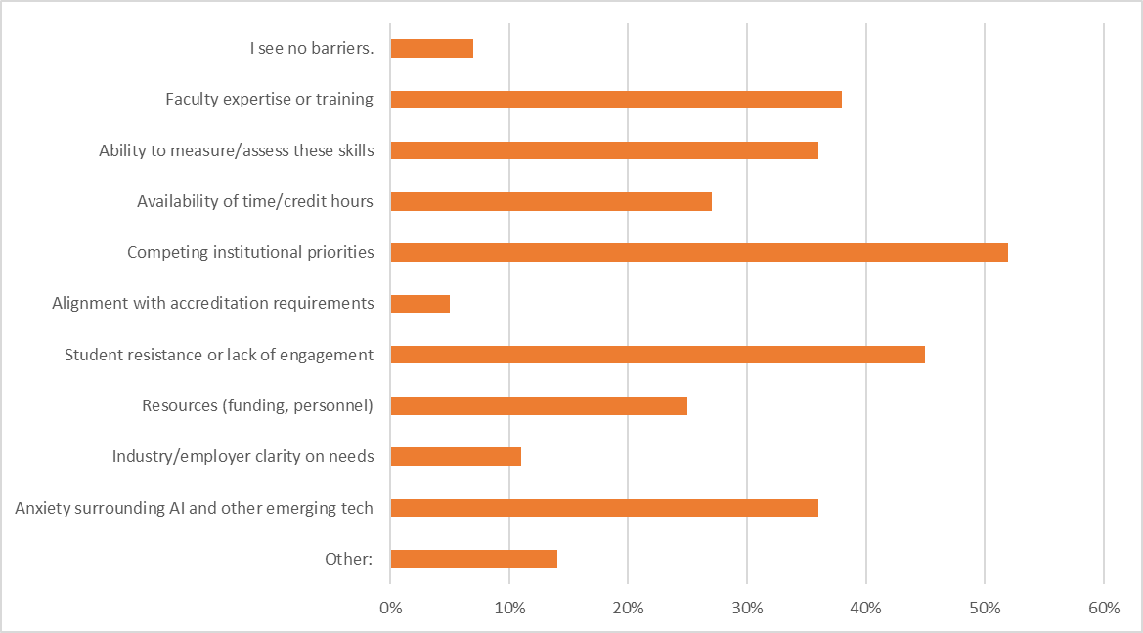
Do you see any of the following as barriers to developing and assessing the competencies you ranked as most important?
Top Five Barriers
Faculty expertise or training | 38%
Ability to measure/assess these skills | 36%
Competing institutional priorities | 52%
Student resistance or lack of engagement | 45%
Anxiety surrounding AI and other emerging tech | 36%

Slide 10
Do you see any of the following as barriers to developing and assessing the competencies you ranked as most important?
Other:
Barriers cited by academic leaders center on structural constraints rather than individual faculty shortcomings — competing institutional demands, bureaucratic processes, siloed departmental thinking, and the chilling effect of course evaluations on academic rigor all limit the time and flexibility needed to teach and assess these competencies well. Curriculum currency, particularly around technology and AI, was also flagged as an ongoing concern.
View all responses here.

Slide 11
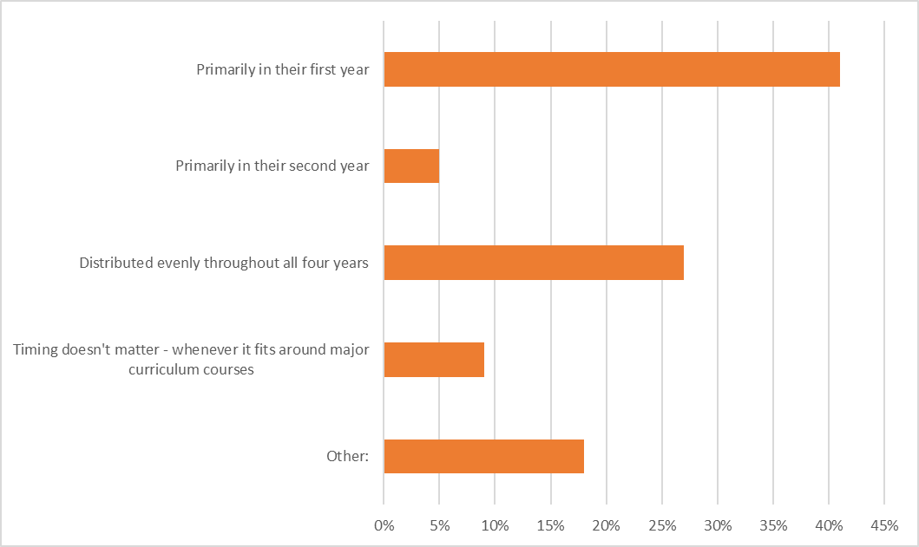
In your school/department's ideal curriculum sequencing, when should students complete the majority of their general education requirements?
Primarily in their first year | 41%
Primarily in their second year | 5%
Distributed evenly throughout all four years | 27%
Timing doesn't matter - whenever it fits around major curriculum courses | 9%
Other: | 18%

Slide 12
In your school/department's ideal curriculum sequencing, when should students complete the majority of their general education requirements?
Other:
Respondents consistently agreed that general education requirements should be anchored in years one and two, with skills introduced early and refined through major curriculum rather than completed all at once — noting that "distributed evenly" misses the point, since mastery develops over time. One respondent added an important caveat: many incoming students lack the baseline preparation needed to build on, and regardless of personal reservations about AI, students who enter interviews refusing to use it risk immediate disqualification — making AI literacy a professional reality even without a clear institutional roadmap.
View all responses here.

Slide 13
What professional development or institutional support would most increase your faculty's capacity to teach and assess these competencies?
Faculty need structured support around AI, digital tools, and assessment frameworks.
Time, staffing, and institutional trust are foundational barriers.
Alignment gaps between foundational/general education courses and major programs are a recurring concern.
View all responses here.

Slide 14
AI Section

Slide 15
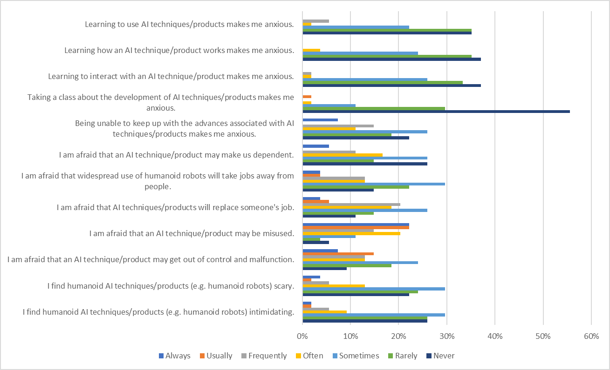
Please indicate how often each of the following statements applies to you.
Takeaways:
The majority aren't anxious about learning to use AI, how it works, or how to interact with it (70-72% "Rarely" or "Never" across these statements).
Many are afraid that AI may be misused (44% "Always"/"Usually" combined) — the highest-rated fear of any statement.

Slide 16
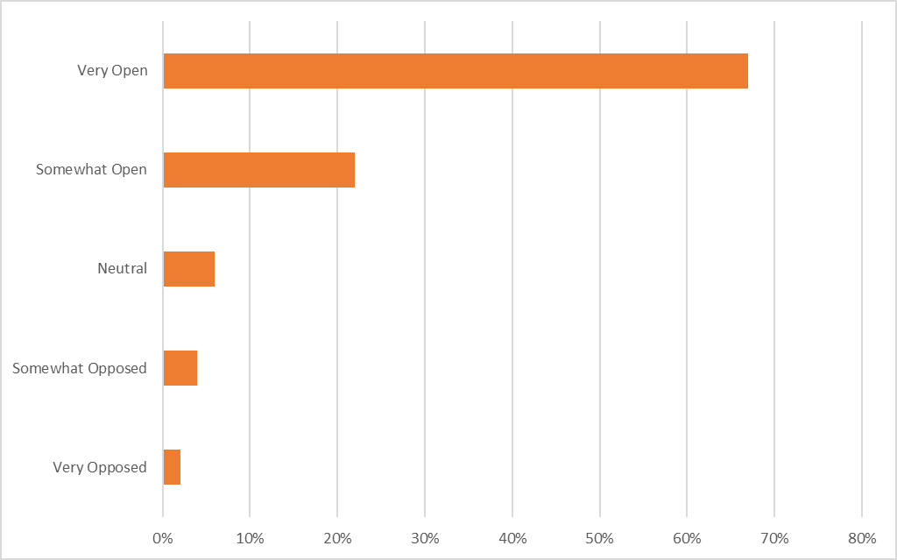
How open are you to working with your faculty to redesign your courses/assignments to more intentionally develop emerging AI-era competencies?
Very Open | 67%
Somewhat Open | 22%
Neutral | 6%
Somewhat Opposed | 4%
Very Opposed | 2%

Slide 17
Is there anything else you would like to share about AI, general education, or your experience as an academic leader navigating these changes?
Faculty and student attitudes toward AI are deeply divided, with environmental and ethical concerns driving significant resistance.
A recurring tension exists between analog skill-building and AI integration, with many leaders advocating for sequencing AI after foundational mastery.
Institutional urgency around AI readiness is growing, but support structures lag behind.
View all responses here.

Slide 18
Alumni Survey Results
Students who completed their undergraduate or undergraduate and graduate degrees at SCAD between 2018 and 2024. May 27-June 8, 2026

Slide 19
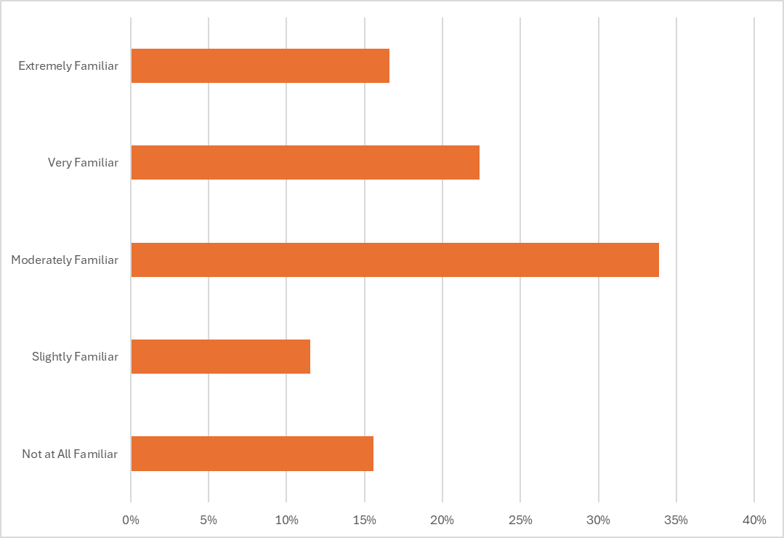
How familiar are you with SCAD's general education learning outcomes?
Extremely Familiar | 16%
Very Familiar | 23%
Moderately Familiar | 34%
Slightly Familiar | 11%
Not at All Familiar | 15%
Results in line with Academic Leaders.

Slide 20
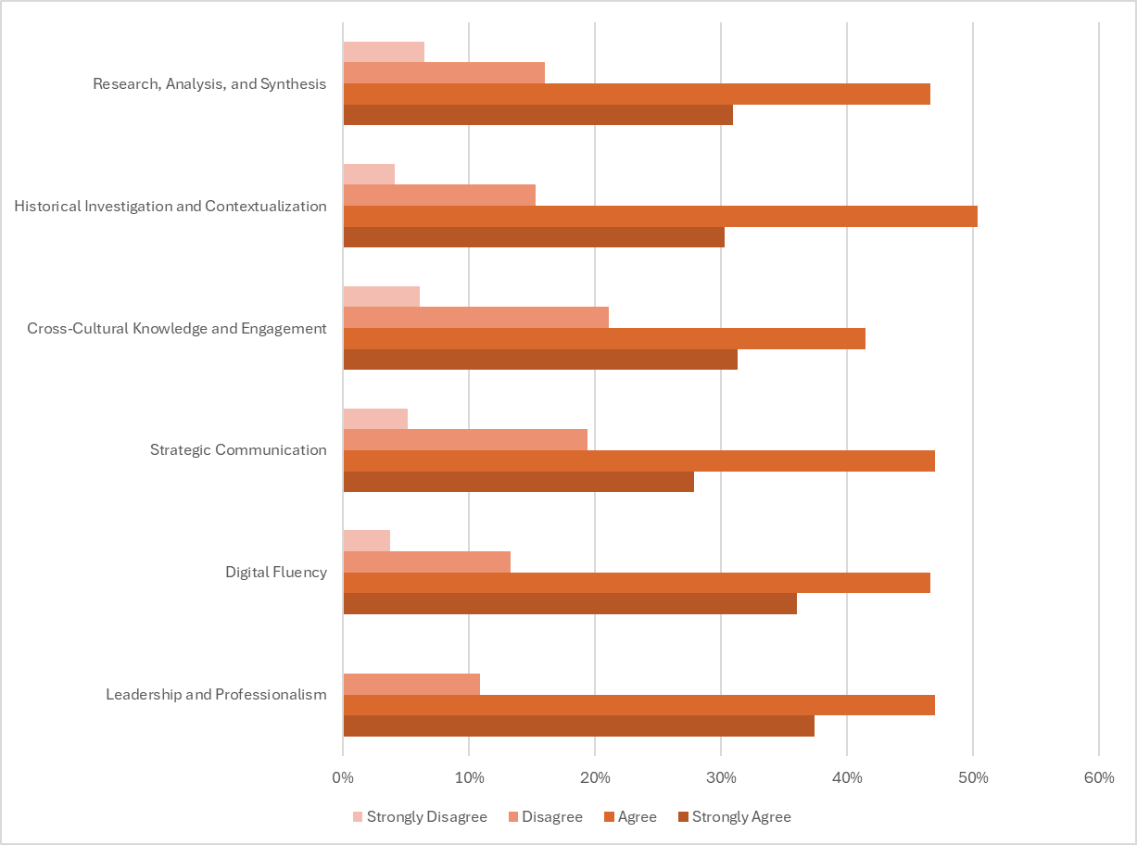
The following six outcomes are the formal general education outcomes that have been taught and assessed at SCAD since the 2017-18 academic year.
To what extent do you agree that each current general education outcome adequately prepares students for their future careers?
 | SA | A | D | SD
Leadership and Professionalism | 37% | 47% | 11% | 0%
Digital Fluency | 36% | 7% | 13% | 4%
Strategic Communication | 28% | 47% | 19% | 5%
Cross-Cultural Knowledge and Engagement | 31% | 41% | 21% | 6%
Historical Investigation and Contextualization | 30% | 50% | 15% | 4%
Research, Analysis, and Synthesis | 31% | 46% | 16% | 6%
Academic leaders tended to Strongly Agree across all outcomes.

Slide 21
What would you change about how any of these outcomes were taught or assessed during your time as a student?
The most consistent gap is between classroom preparation and real-world professional readiness. Across dozens of responses, alumni described leaving SCAD underprepared for the actual mechanics of working — job hunting, interviewing, navigating corporate hierarchy, understanding client relationships, negotiating pay, freelancing logistics (invoicing, taxes, self-promotion), and day-to-day workplace communication. SCADpro was frequently cited as the exception that provided the most authentic professional experience.
Digital fluency and industry-current software instruction were frequently identified as inadequate. Respondents across multiple majors noted being taught outdated programs or too-limited toolsets (e.g., missing Figma, AutoCAD, Toon Boom, Shopify, Klaviyo, CLO3D), often having to self-teach industry-standard tools after graduation. The pace of curriculum updates was seen as too slow relative to how quickly industries are evolving — including around AI.
Collaboration, group work, and cross-major exposure were underdeveloped throughout most of the degree, rather than concentrated at the end. Many alumni noted that meaningful teamwork opportunities arrived only in senior year or thesis projects, leaving students underprepared for the collaborative demands of professional environments. Several called for structured group work, stronger consequences for unequal participation, and more intentional connection across departments throughout the full program.
View all responses here.

Slide 22
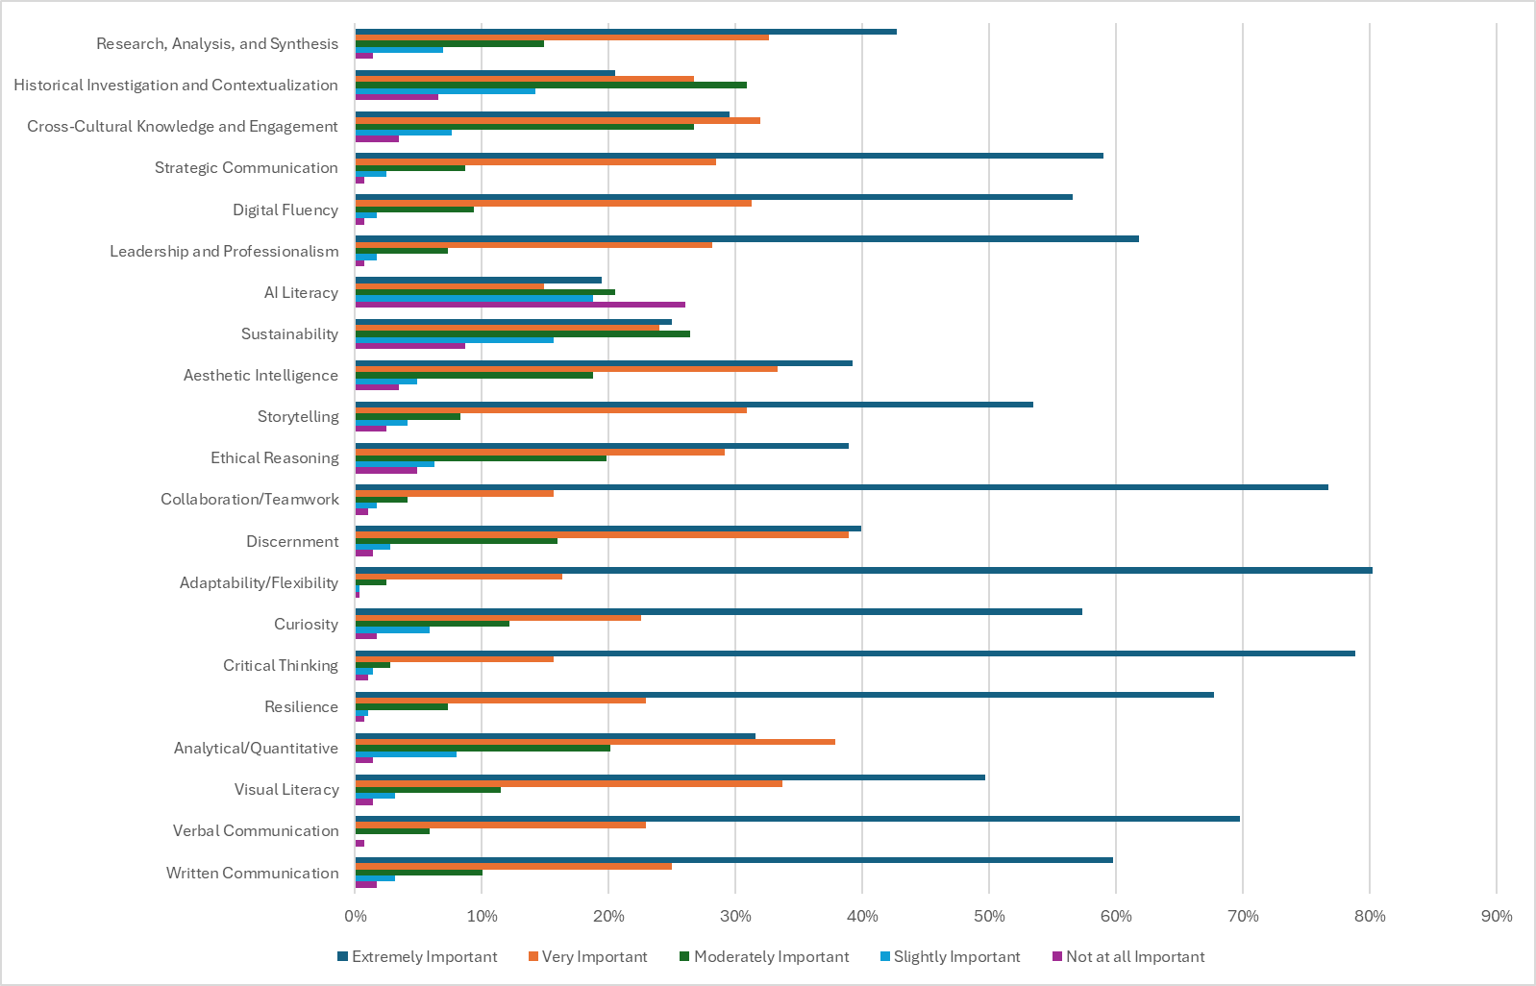
The following questions ask you to reflect on a broader set of competencies and the role they have played in your life and career outcomes since graduation. Rate the importance of each competency below.
Top Six Competencies
Leadership and Professionalism | 62%
Collaboration/Teamwork* | 77%
Adaptability/Flexibility* | 80%
Critical Thinking* | 79%
Resilience* | 68%
Verbal Communication* | 70%
*Academic leaders agreed that these competencies are Extremely Important.

Slide 23
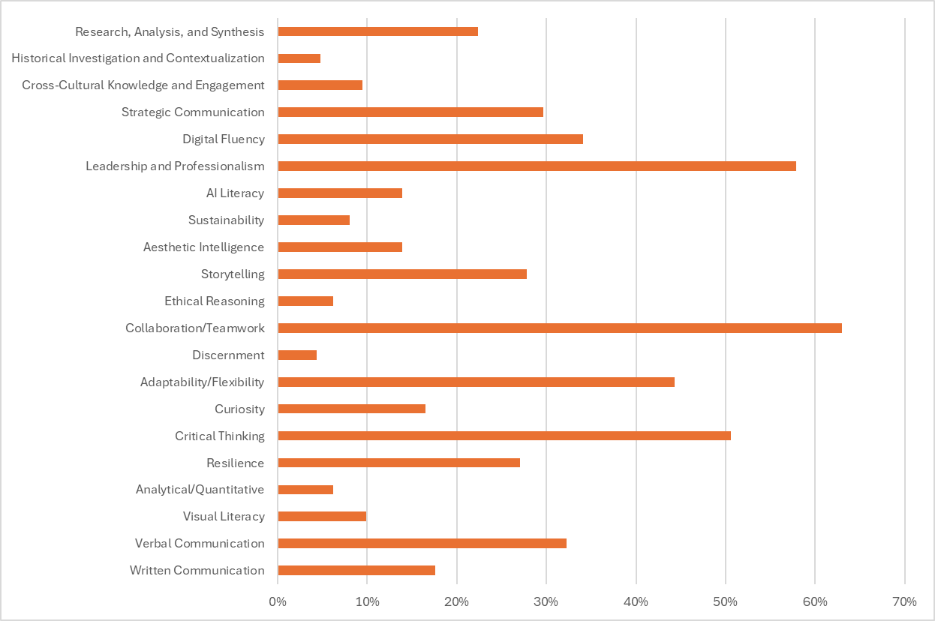
If you could only prioritize FIVE competencies from the list above, which would be most critical for future graduates' career success?
Top Six Competencies
Leadership and Professionalism* | 58%
Digital Fluency | 34%
Collaboration/Teamwork* | 63%
Adaptability/Flexibility* | 44%
Critical Thinking* | 51%
Verbal Communication | 32%
These skills were consistently prioritized by respondents.
Skills in bold were rated Extremely Important in the previous question.
*Academic leaders also prioritized these competencies.

Slide 24
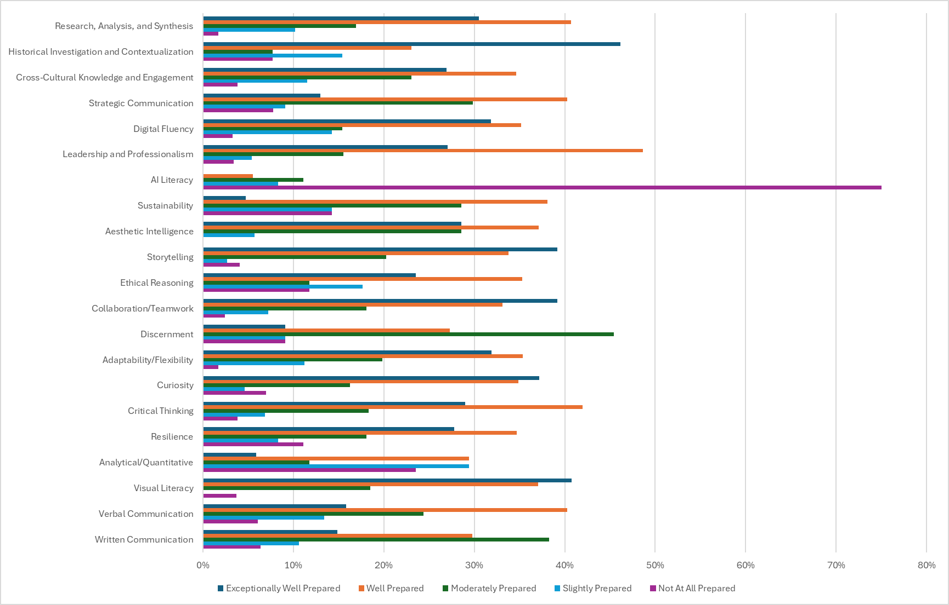
For each of the five competencies you identified as most critical for career success, how well did your SCAD education prepare you in that area?
 | EWP | WP | MP | SP | NAP
Leadership and Professionalism | 27% | 49% | 16% | 5% | 3%
Digital Fluency | 32% | 35% | 15% | 14% | 3%
Collaboration/ Teamwork | 39% | 33% | 18% | 7% | 2%
Adaptability/ Flexibility | 32% | 35% | 20% | 11% | 2%
Critical Thinking | 29% | 42% | 18% | 7% | 4%
Verbal Communication | 16% | 40% | 24% | 13% | 6%

Slide 25
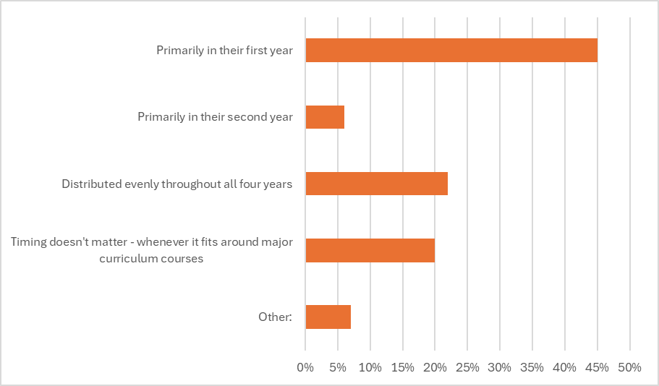
Based on your prior experience, when should students complete the majority of their general education requirements?
Primarily in their first year | 45%
Primarily in their second year | 6%
Distributed evenly throughout all four years | 22%
Timing doesn't matter - whenever it fits around major curriculum courses | 20%
Other: | 7%
9% of Academic Leaders responded Timing doesn't matter,
and 18% responded Other.

Slide 26
Based on your prior experience, when should students complete the majority of their general education requirements?
Other
Alumni responses on gen ed timing were varied, with no single clear consensus. Many favored completing the majority of requirements in the first one to two years to free up later years for major-focused work, while others advocated for distributing competency development across the full degree — arguing that skills like professionalism, research, and communication need repeated practice over time rather than a one-time exposure.
Several respondents emphasized sequencing and flexibility over rigid timing. Responses noted that course availability was a real barrier, that some gen ed courses are prerequisites for major success and should come early, while others (particularly lecture-based ones) could be saved for later to balance studio-heavy schedules. A few also called for gen ed requirements to be re-examined on a major-by-major basis rather than applied uniformly.
A notable undercurrent of skepticism about the value of gen ed as currently structured also emerged. Some respondents felt gen ed requirements delayed access to major coursework without sufficient payoff, with one calling for a full re-examination of which courses count as "general" — arguing that business and professional application skills should be included — and others expressing frustration that required courses were rarely available when needed, disrupting progress and sometimes extending time to graduation.
View all responses here.

Slide 27
AI Section Students who completed their undergraduate, graduate, or both degrees at SCAD.

Slide 28
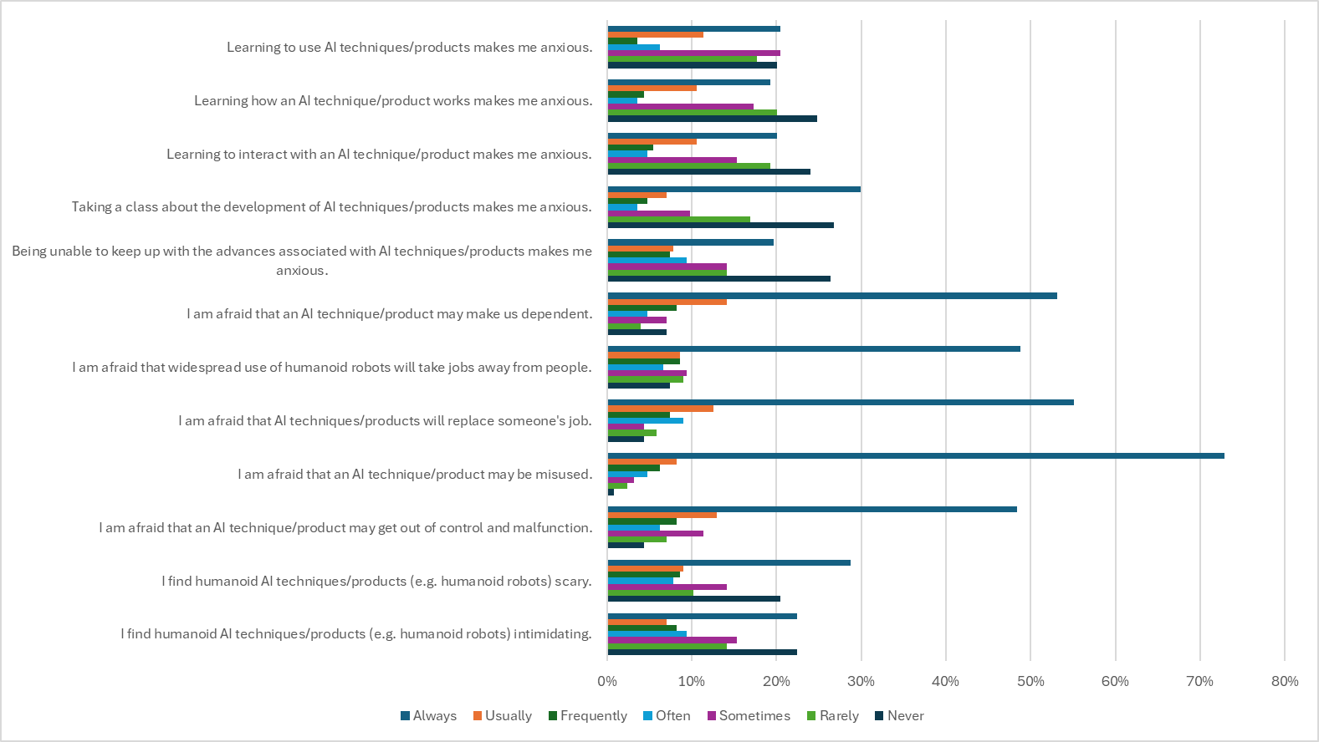
Please indicate how often each of the following statements applies to you.
Takeaways:
Alumni report the highest fear of any group on every consequence-related statement — most notably AI misuse (81% "Always"/"Usually"), dependency (67%), and job replacement (64%).

Slide 29
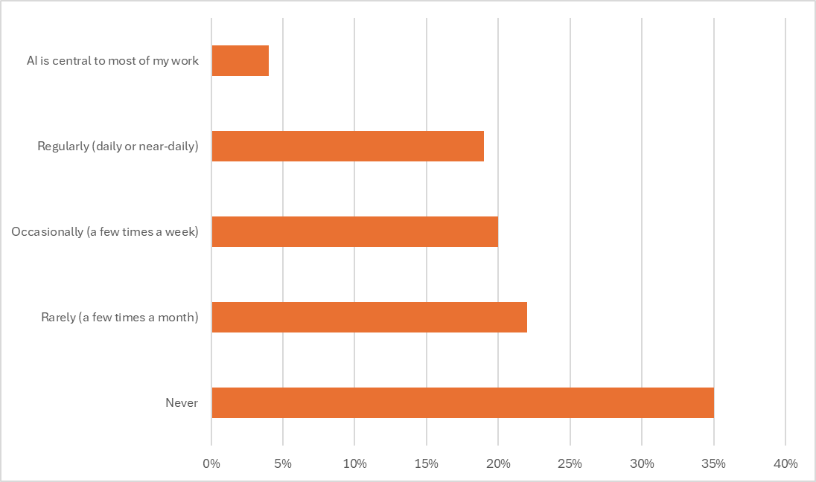
How frequently do you currently use AI tools in your work?
AI is central to most of my work | 4%
Regularly (daily or near-daily) | 19%
Occasionally (a few times a week) | 20%
Rarely (a few times a month) | 22%
Never | 35%

Slide 30
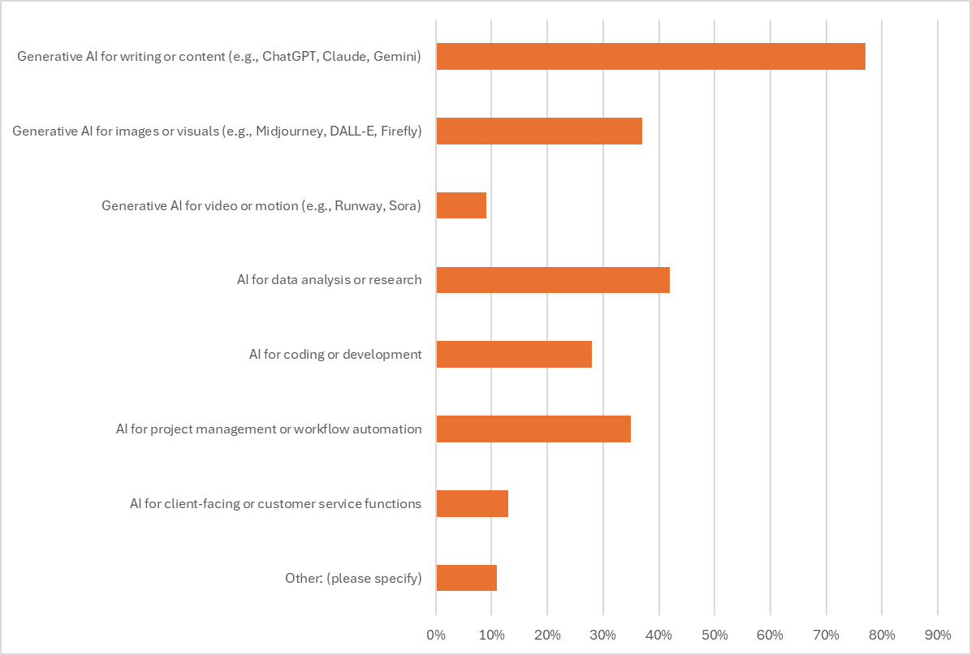
Which types of AI tools do you use in your work?
Generative AI for writing or content (e.g., ChatGPT, Claude, Gemini) | 77%
Generative AI for images or visuals (e.g., Midjourney, DALL-E, Firefly) | 37%
Generative AI for video or motion (e.g., Runway, Sora) | 9%
AI for data analysis or research | 42%
AI for coding or development | 28%
AI for project management or workflow automation | 35%
AI for client-facing or customer service functions | 13%
Other: (please specify) | 11%
View responses for Other here.

Slide 31
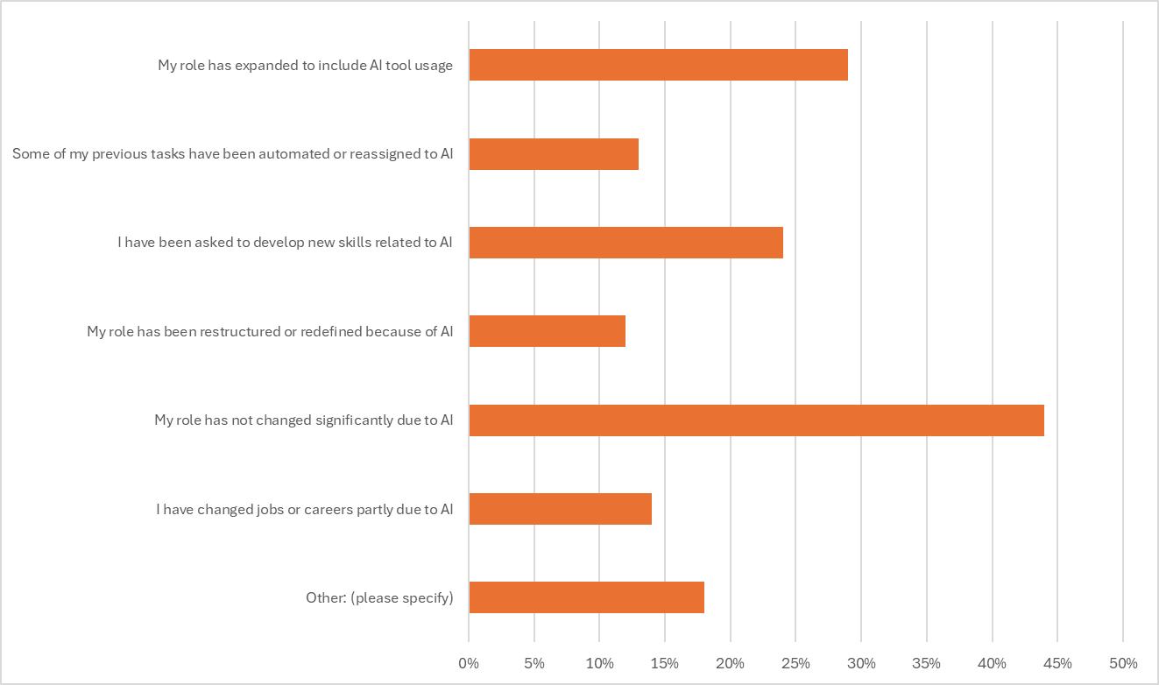
How has your role or responsibilities changed since you were first hired?
My role has expanded to include AI tool usage | 29%
Some of my previous tasks have been automated or reassigned to AI | 13%
I have been asked to develop new skills related to AI | 24%
My role has been restructured or redefined because of AI | 12%
My role has not changed significantly due to AI | 44%
I have changed jobs or careers partly due to AI | 14%
Other: (please specify) | 18%

Slide 32
How has your role or responsibilities changed since you were first hired?
Other:
Unemployment and job market disruption are real and acute for this cohort. Multiple respondents reported being laid off, unable to find work, or employed outside their field — with AI directly cited as a contributing factor. Several also flagged the rise of fake job postings and AI-screened applications as additional structural barriers making entry into the field harder.
Ethical and environmental objections to AI are widespread and strongly held. This is not hesitation or anxiety — respondents were explicit about that distinction. Concerns center on environmental resource consumption, copyright and data theft from working artists, labor exploitation, and erosion of social trust. Many have made deliberate professional choices — seeking employers, clients, or self-employment situations that allow them to opt out entirely.
Where AI is present in the workplace, experiences are mixed. A minority reported positive outcomes, including efficiency gains and expanded agency capacity. Others described being compelled to use tools they oppose, inadvertently training systems to replace their own roles, or inheriting additional quality-control work to screen out AI-generated content submitted by others.
Alumni feel tension between SCAD's institutional AI positioning and its identity as an arts institution. Several responses — some sharply worded — expressed concern that SCAD's engagement with generative AI is at odds with its responsibility to protect students and alumni from the harms those same tools are causing to creative workers. This sentiment is worth treating as a distinct signal rather than folding into general AI skepticism.

Slide 33
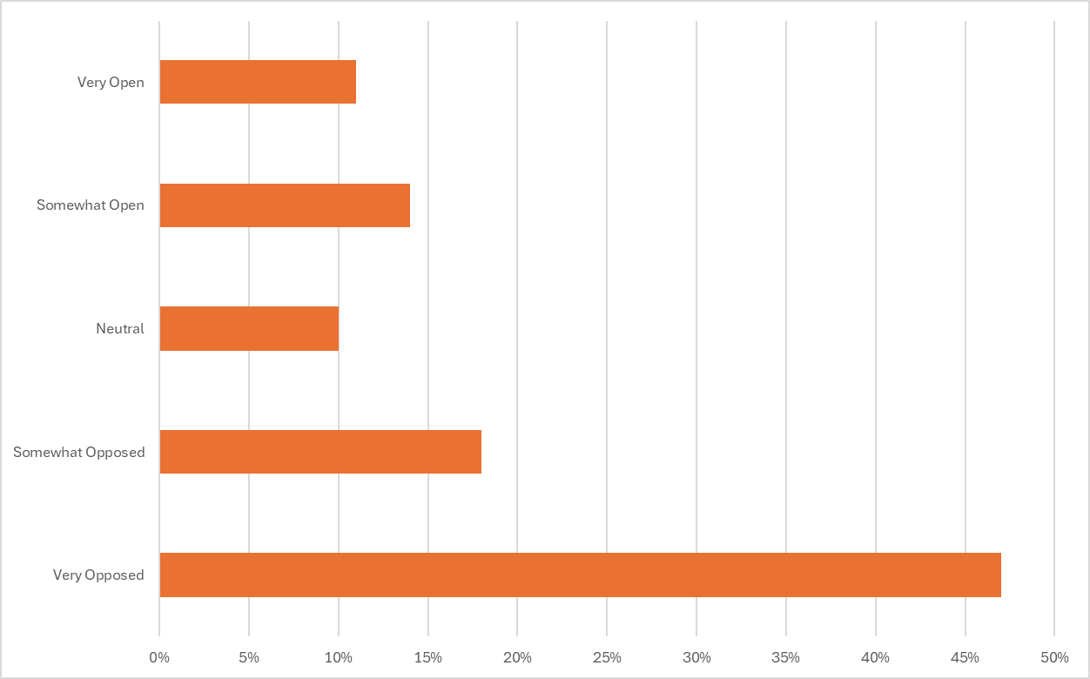
How open are you to AI becoming more integrated into your field of work over the next five years?
Very Open | 11%
Somewhat Open | 14%
Neutral | 10%
Somewhat Opposed | 18%
Very Opposed | 47%

Slide 34
Employer Survey Results May 28-June 2, 2026

Slide 35
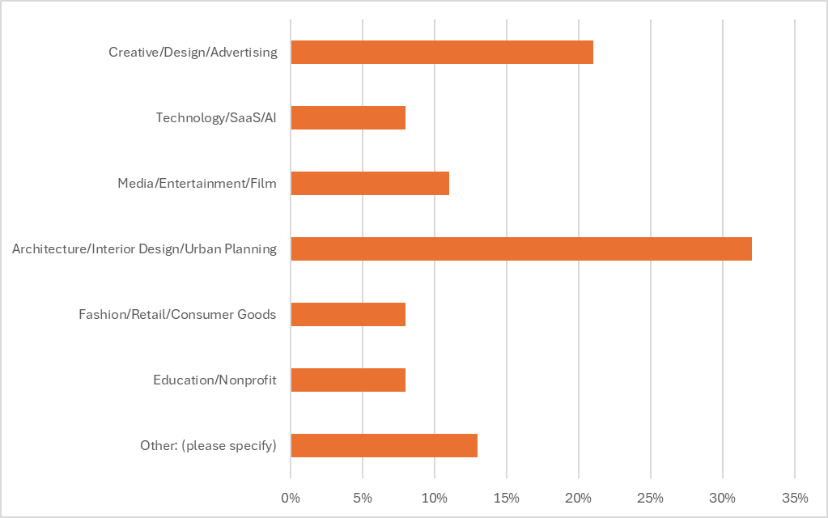
What best describes your organization's primary industry sector?
Creative/Design/Advertising | 21%
Technology/SaaS/AI | 8%
Media/Entertainment/Film | 11%
Architecture/Interior Design/Urban Planning | 32%
Fashion/Retail/Consumer Goods | 8%
Education/Nonprofit | 8%
Other: (please specify) | 13%
Responses for Other included:
Sports events and broadcasts
Custom design and fabrication
Fabrication Design and Construction
High-stakes editorial publication
Insurance

Slide 36
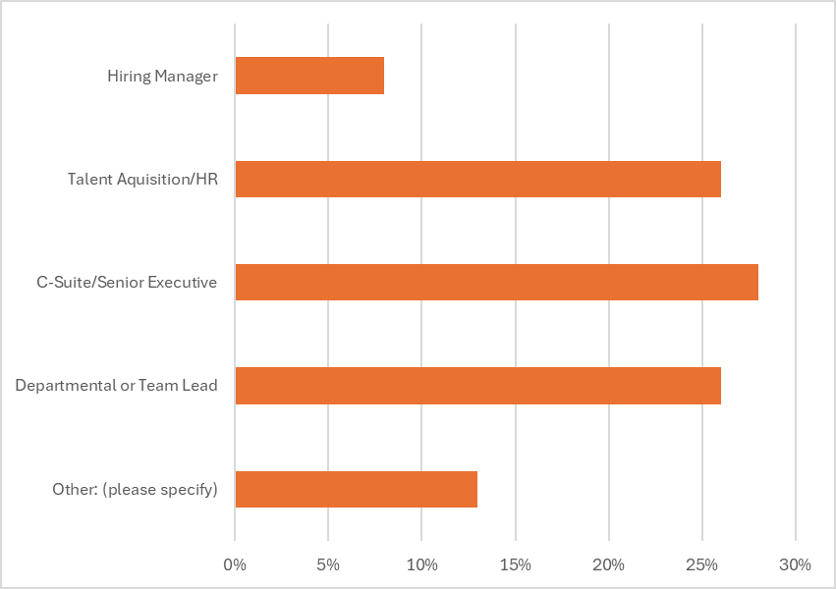
How would you describe your role?
Hiring Manager | 8%
Talent Acquisition/HR | 26%
C-Suite/Senior Executive | 28%
Departmental or Team Lead | 26%
Other: (please specify) | 13%
Responses for Other included:
Portfolio Director
Interior Designer
Architectural Designer
Associate
Sr director, Individual contributor

Slide 37
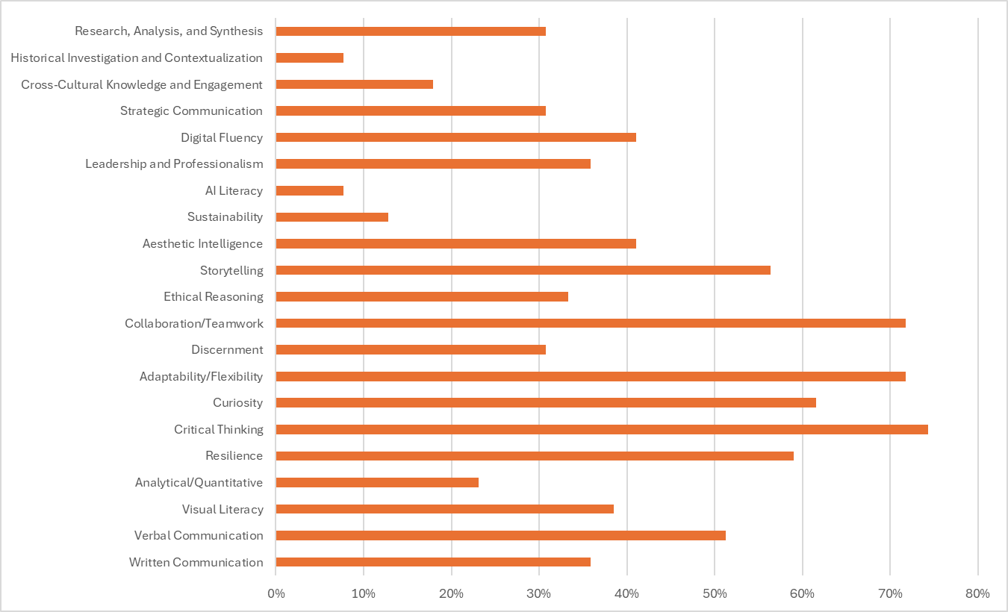
How important are each of the following competencies for new hires entering roles at your organization?
Top Six Competencies
Storytelling | 56%
Collaboration/Teamwork* | 72%
Adaptability/Flexibility* | 72%
Curiosity | 62%
Critical Thinking* | 74%
Resilience* | 59%
*Academic leaders and alumni agreed that these competencies are Extremely Important.

Slide 38
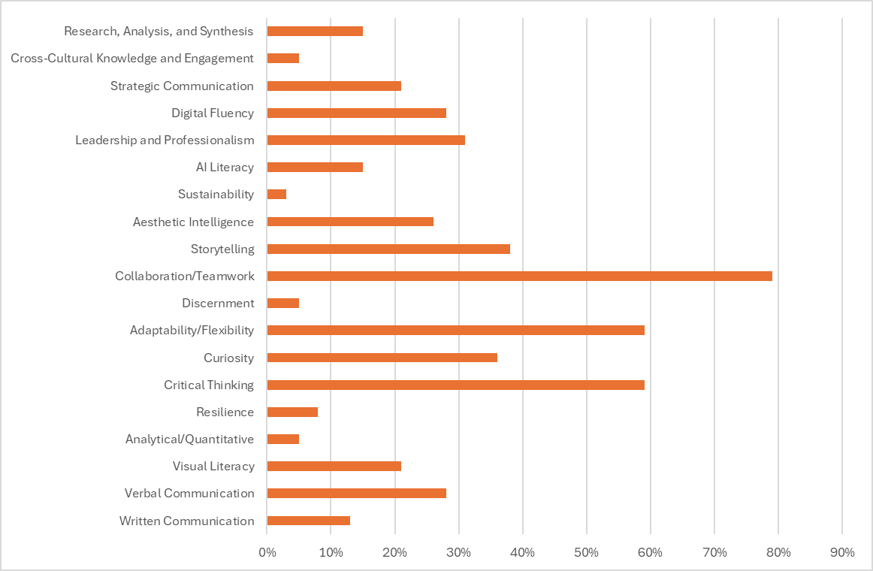
If you could only prioritize FIVE competencies, which would be most critical for future graduates' career success?
Top Six Competencies
Leadership and Professionalism* | 31%
Storytelling | 38%
Collaboration/Teamwork* | 79%
Adaptability/Flexibility* | 59%
Curiosity | 36%
Critical Thinking* | 59%
These skills were consistently prioritized by respondents.
Skills in bold were rated Extremely Important in the previous question.
*Academic leaders and alumni also prioritized these competencies.

Slide 39
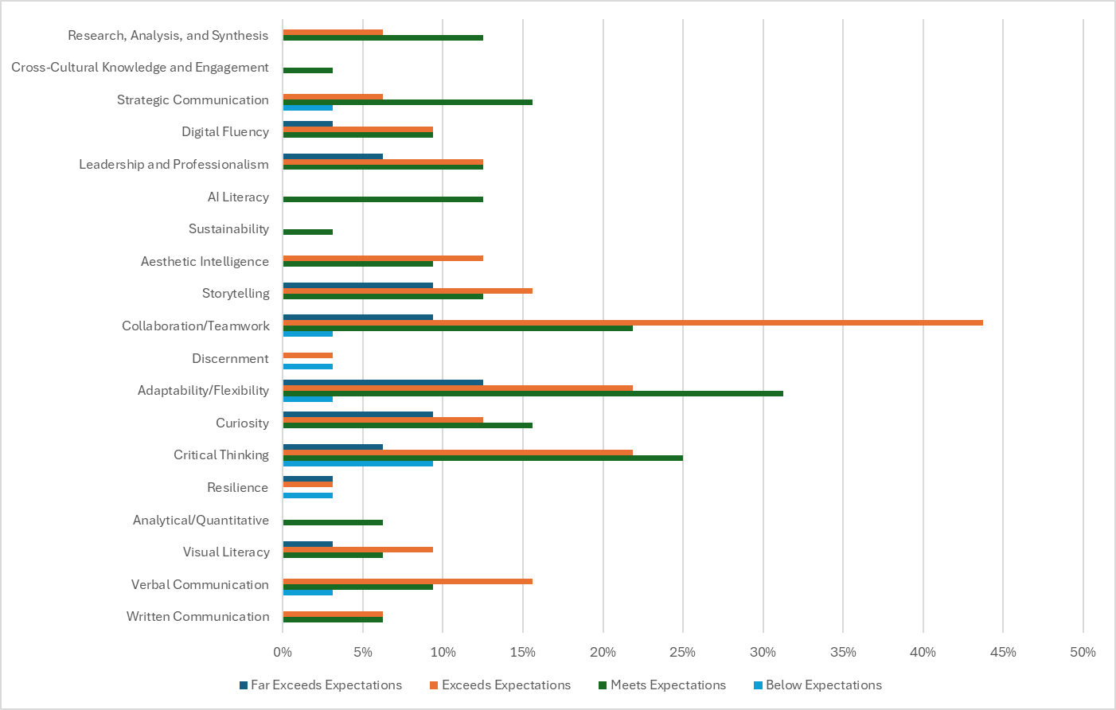
For each of your top five competencies, how well do recent graduates currently demonstrate this competency when they are hired?
 | Far Exceeds | Exceeds | Meets | Below
Leadership and Professionalism | 6% | 13% | 13% | 0%
Storytelling | 9% | 16% | 13% | 0%
Collaboration/ Teamwork | 9% | 44% | 22% | 3%
Adaptability/ Flexibility | 13% | 22% | 31% | 3%
Curiosity | 9% | 13% | 16% | 0%
Critical Thinking | 6% | 22% | 25% | 9%

Slide 40
What skill or quality do you wish recent graduates demonstrated that you feel current higher education is not adequately developing?
Professional readiness and workplace soft skills remain the most frequently cited gap. Employers consistently flagged communication (verbal, written, and client-facing), feedback handling, patience, initiative, and the ability to "bring it" every day as underdeveloped — with several noting that attitude and work ethic often matter more than technical skill in hiring and retention decisions.
Independent problem-solving and adaptability are in high demand but short supply. Across multiple responses, employers described graduates who wait for direction rather than defining problems themselves, struggle with ambiguity, and have difficulty adjusting to the fluid, high-stakes nature of real professional environments — pointing to a gap between academic project structures and the autonomy expected at work.
Business acumen, AI fluency, and entrepreneurial thinking are emerging as critical but underdeveloped competencies. Employers called for stronger grounding in how design functions within business systems, commercialization realities, market intelligence, and design advocacy — alongside a proactive rather than resistant orientation toward AI, and greater emphasis on individual (not just group) project work that demonstrates a student's own thinking and process.
View all responses here.

Slide 41
Is there anything else you would like to share about how higher education can better prepare graduates for careers in your industry?
Real-world, hands-on experience is the most consistent request, though several employers noted SCAD graduates compare favorably overall. Employers across industries called for more practical exposure — managing client relationships, working across disciplines, navigating deadlines and feedback, and understanding the full arc of a professional project — with several noting that the gap between theoretical foundations and applied practice is where graduates most visibly struggle upon entry.
Business translation and self-sufficiency are underdeveloped. Employers want graduates who can articulate the business value of their creative work, convert user insights into impact metrics, and advocate for design within organizational contexts — as well as operate independently, whether that means freelancing logistics for photographers, modeling software fluency for built environment roles, or simply walking into an interview knowing what the company does and why they want to be part of it.
AI tool proficiency and professional self-presentation need more intentional development. Employers flagged over-reliance on AI in the application process as an emerging red flag, while others are actively integrating tools like Vizcom into their workflows and want graduates who arrive ready to engage with them thoughtfully. Alongside this, the interpersonal dimensions of professionalism — how graduates carry and communicate themselves — continue to weigh heavily in hiring decisions.
View all responses here.

Slide 42
AI Section

Slide 43
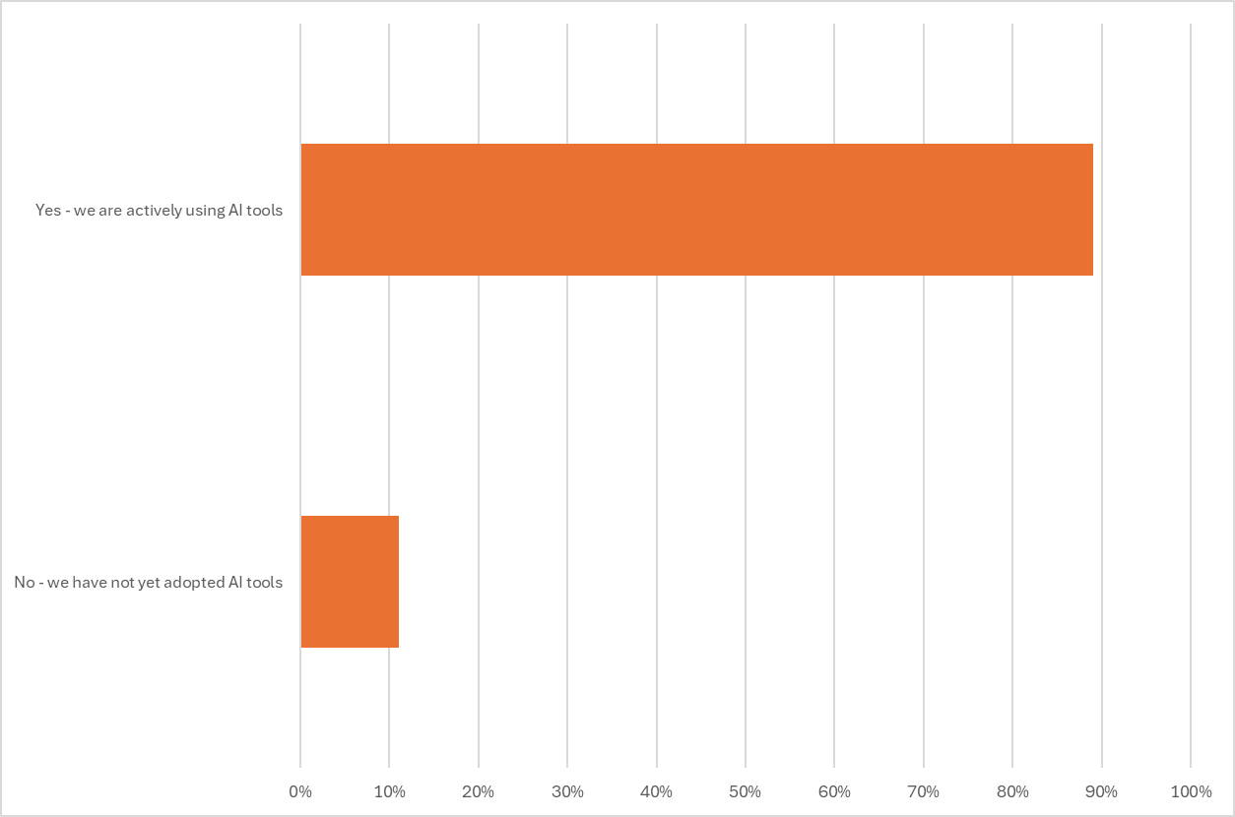
Has your organization begun adopting AI tools in any part of your day-to-day operations or workflows?
Yes – we are actively using AI tools​ | 89%
No – we have not yet adopted AI tools | 11%

Slide 44
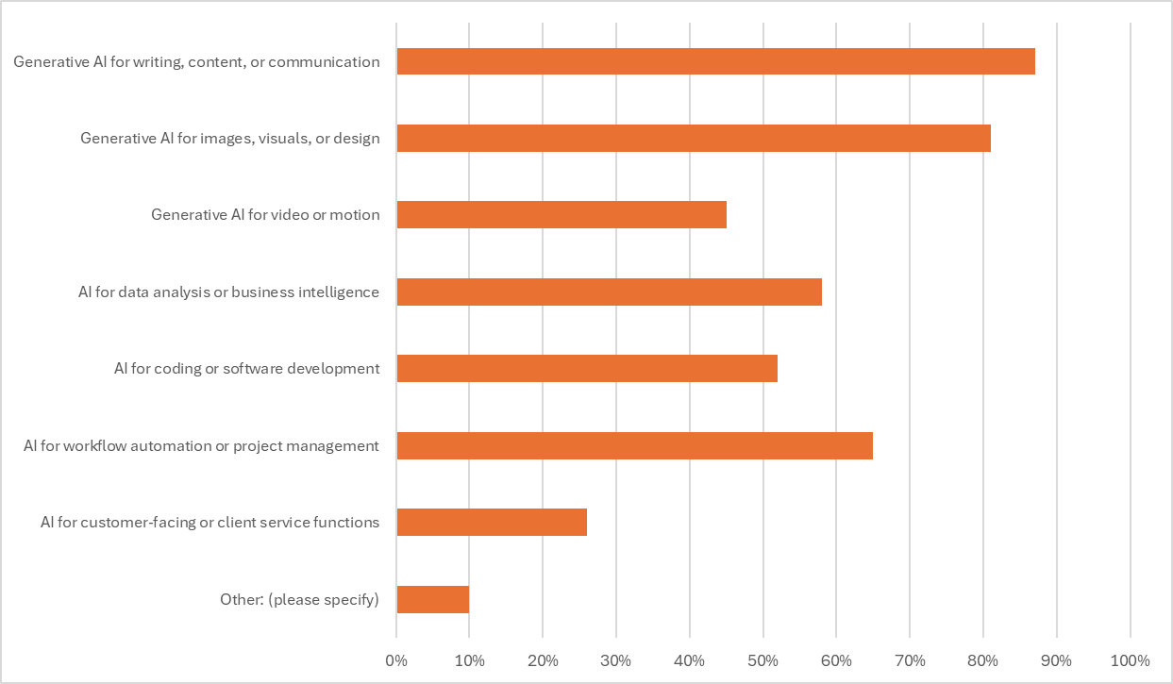
Which of the following AI tools or capabilities does your organization currently use?
Generative AI for writing, content, or communication | 87%
Generative AI for images, visuals, or design | 81%
Generative AI for video or motion | 45%
AI for data analysis or business intelligence | 58%
AI for coding or software development | 52%
AI for workflow automation or project management | 65%
AI for customer-facing or client service functions | 26%
Other: (please specify) | 10%
Responses for Other included:
Runway, Luma
We are waiting for AI to do some things faster and better so we can do more things
On a spectrum from cautiously embracing to shunning completely. Not typically using in final work.

Slide 45
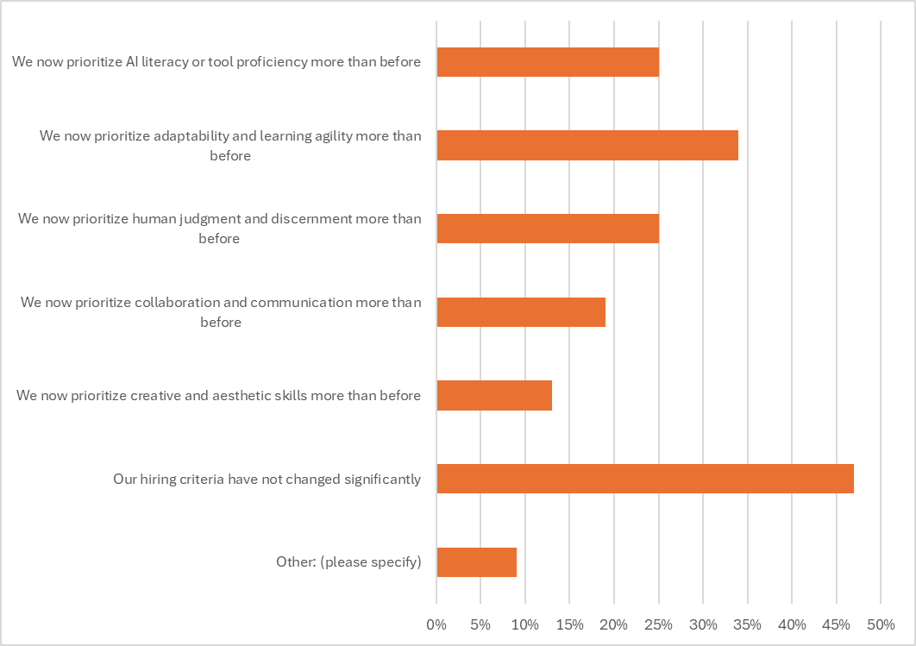
Over the past three years, how has the growing presence of AI in the workplace changed your hiring criteria for entry-level roles?
We now prioritize AI literacy or tool proficiency more than before | 25%
We now prioritize adaptability and learning agility more than before | 34%
We now prioritize human judgment and discernment more than before | 25%
We now prioritize collaboration and communication more than before | 19%
We now prioritize creative and aesthetic skills more than before | 13%
Our hiring criteria have not changed significantly | 47%
Other: (please specify) | 9%
Responses for Other included:
We are interested in seeing students that are exploring AI implementations in order to streamline / expedite workflows, as long as it is explained and process is documented.
We hire people who do not want to give their skills away to AI; use AI, yes, but you see the only box I checked,
we have reorganized our entire global company around the topic

Slide 46
Faculty Survey Results May 28-June 9, 2026

Slide 47
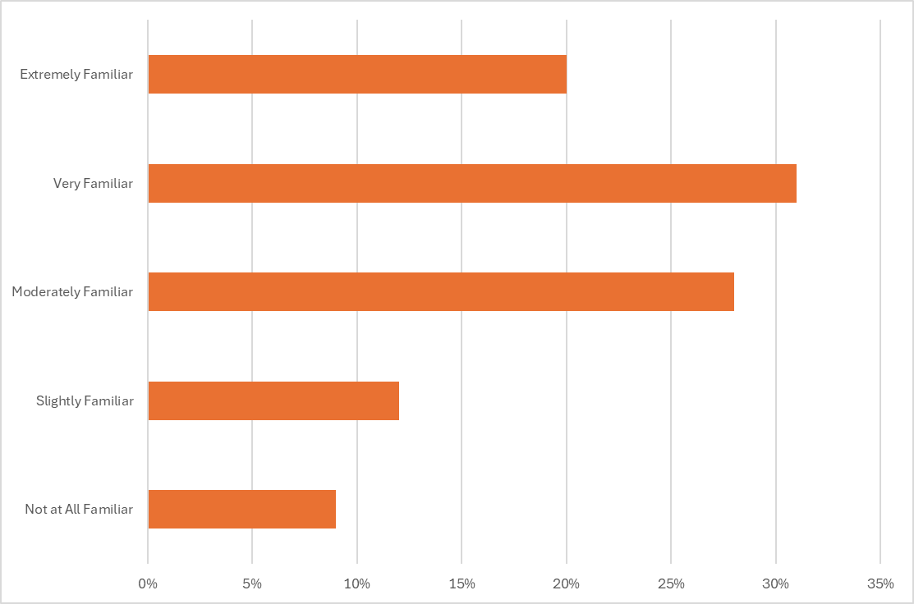
How familiar are you with SCAD's general education learning outcomes?
 | Faculty | Academic Leader | Alumni
Extremely Familiar | 20% | 16% | 16%
Very Familiar | 31% | 28% | 23%
Moderately Familiar | 28% | 39% | 34%
Slightly Familiar | 12% | 10% | 11%
Not at All Familiar | 9% | 7% | 15%

Slide 48
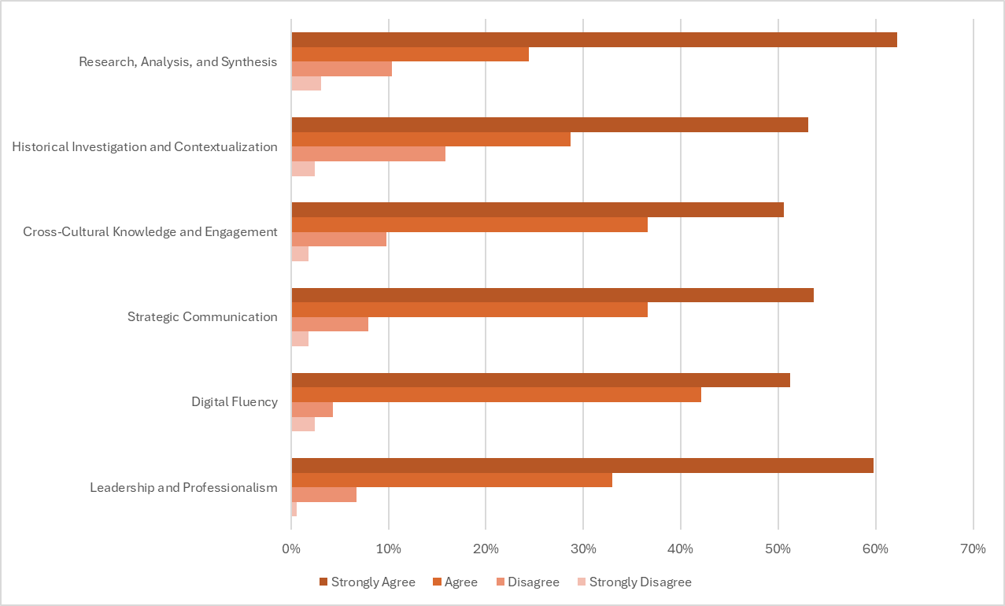
The following six outcomes are the formal general education outcomes that have been taught and assessed at SCAD since the 2017-18 academic year.
To what extent do you agree that each current general education outcome adequately prepares students for their future careers.
 | SA | A | D | SD
Leadership and Professionalism | 60% | 33% | 7% | 1%
Digital Fluency | 51% | 42% | 4% | 2%
Strategic Communication | 54% | 37% | 8% | 2%
Cross-Cultural Knowledge and Engagement | 51% | 37% | 10% | 2%
Historical Investigation and Contextualization | 53% | 29% | 16% | 2%
Research, Analysis, and Synthesis | 62% | 24% | 10% | 3%
Results aligned with Academic Leaders.
Alumni tended to Agree across all outcomes.

Slide 49
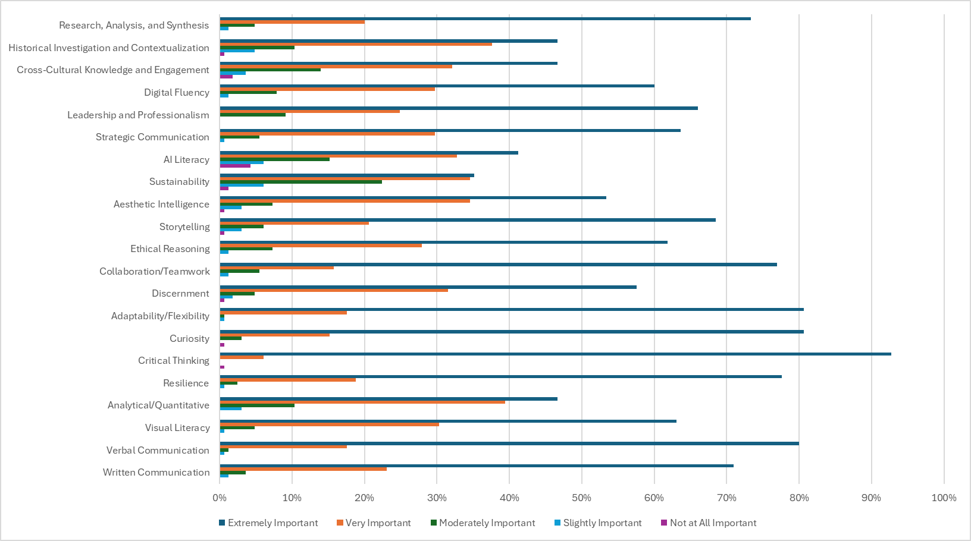
How important are each of the following competencies for students' career success after graduation?
Top Six Competencies | Extremely Important
Leadership | 77%
Adaptability/Flexibility | 81%
Curiosity | 81%
Critical Thinking | 93%
Resilience | 78%
Verbal Communication | 80%
Results aligned with Academic Leaders.
Instead of Curiosity, Alumni rated Leadership and Professionalism as Extremely Important.

Slide 50
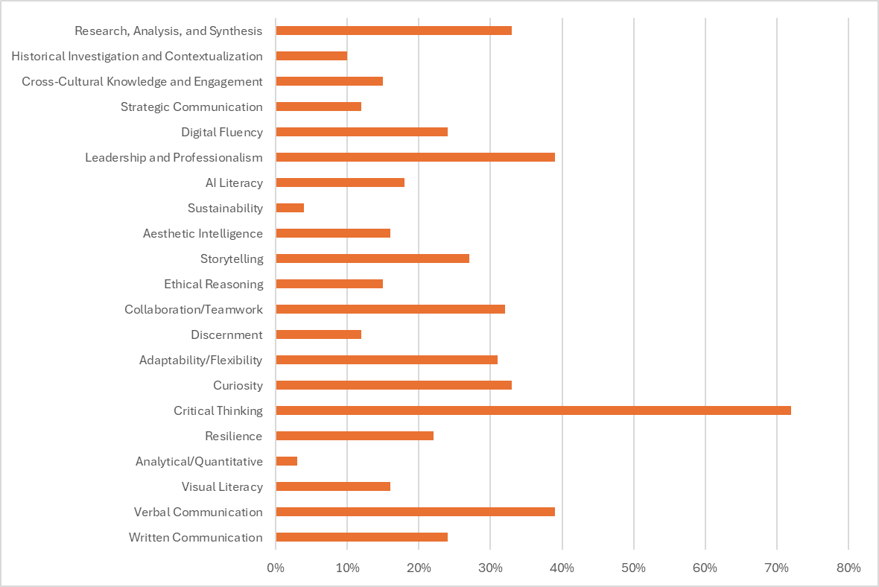
If you could only prioritize FIVE competencies from the list above, which would be most critical for our students' career success?
Top Six Competencies
Leadership and Professionalism** | 39%
Research, Analysis, and Synthesis | 33%
Collaboration/Teamwork** | 32%
Curiosity* | 33%
Critical Thinking* | 72%
Verbal Communication^ | 39%
These skills were consistently prioritized by respondents.
Skills in bold were rated Extremely Important in the previous question.
** Indicates skills prioritized by academic leaders and alumni.
* Indicates skills prioritized by academic leaders only.
^ Indicates skills prioritized by alumni only.

Slide 51
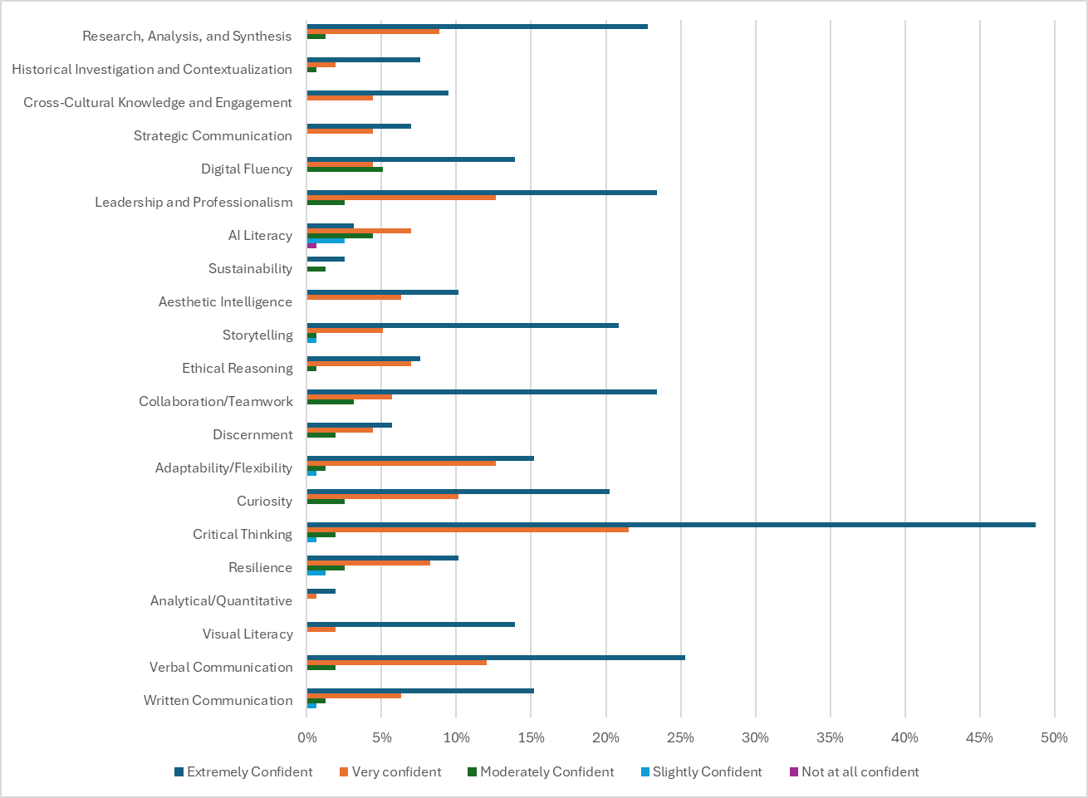
In order to ensure the mastery of critical skills, it is the duty of all faculty to develop and reinforce general education outcomes in their coursework.
Based on the top five skills/competencies you selected, how confident are you in your ability to intentionally develop each of the following competencies in students through your teaching?
 | EC | VC | MC | SC | NAC
Research, Analysis, and Synthesis | 23% | 9% | 1% | 0% | 0%
Leadership and Professionalism | 23% | 13% | 3% | 0% | 0%
Collaboration/ Teamwork | 23% | 6% | 3% | 0% | 0%
Curiosity | 20% | 10% | 3% | 0% | 0%
Critical Thinking | 49% | 22% | 2% | 1% | 0%
Verbal Communication | 25% | 12% | 2% | 0% | 0%

Slide 52
In order to ensure the mastery of critical skills, it is the duty of all faculty to develop and reinforce general education outcomes in their coursework.
Based on the top five skills/competencies you selected, how confident are you in your ability to intentionally develop each of the following competencies in students through your teaching?
 | EC | VC | MC | SC | NAC
Research, Analysis, and Synthesis | 23% | 9% | 1% | 0% | 0%
Leadership and Professionalism | 23% | 13% | 3% | 0% | 0%
Collaboration/ Teamwork | 23% | 6% | 3% | 0% | 0%
Curiosity | 20% | 10% | 3% | 0% | 0%
Critical Thinking | 49% | 22% | 2% | 1% | 0%
Verbal Communication | 25% | 12% | 2% | 0% | 0%
65% of Academic Leaders were Very Confident in their faculty's ability, while 49% of Alumni felt Well Prepared by SCAD.
46% of Academic Leaders were Very Confident in their faculty's ability, while 33% of Alumni felt Well Prepared by SCAD.
40% of Academic Leaders were Very Confident in their faculty's ability, while 42% of Alumni felt Well Prepared by SCAD.

Slide 53
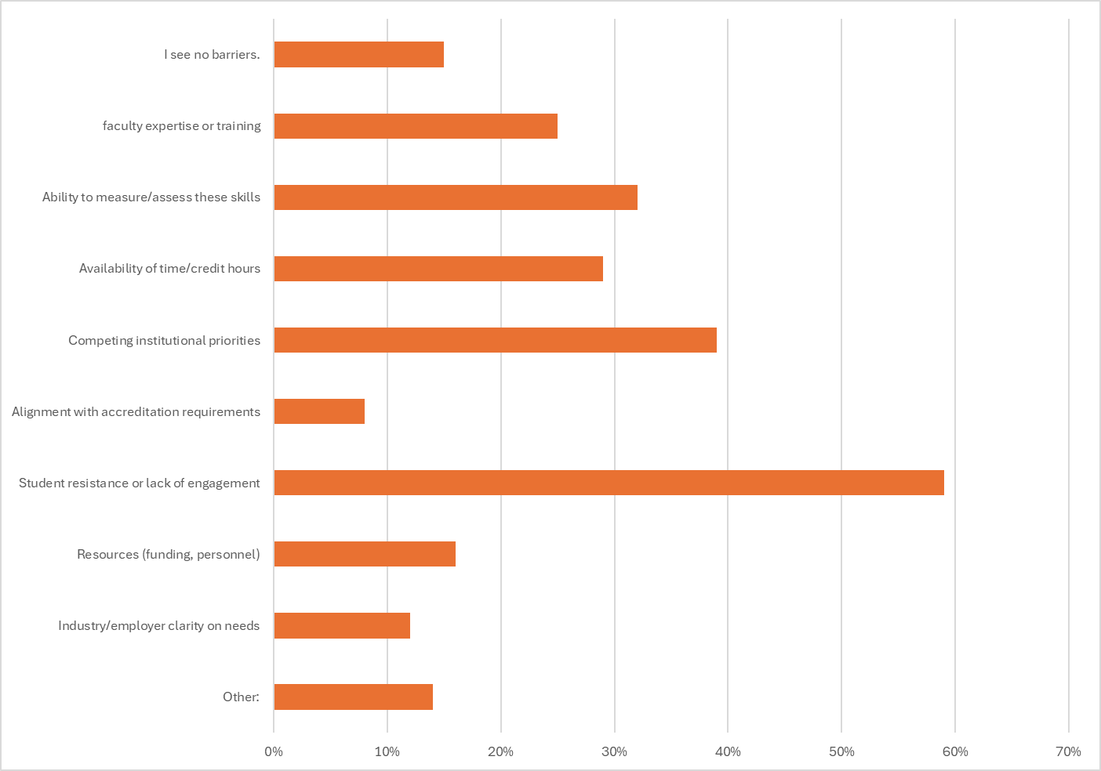
Do you see any of the following as barriers to developing and assessing the competencies you ranked as most important?
Top Five Barriers
Faculty expertise or training* | 25%
Ability to measure/assess these skills* | 32%
Availability of time/credit hours | 29%
Competing institutional priorities* | 39%
Student resistance or lack of engagement* | 59%
*Academic leaders also identified these barriers.

Slide 54
Do you see any of the following as barriers to developing and assessing the competencies you ranked as most important?
Other:
Student engagement and attention are significant barriers, compounded by technology and social media. Faculty consistently flagged that students are resistant to reading, spend extensive time on social media, and increasingly rely on AI to complete written and spoken work — undermining the development of the very competencies ranked most critical. Asynchronous learning formats and the ability to "hide behind the platform" were cited as compounding factors, as are language barriers and students' varied personal challenges including mental health and learning differences. One faculty member noted that students using AI to transcribe lecture notes instead of paying attention in a class involving power tools and chemical agents has led to serious safety consequences.
Structural and institutional conditions constrain faculty effectiveness, and inconsistent expectations are creating friction — and in at least one case, a safety concern. Competing demands on faculty, large class sizes, and lack of curricular coherence all limit how consistently these skills can be developed. Faculty who hold higher standards report being penalized in course evaluations, while inconsistent faculty messaging around AI — including colleagues openly discouraging its use — has created conflict across courses. One respondent received a threatening email specifically because their course instructs and grades AI tool use.
AI presents a dual barrier: it undermines skill-building while also being unevenly understood and applied across the institution. Faculty noted that AI makes it too easy for students to bypass the development of written and oral competencies, while students' ethical and environmental opposition to AI varies significantly by department — meaning any institutional approach will need to account for that range. Financial access to AI tools and the current limitation to Adobe Firefly were both flagged as equity and competitiveness concerns.
View all responses here.

Slide 55
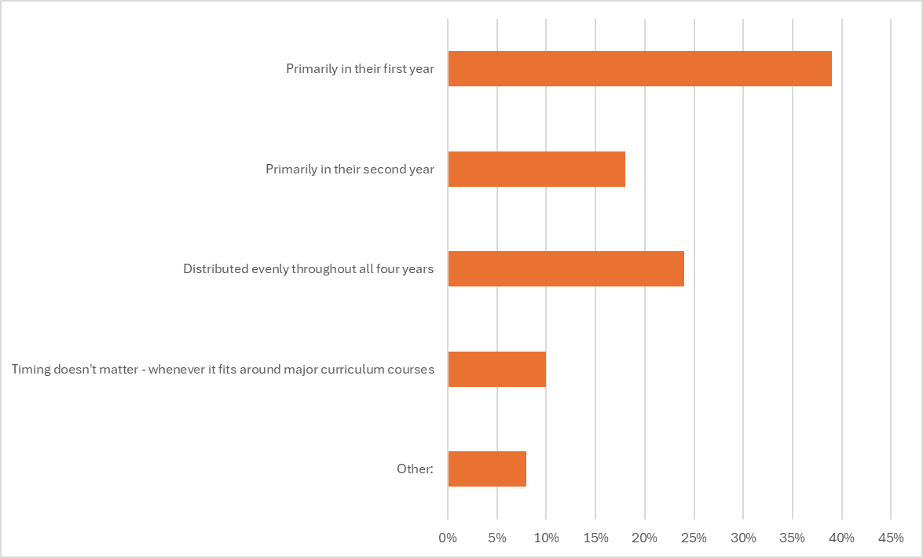
In your school/department's ideal curriculum sequencing, when should students complete the majority of their general education requirements?
 | Faculty | Academic Leaders | Alumni
Primarily in their first year | 39% | 41% | 45%
Primarily in their second year | 18% | 5% | 6%
Distributed evenly throughout all four years | 24% | 27% | 22%
Timing doesn't matter - whenever it fits around major curriculum courses | 10% | 9% | 20%
Other: | 8% | 18% | 7%

Slide 56
In your school/department's ideal curriculum sequencing, when should students complete the majority of their general education requirements?
Other:
Faculty responses on gen ed timing largely favored distribution across the first two to three years rather than concentration in any single year, with some advocating for even distribution across all four years. A recurring concern was that students feel locked out of their major coursework for too long — suggesting that whatever sequencing model is adopted, earlier and more meaningful access to major courses alongside gen ed requirements would better serve student engagement and retention in their chosen field.
View all responses here.

Slide 57
What professional development or institutional support would most increase your faculty's capacity to teach and assess these competencies?
AI training, tool access, and institutional clarity are the most frequently cited needs. Faculty across departments called for structured, discipline-specific AI professional development — not generic overviews — along with funded access to a broader range of industry-relevant platforms beyond Adobe Firefly. Several noted that inconsistent institutional messaging around AI (including faculty openly discouraging its use in ways that affect other courses) is creating confusion and, in at least one case, a safety concern. Faculty want clear ethical frameworks, updated rubrics that account for AI use, and guidance on how to teach students to engage with AI critically rather than use it to avoid learning.
Smaller class sizes, reduced administrative load, and protected time for development are structural necessities. A significant number of respondents identified workload and scale as the core limiting factor — too many students, too many competing demands, and too little time to meet individual needs, develop new courses, or stay current with rapidly evolving industries. Requests for course releases, conference funding, teaching assistants, and more flexibility in scheduling reflect a faculty that is stretched thin and asking for investment in their capacity, not just their knowledge.
Stronger cross-departmental alignment and a cultural shift toward academic rigor are needed institution-wide. Faculty called for greater coherence between general education and studio departments, consistent standards for professionalism across courses, better onboarding for new faculty, and clearer communication to students from day one about the value of transferable competencies. Several noted that student resistance to foundational and liberal arts coursework — and the broader institutional tendency to cater to student feedback over academic standards — is itself a barrier, and one that requires a coordinated response rather than individual faculty effort.
View all responses here.

Slide 58
AI Section

Slide 59
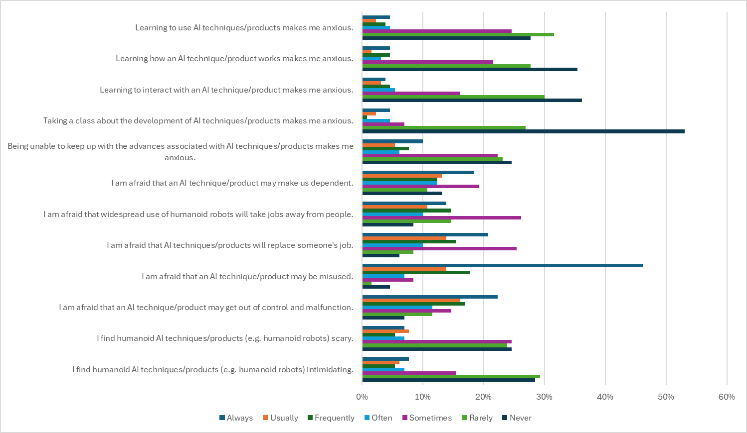
Please indicate how often each of the following statements applies to you.
Takeaways:
Like Academic Leaders, the majority aren't anxious about learning AI itself (60-66% "Rarely" or "Never").
However, Faculty report higher fear than Academic Leaders on every consequence-related statement — most notably AI misuse (60% "Always"/"Usually") and job replacement (35%, more than triple Academic Leaders' 10%).

Slide 60
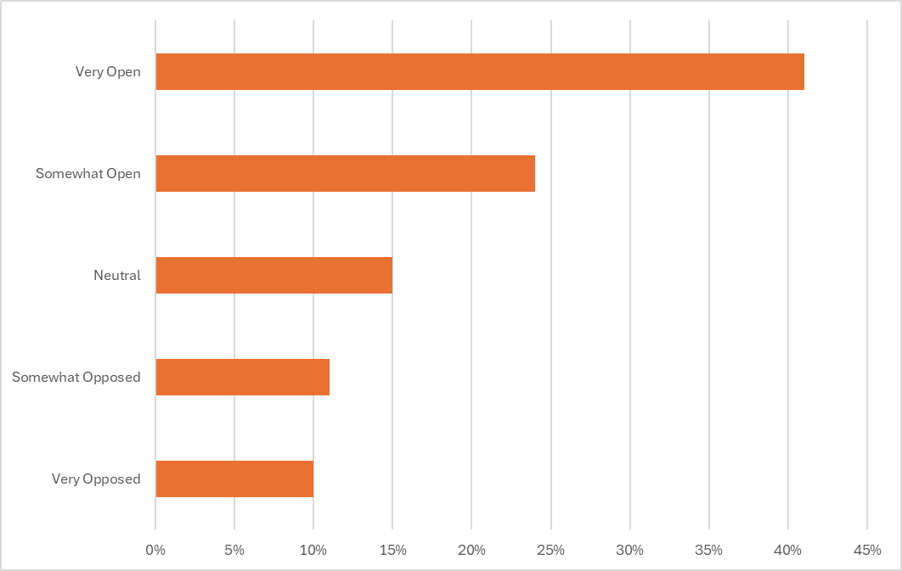
How open are you to redesigning your courses/assignments to more intentionally develop emerging AI-era competencies?
Very Open | 41%
Somewhat Open | 24%
Neutral | 15%
Somewhat Opposed | 11%
Very Opposed | 10%
67% of Academic Leaders were Very Open.

Slide 61
Is there anything else you would like to share about AI, general education, or your experience as an academic leader navigating these changes?
"I firmly believe that students must develop foundational skills independently before relying on AI" — and many faculty see this as non-negotiable. Across responses, faculty expressed that critical thinking, writing, speaking, and creative problem-solving cannot be outsourced to AI without undermining the very learning those skills require. Several noted that students who use AI-generated work frequently cannot explain or defend it, lack ownership of their ideas, and are ultimately less capable — not more — with the technology than students who do the harder cognitive work first.
Faculty are navigating deep, unresolved divisions — among students, among colleagues, and within the institution itself — about how AI should be treated. Student resistance remains widespread and emotionally charged, rooted in environmental, ethical, and creative concerns that faculty report taking seriously. At the same time, inconsistent faculty approaches to AI are creating friction across courses, and the institution has yet to provide the clear, sustained, discipline-specific guidance and tool access faculty need to teach it responsibly and equitably — including addressing cost barriers for students and the unsustainable pace of technological change relative to a 10-week quarter.
Several faculty raised substantive concerns about SCAD's institutional direction on AI and its implications for the institution's identity and reputation. Responses ranged from measured critique to sharp rebuke, with some faculty warning that pushing AI into the curriculum risks alienating the student body, undermining the liberal arts, and positioning SCAD on the wrong side of a cultural and ethical moment. Others took a more pragmatic view — arguing that the institution has a responsibility to prepare students for the world they will enter, and that avoidance is its own form of harm — but nearly all agreed that the current approach lacks the coherence, support, and trust-building necessary to move faculty and students forward together.
View all responses here.

