Slide 1
Implementation
Key to forming habits.
Helps with organization and management
Integrates all together
Identifies role of each
Helps find areas to improve/add on.
Integrate 7 habits points here.

Slide 2
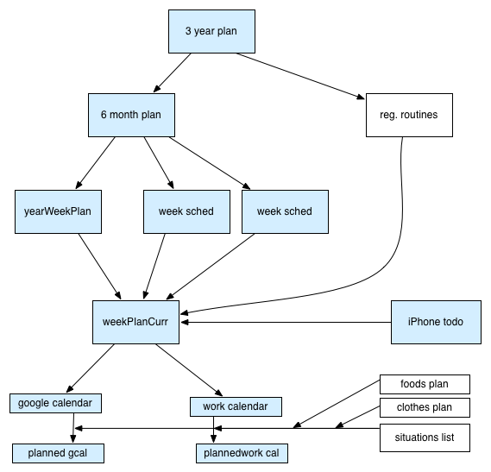
happiness
Anger and worry list
Resume
Ref letter 1
Spaces
Ref letter 2
todo
Cover Letter
Jobs
Daily notepad
TM meeting
Experiences sheet
rel

Slide 3
happiness
Resume
Ref letter 1
Happiness
3-year
Habits
6-month plan
Reg. Routines
Month-by-month
Spaces
Ref letter 2
Month Goals
Resume
Life Notes
Week-by-week
News
Weather
Anger/worry list
Books
Ref letter 2
Cover Letter
Week summary
Food plan
Real-time confidence
projecte
Running TODO
Clothes Plan
Ref letter 1
Clothes plan
projecte
Wl-cheatsheet
Calendar
Situation List
Jobs
Daily notepad
Situation list
TM meeting
Experiences sheet
rel
Notes:
Must do it, and not worry about others.

Slide 4
Wl-cheatsheet
TODO
Intro
Cheatsheet
Experiences
Detail sheets
6-month Goals

Slide 5
Happiness -Own
Positive thoughts
Think about house in Urbana → Bmw
Current: Riding in car in L.A. → talking to Atul for weekend, Meeting with Ranjit:
Current: hlf stuff(artif. But ok)
Negative thoughts
Past girl → match
Dp → showed her
Current: talking to Rishi → works for a bit

Slide 6
Ecological Intelligence
Costs
Energy Efficiency
Money

Slide 7
Real-time Confidence

Slide 8
AngerAndWorryList
Dad talking on phone:
Identification:
Solving:
Udatta Kaka dinner:
Identification:
Solving:
Atul going to talk about Ridhima.
Identification:
Solving:
Dad’s matrimony:
Identification:
Solving:

Slide 9
Resume

Slide 10
Reference Letters
Cappello
Gropp
Garzaran
Padua

Slide 11
Cover Letter

Slide 12
jobs

Slide 13
Work

Slide 14
Spaces
webpresence
Computer
Personal
Computer
Car
Shared
World

Slide 15
WeekPlanDoc
Habits
Week summary
News
Weather
Happiness
Running TODO
Clothes Plan
Stresses
Real-time confidence
Week Schedule
Situations
Life Notes

Slide 16
Happiness
3-year
Habits
Reg. Routines
6-month plan
Month-by-month
June Goals
Week-by-week
News
Life Notes
Weather
Stresses
Week summary
projecte
Real-time confidence
Running TODO
Clothes Plan
projecte
Situations
Week Schedule

Slide 17
TM Meeting Interaction
Comm Org
Word
Introductions
Theme

Slide 18
Relationship Management
At the mall
Main
Date
Second
Speed Dating
Date
Matrimony Site
Met randomly
Date

Slide 19
Experiences sheet
Practice and learn from experiences
Situations

Slide 20
Daily Notepad
Acts as calendar

Slide 21
Spirituality (check loc)
Chance
Luck

Slide 22
Appendix

Slide 23
TM
Jokemaster
Speech
Evaluator
General Evaluator
Grammarian
Timer
Toastmaster
Table Topics
Table Topics Presenter

Slide 24
Speakers
Presents prepared speech
Focuses on improving a particular aspect of their speaking

Slide 25
Put together social int book notes

