Slide 1
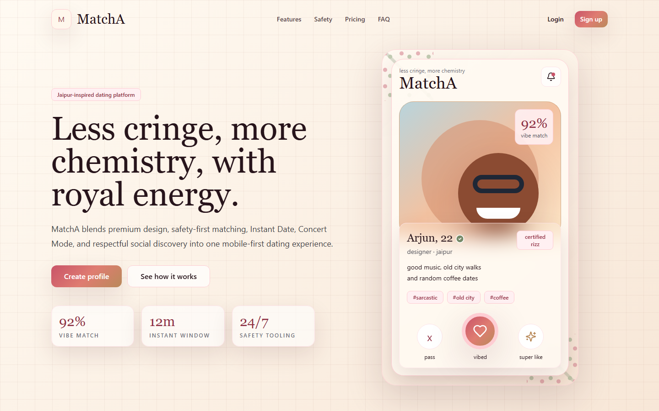
MatchA
MatchA
Product Design & Development Review
A responsive Jaipur-inspired dating platform with matching, chat, instant plans, event discovery, notifications, and admin moderation.
Prepared for MatchA team review
30/6/2026

Slide 2
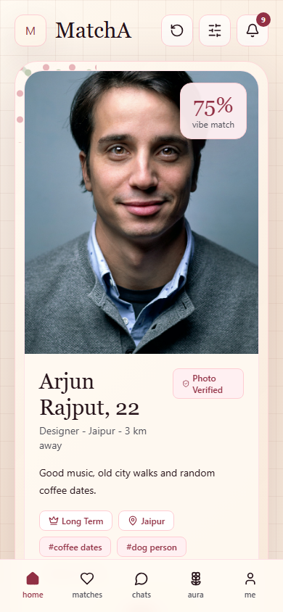
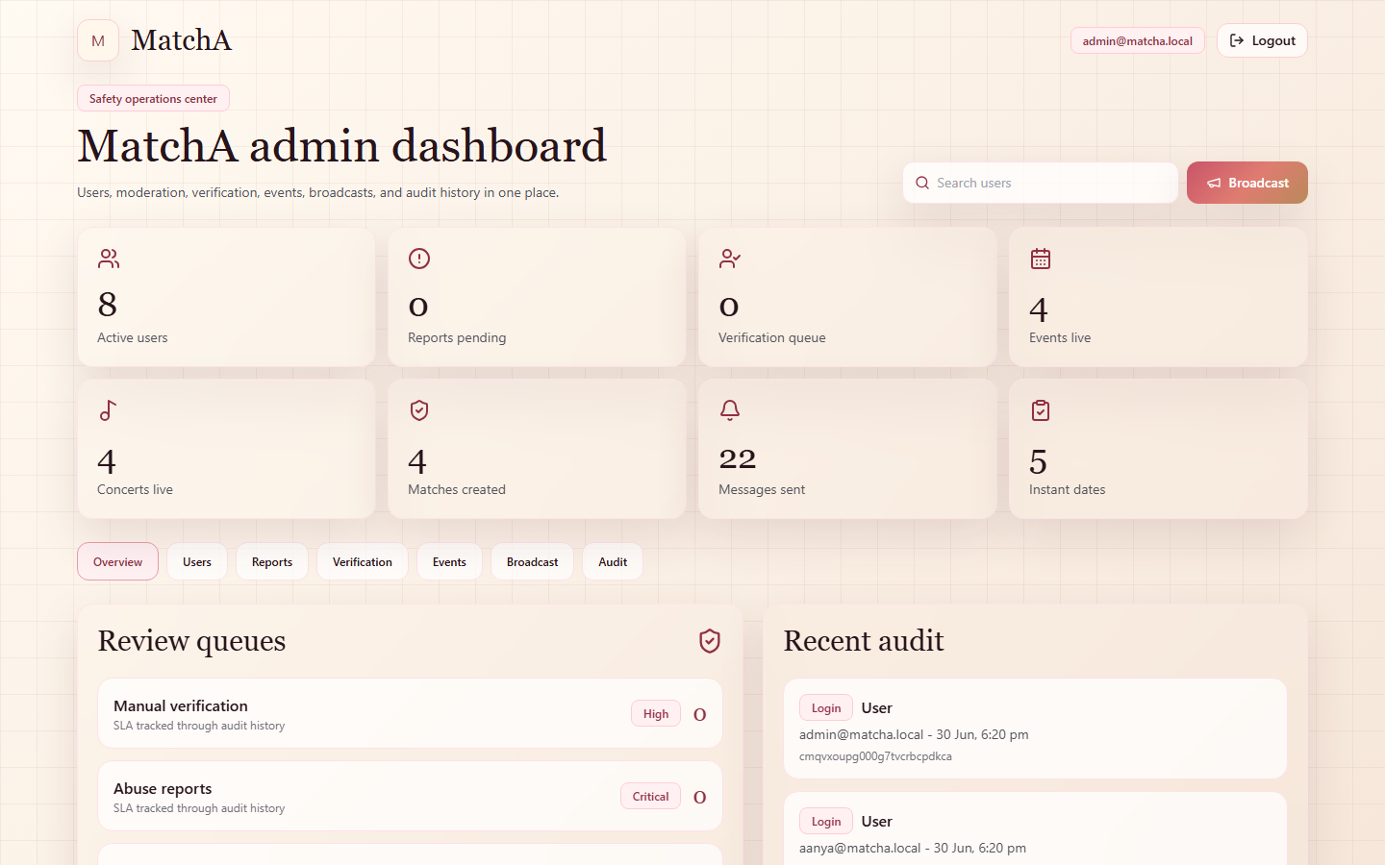
MatchA
Executive Summary
What has been built through Phase 11
Monorepo foundation with Next.js web/admin apps, Express API, Prisma, PostgreSQL, JWT auth, and shared UI packages.
Mobile-first dating experience: landing, auth, onboarding/profile, home matching, matches, chats, Instant Date, Concert Mode, Events, Notifications.
Admin operations console: users, reports, verification review, events/concert publishing, broadcasts, and audit logs.
Visual direction follows luxury, minimal, Jaipur-inspired cream/rose-gold/maroon styling with floral frames and soft glass surfaces.
Scope snapshot: phases 1 through 11
30/6/2026

Slide 3
MatchA
Brand & Landing Page
Public web entry with premium MatchA positioning
Elegant cream/ivory base with rose-gold and maroon accents.
Sections implemented for hero, features, how it works, testimonials, safety, pricing, FAQ, and footer.
Primary CTAs route to sign up and login.
Designed to present the product as premium and safety-first, not a generic dating app.
Landing page, desktop viewport
Real screenshot captured from local MatchA build
30/6/2026

Slide 4
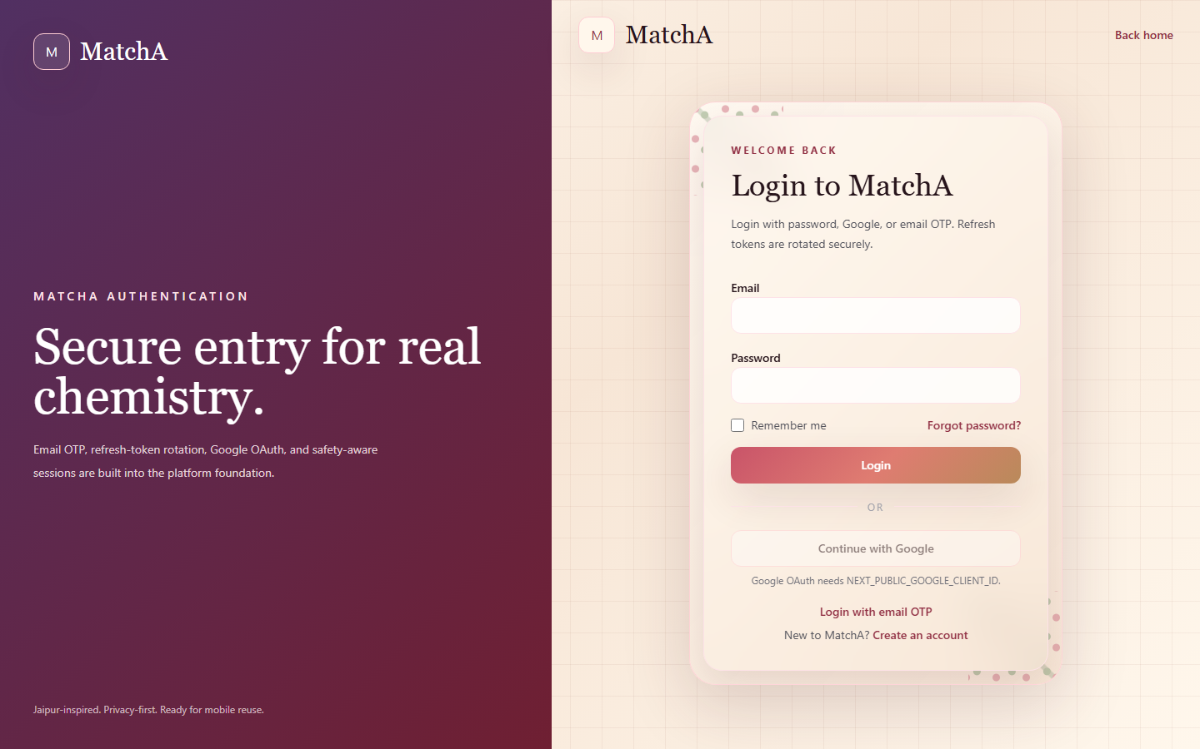
MatchA
Authentication
Secure login foundation with future OAuth/OTP support
Email/password login connected to backend JWT and secure refresh-token cookies.
Google OAuth and Email OTP surfaces are present for provider configuration.
Forgot/reset password and OTP screens are part of the auth module.
Admin and web share the same secure backend auth foundation.
Login page, desktop viewport
Real screenshot captured from local MatchA build
30/6/2026

Slide 5
MatchA
Home & Matching
Figma-inspired mobile-first dating card
Top nav with logo, undo, filters, and notification count.
Profile card with image, verification, age, profession, location, bio, interests, and compatibility percentage.
Matching actions: pass, like, super like, and undo.
Feature cards lead into Instant Date, Concert Mode, and Events.
Home screen, mobile viewport
Real screenshot captured from local MatchA build
30/6/2026

Slide 6
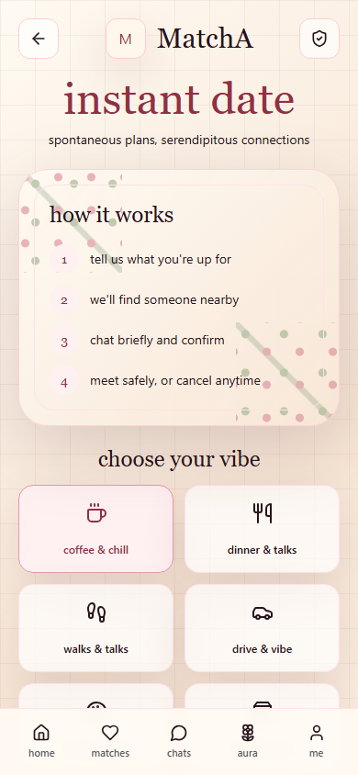
MatchA
Instant Date
Spontaneous plans with activity and time selection
Activity choices: coffee, dinner, walk, drive, art, market, casual.
Time windows: now, tonight, weekend, and custom date/time.
Backend creates request records and finds nearby compatible users.
Supports accept, reject, cancel, reschedule, and live-location-ready data model.
Instant Date screen, mobile viewport
Real screenshot captured from local MatchA build
30/6/2026

Slide 7
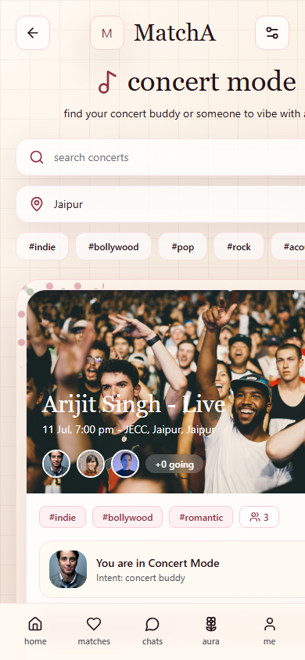
MatchA
Concert Mode
Find a concert buddy, new friends, or maybe more
Search concerts by city, title, artist, venue, and genre tags.
Featured concert card includes attendees, intent, join/update/cancel actions.
Looking-for modes support concert buddy, new friends, maybe more, and group vibe.
Participants and notifications are backed by Prisma models.
Concert Mode screen, mobile viewport
Real screenshot captured from local MatchA build
30/6/2026

Slide 8
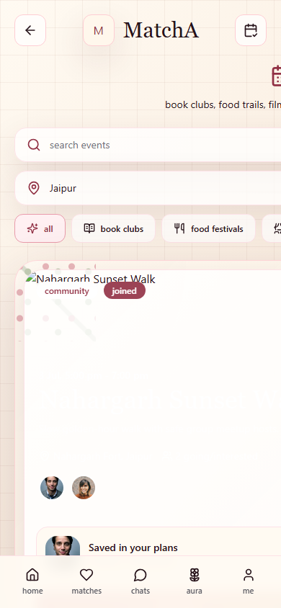
MatchA
Events
Local group-first plans beyond concerts
Categories include book clubs, food festivals, comedy, movies, workshops, community, and concerts.
Users can join, mark interested, share, invite, and leave events.
Event participants and invite notifications are stored server-side.
Designed for safer, lower-pressure social discovery.
Events screen, mobile viewport
Real screenshot captured from local MatchA build
30/6/2026

Slide 9
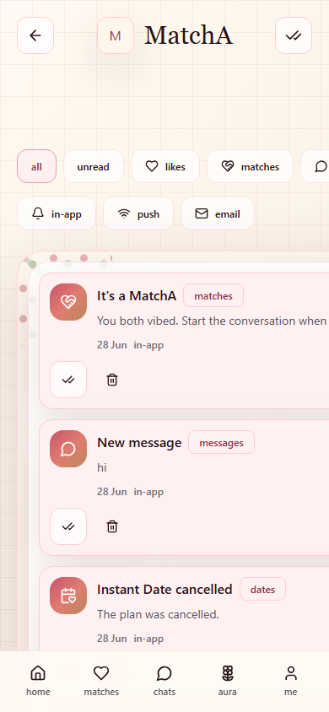
MatchA
Notifications
In-app inbox and preference management
Notification inbox with unread count, filters by type/channel, and read/delete actions.
Covers likes, matches, messages, concert invites, instant date requests, profile views, verification, and system alerts.
Push/email preference toggles persist through user settings.
Home bell displays live unread count.
Notifications screen, mobile viewport
Real screenshot captured from local MatchA build
30/6/2026

Slide 10
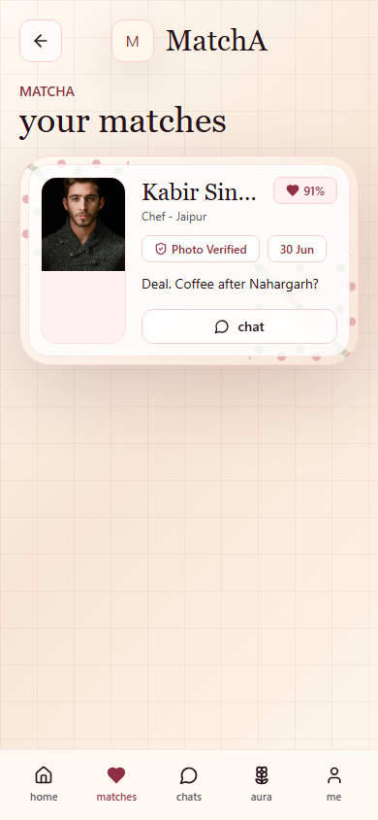
MatchA
Matches
Mutual connection list for follow-up
Mutual matches created through like/super-like flow.
Cards show profile preview, compatibility, match date, and latest message.
Routes into chat conversations.
Backend prevents duplicates and respects blocked/unmatched states.
Matches screen, mobile viewport
Real screenshot captured from local MatchA build
30/6/2026

Slide 11
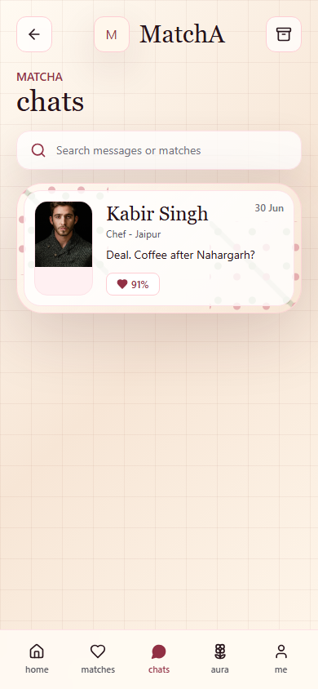
MatchA
Chats
Realtime messaging foundation
Conversation list backed by match records and message history.
Socket.IO foundation supports realtime typing, delivery/read state, and online indicators.
Chat module includes images, GIFs, voice-note metadata, edit, delete, reply, mute, archive, block, and report endpoints.
Report actions feed the admin moderation queue.
Chats screen, mobile viewport
Real screenshot captured from local MatchA build
30/6/2026

Slide 12
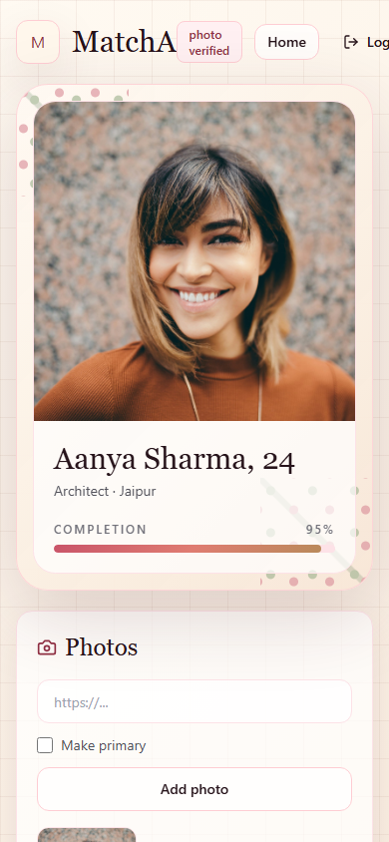
MatchA
Profile & Verification
Onboarding, profile completion, photos, safety review
Full profile editor: bio, location, gender, interests, lifestyle, prompts, music, food, travel, pets, smoking/drinking.
Photo gallery with primary photo management.
Profile completion percentage drives route access.
Verification request creates admin queue and user notification.
Profile screen, mobile viewport
Real screenshot captured from local MatchA build
30/6/2026

Slide 13
MatchA
Admin Dashboard
Operations console for trust and moderation
Role-gated admin login with live dashboard metrics.
User controls: search, ban, unban, soft delete.
Moderation queues: reports and verification review.
Publishing controls for events/concerts, broadcast notifications, and audit log viewer.
Admin app, desktop viewport
Real screenshot captured from local MatchA build
30/6/2026

Slide 14
MatchA
Architecture Snapshot
Current implementation stack and module boundaries
Frontend: Next.js 15 App Router, React 19, TypeScript, Tailwind CSS, shared UI package.
Backend: Express.js TypeScript API, Prisma ORM, PostgreSQL, JWT access/refresh tokens, Socket.IO chat foundation.
Modules implemented: Auth, Profile, Matching, Chat, Instant Date, Concert Mode, Events, Notifications, Admin.
Data model covers users, photos, interests, likes, matches, messages, notifications, events, concerts, instant dates, reports, blocks, verification, sessions, settings, and audit logs.
Future mobile reuse is supported by keeping API/business logic separate from UI surfaces.
Technical architecture overview
30/6/2026

Slide 15
MatchA
Next Milestones
Recommended path after Phase 11
Phase 12: automated tests for auth, API modules, matching, chat, events, notifications, and admin flows.
Phase 13: production deployment setup with Vercel, Railway, Supabase PostgreSQL, environment management, health checks, and CI/CD.
Provider integrations: Cloudinary upload flow, Firebase Cloud Messaging, SMTP production email, Google OAuth, Google Maps API.
Product hardening: richer admin analytics, support tickets, ID verification provider, fake-profile detection, SOS/emergency contact flows.
Design pass: final floral border assets, dark mode polish, accessibility audit, and responsive visual QA.
Recommended roadmap
30/6/2026

