Slide 1
LEADERSHIP OVERVIEW / CUSTOMER ANALYSIS
CUSTOMER
SHOPPING
BEHAVIOR
Purchase patterns, customer segments, and the actions most likely to improve growth and retention.
3,900 PURCHASES ANALYZED

Slide 2
THE OPPORTUNITY
The clearest opportunity is retention, not reach
3,900
73%
3,116
PURCHASES ANALYZED
NON-SUBSCRIBERS
LOYAL CUSTOMERS
The dataset is broad enough to compare customers, products, and buying patterns.
The largest growth lever is converting existing demand into a stronger repeat relationship.
Compared with 701 returning and 83 new customers.

Slide 3
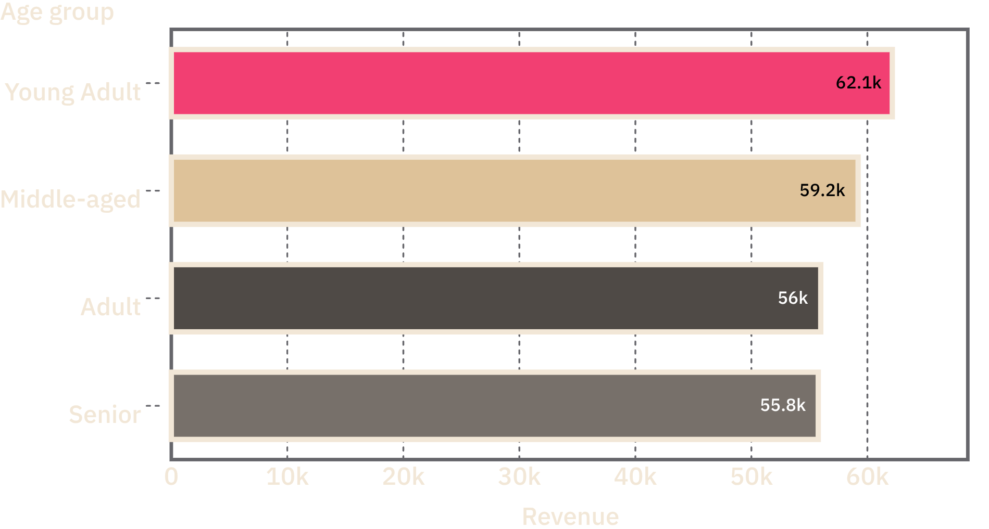
COMMERCIAL MIX
Clothing leads the commercial picture
Clothing leads revenue and sales, ahead of accessories, footwear, and outerwear.
Young adults contribute the highest revenue, followed by middle-aged customers.
REVENUE BY AGE GROUP
CORE PRODUCTS: BLOUSE · PANTS · SHIRT
ACCESSORIES: JEWELRY · SUNGLASSES · BELTS

Slide 4
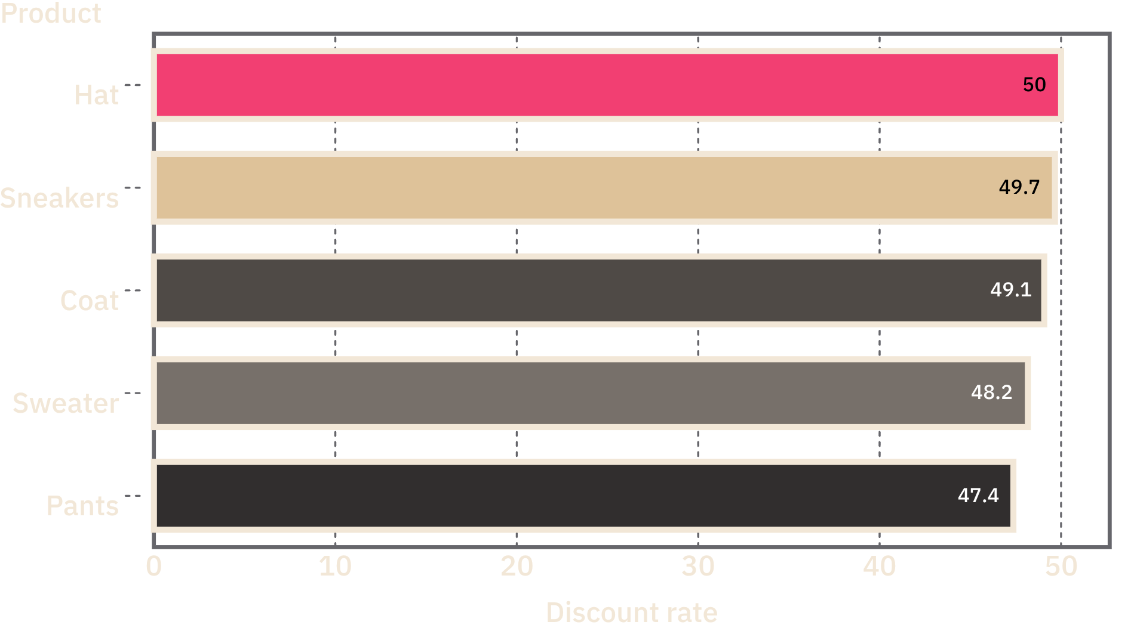
PROMOTION ECONOMICS
Discounts can drive value without eroding demand
839
Customers used discounts and still spent above the average purchase amount of $59.76.
PRODUCTS WITH THE HIGHEST DISCOUNT RATES
KEEP DISCOUNTS TARGETED. TEST MARGIN-AWARE OFFERS INSTEAD OF BROAD PROMOTIONS.

Slide 5
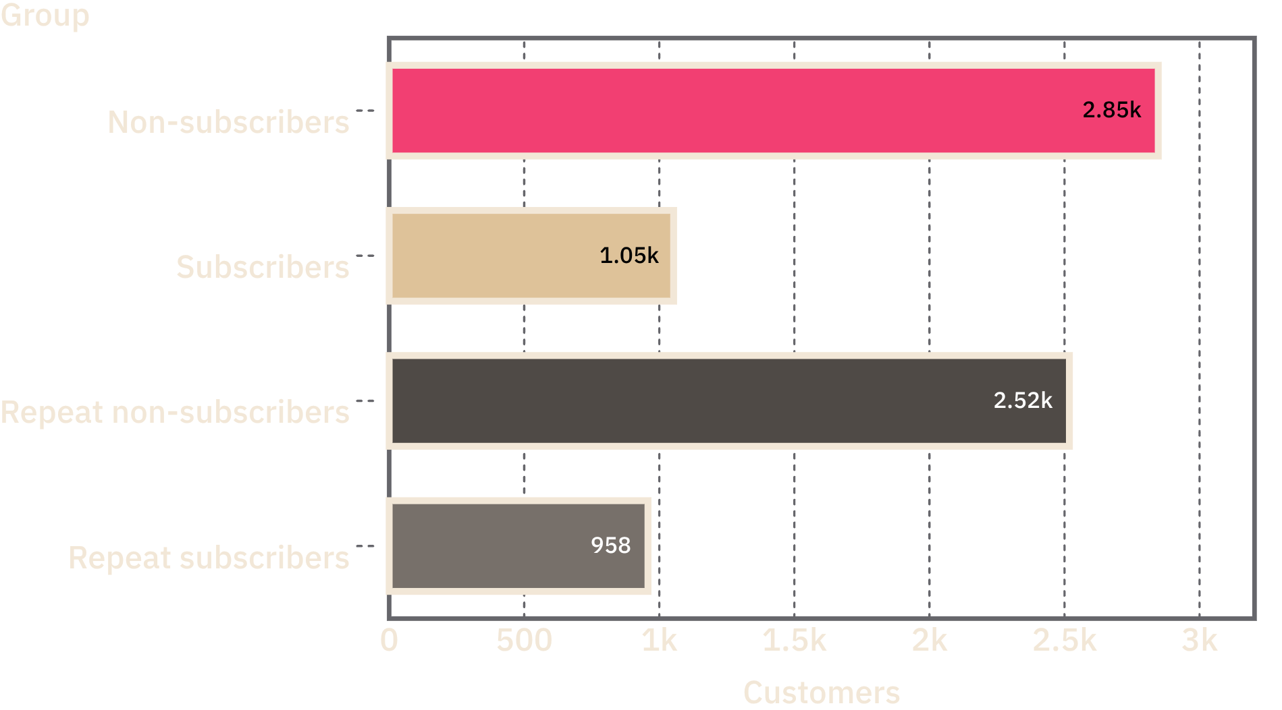
SUBSCRIPTION MIX
Subscription is under-penetrated among repeat buyers
2,518
SUBSCRIPTION AND REPEAT-BUYER MIX
Repeat buyers remain non-subscribers, compared with 958 repeat subscribers.
SUBSCRIBERS AVERAGE $59.49
NON-SUBSCRIBERS AVERAGE $59.87

Slide 6
PRODUCT EXPERIENCE
Product experience is strongest in practical accessories
The highest-rated products are practical accessories and adjacent wardrobe staples.
3.86
3.84
3.82
3.80
3.78
GLOVES
SANDALS
BOOTS
HATS
SKIRTS
AVERAGE PURCHASE AMOUNT: $60.48 EXPRESS SHIPPING · $58.46 STANDARD SHIPPING

Slide 7
FROM ANALYSIS TO ACTION
Three moves can turn analysis into action
01
02
03
CONVERT REPEAT BUYERS
PROTECT MARGIN
CONCENTRATE DEMAND
Set product-level discount guardrails for the five most discount-dependent products.
Lead campaigns with clothing, young-adult revenue segments, and top-rated accessories.
Create a targeted subscription journey for the 2,518 repeat buyers who are not subscribed.

Slide 8
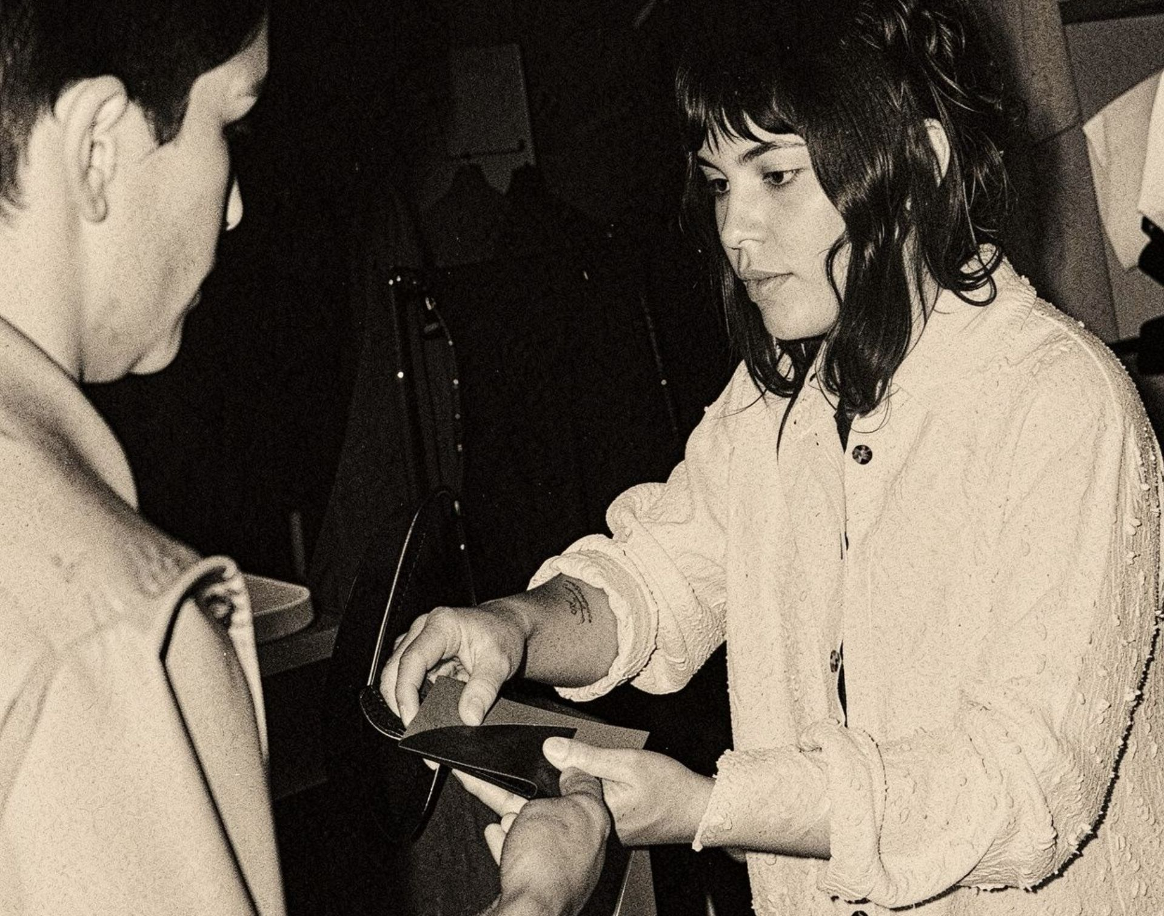
NEXT DECISION
Next decision: test the retention engine
Start with repeat non-subscribers. Keep the first test focused, measurable, and tied to contribution margin.
LAUNCH
MEASURE
SCALE
A focused subscription offer for repeat non-subscribers.
Conversion, repeat purchase rate, discount cost, and contribution margin.
The products, audiences, and shipping messages that outperform in the first test.

