Slide 1
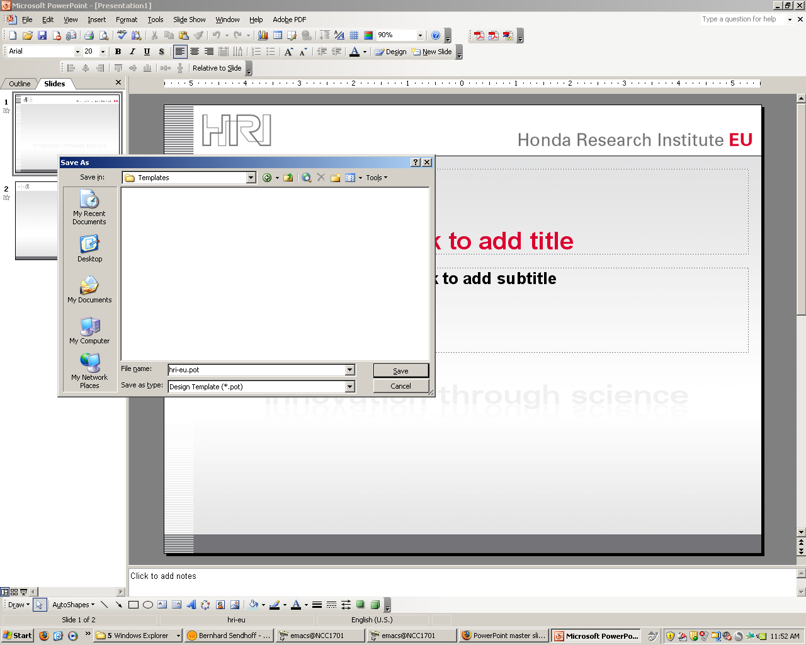
start PowerPoint with
hri-eu.pot
save as
save as type: design template
file name: hri-eu.pot

Slide 2
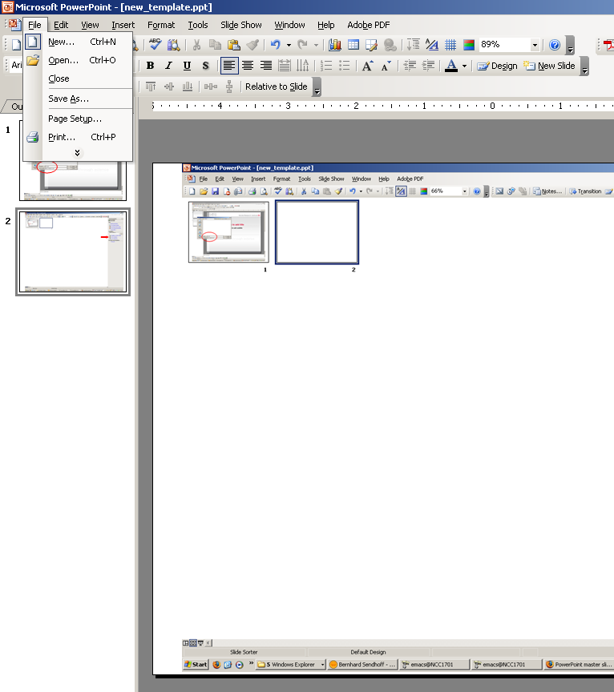
start PowerPoint
new presentation

Slide 3
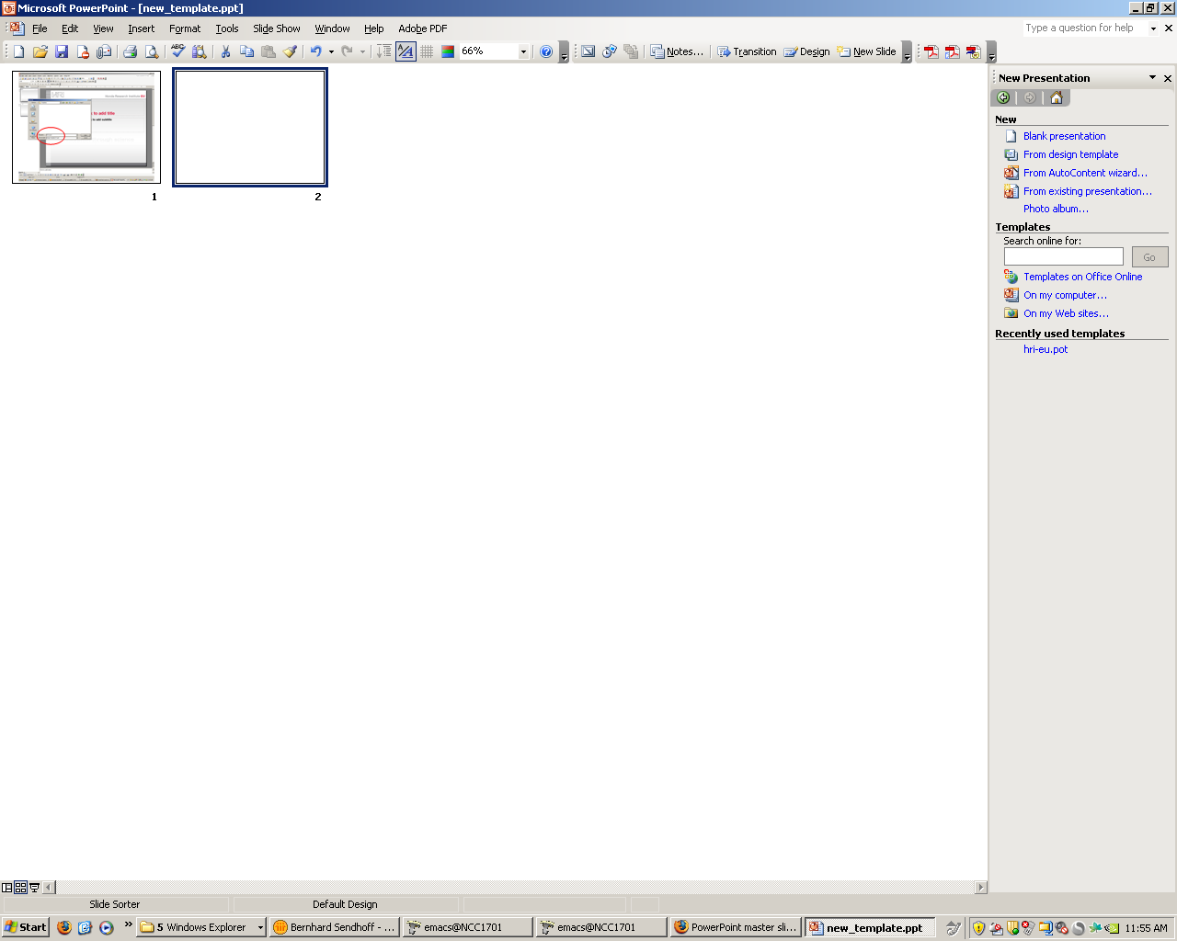
choose template "on my computer"

Slide 4
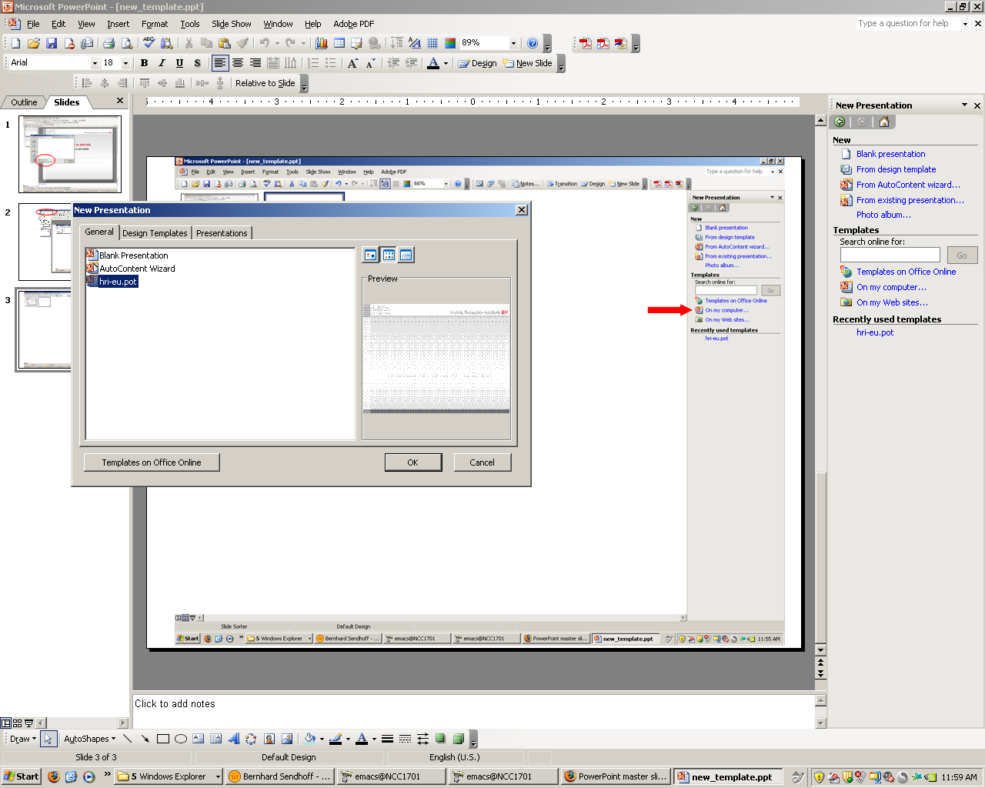
choose the one you just saved
produce meaningful and pretty slides

