Slide 1
Yandex
Mikhaylova Lera

Slide 2
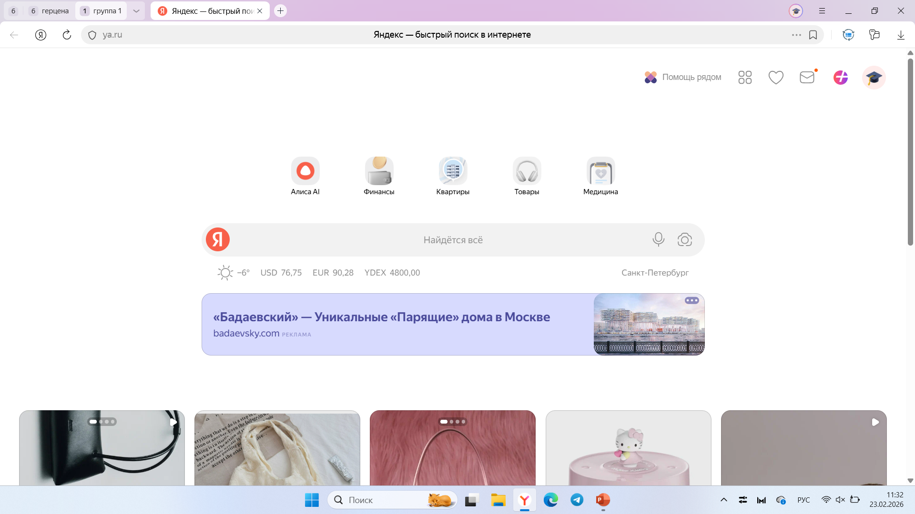
Refresh the current page
Search box
Bookmark
Go back one page
URL address
Clickable image links
Favourites
Scroll bar
Search box
Clickable hypertext links
Clickable image links

Slide 3
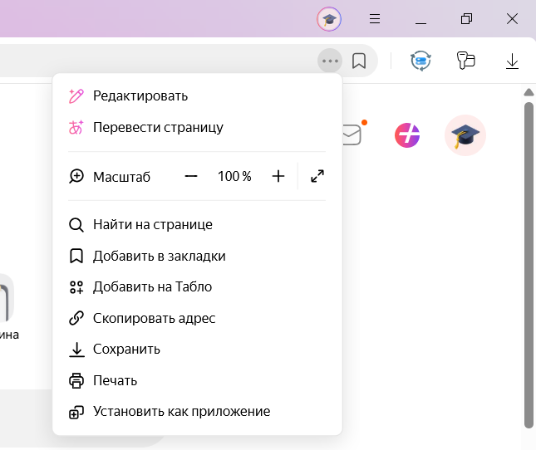
Drop-down menu
Collapse
Expand
Close
Downloads
Password manager
Clickable image links
Mail
Groups
Tab

