Slide 1











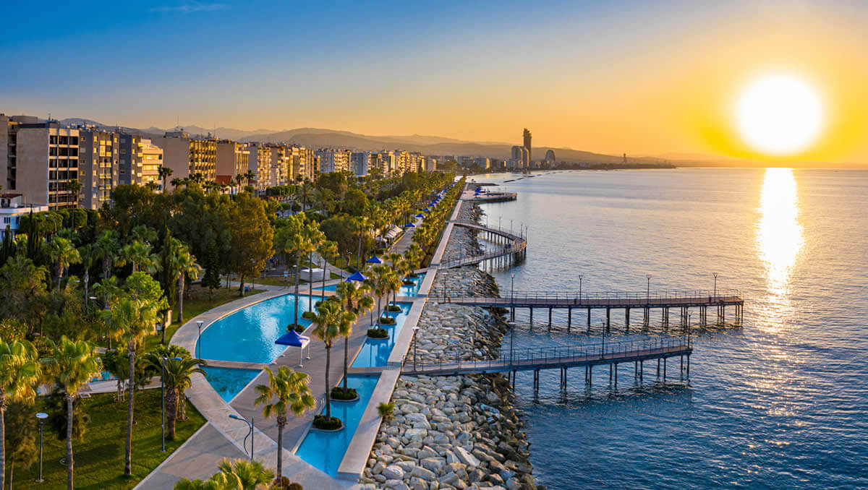


34th IFIP/IEEE International Conference on Very Large-Scale Integration
VLSI-SoC 2026
October 11-14, 2026
Limassol, Cyprus
www.vlsi-soc.com
VLSI-SoC 2026 is the 34th in a series of international conferences sponsored by IFIPTC 10 WG 10.5, IEEE CASS, IEEE CEDA and ACM SIGDA, which explores the state-of-the-art in the areas that surround Very Large Scale Integration (VLSI) and System-on-Chip (SoC). Previous conferences have taken place in Edinburgh, Trondheim, Tokyo, Vancouver, Munich, Grenoble, Gramado, Lisbon, Montpellier, Darmstadt, Perth, Nice, Atlanta, Rhodes, Florianópolis, Madrid, Hong Kong, Santa Cruz, Istanbul, Playa del Carmen, Daejeon, Tallinn, Abu Dhabi, Verona, Cuzco, Salt Lake City, Singapore, Patras, Sharjah, Tanger, and Puerto Varas. The 2026 edition will take place at Limassol, Cyprus, a tourist and top destination in Southeast Europe.
Paper Submission: Papers should present original research and industrial results not published or submitted for publication in other forums. Electronic submission in PDF format to the EasyChair platform for VLSI-SoC 2026 is required. The proceedings will be published by IEEE and will be made available through IEEE Xplore. A selection of the conference best papers will be invited to be submitted to a special issue of the ACM Journal on Emerging Technologies in Computing Systems. Papers from special sessions will be invited to submit an extended version to be included as chapters of a book to be published by Springer.
Paper Format: Papers should not exceed 4 pages + 1 page with only references (single-spaced, 2 columns, 10pt font). Submissions should be camera-ready, following the IEEE proceedings specifications.
Paper Publication and Presenter Registration: Papers will be accepted for regular or poster presentation at the conference. Every accepted paper MUST have at least one author registered (full rate) at the conference by the time the camera-ready paper is submitted; the registered author is also expected to attend the conference and present the paper. A limited number of travel grants are available to needy PhD students from emerging countries.
PhD & Student Forum: A dedicated poster session will be included in the technical program of the main conference. The Best PhD & Student Forum winner will be invited to submit an extended version to be included as chapters of a book to be published by Springer.
Topics of interest include (but not limited to) the following:
Applications and Architectures for AI and ML
Communication Architectures and Technologies
Computing Paradigms
Digital Circuits Design and Synthesis
Embedded System Design
Emerging Technologies and Applications
Low-Power, Energy-Efficient and Thermal-Aware Design
Security
Sensing and Signal Processing Technologies
Smart Systems, Devices and Applications
System Specification, Simulation and Verification
Test and Dependability
Look
Back
General Co-Chairs:
Tiziana Margaria (Univ. of Limerick, IE),
Ian O’Connor (École Centrale de Lyon, FR)
Program Co-Chairs:
Panagiota Nikolaou (Univ. of Central Lancashire, CY),
Florenc Demrozi (Univ. of Stavanger, NO)
Publication Co-Chairs:
Enrico Fraccaroli (UNC Chapel Hill, US)
Christiana Ioannou (University of Central Lancashire, CY)
Special Session Co-Chairs:
Maria Michael (University of Cyprus, CY)
Theocharis Theocharides (University of Cyprus, CY)
Tutorial Co-Chairs:
Alberto Bosio (École Centrale de Lyon, FR)
Rafaella Elia (University of Cyprus, CY)
Finance Chair: Anna Philippou (University of Cyprus, CY)
Industrial Chair: Leticia B. Pöhls (Leibniz IHP Microelectronics, DE)
Local Industrial Chair: Andreas Diavastos (Cyprus Univ. of Technology, CY)
Publicity Chair: Nicolo´ Bellarmino (Politecnico di Torino, Italy)
Extended:
Abstract Deadline: 04 May 2026
Full Paper Deadline: 11 May 2026
Special Session Deadline: 11 May 2026
Author Notification: 22 June 2026
PhD & Student Forum: 02 July 2026
Camera Ready: 13 July 2026
Panel Chair: Sara Vinco (Politecnico di Torino, IT)
Award Co-Chairs:
Katell Morin-Allory (TIMA Laboratory, FR)
George Papadimitriou (University of Patras, GR)
Mohammad Iman (Université Grenoble Alpes, FR)
Ph.D. Forum Co-Chairs:
Fatih Ugurdag (Ozyegin Univ., TR)
Nahla El-Araby (TU Wein, AT)
Local Arrangements: Nicolas Stratis, Petros Stratis (EasyConferences, CY)
Web Chair: Matteo Iervasi (Univ. of Stavanger, NO)

Slide 2
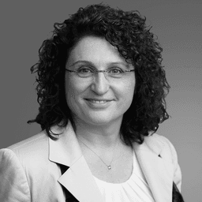


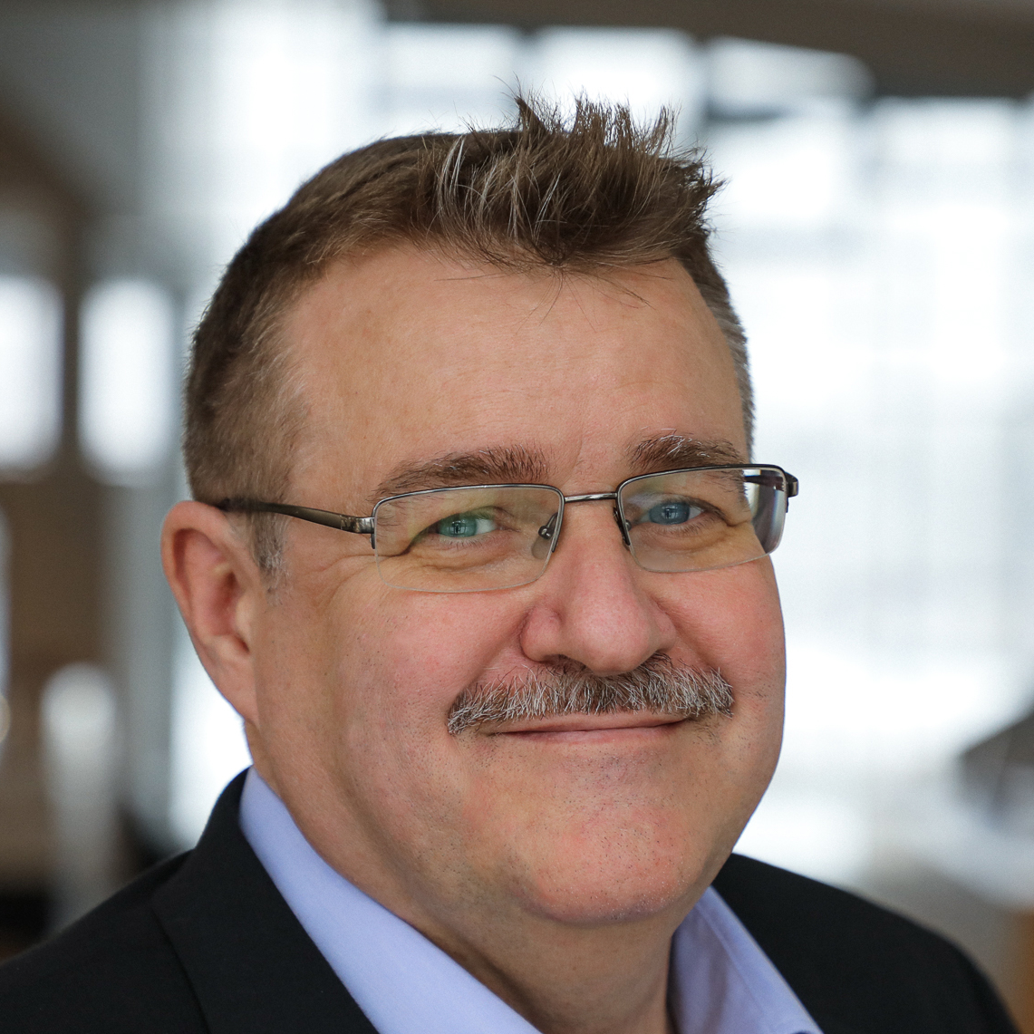
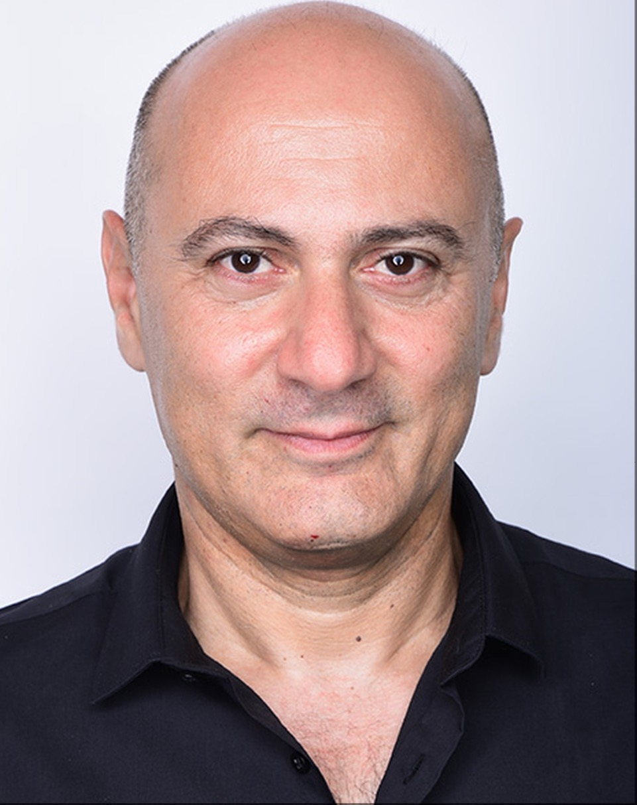


34th IFIP/IEEE International Conference on Very Large-Scale Integration
VLSI-SoC 2026
October 11-14, 2026
Limassol, Cyprus
www.vlsi-soc.com
Confirmed Keynote Speakers
Confirmed Industrial Keynote Speakers
Prof. Valeria Bertacco
University of Michigan, USA
From Edge AI to Intelligent Systems-on-Chip
Short Abstract: This keynote discusses the integration of AI into Systems-on-Chip, focusing on efficient hardware–software co-design for edge intelligence and future AI-native architectures.
Dr. Victor Grimblatt
Synopsys, Vitacura, Chile
Low Power IC Design for a Sustainable World
Short Abstract: This keynote explores key low-power IC design techniques and their role in reducing energy consumption, enabling more sustainable and efficient electronic systems.
Prof. Giovanni De Micheli
EPFL, Switzerland
Sustainable and Secure Computing: the Last Frontier
Short Abstract: This keynote explores the convergence of sustainability and security in modern computing, highlighting key challenges and emerging approaches for building energy-efficient and resilient systems.
Prof. Wolfgang Ecker
TUM- Infineon, Germany
What is the IP Reuse Trap for Digital Hardware, and how can it be escaped?
Short Abstract: This keynote explores the challenges of IP reuse in digital design and highlights emerging approaches to improve scalability and efficiency in SoC development.
Prof. Freddy Gabbay
Hebrew Univ. of Jerusalem
Do We Really Need All the Bits? Value-Driven Approximate Computing for AI Accelerators
Short Abstract: This keynote explores value-driven approximate computing for AI accelerators, using selective precision and co-design techniques to improve efficiency while preserving model accuracy.
Odysseas Economides
HardwareX Engineering, Cyprus
Bridging the gap between research and industry through embedded systems
Short Abstract: This keynote explores how embedded systems enable the translation of research innovations into real-world industrial applications, highlighting challenges and strategies for effective technology transfer.
Further Opportunities
Call for Special Sessions
PhD & Student Forum
Two Exciting Tutorial Sessions
Inspiring Panel Session

Slide 3
34th IFIP/IEEE International Conference on Very Large-Scale Integration
VLSI-SoC 2026
October 11-14, 2026
Limassol, Cyprus
www.vlsi-soc.com
VLSI-SoC 2026 is the 34th in a series of international conferences sponsored by IFIPTC 10 WG 10.5, IEEE CASS, IEEE CEDA and ACM SIGDA, which explores the state-of-the-art in the areas that surround Very Large Scale Integration (VLSI) and System-on-Chip (SoC). Previous conferences have taken place in Edinburgh, Trondheim, Tokyo, Vancouver, Munich, Grenoble, Gramado, Lisbon, Montpellier, Darmstadt, Perth, Nice, Atlanta, Rhodes, Florianópolis, Madrid, Hong Kong, Santa Cruz, Istanbul, Playa del Carmen, Daejeon, Tallinn, Abu Dhabi, Verona, Cuzco, Salt Lake City, Singapore, Patras, Sharjah, Tanger, and Puerto Varas. The 2026 edition will take place at Limassol, Cyprus, a tourist and top destination in Southeast Europe.
Paper Submission: Papers should present original research and industrial results not published or submitted for publication in other forums. Electronic submission in PDF format to the EasyChair platform for VLSI-SoC 2026 is required. The proceedings will be published by IEEE and will be made available through IEEE Xplore. Accepted Regular track papers will be invited to be submitted to a special issue of the ACM Journal on Emerging Technologies in Computing Systems. Papers from special sessions will be invited to submit an extended version to be included as chapters of a book to be published by Springer.
Paper Format: Papers should not exceed 4 pages + 1 page with only references (single-spaced, 2 columns, 10pt font). Submissions should be camera-ready, following the IEEE proceedings specifications.
Paper Publication and Presenter Registration: Papers will be accepted for regular or poster presentation at the conference. Every accepted paper MUST have at least one author registered (full rate) at the conference by the time the camera-ready paper is submitted; the registered author is also expected to attend the conference and present the paper. A limited number of travel grants are available to needy PhD students from emerging countries.
PhD & Student Forum: A dedicated poster session will be included in the technical program of the main conference. The Best PhD & Student Forum winner will be invited to submit an extended version to be included as chapters of a book to be published by Springer.
Topics of interest include (but not limited to) the following:
Applications and Architectures for AI and ML
Communication Architectures and Technologies
Computing Paradigms
Digital Circuits Design and Synthesis
Embedded System Design
Emerging Technologies and Applications
Low-Power, Energy-Efficient and Thermal-Aware Design
Security
Sensing and Signal Processing Technologies
Smart Systems, Devices and Applications
System Specification, Simulation and Verification
Test and Dependability
Look
Back
General Co-Chairs:
Tiziana Margaria (Univ. of Limerick, IE),
Ian O’Connor (École Centrale de Lyon, FR)
Program Co-Chairs:
Panagiota Nikolaou (Univ. of Central Lancashire, CY),
Florenc Demrozi (Univ. of Stavanger, NO)
Publication Co-Chairs:
Enrico Fraccaroli (UNC Chapel Hill, US)
Christiana Ioannou (University of Central Lancashire, CY)
Special Session Co-Chairs:
Maria Michael (University of Cyprus, CY)
Theocharis Theocharides (University of Cyprus, CY)
Tutorial Co-Chairs:
Alberto Bosio (École Centrale de Lyon, FR)
Rafaella Elia (University of Cyprus, CY)
Finance Chair: Anna Philippou (University of Cyprus, CY)
Industrial Chair: Leticia B. Pöhls (Leibniz IHP Microelectronics, DE)
Local Industrial Chair: Andreas Diavastos (Cyprus Univ. of Technology, CY)
Publicity Chair: Nicolo´ Bellarmino (Politecnico di Torino, Italy)
Extended:
Abstract Deadline: 04 May 2026
Full Paper Deadline: 11 May 2026
Special Session Deadline: 11 May 2026
Author Notification: 22 June 2026
PhD & Student Forum: 02 July 2026
Camera Ready: 13 July 2026
Panel Chair: Sara Vinco (Politecnico di Torino, IT)
Award Co-Chairs:
Katell Morin-Allory (TIMA Laboratory, FR)
George Papadimitriou (University of Patras, GR)
Mohammad Iman (Université Grenoble Alpes, FR)
Ph.D. Forum Co-Chairs:
Fatih Ugurdag (Ozyegin Univ., TR)
Nahla El-Araby (TU Wein, AT)
Local Arrangements: Nicolas Stratis, Petros Stratis (EasyConferences, CY)
Web Chair: Matteo Iervasi (Univ. of Stavanger, NO)

Slide 4
34th IFIP/IEEE International Conference on Very Large-Scale Integration
VLSI-SoC 2026
October 11-14, 2026
Limassol, Cyprus
www.vlsi-soc.com
Confirmed Keynote Speakers
Confirmed Industrial Keynote Speakers
Prof. Valeria Bertacco
University of Michigan, USA
TBA
Short Abstract: TBA
Dr. Victor Grimblatt
Synopsys, Vitacura, Chile
Low Power IC Design for a Sustainable World
Short Abstract: This keynote explores key low-power IC design techniques and their role in reducing energy consumption, enabling more sustainable and efficient electronic systems.
Prof. Giovanni De Micheli
EPFL, Switzerland
Sustainable and Secure Computing: the Last Frontier
Short Abstract: This keynote explores the convergence of sustainability and security in modern computing, highlighting key challenges and emerging approaches for building energy-efficient and resilient systems.
Prof. Wolfgang Ecker
TUM- Infineon, Germany
What is the IP Reuse Trap for Digital Hardware, and how can it be escaped?
Short Abstract: This keynote explores the challenges of IP reuse in digital design and highlights emerging approaches to improve scalability and efficiency in SoC development.
Prof. Freddy Gabbay
Hebrew Univ. of Jerusalem
Do We Really Need All the Bits? Value-Driven Approximate Computing for AI Accelerators
Short Abstract: This keynote explores value-driven approximate computing for AI accelerators, using selective precision and co-design techniques to improve efficiency while preserving model accuracy.
Odysseas Economides
HardwareX Engineering, Cyprus
Bridging the gap between research and industry through embedded systems
Short Abstract: This keynote explores how embedded systems enable the translation of research innovations into real-world industrial applications, highlighting challenges and strategies for effective technology transfer.
Further Opportunities
Call for Special Sessions
PhD & Student Forum
Two Exciting Tutorial Sessions
Inspiring Panel Session
AI as the Chip Designer: Evolution or Illusion?

