Slide 1
Crop production analysis
MGT3614 – Business Analytics
Project Presentation
12 May 2023

Slide 2
Team Details
Vallabhapurapu L Sai Ruthwik – 20BCI7030
Shiva Kumar Jalla – 19BCE7778

Slide 3
Table of Contents
Problem Statements
Data Description
Descriptive Analytics
Predictive Analytics
Findings and Insights
Interpretation and Business Recommendations
Codes & Data Files

Slide 4
Problem Statements
Predict crop yields for future growing seasons
Optimal time to harvest a crop
Best crops to grow in given area

Slide 5
Data Description
Dataset Name: crop production
This dataset provides a huge amount of information on crop production in India ranging from several years.
Variables:
State_Name: The name of the Indian state where the crop was grown (categorical)
District_Name: The name of the district within the state where the crop was grown (categorical)
Crop_Year: The year of the crop harvest (numeric)
Season: The season in which the crop was grown, categorized as "Kharif" (monsoon season)
Crop: The type of crop grown (categorical)
Area: The total area of land (in hectares) on which the crop was grown (numeric)
Production: The total quantity of the crop produced (in metric tons) (numeric)

Slide 6
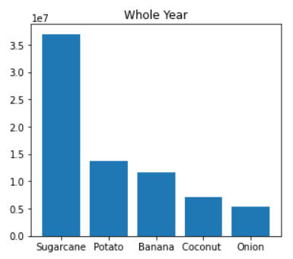
Descriptive Analytics
Sugarcane, Potato, Banana, Coconut, Onion are the top 5 crops produced whole year

Slide 7
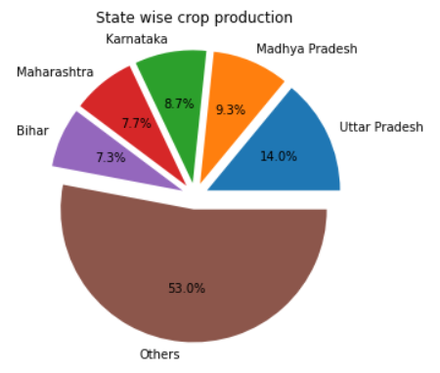
Descriptive Analytics
Uttar Pradesh is the state which had highest share of production

Slide 8
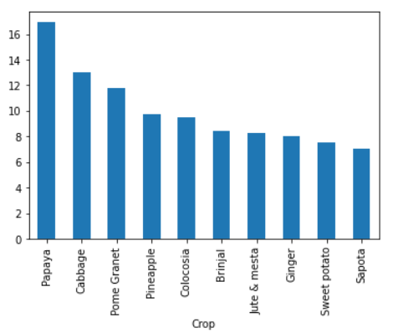
Descriptive Analytics
Productivity of crops
These are the crops that give good production for less area of crop

Slide 9
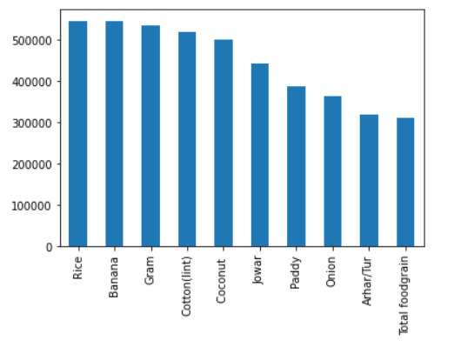
Predictive Analytics
Using ARIMA, the forecast of each crop are calculated. The bar plot shows top 10 crops that showed high production for next 5 years.

Slide 10
Predictive Analytics
A Random Forest Regressor with 100 estimates is built to predict Production of a crop given the location (State name, District name) and Area of Production

Slide 11
Findings and Insights
Some crops give good yield through out the year, while some are only season specific.
Some crops are grown region specific
Production of crops are not specific to any region in India, crops grow across all regions of India

Slide 12
Interpretation and Business Recommendations
Using the ML model, we can predict the Production of a crop given its place and area.
Using the forecast of crops we can know if certain crop is profitable in the future or not.
Using the productivity of crop, we can know which crop gives more production for a given amount of area.

Slide 13
Codes & Data Files
https://github.com/vlsruthwik/Crop_Production_Analysis

Slide 14
Thank You
ruthwik.20bci7030@vitap.ac.in
shiva.19bce7778@vitap.ac.in

