Slide 1
PHASE 6 — CUSTOMER SEGMENTATION
5 Personas that Drive CRM Strategy
From rules-based RFM to ML-discovered personas, with named campaigns per segment.
Customer Segmentation & CRM Intelligence Platform · UCI Online Retail (Dec 2010 – Dec 2011)

Slide 2
EXECUTIVE SUMMARY
2 / 13
Three things to take away
1.
VIP B2B Accounts ARE the business.
689 customers (16% of base) drive 60% of revenue. Defending them is the single highest-leverage CRM action.
2.
Engaged New Buyers are the pipeline.
1,140 customers in the 30-day post-purchase window. Phase 4 H3 finding: fast 2nd-buyers have 11.9× the CLV of one-timers.
3.
Dormant Former Buyers are not worth chasing.
803 customers · 1.4% of revenue. Suppress, do not over-invest. Redirect budget to VIP retention.
Customer Segmentation & CRM Intelligence Platform · Phase 6

Slide 3
METHODOLOGY AT A GLANCE
3 / 13
How we built the 5 personas
Input
4,338 customers · log-transformed RFM + basket + tenure features
Algorithm
K-means clustering on standardized features
K selection
K=5 chosen for interpretability (silhouette 0.28 · PCA explains 84% of variance)
Validation
Cross-tabulated ML personas vs. Phase 5 RFM segments — strong convergence at top tier
Output
Persona label per customer · per-persona playbook · CSV ready for Phase 7 AI Agent
Customer Segmentation & CRM Intelligence Platform · Phase 6

Slide 4
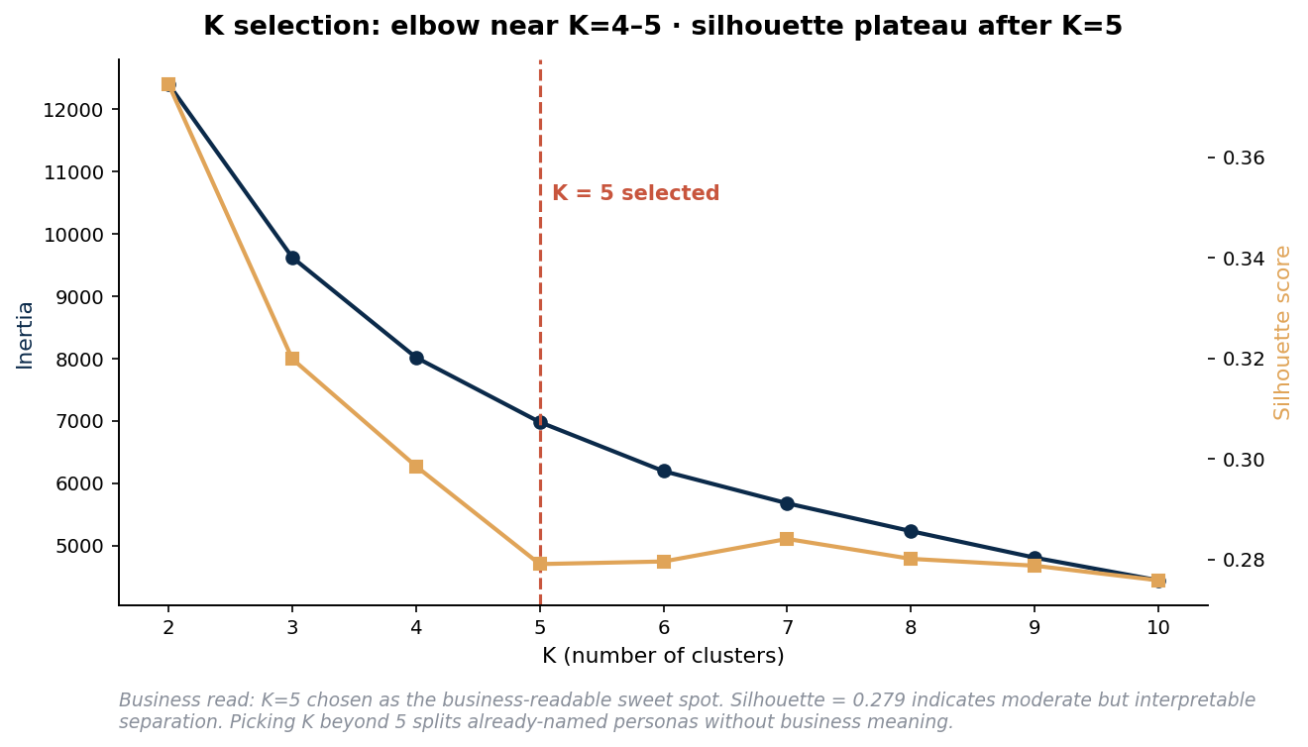
WHY K = 5
4 / 13
Elbow + Silhouette diagnostics
K=5 is the business sweet spot
• K=2 highest silhouette → useless
collapses VIPs into a 'high-value blob'
• K=5 sits near the elbow
with interpretable persona names
• K=8+ marginal silhouette gain
subdivides already-named personas
• Silhouette 0.28
moderate; overlapping behaviors expected in real customer data
Customer Segmentation & CRM Intelligence Platform · Phase 6

Slide 5
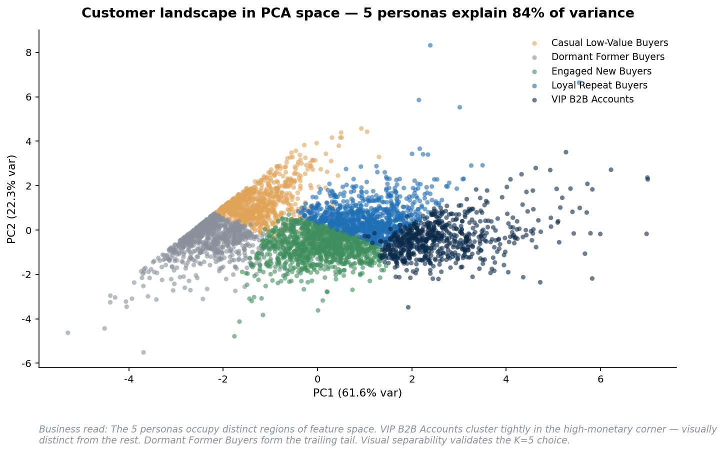
CUSTOMER LANDSCAPE — PCA VIEW
5 / 13
5 personas explain 84% of customer variance
VIP B2B Accounts occupy the high-monetary corner — visually distinct from the rest.
Customer Segmentation & CRM Intelligence Platform · Phase 6

Slide 6
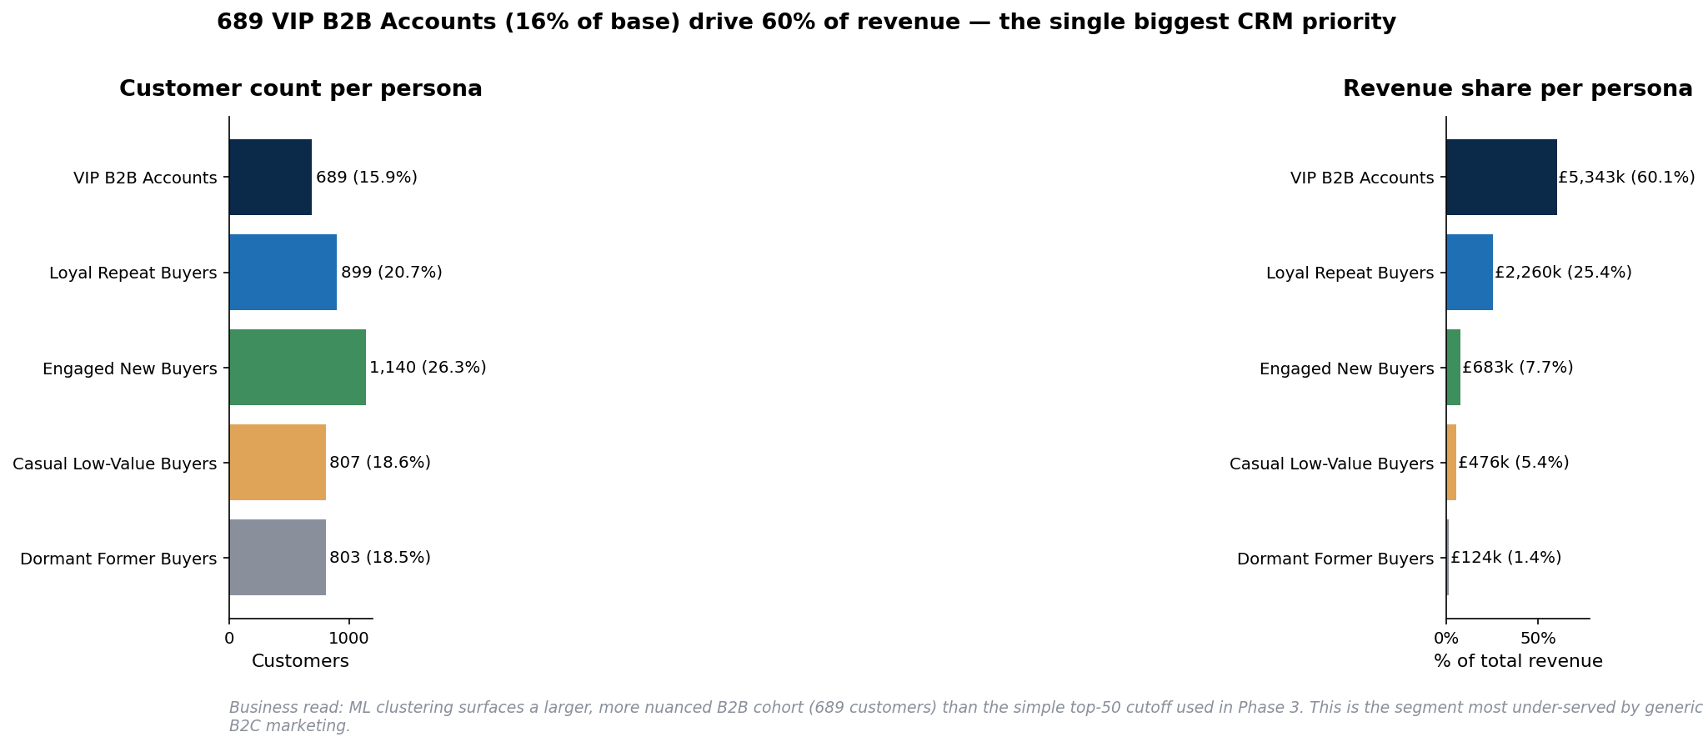
THE 5 PERSONAS — REVENUE MIX
6 / 13
Customer share is inverted from revenue share
689 VIP B2B Accounts (16% of base) drive 60% of revenue. Hibernating tail is large but cheap.
Customer Segmentation & CRM Intelligence Platform · Phase 6

Slide 7
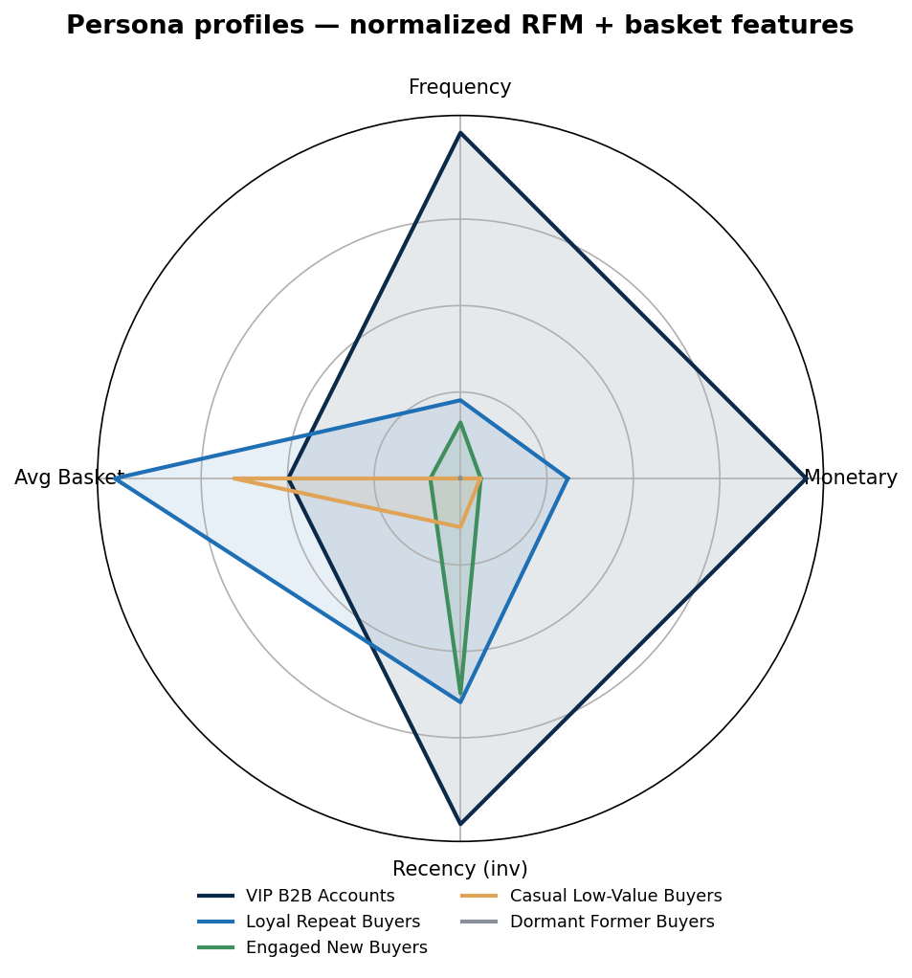
PERSONA FINGERPRINTS
7 / 13
Each persona has a distinct multi-dimensional signature
VIP B2B = high on EVERY dimension. Dormant = low on every. The radar makes them visually unmistakable.
Customer Segmentation & CRM Intelligence Platform · Phase 6

Slide 8
PERSONA 1 / 5 — VIP B2B ACCOUNTS
8 / 13
HIGHEST PRIORITY
VIP B2B Accounts
Customers
% of base
Revenue
% revenue
689
15.9%
£5,343k
60.1%
Named Campaign: Named Account Program
Channel: Direct human (AM) + personalized email · Budget: Highest per-customer spend
Why: Drives 60% of revenue from 16% of customers. Highest cost of loss per customer.
Actions:
• Assign account managers to top-50 within this cluster
• Custom pricing tier · early product access · quarterly business reviews
• Reorder workflows (B2B never want to re-enter the same order monthly)
• Suppress from generic email blasts — they get individualized comms
KPI: Account retention rate · revenue per account YoY

Slide 9
PERSONA 2 / 5 — LOYAL REPEAT BUYERS
9 / 13
GROWTH ENGINE
Loyal Repeat Buyers
Customers
% of base
Revenue
% revenue
899
20.7%
£2,260k
25.4%
Named Campaign: Tier-Up to VIP
Channel: Triggered email + retargeting + loyalty platform · Budget: High — promotion ROI is strong
Why: 25% of revenue from 21% of base. Natural promotion path to VIP.
Actions:
• Frequency-uplift campaigns (volume discounts, basket-builder offers)
• Loyalty tier program with VIP benefits at threshold
• Personalized product recommendations based on category affinity
• Cross-sell adjacent categories to grow basket size
KPI: Tier-migration rate to VIP · avg basket value · NPS

Slide 10
PERSONA 3 / 5 — ENGAGED NEW BUYERS
10 / 13
PIPELINE
Engaged New Buyers
Customers
% of base
Revenue
% revenue
1,140
26.3%
£683k
7.7%
Named Campaign: 30-Day Nurture (H3 — 11.9× CLV multiplier)
Channel: Automated lifecycle email + onboarding · Budget: Medium per-customer · highest aggregate ROI lever
Why: Phase 4 finding: fast 2nd-buyers have 11.9× the CLV of one-time buyers. This is the pipeline.
Actions:
• Welcome series within 24 hours of first purchase
• Day-25 second-purchase trigger email (lands BEFORE natural 73-day cadence)
• Product education content for category breadth
• Light incentive on 2nd order to reduce friction
KPI: 2nd-purchase rate within 30 days · cohort retention at month 3

Slide 11
PERSONA 4 / 5 — CASUAL LOW-VALUE BUYERS
11 / 13
MAINTAIN
Casual Low-Value Buyers
Customers
% of base
Revenue
% revenue
807
18.6%
£476k
5.4%
Named Campaign: Quarterly Reactivation Promo
Channel: Bulk email · light retargeting · Budget: Low-medium · per-customer spend should be modest
Why: 5% of revenue from 19% of base. Not zero-value, but not the priority.
Actions:
• Quarterly seasonal promo email (avoid over-frequency)
• Light retargeting around peak shopping windows
• Reactivation offer at 90-day dormancy
• Do NOT pull into VIP campaigns — economics don't justify
KPI: Reactivation rate · cost per reactivated customer

Slide 12
PERSONA 5 / 5 — DORMANT FORMER BUYERS
12 / 13
SUPPRESS
Dormant Former Buyers
Customers
% of base
Revenue
% revenue
803
18.5%
£124k
1.4%
Named Campaign: Annual Touch / Suppress
Channel: Bulk email — 1× per year max · Budget: Lowest — do not over-invest
Why: 803 customers · 1.4% of revenue · ~168 days dormant. Reactivation economics are unfavorable.
Actions:
• Annual reactivation campaign — that's it
• Suppress from all marketing-frequency campaigns
• Use as a control / lookalike-exclusion group for paid media
• Mark for permanent suppression if no response in 2 cycles
KPI: Cost per reactivation (expect to be unfavorable) · suppression list hygiene

Slide 13
Q1 BUDGET ALLOCATION RECOMMENDATION
13 / 13
Where the next-quarter CRM budget should go
Rank
Persona
Customers
% Revenue
Budget Tier
Q1 Action
🔴 1
VIP B2B Accounts
689
60%
Highest per-customer
Account-managed retention
🔴 2
Engaged New Buyers
1,140
7.7%
Medium per-customer · highest aggregate ROI
30-day nurture (H3)
🟡 3
Loyal Repeat Buyers
899
25.4%
High
Tier-up campaigns
🟡 4
Casual Low-Value Buyers
807
5.4%
Low-medium
Quarterly seasonal promo
⚪ 5
Dormant Former Buyers
803
1.4%
Lowest
Annual touch · suppress otherwise
The principle: budget follows revenue concentration AND lifecycle leverage — not customer-count parity.
Next phase: An AI Marketing Agent that operationalizes these personas — auto-generating per-segment alerts, executive summaries, and campaign briefs from live RFM signals.
Customer Segmentation & CRM Intelligence Platform · Phase 6

