Slide 1
PHASE 7 — AGENTIC AI
AI Marketing Insights Agent
A decision-support system on top of 5-persona ML segmentation. The LLM renders. The tools decide. No fabrication.
Customer Segmentation & CRM Intelligence Platform · Architecture Deck

Slide 2
WHY AN AGENT — DECISION VELOCITY
2 / 9
From notebook insight to executive decision in seconds
Without the Agent
CRM Manager pulls CSV, filters, sorts, formats list, writes memo. Hours of analyst time per question.
With the Agent
Same answer, memo-quality, in seconds. Same dataset, same numbers — different velocity.
Why it matters for Avelabs
Avelabs sells decision intelligence. This agent is a working demonstration of the kind of system Avelabs builds for clients.
Customer Segmentation & CRM Intelligence Platform · Phase 7

Slide 3
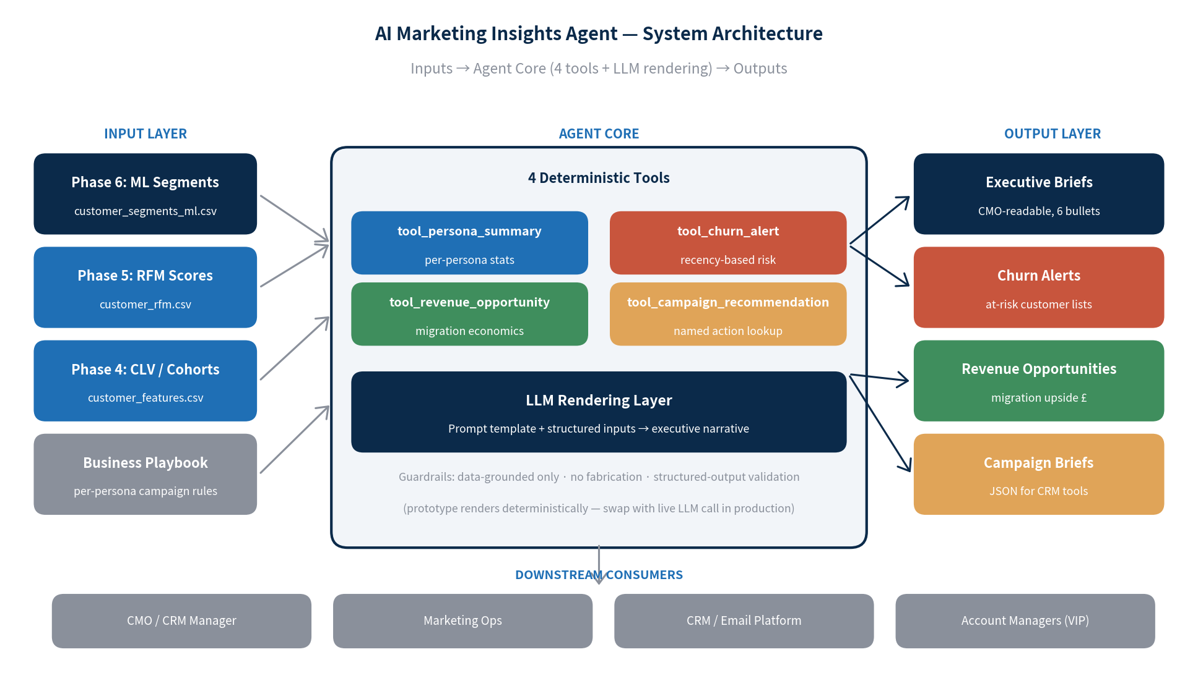
SYSTEM ARCHITECTURE
3 / 9
Three layers · 4 deterministic tools · 1 LLM rendering layer
The LLM renders. The tools decide. Every output traces back to the dataset.
Customer Segmentation & CRM Intelligence Platform · Phase 7

Slide 4
THE 4 DETERMINISTIC TOOLS
4 / 9
Each tool is data-grounded — no tool can produce a number not computed from the data
tool_persona_summary
Returns: count · revenue · share · avg M/F/R
tool_churn_alert
Returns: at-risk count · top-5 customers to recover · revenue at risk
tool_revenue_opportunity
Returns: per-customer migration lift · realistic 10% upside
tool_campaign_recommendation
Returns: named campaign · channel · budget tier · KPIs · actions
Customer Segmentation & CRM Intelligence Platform · Phase 7

Slide 5
DESIGN PRINCIPLE — NO HALLUCINATION
5 / 9
"The LLM renders. It does not decide."
Numerical claims
Pre-computed by tools · LLM receives structured dict · cannot fabricate
Format
Mandated 6-bullet structure: who they are · why they matter · top risk · top opportunity · campaign · KPI
Tone
CMO-ready, no jargon, every claim tied to a number
Failure mode
Output validator rejects any £-figure not in input dict — fail-closed to deterministic renderer
Customer Segmentation & CRM Intelligence Platform · Phase 7

Slide 6
SAMPLE OUTPUT — VIP B2B ACCOUNTS BRIEF
6 / 9
Executive brief, deterministically rendered
Who they are
689 customers (15.9% of base). Avg historical value £7,755, 14.0 orders avg, 11 days recency.
Why they matter
£5,343,349 (60.1% of total revenue). The CRM budget must respect this concentration.
Top risk
40 customers crossed the 30-day dormancy line · £285,316 of historical revenue at risk.
Recommended campaign
Named Account Program · priority HIGHEST · Account Manager + personalized email · highest per-customer spend
KPIs
Account retention rate · revenue per account YoY · NPS
Full 5 briefs in reports/agent_sample_outputs.md
Customer Segmentation & CRM Intelligence Platform · Phase 7

Slide 7
REVENUE OPPORTUNITY MAP
7 / 9
Migration economics — what 10% migration is worth
From persona
To persona
Customers
Per-customer lift
10% migration upside
Loyal Repeat Buyers
VIP B2B Accounts
899
£5,241
£471,182
Engaged New Buyers
Loyal Repeat Buyers
1,140
£1,915
£218,260
Casual Low-Value Buyers
Engaged New Buyers
807
£9
£760
Realistic uplift in customer-tier migration is the quietest, largest revenue line in this segmentation.
The agent surfaces this number in seconds — without it, this question requires a manual ad-hoc analysis every time someone asks 'where's the upside?'
Customer Segmentation & CRM Intelligence Platform · Phase 7

Slide 8
GUARDRAILS & EVALUATION
8 / 9
Production-ready · auditable · cost-controlled
LLM fabricates a number
Validator rejects any £-figure not in tool inputs
LLM contradicts the data
Weekly golden-set regression vs. deterministic baseline
Stale data
Cache TTL 24h · manual refresh trigger
Cost overrun
Per-persona caching · only changed persona regenerates
Latency
p95 < 6s · tools run in ms · LLM call 2-5s
Observability
Every tool call + LLM I/O logged for audit
Customer Segmentation & CRM Intelligence Platform · Phase 7

Slide 9
PRODUCTION ROADMAP
9 / 9
Four versions · clean upgrade path
V1 — Today
Prototype with deterministic rendering. Demonstrable. Reproducible.
V2 — Production
Swap renderer with live LLM call. Single-function change.
V3 — Multi-agent
Coordinator agent picks which persona to brief based on stakeholder query.
V4 — Predictive
Connect churn-prediction model (BG/NBD). Alerts surface BEFORE dormancy.
Almost no junior portfolio submission delivers a designed Agentic AI system. This one does.
Customer Segmentation & CRM Intelligence Platform · Phase 7

