Slide 1

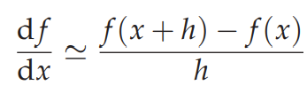
Computational Physics (PHYS6350)
Lecture 8: Numerical Derivatives
Finite differences
Automatic differentiation
February 18, 2025
Instructor: Volodymyr Vovchenko (vvovchenko@uh.edu)
Course materials: https://github.com/vlvovch/PHYS6350-ComputationalPhysics/tree/spring2025

Slide 2
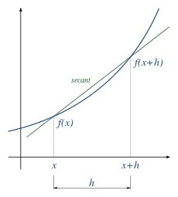
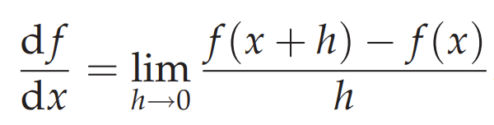
Numerical differentiation
Generic problem: evaluate
We need numerical differentiation when
Function f is known at a discrete set of points
Too expensive/cumbersome to do directly
For example, when f(x) itself is a solution to a complex system of non-linear equations, calculating f’(x) explicitly will require rewriting all the equations
References:
Chapter 5 of Computational Physics by Mark Newman
https://autodiff.github.io/

Slide 3
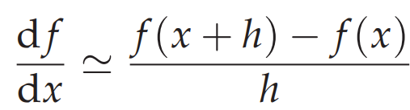
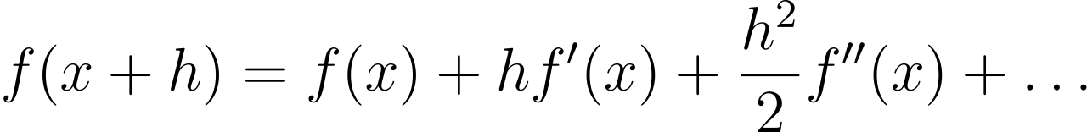
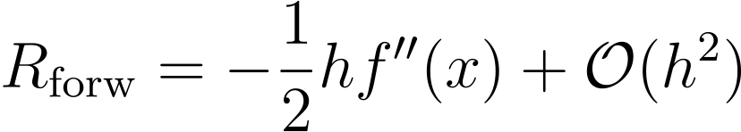
Forward difference
Simply approximate
by
where h is finite
Taylor theorem:
gives the approximation error estimate of

Slide 4
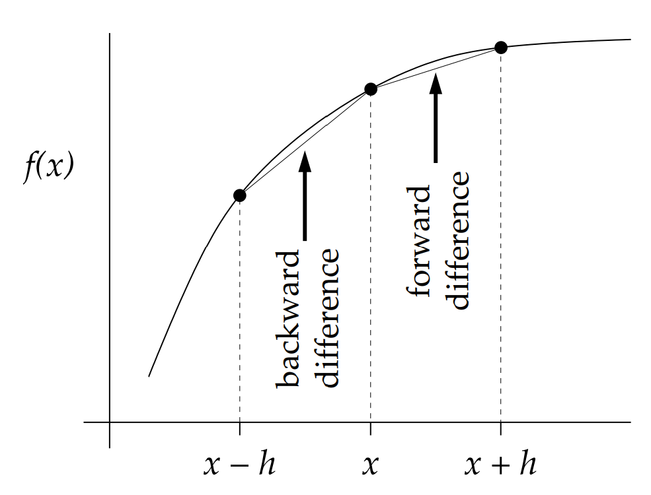
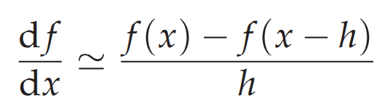
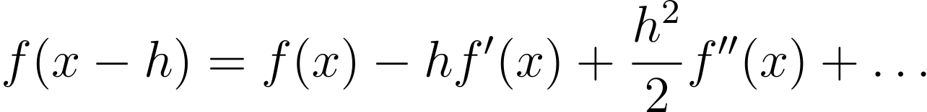
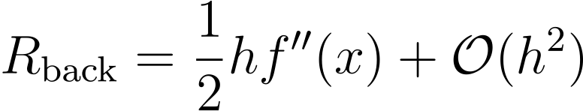
Backward difference
Backward difference
Taylor theorem:
gives the approximation error estimate of

Slide 5
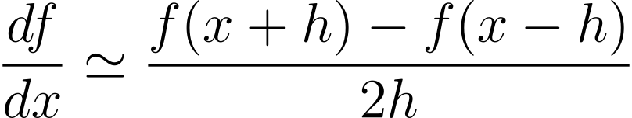
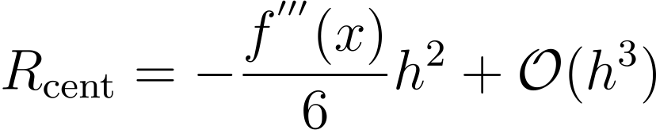
Central difference
Recall the forward and backward difference and their errors
Taking the average of the two cancels out the O(h) error term
central difference
Error:

Slide 6
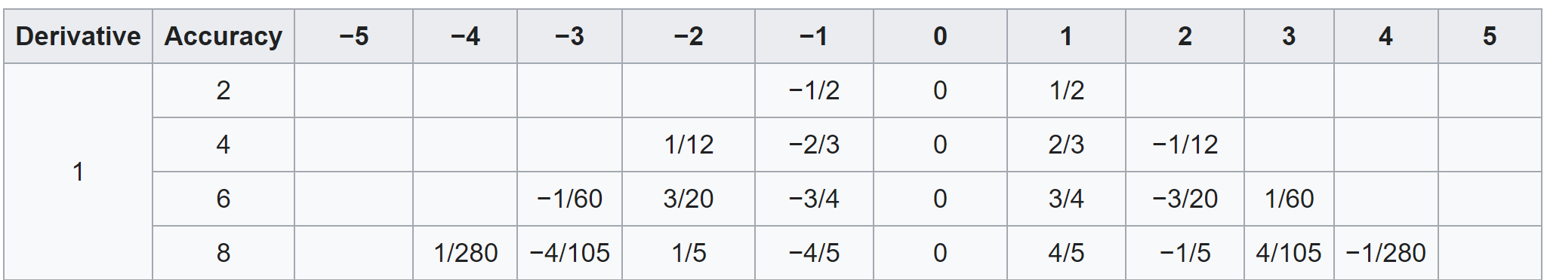
High-order central difference
To improve the approximation error, use more function evaluations, e.g.
Determine A,B,C,D,E using Taylor expansion to cancel all terms up to h⁴
High-order terms:

Slide 7
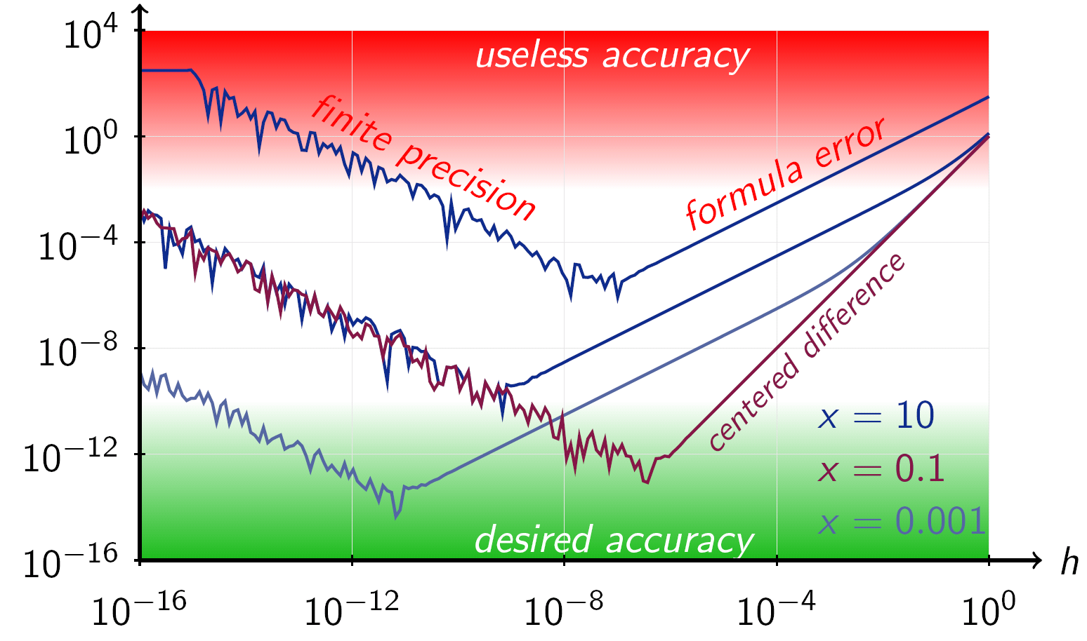
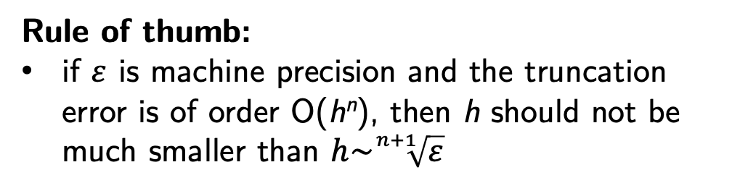
Balancing truncation and round-off errors
If h is too small, round-off errors become important
cannot distinguish x+h and x and/or f(x+h) and f(x) with enough accuracy
Rule of thumb:
if $ε$ is machine precision and the truncation error is of order O(h^{n}), then h should not be much smaller than $h\sim \sqrt[n+1]{ε}$
Credit: Wikipedia
The higher the finite difference order is, the larger h should be

Slide 8

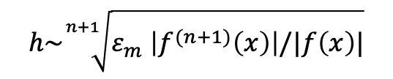


Balancing truncation and round-off errors
Consider central difference:
Total error:
$ε_{m}$ - relative error in f(x)
error(df/dx) = $ε_{m}\frac{|f\left(x\right)|}{h} + \frac{|f^{′′′}\left(x\right)|}{6}h^{2}$
$$ε_{m} \sim {10}^{−16}$$
round-off
truncation
Best case: machine precision
Minimizing with respect to h gives optimal choice for the step size:
$$h=\sqrt[3]{6 ε_{m}\left|f^{′′′}\left(x\right)\right|/|f\left(x\right)|} \sim \sqrt[3]{ε_{m} \left|f^{′′′}\left(x\right)\right|/|f\left(x\right)|}$$
More generally, for O(h^{n}) scheme one has
$$h\sim \sqrt[n+1]{ε_{m} \left|f^{(n+1)}\left(x\right)\right|/|f\left(x\right)|}$$

Slide 9
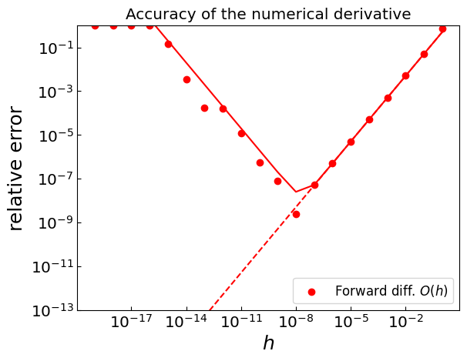
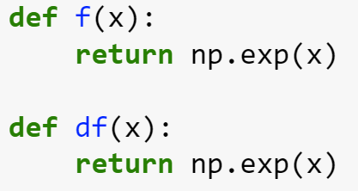

Balancing truncation and round-off errors
Let f(x) = exp(x)
Calculate the derivatives at x = 0
Forward difference O(h):
Optimal $h\sim \sqrt[2]{{10}^{−16}}\sim {10}^{−8}$

Slide 10
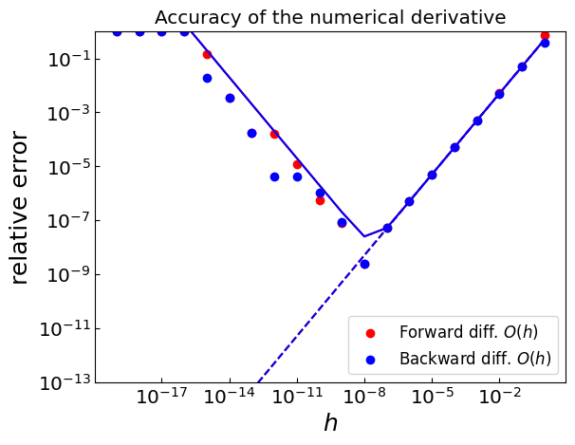
Balancing truncation and round-off errors
Let f(x) = exp(x)
Calculate the derivatives at x = 0
Backward difference O(h):
Optimal $h\sim \sqrt[2]{{10}^{−16}}\sim {10}^{−8}$

Slide 11
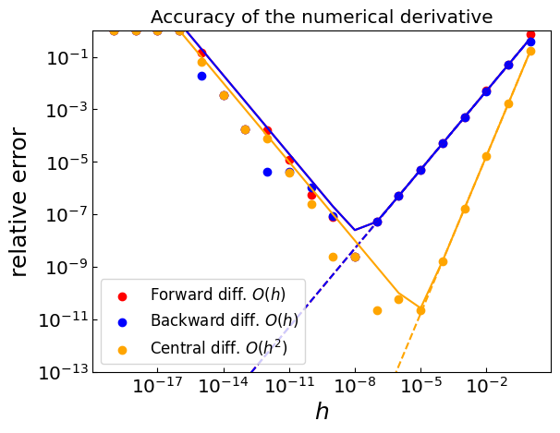

Balancing truncation and round-off errors
Let f(x) = exp(x)
Calculate the derivatives at x = 0
Central difference O(h²):
Optimal $h\sim \sqrt[3]{{10}^{−16}}\sim {10}^{−5}$

Slide 12

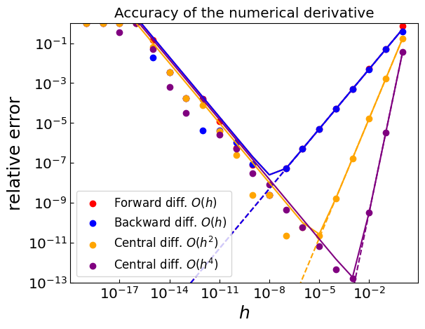
Balancing truncation and round-off errors
Let f(x) = exp(x)
Calculate the derivatives at x = 0
Central difference O(h⁴):
Optimal $h\sim \sqrt[5]{{10}^{−16}}\sim {10}^{−3}$

Slide 13
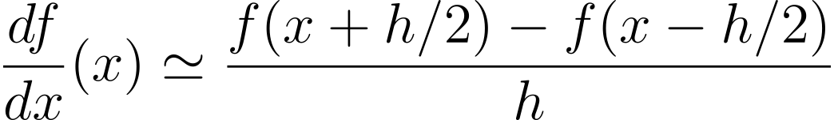
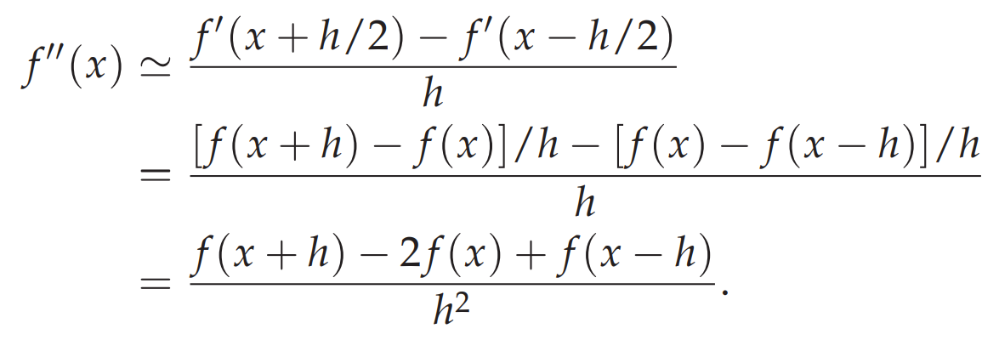
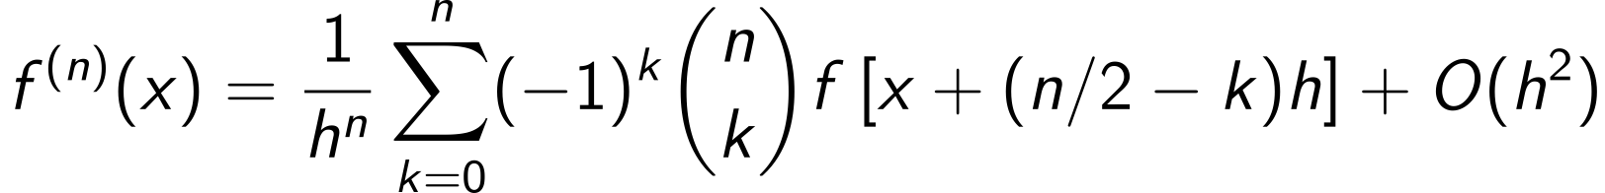
High-order derivatives
Central difference
Now apply the central difference again to f’(x+h/2) and f’(x-h/2)
General formula [to order O(h²)]

Slide 14

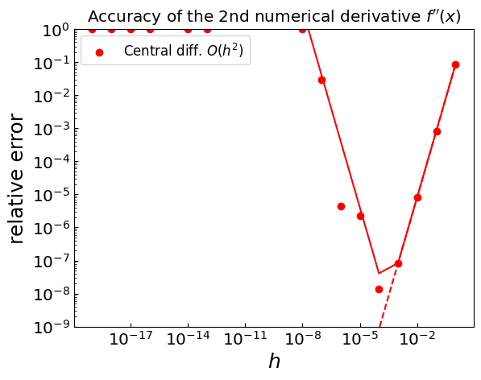
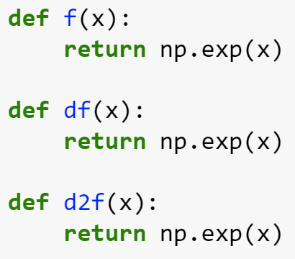

Second derivative
f(x) = exp(x)
Optimal $h\sim \sqrt[4]{{10}^{−16}}\sim {10}^{−4}$

Slide 15
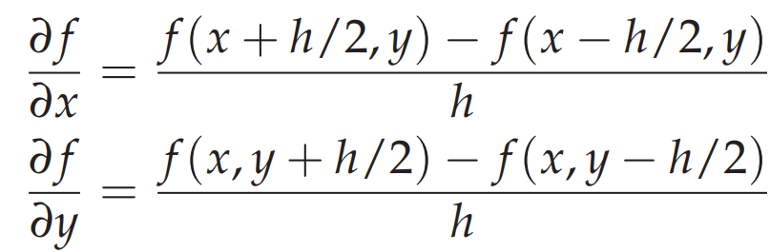

Partial derivatives
Let us have a function of two variables: f(x,y)
Use central difference to calculate first-order derivatives
Reapply the central difference to calculate

Slide 16
Finite differences: Summary
Forward/backward differences
Useful when we are given a grid of function values
Need f’(x) at the same point as x
Have limited accuracy (error is linear in h)
Central difference
More precise than forward/backward differences (error is quadratic in h)
Gives f’(x) estimate at the midpoint of function evaluation points
Higher-order formulas are obtained by using more than two function evaluations
Can be used when limited number of function evaluations available
Straightforwardly extendable to high-order and partial derivatives
Balance between truncation and round-off error must be respected
h should not be taken too small

Slide 17

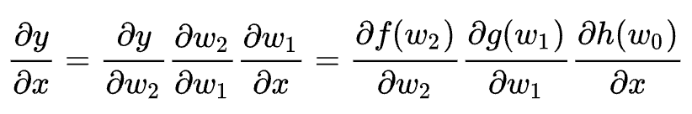
Automatic differentiation
Automatic differentiation (or algorithmic differentiation) is a computational technique to evaluate derivatives of a function specified by a computer program
It is based on the fact that every computer calculation executes a sequence of
Elementary arithmetic operations (+,-,*,/)
Elementary functions (exp, log, sin, …)
Calculation of the derivatives then proceeds via the chain rule
View computer calculation as evaluating a composite function:
Numerical value:
Derivative (gradient):
Resulting calculating is in theory exact

Slide 18

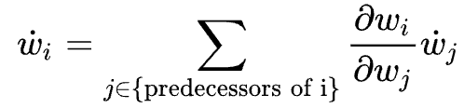








Automatic differentiation: Example
Numerical value
Derivative (gradient)
Keep track not only of intermediate function values $w_{i}$ but also of gradients ${\dot{w}}_{i}=∂w_{i}/∂x$
Step 0:
$$w_{0}=x$$
$${\dot{w}}_{0}=1$$
Step 1:
$$w_{1}=h(w_{0})$$
$${\dot{w}}_{1}=h^{′}\left(w_{0}\right)∗{\dot{w}}_{0}$$
Step 2:
$$w_{2}=g(w_{1})$$
$${\dot{w}}_{2}=g^{′}\left(w_{1}\right)∗{\dot{w}}_{1}$$
Step 3:
$$w_{3}=f\left(w_{2}\right)=y$$
$${\dot{w}}_{3}=f^{′}\left(w_{2}\right)∗{\dot{w}}_{2}=dy/dx$$
$w_{i}$ can be a function of multiple predecessors $w_{j}:$

Slide 19
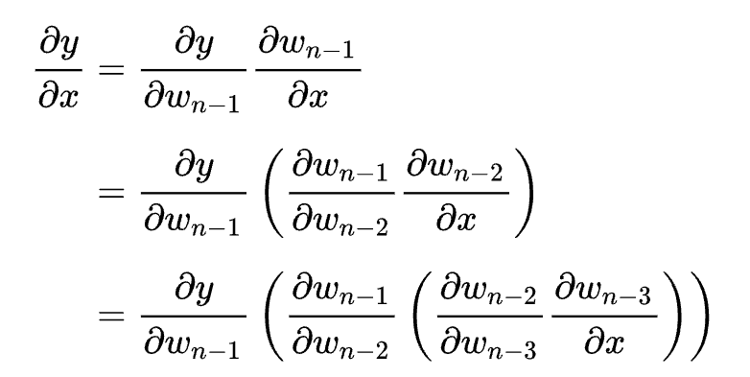
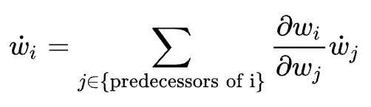

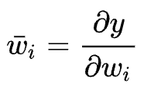
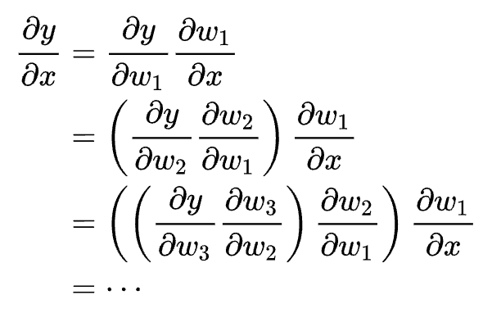
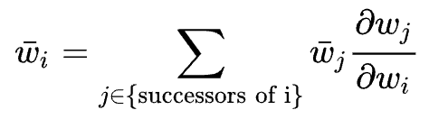


Automatic differentiation: Forward and backward
Forward accumulation:
$$w_{0}=x$$
$${\dot{w}}_{0}=1$$
Good for computing derivatives of many functions with respect to single variable
Reverse (adjoint) accumulation:
Good for computing derivatives of a single function with respect to many variables (neural networks)

Slide 20
Automatic differentiation: Implementation
Implementing automatic differentiation proceeds by replacing real numbers by dual numbers (value + derivative) and implementing dual number algebra
Python:
JAX: https://docs.jax.dev/
MyGrad: https://mygrad.readthedocs.io/en/latest/
TensorFlow, PyTorch, …
C++:
autodiff: https://autodiff.github.io/
xad: https://auto-differentiation.github.io/
…

Slide 21


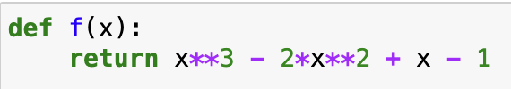
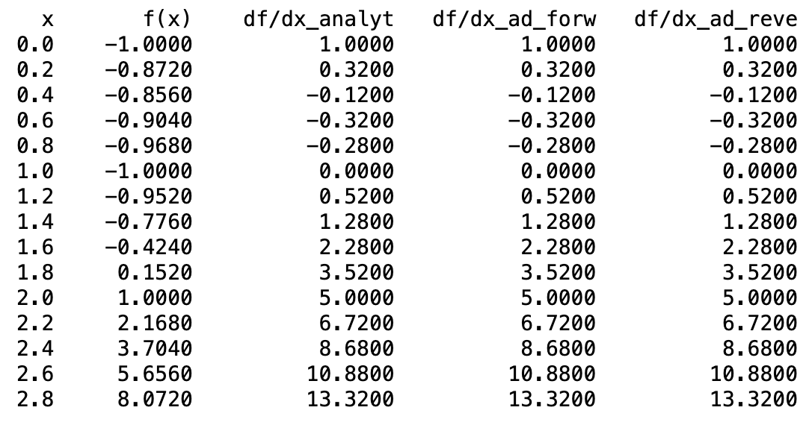
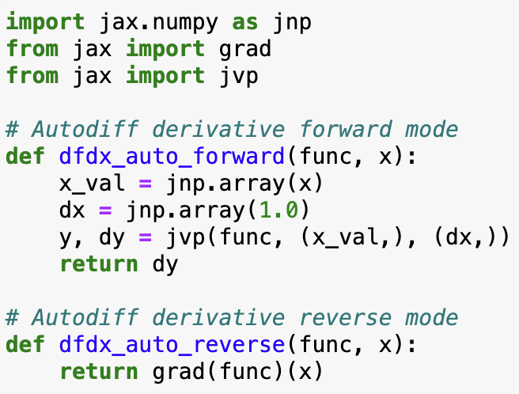
Automatic differentiation: Example
analytic
forward AD
reverse AD

Slide 22
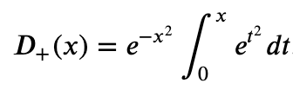
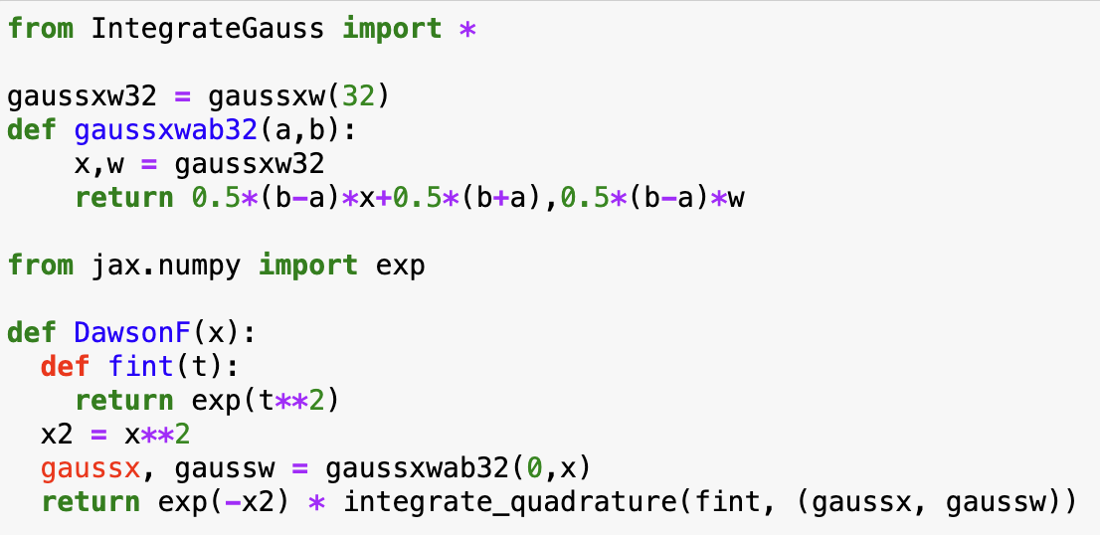
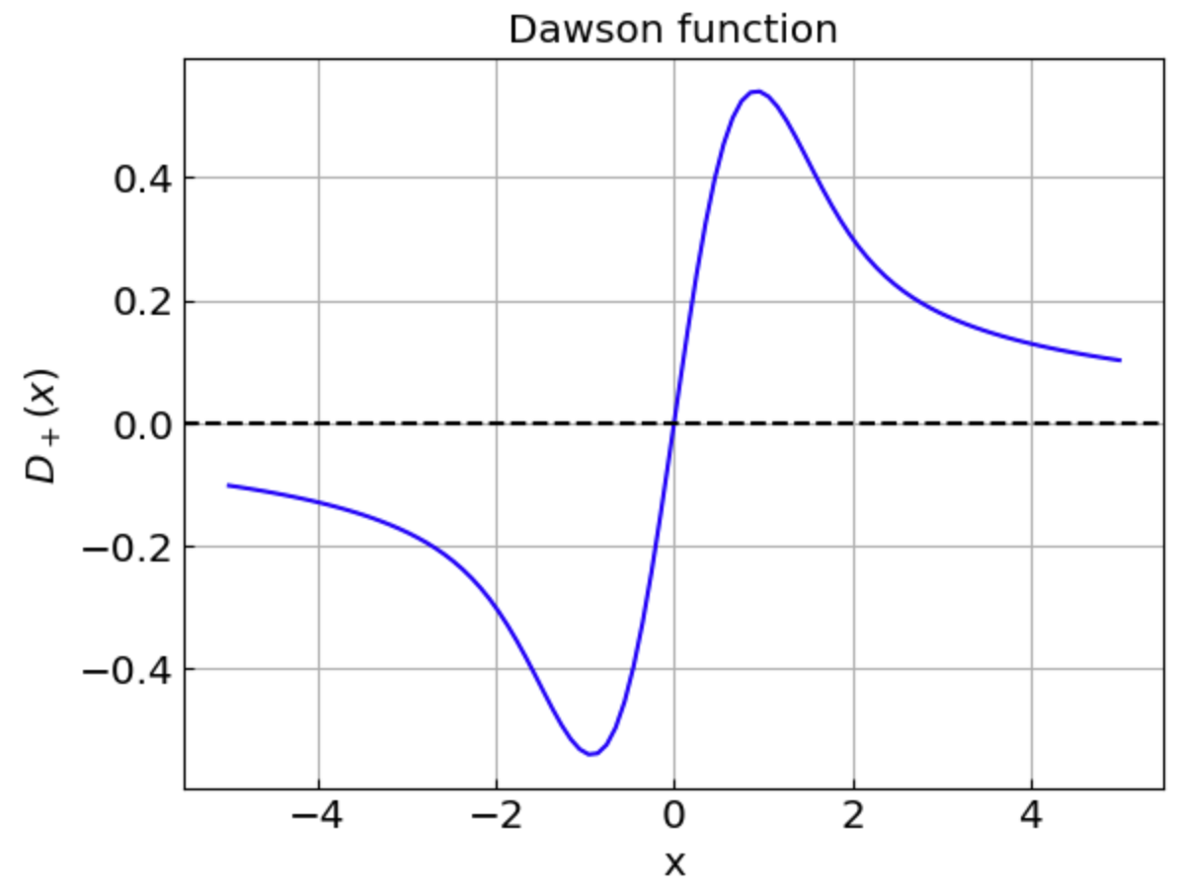
Automatic differentiation: A more involved example
Consider Dawson function
Compute using Gaussian quadrature

Slide 23
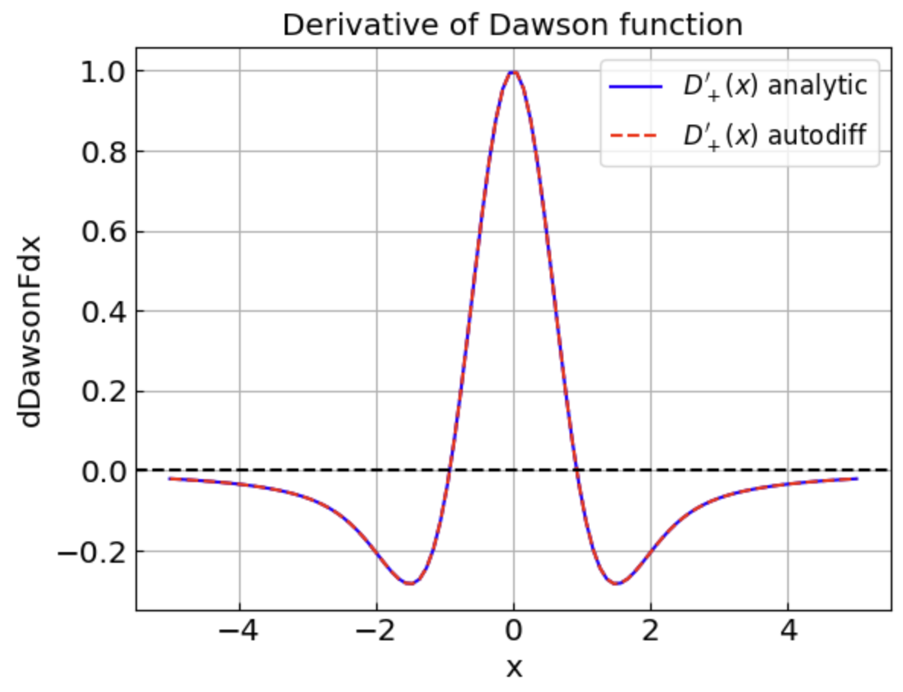
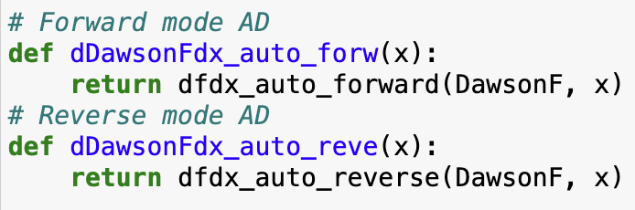

Automatic differentiation: A more involved example
Compute derivative with AD
Compare with the expected result
We combined numerical integration and automatic differentiation!

Slide 24
Automatic differentiation: Summary
Advantages:
In theory exact calculation limited only by machine precision and by accuracy of the function calculation itself
Efficient, often requiring comparable number of operations relative to the original calculation
Works for implicit functions (such as those computed through Newton-Raphson method)
Can be extended to high-order derivatives (gradient of a gradient)
Disadvantages:
Requires adjustments to the existing code
Can yield unexpected behavior for functions with noise of discontinuities
Does not work well in the presence of branching [e.g. if bisection or golden section search is used to compute f(x)]

Slide 25
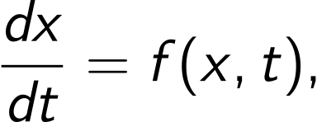

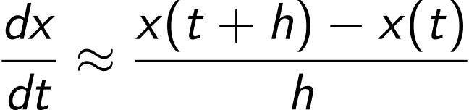
Numerical derivative and ordinary differential equations
Ordinary differential equation
with initial condition
Use the forward difference to approximate dx/dt
gives the Euler method of solving the equation for x(t)

