Slide 1

Computational Physics @ NuSTEAM
Lecture 3
Non-linear equations
Random numbers
June 13, 2025
Instructor: Volodymyr Vovchenko (vvovchenko@uh.edu)
based on Computations Physics course at UH
GitHub: https://github.com/vlvovch/PHYS6350-ComputationalPhysics/tree/nusteam
Online textbook: https://vovchenko.net/computational-physics

Slide 2
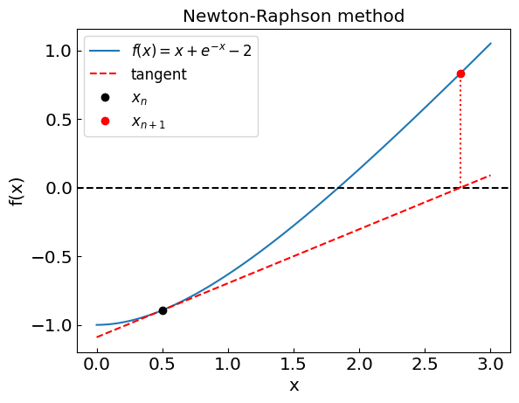
Non-linear equations
Jupyter Notebook: 3_NonlinearEquations_NuSTEAM.ipynb

Slide 3
Non-linear equations
Suppose we have an equation f(x) = 0
We can evaluate f(x), but we do not know how to solve it for x
Examples:
Roots of high-order polynomials
Transcendental equations
Implicit ODE/PDE methods

Slide 4
Root-finding techniques
Numerical root-finding method: iterative process to determine the root(s) of non-linear equation(s) to desired accuracy
Types:
Two-point (bracketing)
Bisection method
False position method (regula falsi)
Local
Secant method
Newton-Raphson method (using the derivative)
Relaxation method
Multi-dimensional
Newton method
Broyden method

Slide 5

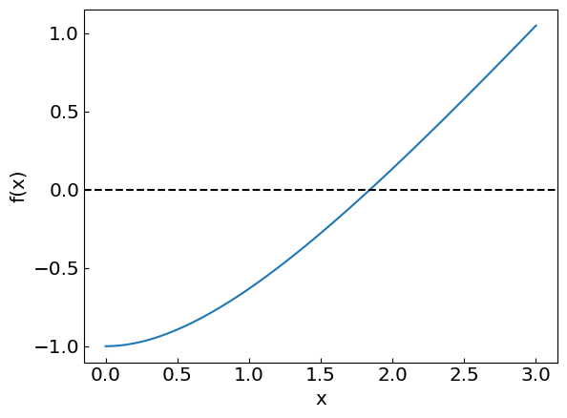
Non-linear equations
Consider an equation

Slide 6
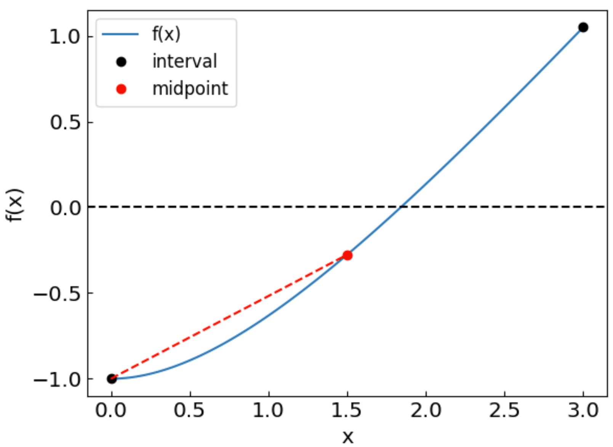
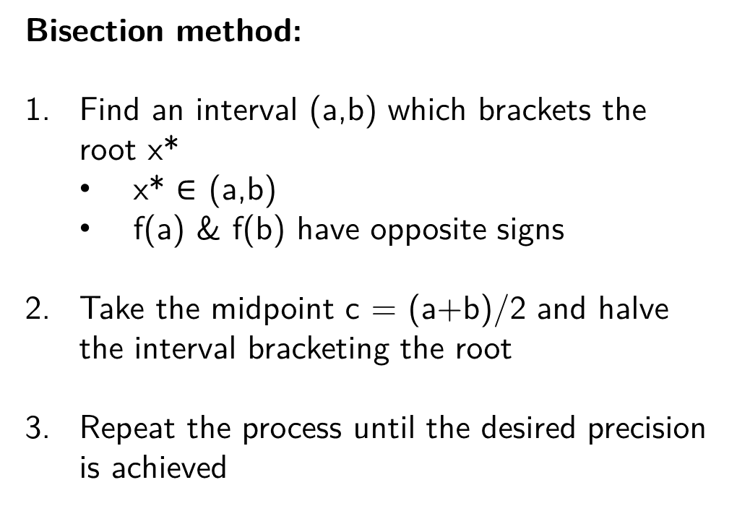
Bisection method
Bisection method:
Find an interval (a,b) which brackets the root x*
x* $∈$ (a,b)
f(a) & f(b) have opposite signs
Take the midpoint c = (a+b)/2 and halve the interval bracketing the root
Repeat the process until the desired precision is achieved
Method is guaranteed to converge to the root
The error is halved at each step – “linear” convergence

Slide 7
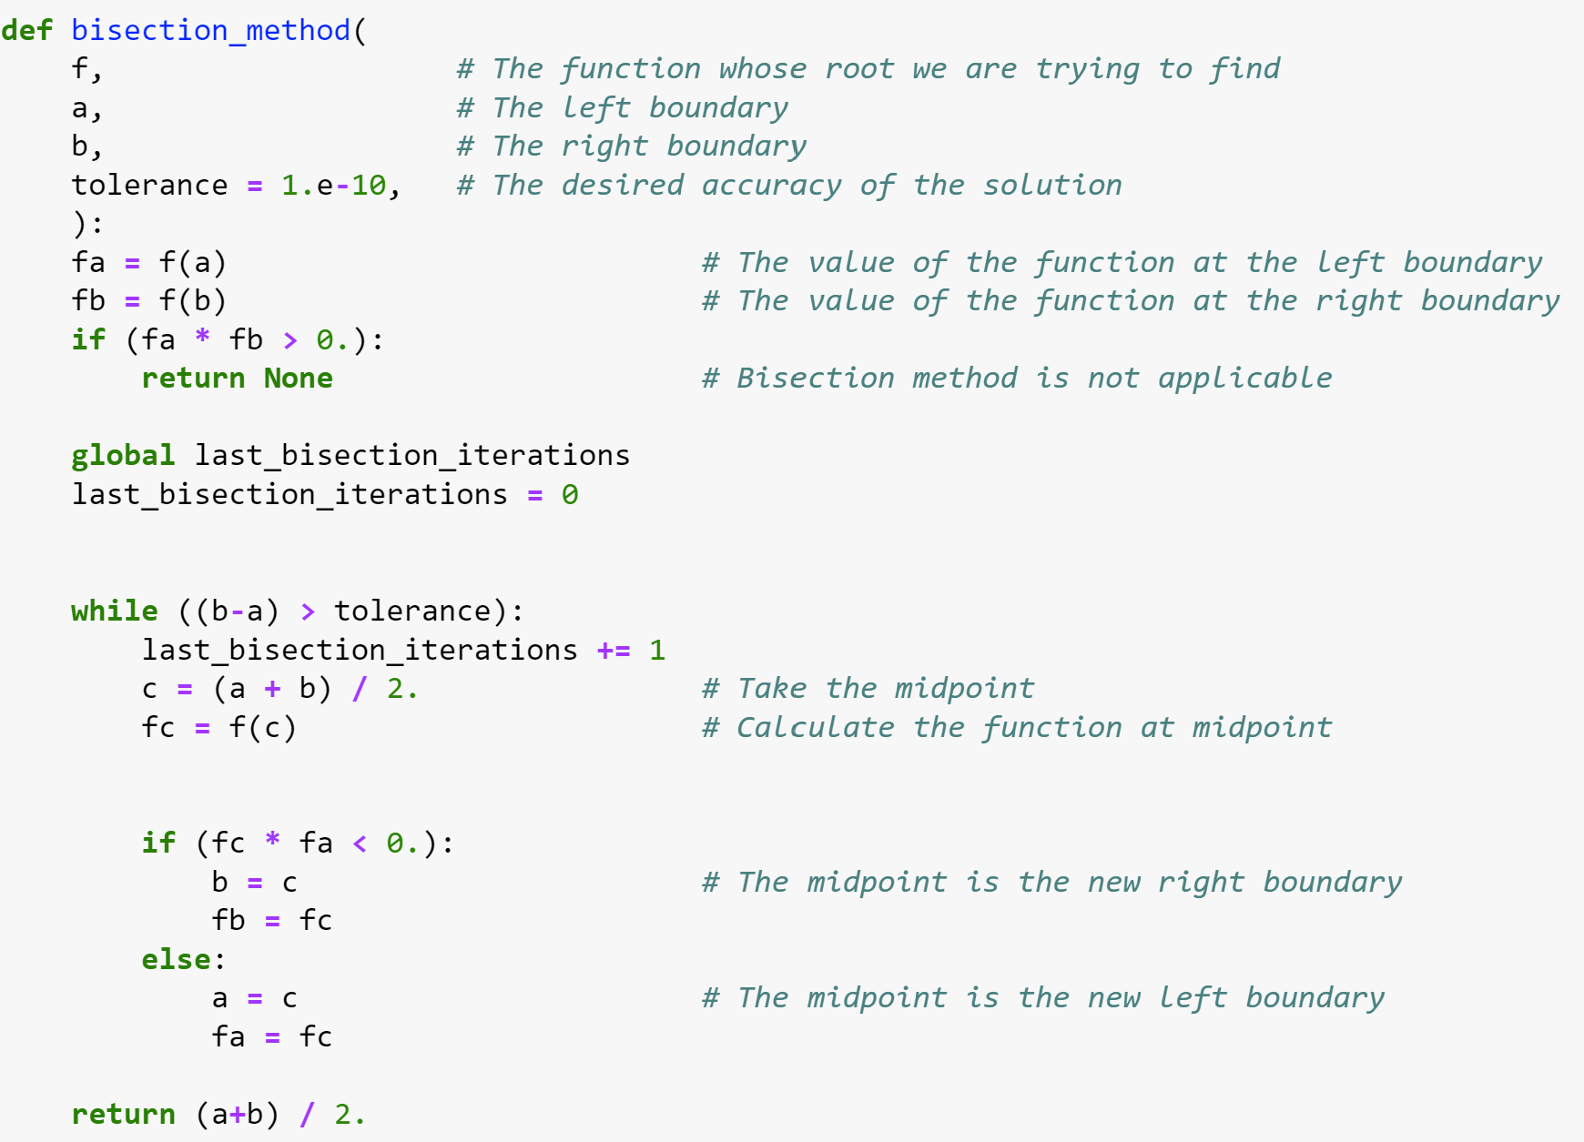
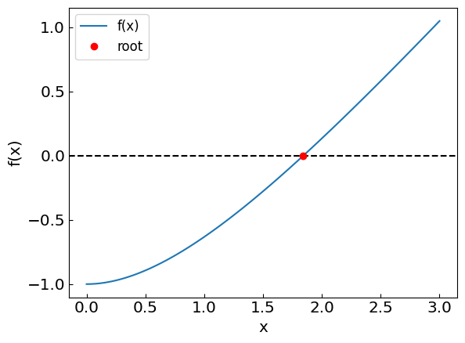
Bisection method

Slide 8
Bisection method: how the iterations look like

Slide 9

Bisection method: another example
Let us consider another equation:
35 iterations in both cases

Slide 10
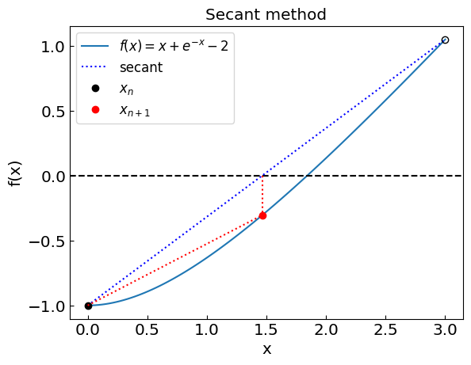
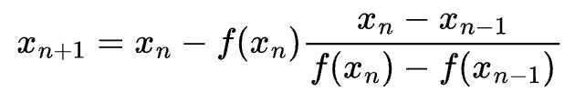
Secant method
Secant method:
Find an interval (x₀,x₁), the interval need not bracket the root
Instead of midpoint take a point where the straight line between the endpoints crosses the y = 0 axis
Repeat the process until the desired precision |x_{n+1}-x_{n}| < eps
Typically much faster convergence than bisection occurs when the algorithm is effective. However, it can still be slower than bisection or may not converge at all (e.g., the secant may be parallel to the x-axis).

Slide 11
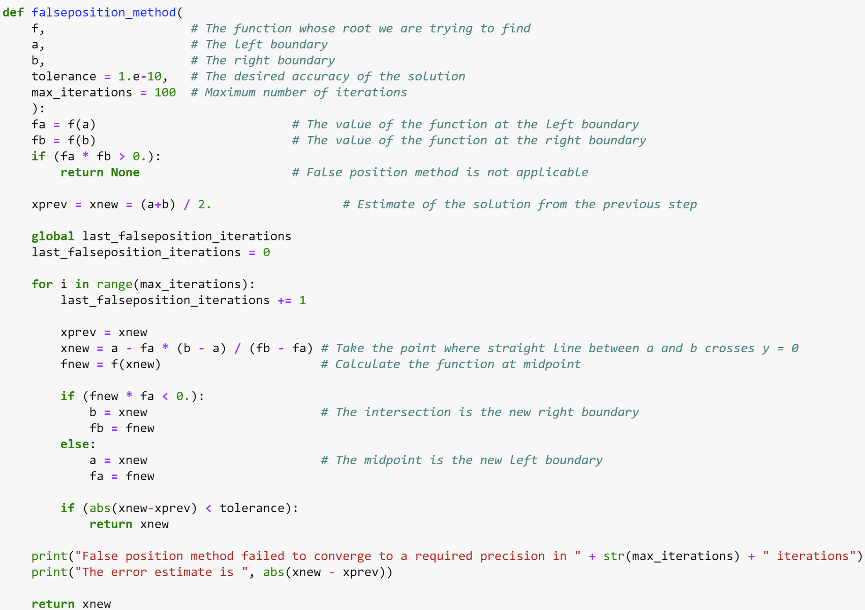
False position method

Slide 12
False position method

Slide 13
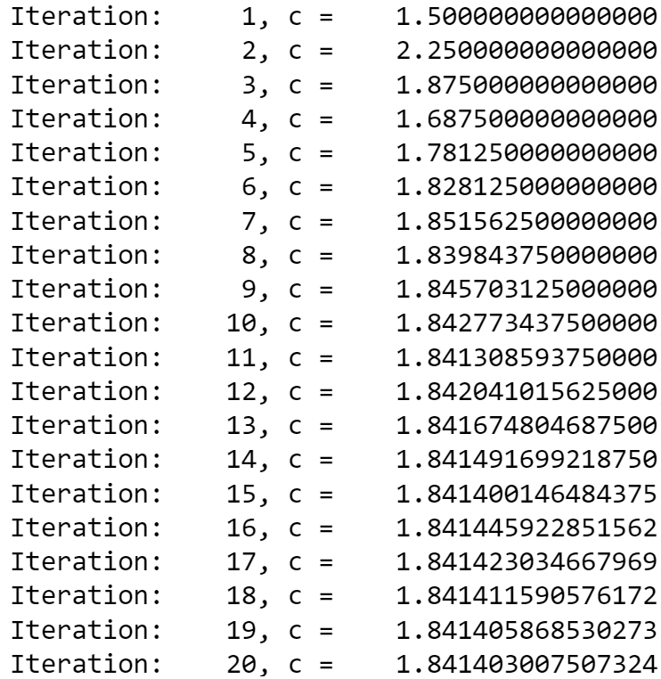
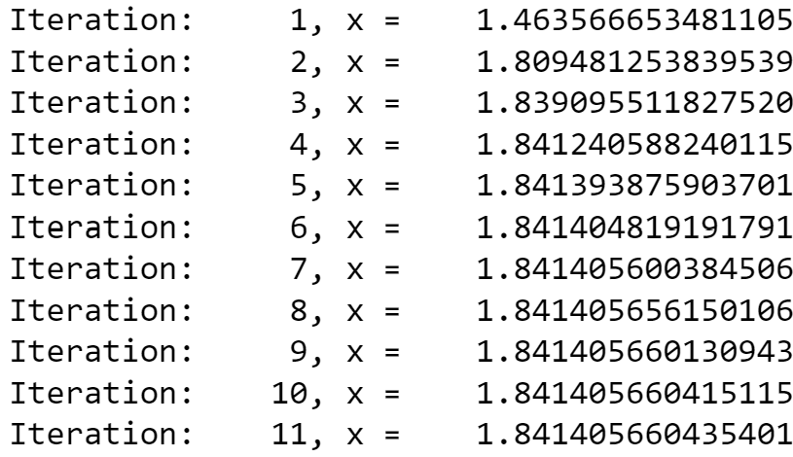
False position vs bisection (to 10 decimal digits)
Bisection method:
False position method:
…

Slide 14
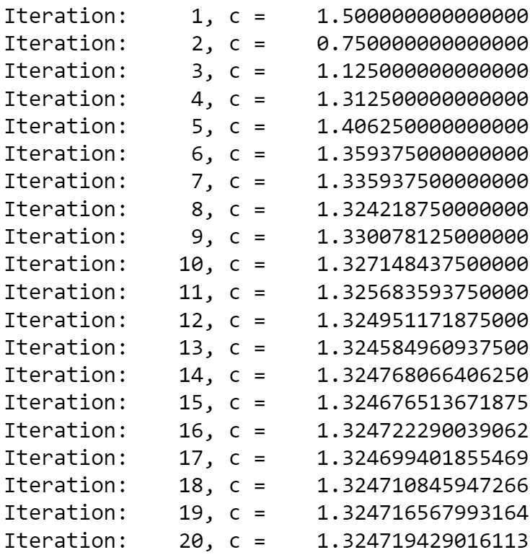
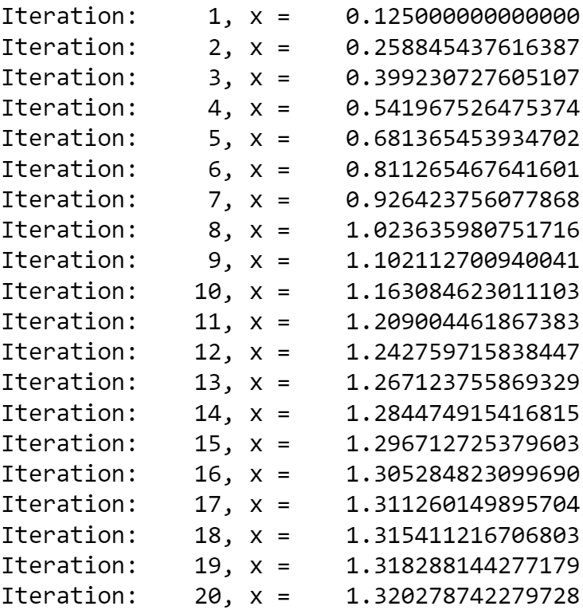
False position vs bisection: not always clear who wins
Bisection method:
False position method:
…
…

Slide 15
False position vs bisection: not always clear who wins
Bisection method:
False position method:
More advanced methods combine the two and add other refinements*
Ridders’ method
Brent method
see chapters 9.2, 9.3 of Numerical Recipes Third Edition by W.H. Press et al.

Slide 16
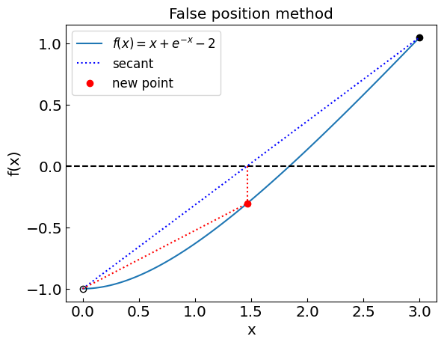
Secant method
Secant method: similar to false position, but the interval need not bracket the root
Always uses the last two points
vs
Typically “superlinear” convergence when works
Can still be slower than bisection or not converge at all (e.g. secant is parallel to y = 0 axis)

Slide 17
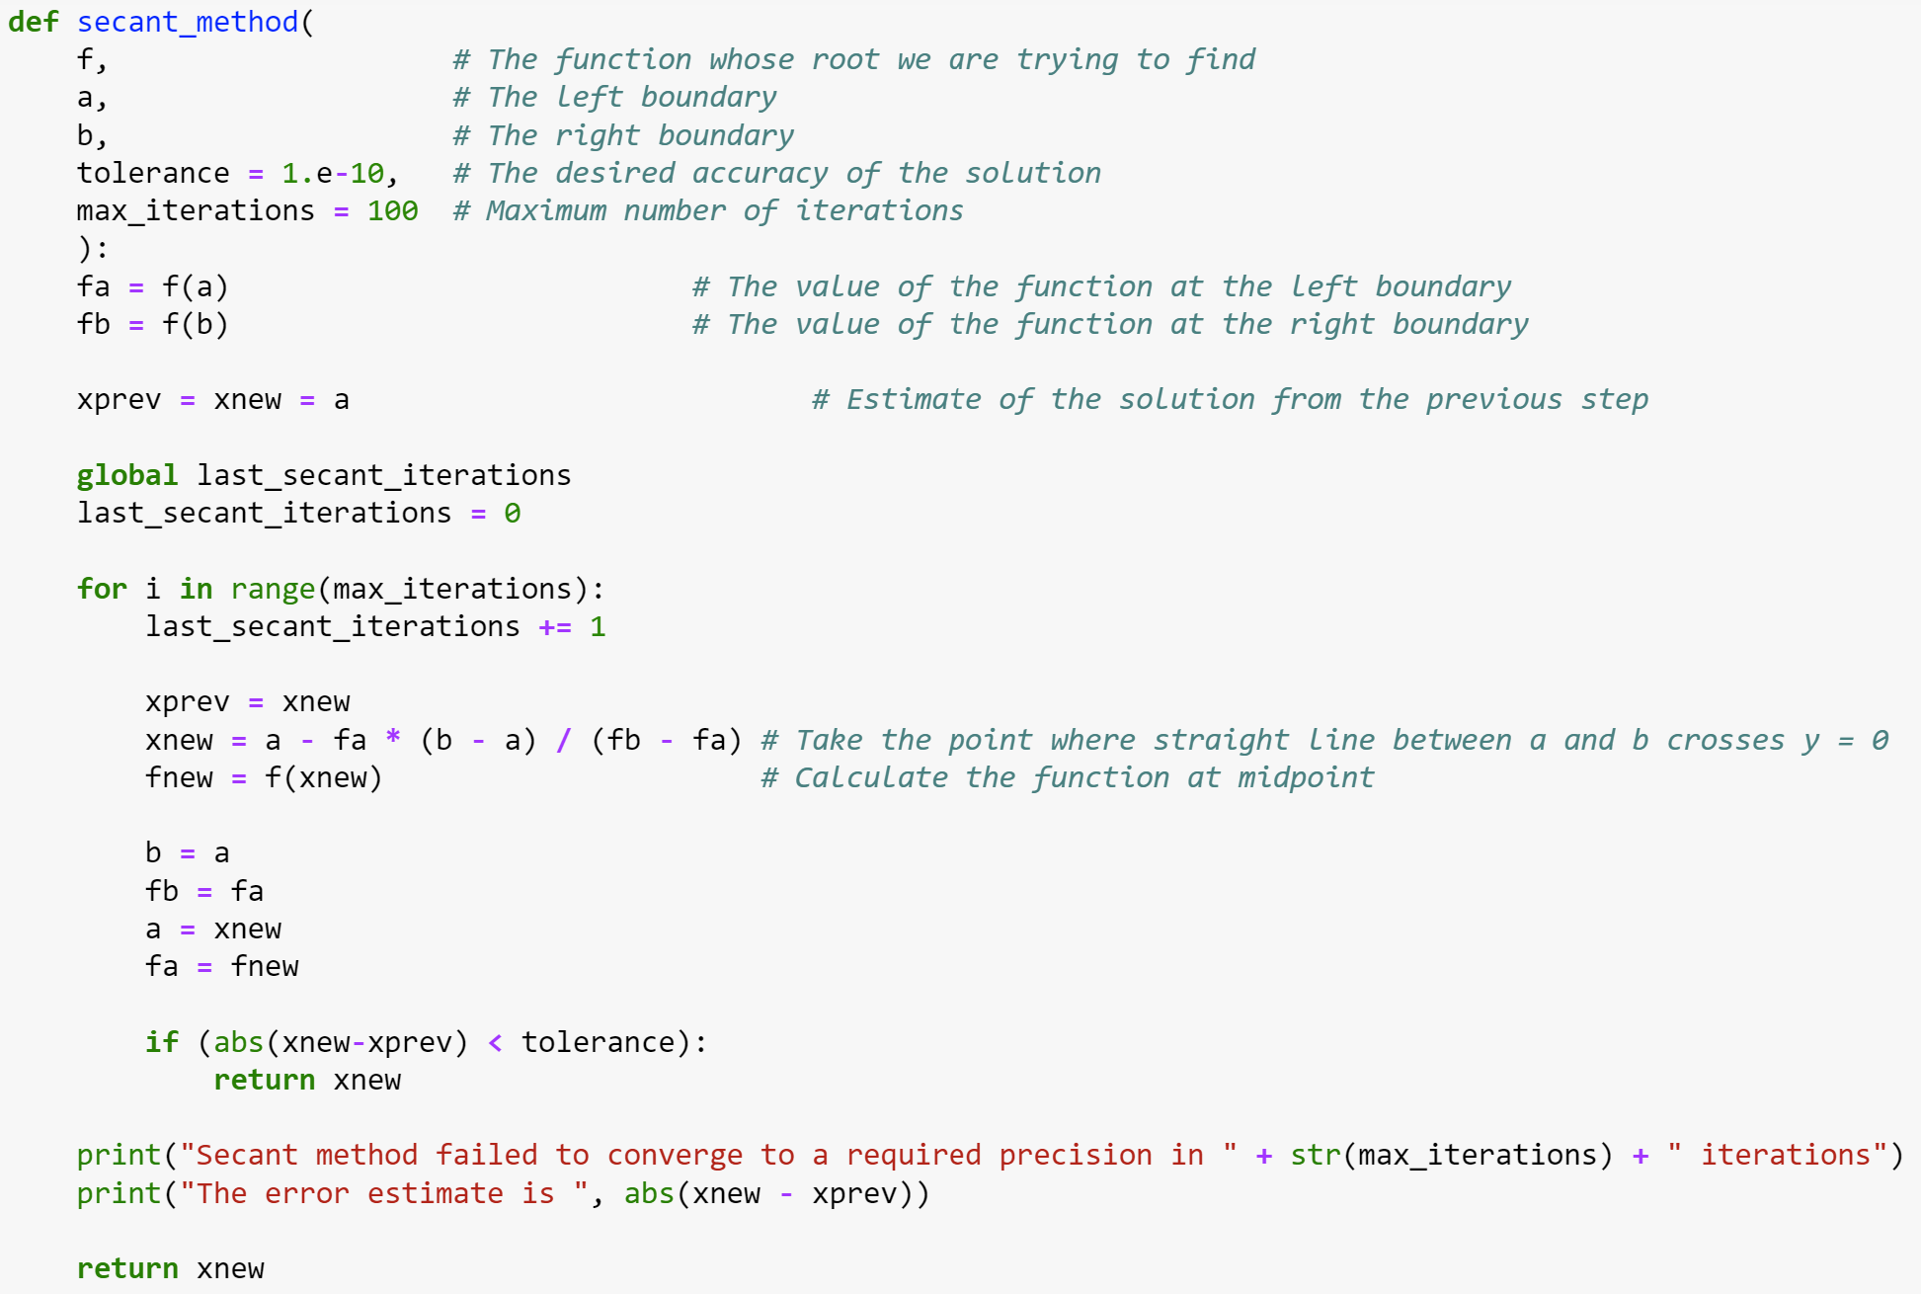
Secant method

Slide 18
Secant method

Slide 19
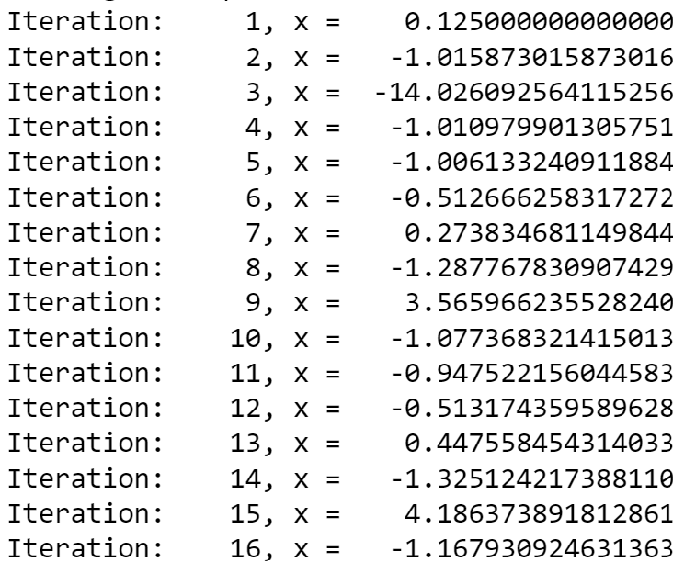
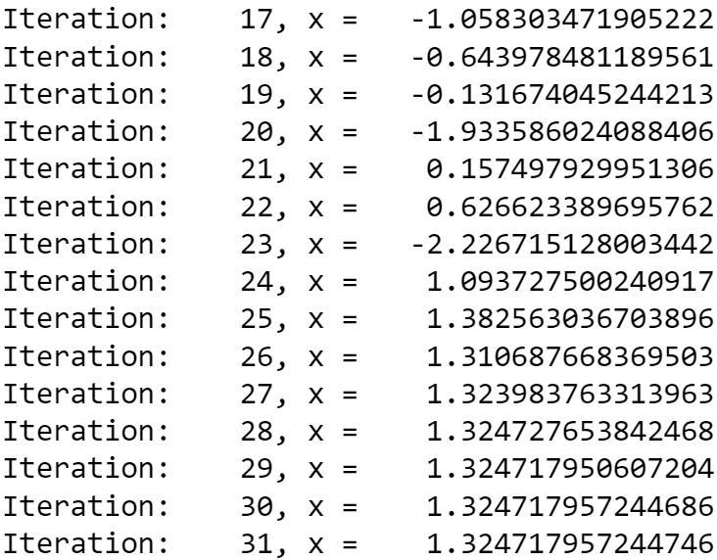
Secant method
Because the method does not bracket the root, it is not guaranteed to converge
In this case, it managed to recover

Slide 20
Secant method
Choose the initial interval as (1,3) instead of (0,3)

Slide 21

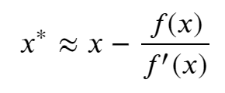

Newton-Raphson method
Newton-Raphson method:
Local method (uses only the current estimate to get the next one)
Requires the evaluation of derivative
Idea: Assume that a given point x is close to the root x* [f(x*)=0]
Then
and since f(x*) = 0 we have
Iterative procedure:
starting from an initial guess x₀

Slide 22
Newton-Raphson method
“Quadratic” convergence when works
However, when we are close to f’ = 0, we have a problem

Slide 23
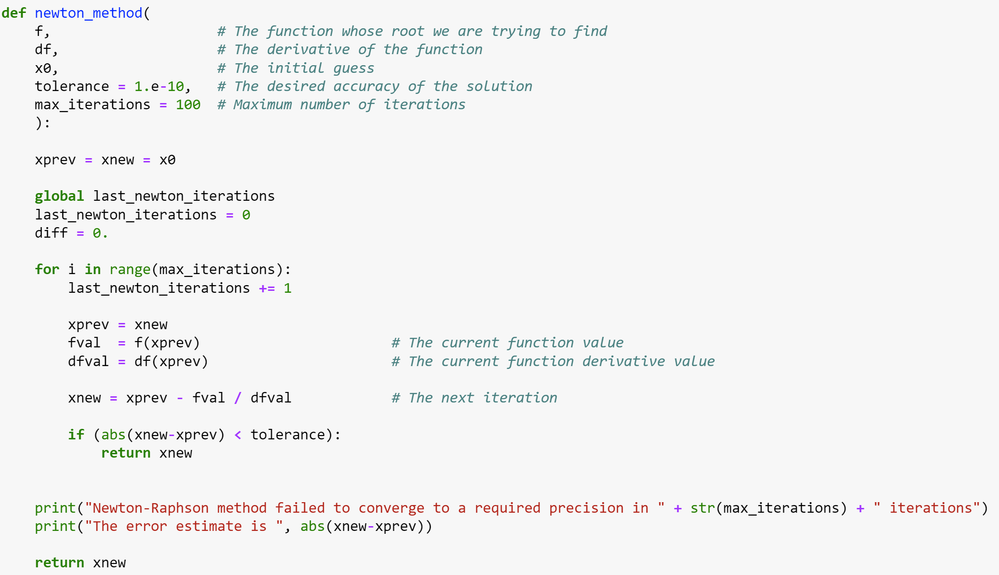
Newton-Raphson method

Slide 24
Newton-Raphson method

Slide 25
Newton-Raphson method: issues
Similar issue as with the secant method; the reason: f’ = 0 at x = 0.577…

Slide 26




Newton-Raphson method: issues
Try finding the root of $f\left(x\right)=x^{3}−2x+2$ with an initial guess of $x_{0}=0$
Iteration 1: $f\left(x_{0}\right)=2, f^{′}\left(x_{0}\right)=−2$
$x_{1}=x_{0}−\frac{f(x_{0})}{f^{′}\left(x_{0}\right)}$ = 1
Iteration 2: $f\left(x_{1}\right)=1 f^{′}\left(x_{1}\right)=1$
$x_{2}=x_{1}−\frac{f(x_{1})}{f^{′}\left(x_{1}\right)}$ = 0
We are back to x₀!
The main issue is, again, we have points with f’ = 0 in the neighborhood

Slide 27
Summary

Slide 28
Summary
Bisection method:
Guaranteed to converge with a fixed rate
Need to bracket the root
Secant method:
Typically faster than bisection and false position
May not always converge
False position method:
Guaranteed to converge
Can be faster than bisection but not always
Need to bracket the root
Newton-Raphson method:
Very fast when converges
Can be sensitive to initial guess
May not converge if f’(x)=0
Requires evaluation of the derivative at each step

Slide 29
Summary
Bisection method:
Guaranteed to converge with a fixed rate
Need to bracket the root
Secant method:
Typically faster than bisection and false position
May not always converge
Newton-Raphson method:
Very fast when converges
Can be sensitive to initial guess
May not converge if f’(x)=0
Requires evaluation of the derivative at each step

Slide 30
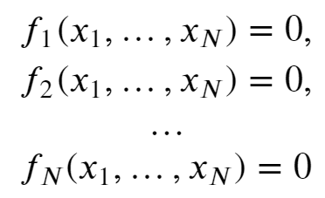

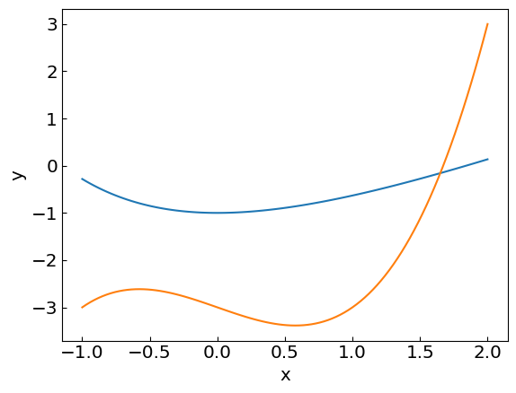
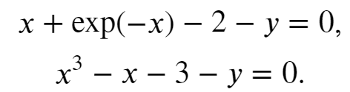
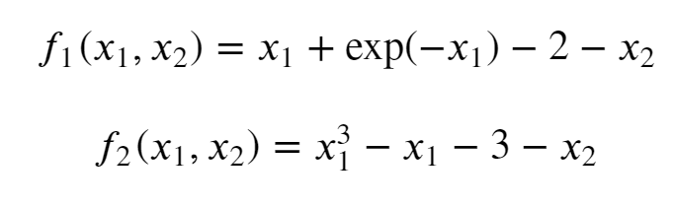
Systems of non-linear equations
Sometimes we need to solve a system of non-linear equations, e.g.
For example:
i.e.

Slide 31



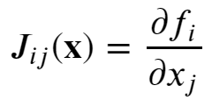
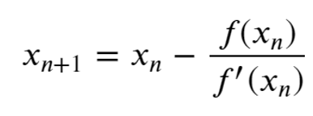

Newton-Raphson method in multiple dimensions
Single equation
System of equations
Equation(s)
Taylor expansion
is Jacobian
Iteration
Multi-dimensional Newton-Raphson method requires matrix inversion of the Jacobian (J⁻¹)
Alternative: Multi-dimensional secant method called Broyden method

Slide 32
Random numbers and Monte Carlo methods
Jupyter Notebook: 3_RandomNumbers-NuSTEAM.ipynb

Slide 33
(Pseudo-)random numbers
Random numbers play important role, both in modelling physics processes (some of which are regarded as truly random, such as radioactive decay) and as a tool to tackle otherwise intractable problems.
Examples:
Numerical integration (especially in many dimensions)
Sampling microstates in statistical mechanics
Simulating quantum processes
Monte Carlo event generators
Numbers generated on a computer are not truly random, but a good generator produces numbers that reflect the desired properties of a random variable, hence they are called pseudo-random.

Slide 34
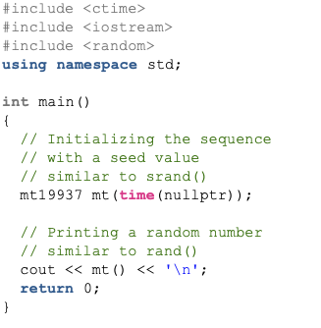

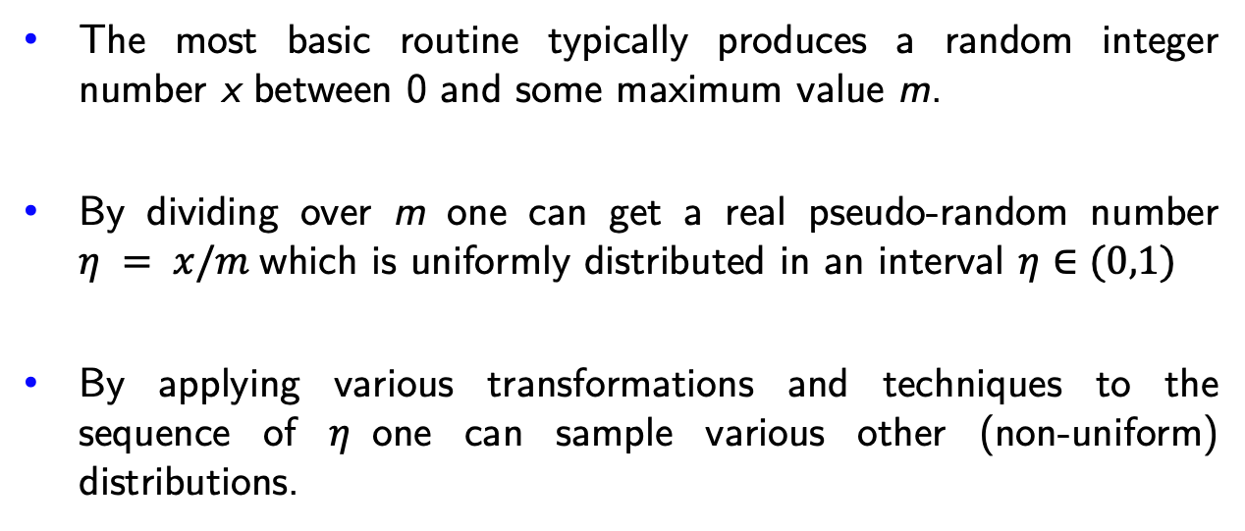
Pseudo-random numbers on a computer
The most basic routine typically produces a random integer number x between 0 and some maximum value m.
By dividing over m one can get a real pseudo-random number $η = x/m$which is uniformly distributed in an interval $η∈(0,1)$
By applying various transformations and techniques to the sequence of $η$one can sample various other (non-uniform) distributions.
Most common routine for sampling x is Mersenne Twister
Python:
C++ (since C++11):
avoid using rand()

Slide 35
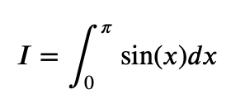
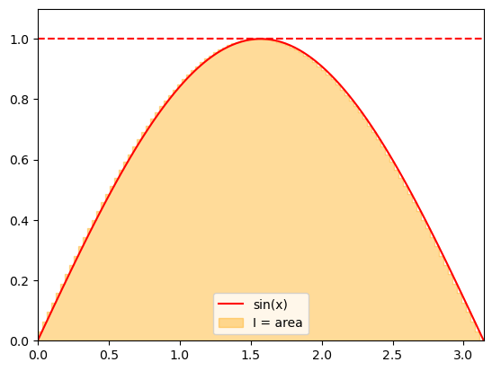
Computing integrals: Estimating the area under the curve
Recall the interpretation of a definite integral as the area under the curve.
We can use this interpretation to apply random numbers for approximating integrals.
Consider

Slide 36
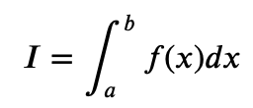

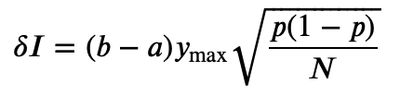
Computing integrals: Estimating the area under the curve
We can estimate the area by sampling the points uniformly from an enveloping rectangle and counting the
fraction of points under the curve given by the integrand f(x).
Assuming an integral
where f(x) > 0 and f(x) < y_{max}, the integrand can be evaluated as
where C is the number of the sampled points that fall under f(x).
The statistical error of the integrand can be estimated using the properties of the binomial distribution
with p = C/N:
The error scales with N^{-1/2}
To reduce the error by factor x2 we need to sample x4 more numbers – true for most Monte Carlo methods.

Slide 37
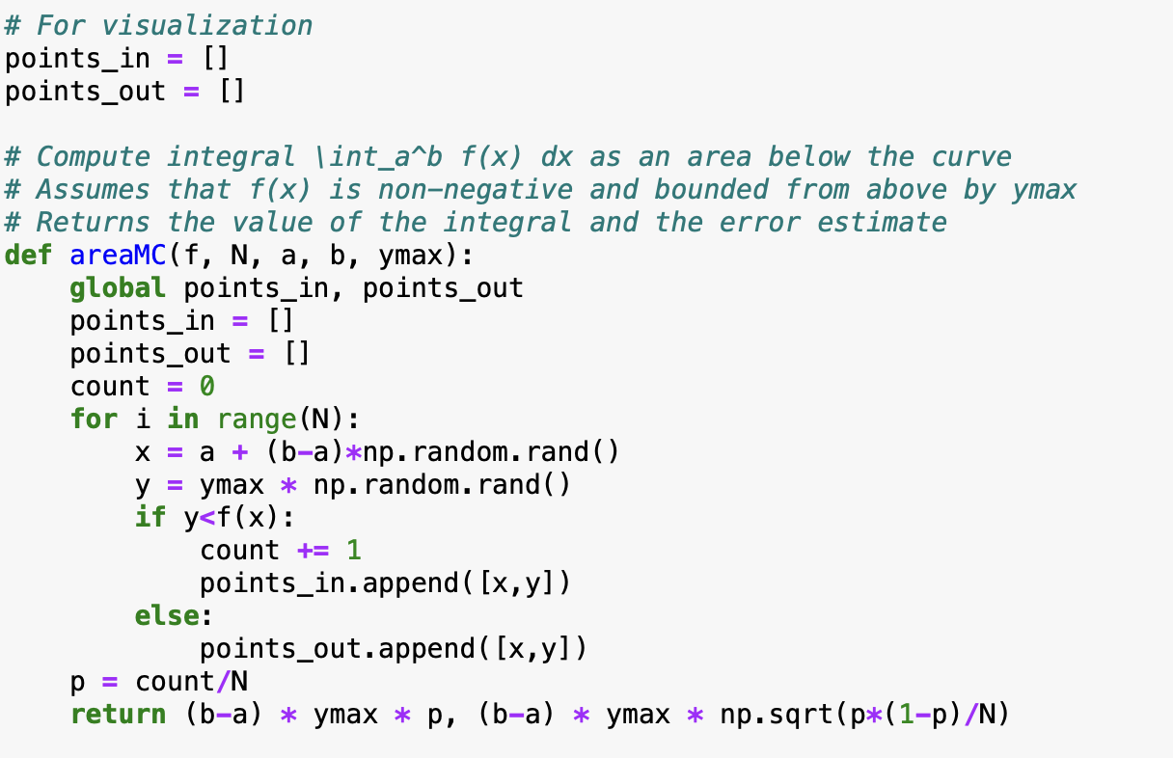
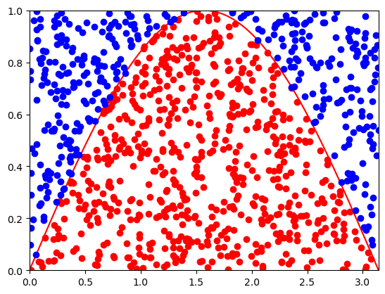
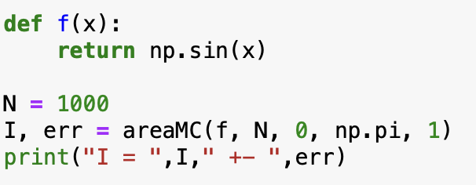
Computing integrals: Estimating the area under the curve

Slide 38


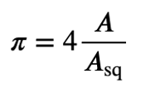
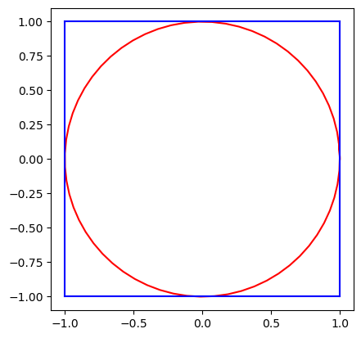

Computing $π$
Consider a circle of unit radius r = 1. Its area is:
The circle can be embedded into a square with a side length of two. The area of the square is: A_{sq} = 2² = 4
Consider now a random point anywhere inside the square. The probability that it is also inside the circle is the ratio of their areas:
This probability can be estimated by sampling points inside the square many times and counting how many fall inside the circle. $π$ can therefore be estimated as:

Slide 39
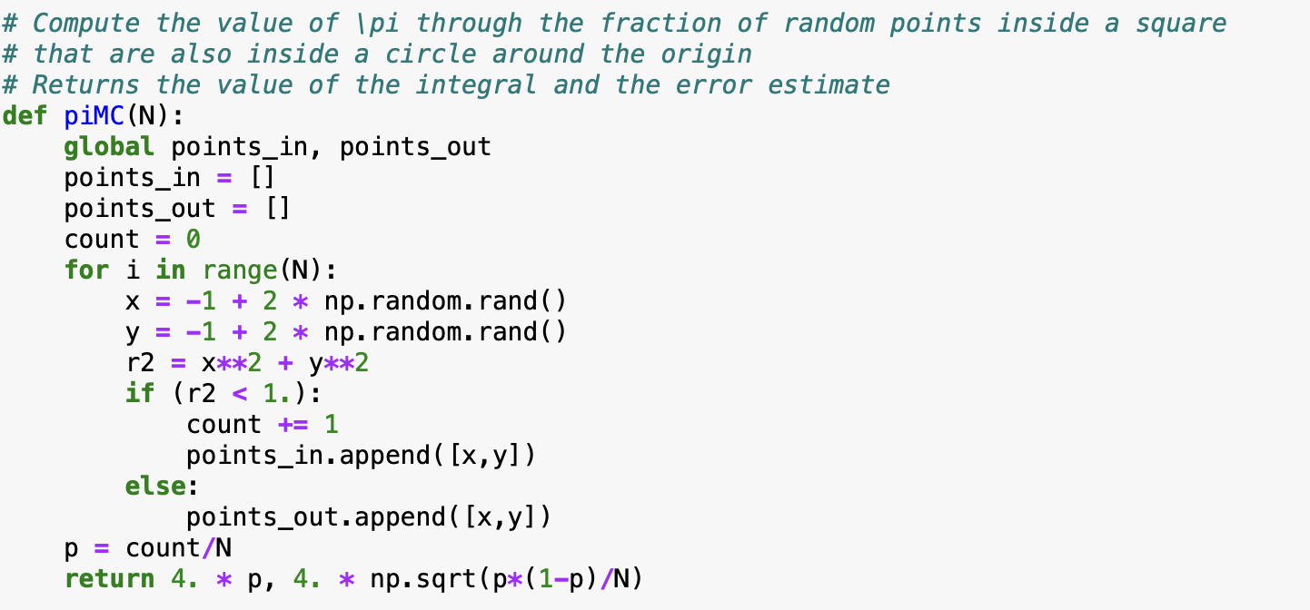
Computing $π$
Consider a circle of unit radius r = 1. Its area is:
The circle can be embedded into a square with a side length of two. The area of the square is: A_{sq} = 2² = 4
Consider now a random point anywhere inside the square. The probability that it is also inside the circle is the ratio of their areas:
This probability can be estimated by sampling points inside the square many times and counting how many fall inside the circle. $π$ can therefore be estimated as:
This method is known as the Monte Carlo estimation of π.

Slide 40
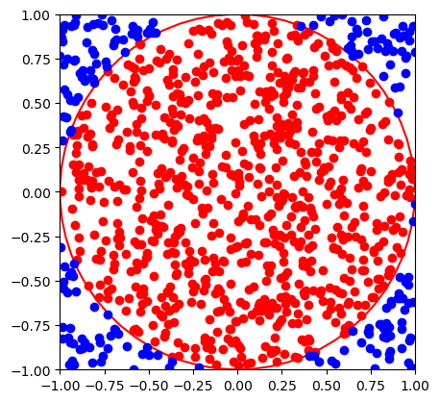
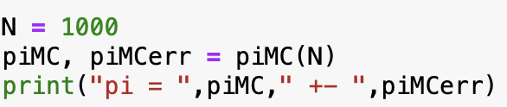
Computing pi
Try a larger number of points

Slide 41
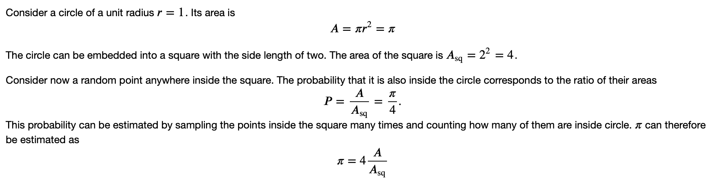
Computing pi

Slide 42
Computing pi

Slide 43
Computing pi
Try to implement it yourself!

Slide 44
Computing pi
Try a larger number of points

Slide 45
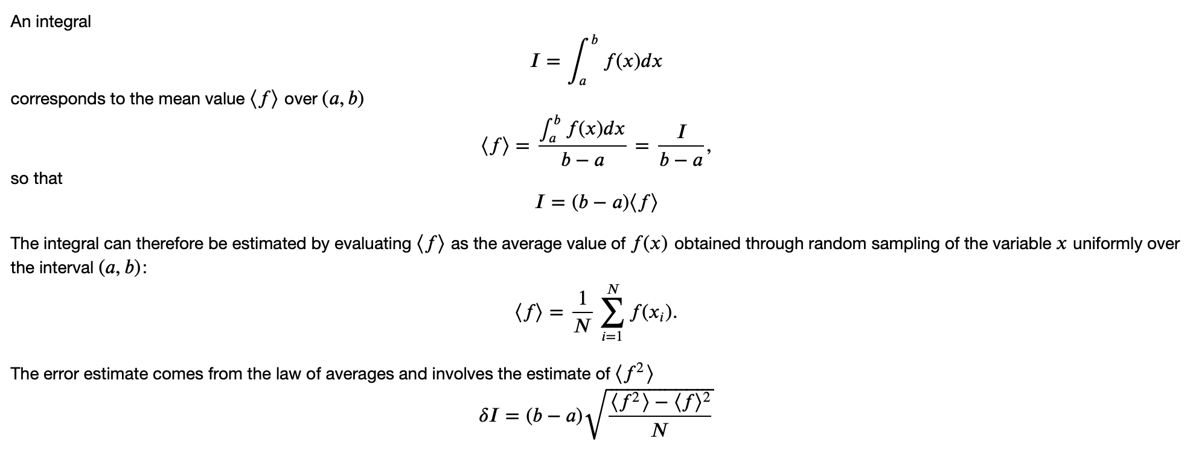
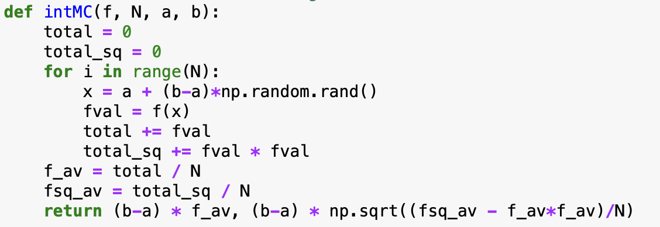
Computing integral as the average

Slide 46
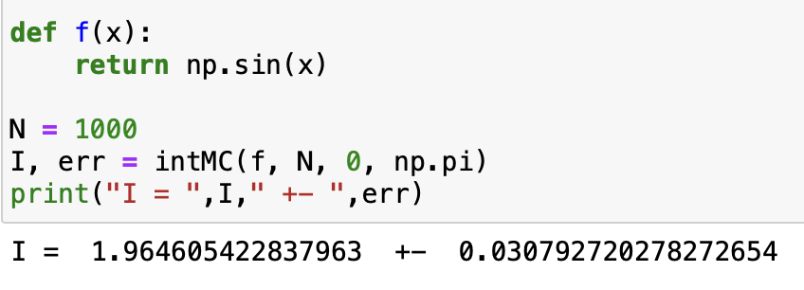
Computing integral as the average
Advantage: the method works also if f(x) is negative, also no need to know its maximum value

Slide 47
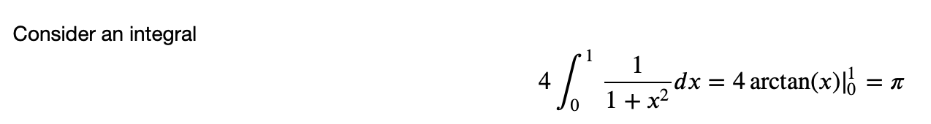
Another way to compute pi

Slide 48
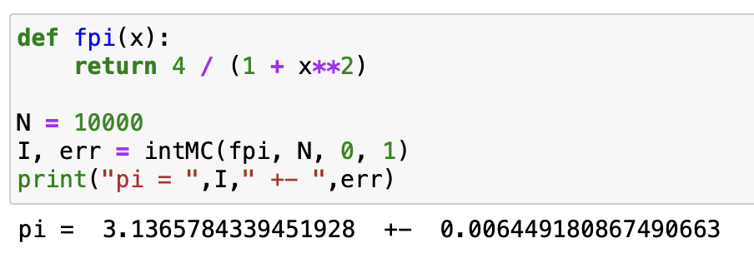
Another way to compute pi

Slide 49
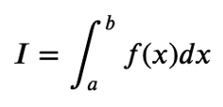
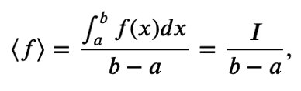

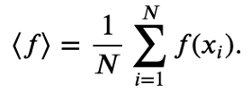

Computing integral as the average
The integral of a function over an interval (a, b) is given by:
The mean value of f(x) over (a, b) is:
which gives:
The integral can be estimated by computing the average value of f(x), where x is randomly sampled over (a, b):
Using the law of averages, the error estimate involves the variance of f(x):

Slide 50
Computing integral as the average
Advantages:
the method works also if f(x) is negative
no need to know its maximum value

Slide 51
Another way to compute pi
Consider an integral

Slide 52
Another way to compute pi
Consider an integral

Slide 53
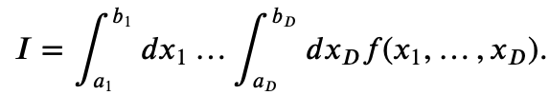
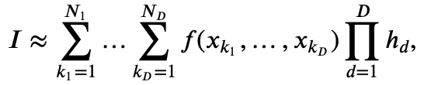


Computing multi-dimensional integrals
Monte Carlo methods really shine when it comes to numerical evaluation of integrals in multiple dimensions.
Consider the following D-dimensional integral
Computing it numerically using for instance the rectangle rule would involve the evaluation of a multi-dimensional sum
where
The total number of integrand evaluations is $N_{tot}=\prod_{d=1}^{N_{D}}{N_{d}}$,
e.g. if we use the same number N of points in each dimension, $N_{tot}$ scales exponentially with D
curse of dimensionality

Slide 54


Computing multi-dimensional integrals: Monte Carlo
Similar to 1D case, replace
by the mean
Here x₁,…,x_{D} are independent random variables distributed uniformly in intervals x_{k} in [a_{k},b_{k}].
Error estimate:
Increasing the number of dimensions by one: sample one more number each iteration.
linear complexity in D

Slide 55
Computing multi-dimensional integrals
Monte Carlo methods really shine when it comes to numerical evaluation of integrals in multiple dimensions.
Consider the following D-dimensional integral
Computing it numerically using for instance the rectangle rule would involve the evaluation of a multi-dimensional sum
where
The total number of integrand evaluations is $N_{tot}=\prod_{d=1}^{N_{D}}{N_{d}}$,
e.g. if we use the same number N of points in each dimension, $N_{tot}$ scales exponentially with D
curse of dimensionality

Slide 56
Computing multi-dimensional integrals: Monte Carlo
Similar to 1D case, replace
by the mean
Here x₁,…,x_{D} are independent random variables distributed uniformly in intervals x_{k} in [a_{k},b_{k}].
Error estimate:
Increasing the number of dimensions by one: sample one more number each iteration.
linear complexity in D

Slide 57

Nonuniformly distributed random numbers
In many cases we deal with random numbers $ξ$ that are distributed non-uniformly.
Common examples are:
There are two common methods for generating nonuniform random variates. They both make use of uniformly distributed variates.
Inverse transform sampling
Rejection sampling

Slide 58


Inverse transform sampling

Slide 59



Inverse transform sampling
The algorithm follows these steps:
1. Calculate the cumulative distribution function (CDF)
2. Find the inverse function G⁻¹(y) as the solution to the equation
3. Sample uniformly distributed random variables $η$ and compute $ξ$ using the inverse function:
$$ξ=G^{−1}(η)$$
Main idea: G(x) is monotonic and between 0 and 1, where it grows quicker is where more probability is
Challenges: Sometimes, evaluating G(x) and/or G⁻¹(y) explicitly is difficult. In such cases, numerical integration and/or non-linear equation solvers may be required.

Slide 60




Inverse transform sampling: Exponential distribution
Example: Exponential Distribution
1. Recall the radioactive decay process. The time of decay is distributed according to the probability density function:
2. The cumulative distribution function is given by:
3. To apply inverse transform sampling, we need to invert F(x) by solving:
4. Solving for t, we obtain:

Slide 61


Sampling radioactive decay time

Slide 62


Sampling points inside a circle
One way to sample points inside a unit circle is by switching to polar coordinates:
where we sample r $∈$[0,1) and $φ∈\text{[0, 2}π\text{)}.$
Naively, one could sample r and $φ$ independently from two uniform distributions. Let’s see what happens!

Slide 63

Sampling points inside a circle
One way to sample points inside a unit circle is by switching to polar coordinates:
where we sample r $∈$[0,1) and $φ∈\text{[0, 2}π\text{)}.$
Naively, one could sample r and $φ$ independently from two uniform distributions. Let’s see what happens!
The points clump more in the center!

Slide 64



Sampling points inside a circle
The points clump more in the center because r is not uniformly distributed.
Recall the differential area element in polar coordinates:
This leads to the probability density functions:
Cumulative Distribution Function (CDF)
To obtain a properly distributed r, we solve $F_{r}\left(r\right)=η$ which gives:
$$r=\sqrt{η}$$

Slide 65



Sampling points inside a circle
The points clump more in the center because r is not uniformly distributed.
Recall the differential area element in polar coordinates:
This leads to the probability density functions:
Cumulative Distribution Function (CDF)
To obtain a properly distributed r, we solve $F_{r}\left(r\right)=η$ which gives:
$$r=\sqrt{η}$$
Other examples (extra slides):
Isotropic direction (3D)
Gaussian distribution

Slide 66




Rejection sampling
The rejection sampling method allows one to sample a variable $ξ$from an envelope distribution and accept or reject it with a certain probability.
Consider again the probability density function for the polar angle:
Since $ρ_{θ}$ is bounded from above, we define:
1. Sample a candidate value $θ_{cand}$from a uniform distribution over (0, $π$).
2. Accept $θ_{cand}$with probability:
3. This step can be performed by sampling y from a uniform distribution over (0, $ρ_{θ}^{max}$) and accepting $θ_{cand}$ if $y < ρ_{θ}(θ_{cand})$
Geometric Interpretation: If we consider $θ_{cand}=x$ and y as the coordinates of a point in a plane, we accept $θ_{cand}$if it lies below the curve defined by $ρ_{θ}\left(θ\right)$. This ensures that $θ_{cand}$values are accepted at a rate proportional to $ρ_{θ}\left(θ\right)$, as desired.
Advantages of Rejection Sampling:
$ρ_{θ}\left(θ\right)$does not need to be a normalized distribution for the method to work.

Slide 67


Rejection sampling

Slide 68
Pros and Cons of Rejection Sampling
Pros:
• Does not require the distribution to be normalized.
• Works even if y_{max} is larger than the true maximum of $ρ(x)$
• Applicable to generic distributions and does not require the evaluation of the cumulative distribution function.
Cons:
• Can be inefficient if the rejection rate is high (e.g., for highly peaked distributions).
• Not directly applicable to distributions over infinite ranges.
Generalizations of Rejection Sampling
To address some of its limitations, several generalizations of rejection sampling can be used, including:
• Adaptive rejection sampling by considering multiple enveloping rectangles.
• Variable transformation to map an infinite interval into a finite one.
• Sampling from a non-uniform enveloping distribution for better efficiency.

Slide 69






Importance sampling
Recall the calculation of an integral as statistical average
where
Some issues with the method:
Sample unimportant regions (e.g. f is highly peaked)
Integrable singularities
Importance sampling:
Sample $x_{i}$ from a non-uniform distribution w(x) that resembles f(x).
The integrand is then calculated as
Normalization:
Error:

Slide 70

Importance sampling
For w(x)=1/(b-a) we recover the mean value method
For w(x) $∝$ f(x) one has $\left\langle \frac{f(x)}{w(x)}\right\rangle$ = const = I and $δI=0$

Slide 71

Importance sampling

Slide 72


Importance sampling: Example
Integrable singularity at x=0

Slide 73








Importance sampling: Example
Mean value method
Importance sampling
f(x)/w(x)
Statistical error is more than x10 smaller than in the mean value method.
We would need more than x100 samples in the mean value method to reach the same accuracy as importance sampling in this case.

Slide 74
Extra slides

Slide 75



Relaxation method
Relaxation method:
Cast the equation f(x) = 0 in a form
For example $φ\left(x\right)=f\left(x\right)+x$ but this choice is not unique
The root is approximated by an iterative procedure
Convergence criterion:

Slide 76

Relaxation method

Slide 77




Relaxation method
as
i.e.
Starting with $x_{0}$=0.5 we have
Not as fast as Newton-Raphson but does not require evaluation of the derivative

Slide 78





Relaxation method
as
i.e.
Starting with $x_{0}$=0.5 we have
Divergent!
violated [try to come up with a better form of $φ(x)$?]
Reason:

Slide 79
Sampling of an Isotropic Direction in 3D
One common problem in Monte Carlo simulations is the random sampling of an isotropic direction in 3D space. This issue arises in various contexts, such as:
• Sampling a random orientation of an axially symmetric object (e.g., a rod).
• Sampling the momentum direction of a particle.
This problem is equivalent to choosing a random point on a unit sphere. The coordinates x, y, z on the sphere can be parametrized using azimuthal and polar angles:
• $φ∈[0, 2π)$ (azimuthal angle)
• $θ∈[0, π)$ (polar angle)
Using these angles, the Cartesian coordinates are given by:
$$x=\sin{θ}\cos{φ}$$
$$y=\sin{θ}\sin{φ}$$
$$z=\cos{θ}$$

Slide 80






Sampling of an Isotropic Direction in 3D
$$x=\sin{θ}\cos{φ}$$
$$y=\sin{θ}\sin{φ}$$
$$z=\cos{θ}$$
The solid angle element is:
The random variables $φ$ and $θ$are independent.
$φ$is uniformly distributed in [0, 2$π$], making its sampling straightforward.
However, $θ$has a weighted probability density function:
The cumulative distribution function is:
In practice, work directly with $\cos{θ}$ and $\sin{θ:}$
Solving $F_{θ}\left(θ\right)=η$, we obtain:

Slide 81


Sampling an isotropic direction

Slide 82



Sampling normally distributed variables
One of the most common probability distributions is the normal (or Gaussian) distribution, given by:
There are many standard methods for sampling from this distribution. One common approach is to standardize the variable by making the transformation $x→μ+σx$
After this transformation, the new variable follows a standard normal distribution with zero mean and unit standard deviation:
Calculating the cumulative distribution function $F\left(x\right)=\int_{−∞}^{x}{ρ\left(x^{′}\right)dx′}$ is not straightforward, use numerical methods.

Slide 83

Sampling normally distributed variables

Slide 84


Sampling normally distributed variables

