Slide 1

Computational Physics @ NuSTEAM
Lecture 2
Numerical integration
Numerical differentiation
June 12, 2025
Instructor: Volodymyr Vovchenko (vvovchenko@uh.edu)
based on Computations Physics course at UH
GitHub: https://github.com/vlvovch/PHYS6350-ComputationalPhysics/tree/nusteam
Online textbook: https://vovchenko.net/computational-physics

Slide 2
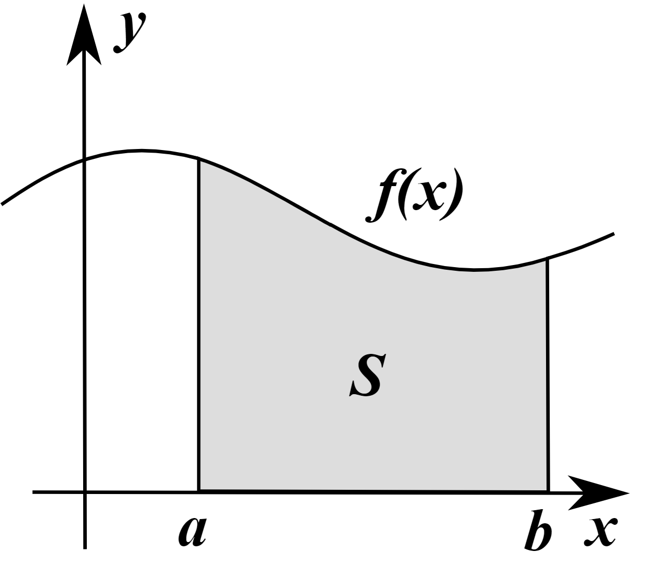
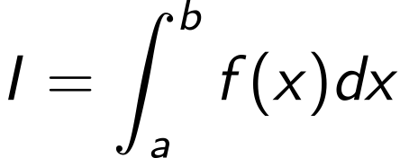
Numerical integration
I

Slide 3
Numerical integration
Generic problem: evaluate
We need numerical integration when
Cannot/difficult integrate analytically
Only know the integrand f(x) at certain points x
I

Slide 4
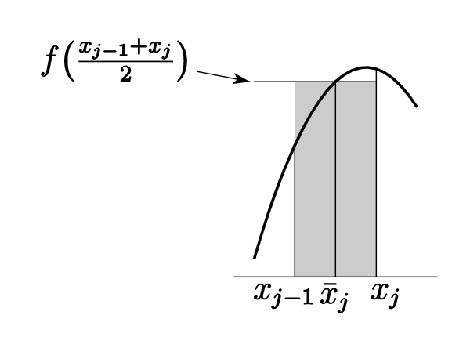
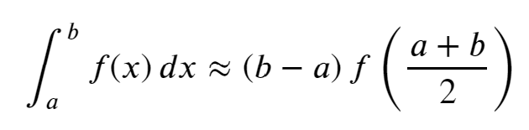
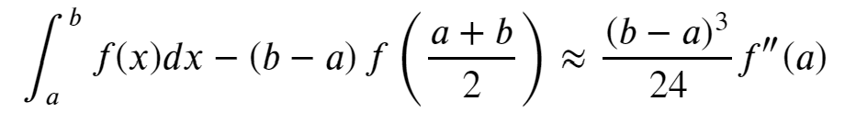
Numerical integration: rectangle (midpoint) rule
Interpret the integral as the area under the curve and approximate by a rectangle evaluated at midpoint
Error (from Euler-McLaurin formula):
The rule is exact for the integration of linear functions

Slide 5
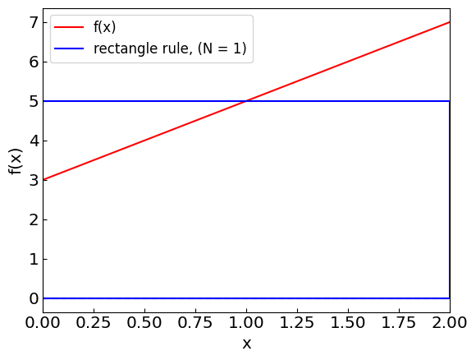
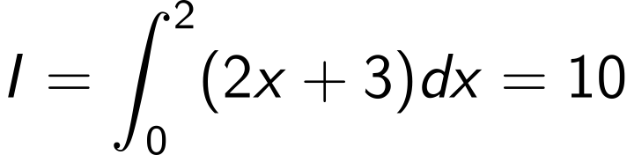
Numerical integration: rectangle (midpoint) rule
Example:
Although the rectangle is a poor approximate of the line (which is a trapezoid here), the errors cancel out

Slide 6
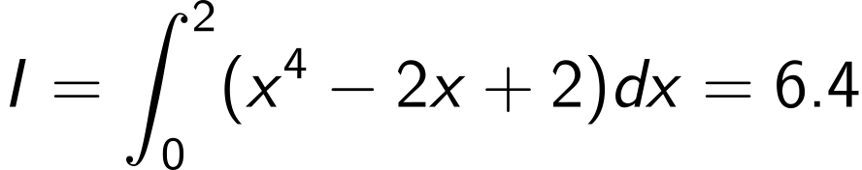
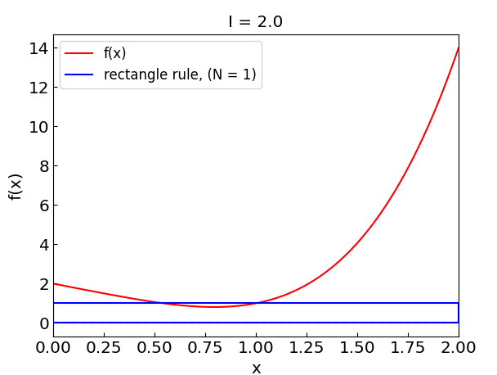
Numerical integration: rectangle (midpoint) rule
Another example:
Rectangle rule gives I_{rect} = 2 which is way off

Slide 7
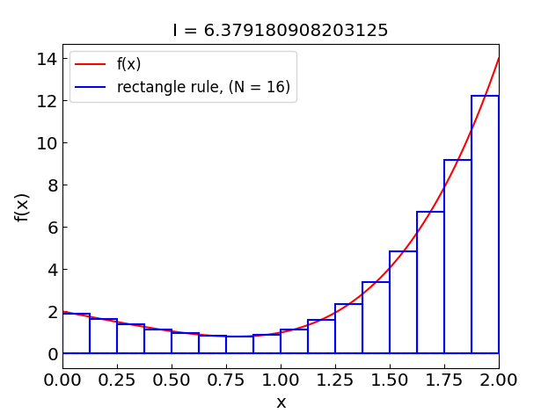
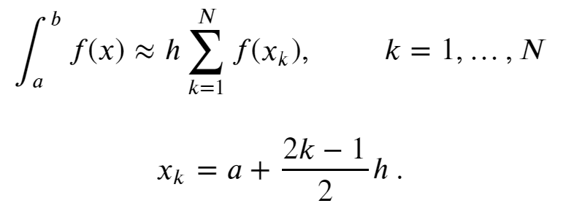

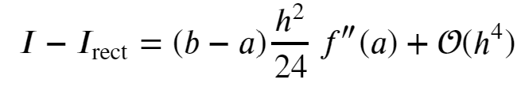
Extended (composite) rectangle rule
Split the integration interval into N sub-intervals and apply the rectangle rule separately to each one
Error estimate:

Slide 8
Extended (composite) rectangle rule

Slide 9
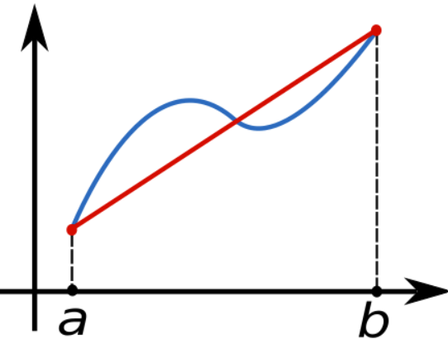
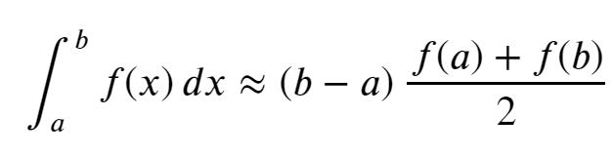
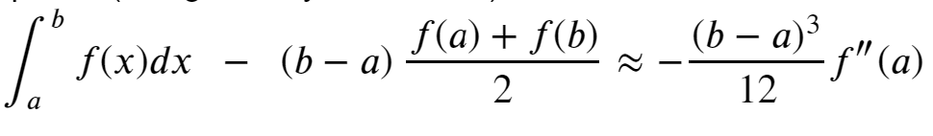
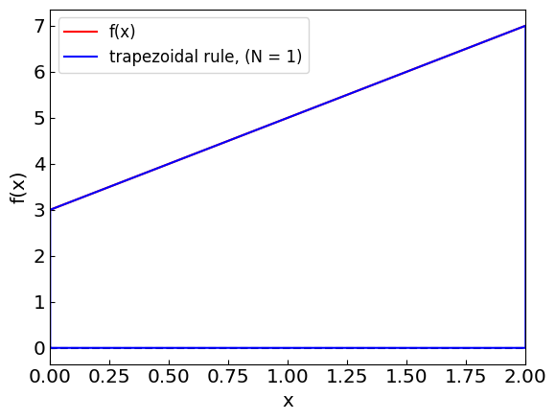
Numerical integration: trapezoidal rule
Approximate the integral by a trapezoid
Error:
The rule is exact for the integration of linear functions

Slide 10
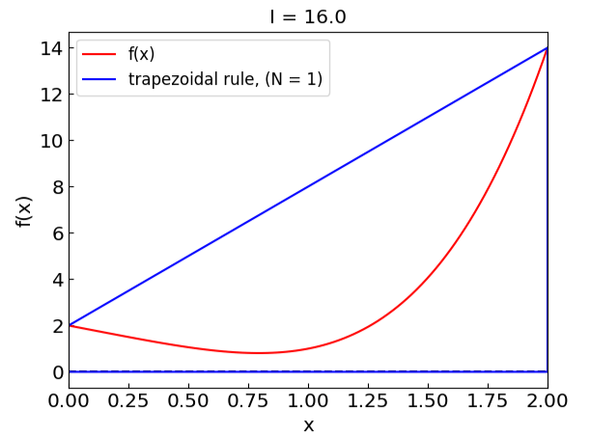
Numerical integration: trapezoidal rule
Trapezoidal rule gives I_{trap} = 16, way off and in the opposite direction relative to rectangle rule

Slide 11
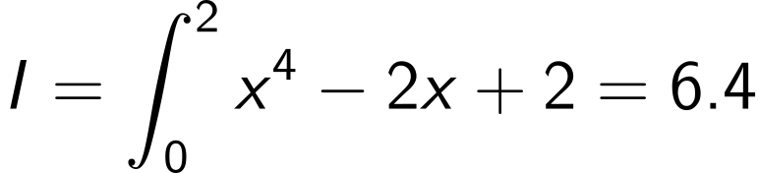
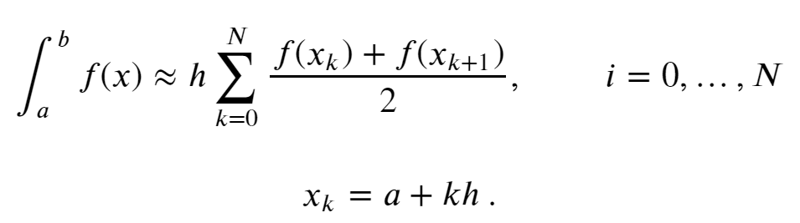
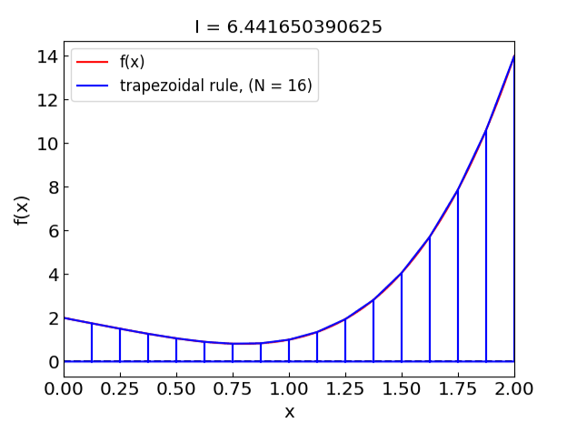
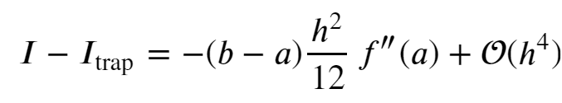
Extended trapezoidal rule
Error estimate:

Slide 12
Extended (composite) trapezoidal rule

Slide 13
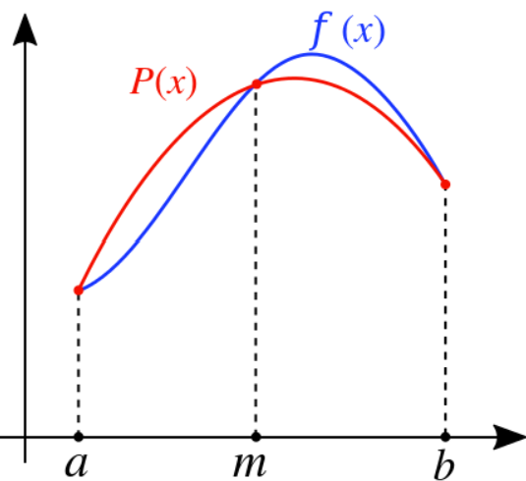
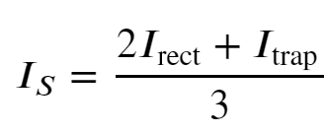
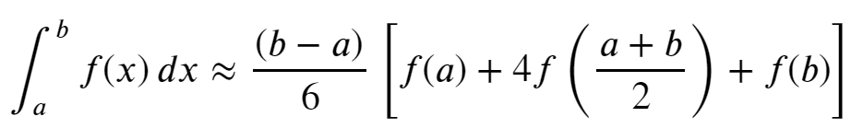
Numerical integration: Simpson’s rule
Recall the error estimates for rectangular and trapezoidal rules
Combine them to eliminate the O(h²) error term:
i.e.
An equivalent way to obtain the rule: replace the integrand by the parabolic interpolation

Slide 14

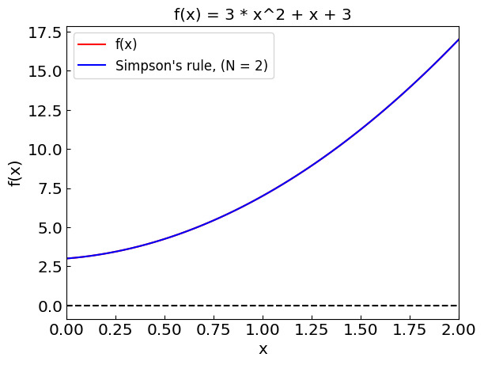
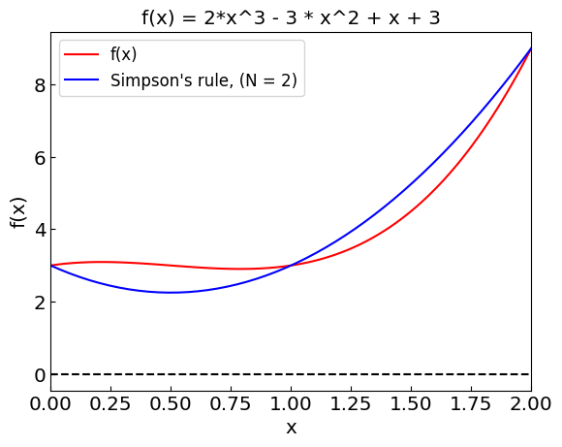
Numerical integration: Simpson’s rule
The error for the Simpson’s rule is
The method is exact for polynomials up to third order

Slide 15
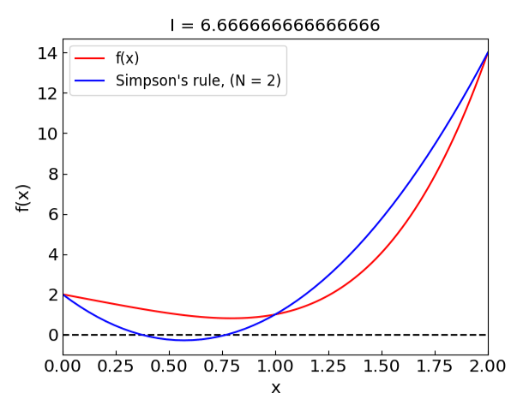
Numerical integration: Simpson’s rule
Simpson’s rule gives I_{trap} = 6.66 using three points, which is already not too bad!

Slide 16
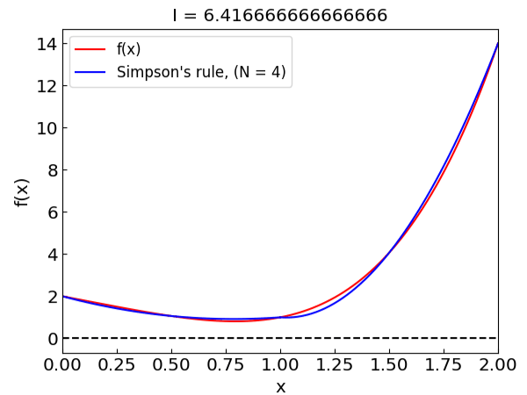
Extended Simpson’s rule
N must be even!
Error estimate:

Slide 17
Extended Simpson’s rule

Slide 18
Comparing the methods
Rectangle
Trapezoid
Simpson

Slide 19

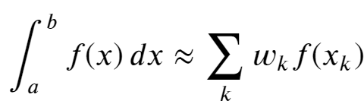
Advanced methods
Adaptive quadrature
Increase (e.g. double) the number of subintervals and use the difference as the measure of error, e.g.
More formal implementation: Romberg method
Gaussian quadrature
N-point quadrature which is exact for integration of polynomials of order up to 2n-1
Improper integrals
(Semi-)infinite integration limits
Singularities
Discontinuous integrals
Adaptive trapezoidal rule

Slide 20
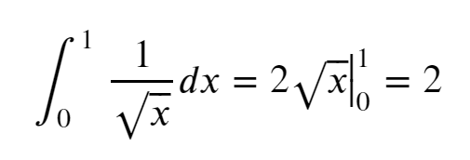
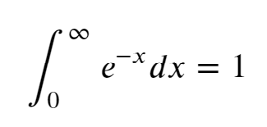
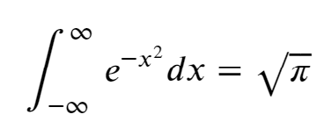
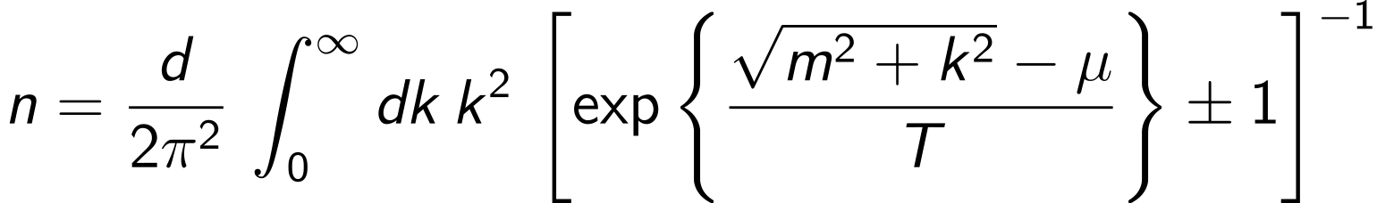
Improper integrals
Contain integrable singularities (typically at the endpoints)
(Semi-)infinite integration range
Example: Momentum integration over thermal distributions (Fermi-Dirac/Bose-Einstein)

Slide 21
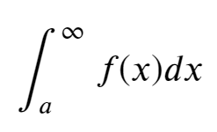
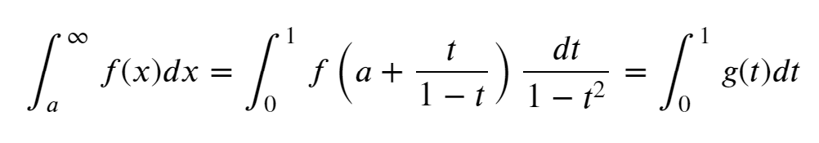

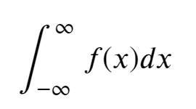
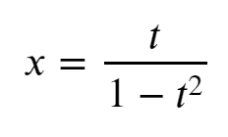
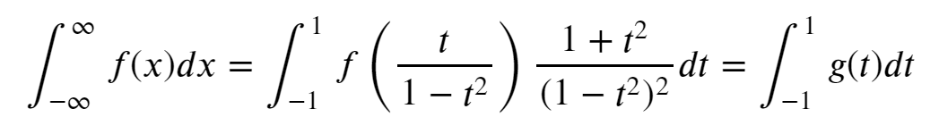
Improper integrals: (Semi-)infinite intervals
Solution: map to a finite interval [e.g. (0,1)] by a change of variables
Semi-infinite:
Infinite:
Then apply a standard method (e.g. rectangle rule to avoid endpoint singularities) to g(t)
NB: Other options for the change of variable are possible

Slide 22
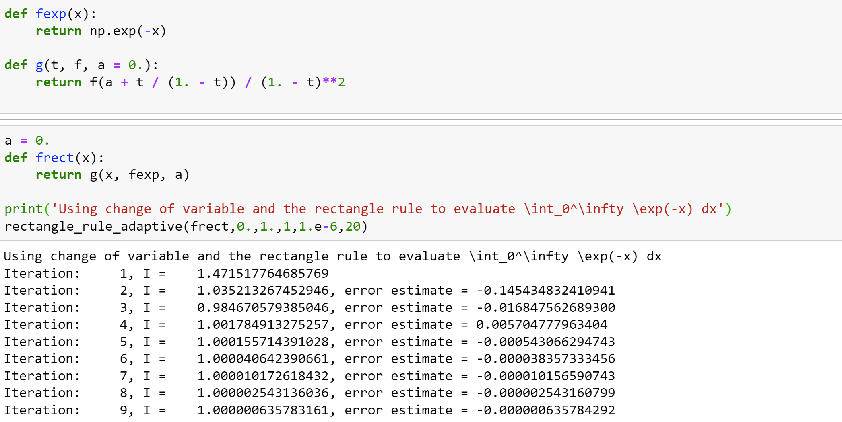
Improper integrals: Semi-infinite intervals

Slide 23
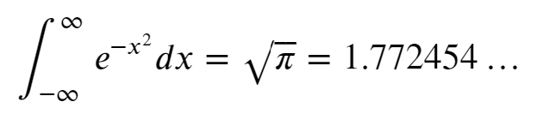
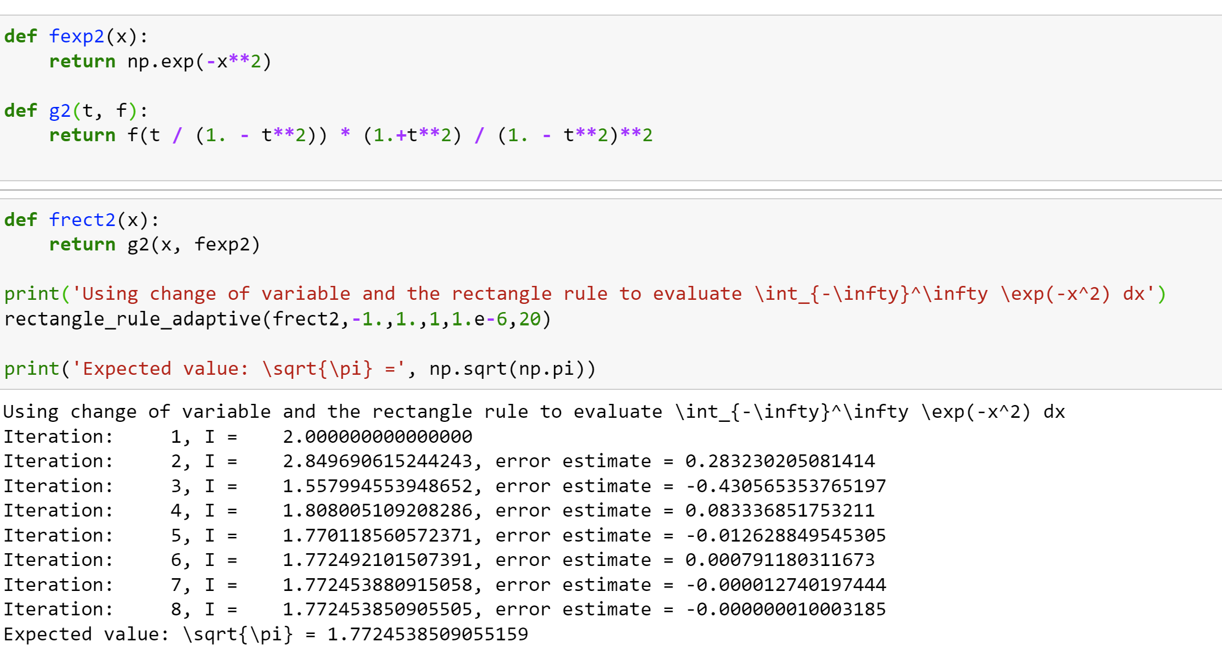
Improper integrals: Infinite intervals

Slide 24
Summary: Numerical integration
Trapezoidal/rectangle method
Good generic choice
Gaussian quadrature
Good choice for repeatedly calculating the same kind of integral
Improper integrals
Make a change of variable to transform into finite interval
Advanced: Using generalized Gaussian quadratures
Control over error
Advanced: Romberg method

Slide 25
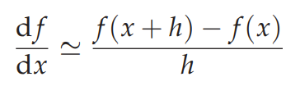
Numerical derivatives

Slide 26
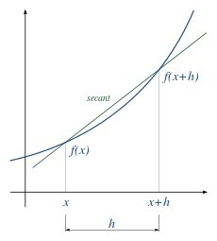
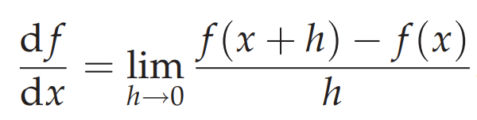
Numerical differentiation
Generic problem: evaluate
We need numerical differentiation when
Function f is known at a discrete set of points
Too expensive/cumbersome to do directly
E.g. when f(x) itself is a solution to a complex web of non-linear equations, calculating f’(x) explicitly will require rewriting all the equations

Slide 27
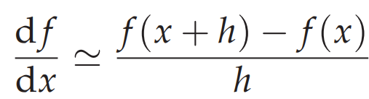
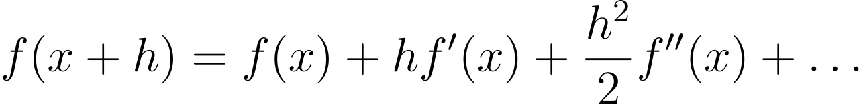
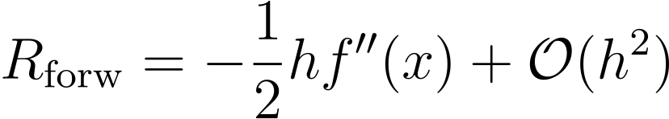
Forward difference
Simply approximate
by
where h is finite
Taylor theorem:
gives the approximation error estimate of

Slide 28
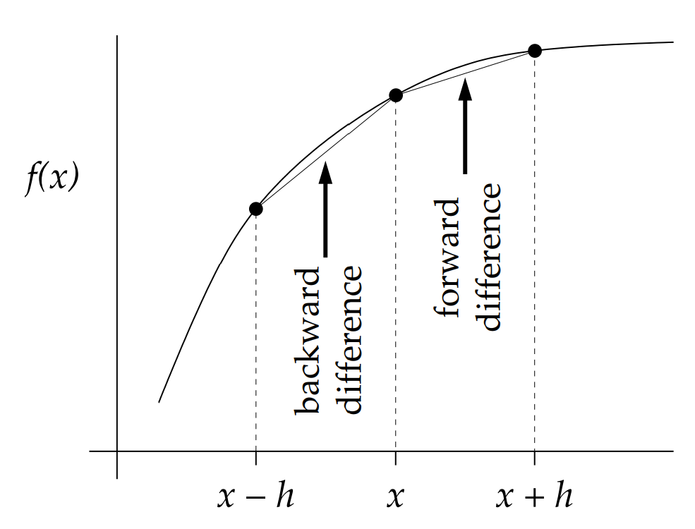
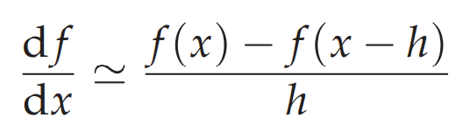
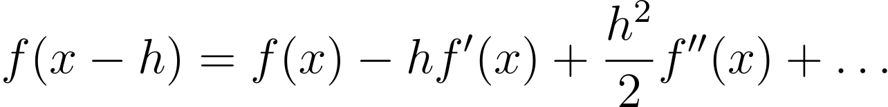

Backward difference
Backward difference
Taylor theorem:
gives the approximation error estimate of

Slide 29


Central difference
Recall the forward and backward difference and their errors
Taking the average of the two cancels out the O(h) error term
central difference
Error estimate:

Slide 30

High-order central difference
To improve the approximation error use more than two function evaluations, e.g.
Determine A,B,C,D,E using Taylor expansion to cancel all terms up to h⁴
High-order terms:

Slide 31


Balancing truncation and round-off errors
If h is too small, round-off errors become important
cannot distinguish x and x+h and/or f(x+h) and f(x) with enough accuracy
As a rule of thumb, if $ε$ is machine precision and the truncation error is of order O(h^{n}), then h should not be much smaller than $h\sim \sqrt[n+1]{ε}$
Credit: Wikipedia
The higher the finite difference order is, the larger h should be

Slide 32
Balancing truncation and round-off errors
Consider central difference:
Total error:
$ε_{m}$ - relative error in f(x)
error(df/dx) = $ε_{m}\frac{|f\left(x\right)|}{h} + \frac{|f^{′′′}\left(x\right)|}{6}h^{2}$
$$ε_{m} \sim {10}^{−16}$$
round-off
truncation
Best case: machine precision
Minimizing with respect to h gives optimal choice for the step size:
$$h=\sqrt[3]{6 ε_{m}\left|f^{′′′}\left(x\right)\right|/|f\left(x\right)|} \sim \sqrt[3]{ε_{m} \left|f^{′′′}\left(x\right)\right|/|f\left(x\right)|}$$
More generally, for O(h^{n}) scheme one has
$$h\sim \sqrt[n+1]{ε_{m} \left|f^{(n+1)}\left(x\right)\right|/|f\left(x\right)|}$$

Slide 33


Balancing truncation and round-off errors
Let f(x) = exp(x)
Calculate the derivatives at x = 0
Forward difference O(h):
Optimal $h\sim \sqrt[2]{{10}^{−16}}\sim {10}^{−8}$

Slide 34

Balancing truncation and round-off errors
Let f(x) = exp(x)
Calculate the derivatives at x = 0
Backward difference O(h):
Optimal $h\sim \sqrt[2]{{10}^{−16}}\sim {10}^{−8}$

Slide 35

Balancing truncation and round-off errors
Let f(x) = exp(x)
Calculate the derivatives at x = 0
Central difference O(h²):
Optimal $h\sim \sqrt[3]{{10}^{−16}}\sim {10}^{−5}$

Slide 36


Balancing truncation and round-off errors
Let f(x) = exp(x)
Calculate the derivatives at x = 0
Central difference O(h⁴):
Optimal $h\sim \sqrt[5]{{10}^{−16}}\sim {10}^{−3}$

Slide 37



High-order derivatives
Central difference
Now apply the central difference again to f’(x+h/2) and f’(x-h/2)
General formula [to order O(h²)]

Slide 38



Second derivative
f(x) = exp(x)
Optimal $h\sim \sqrt[4]{{10}^{−16}}\sim {10}^{−4}$

Slide 39


Partial derivatives
Let us have a function of two variables: f(x,y)
Use central difference to calculate first-order derivatives
Reapply the central difference to calculate

Slide 40


Balancing truncation and round-off errors
Let f(x) = exp(x)
Calculate the derivatives at x = 0
Forward difference O(h):
Optimal $h\sim \sqrt[2]{{10}^{−16}}\sim {10}^{−8}$

Slide 41

Balancing truncation and round-off errors
Let f(x) = exp(x)
Calculate the derivatives at x = 0
Backward difference O(h):
Optimal $h\sim \sqrt[2]{{10}^{−16}}\sim {10}^{−8}$

Slide 42


Balancing truncation and round-off errors
Let f(x) = exp(x)
Calculate the derivatives at x = 0
Central difference O(h²):
Optimal $h\sim \sqrt[3]{{10}^{−16}}\sim {10}^{−5}$

Slide 43

Balancing truncation and round-off errors
Let f(x) = exp(x)
Calculate the derivatives at x = 0
Central difference O(h⁴):
Optimal $h\sim \sqrt[5]{{10}^{−16}}\sim {10}^{−3}$

Slide 44
High-order derivatives
Central difference
Now apply the central difference again to f’(x+h/2) and f’(x-h/2)
General formula (to order h)

Slide 45


Second derivative
f(x) = exp(x)
Optimal $h\sim \sqrt[4]{{10}^{−16}}\sim {10}^{−4}$

Slide 46
Partial derivatives
Let us have f(x,y)
Use central difference to calculate first-order derivatives
Reapply the central difference to calculate

Slide 47
Summary: Numerical differentiation
Forward/backward differences
Useful when we are given a grid of function values
Have limited accuracy (linear in h)
Central difference
More precise than forward/backward differences (quadratic in h)
Gives f’(x) estimate at the midpoint of function evaluation points
Higher-order formulas are obtained by using more than two function evaluations
Can be used when limited number of function evaluations available
Straightforwardly extendable to high-order and partial derivatives
Balance between truncation and round-off error must be respected
h should not be taken too small

Slide 48
Summary: Numerical differentiation
Forward/backward differences
Useful when we are given a grid of function values
Need f’(x) at the same point as x
Have limited accuracy (error is linear in h)
Central difference
More precise than forward/backward differences (error is quadratic in h)
Gives f’(x) estimate at the midpoint of function evaluation points
Higher-order formulas are obtained by using more than two function evaluations
Can be used when limited number of function evaluations available
Straightforwardly extendable to high-order and partial derivatives
Balance between truncation and round-off error must be respected
h should not be taken too small
Advanced topic: Automatic differentiation (link)

Slide 49
Extra slides

Slide 50




Adaptive quadrature
We would like to control the error in our calculation
This can be achieved by doubling the number of subintervals and keeping track of the error estimate
Recall that in the rectangle/trapezoidal rule the error is proportional to h²
At step k we have $h_{k}=h_{k−1}/2$ therefore
and the error at step k is estimated as

Slide 51


Adaptive trapezoidal rule

Slide 52



Adaptive Simpson rule
For Simpson’s rule
(understand why 15 and not 3?)

Slide 53



Adaptive quadratures: Romberg method
Recall that we obtained error estimate for trapezoidal method at step k
On the other hand, by definition,
Therefore, we can improve our estimate of the integral as
Romberg method: continue this procedure iteratively
until the desired accuracy is reached

Slide 54


Romberg method

Slide 55

Improper integrals: Singularities at endpoints
Even though if the singularities at integration endpoints are integrable, the trapezoidal, Simpson, etc. methods will fail because they evaluate the integrand at the endpoints
Solution: use method that does use the endpoints (e.g. rectangle rule)

Slide 56


Improper integrals: Singularities at endpoints

