Slide 1

Computational Physics @ NuSTEAM
Lecture 1
Introduction
Data visualization (plotting)
Floating-point precision
June 11, 2025
Instructor: Volodymyr Vovchenko (vvovchenko@uh.edu)
based on Computations Physics course at UH
GitHub: https://github.com/vlvovch/PHYS6350-ComputationalPhysics/tree/nusteam
Online textbook: https://vovchenko.net/computational-physics

Slide 2
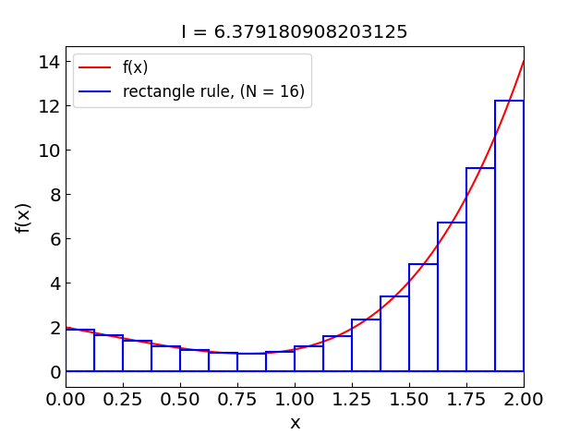
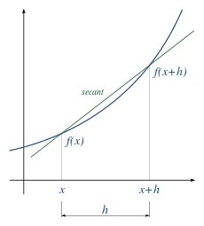
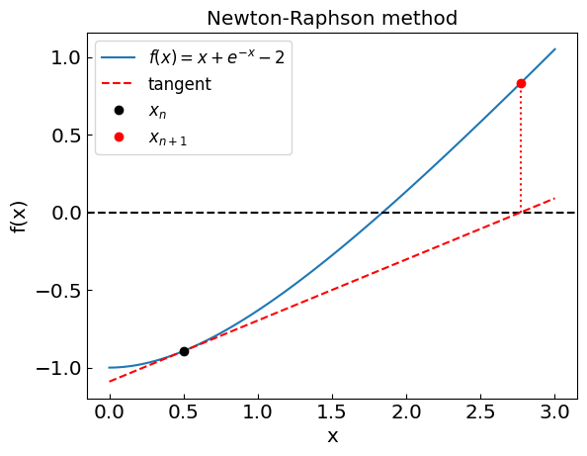
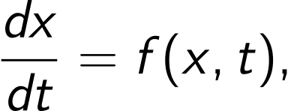

Computational Physics
Description: Application of numerical methods to solve problems in physics, which lies at the intersection of physics, math, and computer science.
Common applications:
Numerical calculus
Numerical integration
Numerical derivatives
Numerical algebra
Systems of linear and non-linear equations
Matrix methods
Ordinary differential equations
Classical mechanics problems
Partial differential equations
Classical and quantum mechanics problems
Random numbers and Monte Carlo methods
2

Slide 3
Data visualization
Line plots
Scatter plots
Contour/density plots (2D data)
References:
Matplotlib documentation
Jupyter Notebook: 1_Plotting-NuSTEAM2025.ipynb

Slide 4
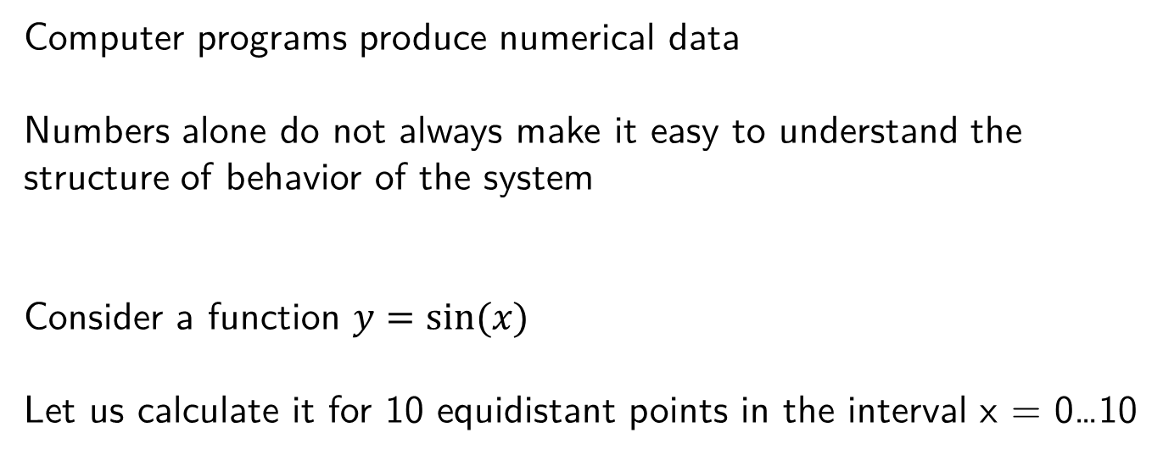
Plotting the data
Computer programs produce numerical data
Numbers alone do not always make it easy to understand the structure of behavior of the system
Consider a function $y=sin⁡(x)$
Let us calculate it for 10 equidistant points in the interval x = 0…10

Slide 5
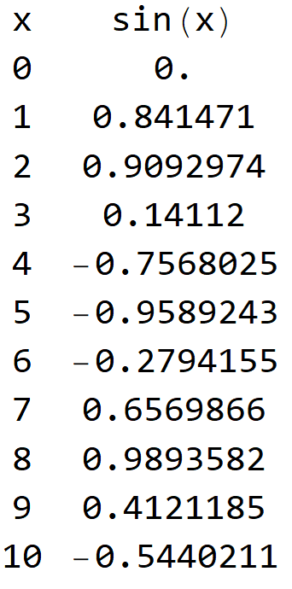
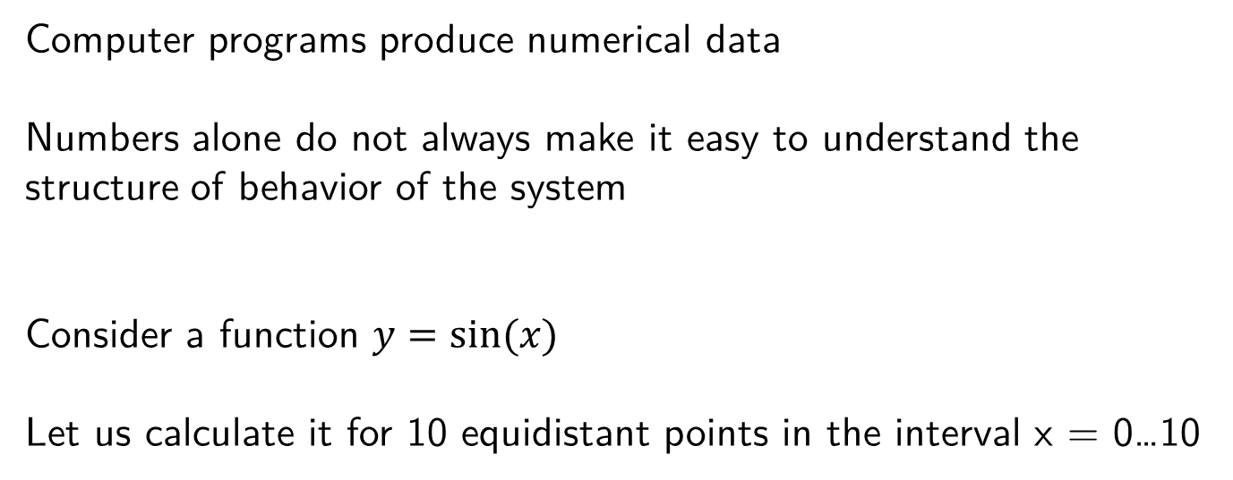
Plotting the data
Computer programs produce numerical data
Numbers alone do not always make it easy to understand the structure of behavior of the system
Consider a function $y=sin⁡(x)$
Let us calculate it for 10 equidistant points in the interval x = 0…10

Slide 6
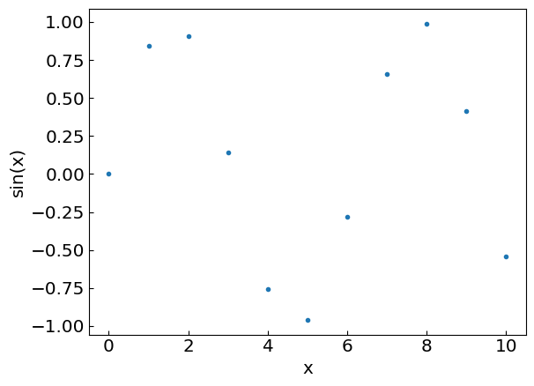
Putting it on a graph
Let us add more points…

Slide 7
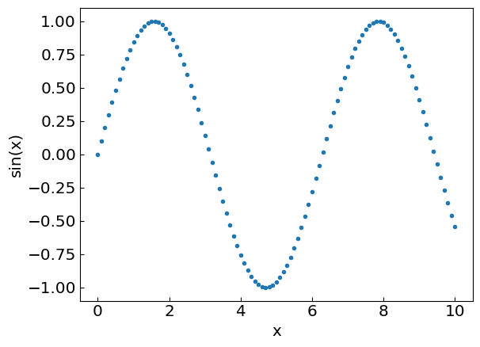
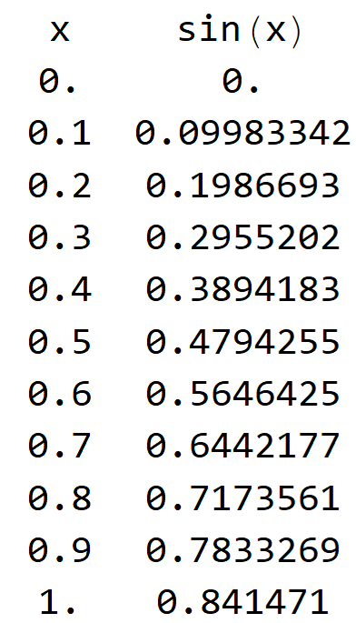
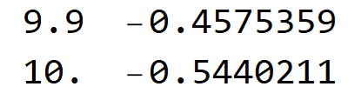
Putting it on a graph
…
Now we have enough points to join them by a smooth line

Slide 8
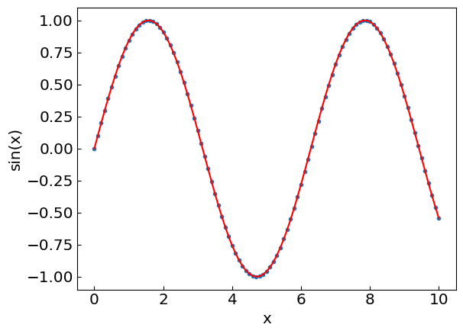
Putting it on a graph
…
Now we have enough points to join them by a smooth line

Slide 9
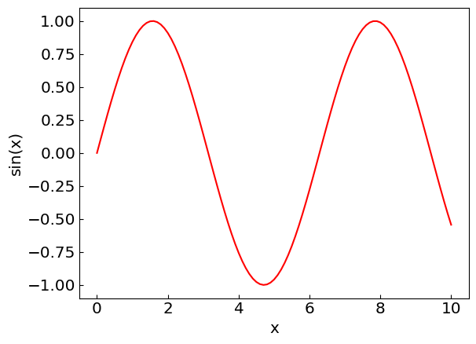
Putting it on a graph
…
Now we have enough points to join them by a smooth line

Slide 10
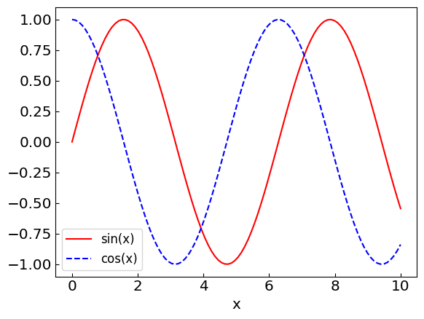
Plot multiple lines to compare functions, profiles, etc.

Slide 11
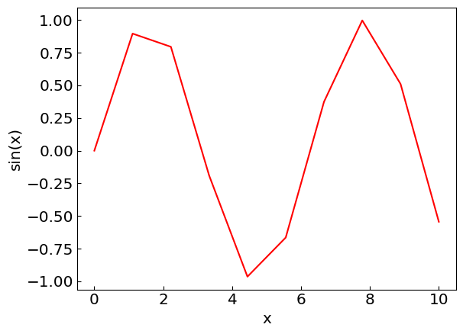
Things to avoid
Insufficient number of data points

Slide 12
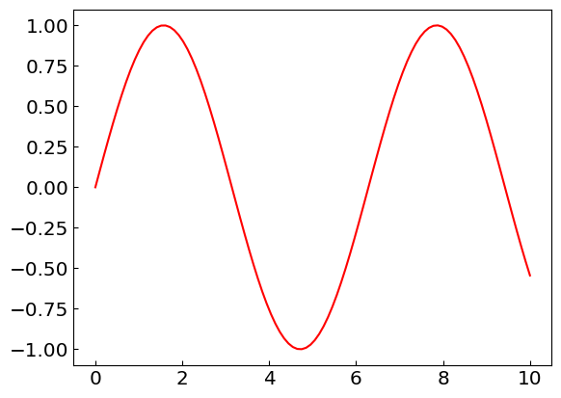
Things to avoid
Unlabeled axes

Slide 13
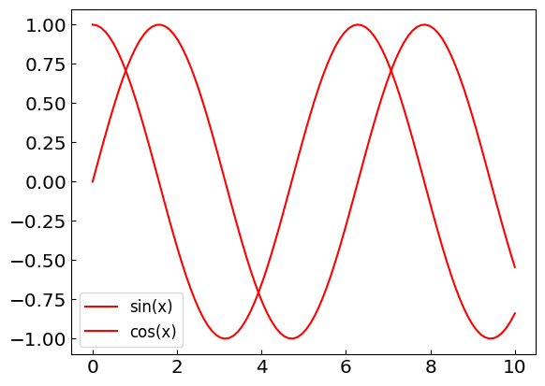
Things to avoid
Indistinguishable line styles

Slide 14
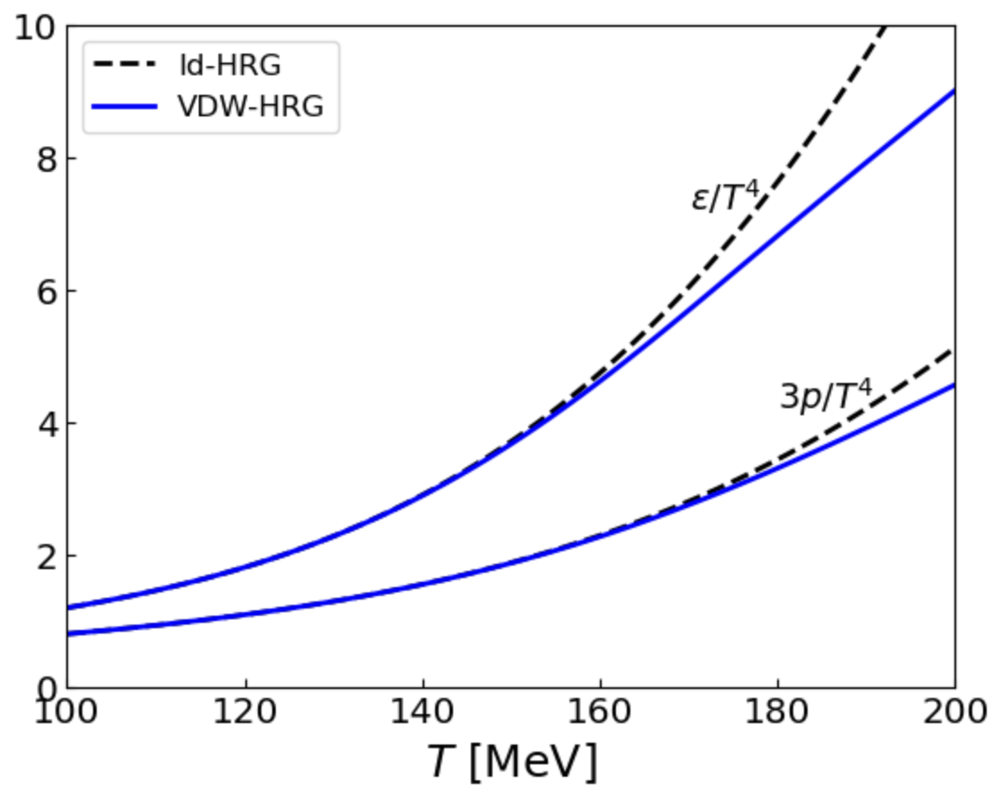
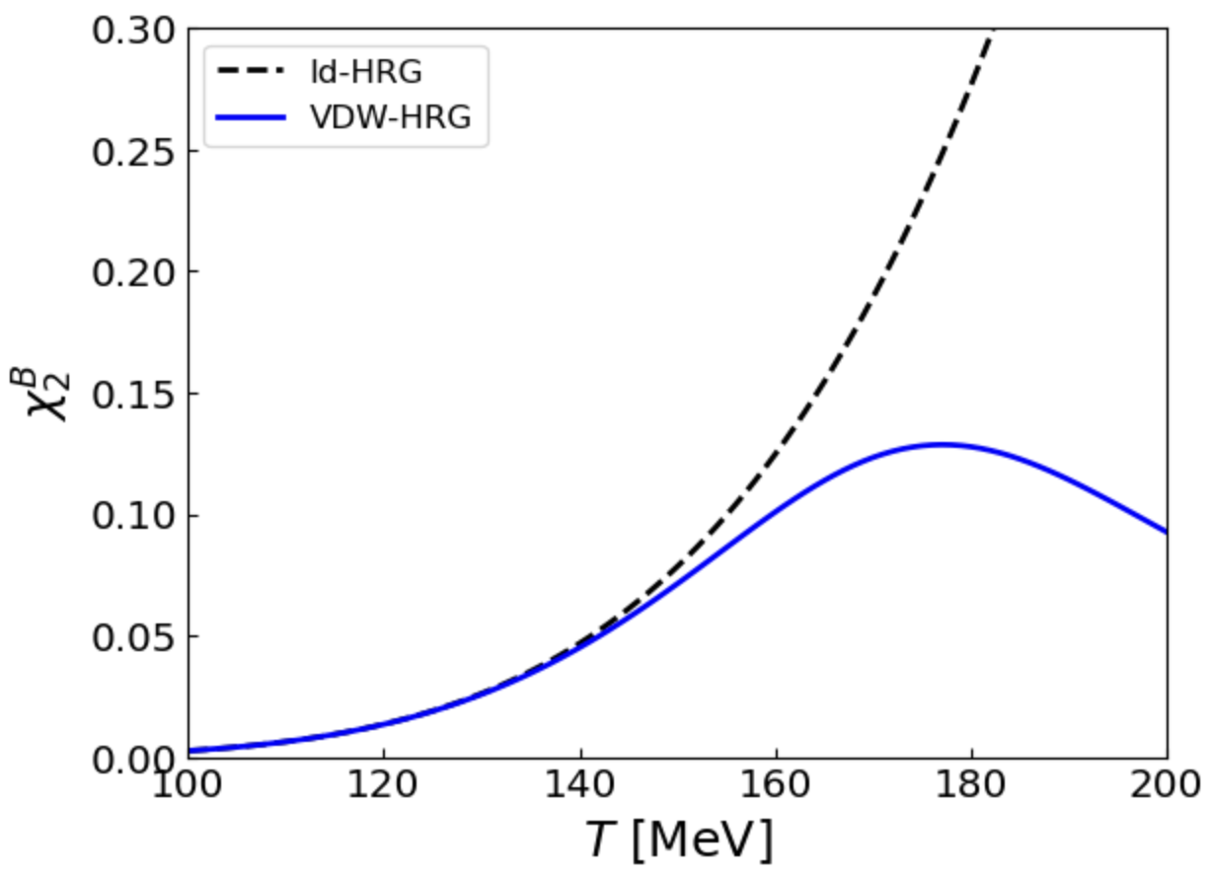
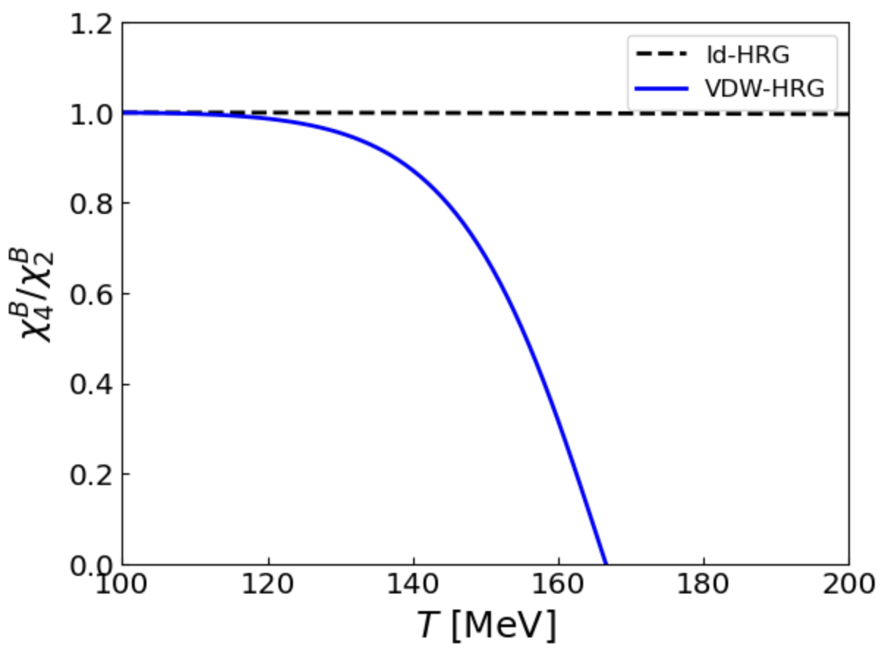
Plotting the HRG equation of state
Yesterday we computed the HRG equation of state with Thermal-FIST
Let us plot it (section “Plotting the HRG equation of state” in Plotting-NuSTEAM2024.ipynb)
You should obtain

Slide 15
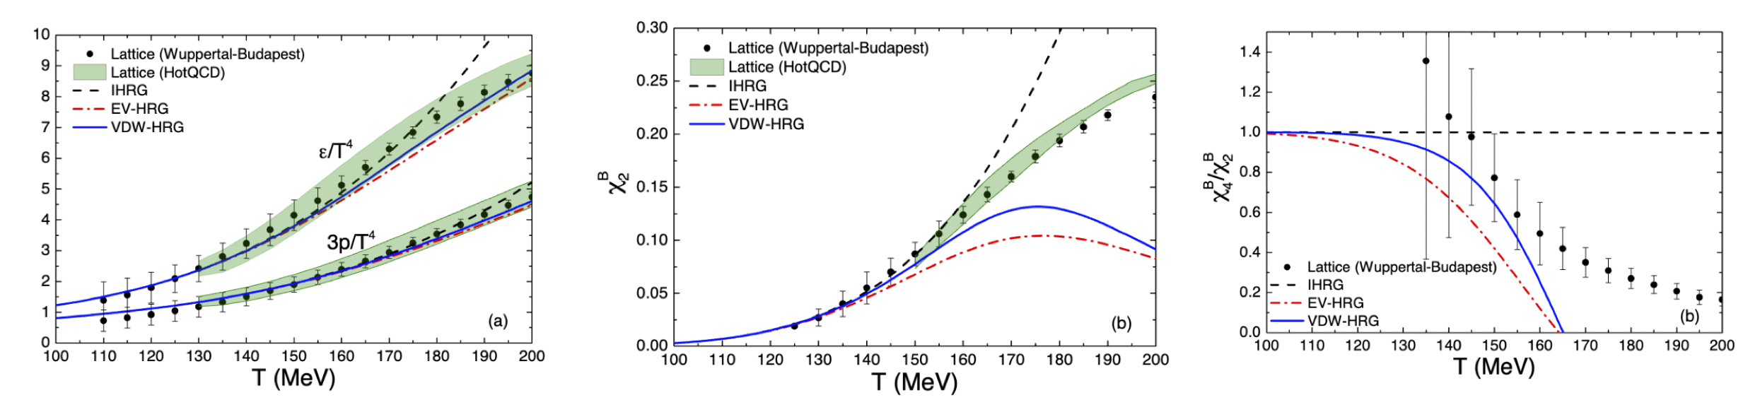
Plotting the HRG equation of state
Published plots:
Figure from Vovchenko, Gorenstein, Stoecker, Phys. Rev. Lett. 118, 182301 (2017)
Exercise: Add EV-HRG curves by performing calculation for a = 0 and b = 3.42 fm³

Slide 16
Errors and accuracy
Numbers representation
Limits
Floating-point precision
Error accumulation
Jupyter Notebook: 1_FloatingPointPrecision-NuSTEAM2024.ipynb

Slide 17
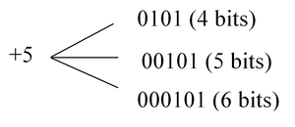



Integer representation
Numbers on a computer are represented by bits – sequences of 0s and 1s
sign
digits
sign
digits
$$+5 = +(1∙2^{0}+0∙2^{1}+1∙2^{2})$$
$−5 =−(1∙2^{0}+0∙2^{1}+1∙2^{2}$)
Most typical native formats:
32-bit integer, range −2,147,483,647 (-2³¹) to +2,147,483,647 (2³¹)
64-bit integer, range ~ −10¹⁸ (-2⁶³) to +10¹⁸ (2⁶³)
Python supports natively larger numbers but calculations can become slow
In C++ it is important to avoid under/over-flow

Slide 18
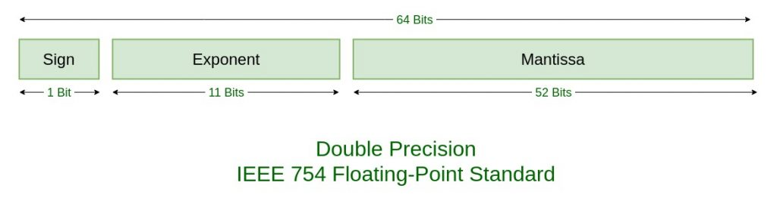

Floating-point number representation
Floating point numbers represented by bit sequences as well, which are separated into:
Sign S
Exponent E
Mantissa M (significant digits)
e.g.
Main consequence: Floating-point numbers are not exact!
For example, with 52 bits one can store about 16 decimal digits
Range: from ~ -10³⁰⁸ to 10³⁰⁸ for a 64-bit float (double precision)

Slide 19

Floating-point number representation
What you write
What it means
for a 64-bit float

Slide 20
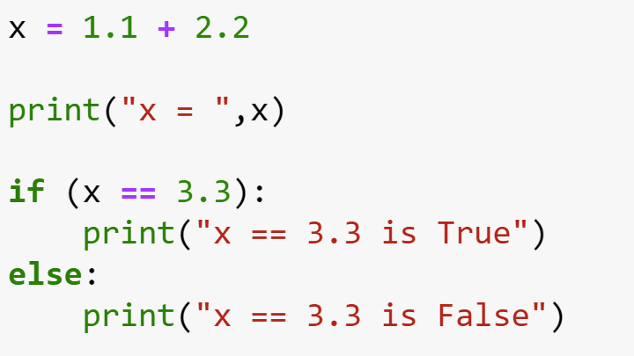
Example: Equality test

Slide 21
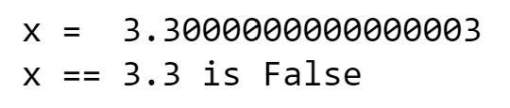
Example: Equality test

Slide 22
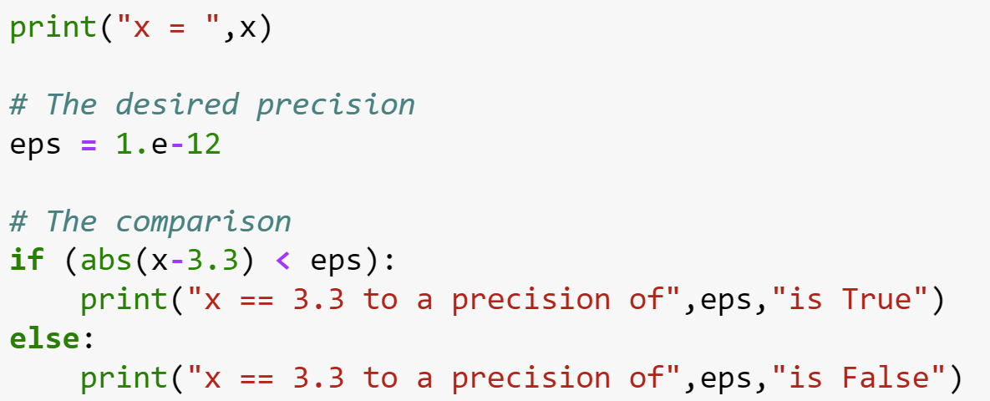
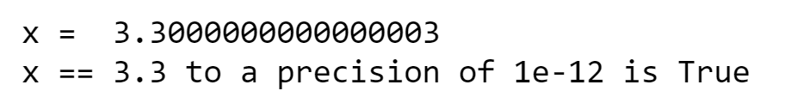
Example: Equality test
You can do instead

Slide 23
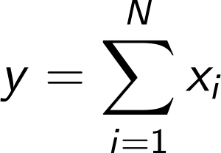
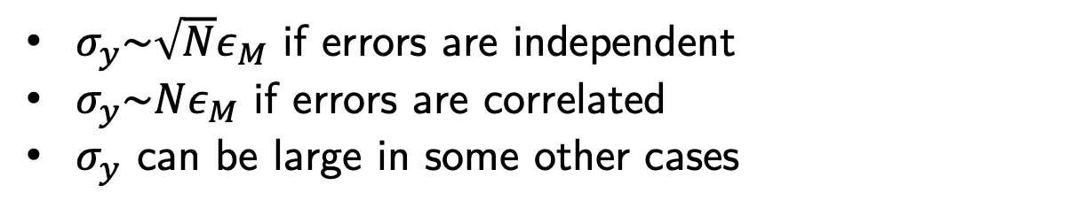
Error accumulation
unavoidable round-off error
Errors accumulate through arithmetic operations, e.g.
$σ_{y}\sim \sqrt{N}ε_{M}$ if errors are independent
$σ_{y}\sim Nε_{M}$ if errors are correlated
$σ_{y}$ can be large in some other cases

Slide 24
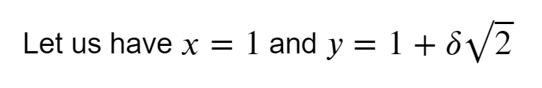
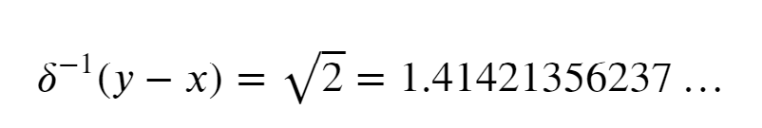
Example: Two large numbers with small difference

Slide 25
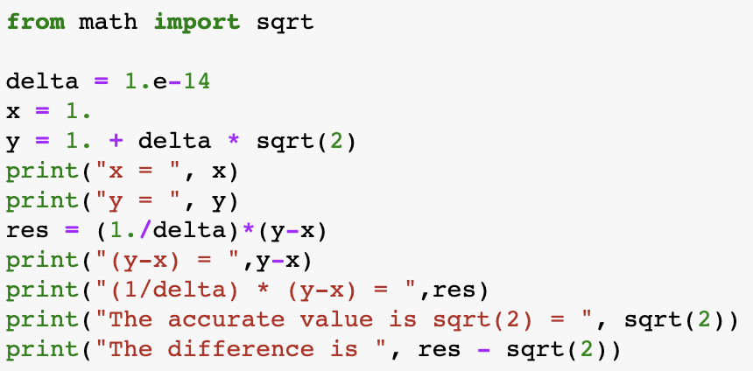
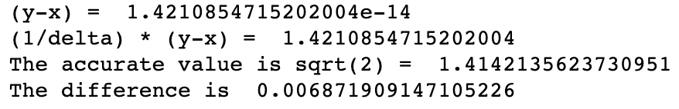
Example: Two large numbers with small difference

Slide 26
Example: Two large numbers with small difference
significant digits
these do not fit
y = 1.000000000000014 142135623730951 …
x = 1.000000000000000 000000000000000 …

Slide 27
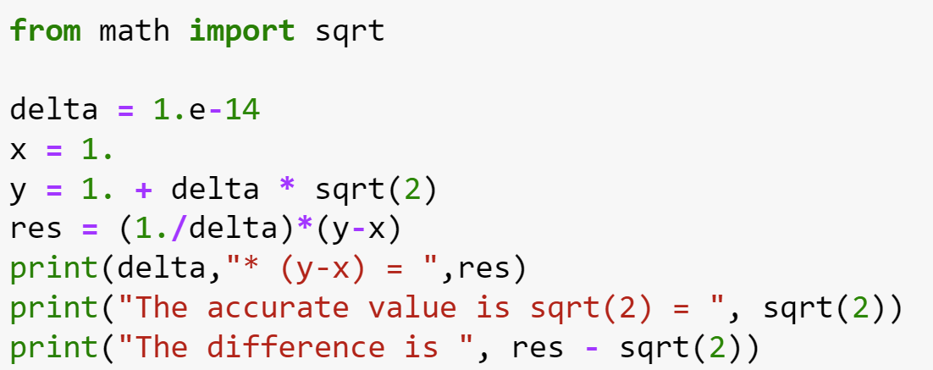
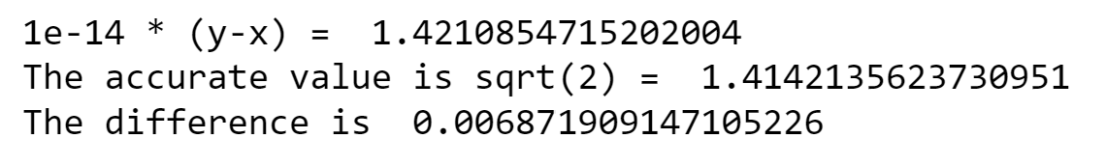
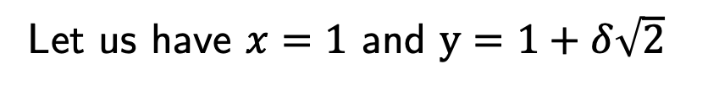
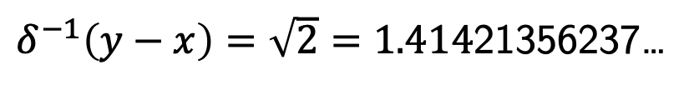
Two large numbers with a small difference
Let us have $x=1$ and $y=1+δ\sqrt{2}$
Symbolically, one has
$δ^{−1}\left(y−x\right)=\sqrt{2}=1.414$21356237…
Let us test this relation on a computer for a very small value of $δ={10}^{−14}$
Catastrophic loss of precision!
What happened?
significant digits
these do not fit
y = 1.000000000000014 142135623730951 …
x = 1.000000000000000 000000000000000 …

Slide 28

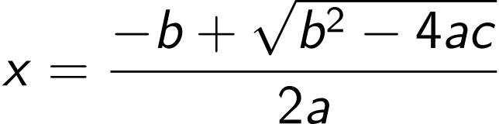
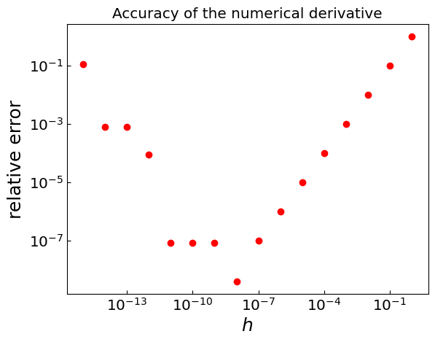
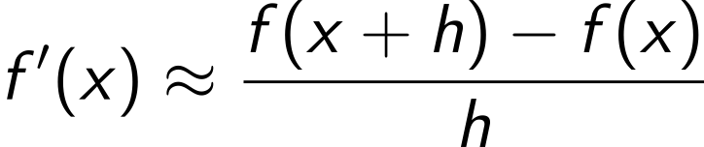
Other examples (hands-on session)
Roots of a quadratic equation with |ac|<<b² (cancellation of two large numbers with small difference)
Simple numerical derivative
Sometimes a small h is too small

Slide 29
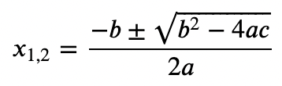
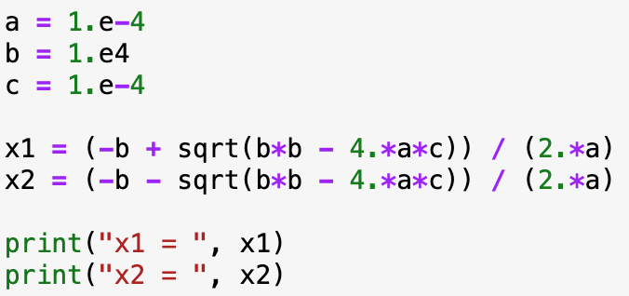


Quadratic equation
Symbolically, the roots are:
$\sqrt{b^{2}−4ac}$ is very close to b
Let us calculate the roots for $a={10}^{−4}, b={10}^{4}, c={10}^{−4}$
|ac|<<b²
x₂ looks ok but x₁ seems off(?)

Slide 30
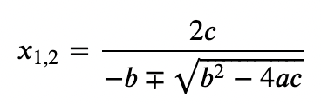
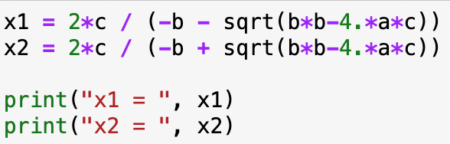

Quadratic equation
Standard form:
Alternative form:
Using the alternative form
x₁ is fixed but now x₂ is off
Solution: Make a judicious choice between standard and alternative form for each root separately, such that subtraction of two similar number is avoided

