Slide 1

HRG thermodynamics with Thermal-FIST
Volodymyr Vovchenko (University of Houston)
NuSTEAM-2025
An example on using open-source C++ code for scientific calculations
June 10, 2025

Slide 2
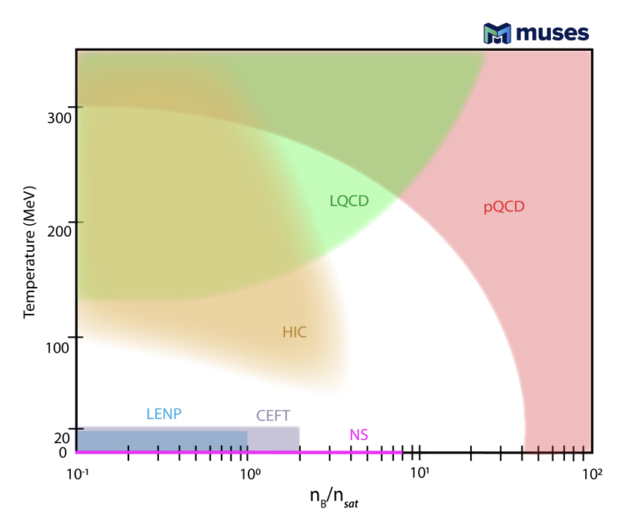
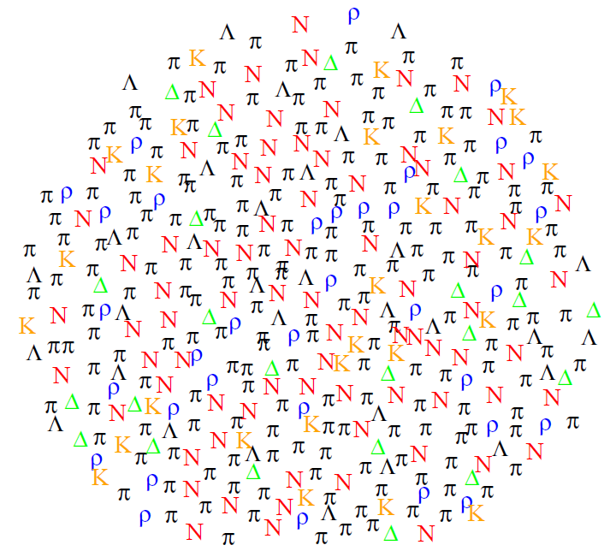
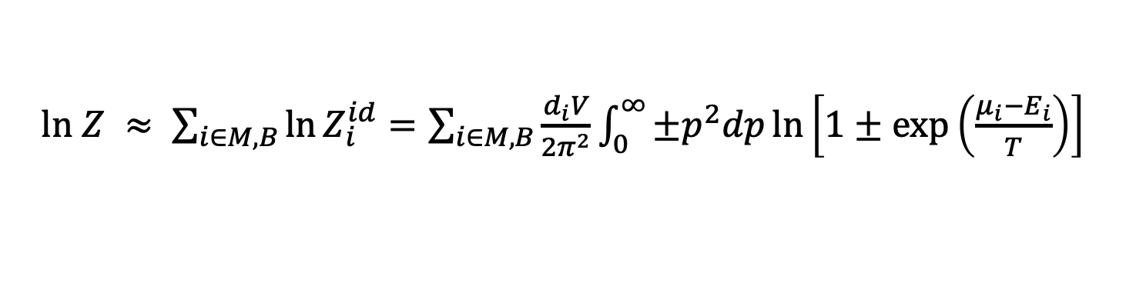
Hadron resonance gas (HRG)
HRG: Equation of state of hadronic matter as a multi-component (non-)interacting gas of known hadrons, resonances, and light nuclei (~400 components)
$ln Z ≈ \sum_{i∈M,B}{\ln{Z_{i}^{id}}}=\sum_{i∈M,B}{\frac{d_{i}V}{2π^{2}}}\int_{0}^{∞}{±p^{2}dp\ln\left[1±\exp\left(\frac{μ_{i}−E_{i}}{T}\right)\right]}$
Grand-canonical ensemble: $μ_{i}=b_{i}μ_{B}+q_{i}μ_{Q}+s_{i}μ_{S}$
chemical equilibrium
© J. Cleymans
Figure from 2303.17021
2

Slide 3
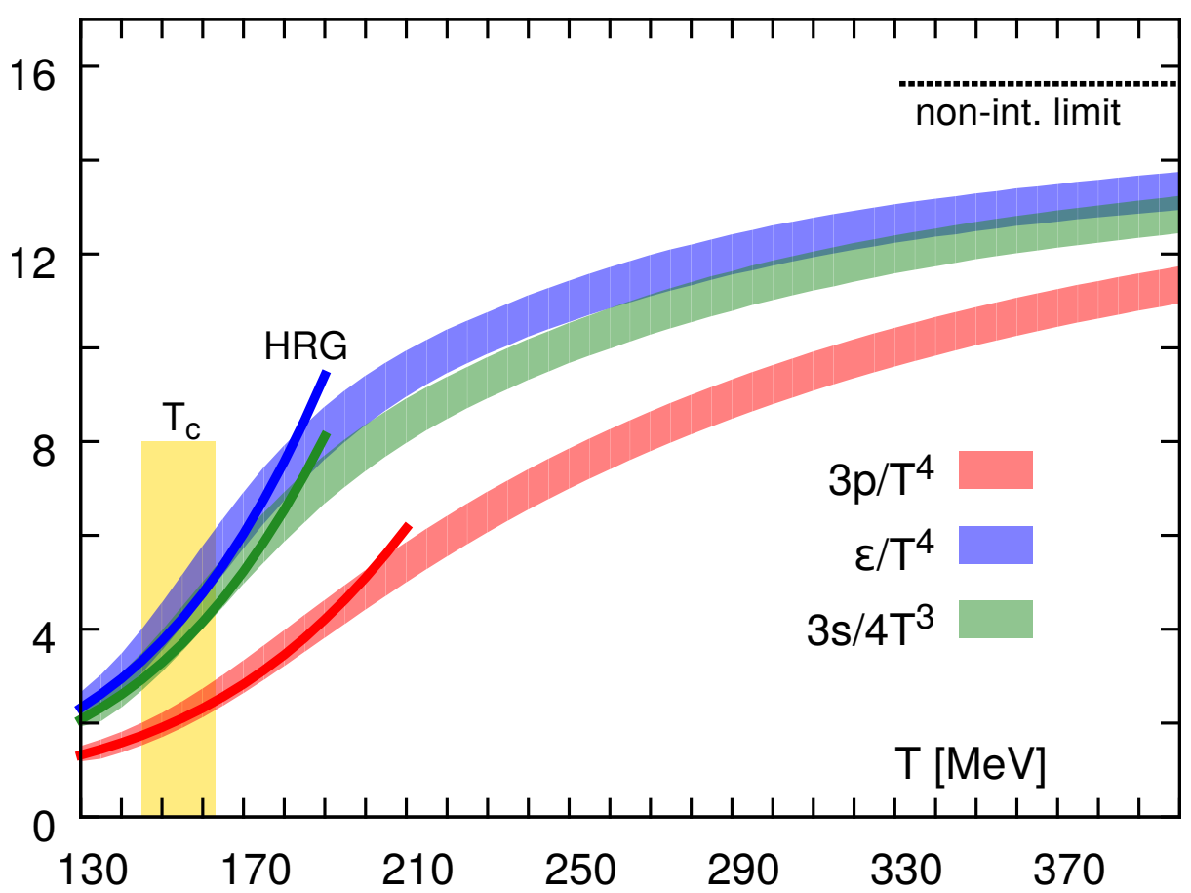
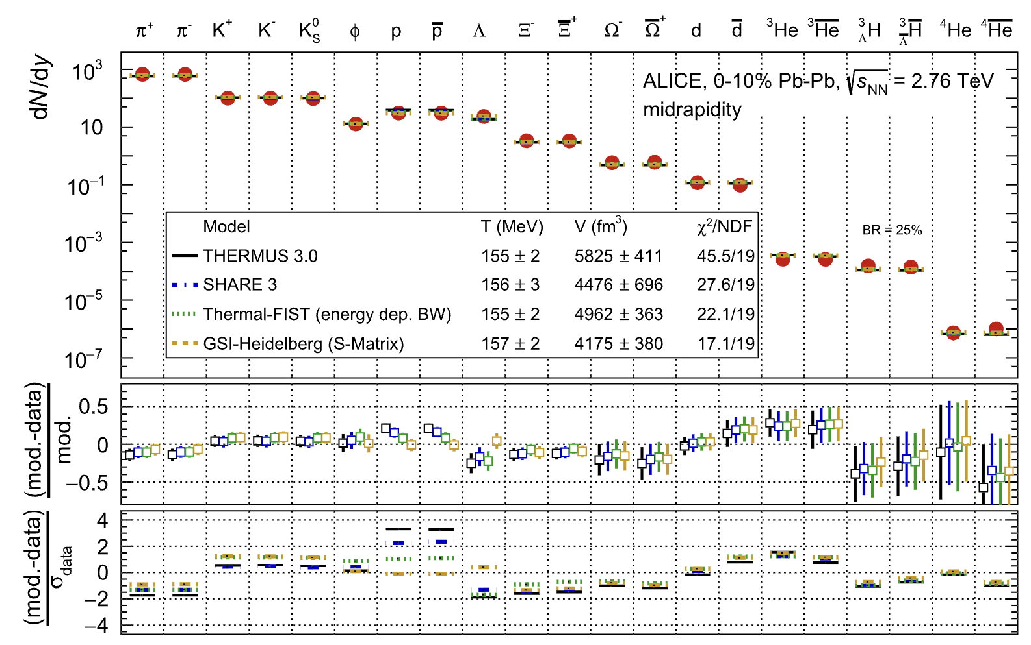
Hadron resonance gas (HRG)
HRG describes the hadronic part of the QCD EoS (low temperature) and the hadron abundances measured in heavy-ion collisions
Figure from HotQCD coll., PRD ‘14
ALICE Collaboration, EPJC 84, 813 (2024)
2

Slide 4

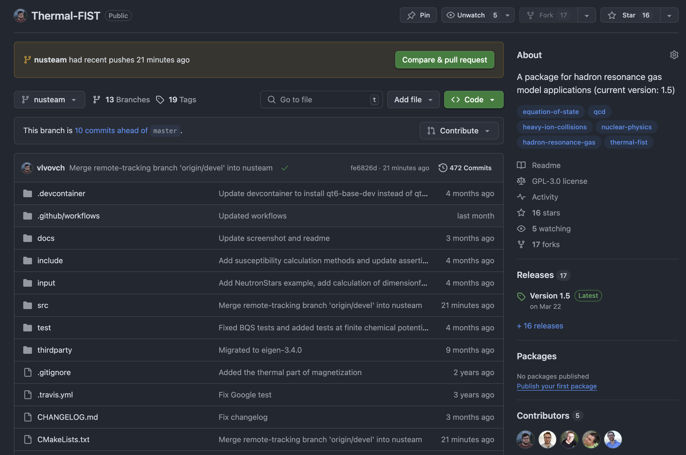
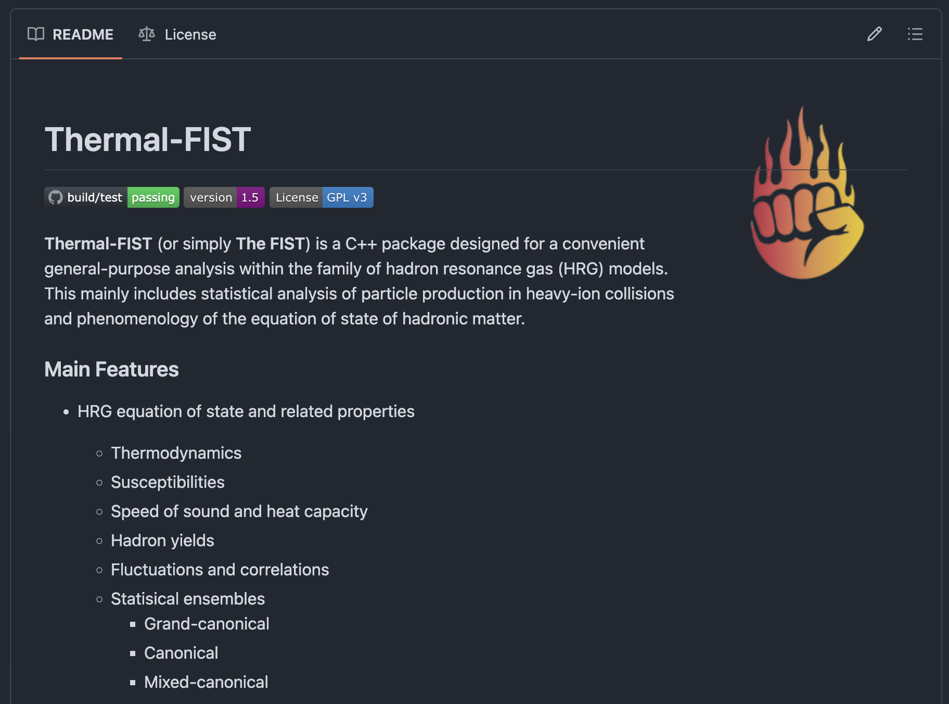
What is Thermal-FIST?
Thermal-FIST* (current version: v1.5)
[V.Vovchenko, H.Stoecker]
Open-source C++ package for general-purpose HRG model analysis
Cross-platform (Linux, Mac, Windows) through cmake
License: GPL-3.0
GitHub: https://github.com/vlvovch/Thermal-FIST
physics manual: Comput. Phys. Commun. 244, 295 (2019)
2014-2018: Initial development and applications (closed source)
June 2018: First public release (v0.6)
Jan 2019: Code documentation and CPC article release (v1.0)
2019-2022: Incremental upgrades
2025-…: Version 1.5 with new features (dense matter EoS, cosmology)
*Thermal, Fast and Interactive Statistical Toolkit
3

Slide 5
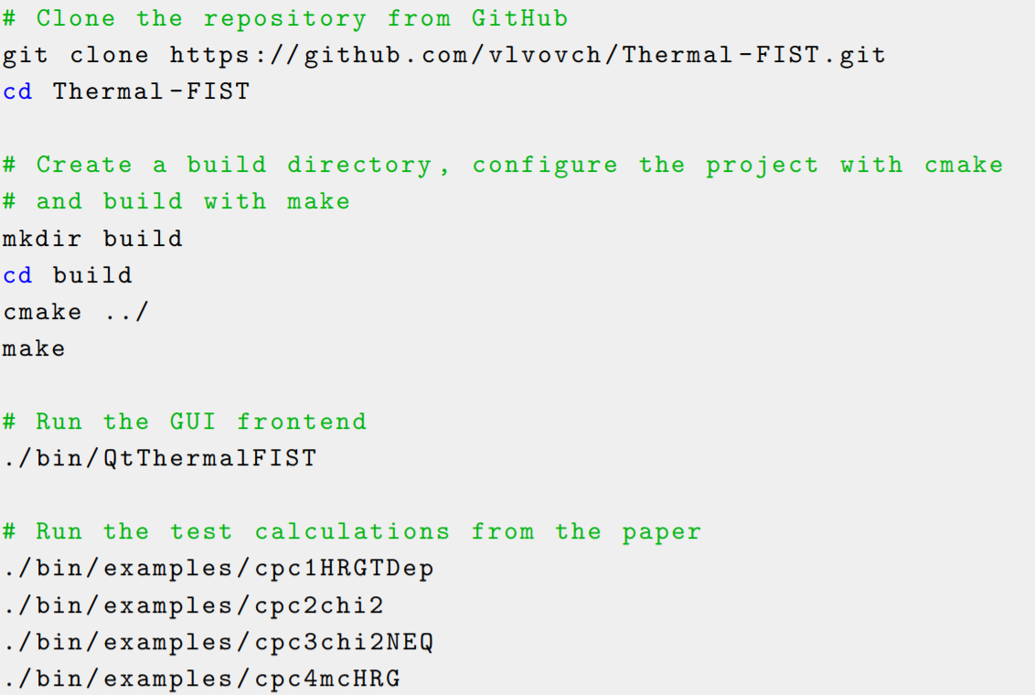
Using Thermal-FIST
Installation using git and cmake
Quick start guide
Documentation
Physics manual
4

Slide 6
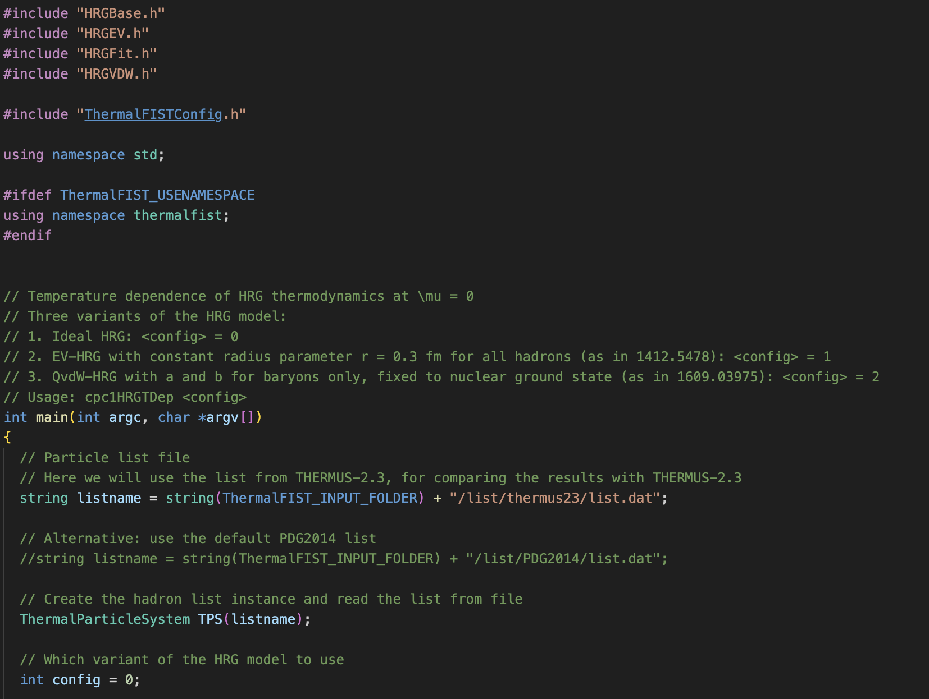
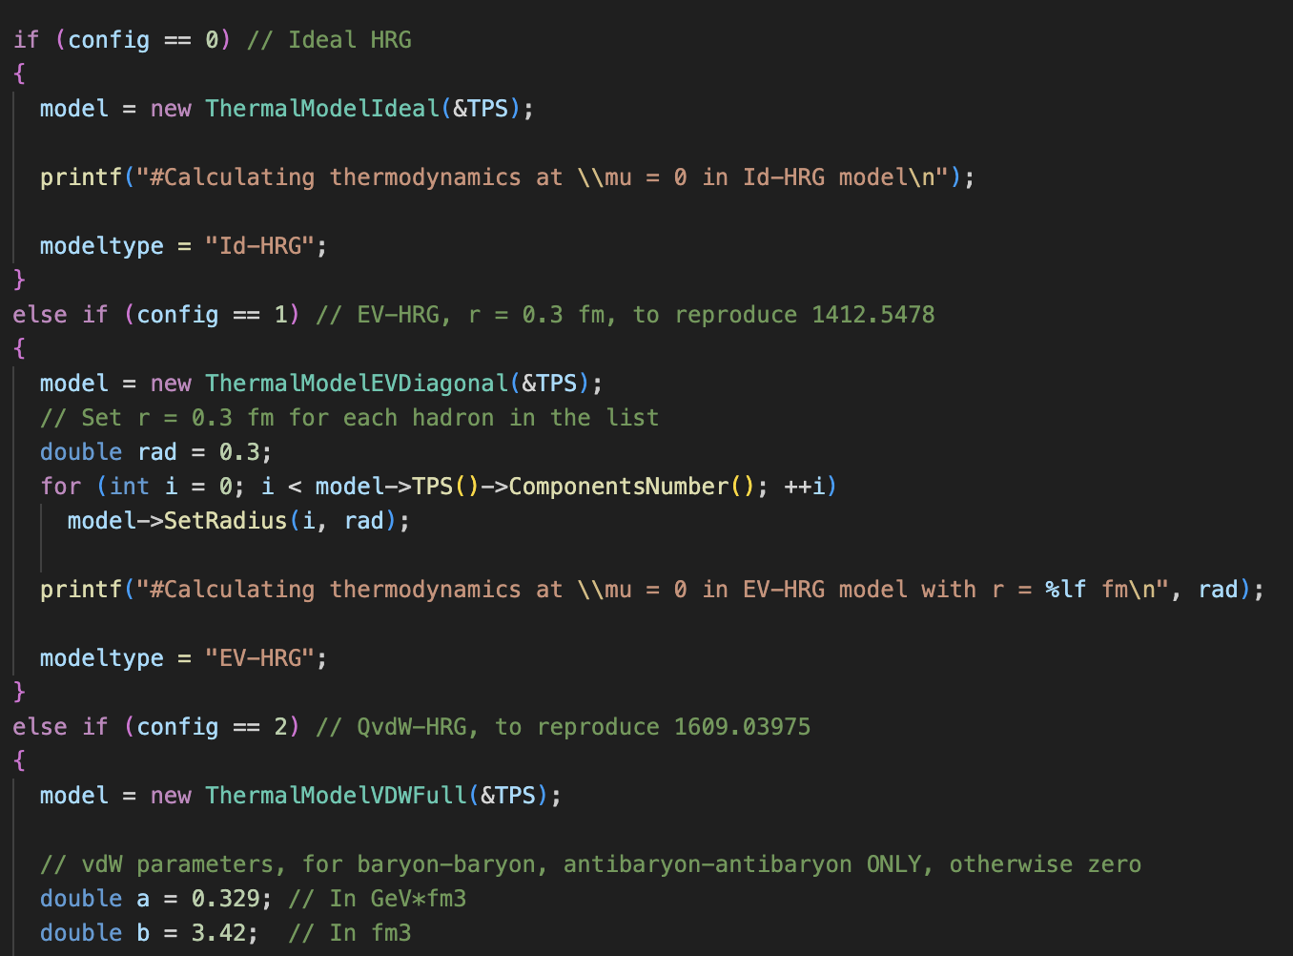
Using Thermal-FIST: Console mode
Link to libThermalFIST and write a C++ macro doing whatever calculation you want
The most flexible way of using the code
git submodule is useful
5

Slide 7
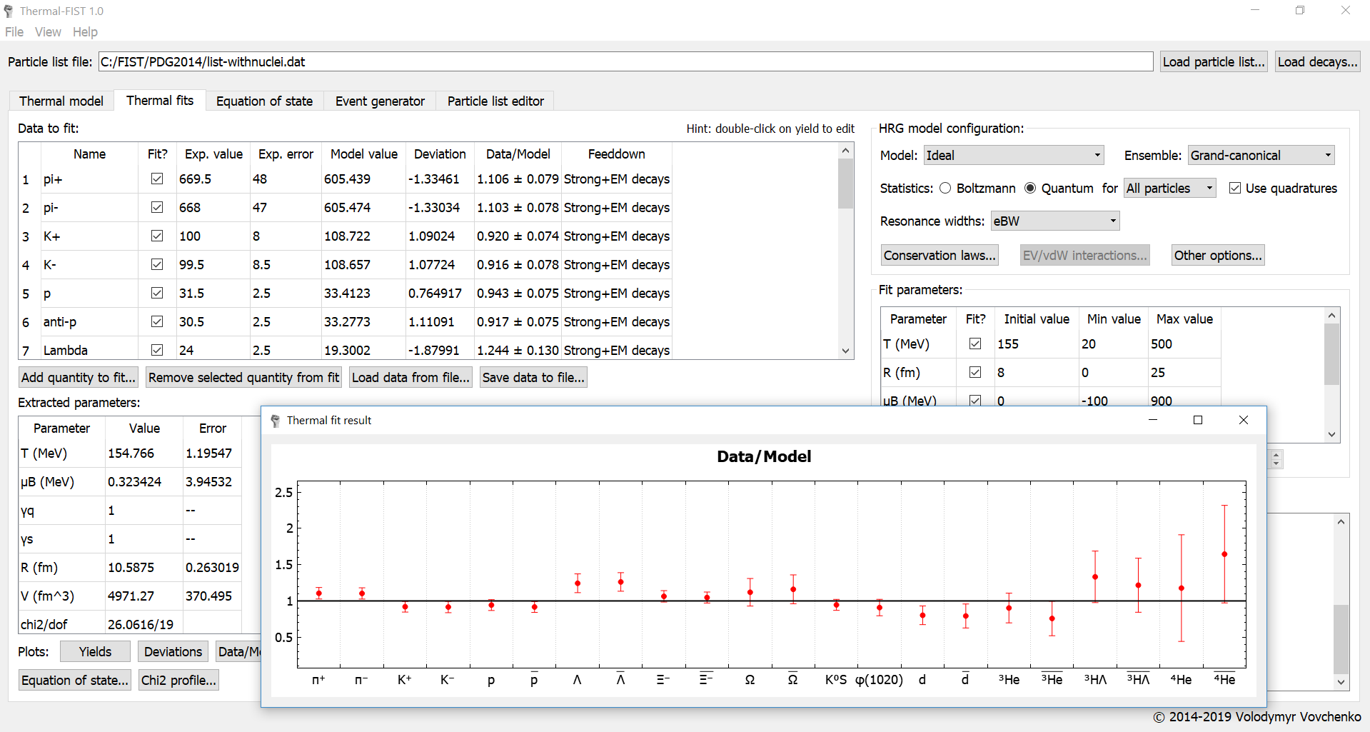
Using Thermal-FIST: GUI
Graphical user interface for general-purpose HRG model applications
Need to install free Qt6 framework from https://www.qt.io/download
6

Slide 8
Example case: HRG thermodynamics

Slide 9
Example case: HRG thermodynamics
Go to https://github.com/vlvovch/Thermal-FIST/tree/nusteam/src/nusteam and follow the instructions
Necessary tools:
git (source version control)
vscode (preferred), Xcode, Clion, Cursor/Windsurf, or Visual Studio (Windows)
CMake tool
On Windows use cmake-gui (https://cmake.org/cmake/help/latest/manual/cmake-gui.1.html) to generate a .sln project for use in Visual Studio
Qt6 framework for running graphical user interface https://www.qt.io/download
Not required for the above example but useful to play around with
8

Slide 10
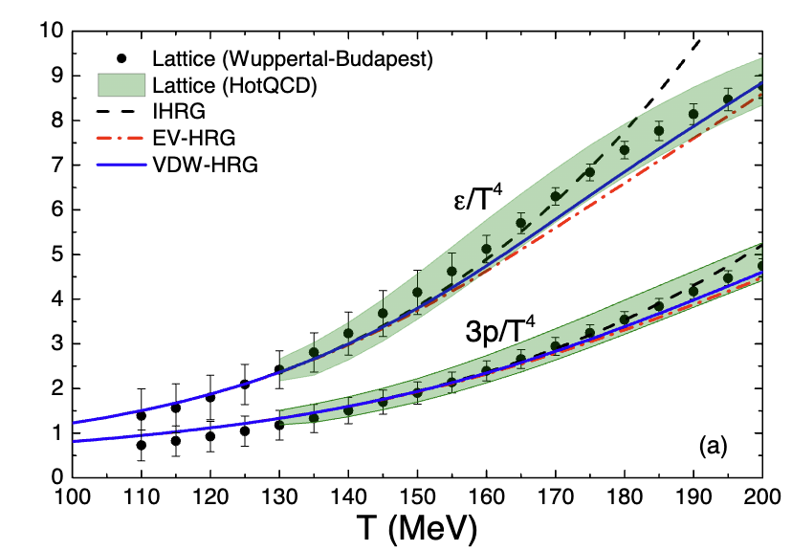
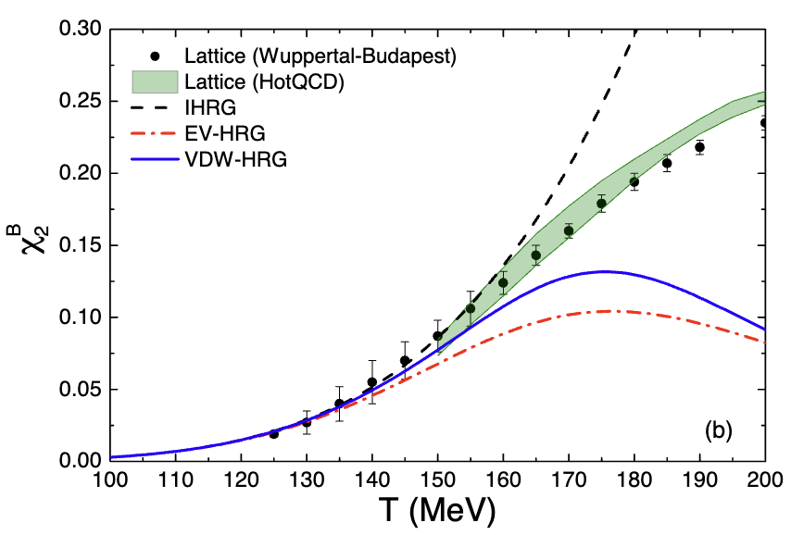
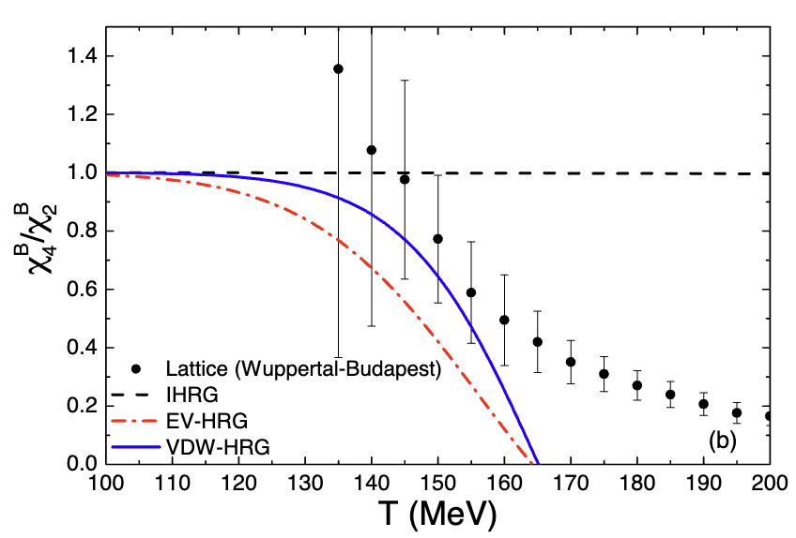
Compare the results to published ones
V. Vovchenko, M.I. Gorenstein, H. Stoecker, van der Waals Interactions in Hadron Resonance Gas: From Nuclear Matter to Lattice QCD, Phys.Rev.Lett. 118 (2017) 182301, arXiv:1609.03975 [hep-ph]
9

Slide 11
Extra slides

Slide 12
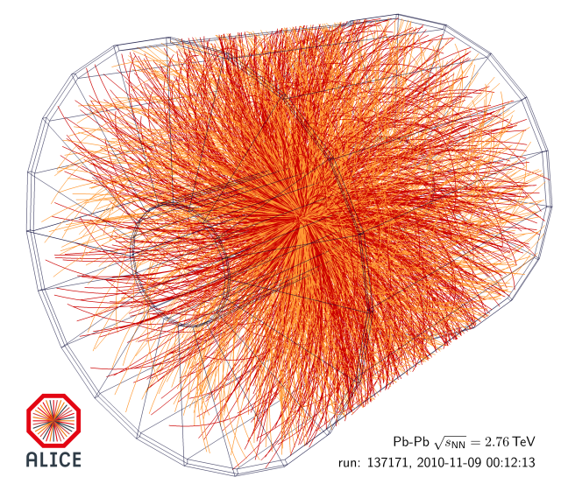
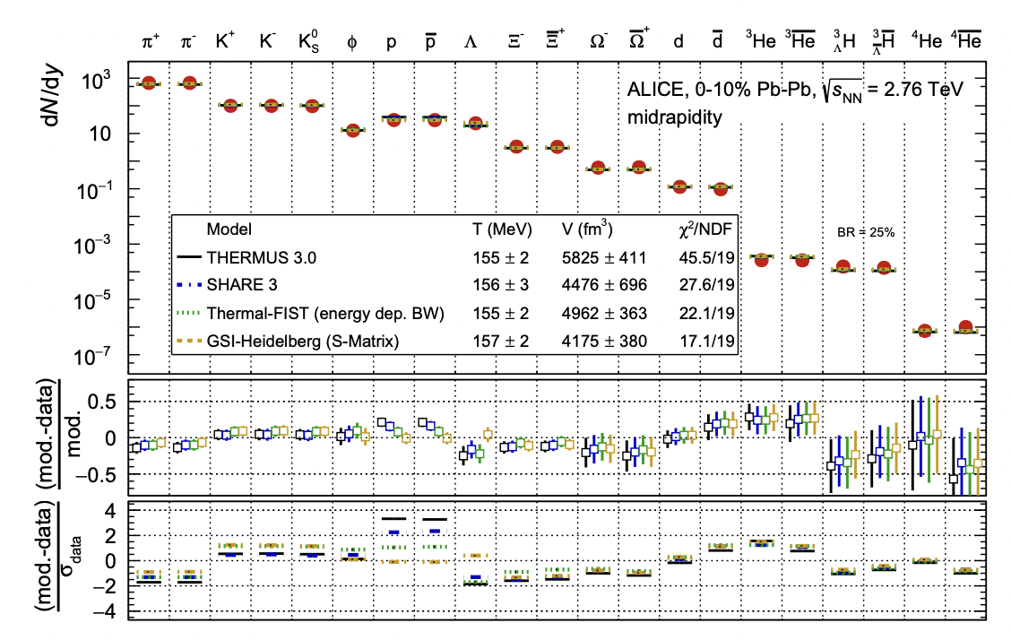
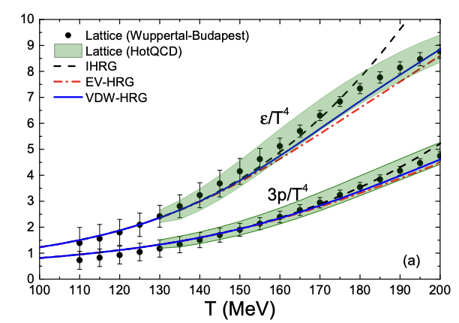
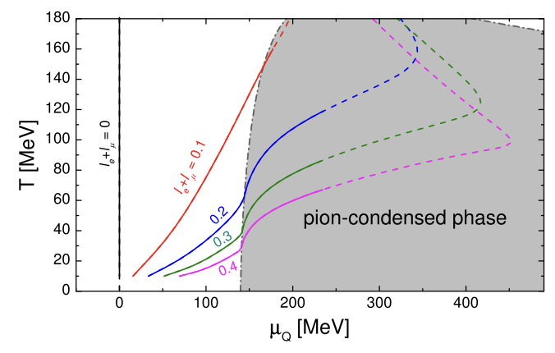
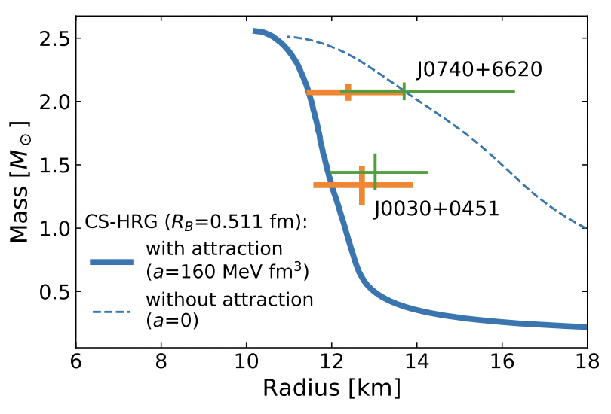
HRG model applications
Heavy-ion collisions
Hadrochemistry (chemical freeze-out)
Fluctuations of conserved charges
Lattice QCD context
Understanding the degrees of freedom
Equation of state, susceptibilities, partial pressures
Early universe
Modeling QCD contribution to cosmic EoS
Finite isospin density
Neutron-star matter
Extending to include non-resonant interactions
Hadronic part of the CMF model
ALICE Coll. (2022)
VV et al., PRL (2017)
VV et al., PRL (2021)
Natural block for MUSES
Fujimoto et al., 2109.06799
3

Slide 13
HRG model aspects in Thermal-FIST
Equation of state and related properties
thermodynamics, hadron yields and fluctuations
Extensions of the base HRG model
finite resonance widths
repulsive (excluded volume) and van der Waals interactions (criticality)
(non-)conserved charges fluctuations and correlations
partial chemical equilibrium
Heavy-ion applications
thermal fits
small systems and canonical effects
Monte Carlo event generator
partial chemical equilibrium
light nuclei
Other applications
Neutron star matter
Early universe (cosmic EoS)
5

Slide 14
What is Thermal-FIST?
Thermal-FIST* (current version: v1.4.2)
[VV, H. Stoecker]
Open-source C++ package for general-purpose HRG model analysis
Cross-platform (Linux, Mac, Windows) through cmake
License: GPL-3.0
GitHub: https://github.com/vlvovch/Thermal-FIST
physics manual: Comput. Phys. Commun. 244, 295 (2019)
Since 2018
Flexible particle lists
Non-resonant interactions (EV/vdW/…)
Finite resonance widths
Fluctuations and correlations
Canonical ensemble effects
Partial chemical equilibrium (hadronic phase)
Monte Carlo mode
Graphical user interface
…
*Thermal, Fast and Interactive Statistical Toolkit
3

Slide 15
Thermal-FIST structure
Core library (libThermalFIST)
Ideal (base) HRG model (HRGBase)
Interacting HRG model (HRGEV/HRGVDW)
Partial chemical equilibrium (HRGPCE)
Monte Carlo mode (HRGEventGenerator)
Thermal fits (HRGThermalFit)
Graphical user interface (QtThermalFIST)
Based on Qt5
Wrapper around libThermalFIST
Sample console applications
Essentially just C++ macros linking to libThermalFIST
External dependencies:
Eigen library for linear algebra (header-only, built-in)
Minuit2 (built-in, i.e. ROOT not needed)
Qt6/Qt5 (for GUI only)
*Thermal, Fast and Interactive Statistical Toolkit
6

Slide 16


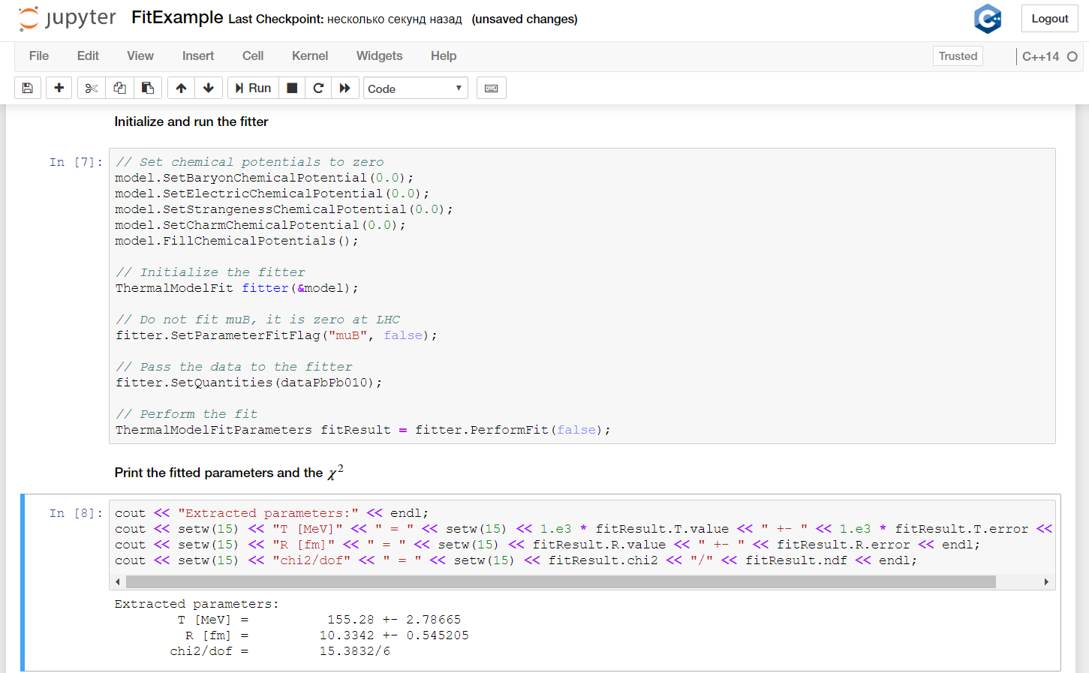
Using Thermal-FIST: Jupyter notebooks
Interactive notebooks through Jupyter (xeus kernel and ROOT-cling)*
*Since version 1.2.1, example at github.com/vlvovch/FIST-jupyter
9

Slide 17
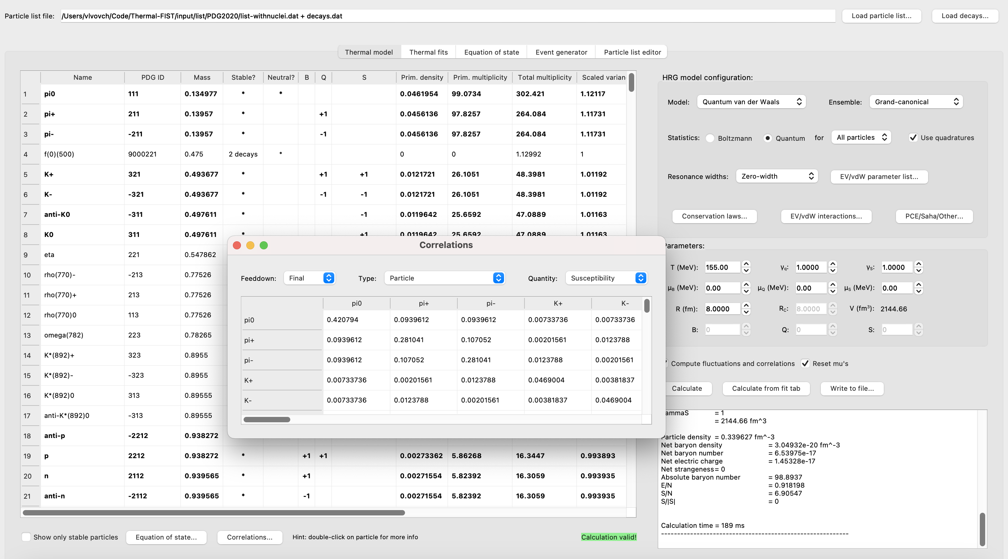
Thermal-FIST and HRG model equation of state
Base calculation is at fixed T & $μ_{B,Q,S}$ (alternatively at fixed s/n_{B}, Q/B, S/|S|)
Thermodynamic functions, hadron abundances, feeddown, correlations and fluctuations
11

Slide 18
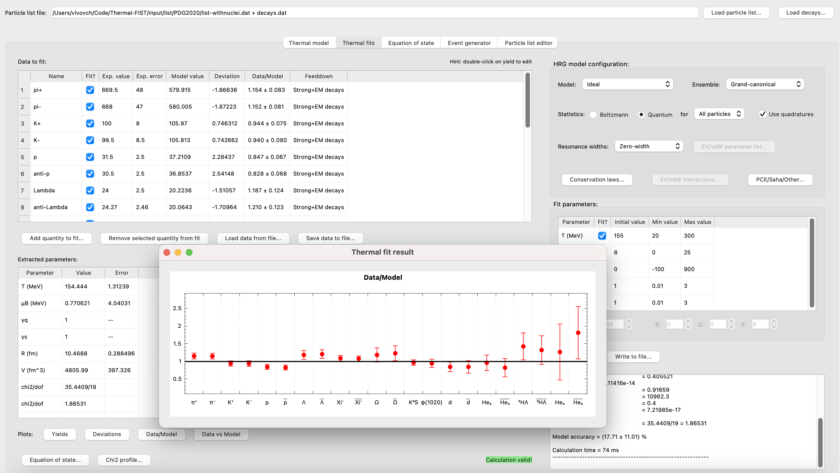
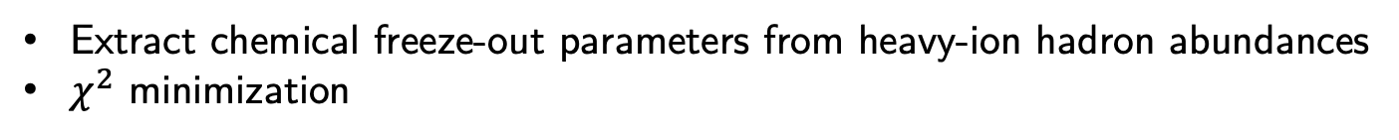
Thermal-FIST and Thermal-FITS
Extract chemical freeze-out parameters from heavy-ion hadron abundances
$χ^{2}$ minimization
12

Slide 19
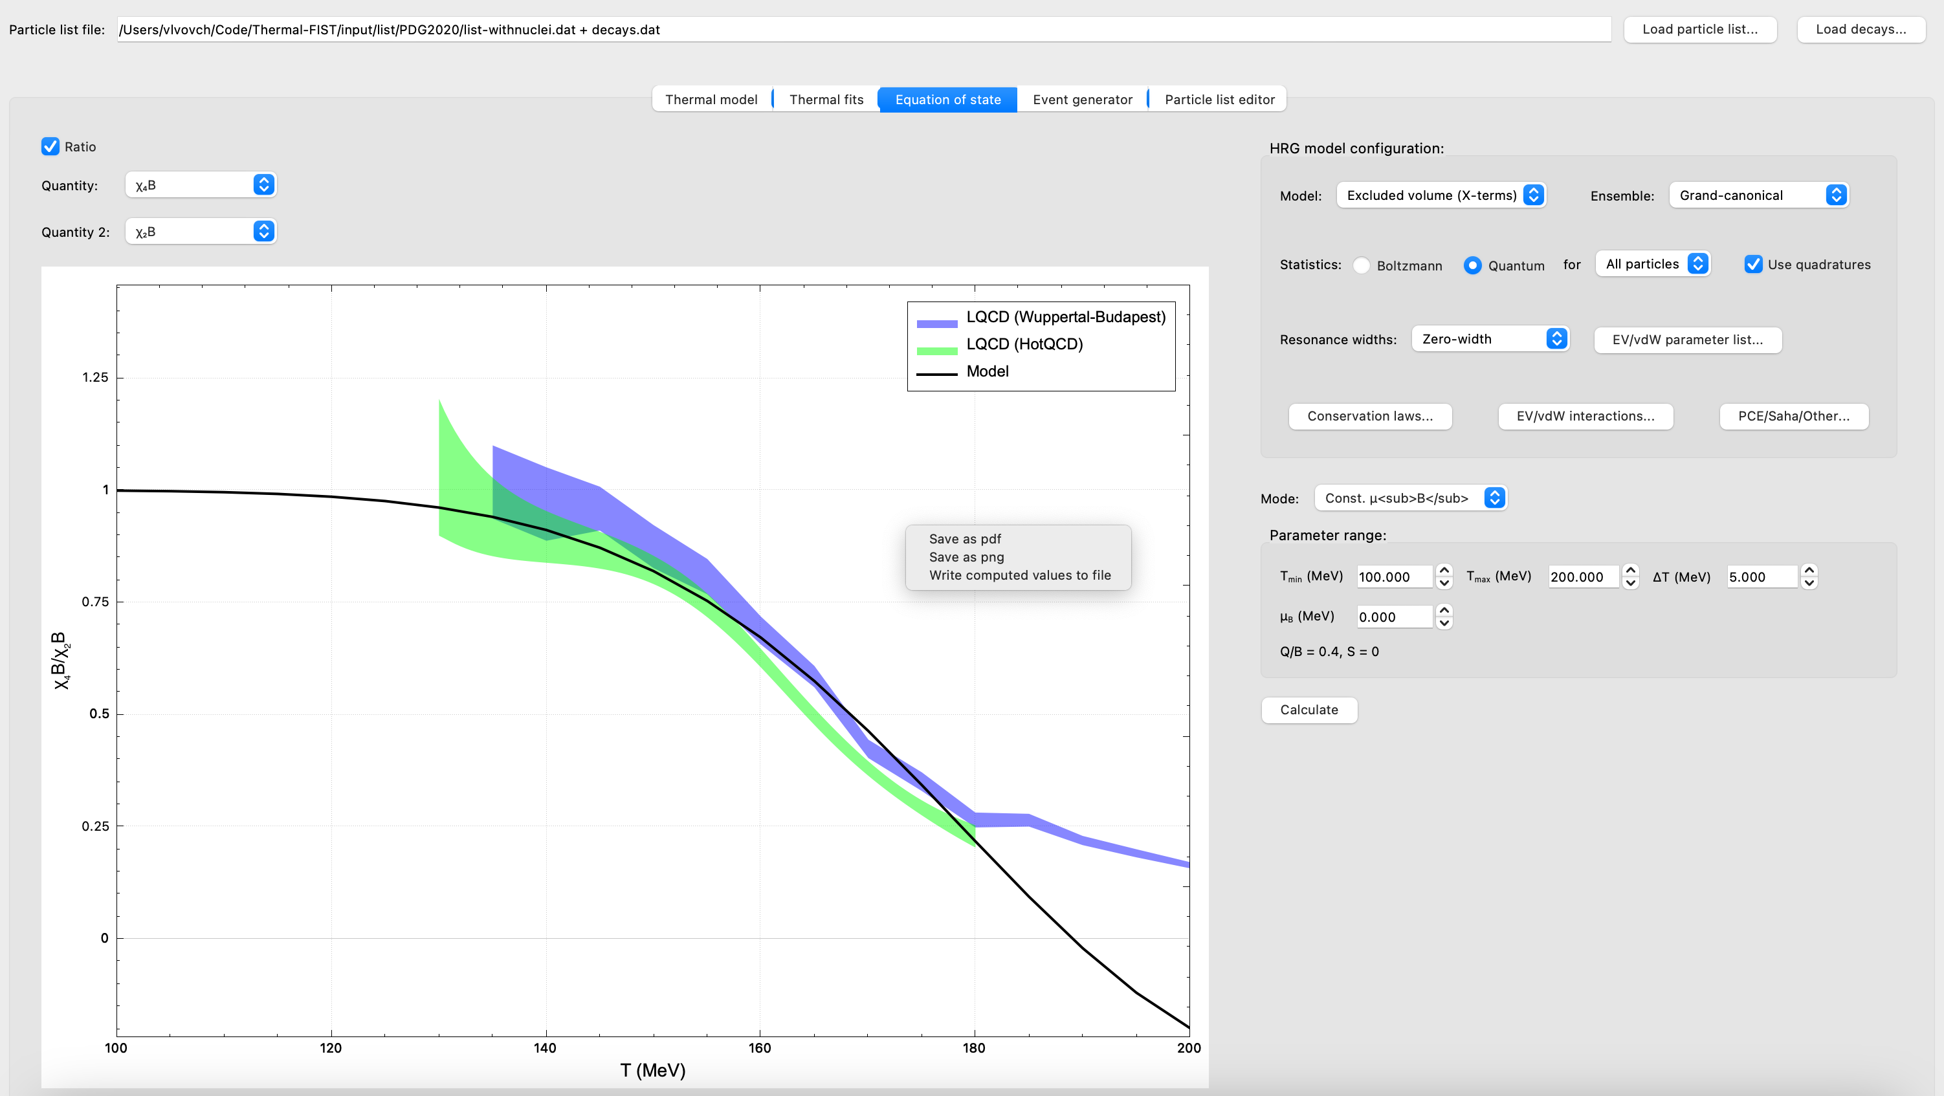
Thermal-FIST and equation of state
Compute HRG model quantities along a fixed T, $μ$_{B}, or $μ$_{B} /T
Impose conservation laws [e.g. strangeness neutrality (heavy-ions) or charge neutrality (neutron stars)]
13

Slide 20
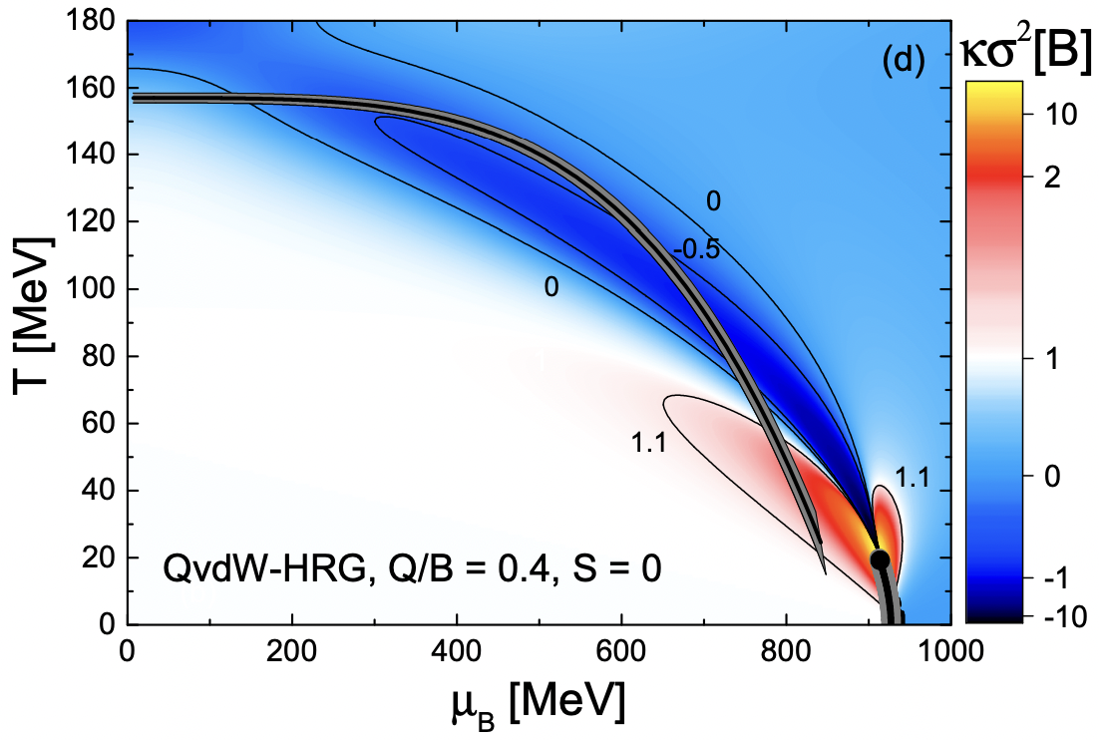
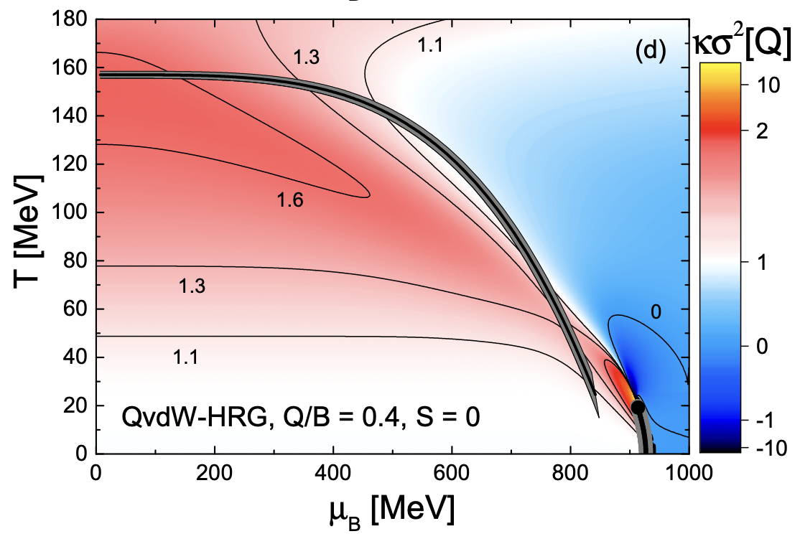
Thermal-FIST and equation of state
Console mode provides more flexibility
baryon number
electric charge
Figure from R.V. Poberezhnyuk et al., PRC 99, 024907 (2019)
14

Slide 21
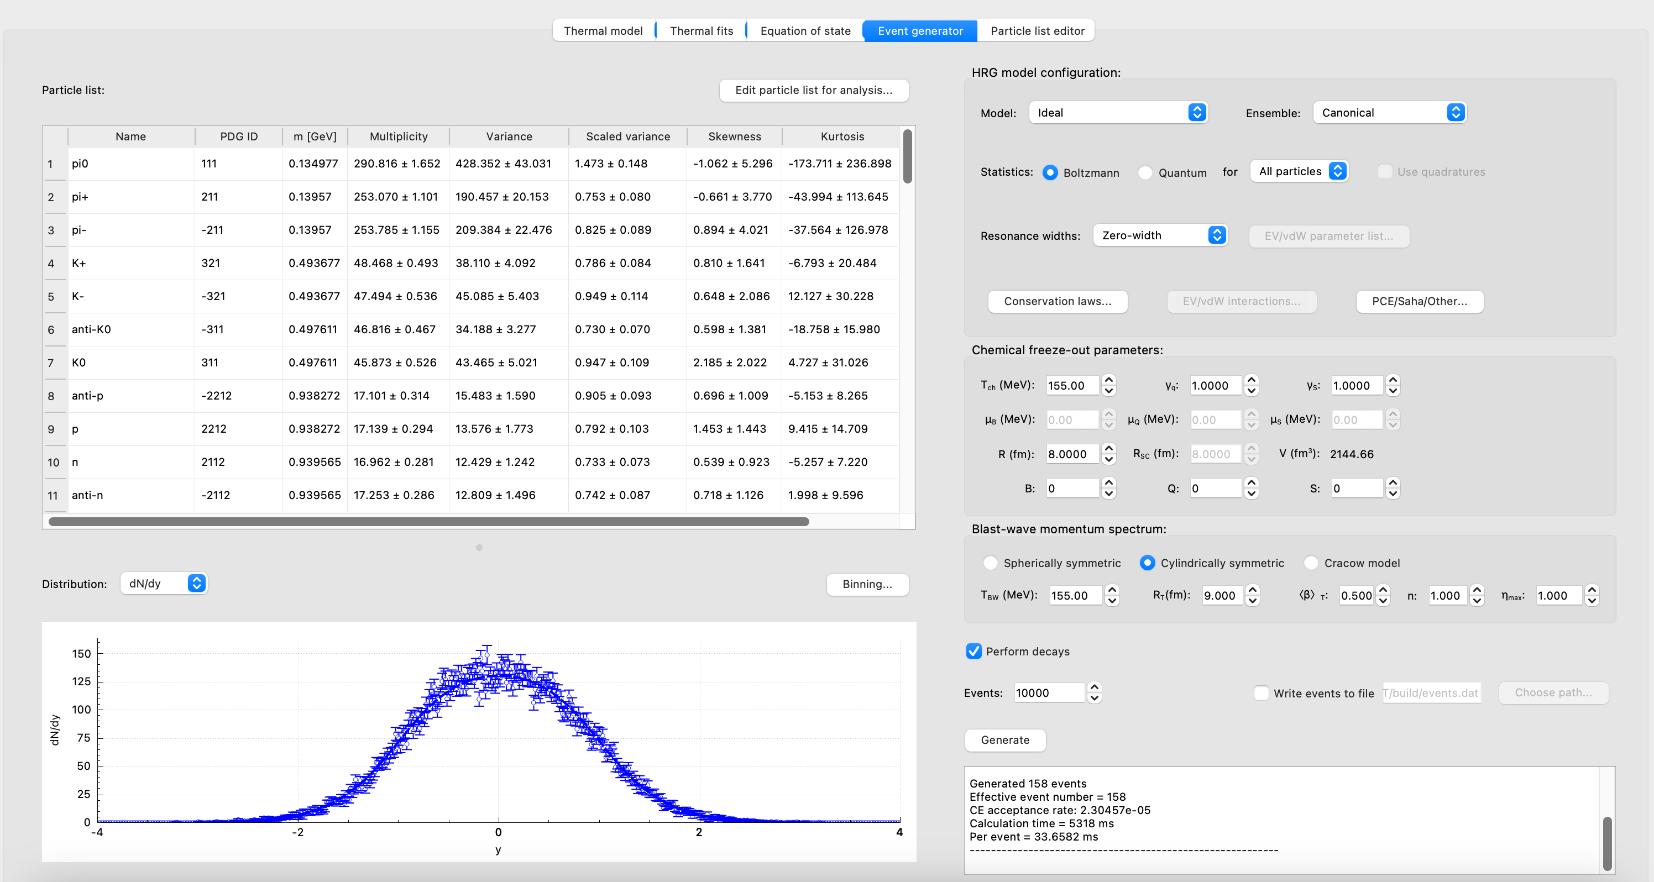
Thermal-FIST and HRG event generator
Monte Carlo sampling of hadron abundances, momenta, and coordinates
Superimposed on blast-wave flow velocity profile
Realistic modeling of acceptance effects, especially for correlations and fluctuations
15

Slide 22
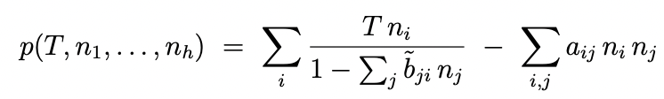
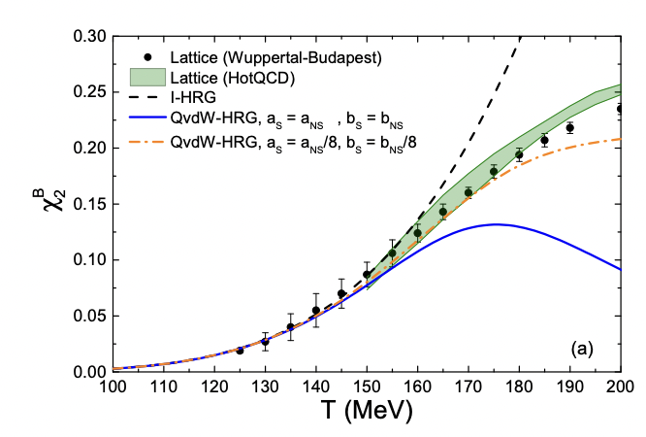
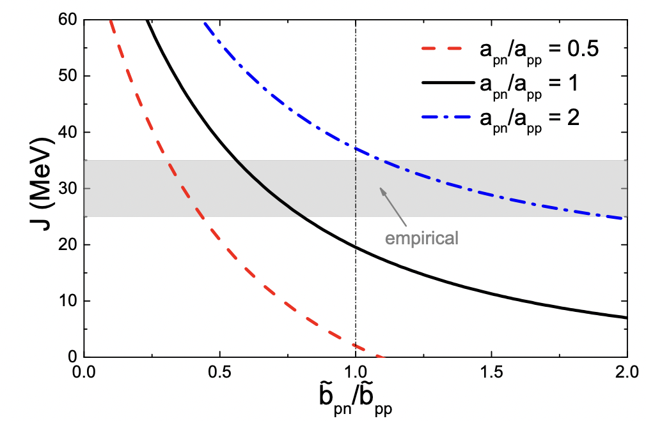
Interactions in HRG
Interacting HRG can be more smoothly connected to other QCD phases than ideal HRG
e.g. the crossover in T direction, Albright, Kapusta, Young, PRC (2014)
Thermal-FIST incorporates van der Waals interactions in the most general form
Separate excluded volume b_{ij} for each pair i,j of species
Separate mean field a_{ij} for each pair i,j of species
So far very little explored!
E.g. indications for flavor-dependent parameters from
Lattice QCD susceptibilities
Symmetry energy
Neutron-star matter EoS
VV, Motornenko, Alba, et al., 1707.09215
[Karthein et al., 2107.00588]
[Fujimoto et al., 2109.06799]
17

Slide 23
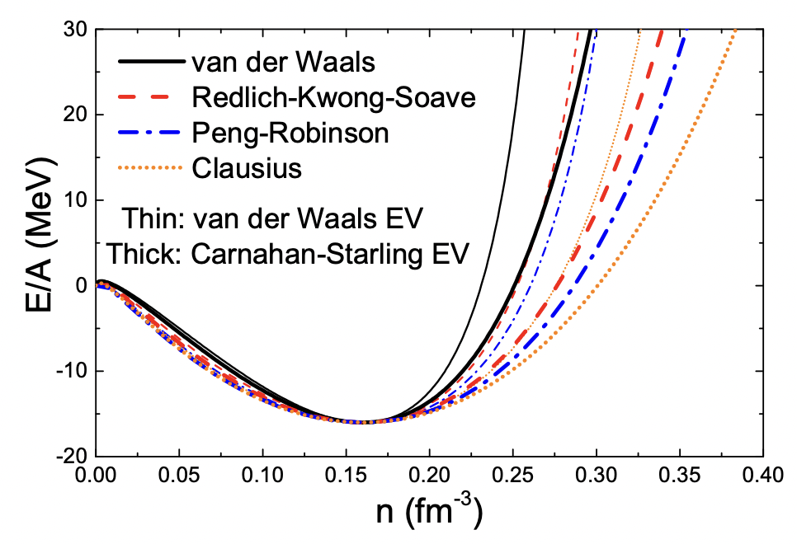
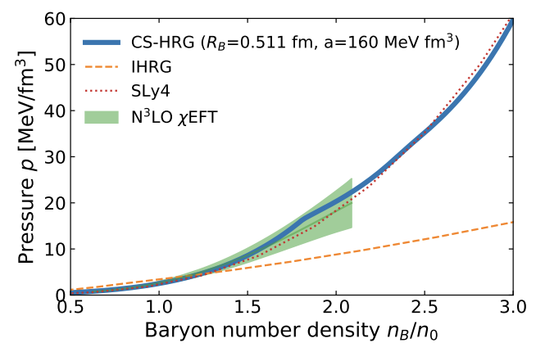
Interactions in HRG: Beyond van der Waals
Standard van der Waals gives too stiff EoS beyond the saturation density
Beyond vdW:
Generalized (non-linear) excluded volume
Carnahan-Starling (CS)
Density-dependent mean-field
Real gases
Skyrme
VDF model
VV, PRC 96, 015206 (2017)
A. Sorensen, V. Koch, PRC 104, 034904 (2021)
Helps soften the EoS in the cold & dense regime, making it easier to match with others
Available out-of-the-box in FIST in next version (already present in devel branch on github), adding leptons into the list one can do neutron-star matter
Another extension: pion interactions and condensation at finite isospin density
VV et al., PRL (2021)
Fujimoto et al., 2109.06799
18

