Slide 1

Computational Physics (PHYS6350)
Lecture 1: Introduction, Syllabus, Technical Details
January 14, 2025
Instructor: Volodymyr Vovchenko (vvovchenko@uh.edu)

Slide 2
Course description
Description: Simulation of classical and quantum mechanical problems on digital computers using numerical and modern programming techniques.
Topics:
General introduction to scientific programming and visualization.
Function interpolation.
Linear algebra and matrices.
Numerical solutions to (systems of) non-linear equations.
Numerical integration and differentiation.
Numerical solutions to ordinary and partial differential equations.
Molecular dynamics and Monte Carlo simulations.
Problems from classical, statistical, and quantum mechanics.
Data analysis, processing, and parameter estimation. Bayesian analysis.
Introduction to parallel computing and machine learning. (tentative)
Textbook: No mandatory textbook but recommend Computational Physics by Mark Newman (Some parts of this text are available on the author’s website: http://www-personal.umich.edu/~mejn/cp/index.html)
2

Slide 3
Requirements
A laptop to run where you can write, compile, and run code.
Plotting of the obtained results.
Preferred languages:
Python within Jupyter Notebook (most of the examples will be given in this format)
Pure Python (.py code)
C/C++
Other languages possible with prior approval (e.g. for assignments)
The operating system is up to you, I will use Mac.
Useful links:
Python/Jupyter Notebook: one may use Anaconda distribution https://www.anaconda.com/
C/C++/Python: Visual Studio Code https://code.visualstudio.com/
Plotting: matplotlib (part of Python), gnuplot (http://www.gnuplot.info/)
3

Slide 4
Class schedule
Lecture: TuTh 10 AM – 11:30 AM
+
Lab: Th 9:00 AM – 10 AM
Instructor: Volodymyr Vovchenko (vvovchenko@uh.edu)
Office Hours: Wednesday 12-1 PM or by appointment (office SR1 629C)
Lecture notes and the solution to sample problems will be posted after each lecture
Course materials:
Teams
https://github.com/vlvovch/PHYS6350-ComputationalPhysics
4

Slide 5
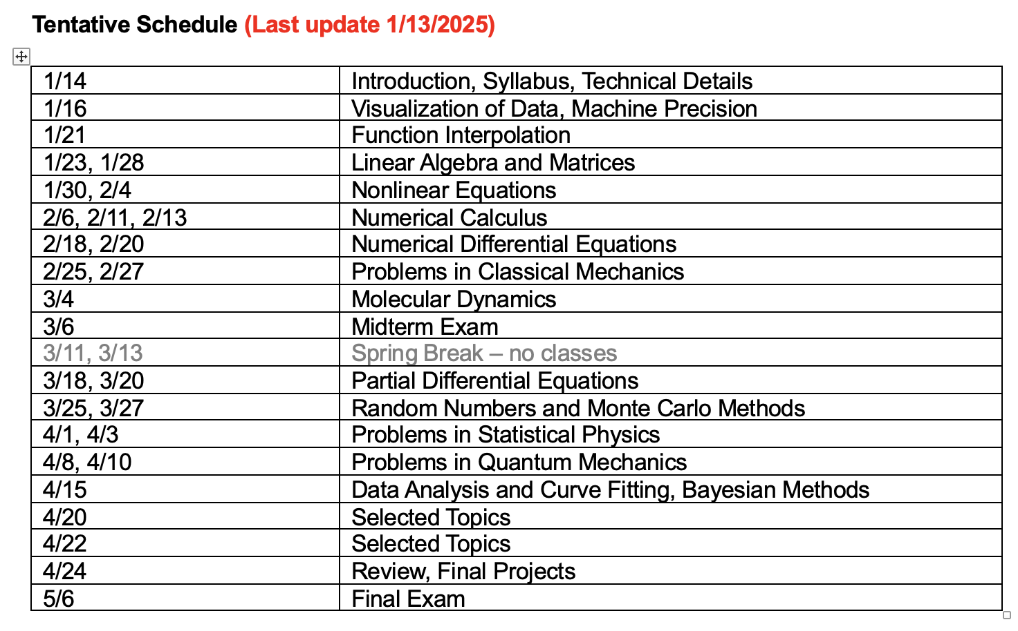
Class schedule II
5

Slide 6
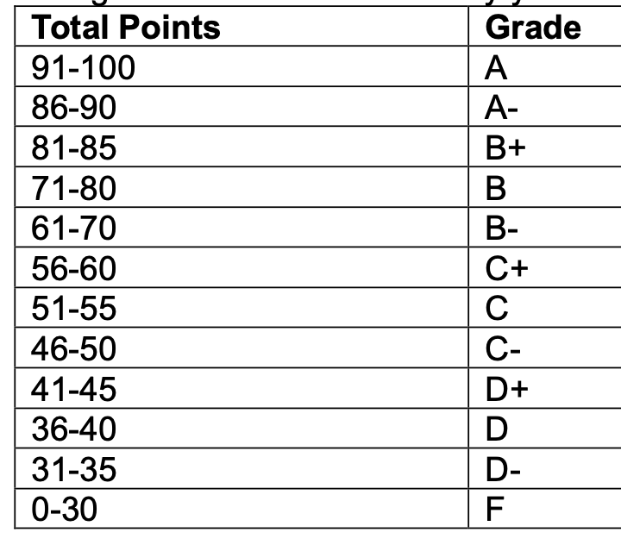
Grading
Homework (40%)
Every 1-2 weeks, due on Friday of the following week
Should include code and where applicable plot/tabulated output
The instructor may ask to explain how the submitted code works
Final project (20%)
A numerical solution to a problem on a pre-approved topic
Or exploration of some of the advanced methods that we did not cover
Should include both the code and a report
Due on last day of class
Mid-term (15%) and Final (25%)
Multiple choice, short and long answer questions
May include a quick programming exercise
Grading scale
6

