Slide 1

Computational Physics (PHYS6350)
Lecture 2: Data Visualization, Machine Precision
January 16, 2025
Data visualization (plotting with matplotlib as an example)
Accuracy of integer and floating-point number representation
Instructor: Volodymyr Vovchenko (vvovchenko@uh.edu)

Slide 2
Course materials
All course material will be available on Teams
Apart from Teams, course materials will be maintained and updated on GitHub*
https://github.com/vlvovch/PHYS6350-ComputationalPhysics/tree/spring2025
*Apart from homework and exams

Slide 3
Data visualization
Line plots
Scatter plots
Contour/density plots (2D data)
References:
Chapter 3 of Computational Physics by Mark Newman
Matplotlib documentation

Slide 4
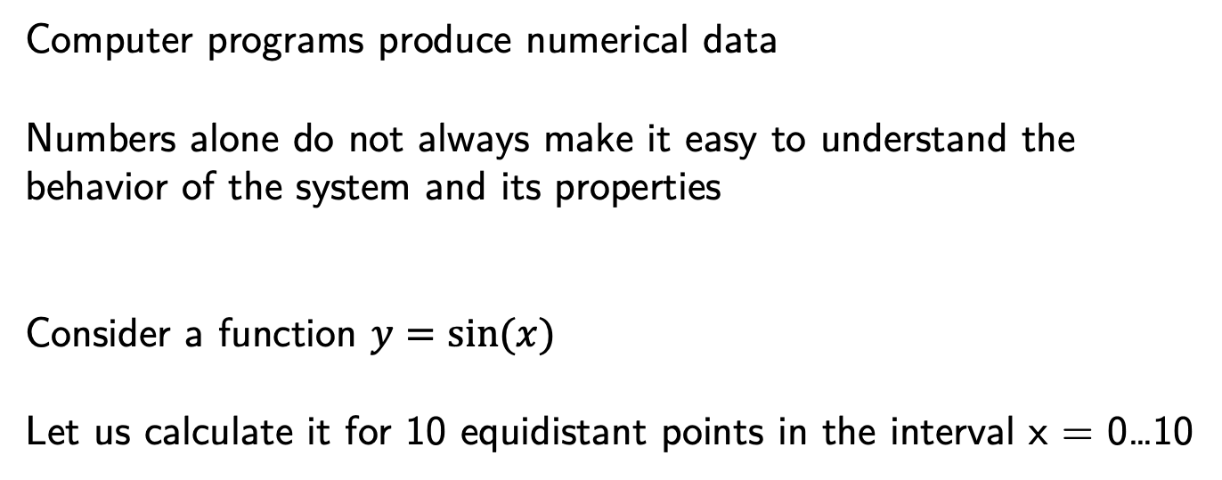
Plotting the data
Computer programs produce numerical data
Numbers alone do not always make it easy to understand the behavior of the system and its properties
Consider a function $y=sin⁡(x)$
Let us calculate it for 10 equidistant points in the interval x = 0…10

Slide 5
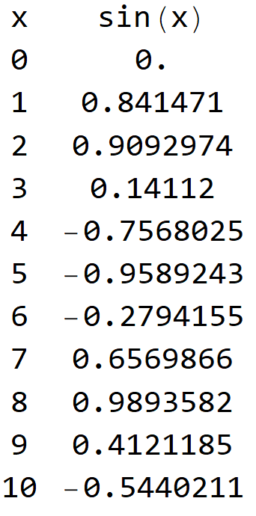
Plotting the data
Computer programs produce numerical data
Numbers alone do not always make it easy to understand the behavior of the system and its properties
Consider a function $y=sin⁡(x)$
Let us calculate it for 10 equidistant points in the interval x = 0…10

Slide 6
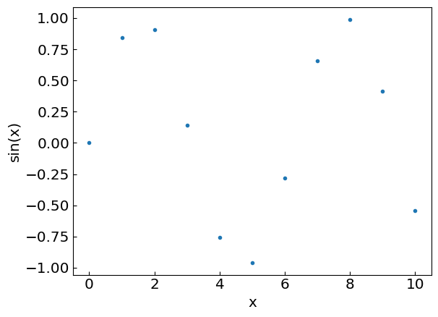
Putting it on a graph
Let us add more points…

Slide 7
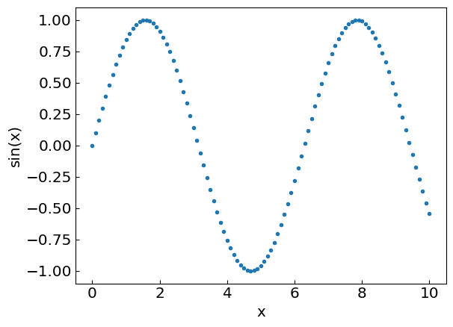
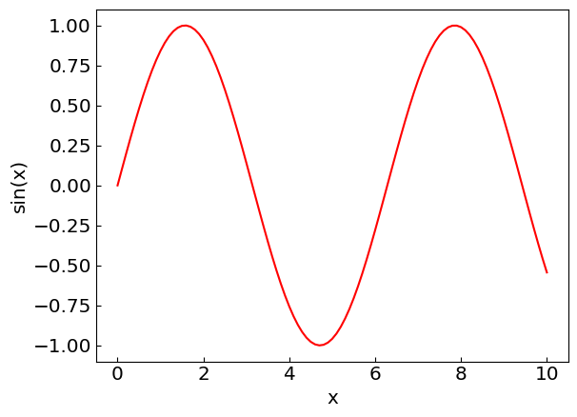
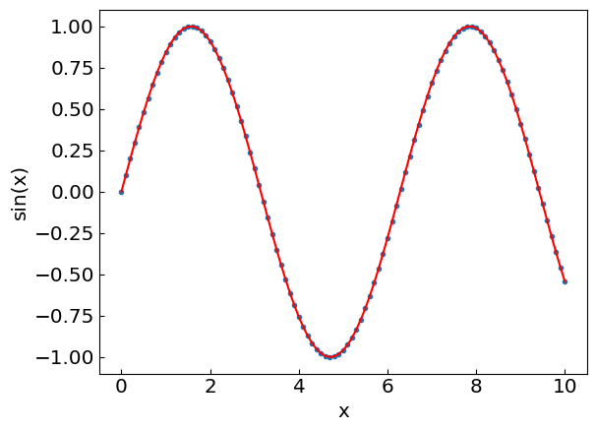
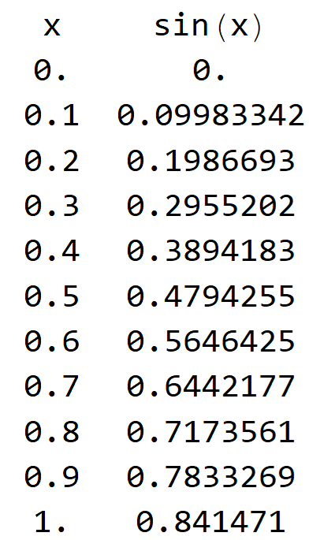
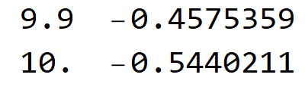
Putting it on a graph
…
Now we have enough points to join them by a smooth line

Slide 8
Putting it on a graph
…
Now we have enough points to join them by a smooth line

Slide 9
Putting it on a graph
…
Now we have enough points to join them by a smooth line

Slide 10
Putting it on a graph
…
Now we have enough points to join them by a smooth line

Slide 11
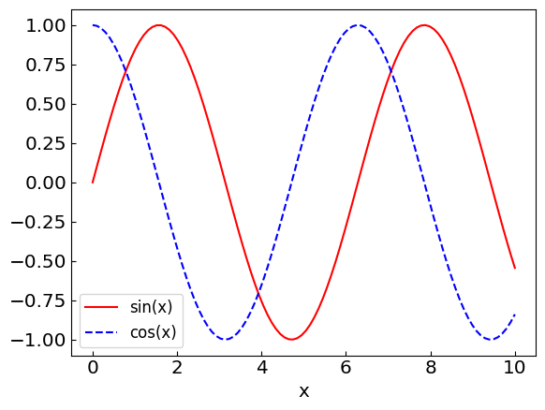
Plot multiple lines to compare functions, profiles, etc.

Slide 12
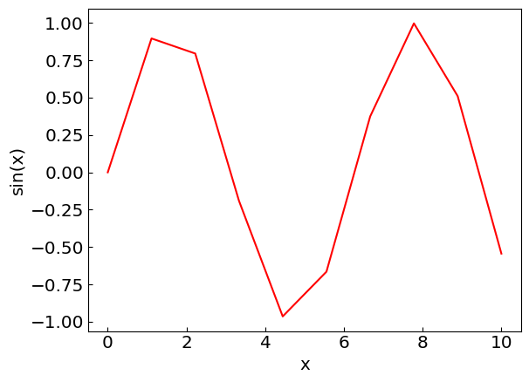
Things to avoid
Insufficient number of data points

Slide 13
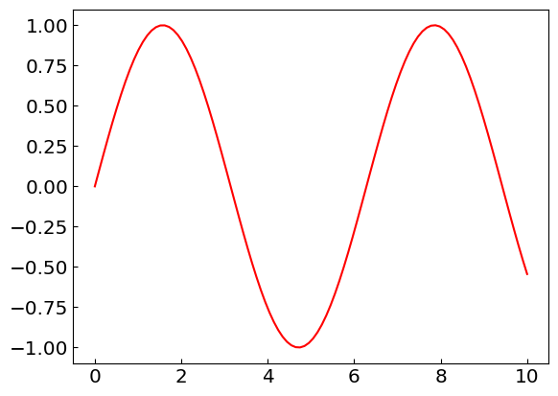
Things to avoid
Unlabeled axes

Slide 14
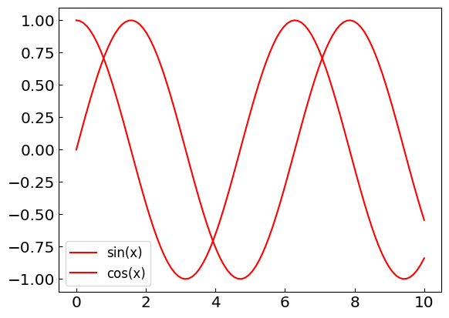
Things to avoid
Indistinguishable line styles

Slide 15
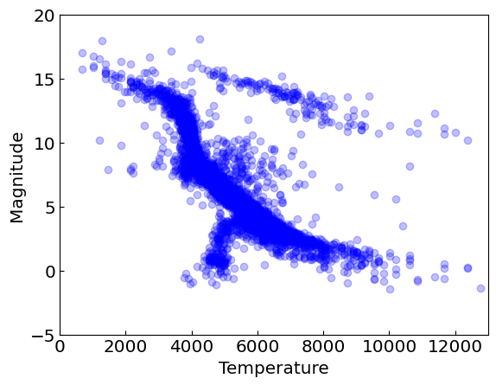
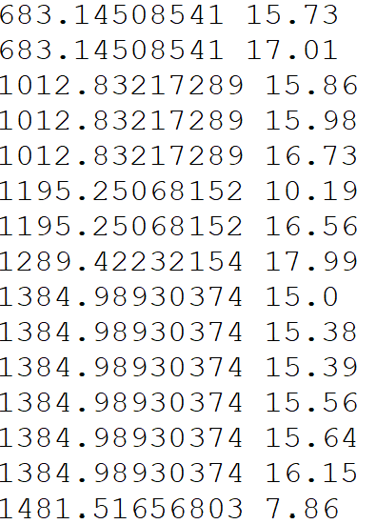
Scatter plots
Not all data points are suitable to be joined by lines
Consider the observations of star surface temperature (= x) and brightness (= y)
Use scatter plot to study correlation and structures between these features
…

Slide 16
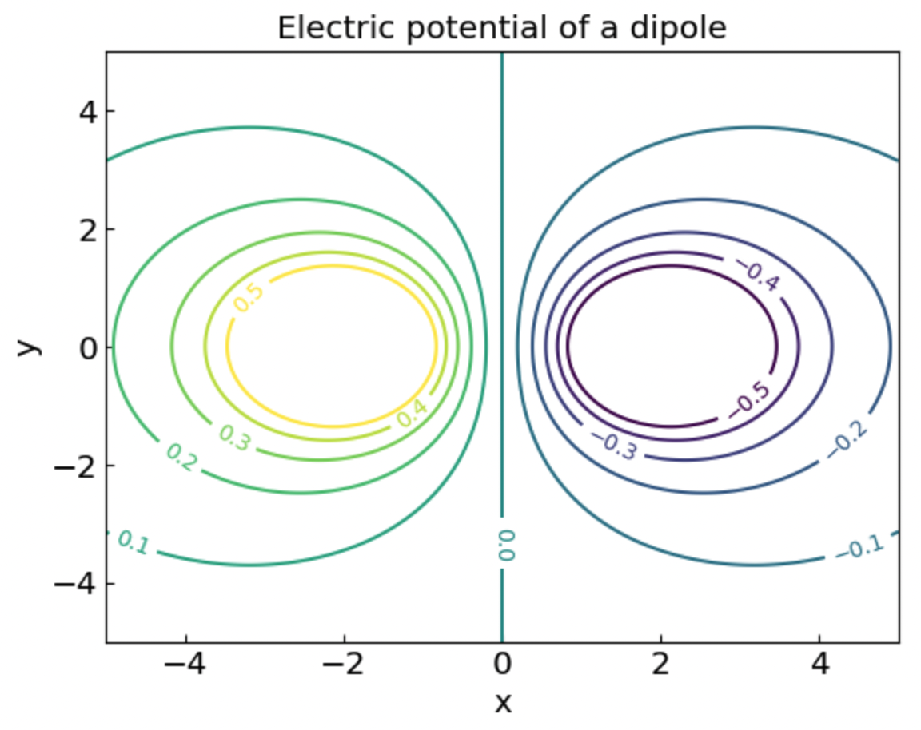
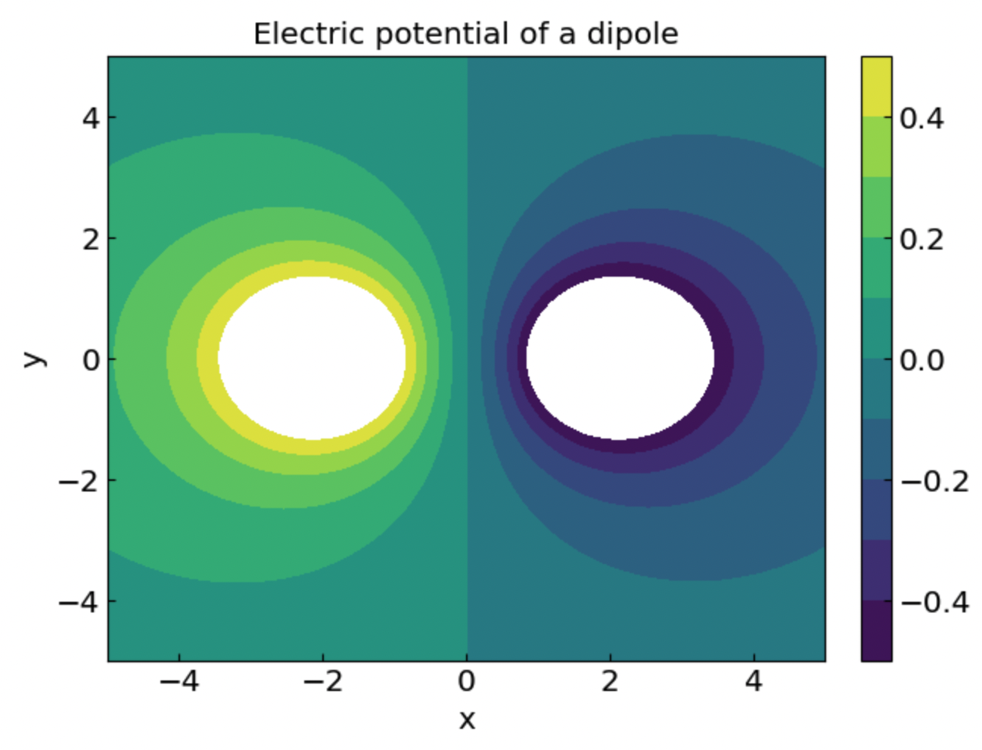
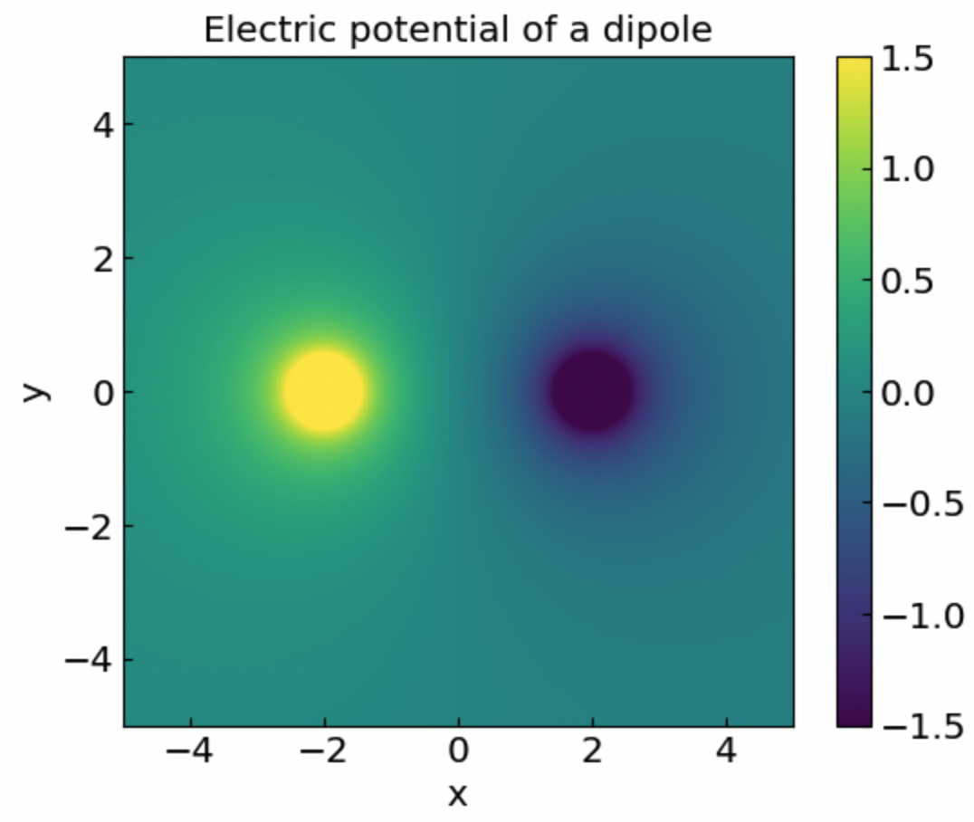
Contour and density plots
For example fields, such as electric potential of a dipole

Slide 17
Errors and accuracy
References:
Chapter 4 of Computational Physics by Mark Newman
Chapter 1.1 of Numerical Recipes Third Edition by W.H. Press et al.

Slide 18
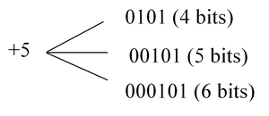



Integer representation
Numbers on a computer are represented by bits – the sequences of 0s and 1s
sign
digits
sign
digits
$$+5 = +(1∙2^{0}+0∙2^{1}+1∙2^{2})$$
$−5 =−(1∙2^{0}+0∙2^{1}+1∙2^{2}$)
Most typical native formats:
32-bit integer, range −2,147,483,647 (-2³¹) to +2,147,483,647 (2³¹)
64-bit integer, range ~ −10¹⁸ (-2⁶³) to +10¹⁸ (2⁶³)
Python supports natively larger numbers but calculations can become slow
In C++ it is important to avoid under/over-flow

Slide 19
Integer representation
Numbers on a computer are represented by bits
Consider integers
Most typical native formats:
32-bit integer, range −2,147,483,647 (-2³¹) to +2,147,483,647 (2³¹)
64-bit integer, range ~ −10¹⁸ (-2⁶³) to +10¹⁸ (2⁶³)
Python supports natively larger numbers but calculations can become slow
In C++ it is important to avoid under/overflow

Slide 20
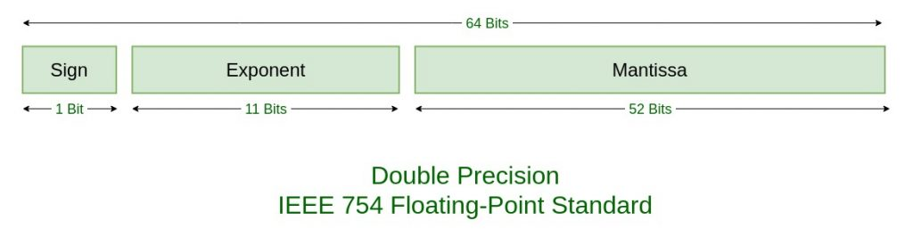

Floating-point number representation
Floating-point, or real, numbers are represented by a bit sequence as well,
which are separated into:
Sign S
Exponent E
Mantissa M (significant digits)
e.g.
Main consequence: Floating-point numbers are not exact!
For example, with 52 bits in mantissa one can store about 16 decimal digits
32-bit float (single precision)
64-bit float (double precision)
Bits: (sign-exponent-mantissa)
1-8-23
1-11-52
Significant digits:
~7 decimal digits
~16 decimal digits
~ -10³⁸ to 10³⁸
~ -10³⁰⁸ to 10³⁰⁸
Range:

Slide 21

Floating-point number representation
When you write
What it means
for a 64-bit float

Slide 22
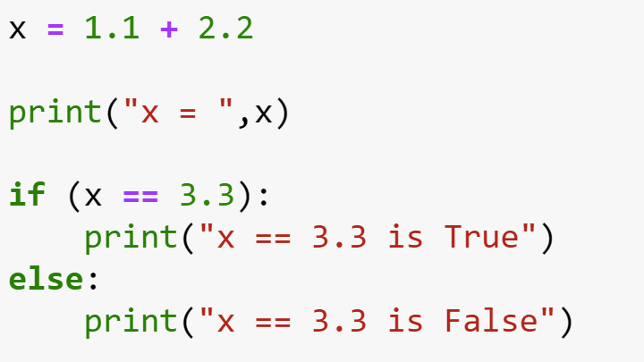
Example: Equality test

Slide 23
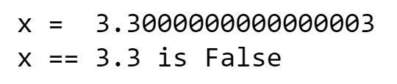
Example: Equality test

Slide 24
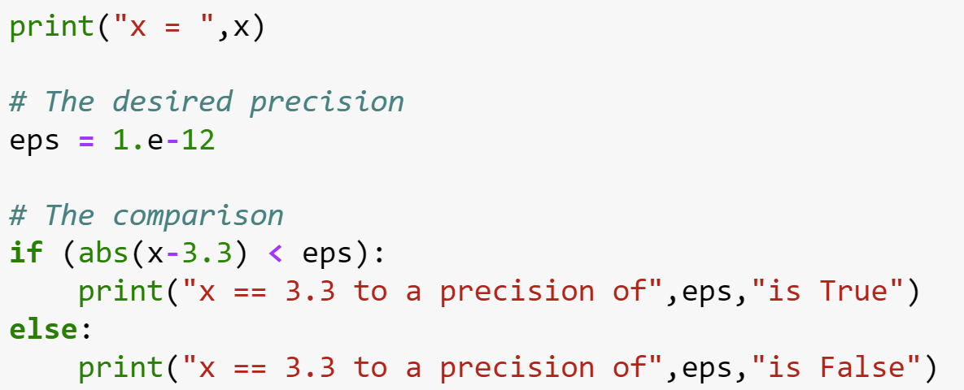
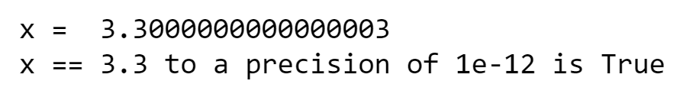
Example: Equality test
You can do instead

Slide 25
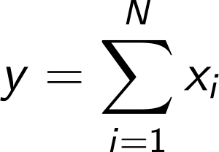
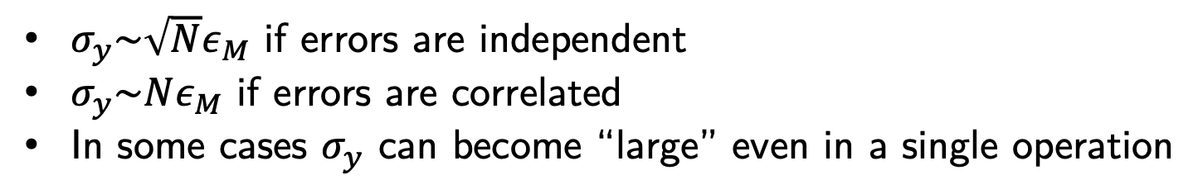
Error accumulation
unavoidable round-off error
Errors also accumulate through arithmetic operations, e.g.
$σ_{y}\sim \sqrt{N}ε_{M}$ if errors are independent
$σ_{y}\sim Nε_{M}$ if errors are correlated
In some cases $σ_{y}$ can become “large” even in a single operation

Slide 26
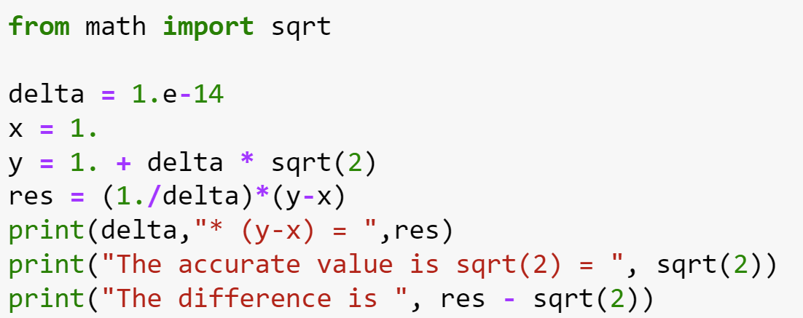
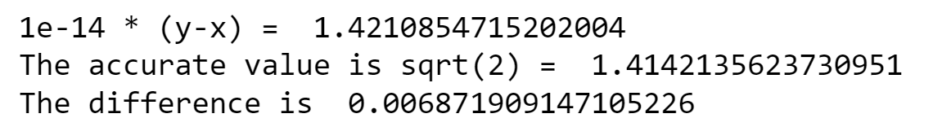
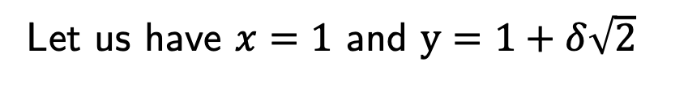
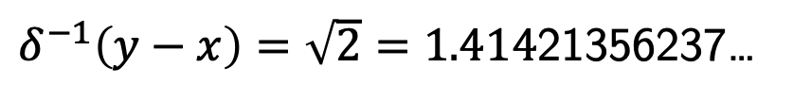
Two large numbers with a small difference
Let us have $x=1$ and $y=1+δ\sqrt{2}$
Symbolically, one has
$δ^{−1}\left(y−x\right)=\sqrt{2}=1.414$21356237…
Let us test this relation on a computer for a very small value of $δ={10}^{−14}$
Catastrophic loss of precision!
What happened?
significant digits
these do not fit
y = 1.000000000000014 142135623730951 …
x = 1.000000000000000 000000000000000 …

Slide 27
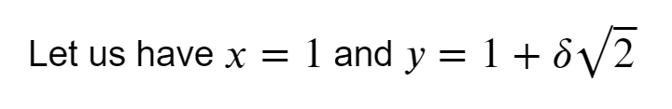
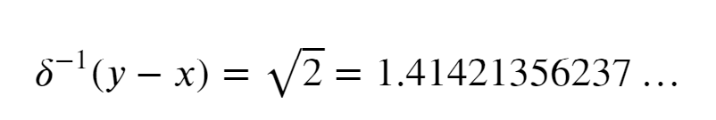
Example: Two large numbers with small difference

Slide 28
Example: Two large numbers with small difference

Slide 29

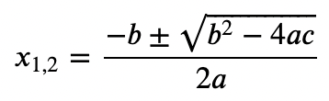
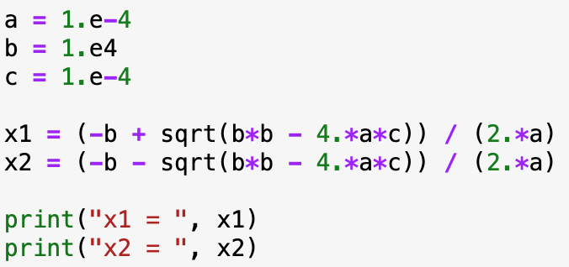


Quadratic equation
Symbolically, the roots are:
$\sqrt{b^{2}−4ac}$ is very close to b
Let us calculate the roots for $a={10}^{−4}, b={10}^{4}, c={10}^{−4}$
|ac|<<b²
x₂ looks ok but x₁ seems off(?)

Slide 30
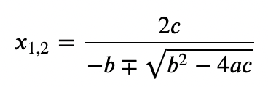
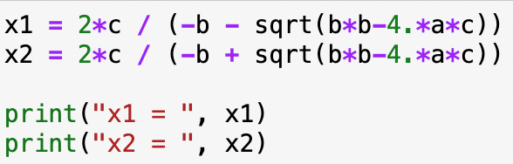

Quadratic equation
Standard form:
Alternative form:
Using the alternative form
x₁ is fixed but now x₂ is off
Solution: Make a judicious choice between standard and alternative form for each root separately, such that subtraction of two similar number is avoided

Slide 31
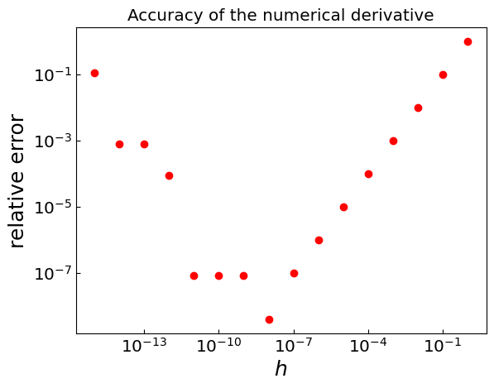
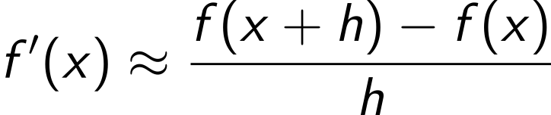
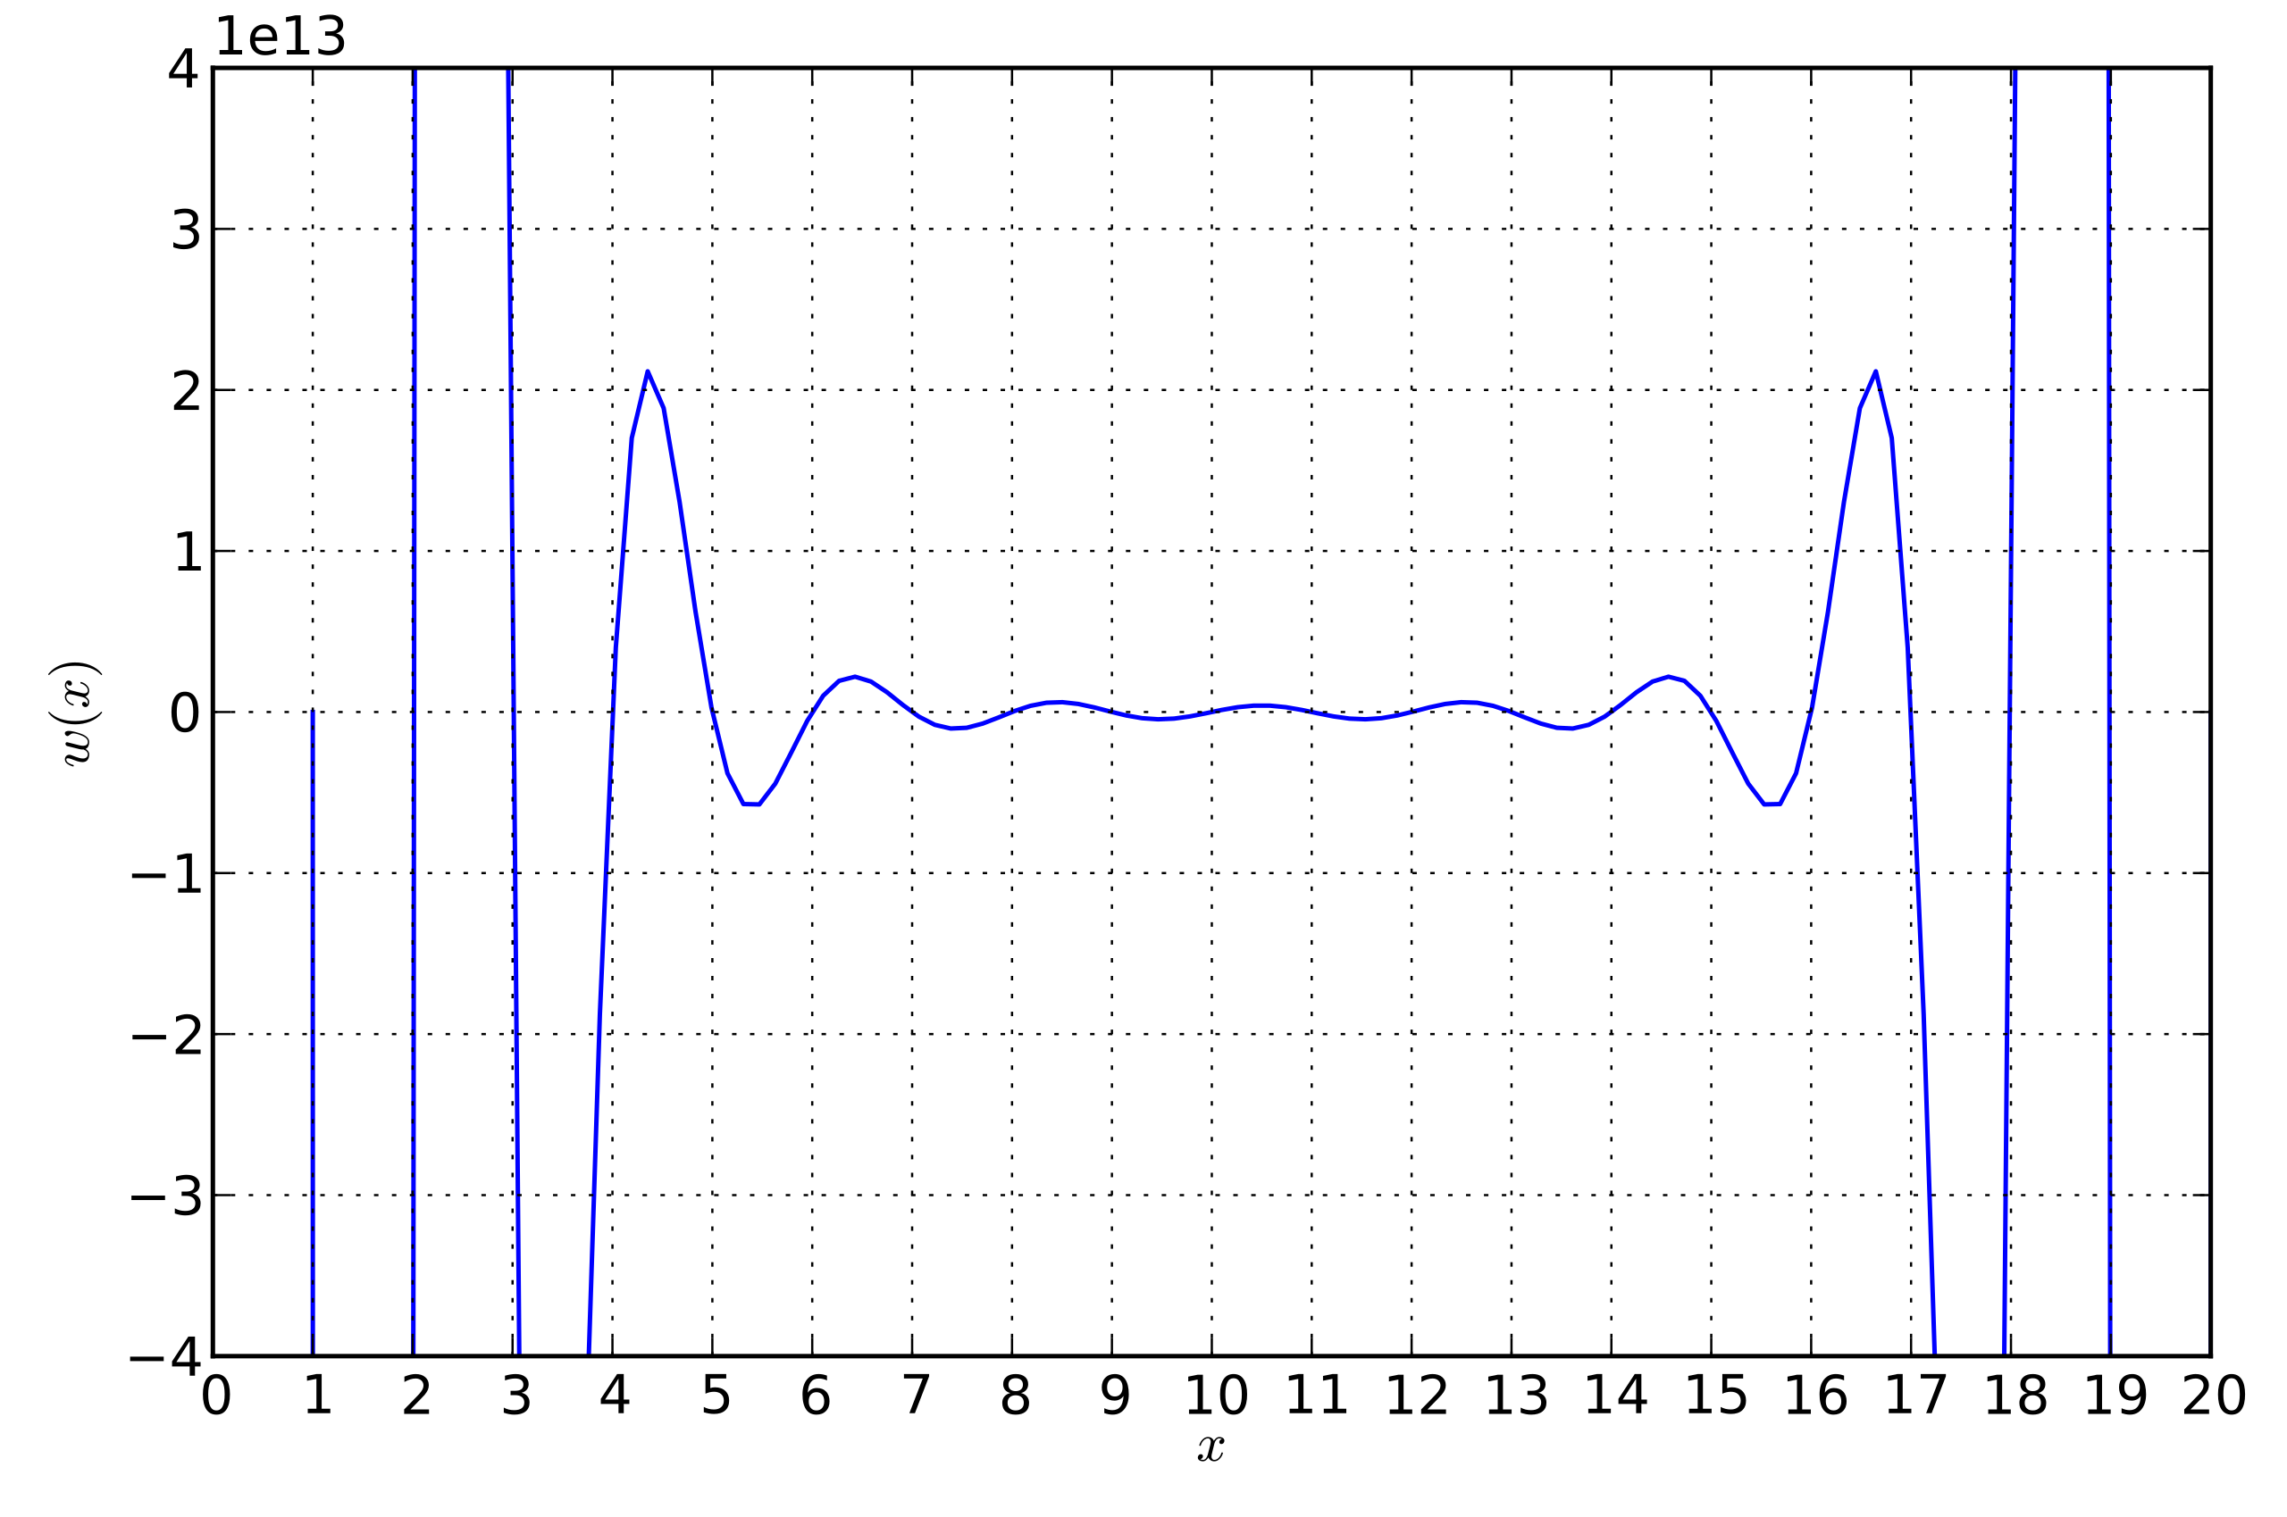
Other common situations
Simple numerical derivative (see the sample code)
Sometimes a small h is too small
Roots of high-degree polynomials
Advanced topic: Kahan summation
final project idea(?)

