Slide 1

Computational Physics (PHYS6350)
Lecture 18: Random numbers: Part II
Non-uniformly distributed random numbers
Importance sampling
Reference: Chapter 10 of Computational Physics by Mark Newman
April 1, 2025
Instructor: Volodymyr Vovchenko (vvovchenko@uh.edu)
Course materials: https://github.com/vlvovch/PHYS6350-ComputationalPhysics

Slide 2
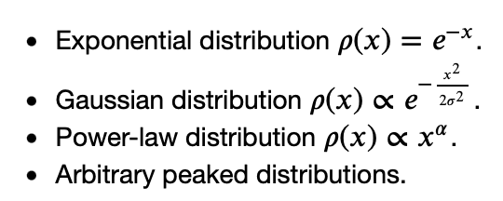
Nonuniformly distributed random numbers
In many cases we deal with random numbers $ξ$ that are distributed non-uniformly.
Common examples are:
There are two common methods for generating nonuniform random variates. They both make use of uniformly distributed variates.
Inverse transform sampling
Rejection sampling

Slide 3
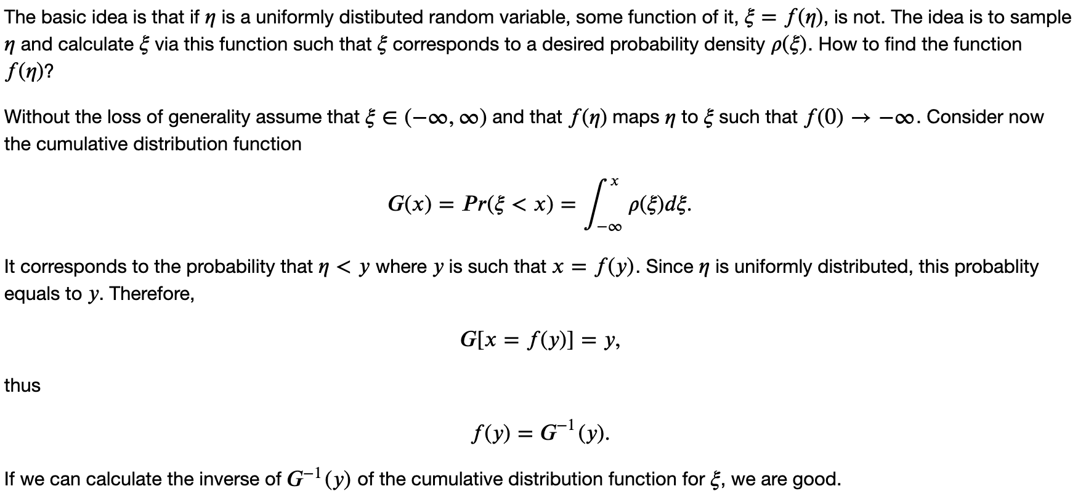
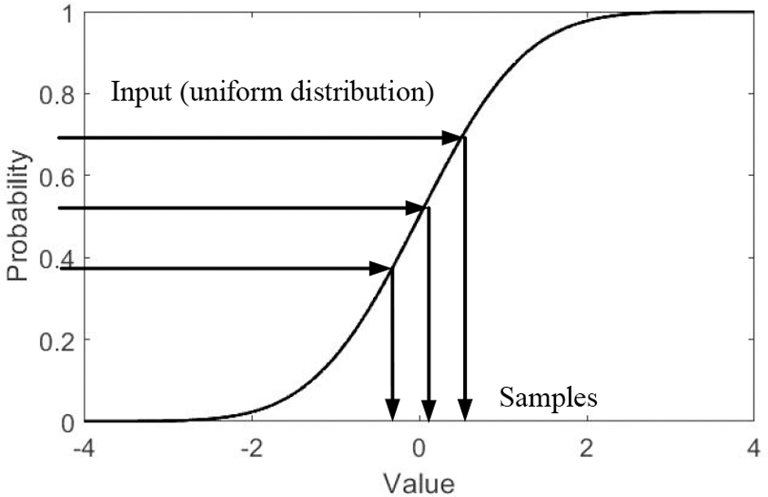
Inverse transform sampling

Slide 4
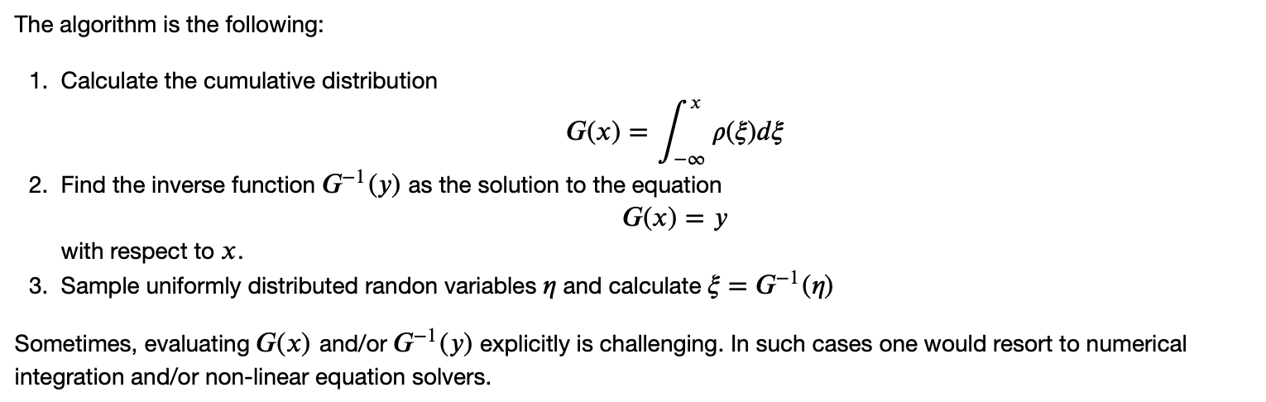
Inverse transform sampling

Slide 5
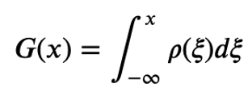

Inverse transform sampling
The algorithm follows these steps:
1. Calculate the cumulative distribution function (CDF)
2. Find the inverse function G⁻¹(y) as the solution to the equation
3. Sample uniformly distributed random variables $η$ and compute $ξ$ using the inverse function:
Challenges: Sometimes, evaluating G(x) and/or G⁻¹(y) explicitly is difficult. In such cases, numerical integration and/or non-linear equation solvers may be required.

Slide 6

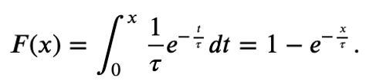


Inverse transform sampling: Exponential distribution
Example: Exponential Distribution
1. Recall the radioactive decay process. The time of decay is distributed according to the probability density function:
2. The cumulative distribution function is given by:
3. To apply inverse transform sampling, we need to invert F(x) by solving:
4. Solving for t, we obtain:

Slide 7
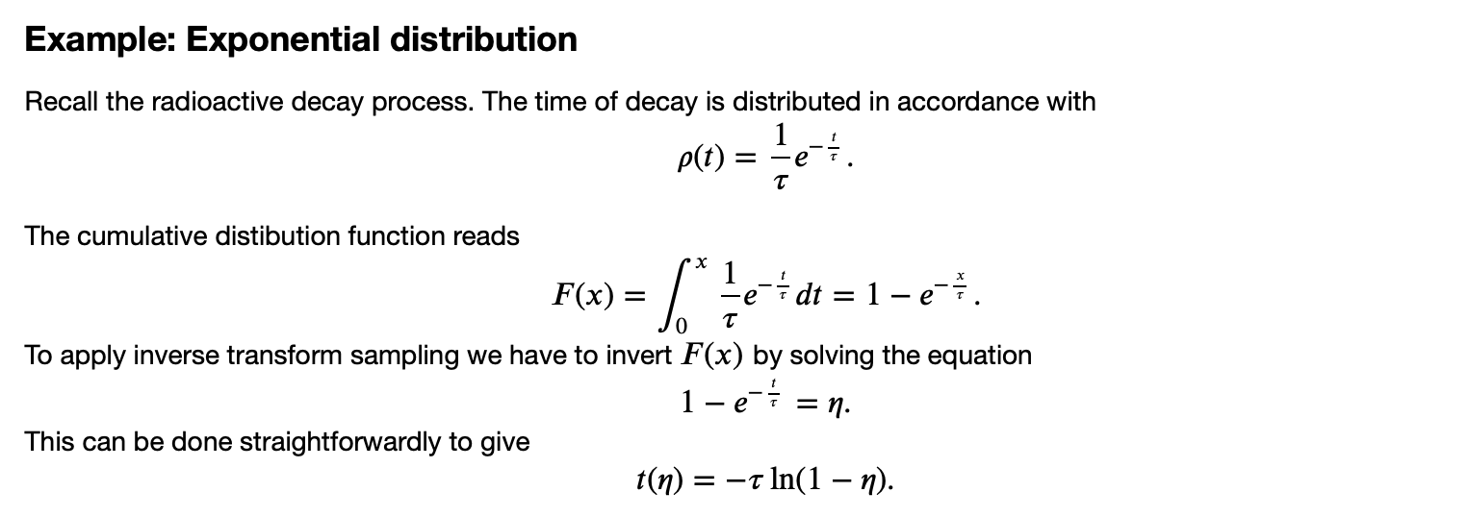
Inverse transform sampling

Slide 8
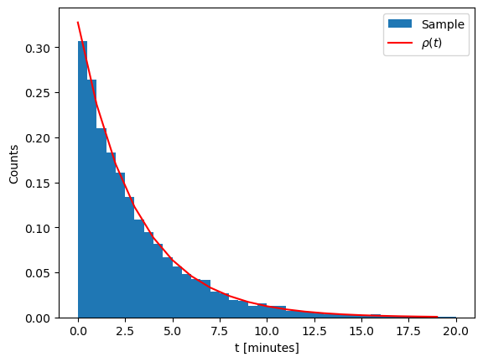
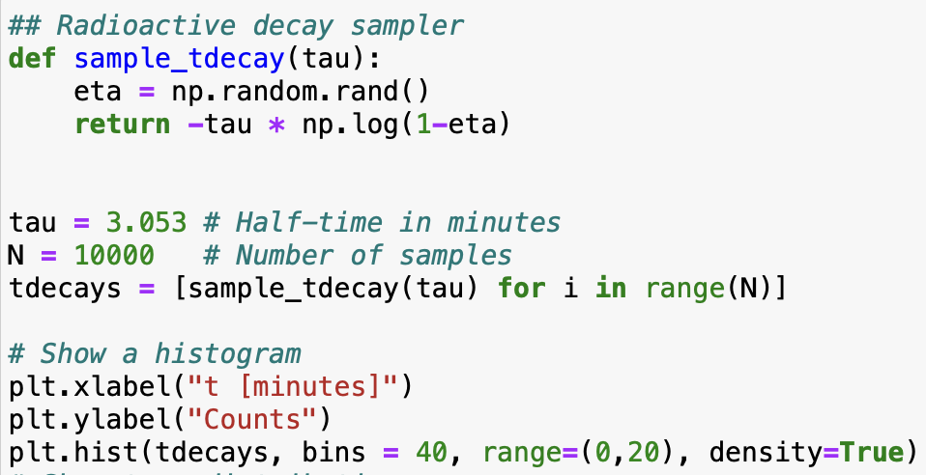
Sampling radioactive decay time

Slide 9
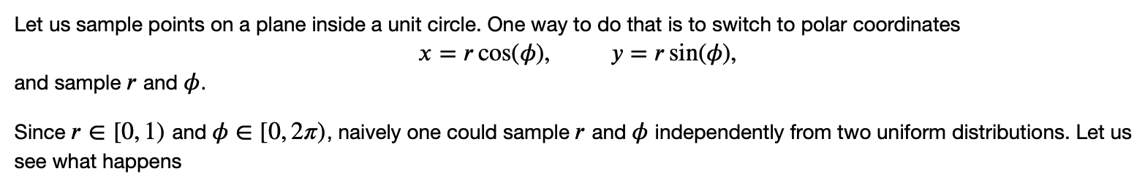
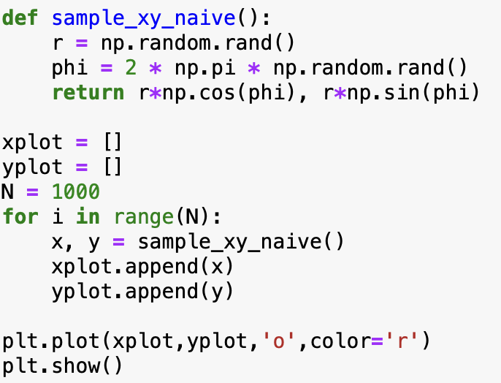
Sampling points inside a circle

Slide 10

Sampling points inside a circle
One way to sample points inside a unit circle is by switching to polar coordinates:
where we sample r $∈$[0,1) and $φ∈\text{[0, 2}π\text{)}.$
Naively, one could sample r and $φ$ independently from two uniform distributions. Let’s see what happens!

Slide 11
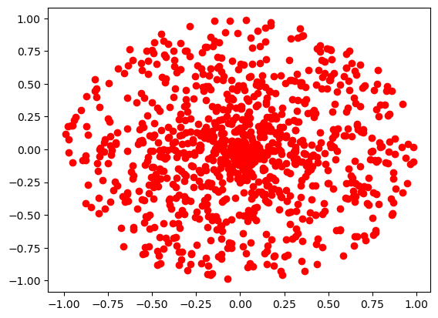
Sampling points inside a circle
One way to sample points inside a unit circle is by switching to polar coordinates:
where we sample r $∈$[0,1) and $φ∈\text{[0, 2}π\text{)}.$
Naively, one could sample r and $φ$ independently from two uniform distributions. Let’s see what happens!
The points clump more in the center!

Slide 12
Sampling points inside a circle
The points clump more in the center!

Slide 13
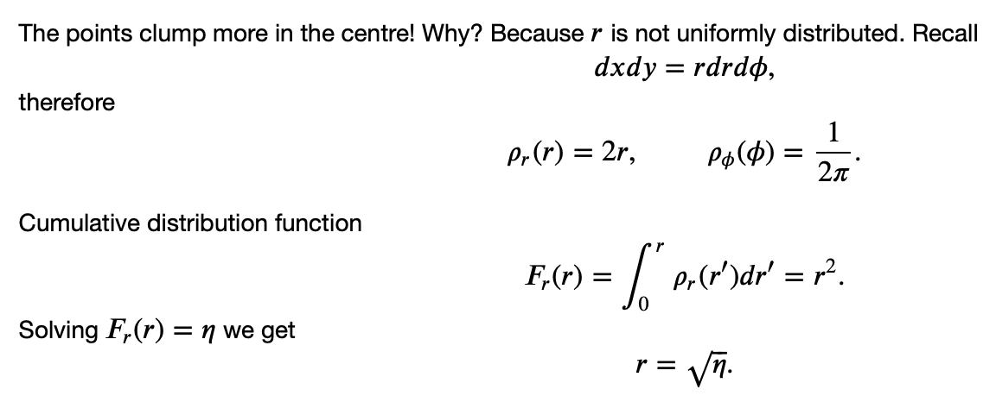
Sampling points inside a circle

Slide 14

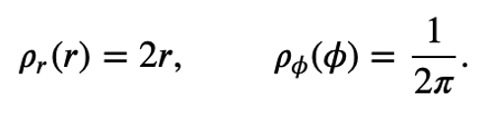
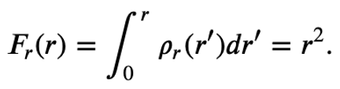

Sampling points inside a circle
The points clump more in the center because r is not uniformly distributed.
Recall the differential area element in polar coordinates:
This leads to the probability density functions:
Cumulative Distribution Function (CDF)
To obtain a properly distributed r, we solve $F_{r}\left(r\right)=η$ which gives:
$$r=\sqrt{η}$$

Slide 15
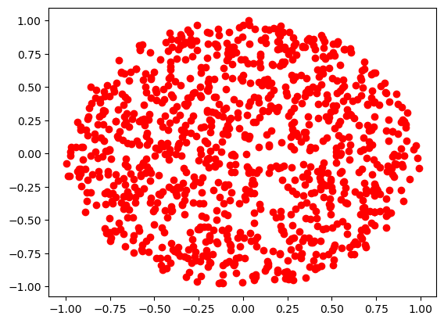
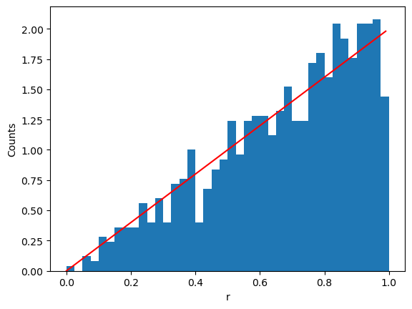
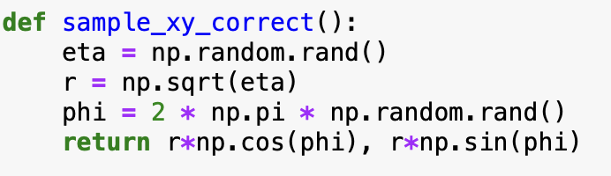
Sampling points inside a circle
The points clump more in the center because r is not uniformly distributed.
Recall the differential area element in polar coordinates:
This leads to the probability density functions:
Cumulative Distribution Function (CDF)
To obtain a properly distributed r, we solve $F_{r}\left(r\right)=η$ which gives:
$$r=\sqrt{η}$$

Slide 16
Sampling points inside a circle

Slide 17
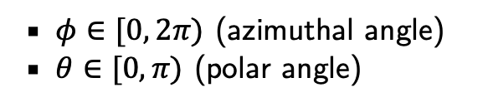



Sampling of an Isotropic Direction in 3D
One common problem in Monte Carlo simulations is the random sampling of an isotropic direction in 3D space. This issue arises in various contexts, such as:
• Sampling a random orientation of an axially symmetric object (e.g., a rod).
• Sampling the momentum direction of a particle.
This problem is equivalent to choosing a random point on a unit sphere. The coordinates x, y, z on the sphere can be parametrized using azimuthal and polar angles:
• $φ∈[0, 2π)$ (azimuthal angle)
• $θ∈[0, π)$ (polar angle)
Using these angles, the Cartesian coordinates are given by:
$$x=\sin{θ}\cos{φ}$$
$$y=\sin{θ}\sin{φ}$$
$$z=\cos{θ}$$

Slide 18


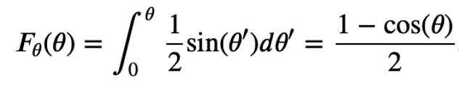






Sampling of an Isotropic Direction in 3D
$$x=\sin{θ}\cos{φ}$$
$$y=\sin{θ}\sin{φ}$$
$$z=\cos{θ}$$
The solid angle element is:
The random variables $φ$ and $θ$are independent.
$φ$is uniformly distributed in [0, 2$π$], making its sampling straightforward.
However, $θ$has a weighted probability density function:
The cumulative distribution function is:
In practice, work directly with $\cos{θ}$ and $\sin{θ:}$
Solving $F_{θ}\left(θ\right)=η$, we obtain:

Slide 19
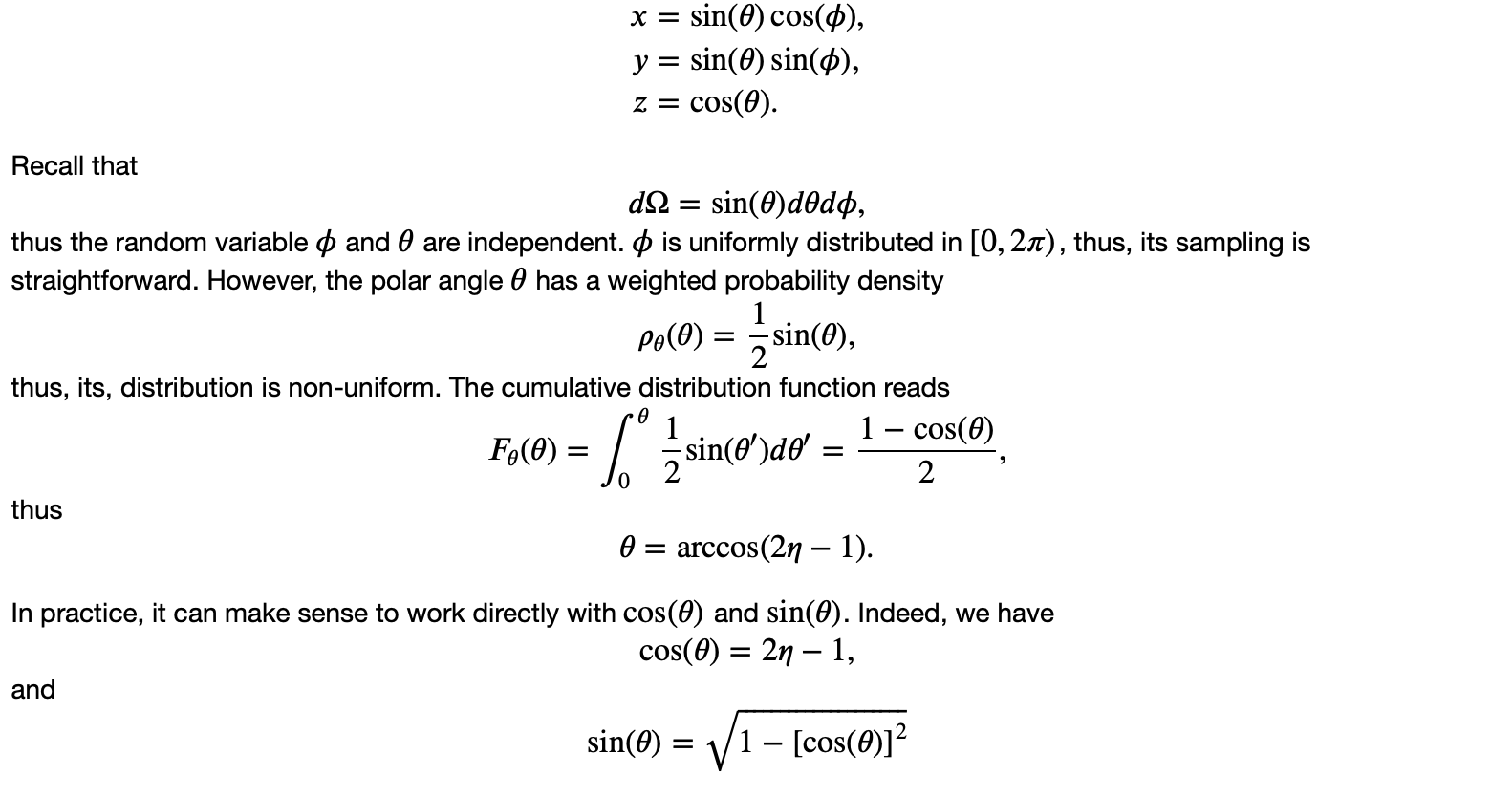
Sampling an isotropic direction

Slide 20
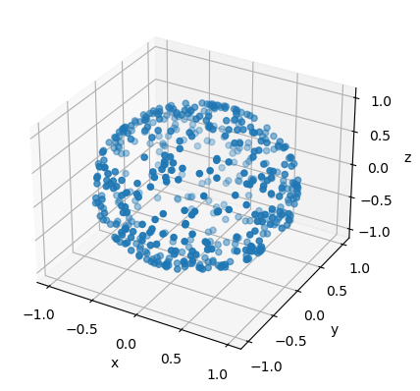
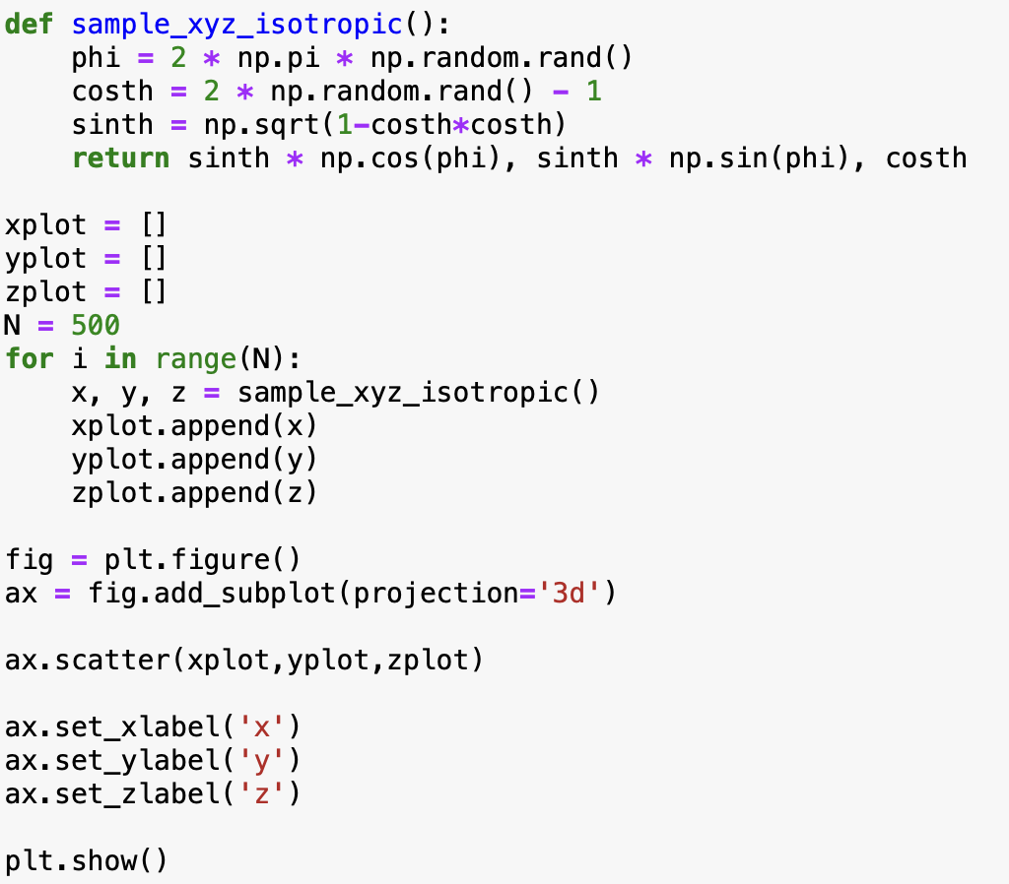
Sampling an isotropic direction

Slide 21
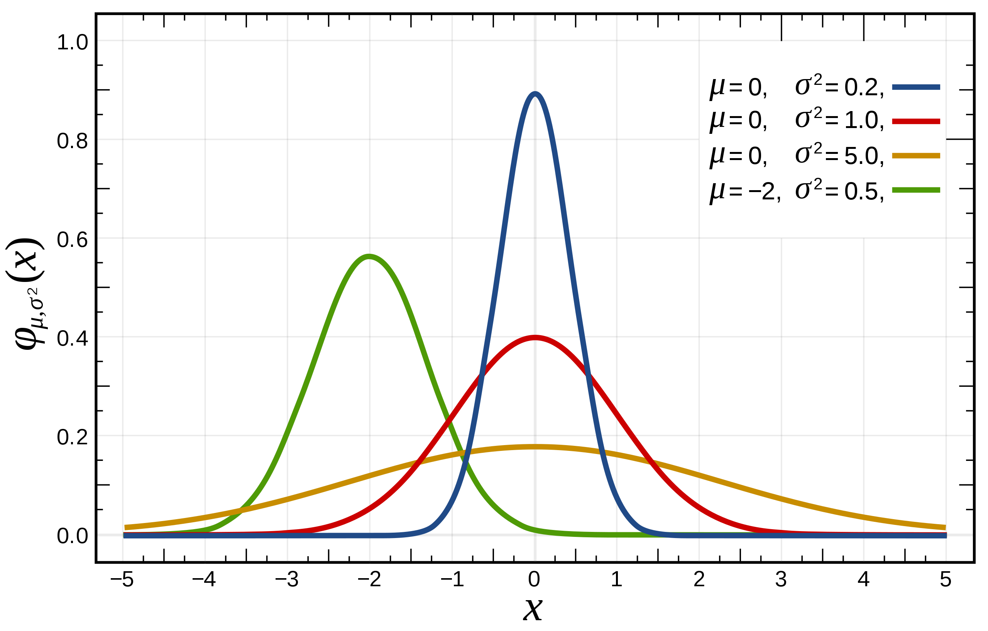
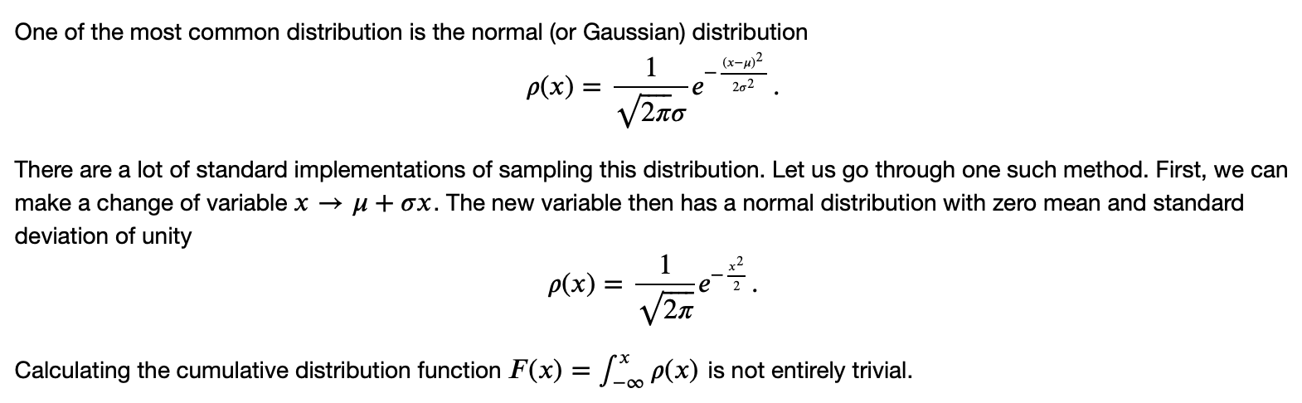
Sampling normally distributed variables

Slide 22
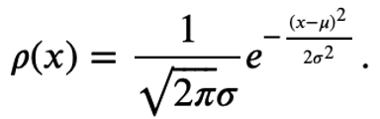
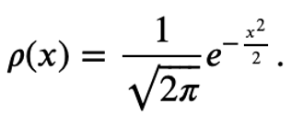
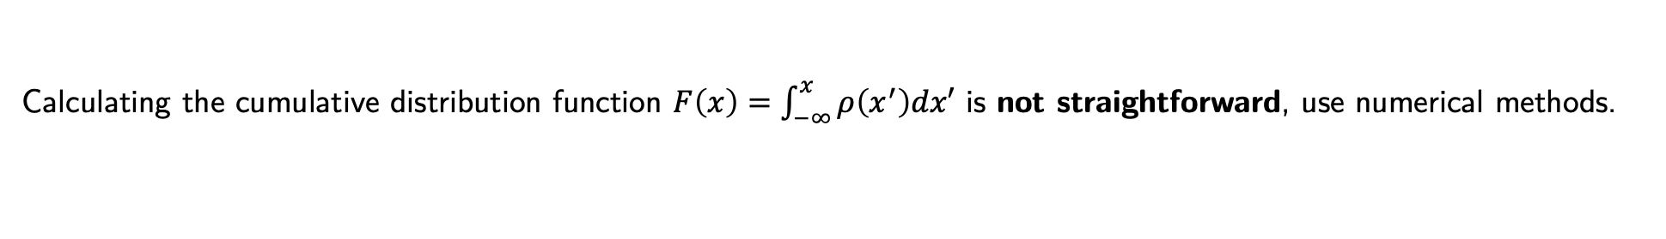
Sampling normally distributed variables
One of the most common probability distributions is the normal (or Gaussian) distribution, given by:
There are many standard methods for sampling from this distribution. One common approach is to standardize the variable by making the transformation $x→μ+σx$
After this transformation, the new variable follows a standard normal distribution with zero mean and unit standard deviation:
Calculating the cumulative distribution function $F\left(x\right)=\int_{−∞}^{x}{ρ\left(x^{′}\right)dx′}$ is not straightforward, use numerical methods.

Slide 23
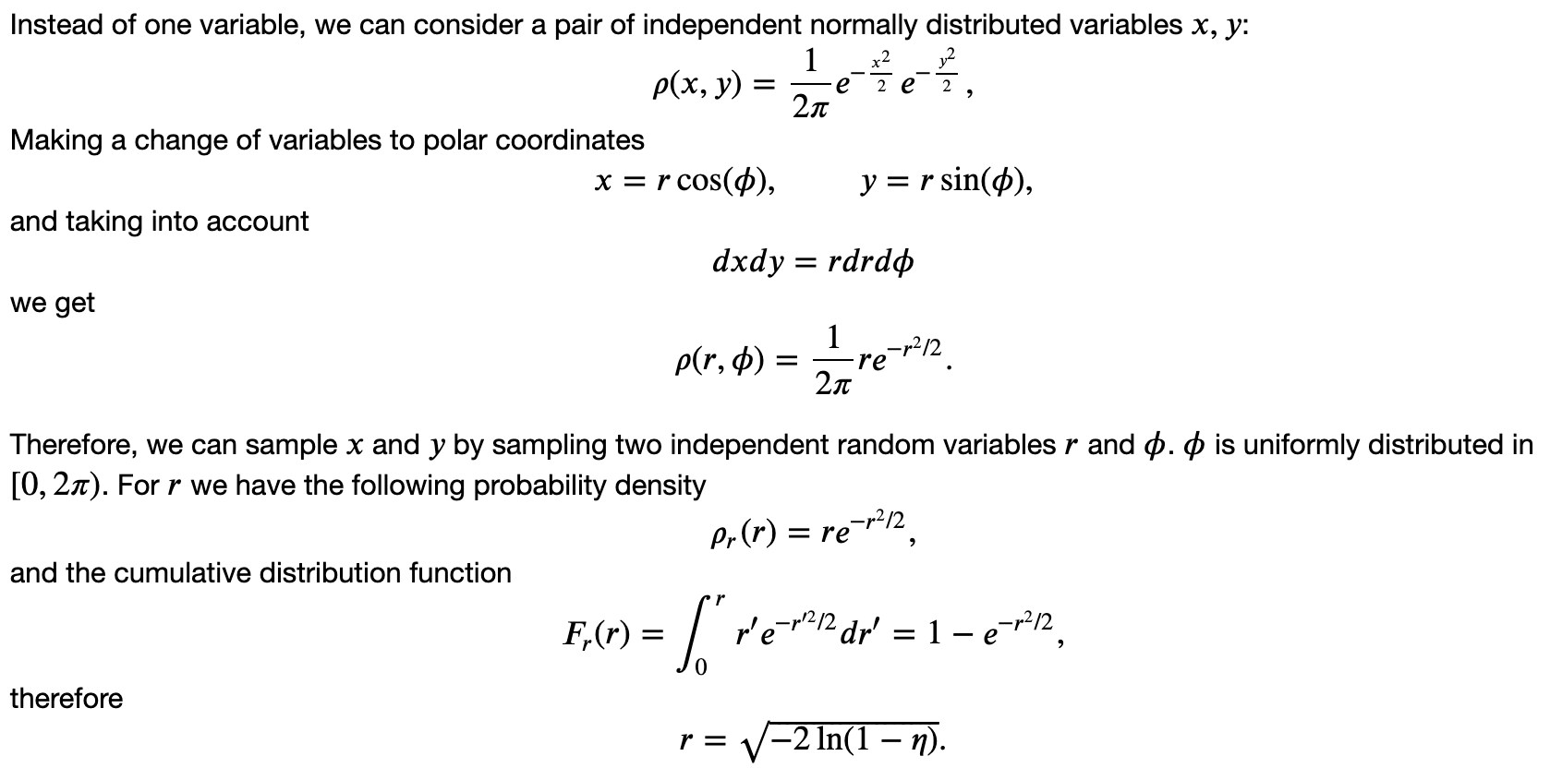
Sampling normally distributed variables

Slide 24
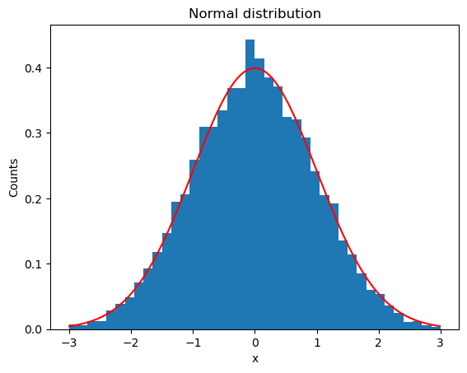
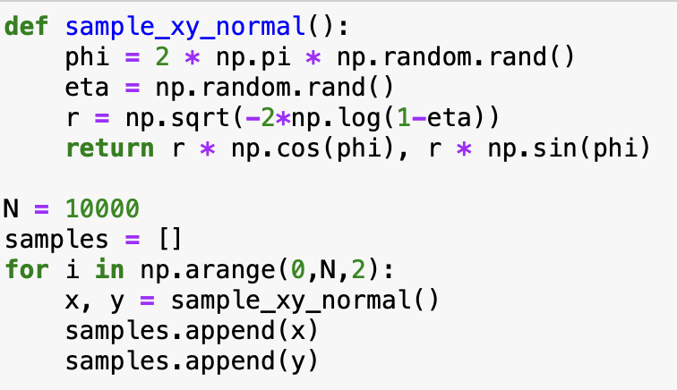
Sampling normally distributed variables

Slide 25

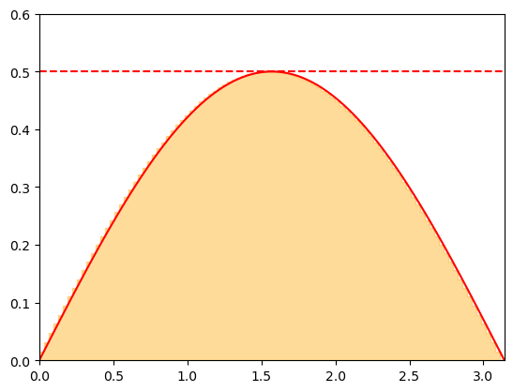



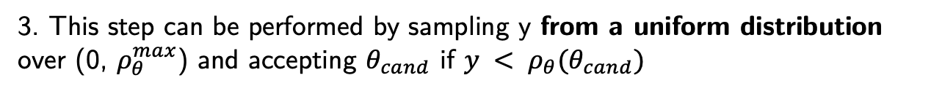
Rejection sampling
The rejection sampling method allows one to sample a variable $ξ$from an envelope distribution and accept or reject it with a certain probability.
Consider again the probability density function for the polar angle:
Since $ρ_{θ}$ is bounded from above, we define:
1. Sample a candidate value $θ_{cand}$from a uniform distribution over (0, $π$).
2. Accept $θ_{cand}$with probability:
3. This step can be performed by sampling y from a uniform distribution over (0, $ρ_{θ}^{max}$) and accepting $θ_{cand}$ if $y < ρ_{θ}(θ_{cand})$
Geometric Interpretation: If we consider $θ_{cand}=x$ and y as the coordinates of a point in a plane, we accept $θ_{cand}$if it lies below the curve defined by $ρ_{θ}\left(θ\right)$. This ensures that $θ_{cand}$values are accepted at a rate proportional to $ρ_{θ}\left(θ\right)$, as desired.
Advantages of Rejection Sampling:
$ρ_{θ}\left(θ\right)$does not need to be a normalized distribution for the method to work.

Slide 26
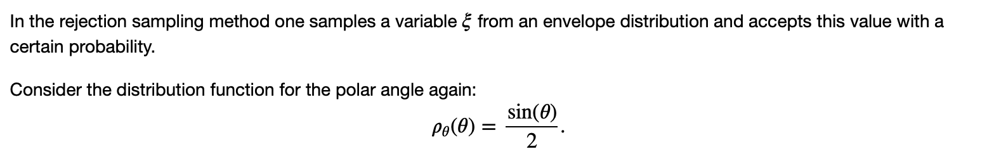
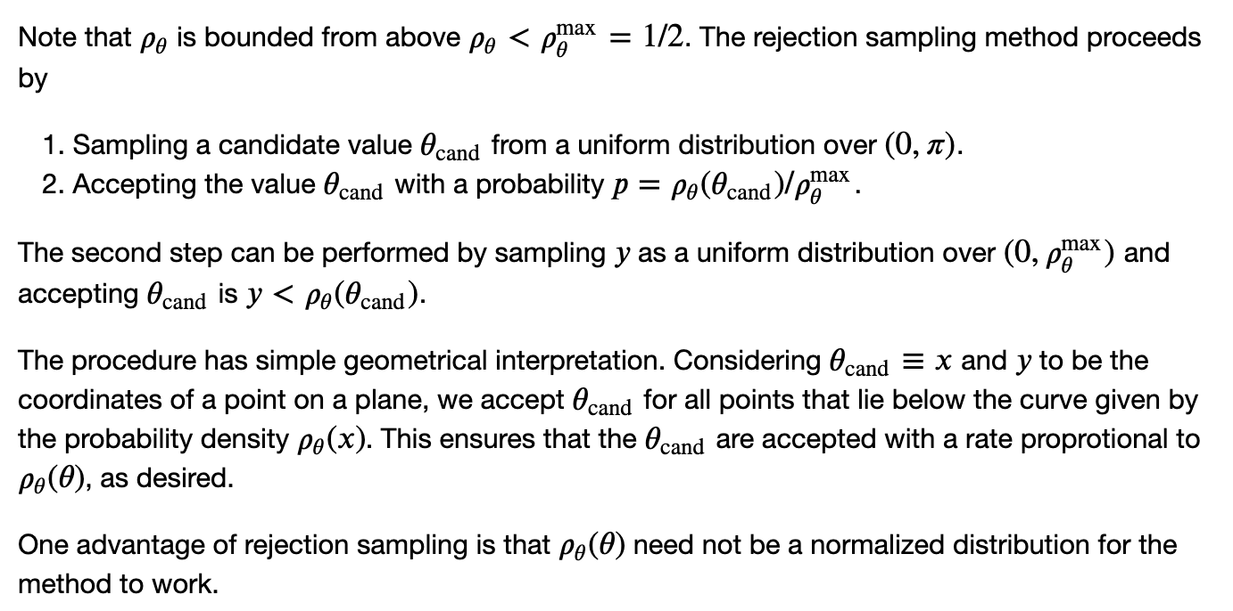
Rejection sampling

Slide 27
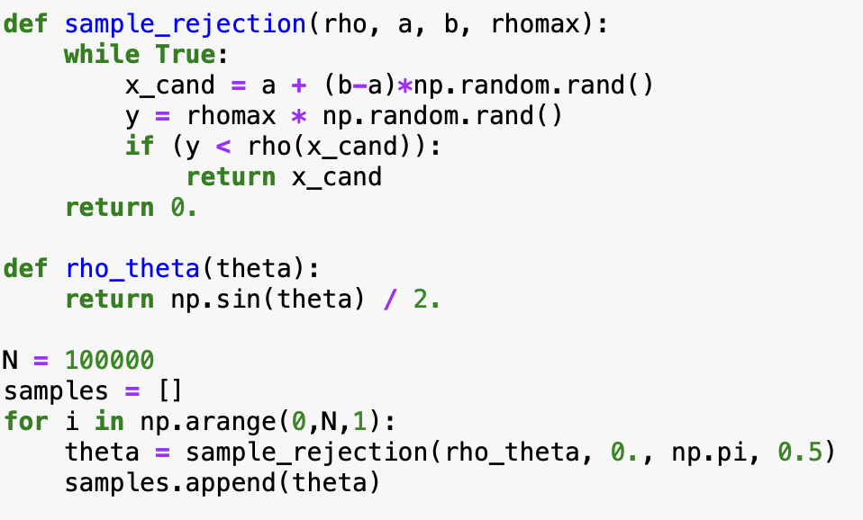
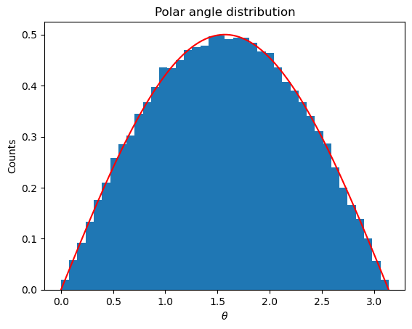
Rejection sampling

Slide 28
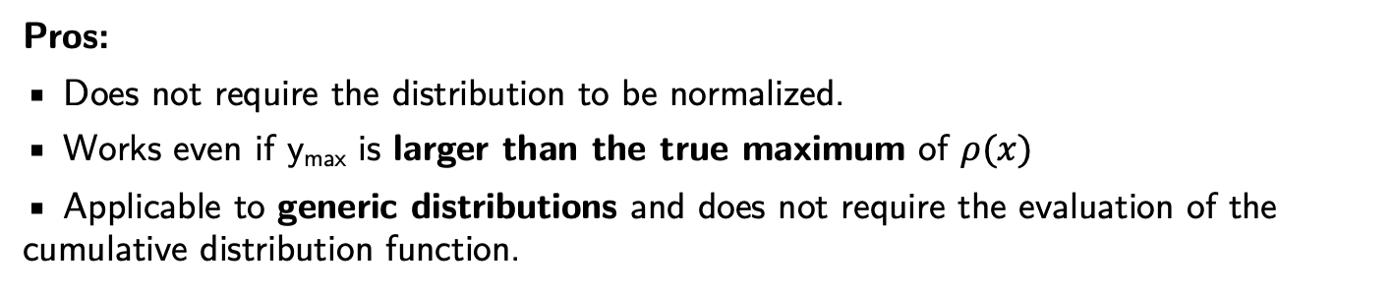
Pros and Cons of Rejection Sampling
Pros:
• Does not require the distribution to be normalized.
• Works even if y_{max} is larger than the true maximum of $ρ(x)$
• Applicable to generic distributions and does not require the evaluation of the cumulative distribution function.
Cons:
• Can be inefficient if the rejection rate is high (e.g., for highly peaked distributions).
• Not directly applicable to distributions over infinite ranges.
Generalizations of Rejection Sampling
To address some of its limitations, several generalizations of rejection sampling can be used, including:
• Adaptive rejection sampling by considering multiple enveloping rectangles.
• Variable transformation to map an infinite interval into a finite one.
• Sampling from a non-uniform enveloping distribution for better efficiency.

Slide 29
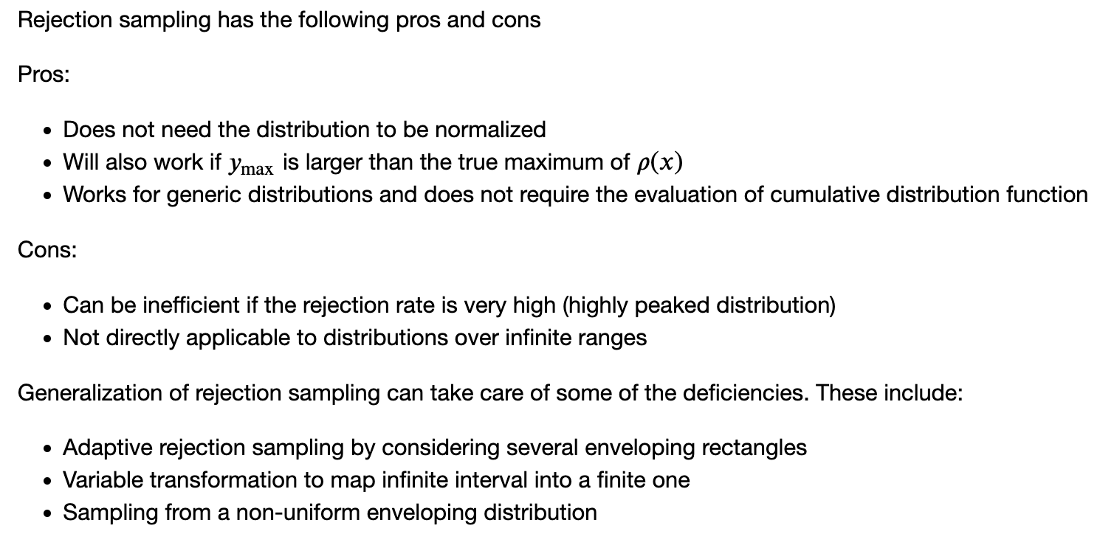
Rejection sampling

Slide 30
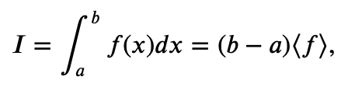
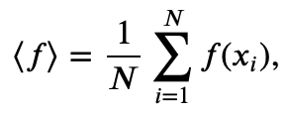

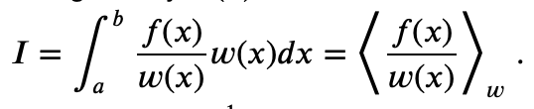


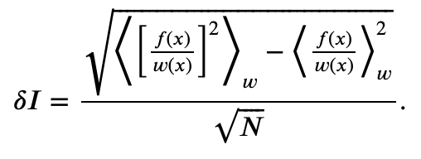
Importance sampling
Recall the calculation of an integral as statistical average
where
Some issues with the method:
Sample unimportant regions (e.g. f is highly peaked)
Integrable singularities
Importance sampling:
Sample $x_{i}$ from a non-uniform distribution w(x) that resembles f(x).
The integrand is then calculated as
Normalization:
Error:

Slide 31
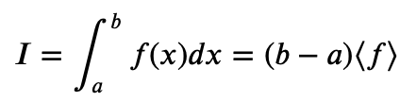
Importance sampling
For w(x)=1/(b-a) we recover the mean value method
For w(x) $∝$ f(x) one has $\left\langle \frac{f(x)}{w(x)}\right\rangle$ = const = I and $δI=0$

Slide 32
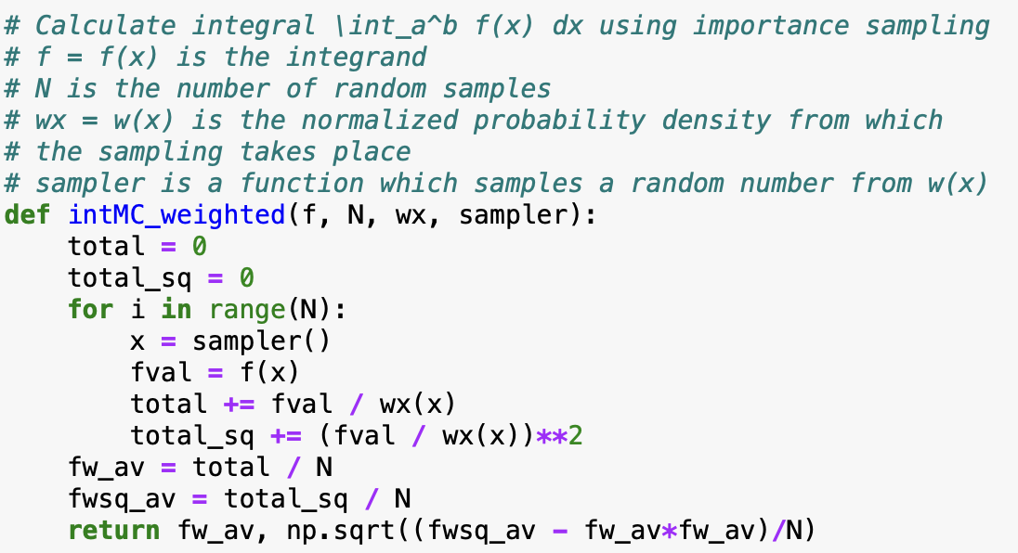
Importance sampling

Slide 33
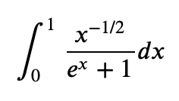
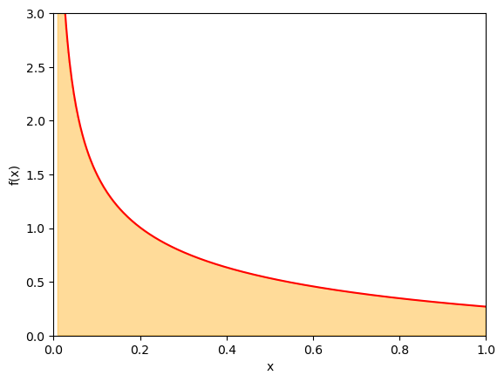
Importance sampling: Example
Integrable singularity at x=0

Slide 34


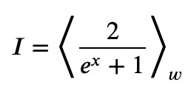

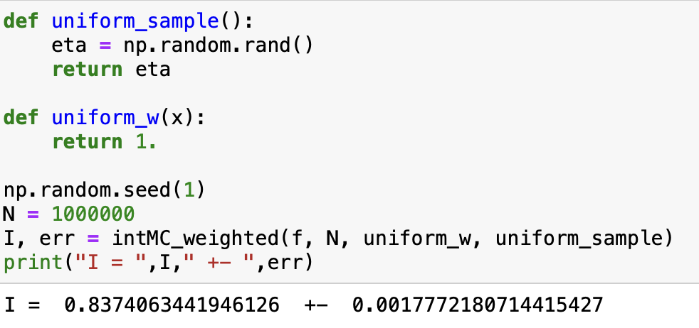
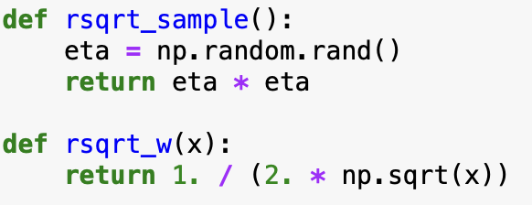


Importance sampling: Example
Mean value method
Importance sampling
f(x)/w(x)
Statistical error is more than x10 smaller than in the mean value method.
We would need more than x100 samples in the mean value method to reach the same accuracy as importance sampling in this case.

