Slide 1

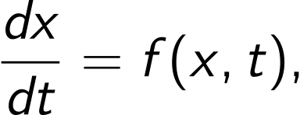
Computational Physics (PHYS6350)
Lecture 11: Ordinary Differential Equations
Instructor: Volodymyr Vovchenko (vvovchenko@uh.edu)
Course materials: https://github.com/vlvovch/PHYS6350-ComputationalPhysics
Online textbook: https://vovchenko.net/computational-physics/

Slide 2

Ordinary Differential Equations (ODE)
First-order ordinary differential equation (ODE) is an equation of the form
with initial condition
This determines the x(t) dependence at t>0.
In many physical applications t plays the role of the time variable (classical mechanics problems), although this is not always the case.
References:
Chapter 8 of Computational Physics by Mark Newman

Slide 3
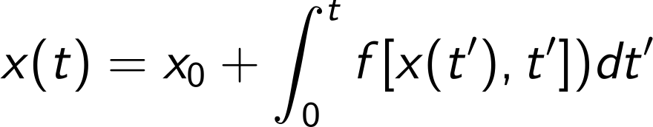
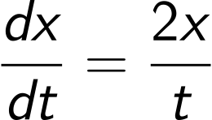
When we need numerical methods for ODEs
The solution to an ODE
can formally be written as
If f does not depend on x, the solution can be obtained through (numerical) integration
In some other cases the solution can be obtained through the separation of variables, e.g.
In all other cases, the solution has to be obtained numerically.

Slide 4
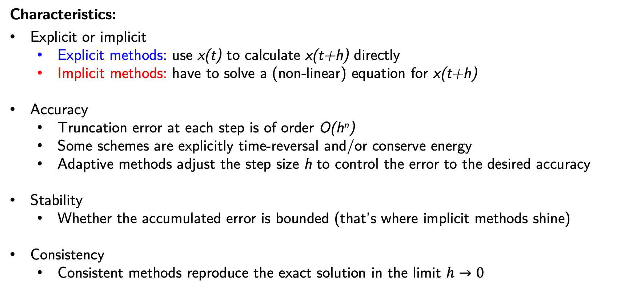
Numerical methods for ODEs
Typically obtain the solution by taking small steps from x(t) to x(t+h)
Characteristics:
Explicit or implicit
Explicit methods: use x(t) to calculate x(t+h) directly
Implicit methods: have to solve a (non-linear) equation for x(t+h)
Accuracy
Truncation error at each step is of order O(h^{n})
Some schemes are explicitly time-reversal and/or conserve energy
Adaptive methods adjust the step size h to control the error to the desired accuracy
Stability
Whether the accumulated error is bounded (that’s where implicit methods shine)
Consistency
Consistent methods reproduce the exact solution in the limit $h→0$

Slide 5
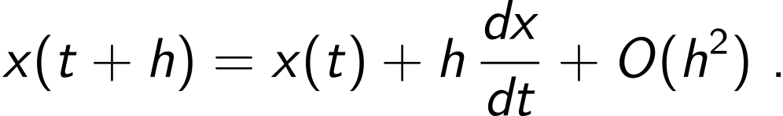
Euler’s method
Let us apply the Taylor expansion to express x(t+h) in terms of x(t):
Given that dx/dt = f(x,t) and neglecting the high-order terms in h we have
Euler method
We can iteratively apply this relation starting from t = 0 to evaluate x(t) at t > 0.
This is the essence of Euler’s method – the simplest method for solving ODEs numerically.
Error:
Local (per time step): O(h²)
Global (N=t_{end}/h time steps): O(h)

Slide 6
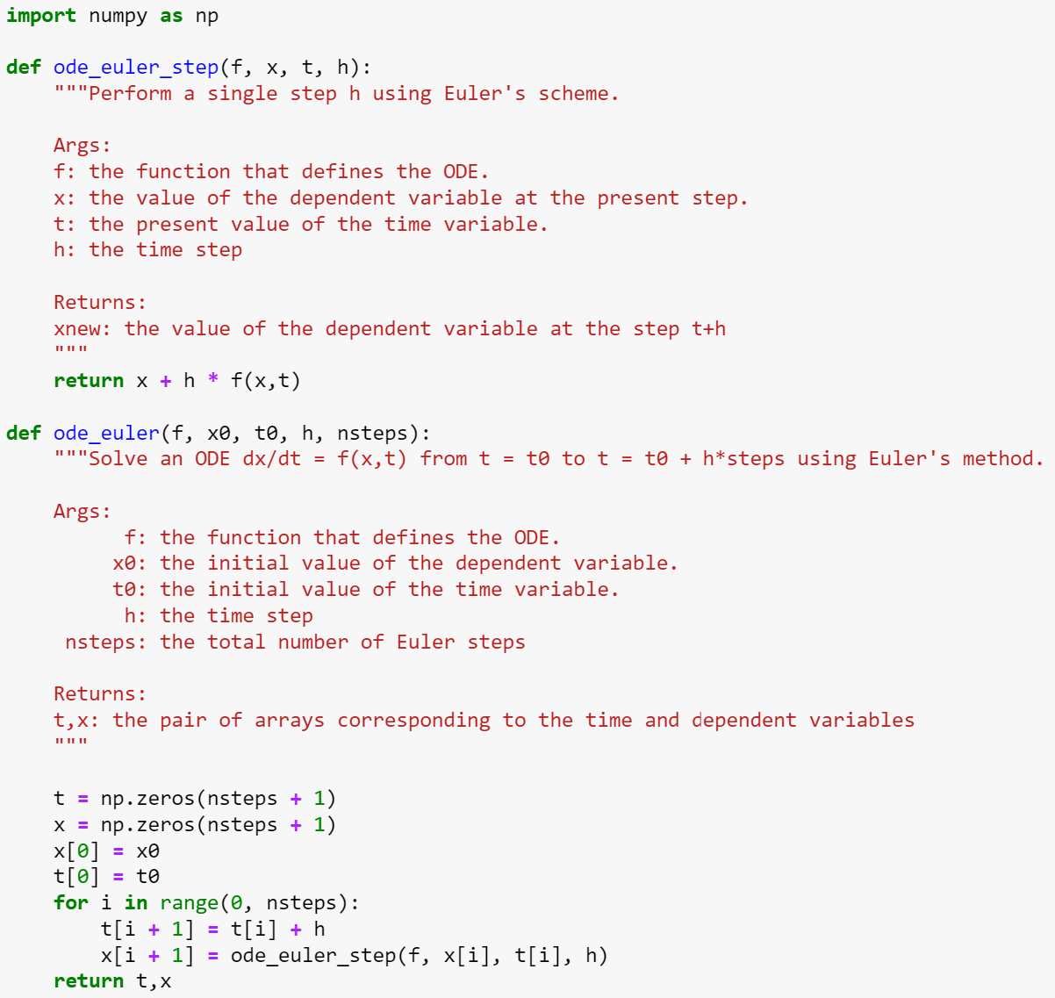
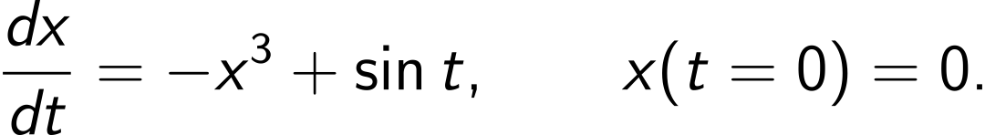
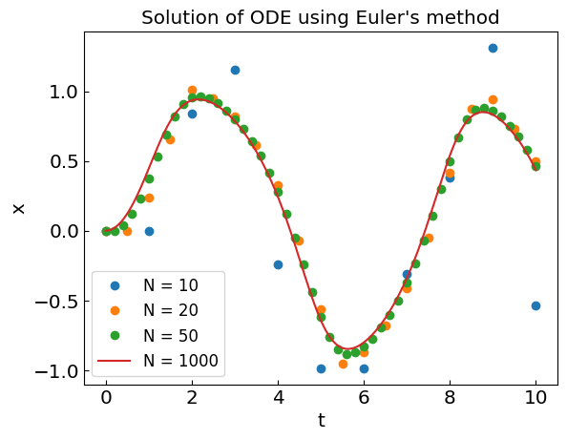
Euler’s method

Slide 7
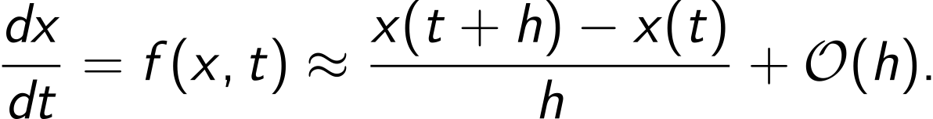
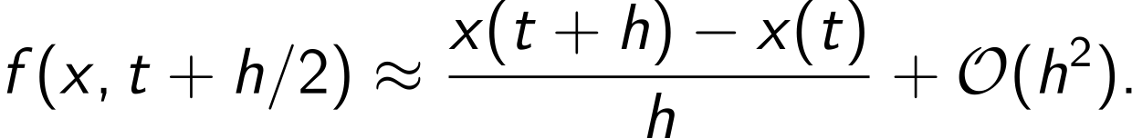
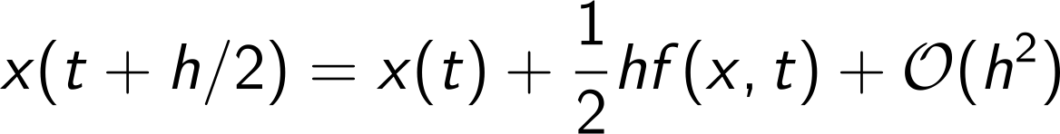
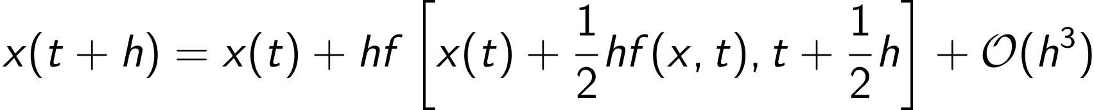
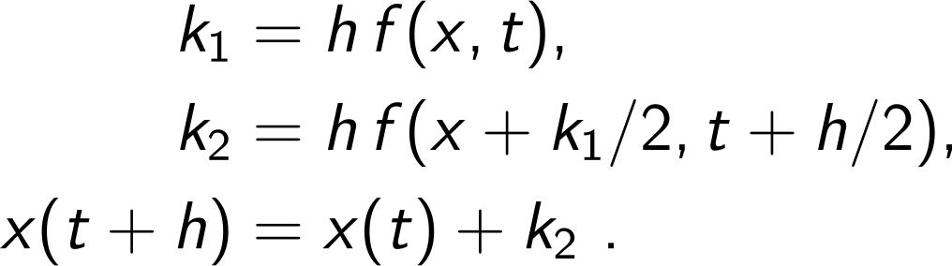
Midpoint method (2nd order Runge-Kutta)
Euler's method essentially corresponds to approximating the derivative dx/dt with a forward difference
Recall that central (midpoint) difference gives better accuracy
therefore
How to calculate x(t+h/2) entering the r.h.s? Use Euler’s method
Therefore, , which can be written in two steps
trial step
real step

Slide 8
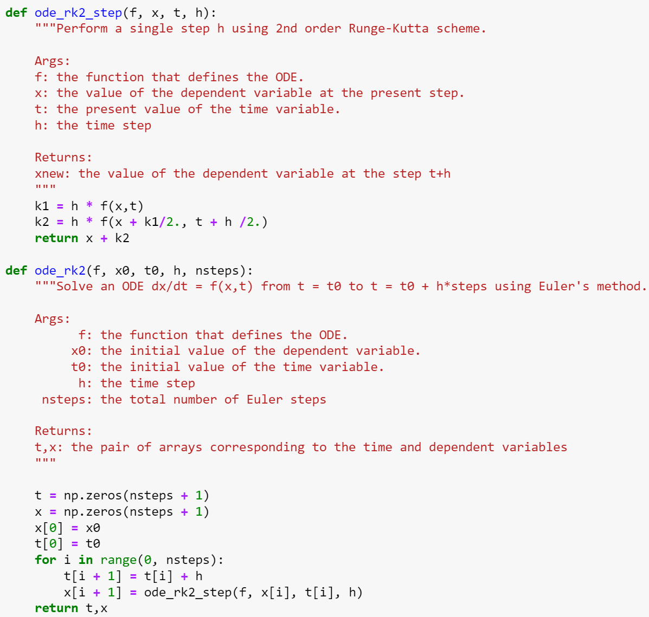
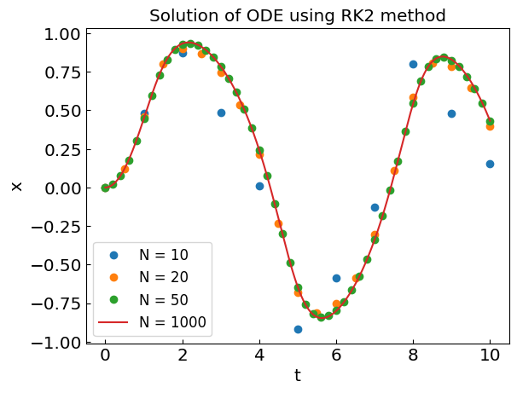
Midpoint method (2nd order Runge-Kutta)
Error:
Local (per time step): O(h³)
Global (N=t_{end}/h time steps): O(h²)

Slide 9
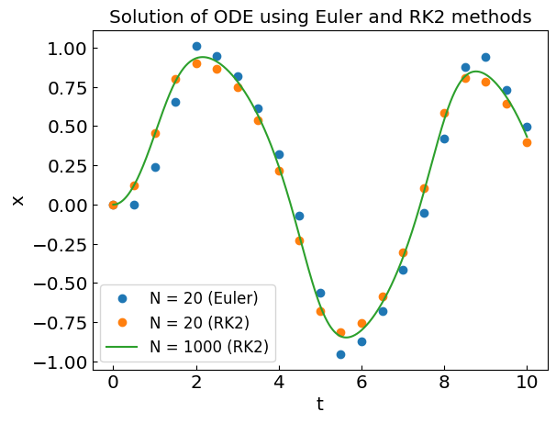
Midpoint method (2nd order Runge-Kutta)
Error:
Local (per time step): O(h³)
Global (N=t_{end}/h time step): O(h²)

Slide 10
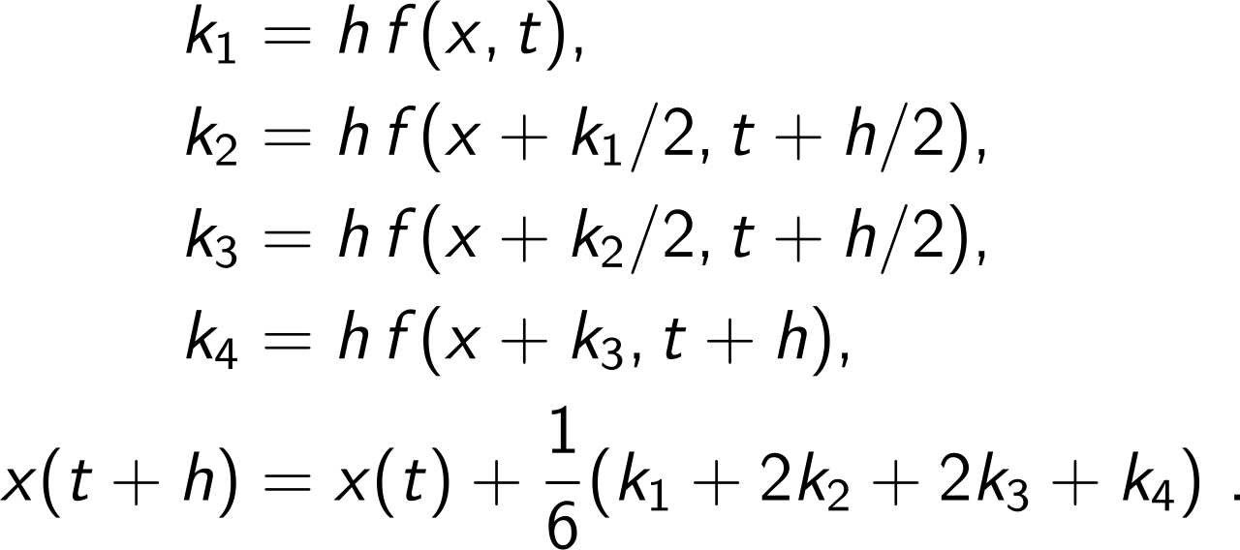
Classical 4th order Runge-Kutta method
The above logic can be generalized to cancel high-order error terms in various powers in h, requiring more and more evaluations of function f(x,t) at intermediate steps.
The classical 4th-order Runge-Kutta method is often considered a sweet spot.
It corresponds to the following scheme:
Error:
Local (per time step): O(h⁵)
Global (N=t_{end}/h time steps): O(h⁴)
The classical 4th-order Runge-Kutta method is a good first choice for solving physics ODEs.

Slide 11
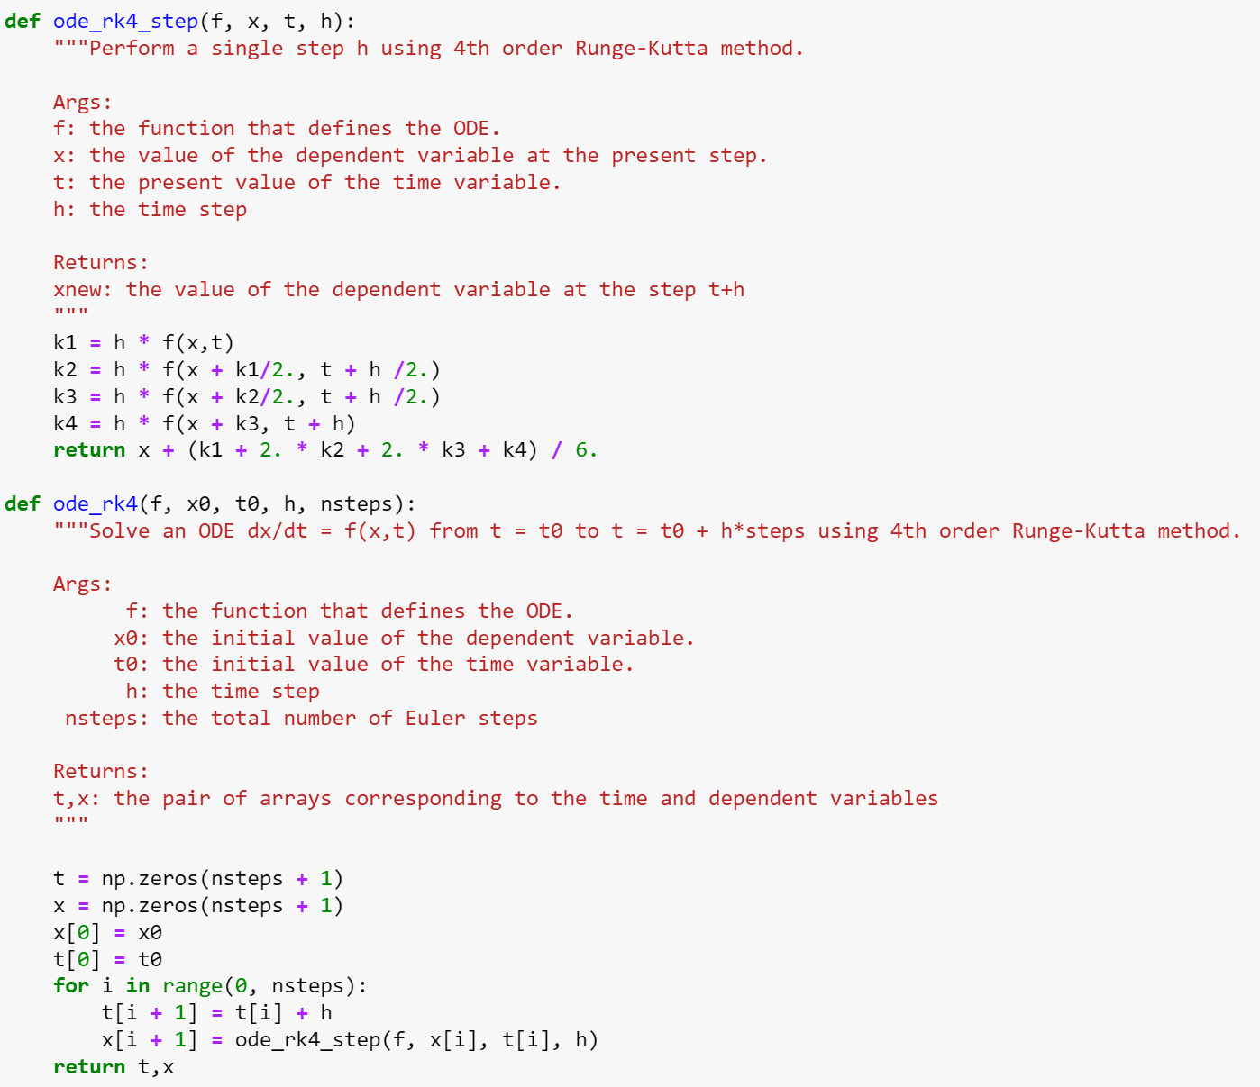
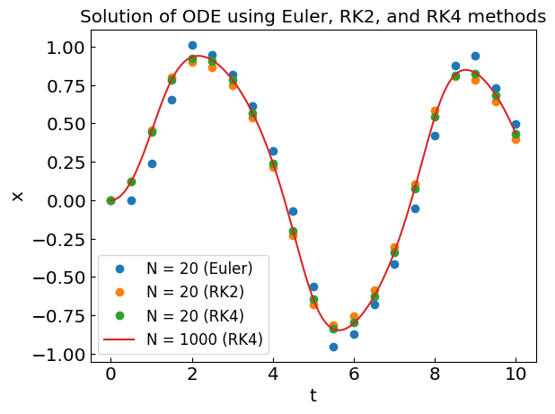
Classical 4th order Runge-Kutta method

Slide 12
Adaptive time step
The choice of the time step is important to reach the desired accuracy/performance.
h too large: the desired accuracy not reached
h too small: we waste computing resources on unnecessary iterations
Local truncation error itself is a function of time depending on the behavior of f(x,t)
Adaptive time step: make a local error estimate and adjust h to correspond to the desired accuracy
Ways to estimate the error:
Make two small steps (h) to compute x(t+2h) and compare to the one from a single double step 2h
Use two methods of a different order and compare their results (e.g. Runge-Kutta-Fehlberg method RKF45)

Slide 13


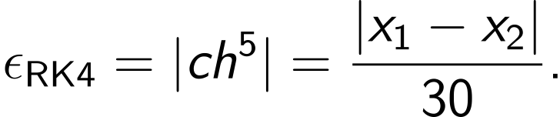

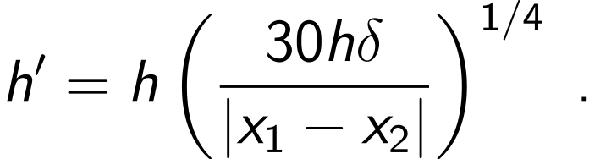
Adaptive time step in RK4 using double step
Recall that the error for one RK4 time step h is of order ch⁵.
Let us take two RK4 steps h to approximate $x(t+2h)≈x_{1}$. Then,
Now take single RK4 step $x(t+2h)≈x_{2}$ of length 2h
The local error estimate for a single RK4 time step h is then
If the desired accuracy per unit time is $δ$, the desired accuracy per time step h’ is
so the time step should be adjusted from h to h’ as
h’>h: our step size is too small, move on to x(t+2h) and increase the step size to h’
h’<h: our step size is too large, decrease step size to h’ and try the current step again

Slide 14
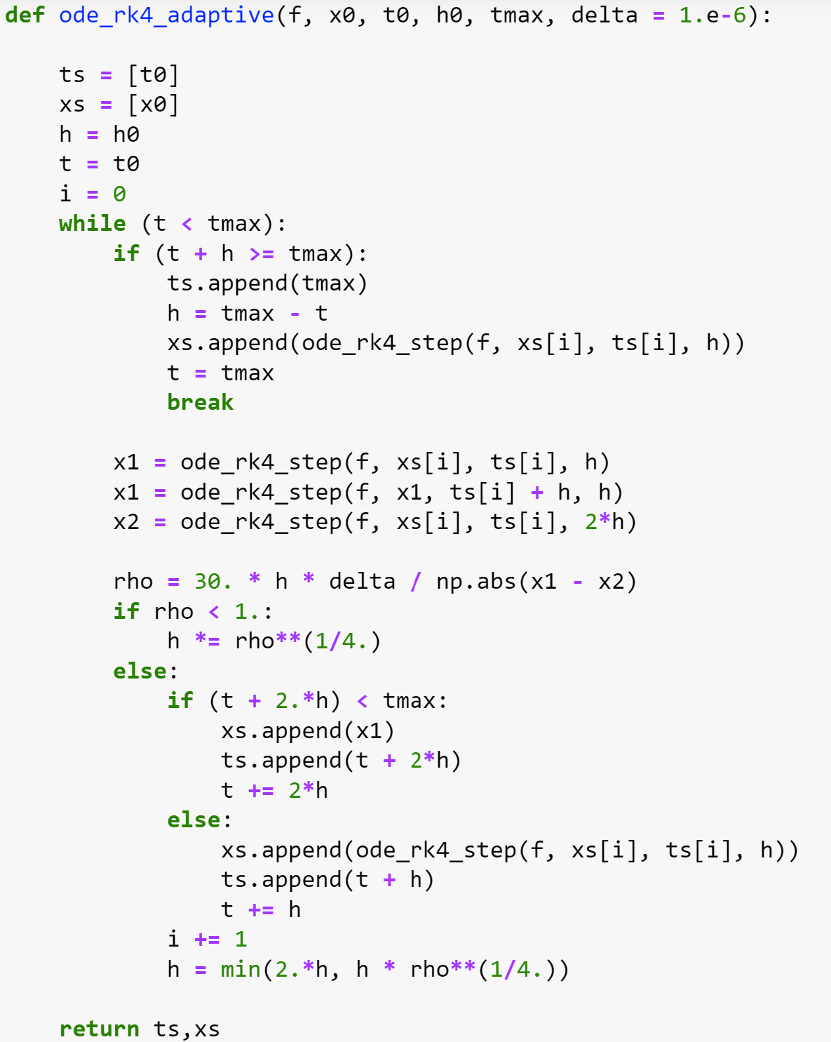
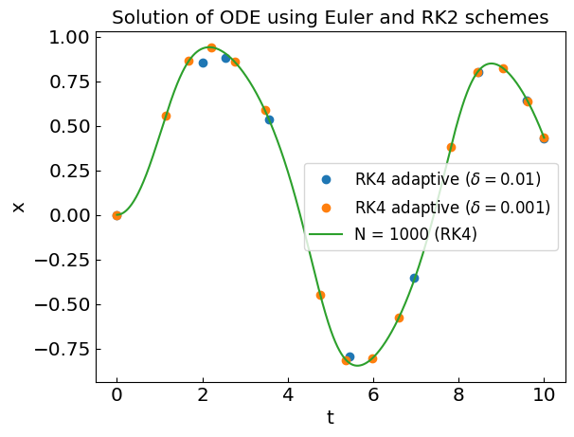
RK4 method with adaptive step size
Step size tends to decrease when dx/dt (the r.h.s) is large

Slide 15
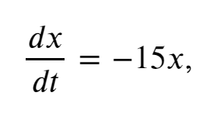
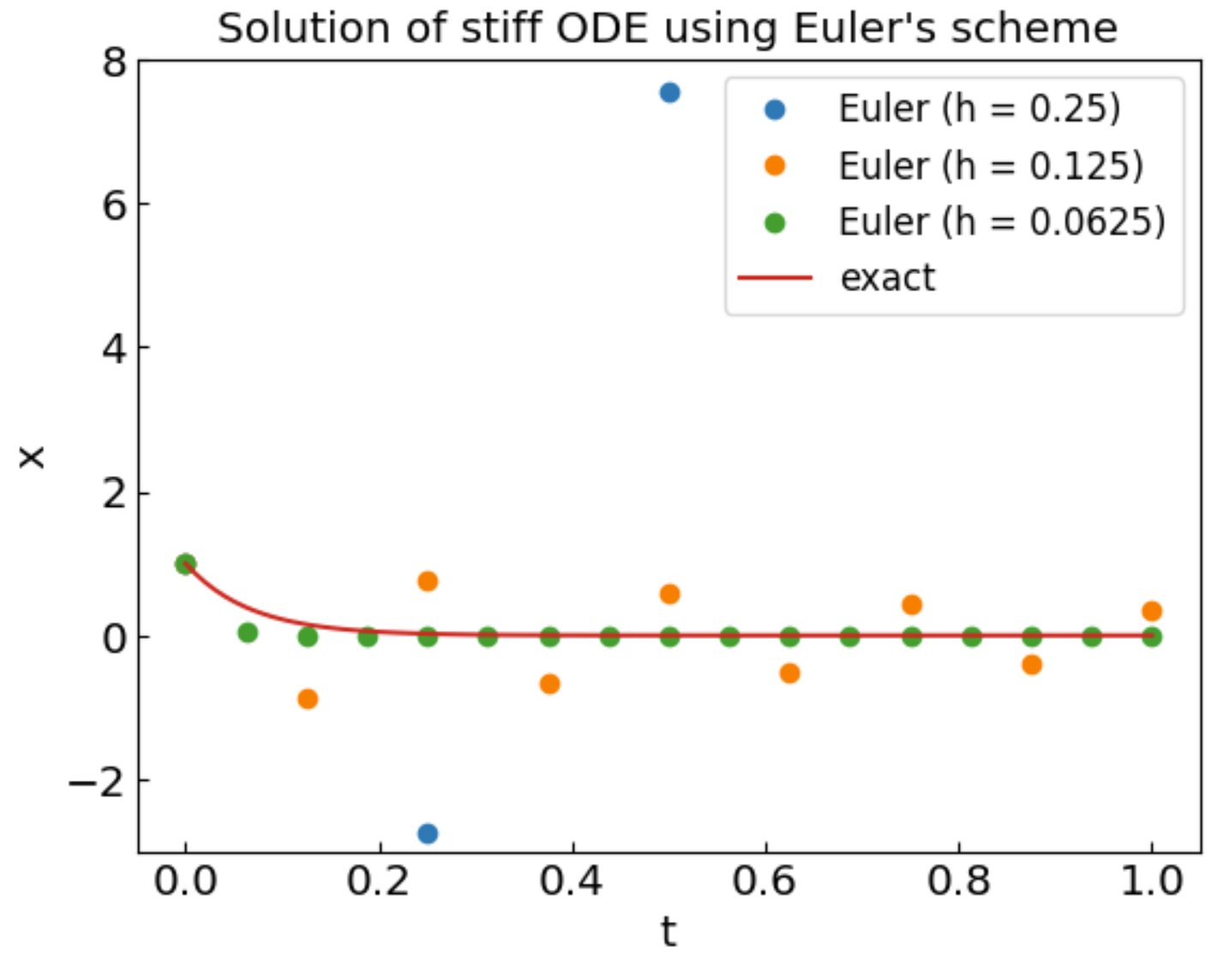
Stability, stiff equations, and implicit methods
Consider the following ODE
stiff equation
with the initial condition x(t=0) = 1.
The exact solution is of course $x\left(t\right)=e^{−15t}$ and goes to zero at large times.
Let us apply Euler’s method with h=1/4, 1/8, 1/16
Divergence for h=1/4!

Slide 16
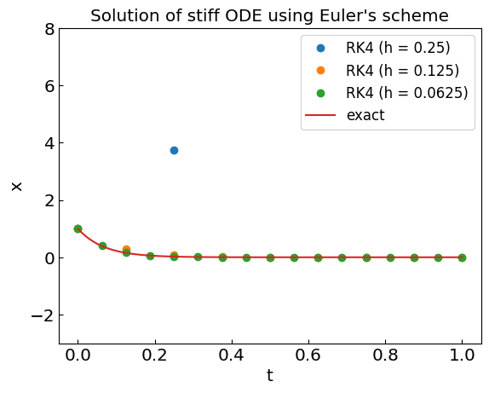
Stability, stiff equations, and implicit methods
Consider the following ODE
stiff equation
with the initial condition x(t=0) = 1.
The exact solution is of course $x\left(t\right)=e^{−15t}$ and goes to zero at large times.
Let us apply Euler’s method with h=1/4, 1/8, 1/16
Divergence for h=1/4!
RK4: better but still diverges for h=1/4

Slide 17
Euler methods and stiff equations
Recall that in Euler’s method x(t+h) = x(t) + h f(x,t)
For we have
If $|1−15h|>1$, i.e. $h>2/15$, the Euler method diverges!
Solution: implicit methods
Implicit Euler method:
Our stiff equation:
Implicit methods are more stable than explicit methods
But require solving non-linear equation for x(t+h) at each step
Semi-implicit methods: use one iteration of Newton’s method to solve for x(t+h)
Other implicit methods: trapezoidal rule, family of implicit Runge-Kutta methods

Slide 18
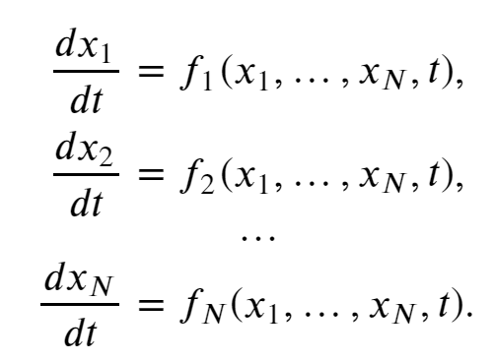
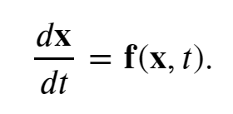
Systems of Ordinary Differential Equations
System of N first-order ODE
Vector notation:
all the methods we covered have the same structure when applied for systems of ODEs
simply apply component by component

Slide 19




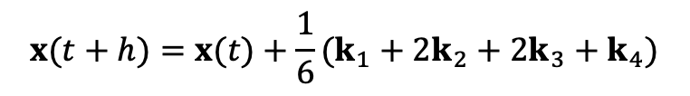




Systems of Ordinary Differential Equations
Euler method
$$x(t+h)=x(t)+hf[x(t),t]$$
RK2
$$k_{1}=h f[x(t),t]$$
$$k_{2}=h f[x\left(t\right)+k_{1}/2,t+h/2]$$
$$x(t+h)=x(t)+k_{2}$$
RK4
$$k_{1}=h f[x(t),t]$$
$$k_{2}=h f[x\left(t\right)+k_{1}/2,t+h/2]$$
$$k_{3}=h f[x\left(t\right)+k_{2}/2,t+h/2]$$
$$k_{4}=h f[x\left(t\right)+k_{3},t+h]$$
$$x(t+h)=x(t)+\frac{1}{6}(k_{1}+2k_{2}+2k_{3}+k_{4})$$

Slide 20
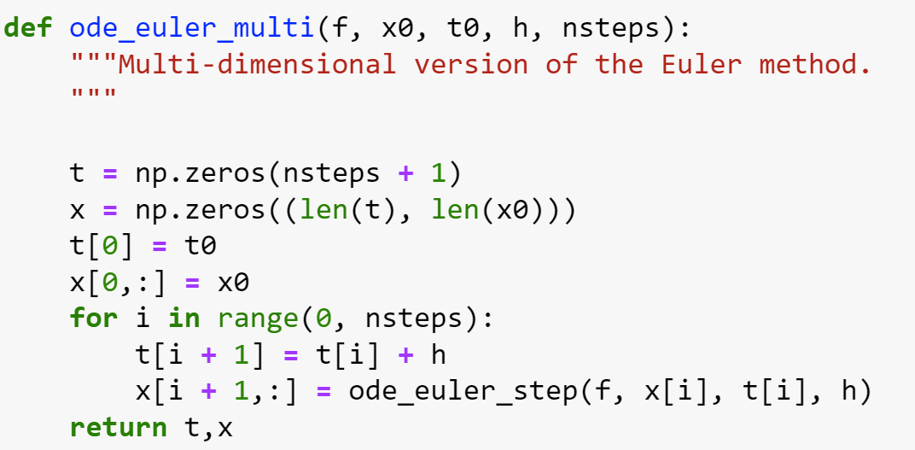
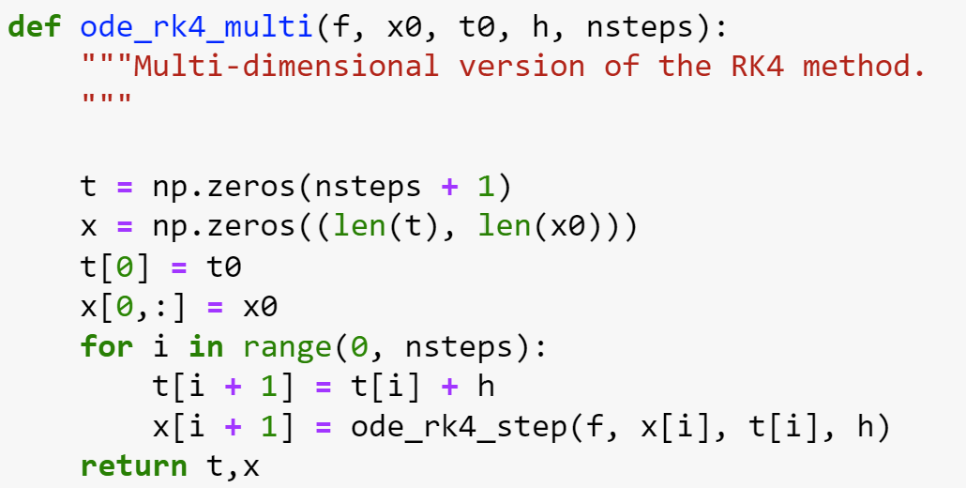
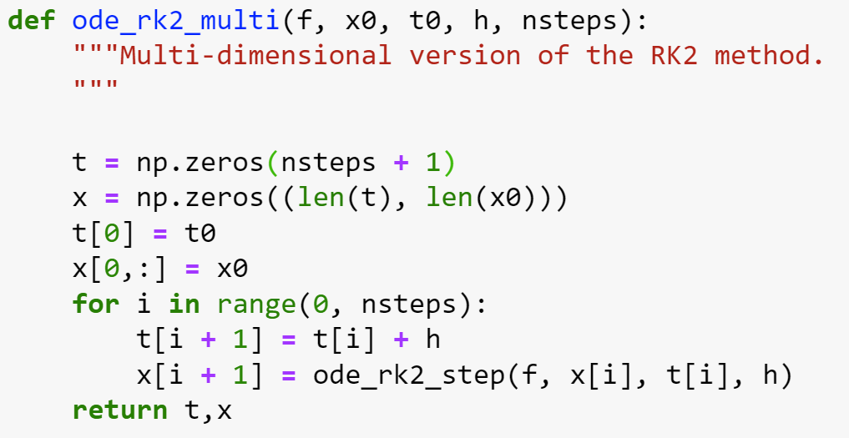
Systems of Ordinary Differential Equations

Slide 21
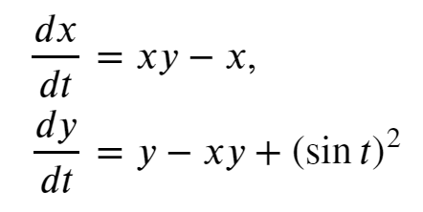
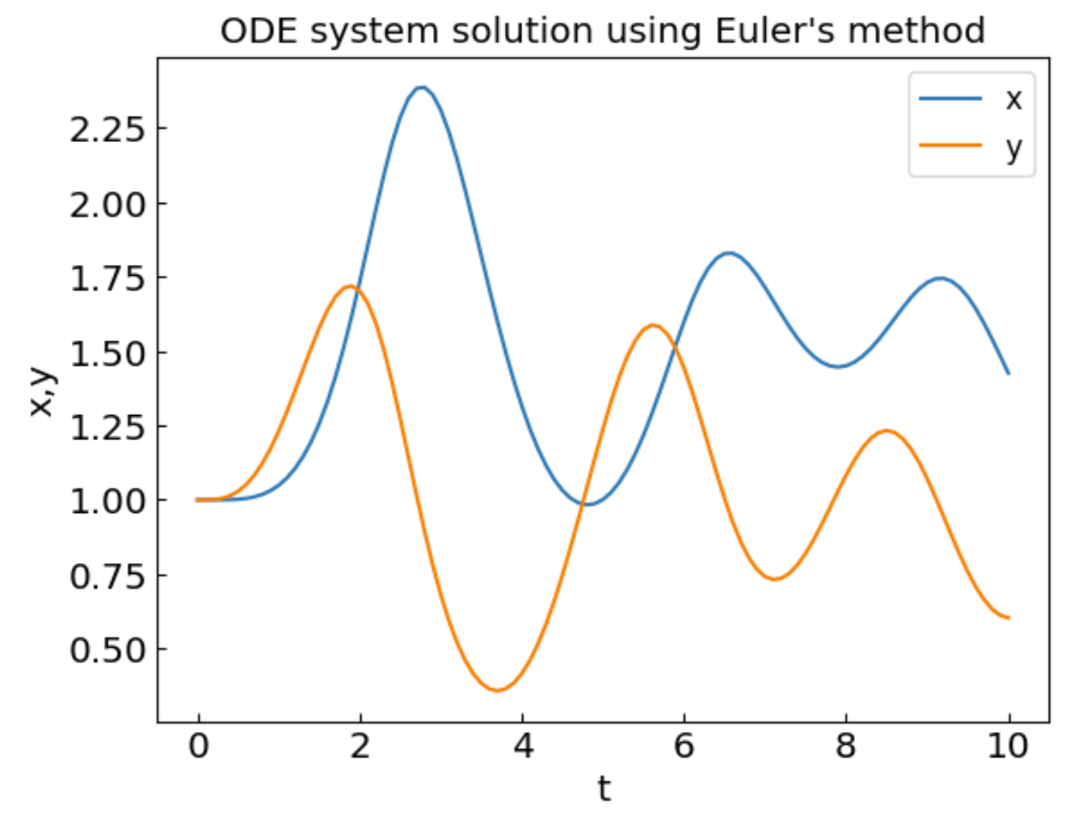
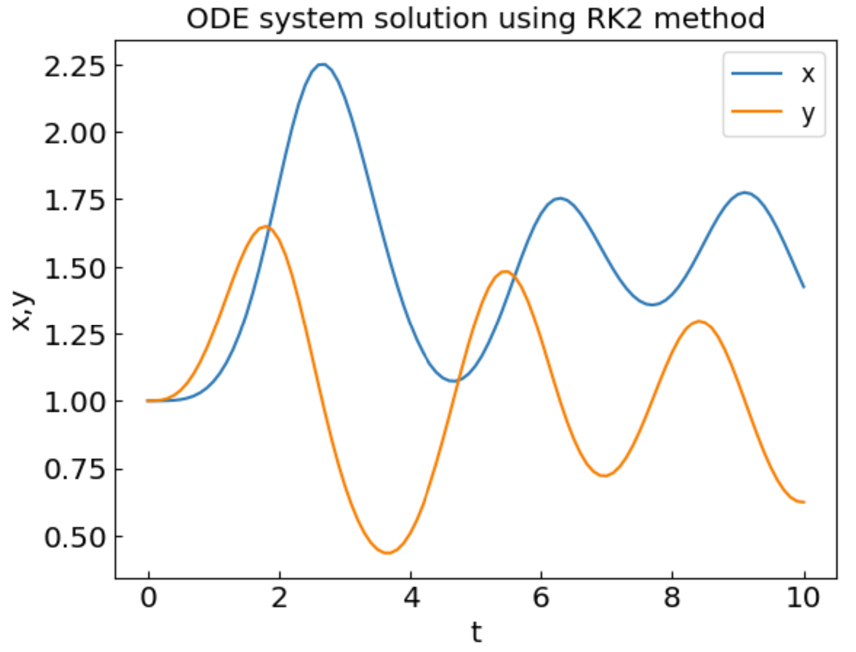
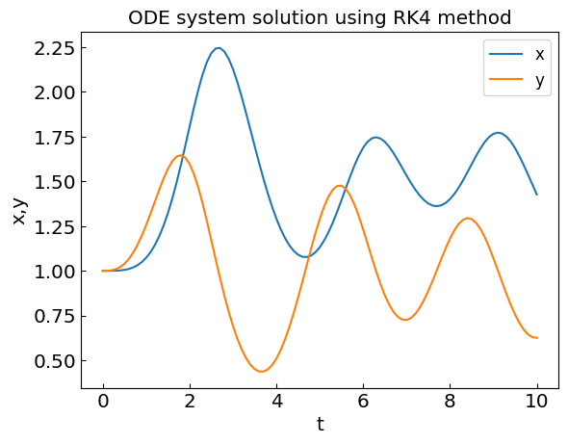
Systems of Ordinary Differential Equations: Example

Slide 22


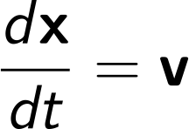
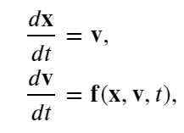
Systems of 2nd-order ODEs
Newton/Lagrange equations of motion are 2nd order systems of ODE
A system of N second-order ODEs
can be written as a system of 2N first-order ODEs by denoting
and can be solved for x(t) and v(t) using standard methods

Slide 23
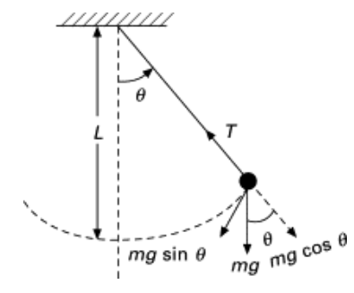

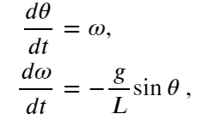

Example: Simple pendulum
The equation of motion for a simple pendulum reads
denote $\frac{dθ}{dt}=ω$ and write a system of two first-order ODE
For small angles $\sin{θ≈θ},$ an analytic solution exists

Slide 24
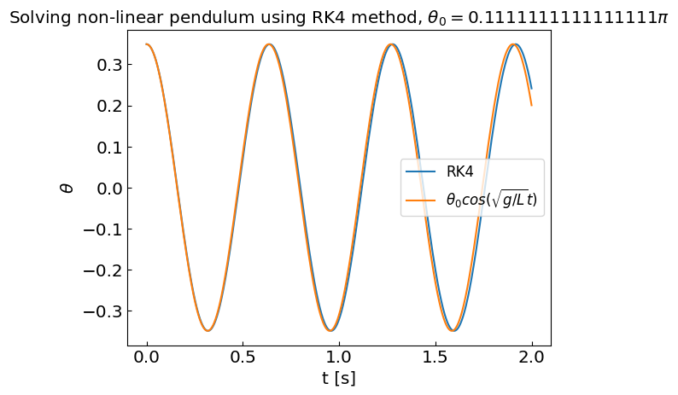
Example: Simple pendulum
Initially at rest at angle $θ_{0}=20°≈0.111π$
L=0.1 m, g=9.81 m/s²
Linear regime at small angles

Slide 25
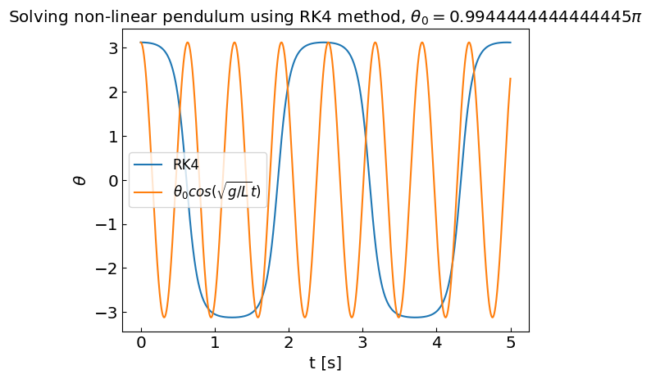
Example: Simple pendulum
Initially at rest at angle $θ_{0}=179°≈0.994π$
L=0.1 m, g=9.81 m/s²
Non-linear regime at large angles, approximate analytic solution fails

