Slide 1

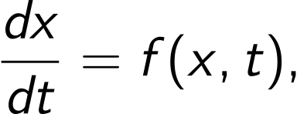
Computational Physics (PHYS6350)
Lecture 12: Ordinary Differential Equations Part II
Instructor: Volodymyr Vovchenko (vvovchenko@uh.edu)
Course materials: https://github.com/vlvovch/PHYS6350-ComputationalPhysics
Online textbook: https://vovchenko.net/computational-physics/

Slide 2
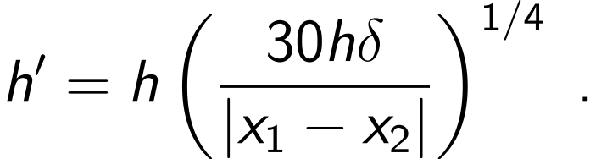

Adaptive time step for systems of ODEs
For a single ODE we devised an adaptive RK4 scheme
Time step is adjusted as
Here $x_{1}=RK4(RK4\left(x,t,h \right),t+h,h)$ and $x_{2}=RK4(x,t+2h,2h)$
How to generalize $ε$=|x₁-x₂| to a system of ODEs where we have a state vector x?
The answer depends on the physical problem at hand. One could take for example
Alternatively, if the accuracy of only one variable matters (e.g. the position but not the velocity), one can use just this one coordinate to define $ε$
The implementation of the adaptive step in systems of ODEs should thus allow for flexibility to define the accuracy

Slide 3
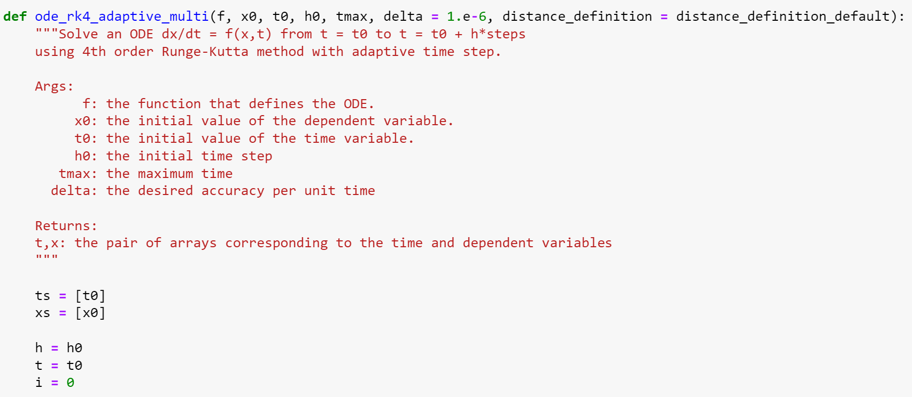
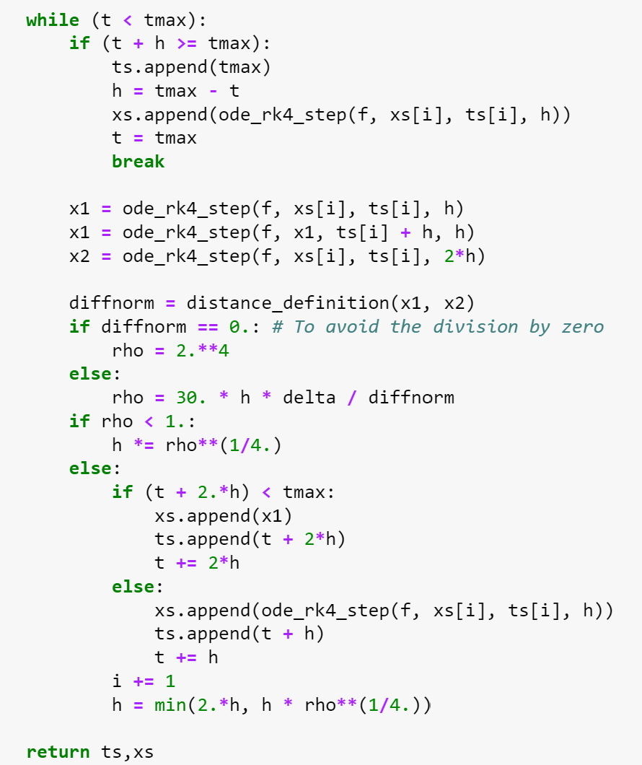
Multi-dimensional RK4 with adaptive time step

Slide 4
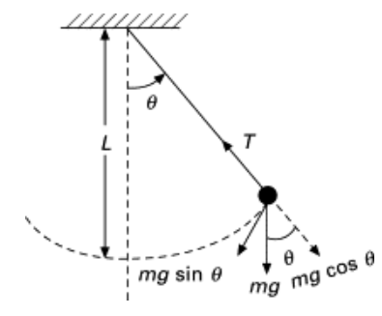

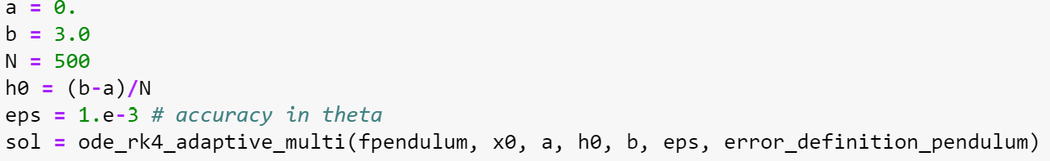
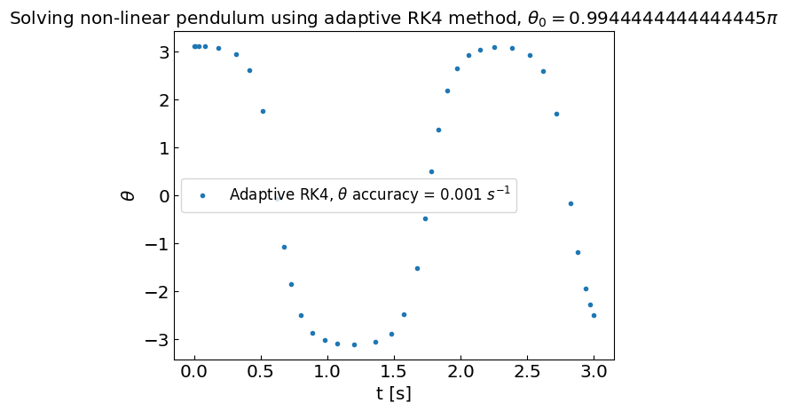
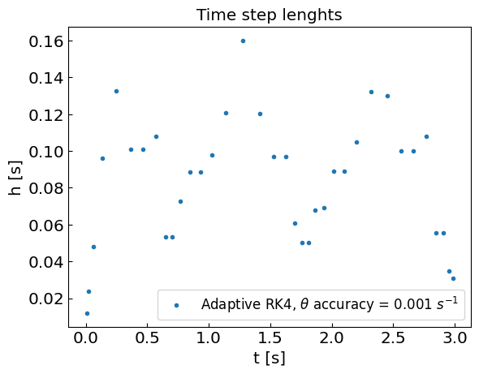
Adaptive time step RK4 for non-linear pendulum
Initially at rest at angle $θ_{0}=179°≈0.994π$
L=0.1 m, g=9.81 m/s²
Accuracy: only the angle $θ$ matters

Slide 5
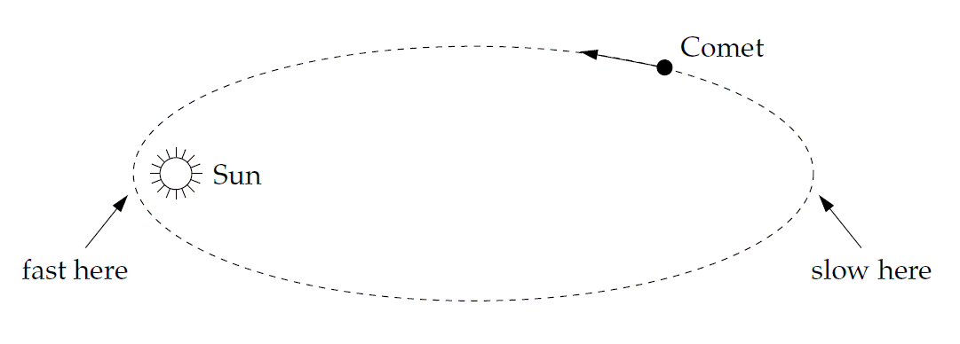

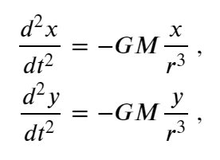
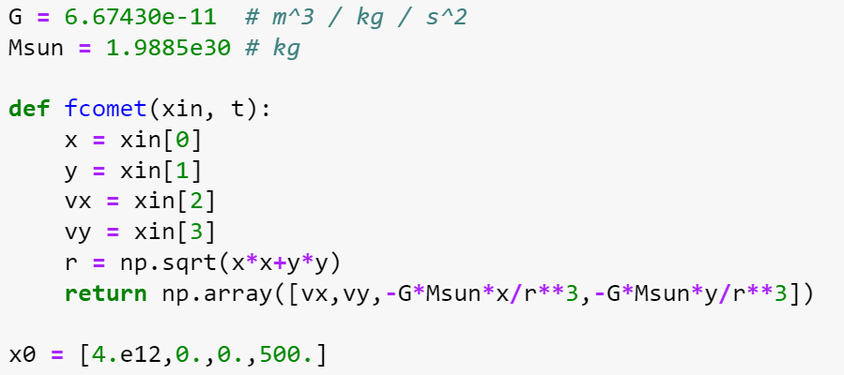

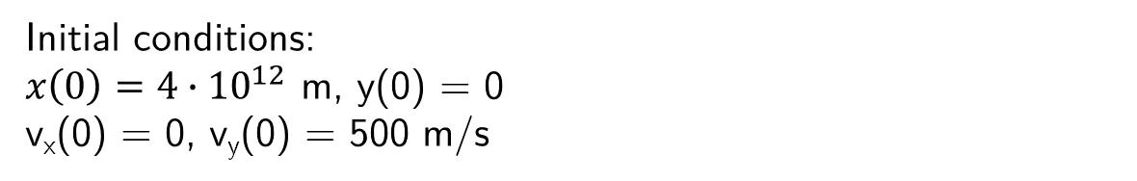
Comet motion
Exercise 8.10 (M. Newman, Computational Physics)
Angular momentum is conserved, the motion is in the plane (z=0), thus only two equations needed
Initial conditions:
$x\left(0\right)=4∙{10}^{12}$ m, y(0) = 0
v_{x}(0) = 0, v_{y}(0) = 500 m/s

Slide 6
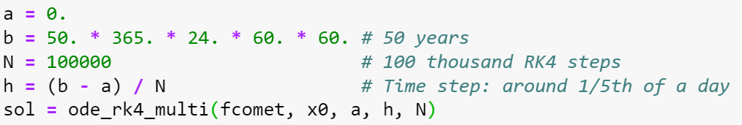
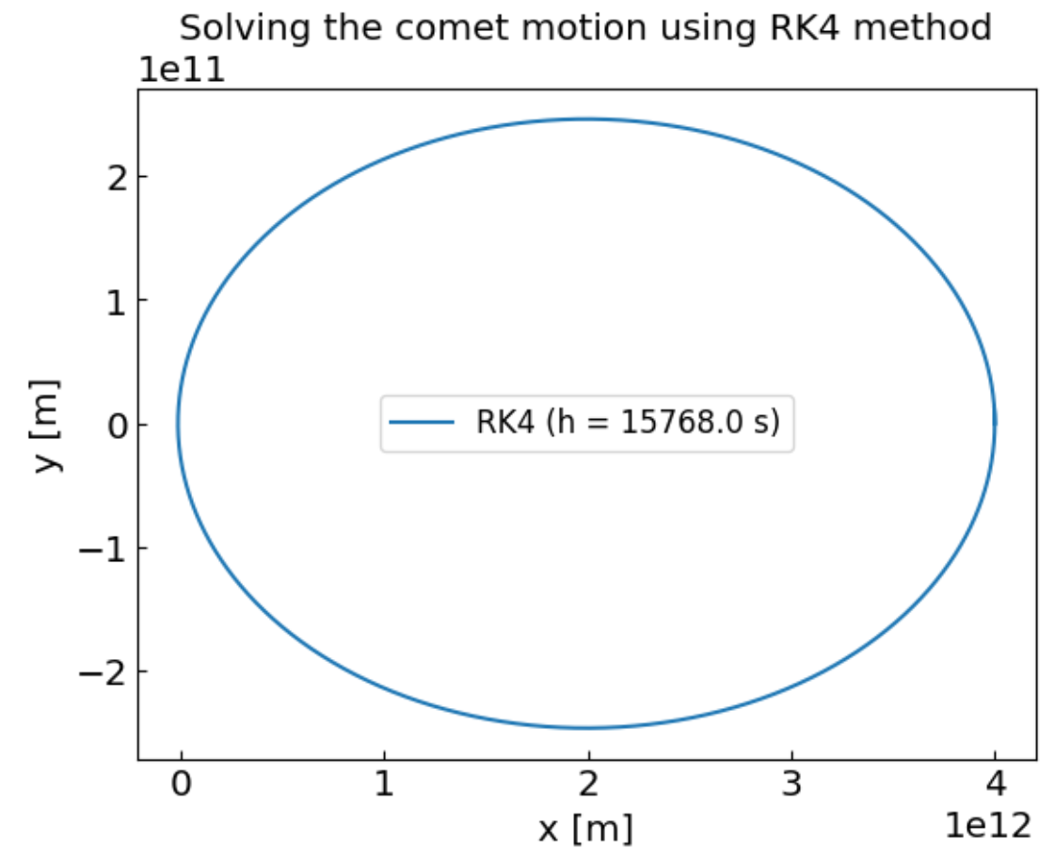
Comet motion: RK4 with fixed time step
Nice elliptic shape but are we wasting computational resources (time step very small)

Slide 7
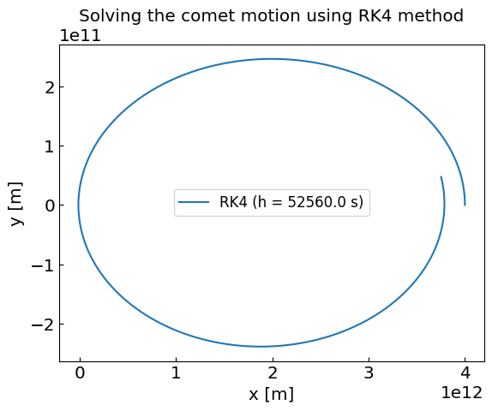
Comet motion: RK4 with fixed time step
Nice elliptic shape but are we wasting computational resources (time step very small)

Slide 8
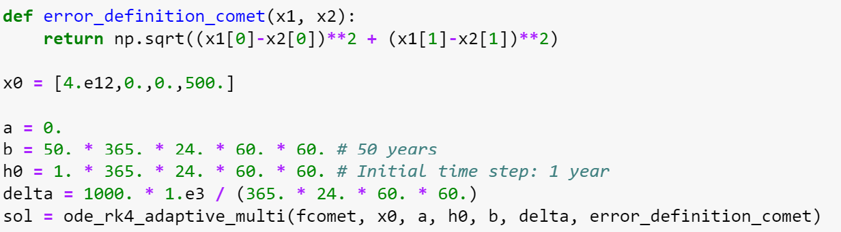
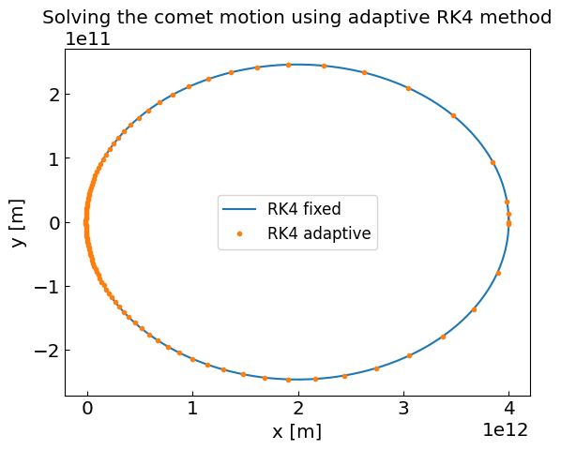
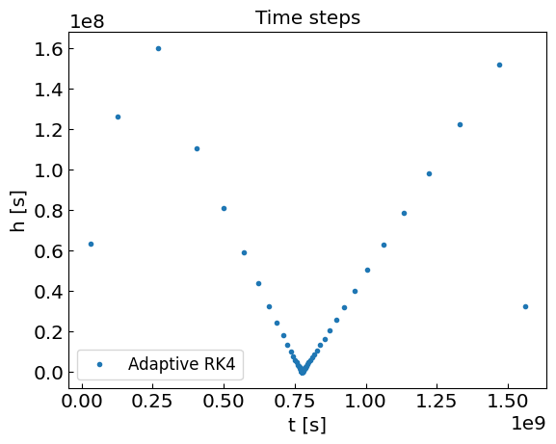
Comet motion: RK4 with adaptive time step

Slide 9
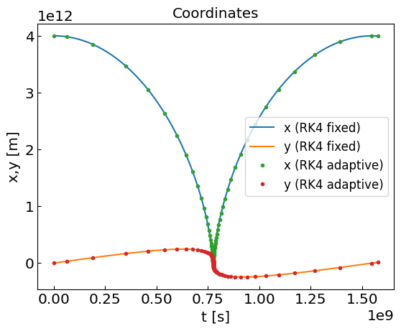
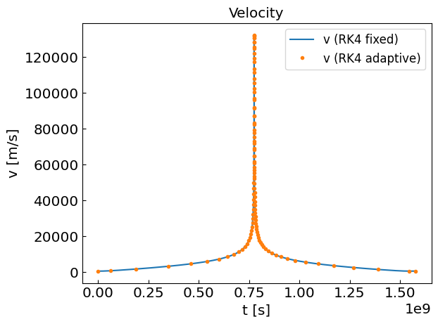
Comet motion: RK4 with adaptive time step

Slide 10
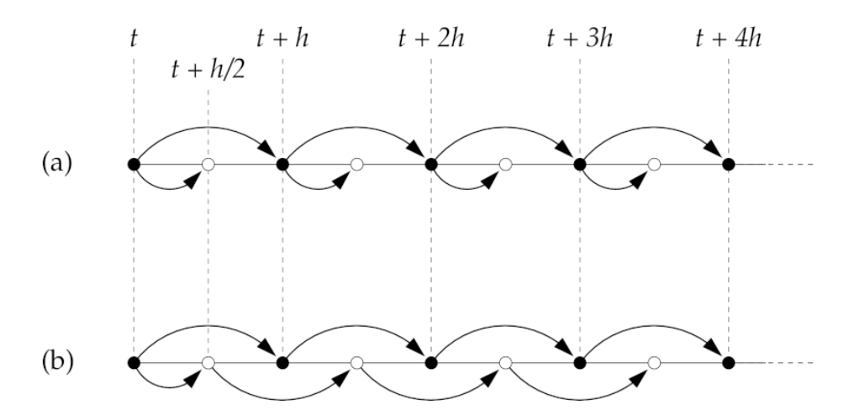


Leapfrog method
Recall the RK2 (midpoint) method
RK2
leapfrog
Leapfrog method: given x(t) and x(t+h/2), estimate x(t+h) and x(t+3h/2) using first equation only
Leapfrog method
Euler’s half-step is used in the first iteration only.
The method is time reversible:
By changing $h→−h$one recovers x(t) and x(t+h/2) from previous iteration.
Error:
Local (per time step): O(h³) + O(h⁵) + O(h⁷) + …
Global (N=t_{end}/h time steps): O(h²) + O(h³) + …
Odd powers in the global error propagated from the Euler’s half-step at the 1st iteration

Slide 11
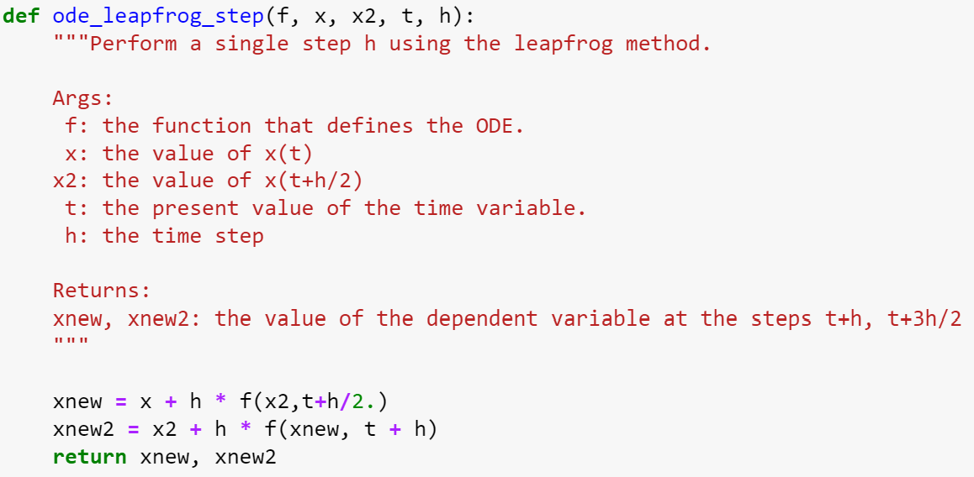
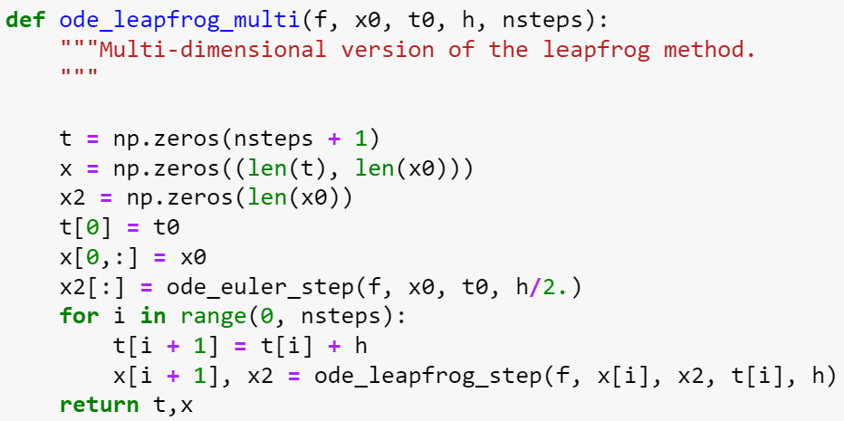
Leapfrog method implementation

Slide 12

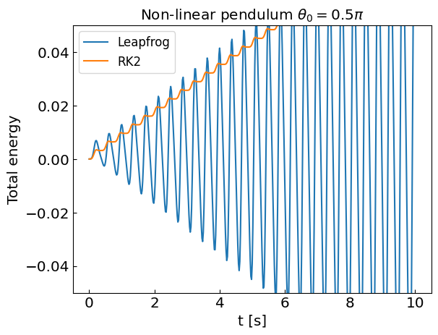
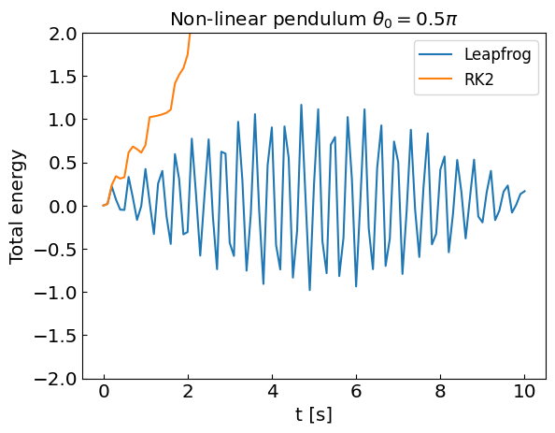
Leapfrog method and non-linear pendulum
Time-reversal symmetry implies average energy conservation
The pendulum energy is
Let us solve it with the leapfrog and RK2 methods and see how energy evolves with time
h=0.02 s
h=0.1 s
Energy is drifting in RK2 but conserved (on average) in leapfrog method

Slide 13

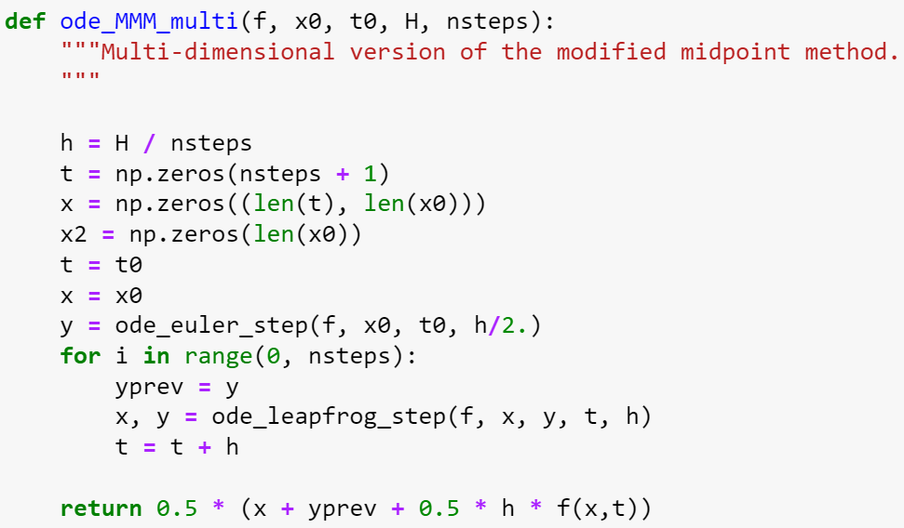
Modified midpoint method
Recall the error in the leapfrog method when integrating from t to t+H in steps of h = H/N
Local (per time step): O(h³) + O(h⁵) + O(h⁷) + …
Global (N=H/h time steps): O(h²) + O(h³) + …
Odd powers in the global error are propagated from Euler’s half-step at 1st iteration
They can be canceled out with an additional Euler half-step at the end
Let $yn = x(t+H−h/2)$and $xn = x(t+H)$be the solution estimates resulting from the leapfrog method.
modified midpoint method
Global error: O(h²) + O(h⁴) + O(h⁶) + … (even powers only)

Slide 14


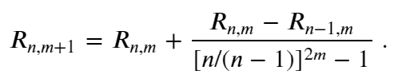
Bulirsch-Stoer method
The error in the modified midpoint method when integrating from t to t+H in steps of h_{n} = H/n
is O(h²) + O(h⁴) + O(h⁶) + … (even powers only)
Bulirsch-Stoer method: Use the modified midpoint method with various steps n to cancel error terms of higher and higher order (Richardson extrapolation, similar to Romberg method for numerical integration)
Let R_{n,1} be an estimate of x(t+H) from the n-step modified midpoint method (h_{n} = H/n)
One constructs high-order approximations R_{n,m} such that
Similar to Romberg integration one can derive
Bulirsch-Stoer method
The method stops when the desired accuracy is achieved, |R_{n,n}-R_{n,n-1}|<$ε$
If n grows too large, it is better to split the (t,t+H) interval into two subintervals (t,t+H/2) & (t+H/2,t+H) and apply the method recursively to each of them

Slide 15
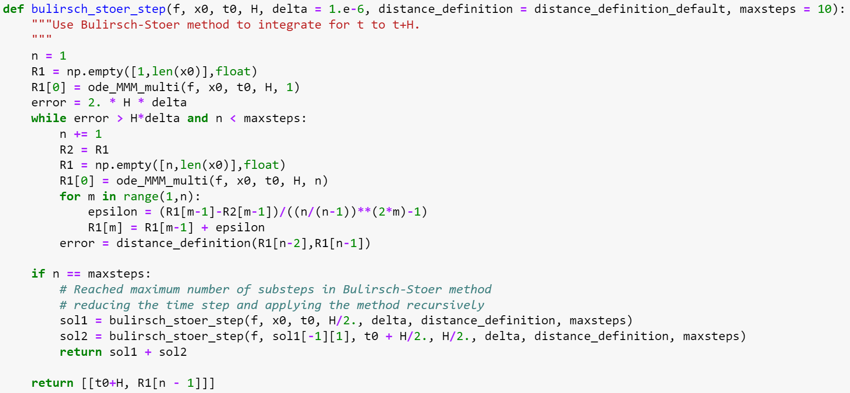
Bulirsch-Stoer method implementation

Slide 16
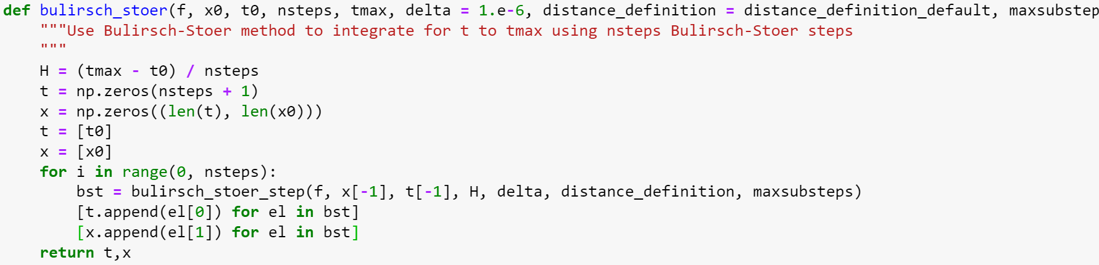
Bulirsch-Stoer method implementation
N-step Bulirsch-Stoer: apply the H step N times:

Slide 17
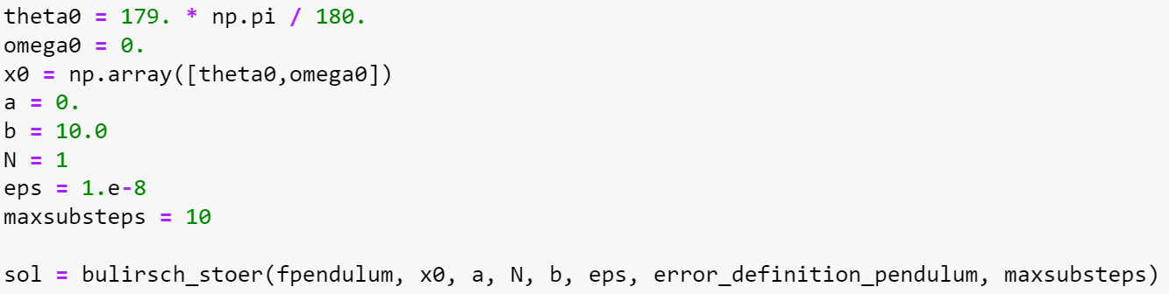
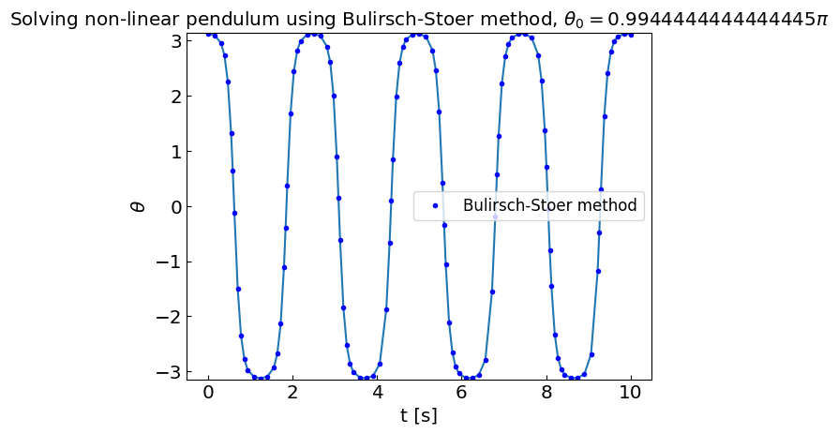
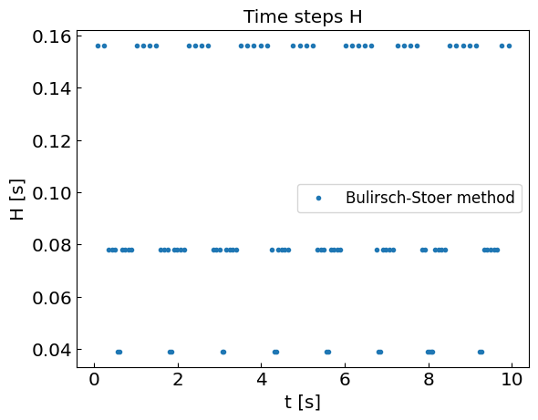
Bulirsch-Stoer method and non-linear pendulum
Apply the method to non-linear pendulum with the initial H = 10 (single step) and a maximum of 10 substeps. The method will adjust H as needed.

Slide 18
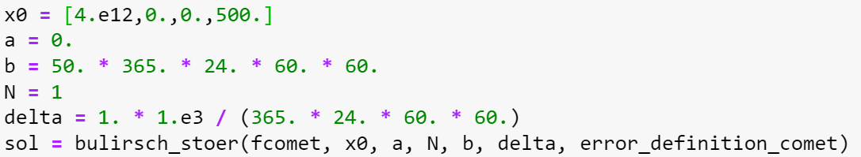
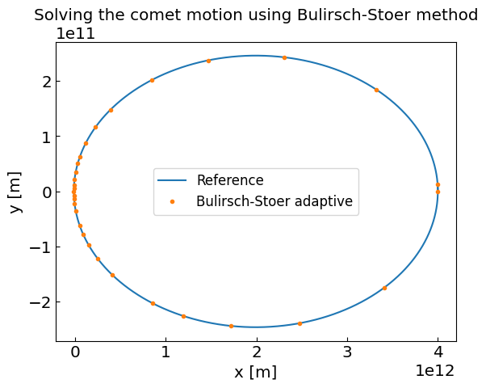
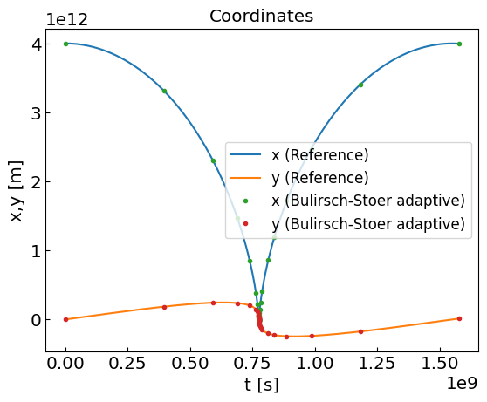
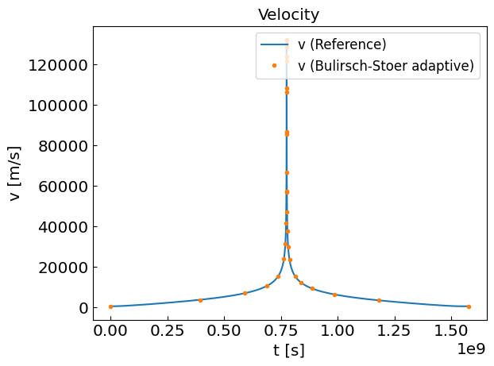
Bulirsch-Stoer method and the comet motion
Same for the comet motion. Accuracy: 1 km per day

Slide 19
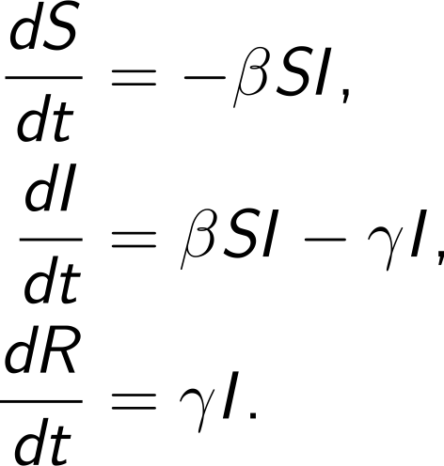
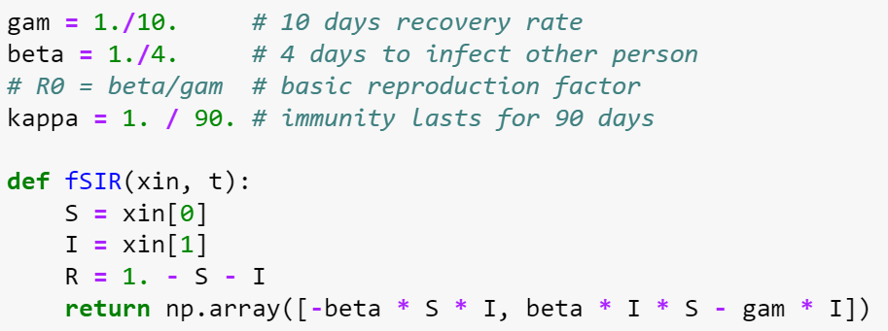
SIR model
The SIR model is the simplest model for infection disease dynamics in the population. The population is split into susceptible (S), infected (I), and recovered/immune (R) parts.
The SIR equations read:
Here $β$ is the infection rate and $γ$ is the recovery rate.
The ratio $R0 = β/γ$ is basic reproduction number.
Given that $S+I+R=1=const$at all times,
one only needs to solve two ODEs, e.g. $dS/dt$and $dI/dt$.

Slide 20
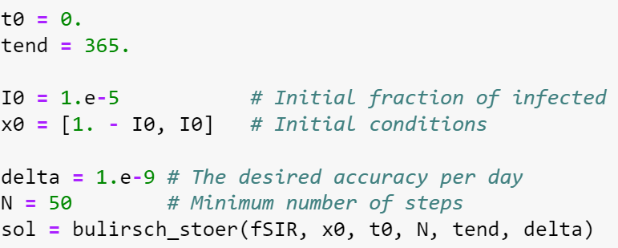
SIR model
Solve the SIR model equations using e.g. Bulirsch-Stoer method

Slide 21
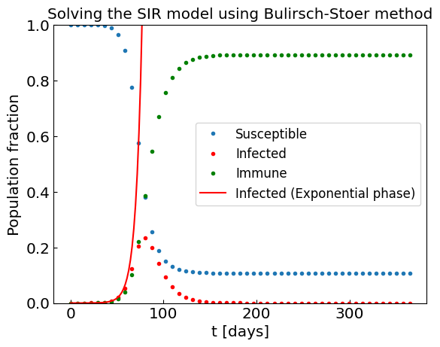
SIR model
Solve the SIR model equations using e.g. Bulirsch-Stoer method
One can clearly see the initial exponential phase of the epidemic, and its end once a sufficient fraction of the population obtained immunity.

Slide 22
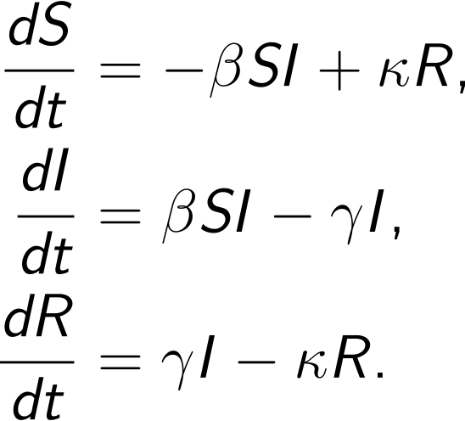
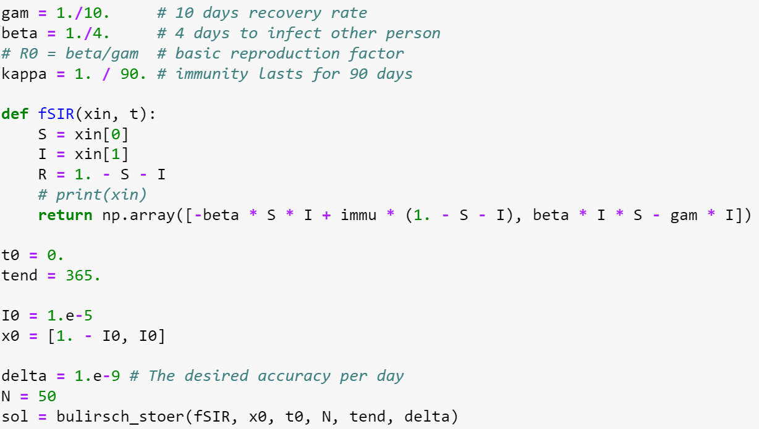
Modified SIR model
What if the immunity disappears with time?
Introduce the loss of immunity rate $κ$

Slide 23
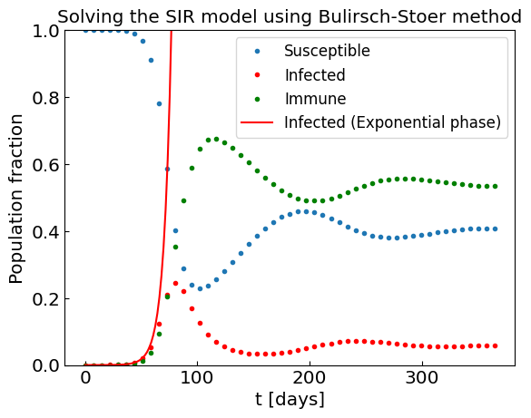
Modified SIR model
What if the immunity disappears with time?
Introduce the loss of immunity rate $κ$

Slide 24
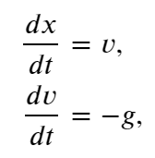
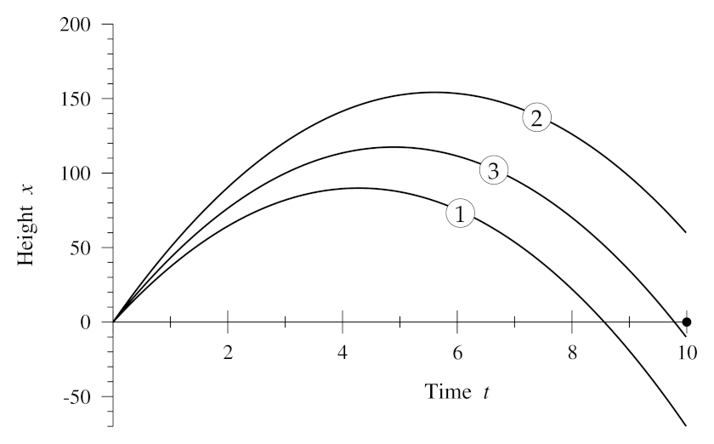
Boundary value problems and the shooting method
Sometimes we have equations, such as vertically thrown object
and boundary conditions, e.g. x(0) = 0 and x(10) = 0 instead of initial conditions v(0) = v₀.
How to solve this problem?
In the shooting method one takes trial values of v₀ until finding the one where the solution satisfies the boundary condition x(10) = 0.
To find v₀ efficiently one combines numerical ODE method (e.g. RK4) with non-linear equation solver (e.g. bisection method).

Slide 25
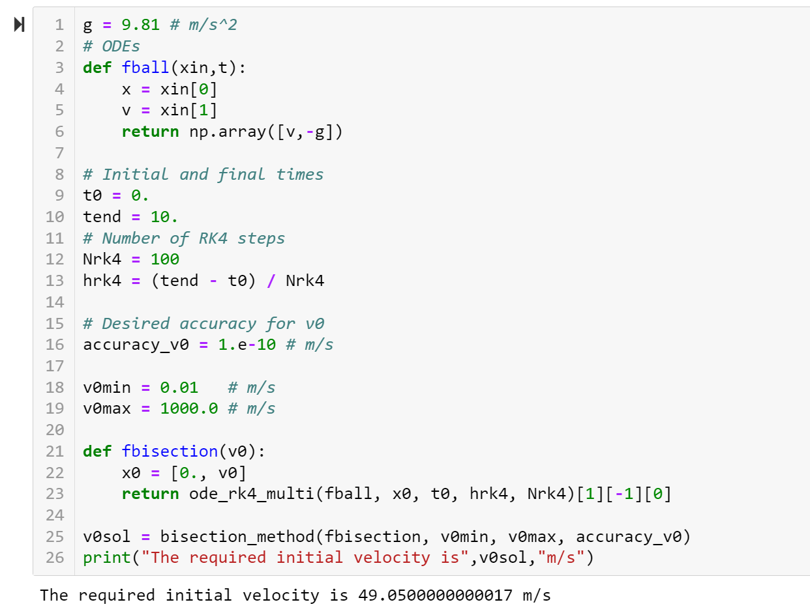
Shooting method for vertically thrown object
Search for v₀ using bisection method and solve the intermediate ODEs using RK4

