Slide 1

Computational Physics (PHYS6350)
Lecture 21: Problems in quantum mechanics
Matrix method for eigenenergies and eigenstates
Time-dependent Schroedinger equation
Variational method
Instructor: Volodymyr Vovchenko (vvovchenko@uh.edu)
Course materials: https://github.com/vlvovch/PHYS6350-ComputationalPhysics
Online textbook: https://vovchenko.net/computational-physics/

Slide 2
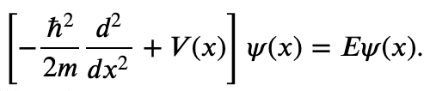

Finding the eigenenergies
Time-independent Schroedinger equation reads
e.g. in a box of length L with boundary conditions
In the case of (an)harmonic oscillator we learned how to use the shooting method to find the eigenenergies by combining a root finder (bisection or secant method) with an ODE integrator (such as RK4).
This involved discretizing the space on a grid.
The problem can also be tackled efficiently by linear algebra methods.

Slide 3
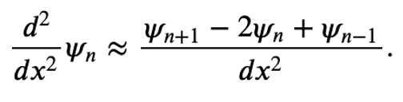
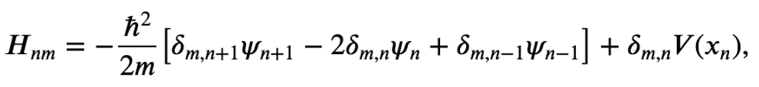
Matrix method for eigenenergies and eigenstates
By discretizing the space into N intervals, we can represent the wave function ψ(x) as an N+1-dimensional vector ψ=(ψ₀​,…,ψ_{N+1​}) such that
Due to the boundary conditions we have ψ₀=ψ_{N+1}=0, thus we effectively deal with a N−1-dimensional space.
Each operator becomes a (N−1)×(N−1) matrix. By discretizing d^{2/}dx² by the central difference we get
Therefore, the Hamiltonian has the following matrix representation:
i.e., H is a tridiagonal symmetric matrix.
Therefore, finding the energies and wave function of the system corresponds to the matrix eigenvalue problem for the matrix H.
Let us apply the method to (an)harmonic oscillator we had before.

Slide 4
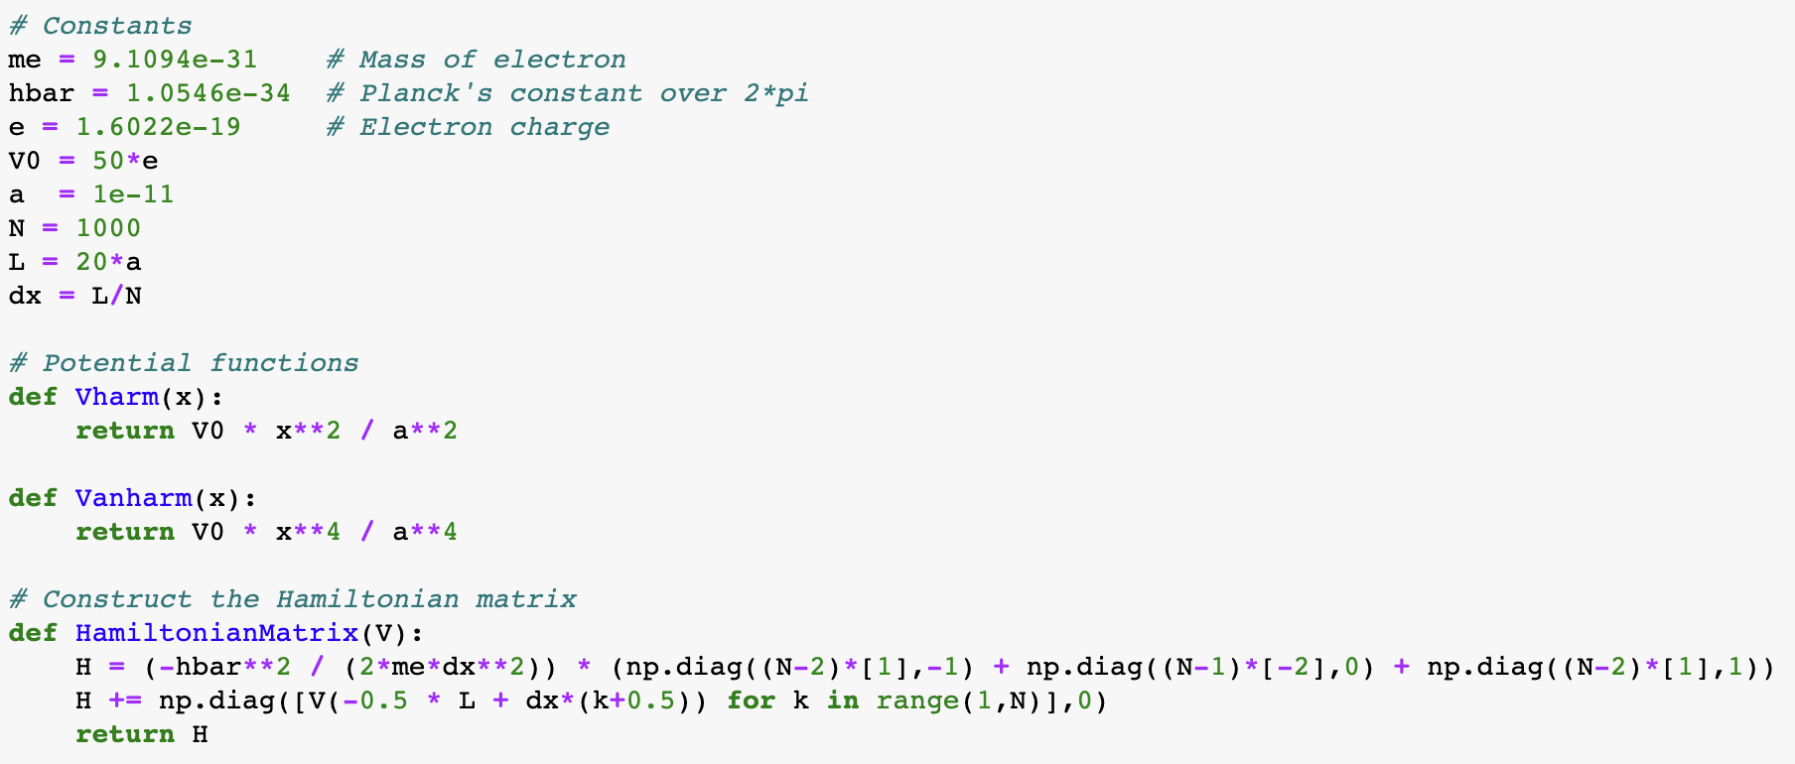
Matrix method

Slide 5
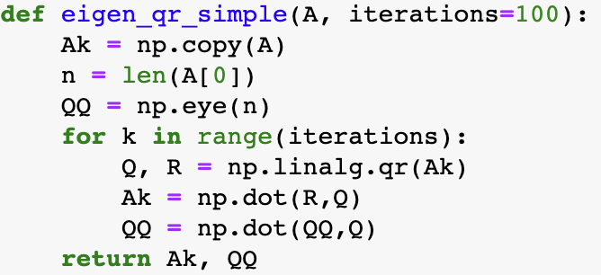
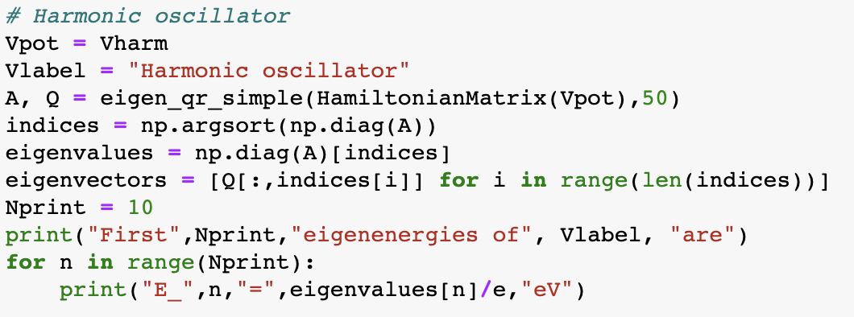
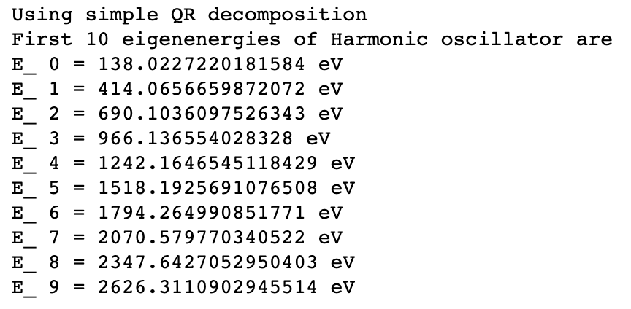

Matrix method for harmonic oscillator
We can use QR decomposition to solve the eigenvalue problem
Since our matrix is real symmetric, we can use a straightforward implementation of the QR algorithm. We thus expect to obtain a representation of H in the form
$$H = QT A Q$$
where A is diagonal and contains the energies, while Q is orthogonal and has eigenvectors (wave functions) in its columns.

Slide 6
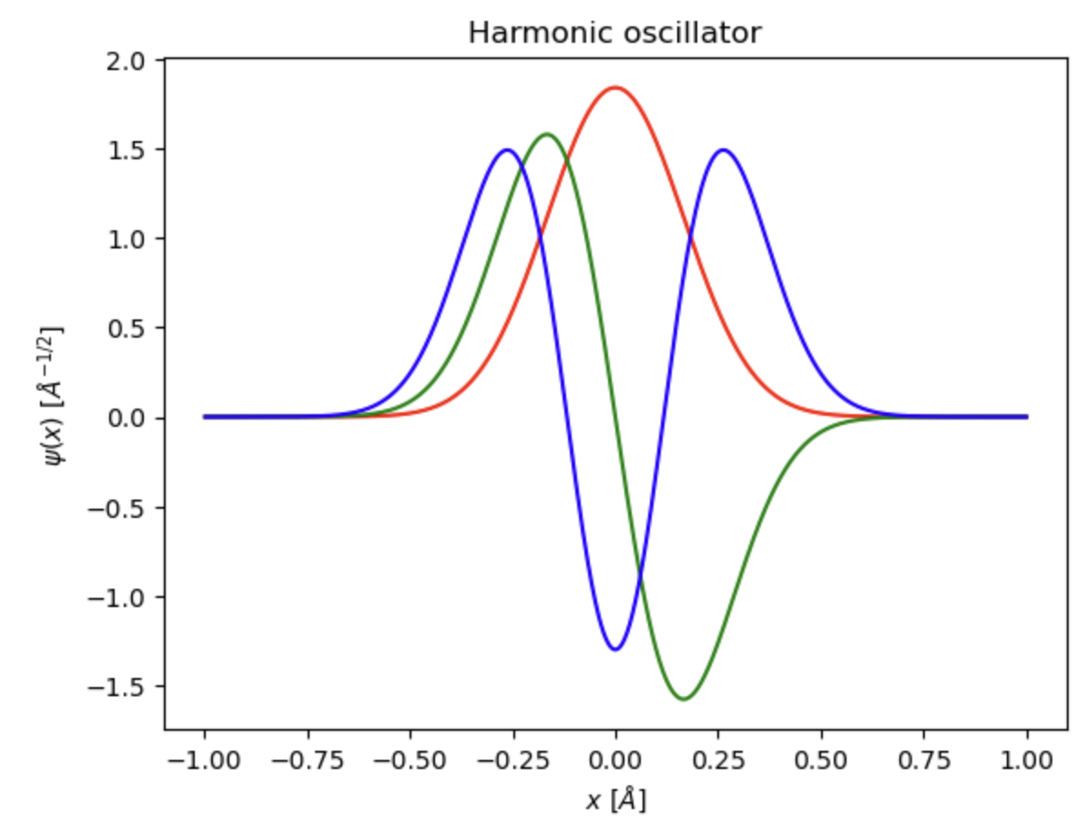
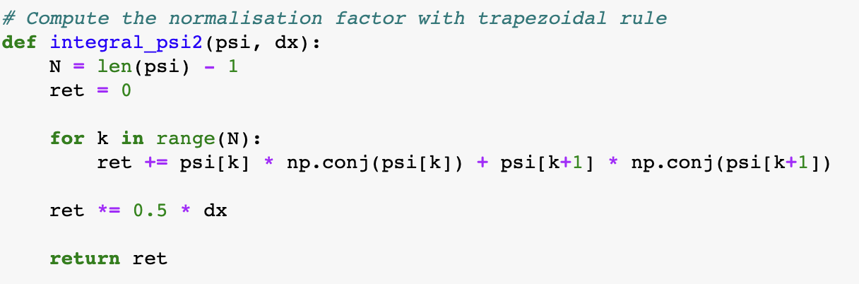
Matrix method for harmonic oscillator
Eigenstates are encoded in the columns of matrix Q
Normalization

Slide 7
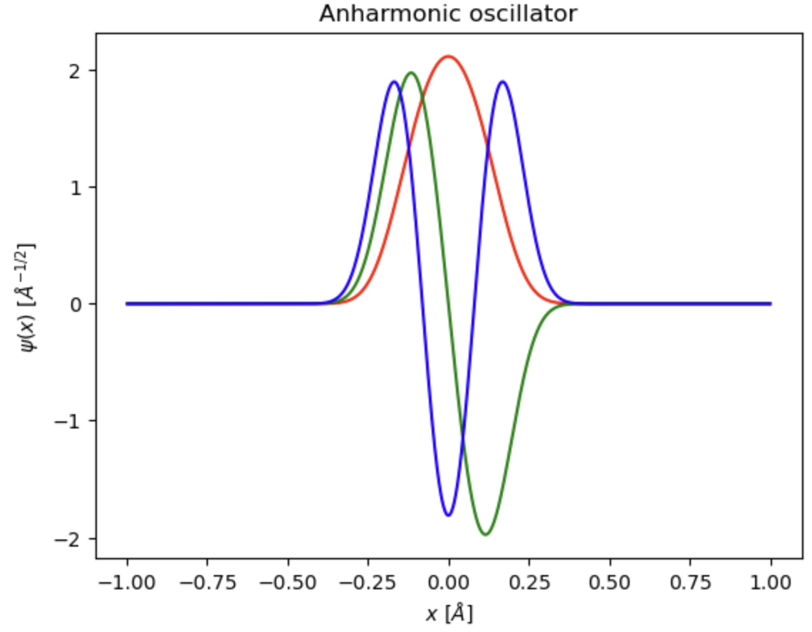
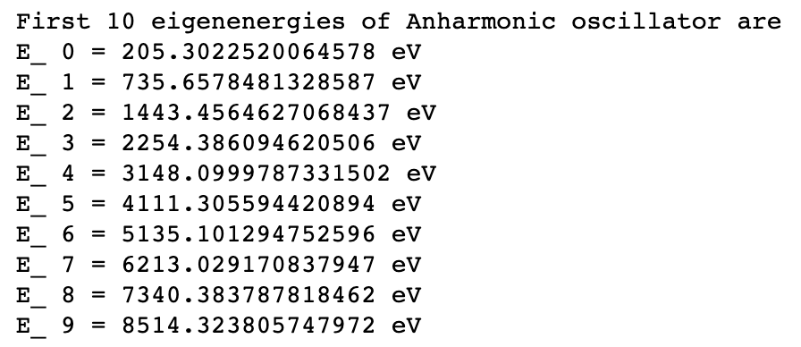
Matrix method for anharmonic oscillator

Slide 8
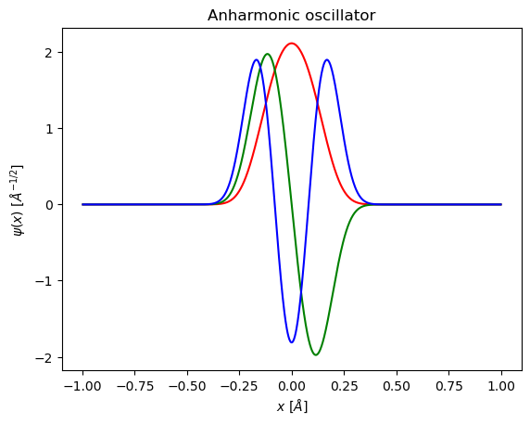
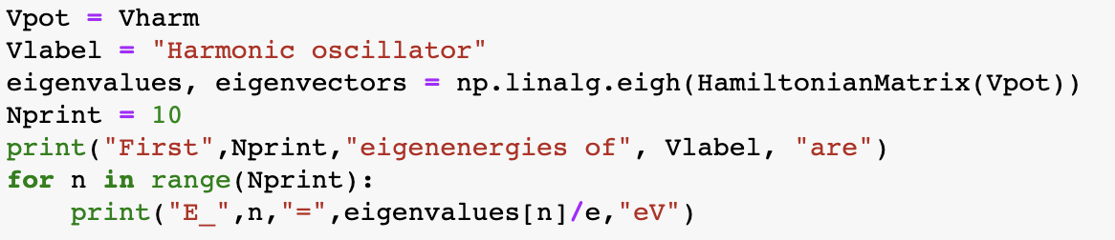

Matrix method
One can also use efficient implementations of the eigenvalue problem in numpy

Slide 9

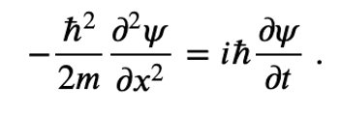




Time-dependent Schroedinger equation
The time-dependent Schrödinger equation reads
e.g., for a free particle it reads
Formal solution can be written as
with
being the time evolution operator. It is a unitary operator:
Therefore, the norm of the wave function is conserved
$${\left|ψ\right|}^{2}=const.$$

Slide 10
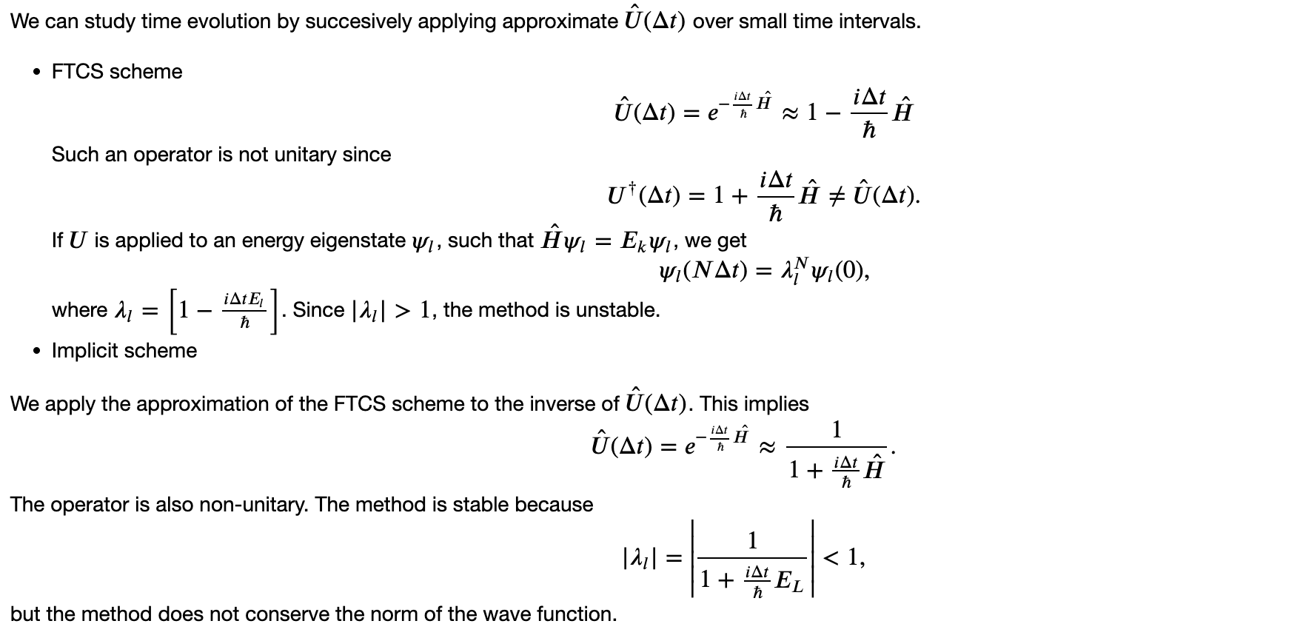
Time integration

Slide 11
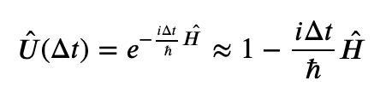
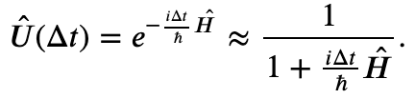
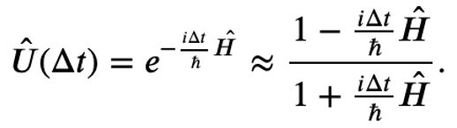
Time integration: Crank-Nicholson scheme
explicit
implicit
• Crank–Nicholson scheme
Crank–Nicholson scheme takes the combination of FTCS and implicit schemes.
This corresponds to a rational approximation of $\hat{U}(∆t)$:
This operator is unitary (for a Hermitian Ĥ):
and conserves the norm of the wave function.

Slide 12

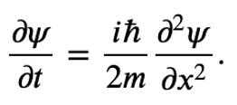

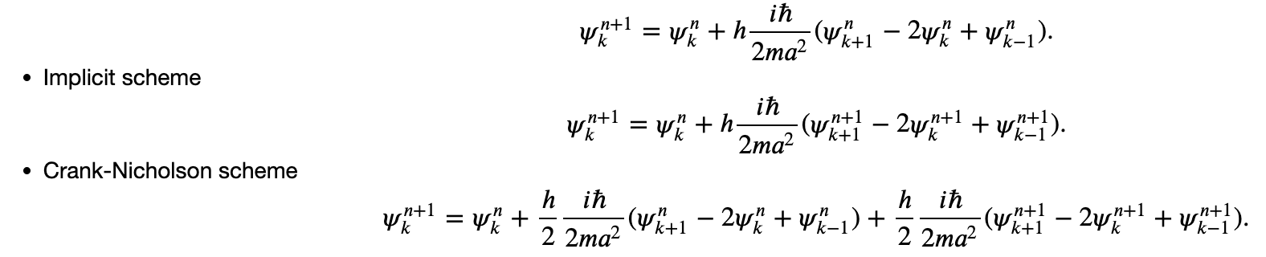
Free particle in a box
Let us consider the particle in a box of length L. We thus have boundary conditions:
Given some initial wave function ψ(x), we can numerically integrate the Schrödinger equation to study the time evolution of the wave function. Let us write the equation in the form:
We can now use the central difference approximation for the spatial derivative:
This gives us discretized wave function in coordinate space, in full analogy to the heat equation that we studied before. The only difference is that now we are dealing with complex-valued functions.

Slide 13
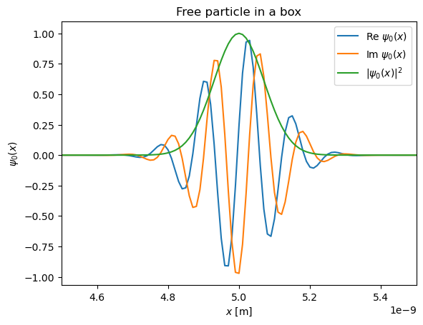
Initial wave function: Gaussian wave packet

Slide 14
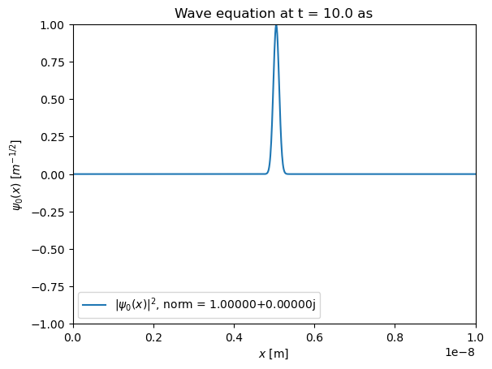
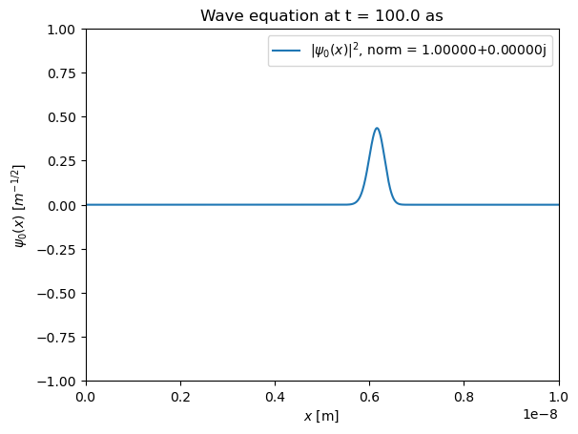
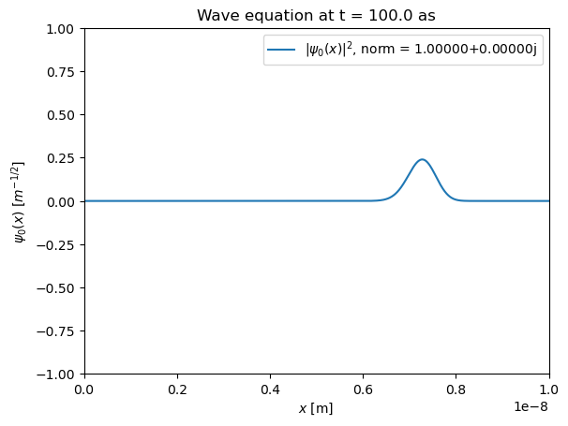
Time evolution
Expanding wave packet (towards plane wave), norm is conserved

Slide 15
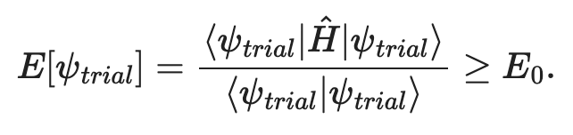


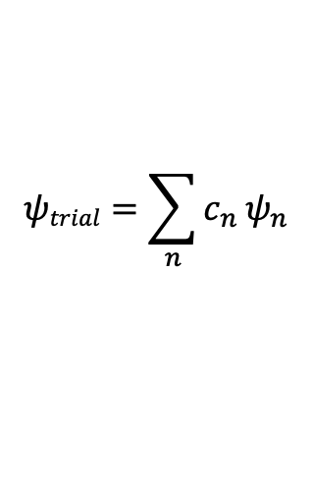

Variational methods
We are often interested in the ground-state energy of the system
This is the lowest energy solution of the time-independent Schroedinger equation:
$$\hat{H}ψ\left(r\right)=Eψ\left(r\right)$$
For many systems it is challenging to solve this problem explicitly.
Variational method involves the use of trial wave functions $ψtrial(r)$
The average energy computed using the trial wave function sets an upper bound of the ground-state energy
This is because we can decompose $ψtrial(r)$ into orthogonal basis functions of the Hamiltonian operator
$$ψtrial=\sum_{n}{c_{n}}ψ_{n}$$
$$\left\langle ψ_{n} | ψ_{m}\right\rangle =δnm$$
$$\hat{H}ψn=Enψn$$

Slide 16
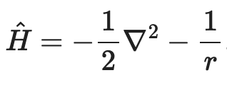
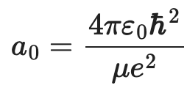
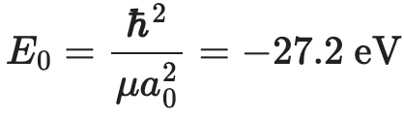
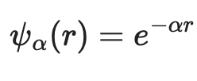
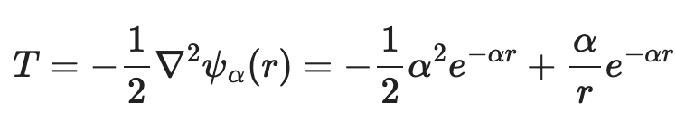
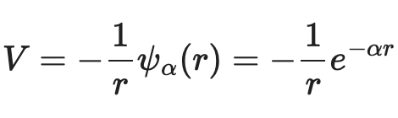
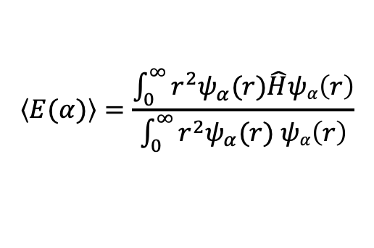
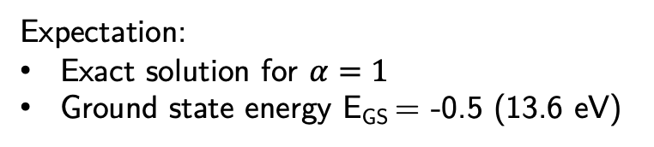
Variational methods: Hydrogen Atom
Let us take the hydrogen atom (in dimensionless form)
Length scale:
Energy scale:
Bohr radius
Trial wave function (unnormalized)
Kinetic energy term:
Expectation:
Exact solution for $α=1$
Ground state energy E_{GS} = -0.5 (13.6 eV)
Potential energy term:
Average energy:
$$\left\langle E(α)\right\rangle =\frac{\int_{0}^{∞}{r^{2}ψ_{α}(r)\hat{H}ψα\left(r\right)}}{\int_{0}^{∞}{r^{2}ψ_{α}(r) ψα\left(r\right)}}$$

Slide 17
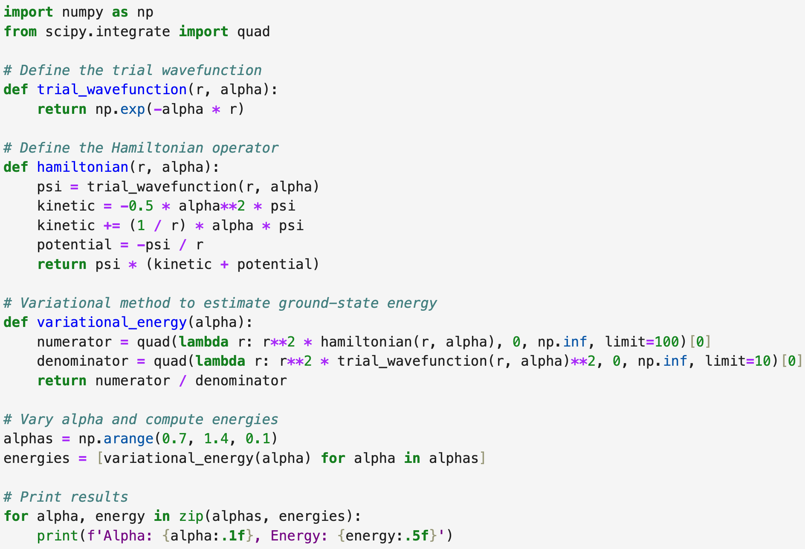
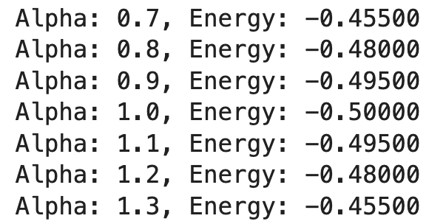
Variational methods: Hydrogen Atom
Let us vary alpha from 0.7 to 1.3
In eV: -0.5 * 27.2 eV = -13.6 eV

Slide 18
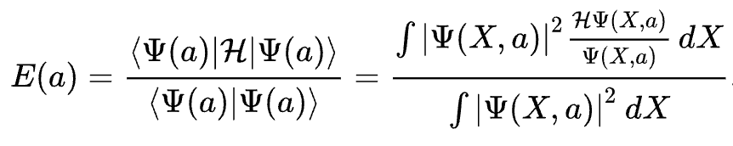
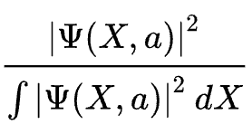
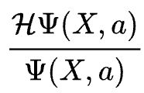


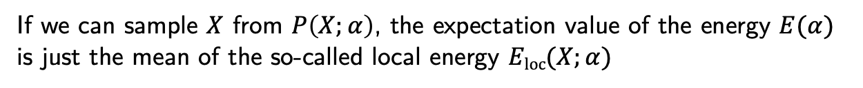
Variational Monte Carlo
In practice, computing the integral explicitly can be difficult, especially when we deal with multi-particle system
In Variational Monte Carlo, the corresponding integrals are computed with Monte Carlo techniques
First, rewrite the expectation value for the energy as
We can interpret
$$P\left(X;α\right)=$$
as probability distribution function
If we can sample $X$ from $P\left(X;α\right)$, the expectation value of the energy $E(α)$
is just the mean of the so-called local energy $Eloc(X;α)$
$Eloc(X;α)$ =
Sampling from $P\left(X;α\right)$ can be achieved through a variety of methods, in the most general case through importance sampling and Metropolis-Hastings algorithm

Slide 19
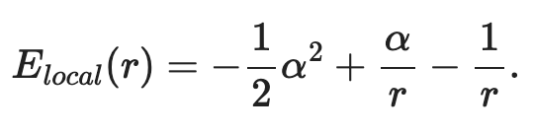

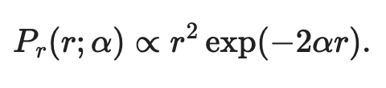
Variational Monte Carlo: Hydrogen Atom
Let us turn back to the Hydrogen Atom. Using the same trial wave function, the local energy reads
The probability distribution for the radial coordinate reads
This is a partial case of the Gamma distribution with k = 3 and scale factor 1/(2$α$).
Algorithm:
For each value of alpha:
Sample r from the Gamma distribution
Compute the value of the local energy E_{local}(alpha)
Do it many times and compute the average

Slide 20
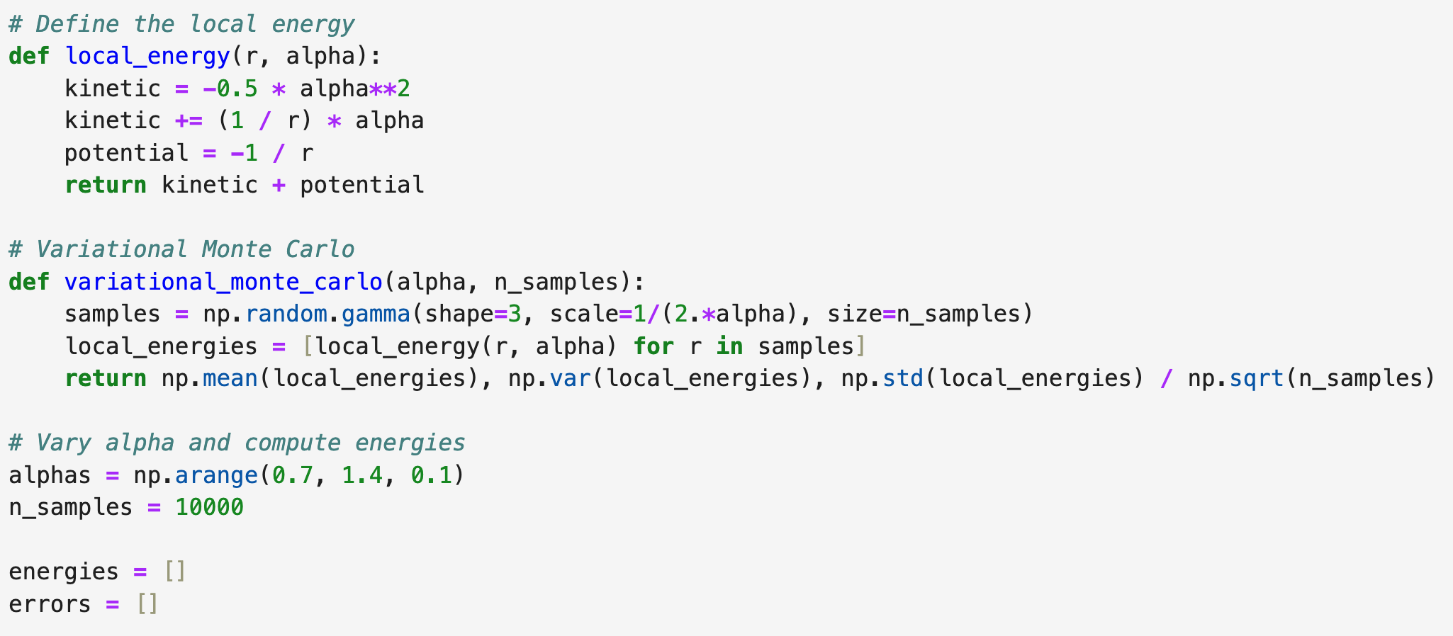
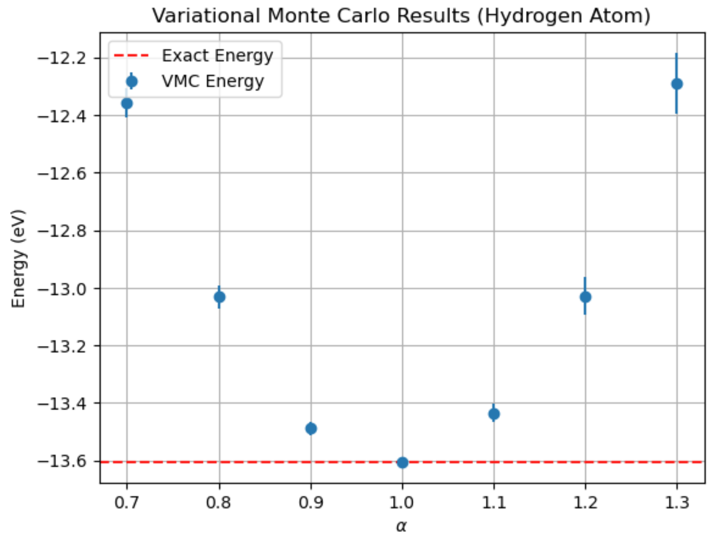
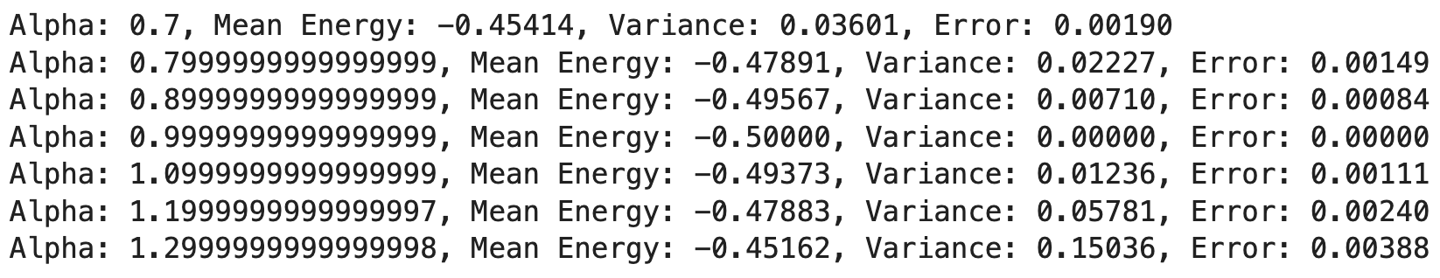
Variational Monte Carlo: Hydrogen Atom

Slide 21
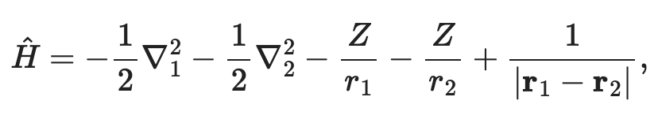
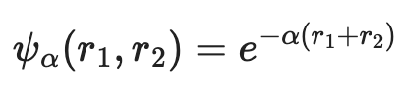
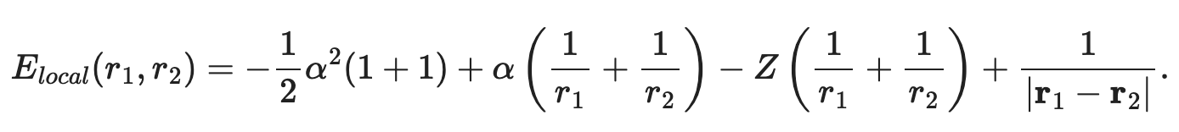
Variational Monte Carlo: Helium Atom
In the Helium Atom we have two electrons. Their interaction complicates things.
Let us take the trial wave function as a product of Hydrogen Atom wave functions
Local energy:
As before, the radial coordinates r₁ and r₂ follow the Gamma distribution with k = 3 and scale factor 1/(2$α$).
However, we have an additional factor in the local energy which depends on the spherical angles:
We have to sample $θ1,2$ and $φ1,2$ from a unit sphere isotropically

Slide 22
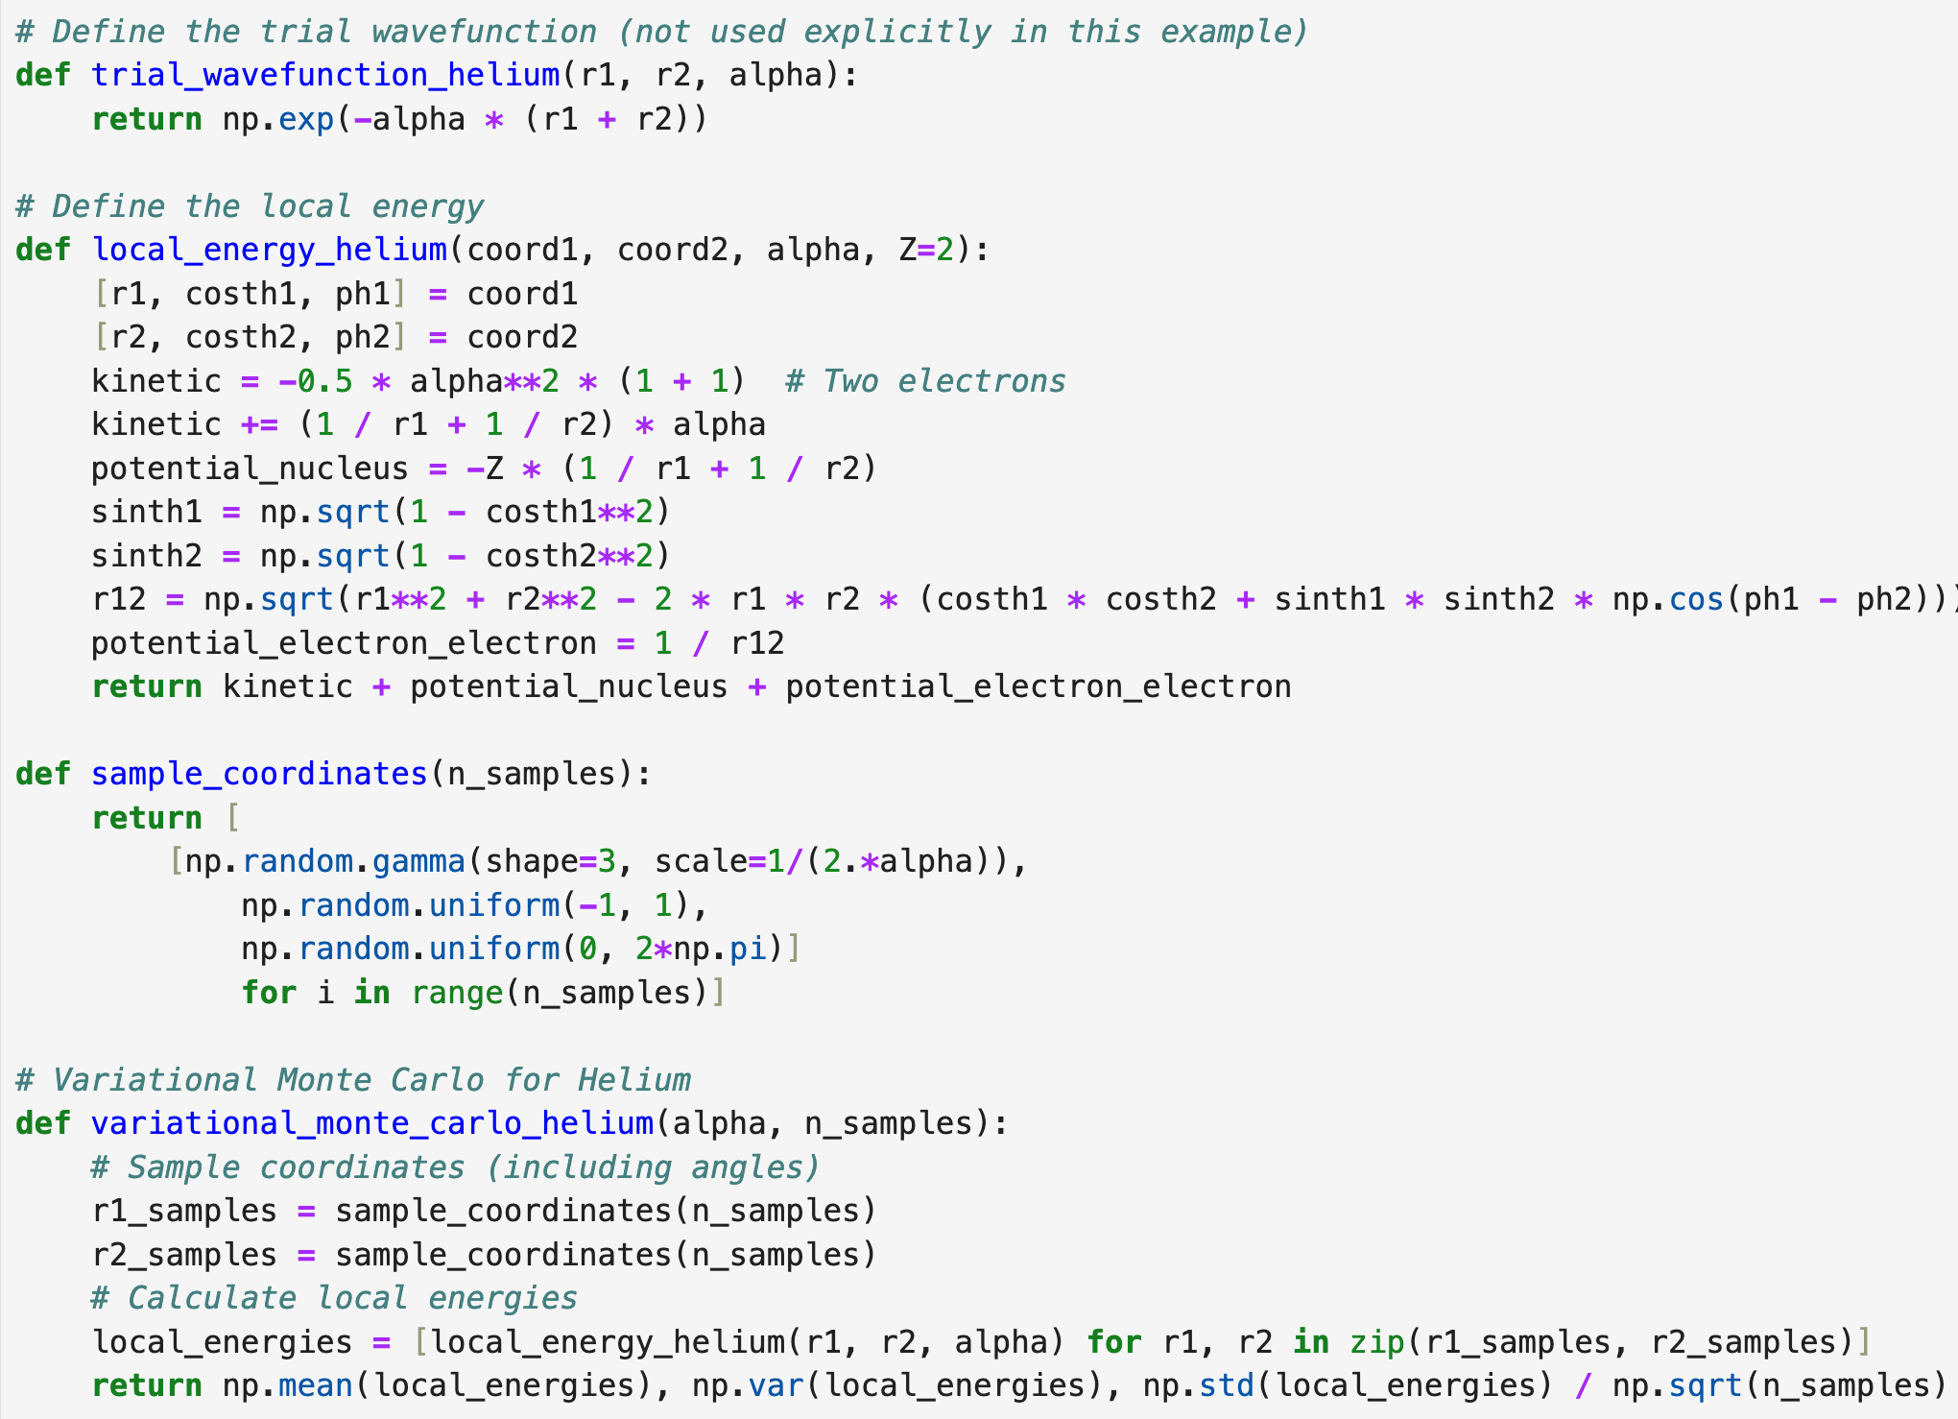
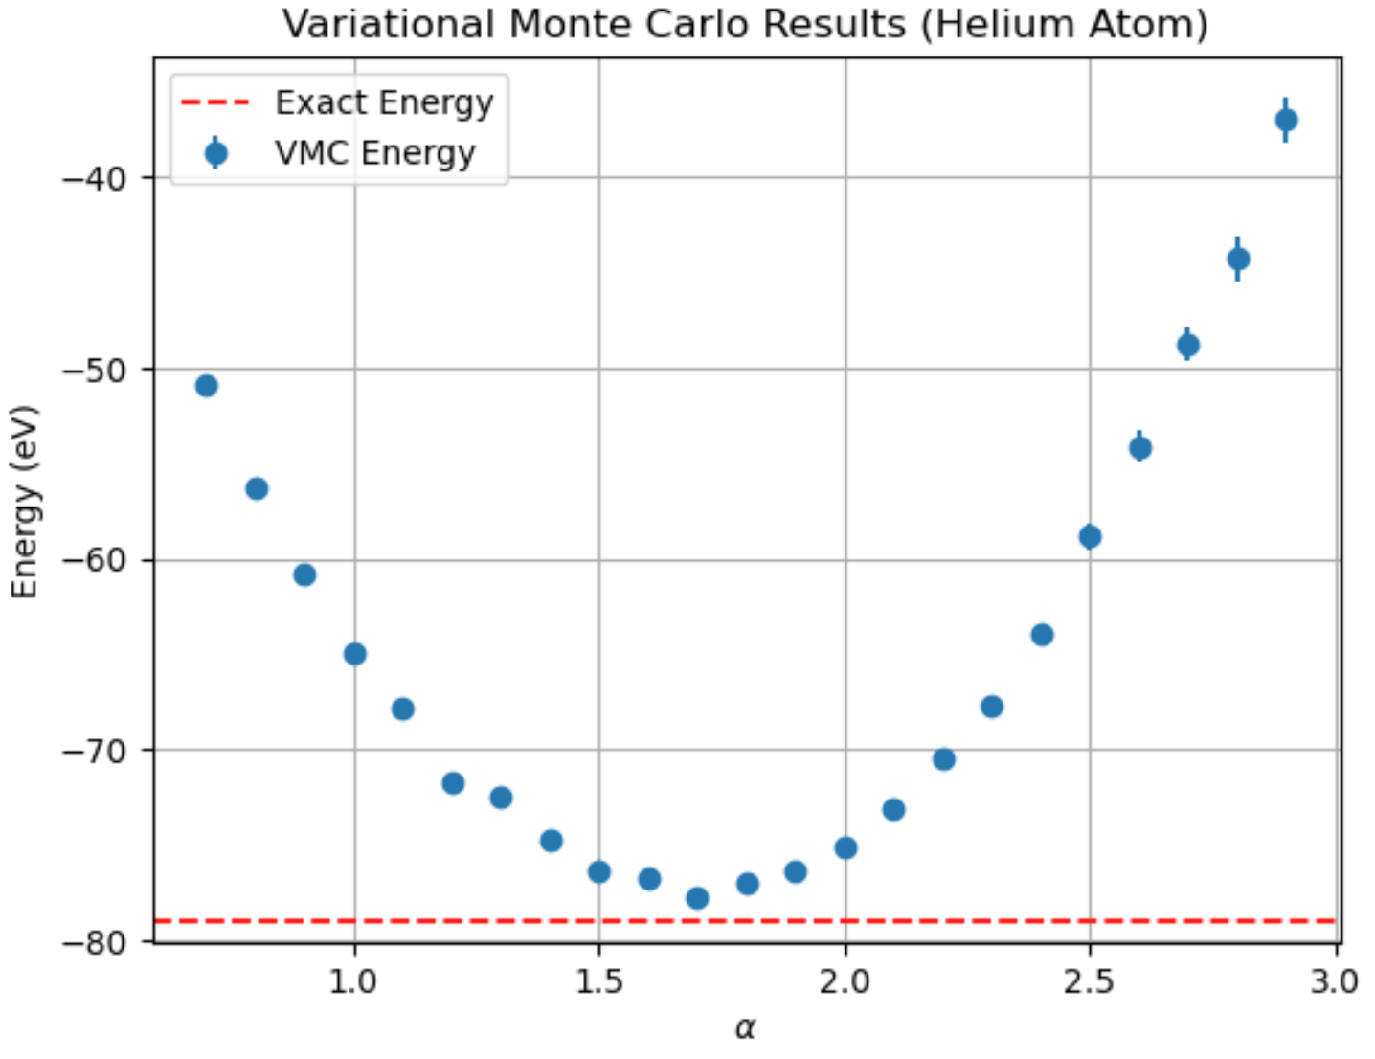
Variational Monte Carlo: Helium Atom
The lowest we get (-77.7 eV) is not too far from the true value (-79.0 eV)!

