Slide 1

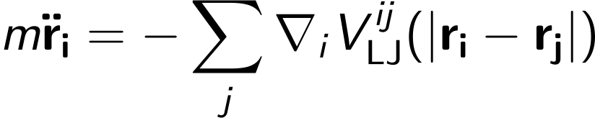
Computational Physics (PHYS6350)
Lecture 14: Classical molecular dynamics
Instructor: Volodymyr Vovchenko (vvovchenko@uh.edu)
Course materials: https://github.com/vlvovch/PHYS6350-ComputationalPhysics
Online textbook: https://vovchenko.net/computational-physics/

Slide 2
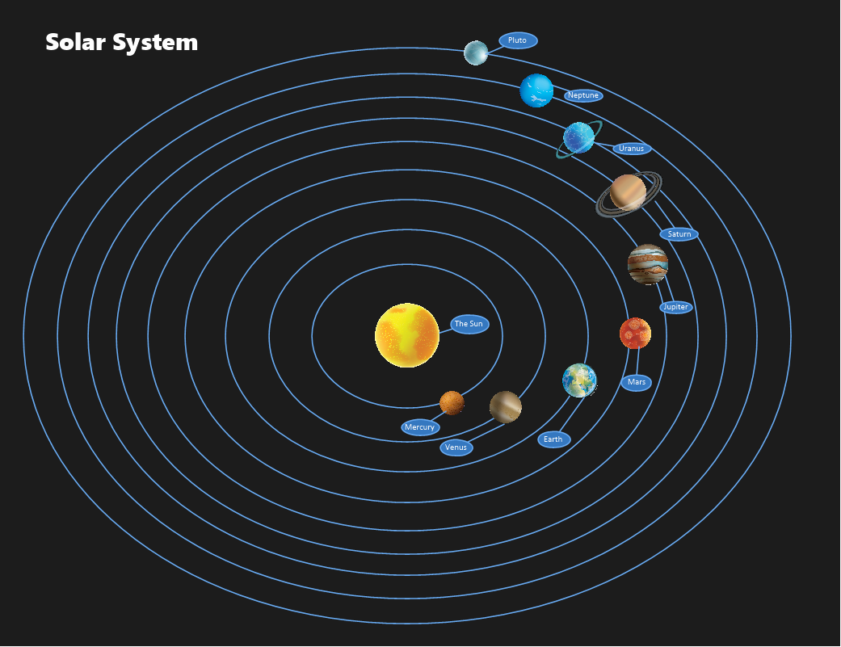
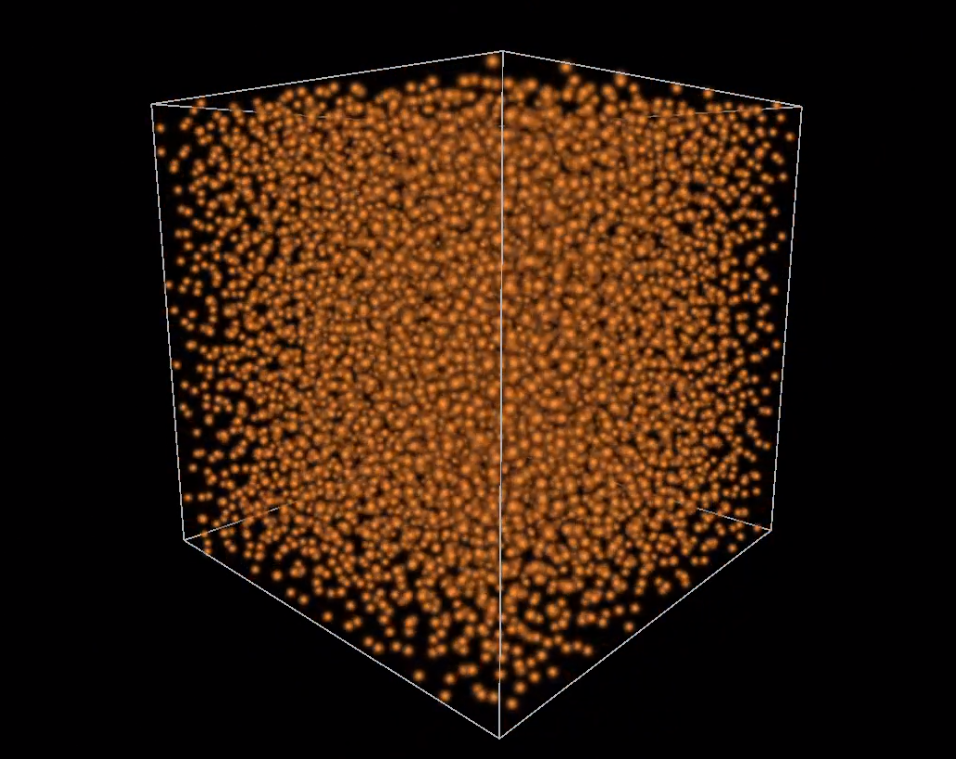
Molecular dynamics (MD)
System of N particles with a pair potential
Newton’s equations of motion (classical N-body problem)
Planetary motion
Solar system simulation
Statistical mechanics properties and the equation of state
Finite simulation box with periodic boundary conditions
Notes:
The important thing here, however, is that this equation defines how the mean B1 depends on t.
We can thus use this straightforwardly to calculate the higher-order cumulants by taking the derivatives from this equation with respect to t.
And by repeatedly abusing the Faa di Bruno formula for high-order derivatives of composite functions we can calculate the net-baryon cumulants subject to global baryon conservation up to a desired order.
Here I am showing the results for three cumulants ratios, the so-called scaled variance, skewness, and kurtosis, our paper contains explicit results up to order 6.
We obtain the B1 cumulants in terms of the subvolume fraction \alpha and the grand-canonical susceptibilities \chi_B.
This is exactly what we want, as the grand-canonical susceptibilities are the intrinsic properties of the equation of state that we want to probe.
Unsurprisingly, in the limit \alpha goes to zero we obtain the grand-canonical susceptibility ratios.
Let me reiterate again that here I did not assume anything about the equation of state, this result is model-independent.

Slide 3

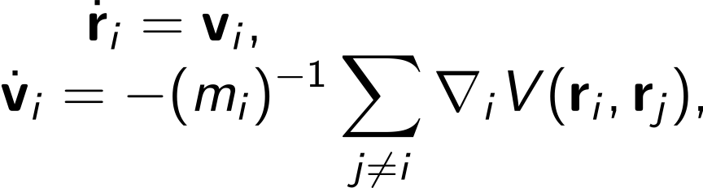
Molecular dynamics equations
Have to solve Newton’s equations of motion
Desired properties
Stability (long simulations)
Energy conservation
Time-reversibility
Rewrite as a system of first-order ODEs
and use the leapfrog method
Notes:
The important thing here, however, is that this equation defines how the mean B1 depends on t.
We can thus use this straightforwardly to calculate the higher-order cumulants by taking the derivatives from this equation with respect to t.
And by repeatedly abusing the Faa di Bruno formula for high-order derivatives of composite functions we can calculate the net-baryon cumulants subject to global baryon conservation up to a desired order.
Here I am showing the results for three cumulants ratios, the so-called scaled variance, skewness, and kurtosis, our paper contains explicit results up to order 6.
We obtain the B1 cumulants in terms of the subvolume fraction \alpha and the grand-canonical susceptibilities \chi_B.
This is exactly what we want, as the grand-canonical susceptibilities are the intrinsic properties of the equation of state that we want to probe.
Unsurprisingly, in the limit \alpha goes to zero we obtain the grand-canonical susceptibility ratios.
Let me reiterate again that here I did not assume anything about the equation of state, this result is model-independent.

Slide 4
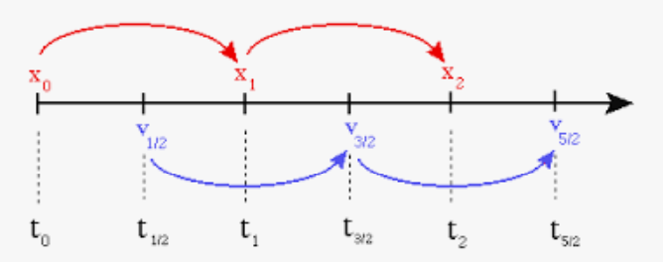
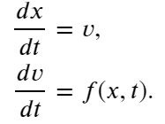

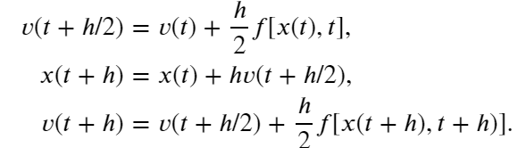
Velocity Verlet method
We have system of equations
The leapfrog scheme applied to this system of equations:
Coordinates are evaluated at full steps
Velocities are evaluated at half-steps
Leapfrog method applied to molecular dynamics proble is called Velocity Verlet method.
Velocity Verlet:
Notes:
The important thing here, however, is that this equation defines how the mean B1 depends on t.
We can thus use this straightforwardly to calculate the higher-order cumulants by taking the derivatives from this equation with respect to t.
And by repeatedly abusing the Faa di Bruno formula for high-order derivatives of composite functions we can calculate the net-baryon cumulants subject to global baryon conservation up to a desired order.
Here I am showing the results for three cumulants ratios, the so-called scaled variance, skewness, and kurtosis, our paper contains explicit results up to order 6.
We obtain the B1 cumulants in terms of the subvolume fraction \alpha and the grand-canonical susceptibilities \chi_B.
This is exactly what we want, as the grand-canonical susceptibilities are the intrinsic properties of the equation of state that we want to probe.
Unsurprisingly, in the limit \alpha goes to zero we obtain the grand-canonical susceptibility ratios.
Let me reiterate again that here I did not assume anything about the equation of state, this result is model-independent.

Slide 5
Box simulation and statistical mechanics
Statistical mechanics: system with large number of particles
Microscopically: Newton’s equations of motion
Perform box simulation to emulate infinite system
Periodic boundary conditions (create images of the system)
Minimum-image convention (consider only closest image for all pairs)
If N is large enough, system can be characterized by macroscopic parameters
Energy-Volume-Number (UVN): microcanonical ensemble describing closed system with fixed energy
Temperature-Volume-Number (TVN): canonical ensemble where the system is coupled to a thermostat to maintain constant temperature
MD simulations give access to the equation of state
Notes:
The important thing here, however, is that this equation defines how the mean B1 depends on t.
We can thus use this straightforwardly to calculate the higher-order cumulants by taking the derivatives from this equation with respect to t.
And by repeatedly abusing the Faa di Bruno formula for high-order derivatives of composite functions we can calculate the net-baryon cumulants subject to global baryon conservation up to a desired order.
Here I am showing the results for three cumulants ratios, the so-called scaled variance, skewness, and kurtosis, our paper contains explicit results up to order 6.
We obtain the B1 cumulants in terms of the subvolume fraction \alpha and the grand-canonical susceptibilities \chi_B.
This is exactly what we want, as the grand-canonical susceptibilities are the intrinsic properties of the equation of state that we want to probe.
Unsurprisingly, in the limit \alpha goes to zero we obtain the grand-canonical susceptibility ratios.
Let me reiterate again that here I did not assume anything about the equation of state, this result is model-independent.

Slide 6
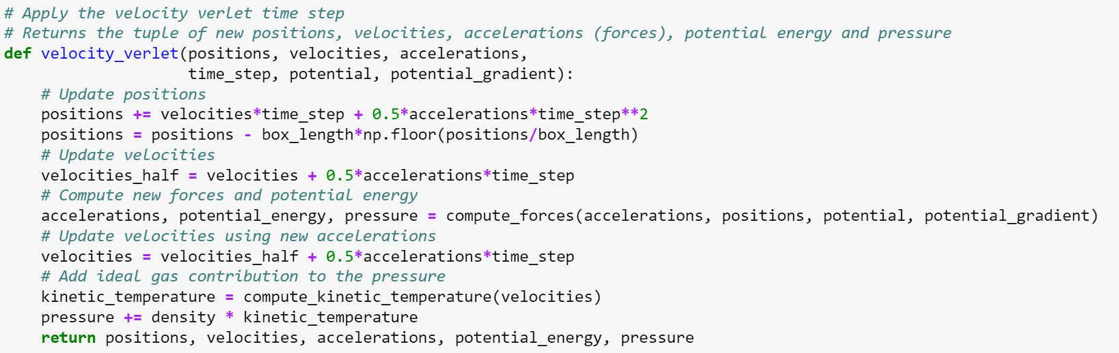
Velocity Verlet method for box simulation
Notes:
The important thing here, however, is that this equation defines how the mean B1 depends on t.
We can thus use this straightforwardly to calculate the higher-order cumulants by taking the derivatives from this equation with respect to t.
And by repeatedly abusing the Faa di Bruno formula for high-order derivatives of composite functions we can calculate the net-baryon cumulants subject to global baryon conservation up to a desired order.
Here I am showing the results for three cumulants ratios, the so-called scaled variance, skewness, and kurtosis, our paper contains explicit results up to order 6.
We obtain the B1 cumulants in terms of the subvolume fraction \alpha and the grand-canonical susceptibilities \chi_B.
This is exactly what we want, as the grand-canonical susceptibilities are the intrinsic properties of the equation of state that we want to probe.
Unsurprisingly, in the limit \alpha goes to zero we obtain the grand-canonical susceptibility ratios.
Let me reiterate again that here I did not assume anything about the equation of state, this result is model-independent.

Slide 7

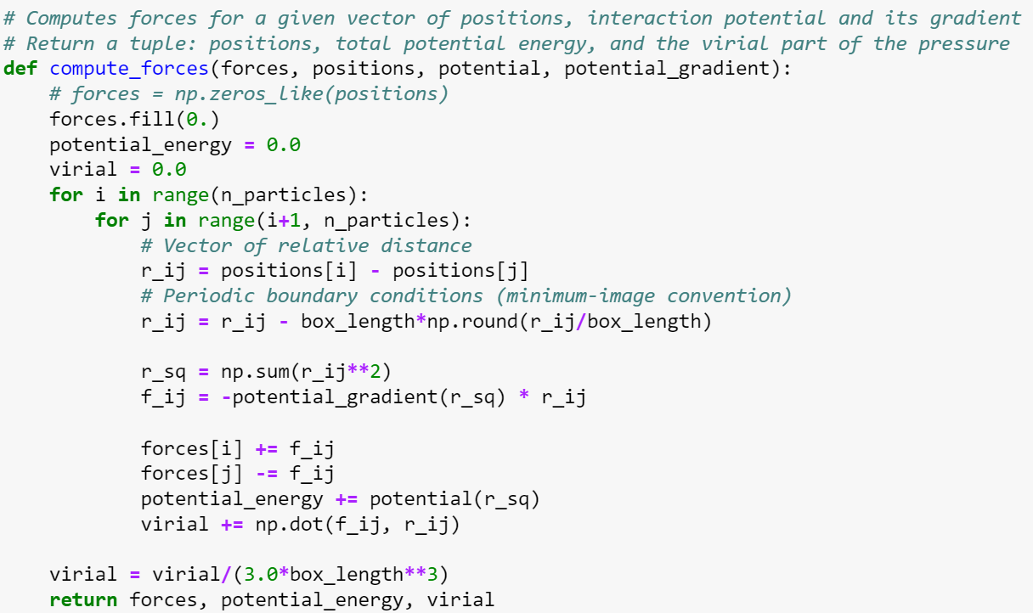
Forces
We will assume all masses are equal to unity, m_{i} = 1 (dimensionless) and that the pair potential depends on the distance only. Then
Notes:
The important thing here, however, is that this equation defines how the mean B1 depends on t.
We can thus use this straightforwardly to calculate the higher-order cumulants by taking the derivatives from this equation with respect to t.
And by repeatedly abusing the Faa di Bruno formula for high-order derivatives of composite functions we can calculate the net-baryon cumulants subject to global baryon conservation up to a desired order.
Here I am showing the results for three cumulants ratios, the so-called scaled variance, skewness, and kurtosis, our paper contains explicit results up to order 6.
We obtain the B1 cumulants in terms of the subvolume fraction \alpha and the grand-canonical susceptibilities \chi_B.
This is exactly what we want, as the grand-canonical susceptibilities are the intrinsic properties of the equation of state that we want to probe.
Unsurprisingly, in the limit \alpha goes to zero we obtain the grand-canonical susceptibility ratios.
Let me reiterate again that here I did not assume anything about the equation of state, this result is model-independent.

Slide 8
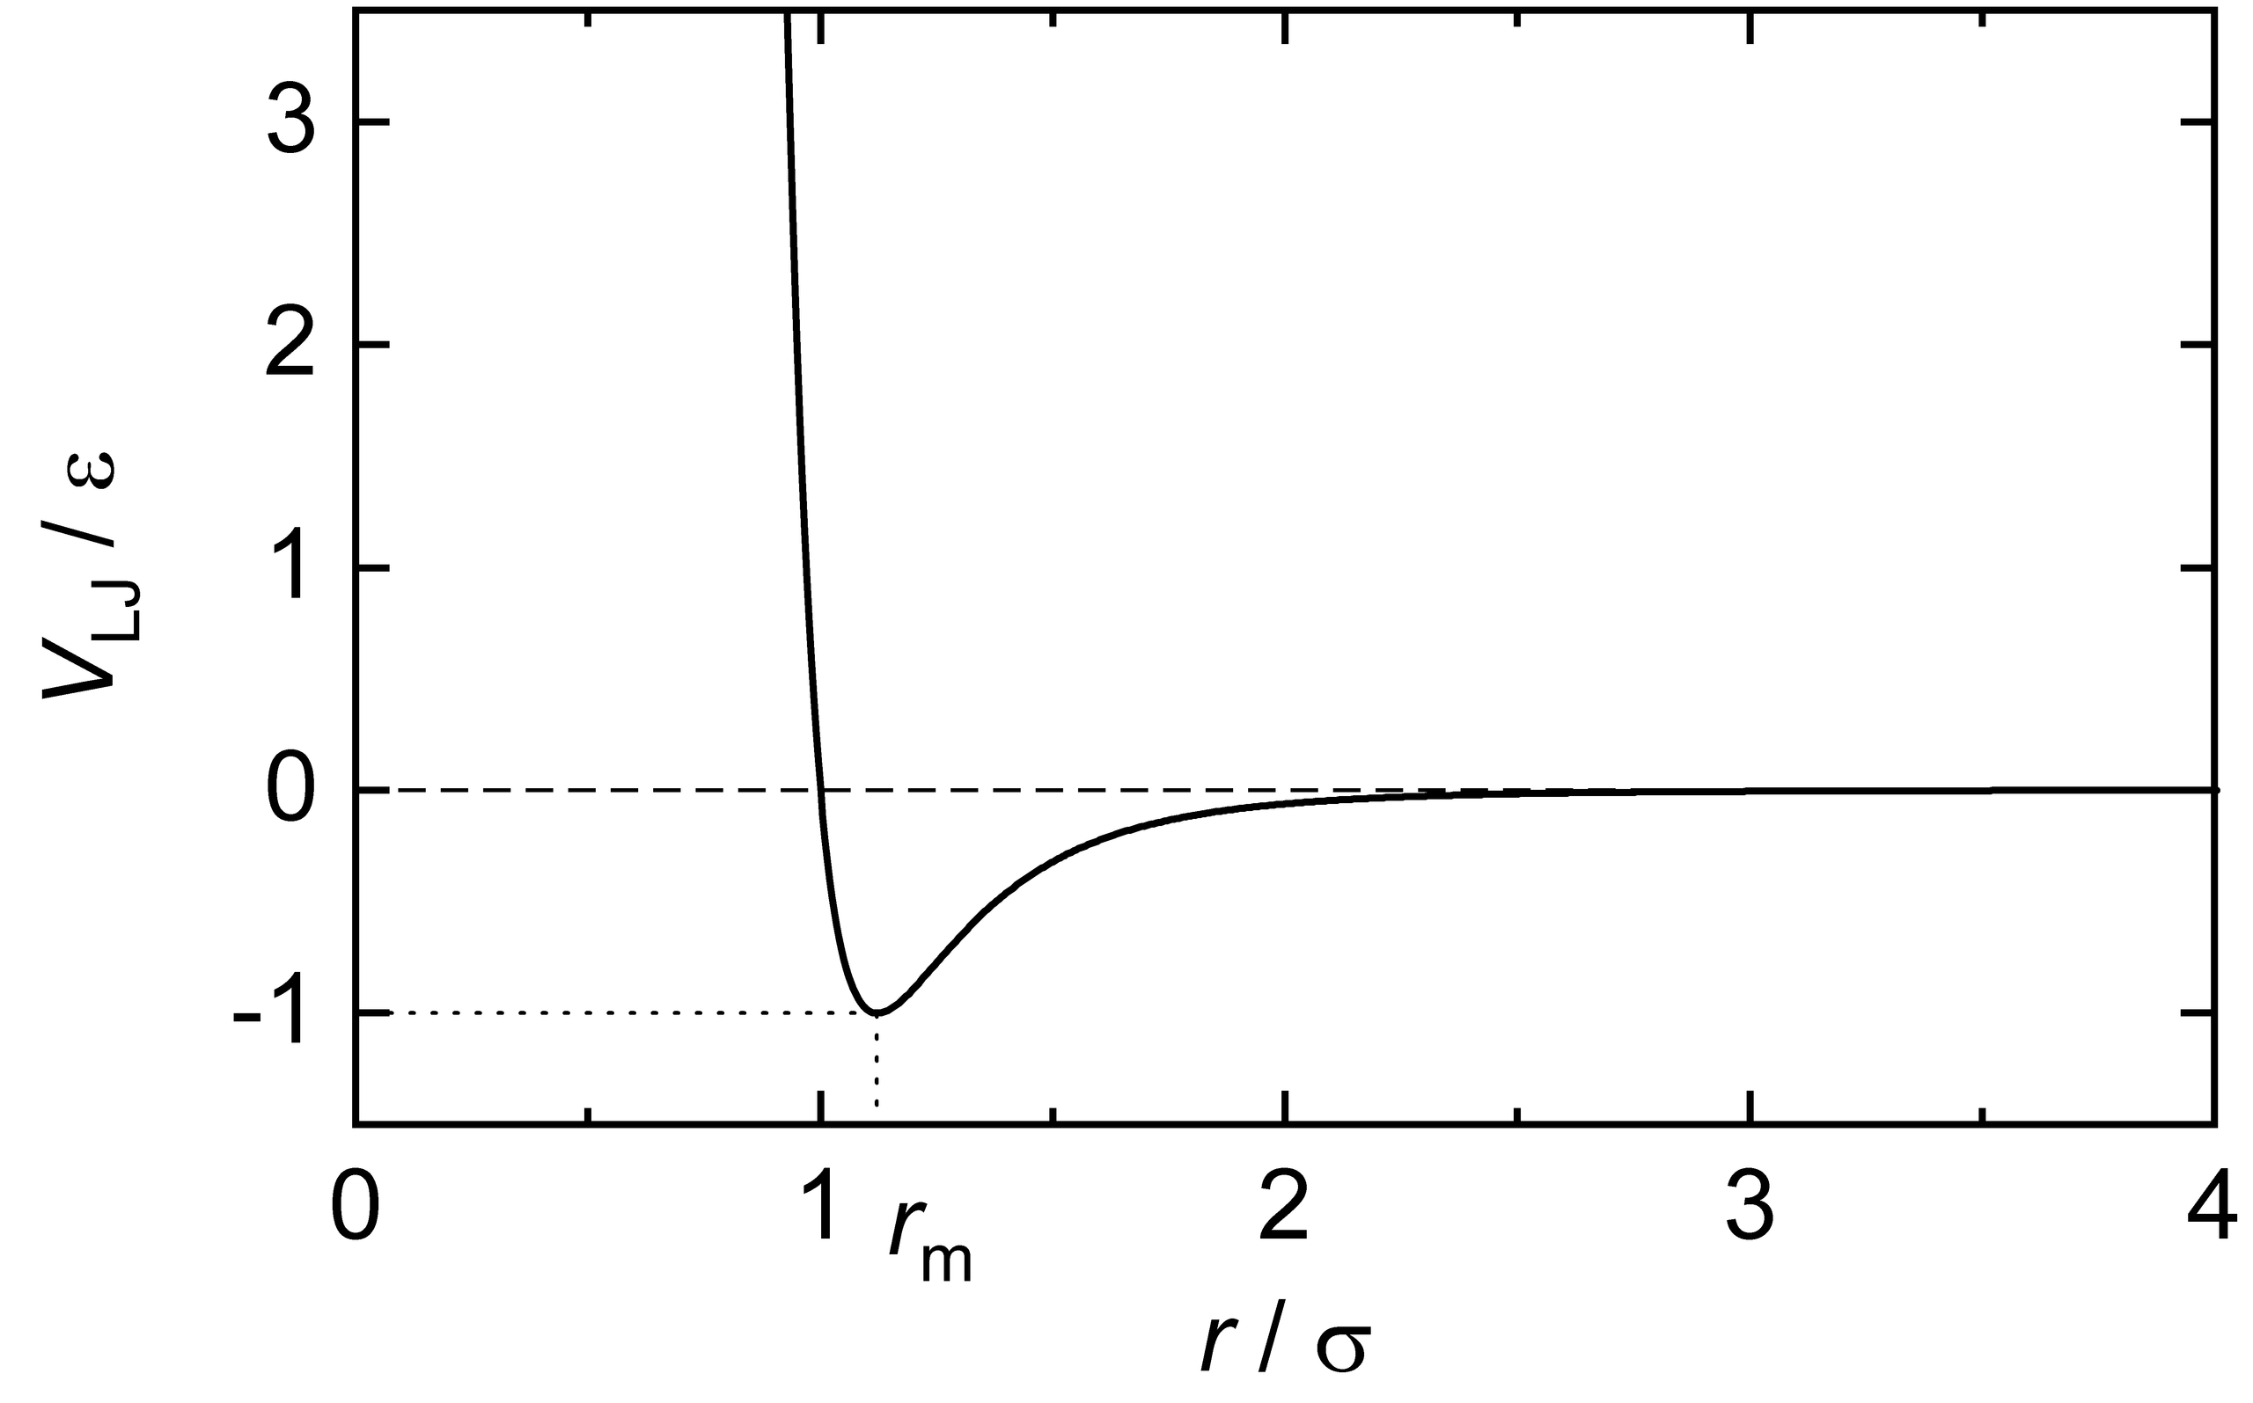
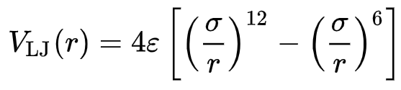
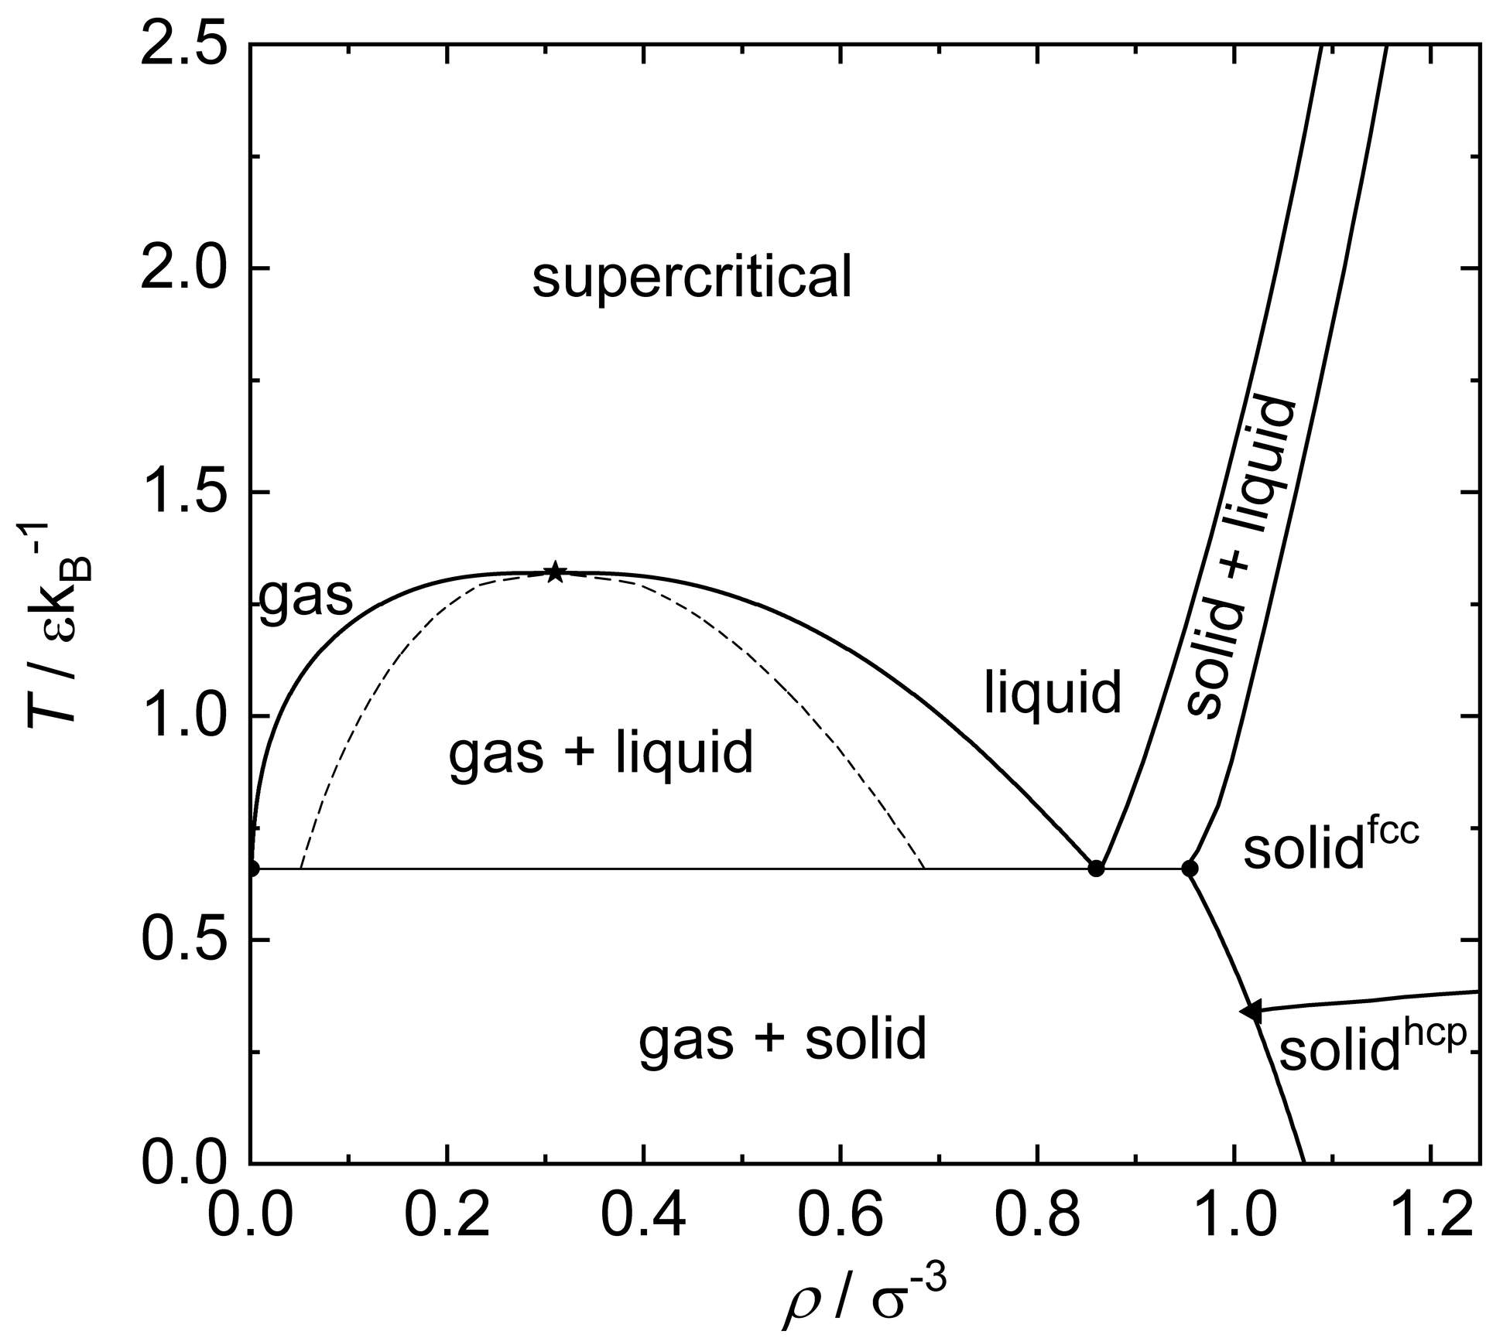




Example: Lennard-Jones fluid
$${\tilde{V}}_{LJ}=V_{LJ}/ε$$
Reduced variables:
$$\tilde{r}=r/σ$$
$$\tilde{T}=T/(k_{B}ε)$$
$$\tilde{n}=nσ^{3}$$
Properties:
Multiple phase transitions, including critical point
Cannot be solved analytically
Tractable with molecular dynamics simulations
S. Stephan, M. Thol, J. Vrabec, H. Hasse, Journal of Chemical Information and Modeling 59, 4248 (2019)
8
Notes:
The important thing here, however, is that this equation defines how the mean B1 depends on t.
We can thus use this straightforwardly to calculate the higher-order cumulants by taking the derivatives from this equation with respect to t.
And by repeatedly abusing the Faa di Bruno formula for high-order derivatives of composite functions we can calculate the net-baryon cumulants subject to global baryon conservation up to a desired order.
Here I am showing the results for three cumulants ratios, the so-called scaled variance, skewness, and kurtosis, our paper contains explicit results up to order 6.
We obtain the B1 cumulants in terms of the subvolume fraction \alpha and the grand-canonical susceptibilities \chi_B.
This is exactly what we want, as the grand-canonical susceptibilities are the intrinsic properties of the equation of state that we want to probe.
Unsurprisingly, in the limit \alpha goes to zero we obtain the grand-canonical susceptibility ratios.
Let me reiterate again that here I did not assume anything about the equation of state, this result is model-independent.

Slide 9
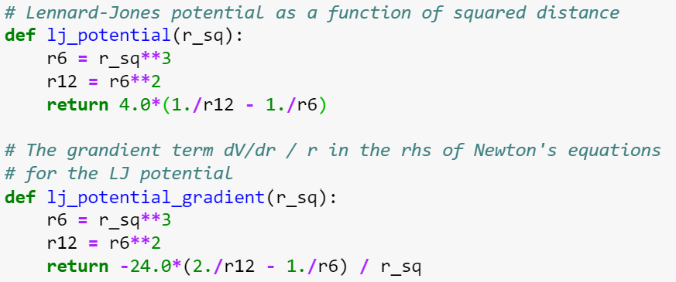
Example: Lennard-Jones fluid
Both the potential and the gradient term can be expressed in terms of |r_{i}-r_{j}|², saves the unnecessary computation of the square root
8
Notes:
The important thing here, however, is that this equation defines how the mean B1 depends on t.
We can thus use this straightforwardly to calculate the higher-order cumulants by taking the derivatives from this equation with respect to t.
And by repeatedly abusing the Faa di Bruno formula for high-order derivatives of composite functions we can calculate the net-baryon cumulants subject to global baryon conservation up to a desired order.
Here I am showing the results for three cumulants ratios, the so-called scaled variance, skewness, and kurtosis, our paper contains explicit results up to order 6.
We obtain the B1 cumulants in terms of the subvolume fraction \alpha and the grand-canonical susceptibilities \chi_B.
This is exactly what we want, as the grand-canonical susceptibilities are the intrinsic properties of the equation of state that we want to probe.
Unsurprisingly, in the limit \alpha goes to zero we obtain the grand-canonical susceptibility ratios.
Let me reiterate again that here I did not assume anything about the equation of state, this result is model-independent.

Slide 10
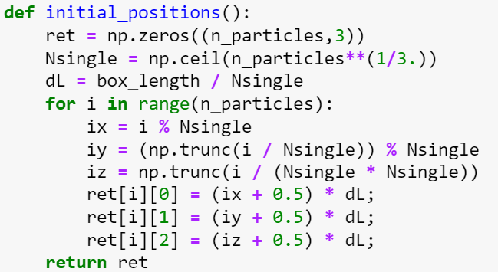
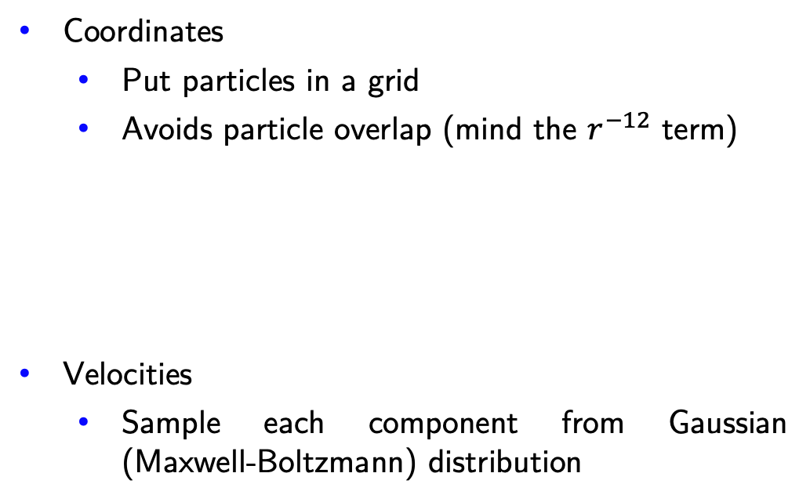
Simulation: Initial conditions
We have to initialize the system with initial positions and velocities
Coordinates
Put particles in a grid
Avoids particle overlap (mind the $r^{−12}$ term)
Velocities
Sample each component from Gaussian (Maxwell-Boltzmann) distribution
Notes:
The important thing here, however, is that this equation defines how the mean B1 depends on t.
We can thus use this straightforwardly to calculate the higher-order cumulants by taking the derivatives from this equation with respect to t.
And by repeatedly abusing the Faa di Bruno formula for high-order derivatives of composite functions we can calculate the net-baryon cumulants subject to global baryon conservation up to a desired order.
Here I am showing the results for three cumulants ratios, the so-called scaled variance, skewness, and kurtosis, our paper contains explicit results up to order 6.
We obtain the B1 cumulants in terms of the subvolume fraction \alpha and the grand-canonical susceptibilities \chi_B.
This is exactly what we want, as the grand-canonical susceptibilities are the intrinsic properties of the equation of state that we want to probe.
Unsurprisingly, in the limit \alpha goes to zero we obtain the grand-canonical susceptibility ratios.
Let me reiterate again that here I did not assume anything about the equation of state, this result is model-independent.

Slide 11


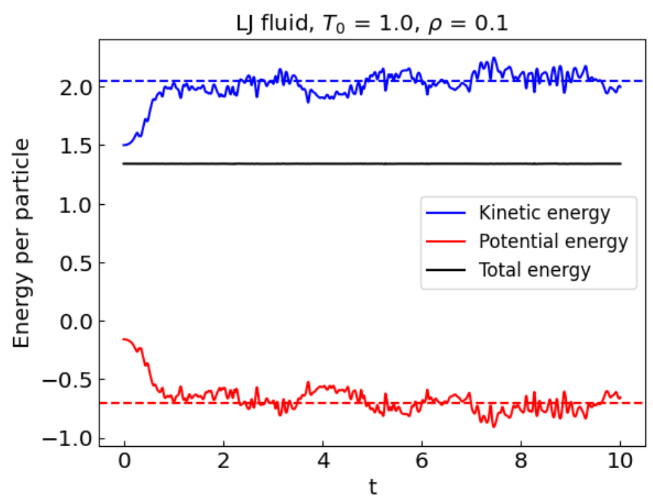
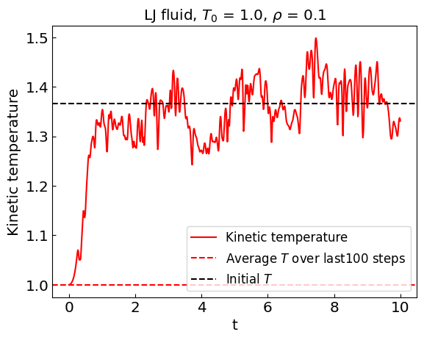
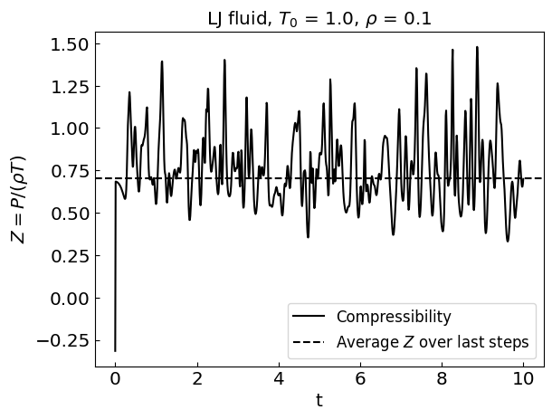
Simulation
T = 1, $ρ$ = 0.1, N = 64
Kinetic temperature drifts away from initial value!
Reason: system takes time to equilibrate, and temperature is not conserved in microcanonical ensemble
Notes:
The important thing here, however, is that this equation defines how the mean B1 depends on t.
We can thus use this straightforwardly to calculate the higher-order cumulants by taking the derivatives from this equation with respect to t.
And by repeatedly abusing the Faa di Bruno formula for high-order derivatives of composite functions we can calculate the net-baryon cumulants subject to global baryon conservation up to a desired order.
Here I am showing the results for three cumulants ratios, the so-called scaled variance, skewness, and kurtosis, our paper contains explicit results up to order 6.
We obtain the B1 cumulants in terms of the subvolume fraction \alpha and the grand-canonical susceptibilities \chi_B.
This is exactly what we want, as the grand-canonical susceptibilities are the intrinsic properties of the equation of state that we want to probe.
Unsurprisingly, in the limit \alpha goes to zero we obtain the grand-canonical susceptibility ratios.
Let me reiterate again that here I did not assume anything about the equation of state, this result is model-independent.

Slide 12
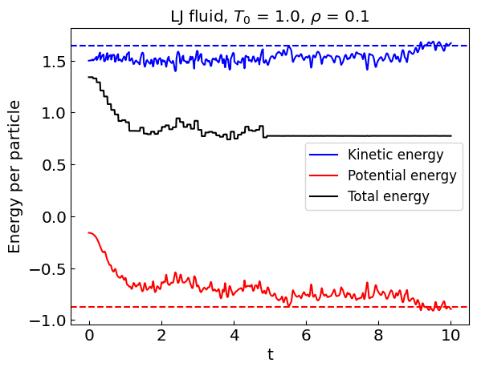
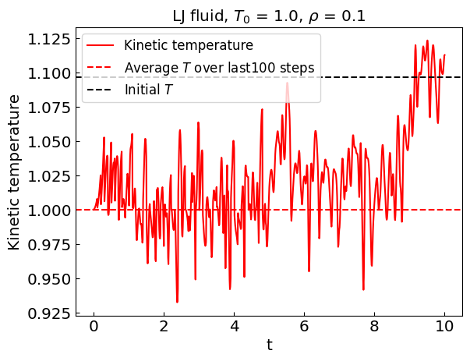
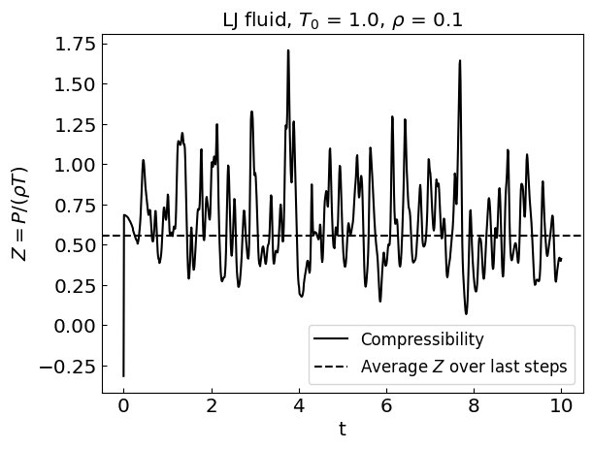
Simulation: Keep the temperature fixed
Keep the temperature fixed during the equilibration phase by periodically rescaling the velocities to have desired temperature
T = 1, $ρ$ = 0.1, N = 64
More involved approaches: thermostat degrees of freedom (Berendsen, Nose-Hoover, …)
final project idea(?)
Notes:
The important thing here, however, is that this equation defines how the mean B1 depends on t.
We can thus use this straightforwardly to calculate the higher-order cumulants by taking the derivatives from this equation with respect to t.
And by repeatedly abusing the Faa di Bruno formula for high-order derivatives of composite functions we can calculate the net-baryon cumulants subject to global baryon conservation up to a desired order.
Here I am showing the results for three cumulants ratios, the so-called scaled variance, skewness, and kurtosis, our paper contains explicit results up to order 6.
We obtain the B1 cumulants in terms of the subvolume fraction \alpha and the grand-canonical susceptibilities \chi_B.
This is exactly what we want, as the grand-canonical susceptibilities are the intrinsic properties of the equation of state that we want to probe.
Unsurprisingly, in the limit \alpha goes to zero we obtain the grand-canonical susceptibility ratios.
Let me reiterate again that here I did not assume anything about the equation of state, this result is model-independent.

Slide 13
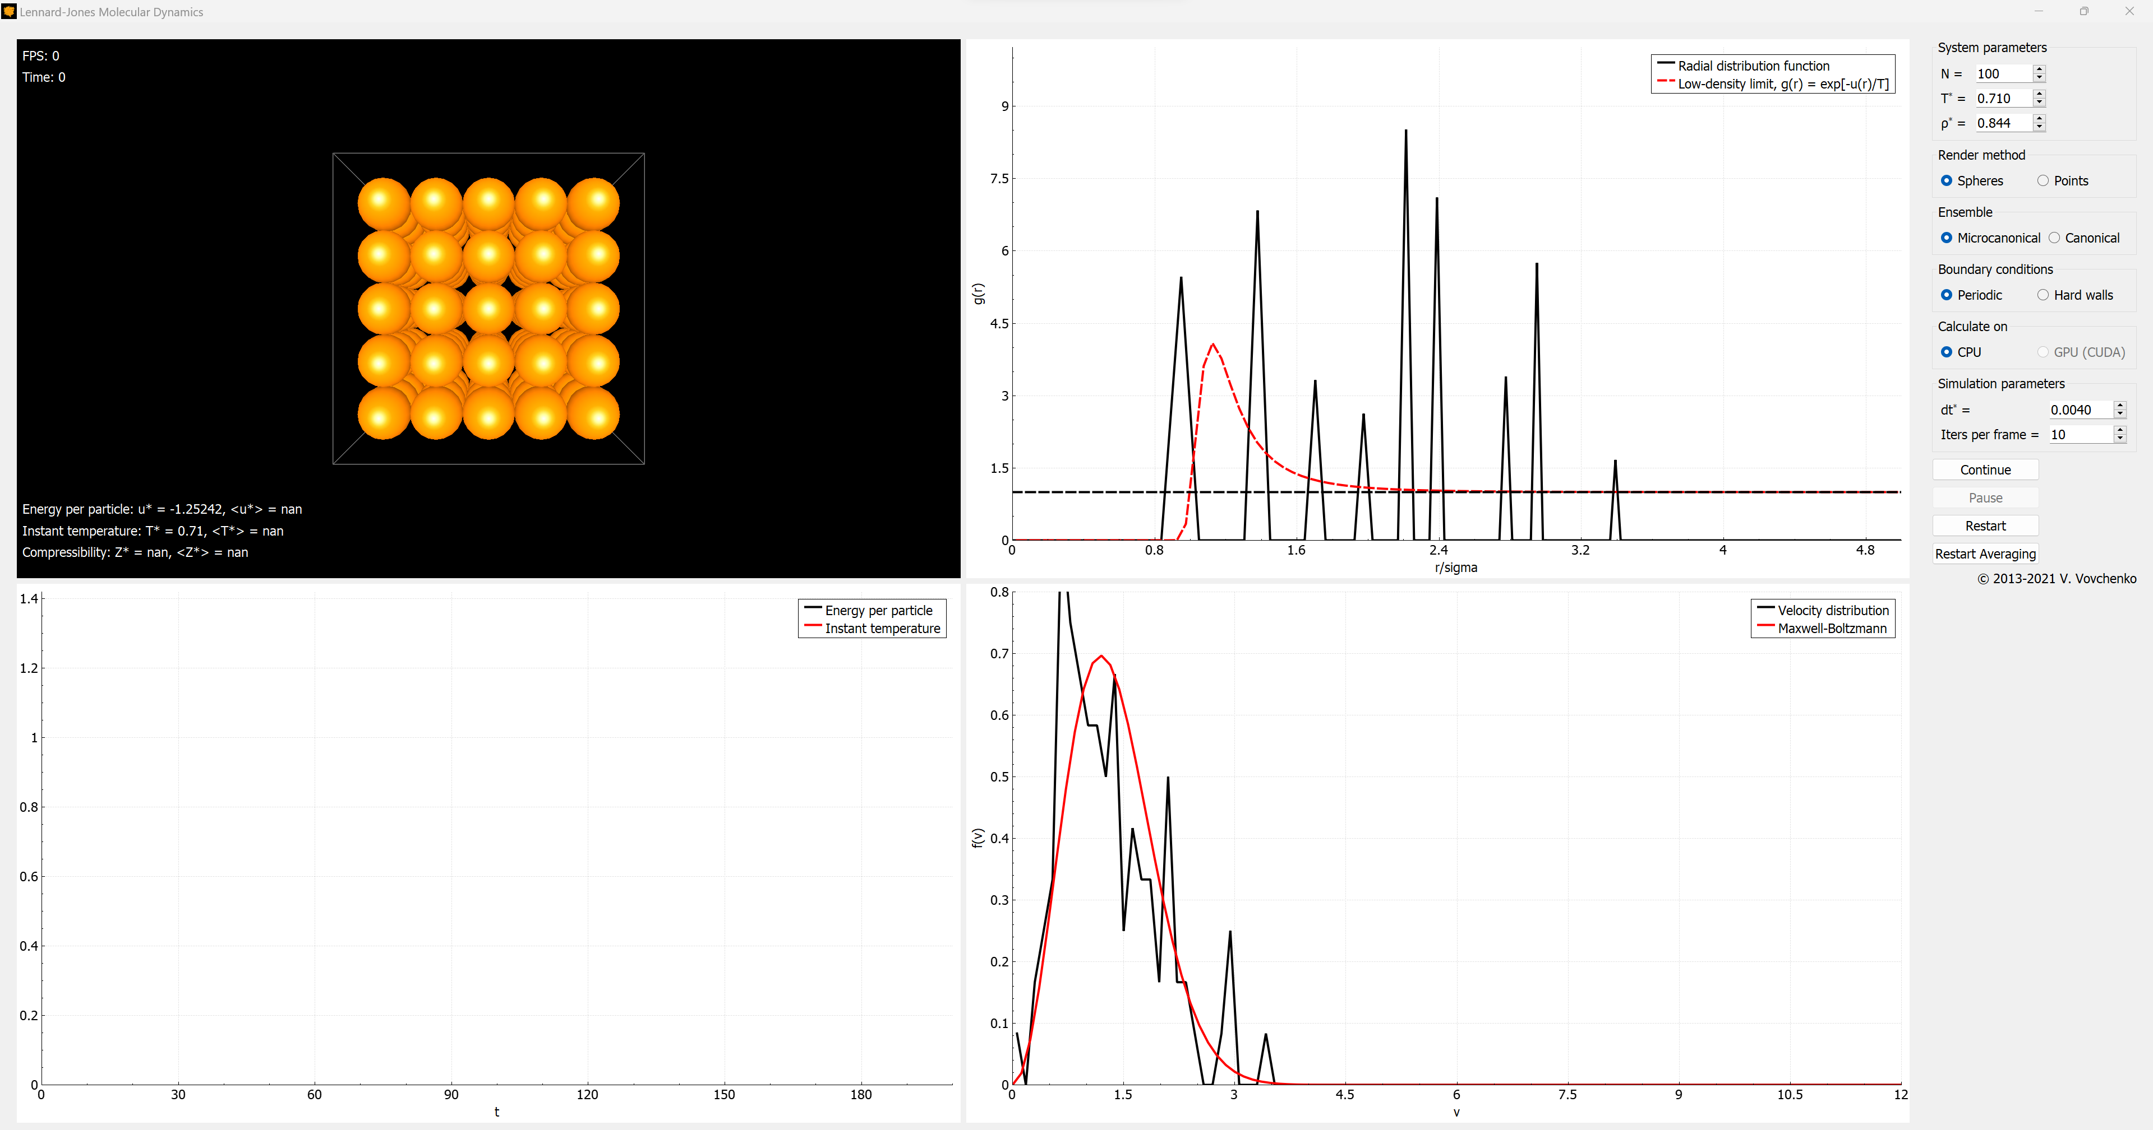

Lennard-Jones fluid: C++/GPU implementation
Implementation:
Velocity Verlet integration scheme implemented on CUDA-GPU (x100-200 speed-up*)
open source: https://github.com/vlvovch/lennard-jones-cuda
Notes:
The important thing here, however, is that this equation defines how the mean B1 depends on t.
We can thus use this straightforwardly to calculate the higher-order cumulants by taking the derivatives from this equation with respect to t.
And by repeatedly abusing the Faa di Bruno formula for high-order derivatives of composite functions we can calculate the net-baryon cumulants subject to global baryon conservation up to a desired order.
Here I am showing the results for three cumulants ratios, the so-called scaled variance, skewness, and kurtosis, our paper contains explicit results up to order 6.
We obtain the B1 cumulants in terms of the subvolume fraction \alpha and the grand-canonical susceptibilities \chi_B.
This is exactly what we want, as the grand-canonical susceptibilities are the intrinsic properties of the equation of state that we want to probe.
Unsurprisingly, in the limit \alpha goes to zero we obtain the grand-canonical susceptibility ratios.
Let me reiterate again that here I did not assume anything about the equation of state, this result is model-independent.

