Slide 1

Computational Physics (PHYS6350)
Lecture 15: Partial Differential Equations
Boundary value problems
Reference: Chapter 9 of Computational Physics by Mark Newman
Instructor: Volodymyr Vovchenko (vvovchenko@uh.edu)
Course materials: https://github.com/vlvovch/PHYS6350-ComputationalPhysics
Online textbook: https://vovchenko.net/computational-physics/

Slide 2
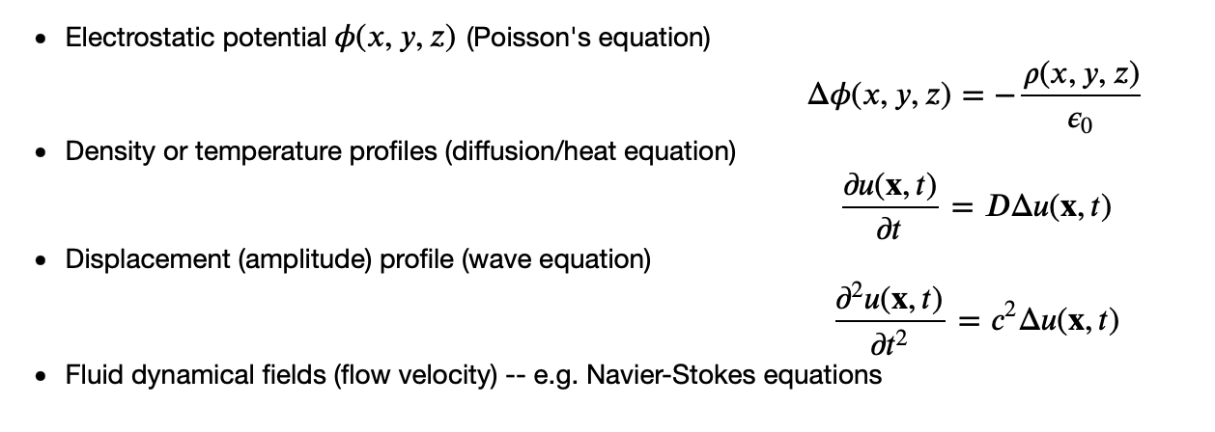

Partial differential equations
Describe functions of more than one variable
In physics, this commonly corresponds to fields $φ(x,y,z)$
Examples:

Slide 3

Common methods for PDEs
- Finite difference method
- Approximate the derivatives by finite differences
- Easier to implement than other methods
- Works best for regular (rectangular) shapes
- Finite element method
- Subdivide the system into smaller parts -- finite elements
- Boundary value problems in 2/3 dimensions
- Works well for irregular shapes
- Finite volume method
- Convert surface integrals around each mesh point into volume integrals
- Conserves the mass by design, good for solving fluid dynamical equations

Slide 4
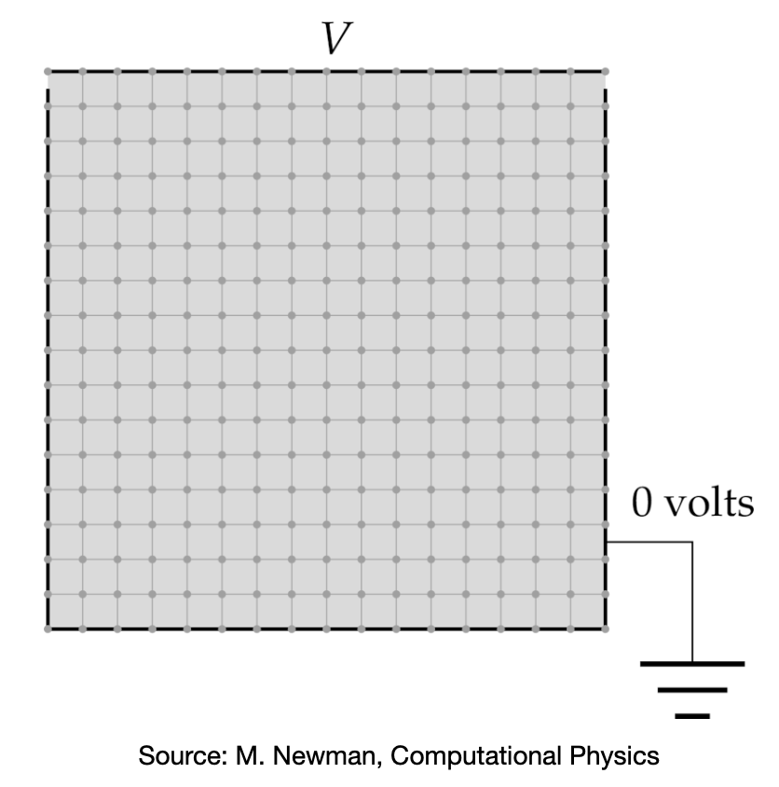
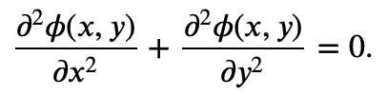
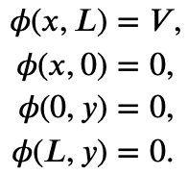

Boundary value problem
Consider Laplace’s equation in two dimensions
Boundary conditions
How to find the profile $φ(x,y$)?

Slide 5


Boundary value problem: Finite difference method
Discretize the space onto a grid $M×M$ of length $a=L/M$
Apply central difference to the derivatives
Laplace’s equation becomes

Slide 6
Boundary value problem: Jacobi method
is a system of M² linear equations
The general solution is O(M⁶)
Jacobi method:
Perform the solution iteratively
until the desired accuracy is met

Slide 7
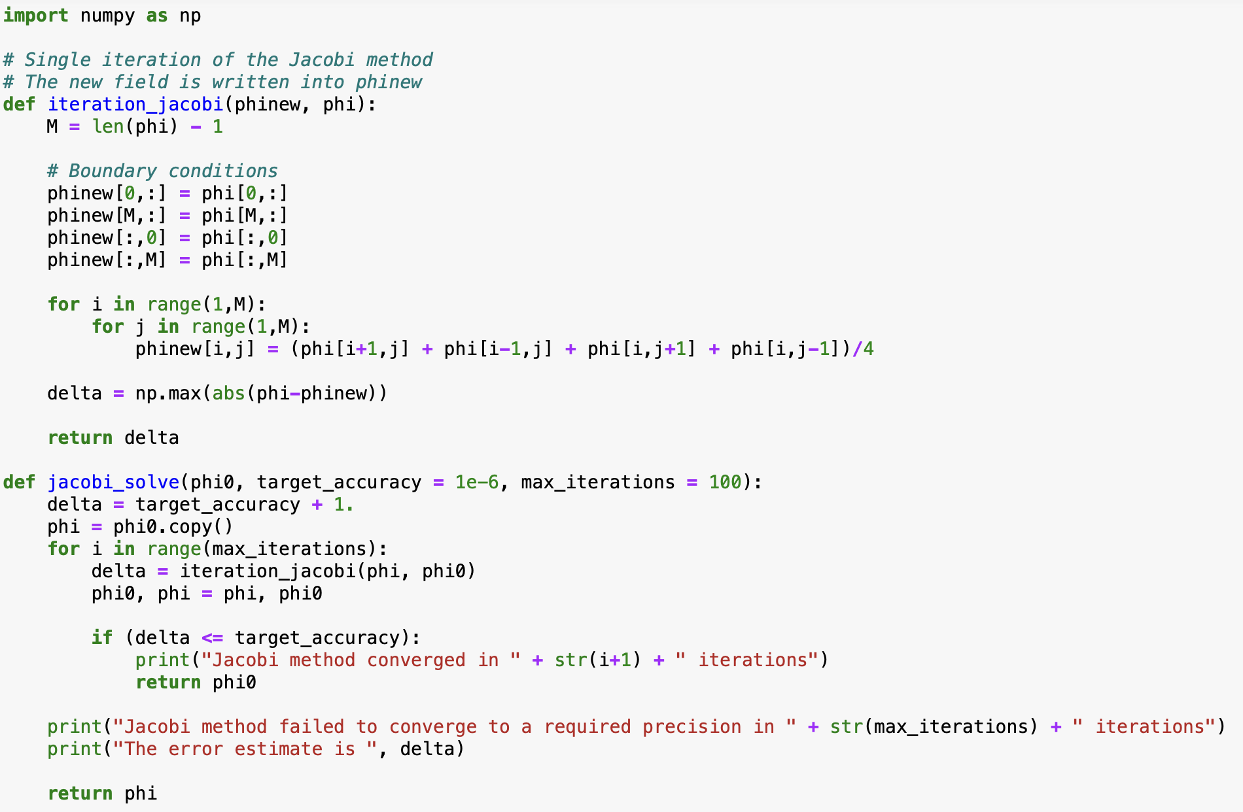
Boundary value problem: Jacobi method

Slide 8
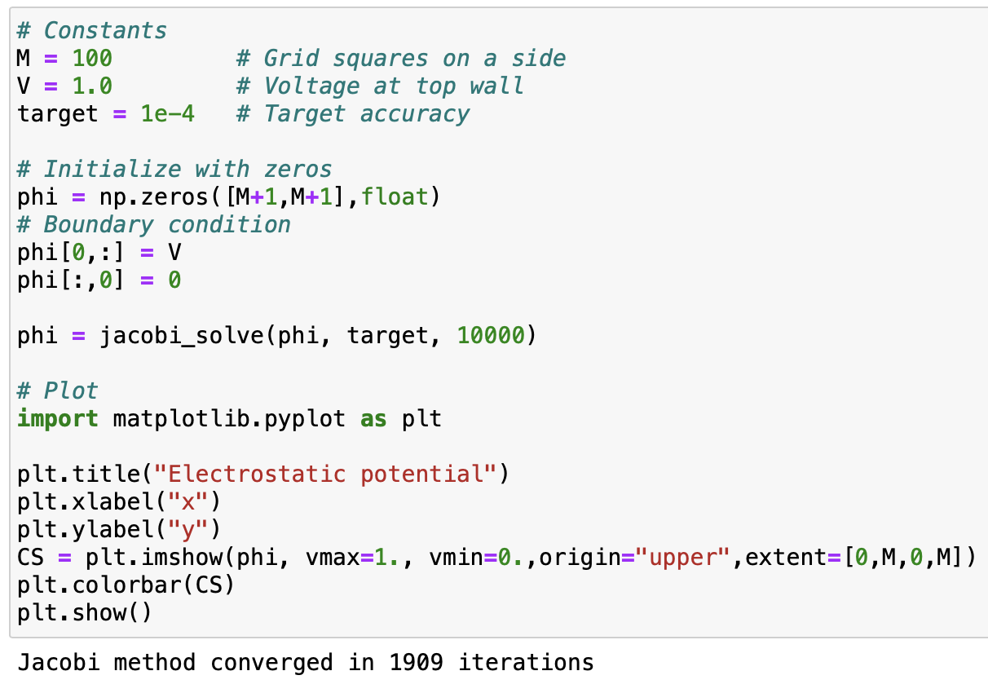
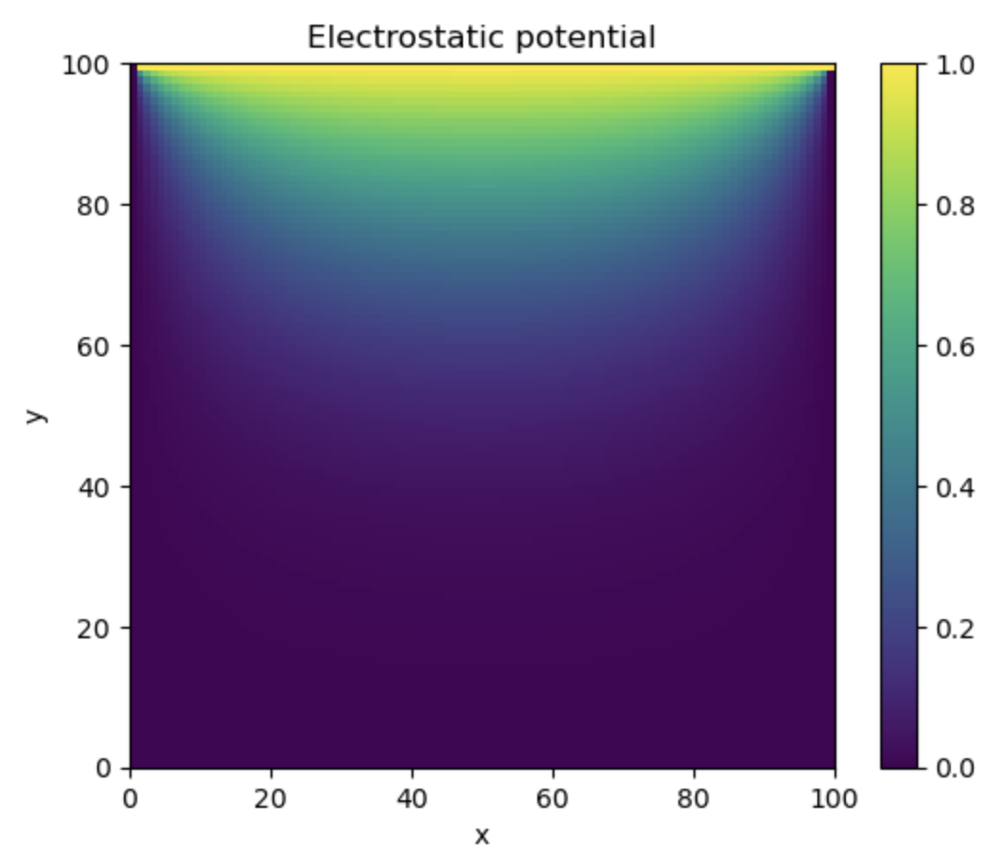
Boundary value problem: Jacobi method

Slide 9
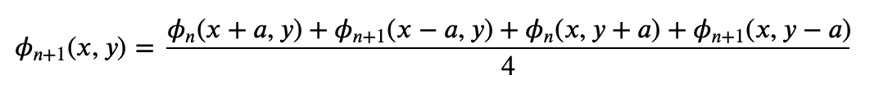
Boundary value problem: Gauss-Seidel with overrelaxation
Gauss-Seidel method: Use newly computed $φ_{n+1}$ whenever available
Overrelaxation:
Combined:
Stable for w < 1, much faster

Slide 10
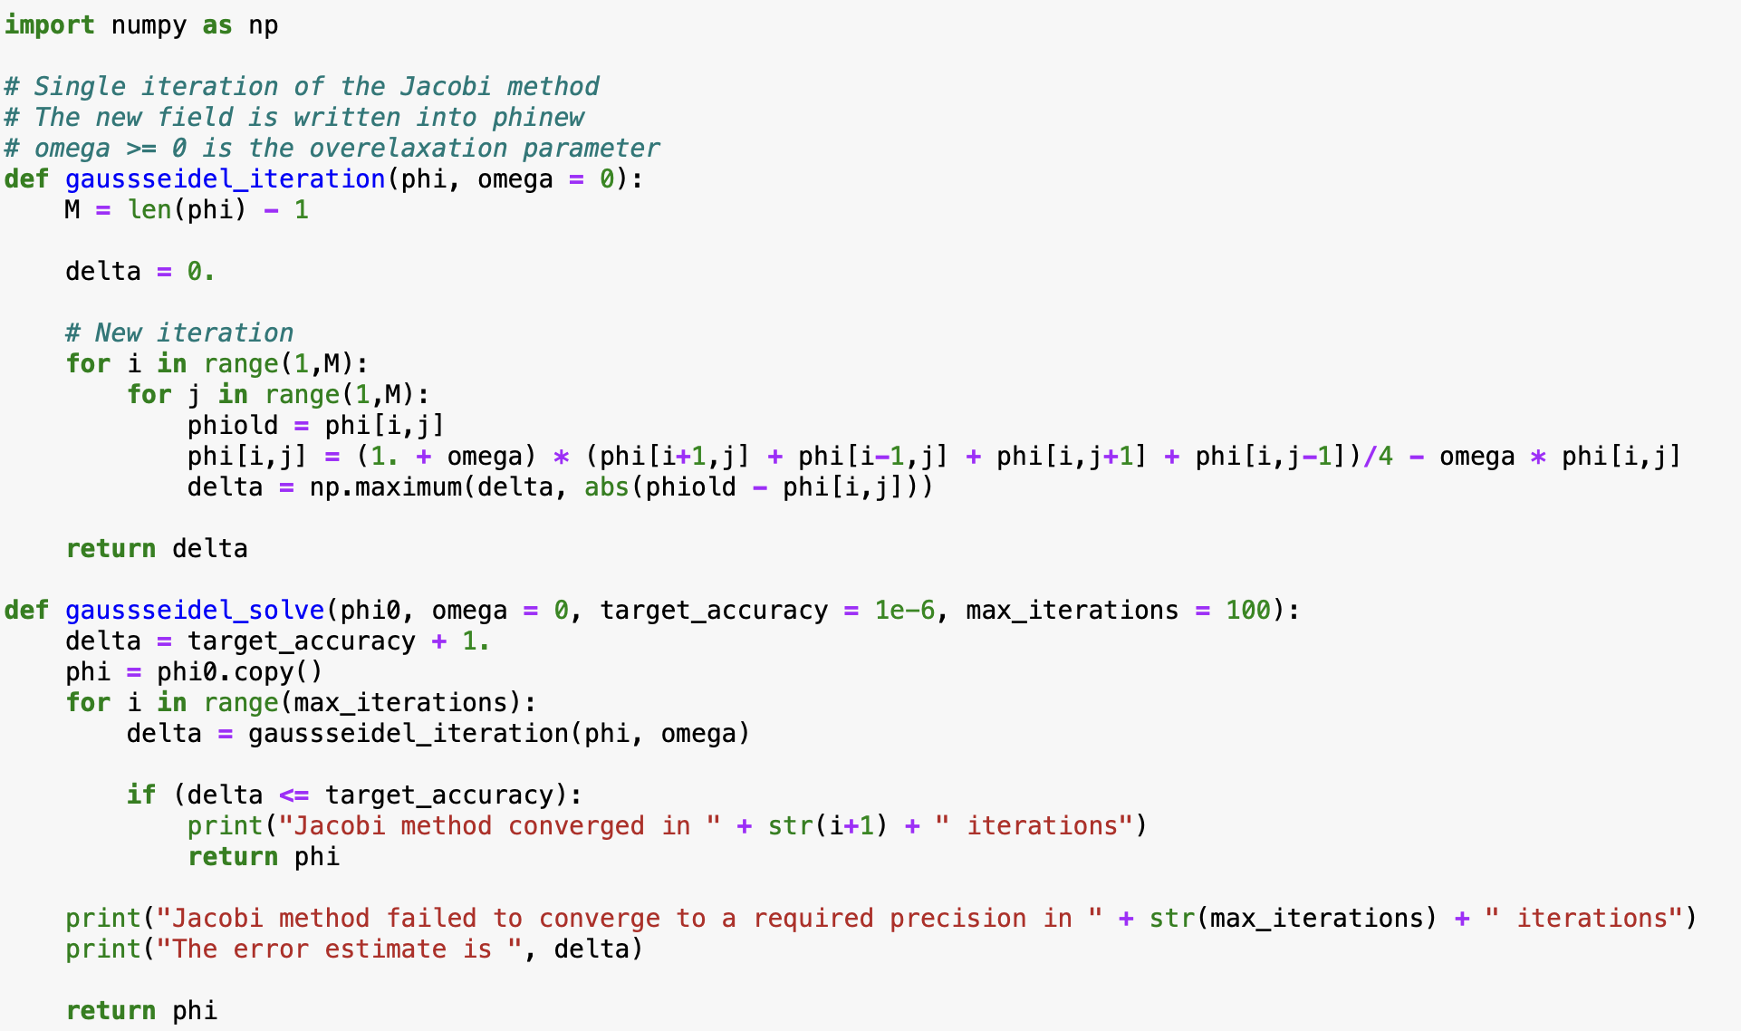
Boundary value problem: Gauss-Seidel method

Slide 11
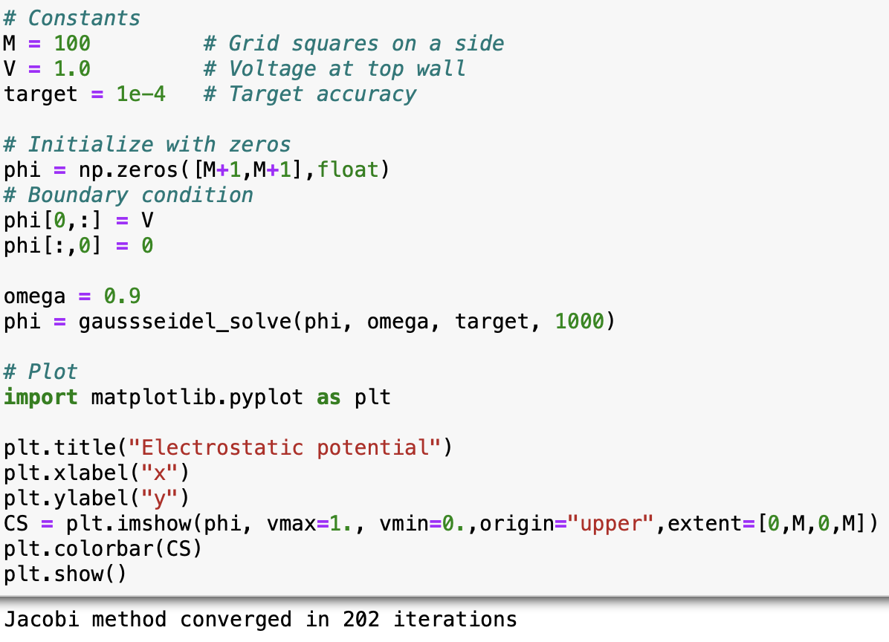
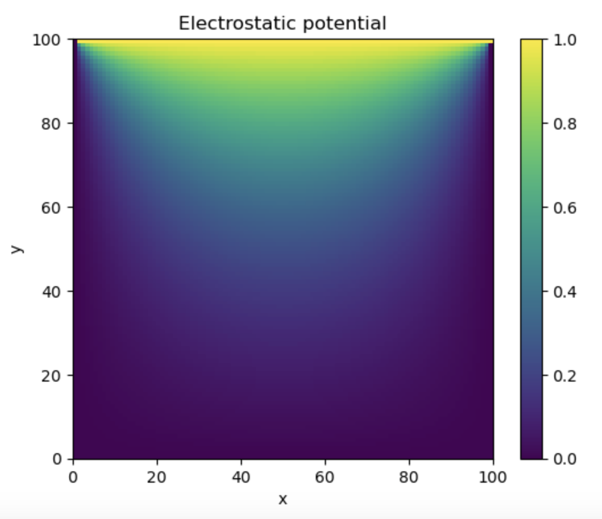
Boundary value problem: Gauss-Seidel method

