Slide 1

Computational Physics (PHYS6350)
Lecture 22: Fourier transform
Discrete Fourier transform (DFT)
Fast Fourier Transform (FFT)
Instructor: Volodymyr Vovchenko (vvovchenko@uh.edu)
Course materials: https://github.com/vlvovch/PHYS6350-ComputationalPhysics
Online textbook: https://vovchenko.net/computational-physics/

Slide 2
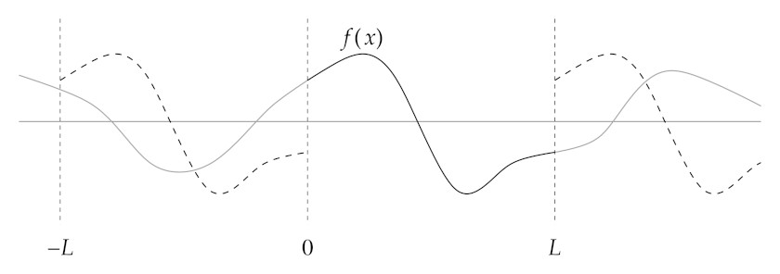
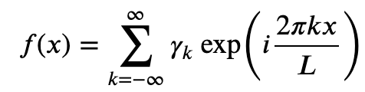
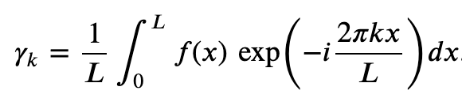
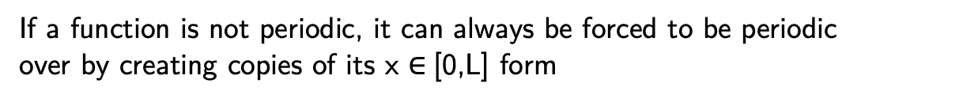
Fourier transform
Periodic functions (e.g. over x $∈$[0,L]) permit Fourier decomposition
If a function is not periodic, it can always be forced to be periodic
over by creating copies of its x $∈$[0,L] form
The Fourier coefficients read
Applications:
signal processing (e.g. frequencies)
image compression
solutions to partial differential equations
convolutions of functions

Slide 3
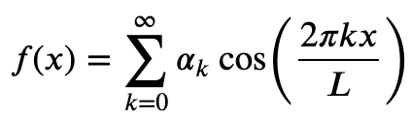
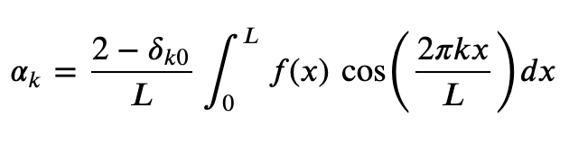
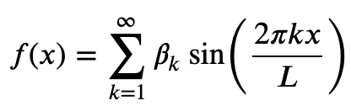
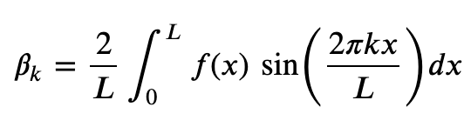
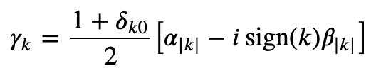
Fourier transform: sines and cosines
If function is even (symmetric) around the midpoint x = L/2, it permits cosine series
If function is odd (antisymmetric) around the midpoint x = L/2, it permits sine series
The coefficients are related to the ones of the exponential series

Slide 4
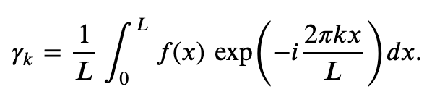
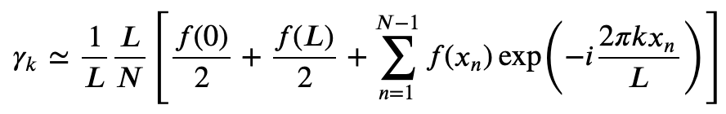


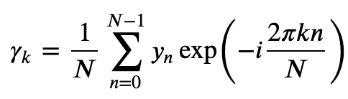

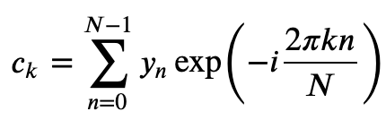


Evaluating Fourier coefficients
Apply N-point trapezoidal rule
The function is periodic, f(0) = f(L), thus
This is the discrete Fourier transform (DFT).
Typically, one uses the coefficients without the factor 1/N, i.e.
If y_{n} are all real,

Slide 5
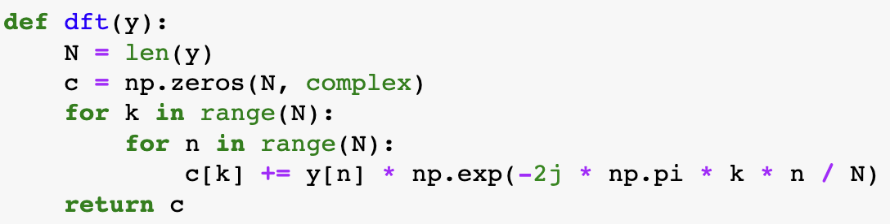
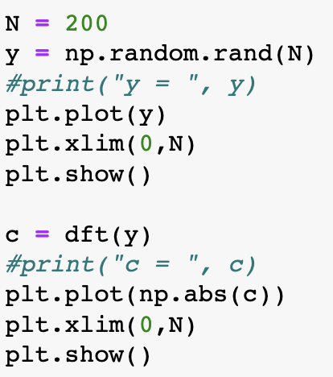
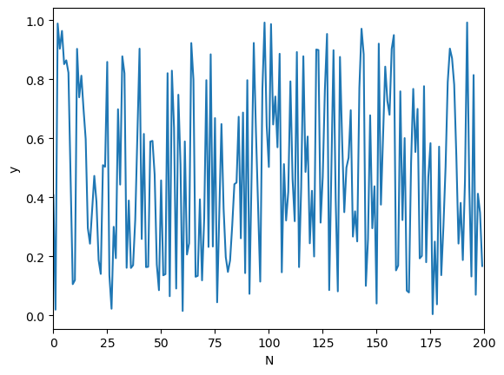
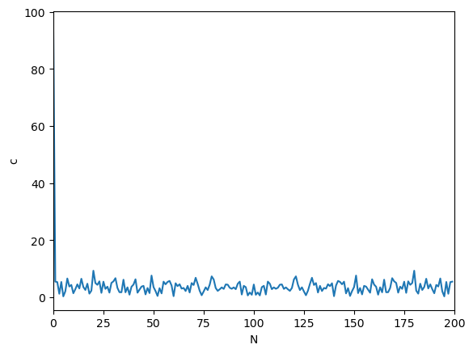
Evaluating Fourier coefficients
Function
Fourier transform

Slide 6
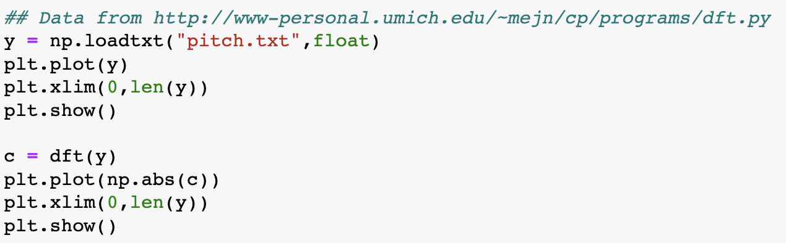
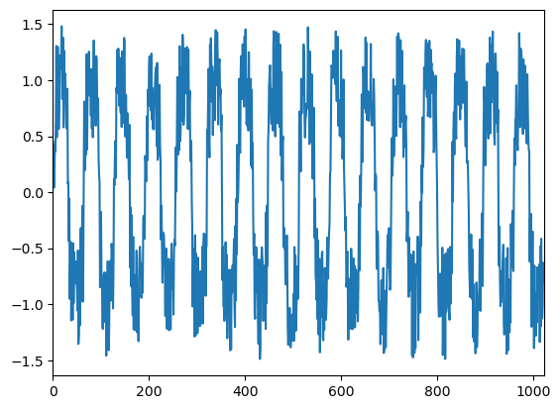
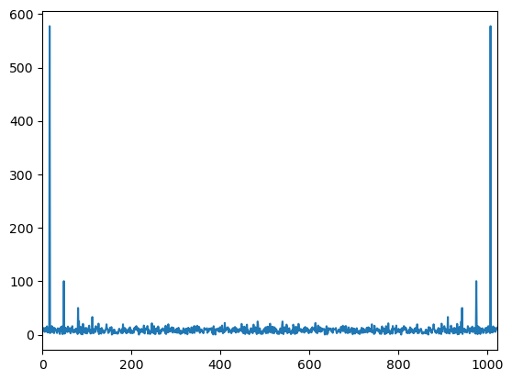
Evaluating Fourier coefficients
Consider a wavelike form with noise

Slide 7
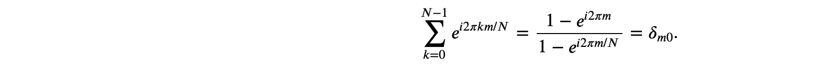
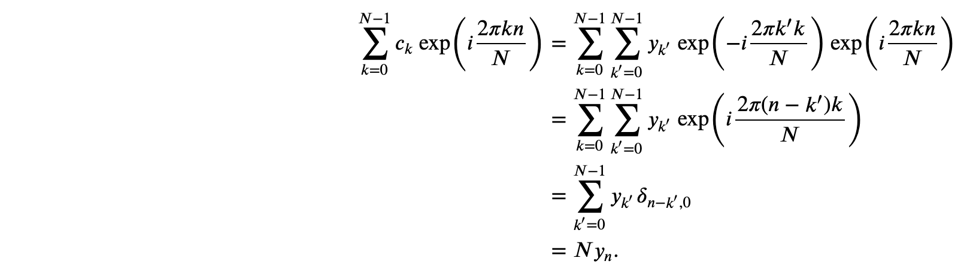
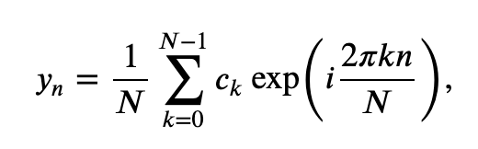
Inverse Fourier transform
Consider the following geometric progression
We use this now to evaluate the following sum
inverse discrete Fourier transform (inverse DFT)

Slide 8
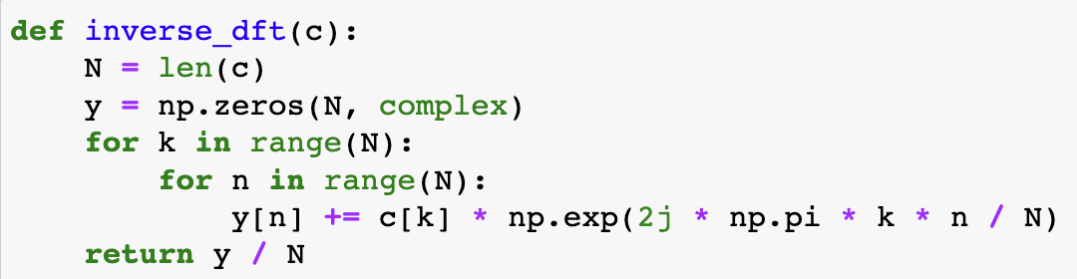
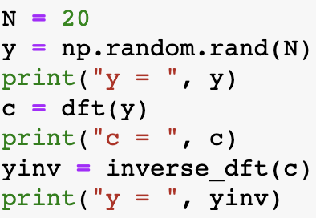
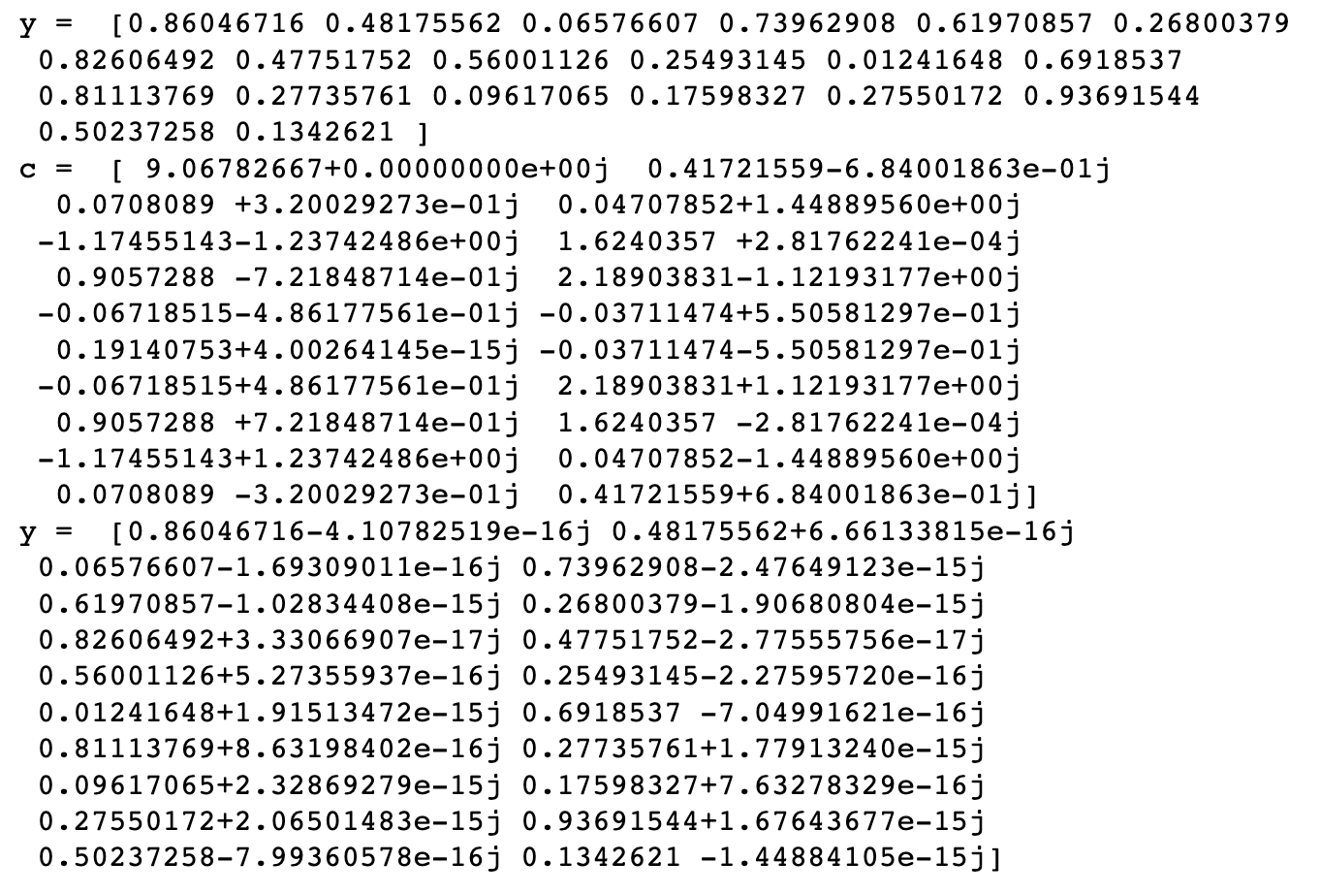
Inverse DFT
Recover the original function up to round-off error

Slide 9
Inverse DFT
Original
DFT
Inverse DFT

Slide 10
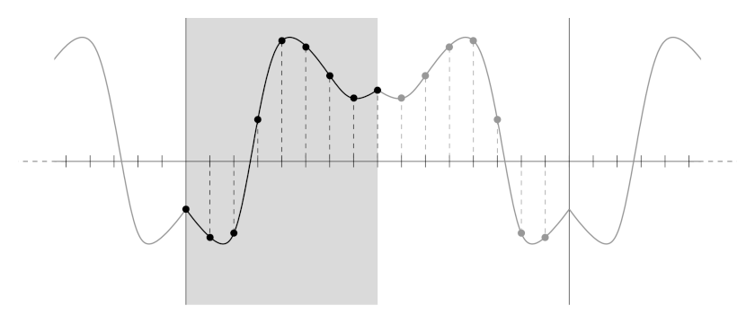
Discrete cosine and sine transforms
With some optimizations one can avoid using complex numbers

Slide 11
Fast Fourier Transform
Straight DFT complexity: O(N²)
Impractical for large data sets
Can we do better?
Fast Fourier Transform (FFT) algorithms achieve O(N log N)

Slide 12
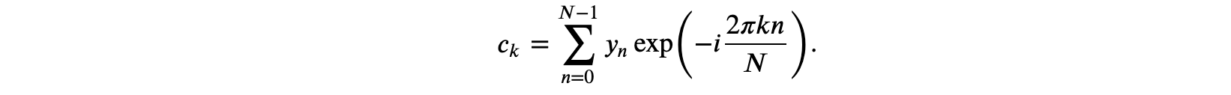
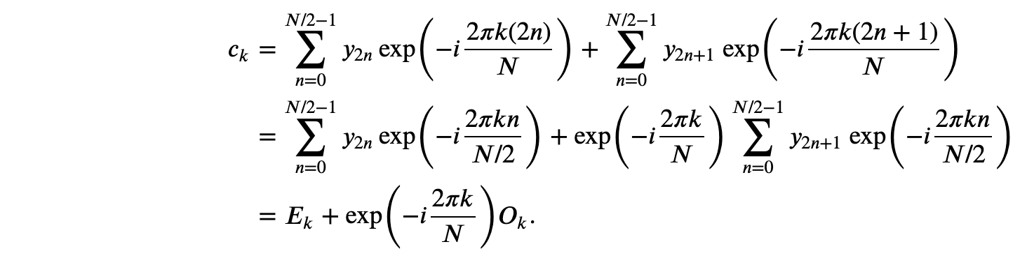
Fast Fourier Transform: Cooley-Tukey algorithm (1965)
To see how it works, let us consider a case where N is a power of two, N = 2^{M}, and we want to compute the Fourier transform of (y₀, y₁, ..., y_{N-1}). By definition we have:
We can split the sum into even and odd elements:
c_{k} can be expressed as a sum of two elements:
one is the kth element from a DFT of all even elements: (y₀, y₂, ..., y_{N−2}),
the other is the kth element from a DFT of all odd elements: (y₁, y₃, ..., y_{N−1})

Slide 13
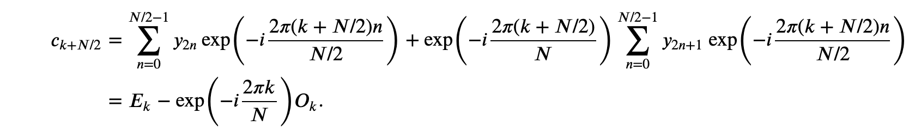
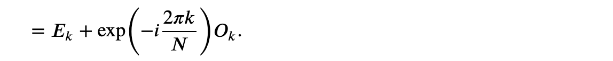

Fast Fourier Transform: Cooley-Tukey algorithm (1965)
The interpretation makes sense if $k < N/2$
Other Fourier components can be expressed as $k+N/2$and read:
Combine with
To compute DFT of (y₀,…,y_{N}) we only need to compute two N/2 DFTs of even and odd components of y.
Divide and conquer: continue recursively until N = 1, where c_{k} = y_{k}
At each step N is halved
Complexity: O(N log N)

Slide 14
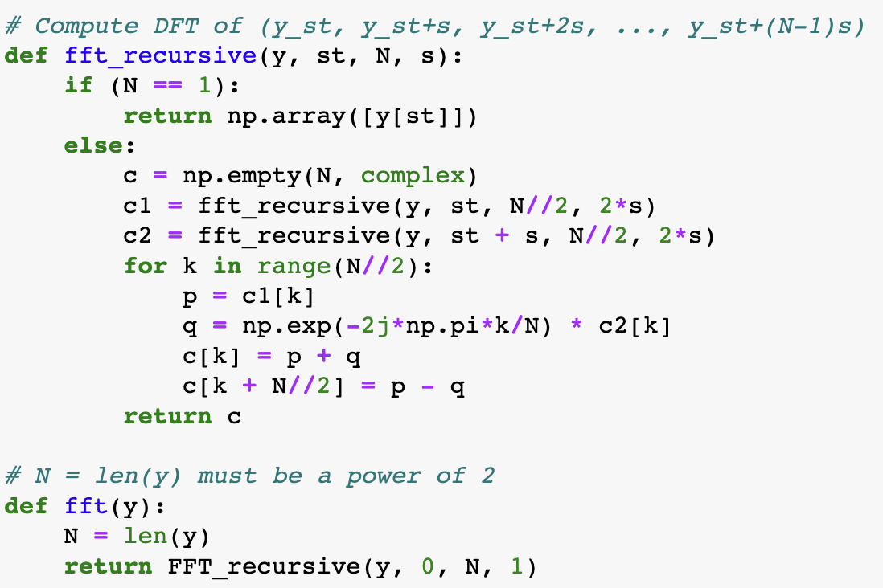
FFT implementation

Slide 15
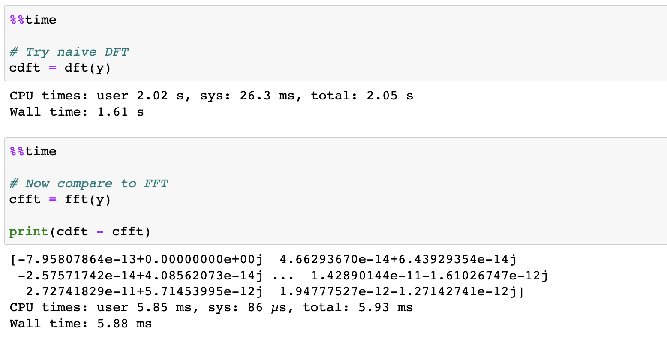
FFT vs simple DFT

Slide 16
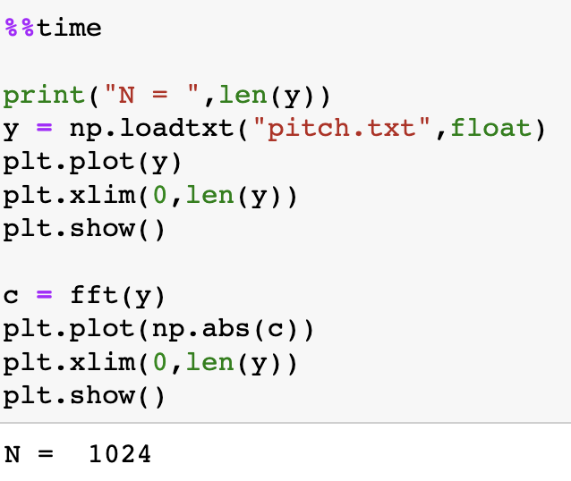
FFT for the signal

Slide 17

FFT for the signal
numpy:

