Slide 1

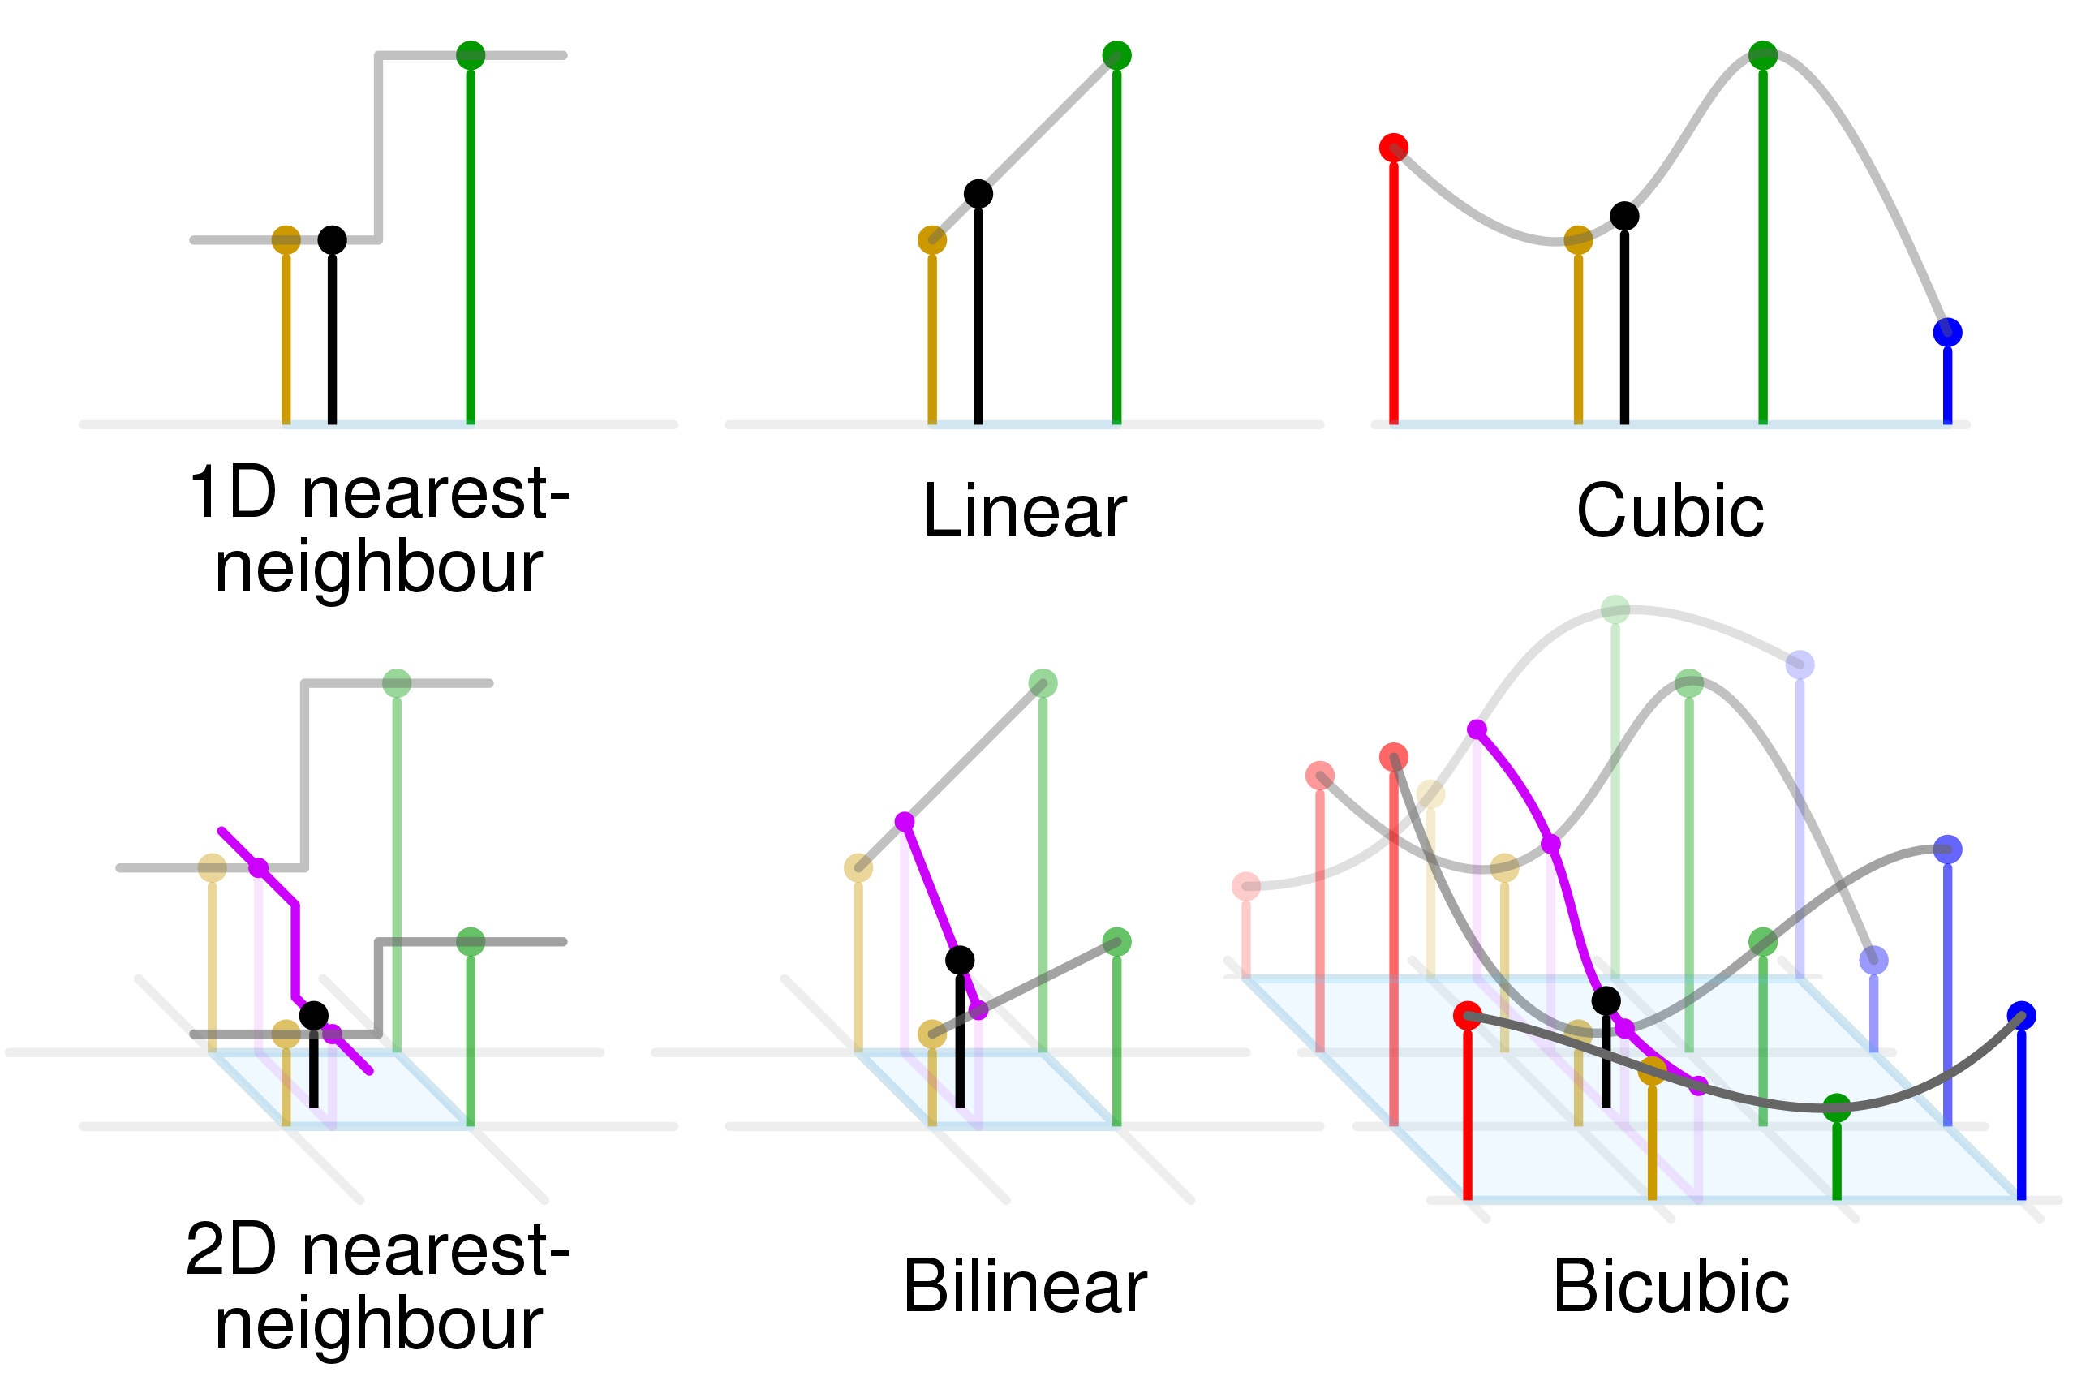
Computational Physics (PHYS6350)
Lecture 3: Interpolation
Instructor: Volodymyr Vovchenko (vvovchenko@uh.edu)
Course materials: https://github.com/vlvovch/PHYS6350-ComputationalPhysics
Online textbook: https://vovchenko.net/computational-physics/

Slide 2
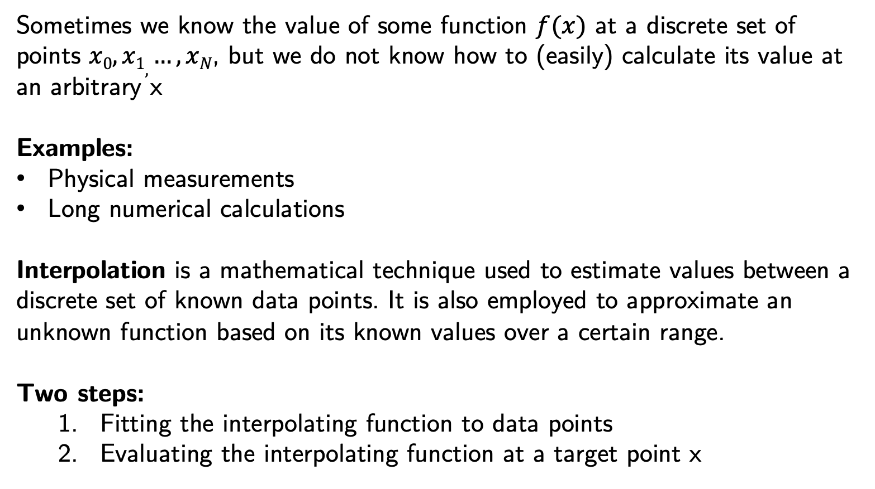
Interpolation
Sometimes we know the value of some function $f(x)$ at a discrete set of points $x0, x1, …, xN$, but we do not know how to (easily) calculate its value at an arbitrary x
Examples:
Physical measurements
Long numerical calculations
Interpolation is a mathematical technique used to estimate values between a discrete set of known data points. It is also employed to approximate an unknown function based on its known values over a certain range.
Two steps:
Fitting the interpolating function to data points
Evaluating the interpolating function at a target point x
Reference:
Chapter 3 of Numerical Recipes Third Edition by W.H. Press et al.

Slide 3
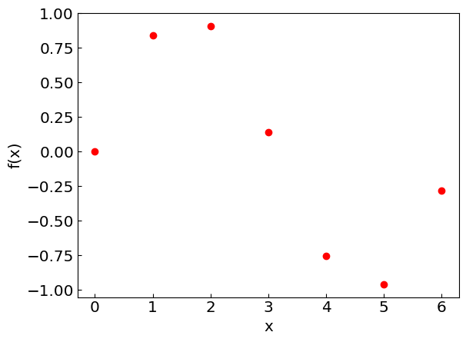
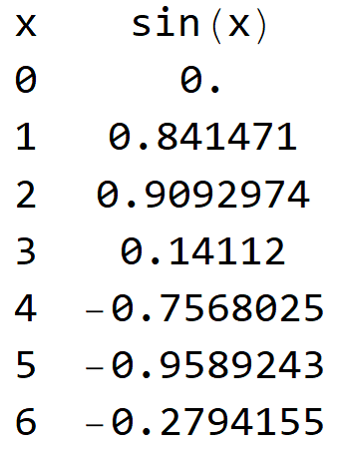
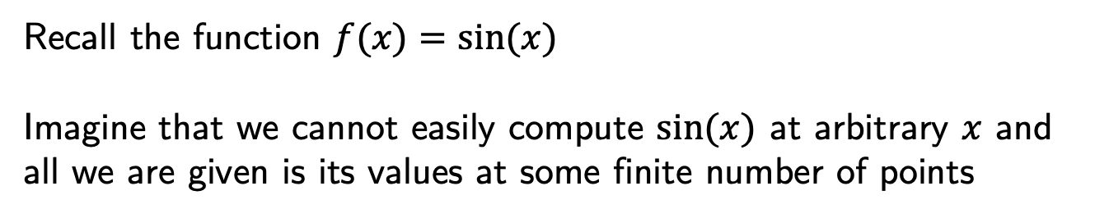
Interpolation
Recall the function $f(x)=sin⁡(x)$
Imagine that we cannot easily compute $sin⁡(x)$ at arbitrary $x$ and all we are given is its values at some finite number of points
Now let us consider different methods of interpolating the function

Slide 4
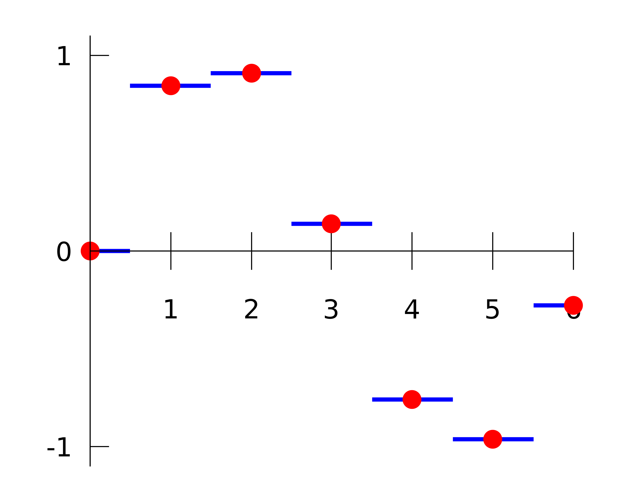
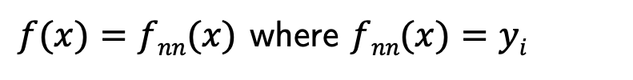
Nearest-neighbor interpolation
Simply assign the value of the closest data point to x, i.e.
$f(x)=fnn(x)$ where $fnn(x)=yi$
Where $i$ is chosen such that $|x−xi|$ is the smallest among all $i$.

Slide 5
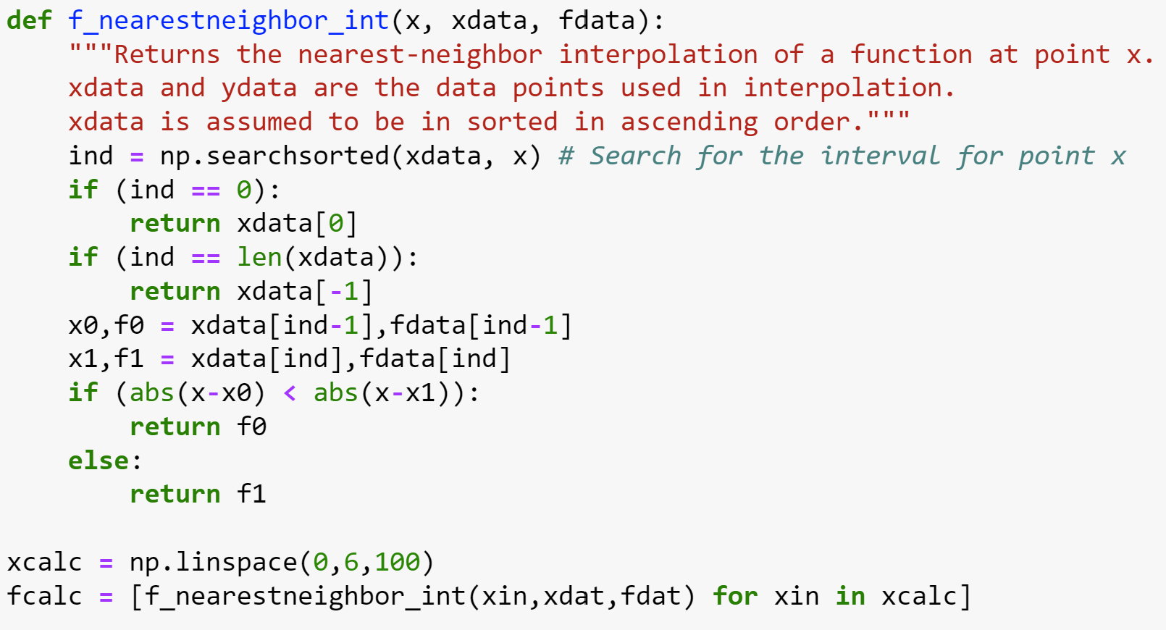
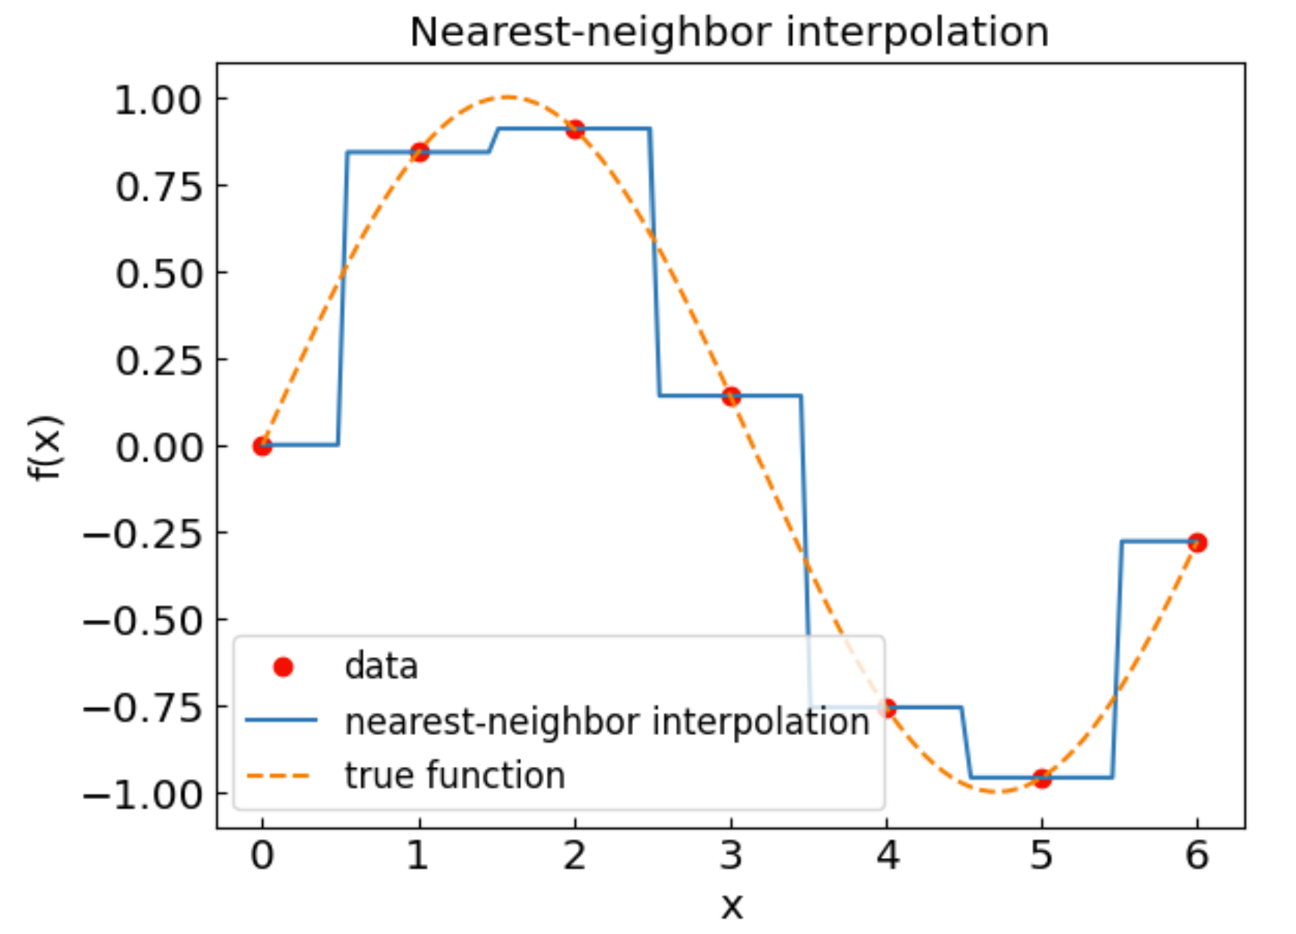
Nearest-neighbor interpolation
In Python:
Advantages:
Very simple
Easy to generalize to multiple dimensions
Disadvantages:
Limited accuracy
Better & simple options available

Slide 6
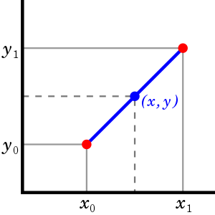
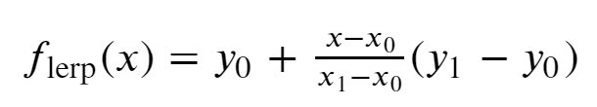
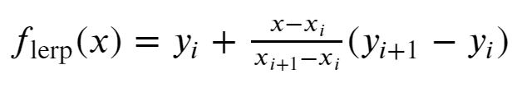
Linear interpolation
Let us have the data points (x₀,y₀) and (x₁,y₁)
Linear interpolant is a straight line between these points
Use it to calculate the function value at any $x ∈[x0,x1]$
For a larger set of points x₀ < x₁ < … < x_{N}, find the interval (x_{i}, x_{i+1}) enveloping x and use the linear interpolant formula
Credit: Wikipedia

Slide 7
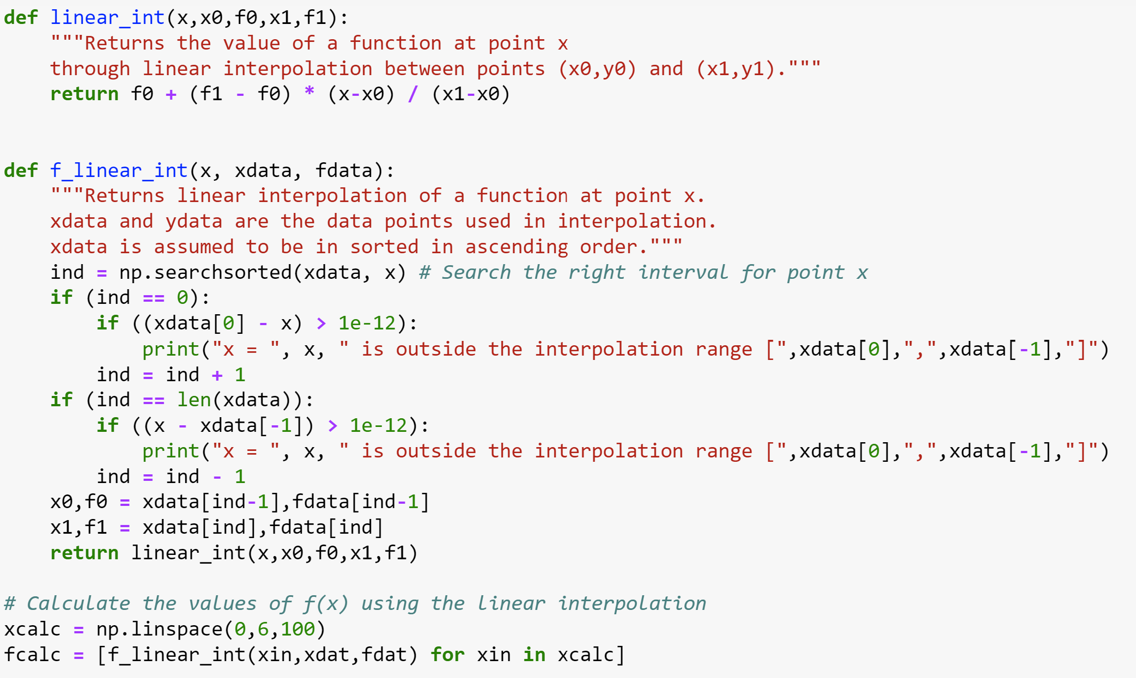
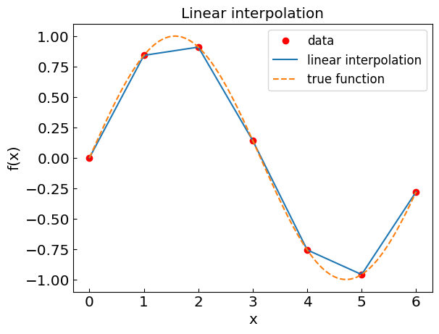
Linear interpolation
In Python:
Advantages:
Simple
Generalizes to multiple dimensions
More accurate than nearest-neighbor appr.
Disadvantages:
Limited accuracy compared to polynomials
Not good for derivatives

Slide 8
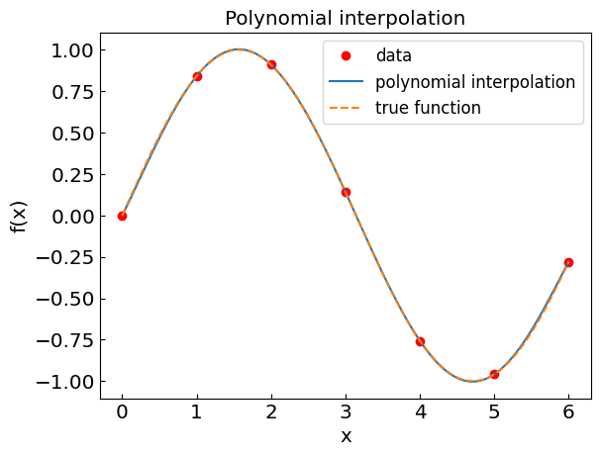
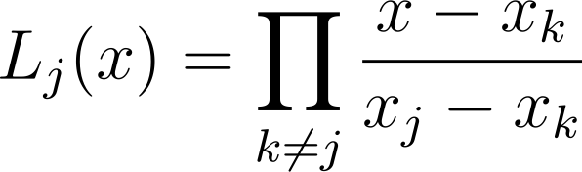
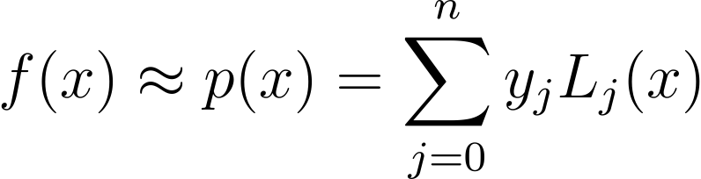
Polynomial interpolation (Lagrange form)
Theorem: There exists a unique polynomial of order n that interpolates through n+1 data points (x₀,y₀), (x₁,y₁), …, (x_{n},y_{n})
How to build such a polynomial?
Consider Lagrange basis functions:
Easy to see that for $x=xk$ one has $Lj(xk)=δkj$
Therefore:

Slide 9
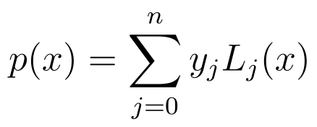
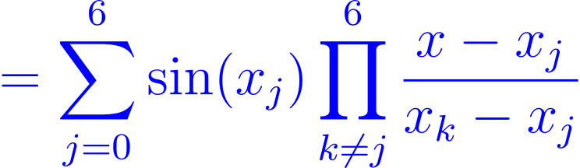
Polynomial interpolation
For our example $f(x) = sin⁡(x)$
one obtains
Lagrange form
Canonical form
In practice, the Lagrange form is more stable with respect to round-off errors

Slide 10
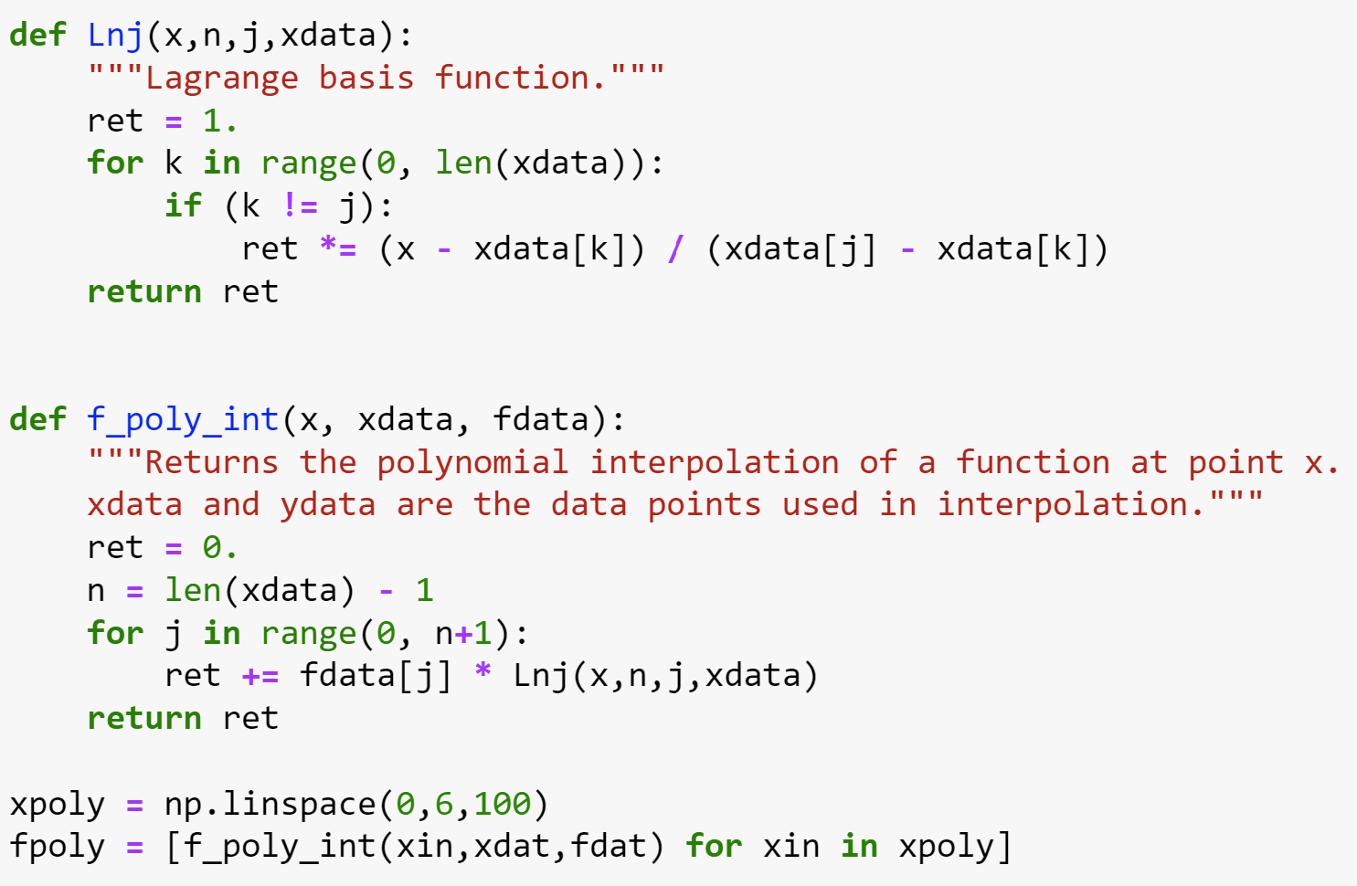
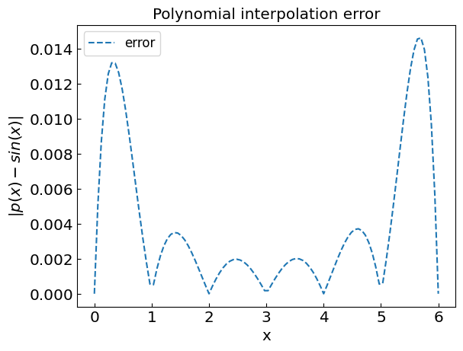
Polynomial interpolation
In Python:

Slide 11
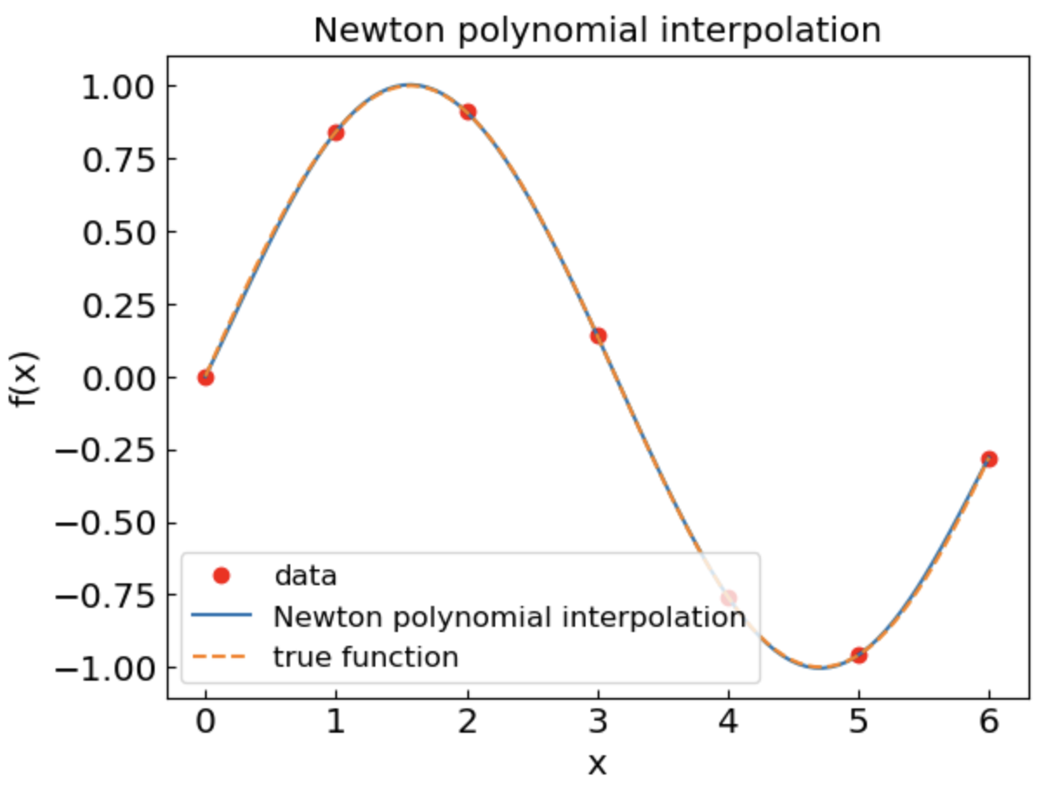
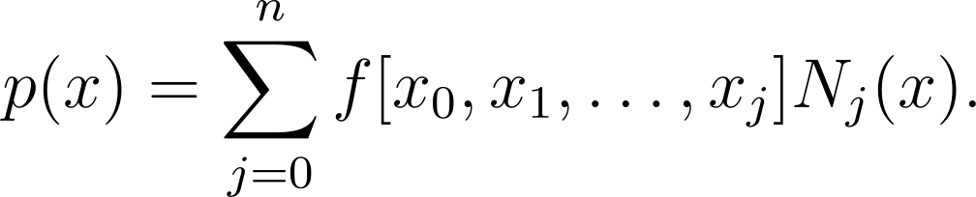
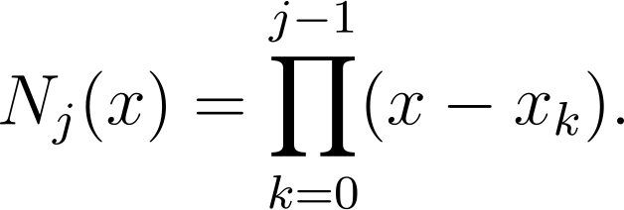
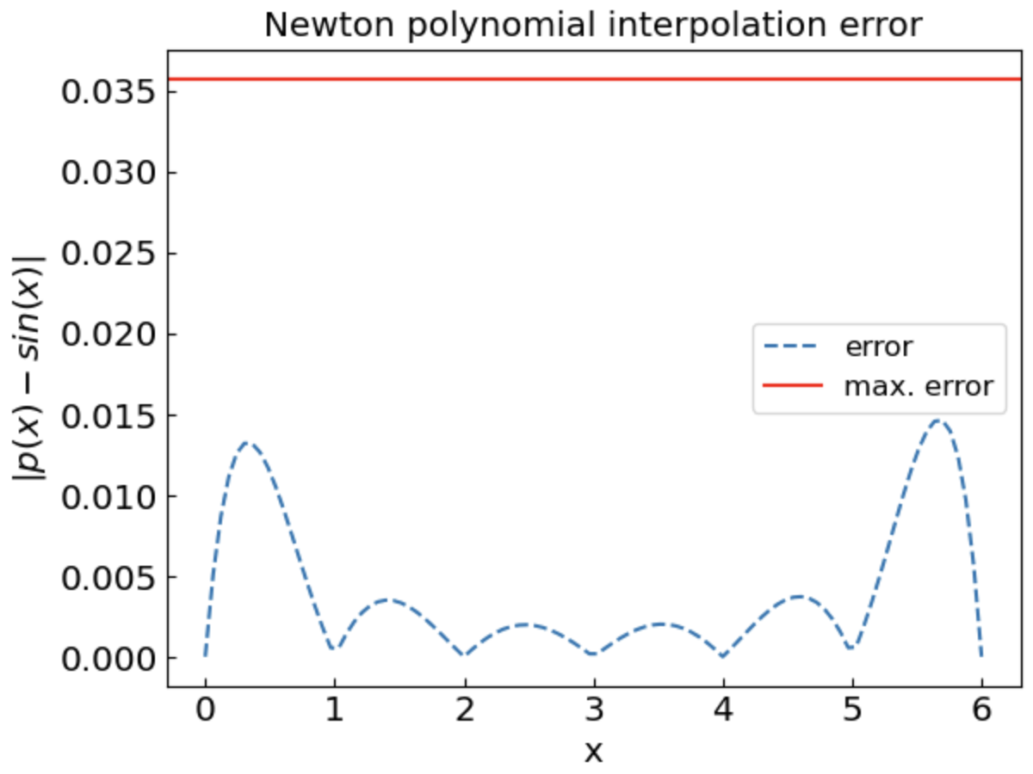
Polynomial interpolation: Newton polynomial
Newton interpolating polynomial
Newton basis functions
Divided differences
The polynomial itself is the same as Lagrange!
Advantage: Easier to incrementally add data points

Slide 12
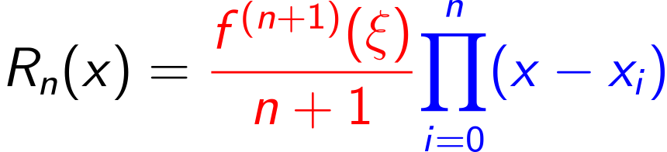
Polynomial interpolation: Errors and artefacts
Truncation errors
Lagrange remainder
Round-off errors
Especially for high-order polynomials
derivative factor
product factor
Truncation errors can be a problem if
High-order derivatives f^{(n+1)}(x) of the function are significant
The choice of nodes leads to a large value of the product factor
Runge phenomenon: Oscillation at the edges of the interval which gets worse as the interpolation order is increased

Slide 13
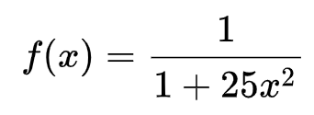
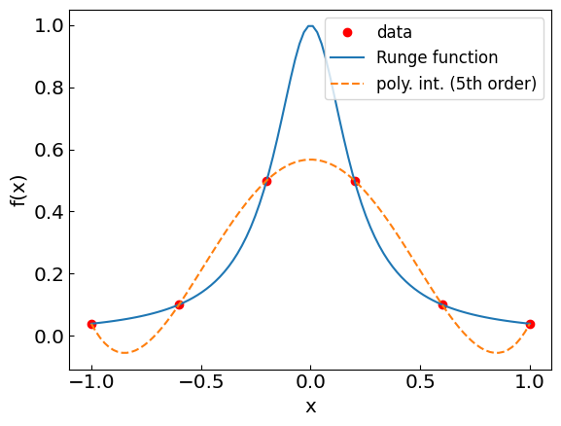
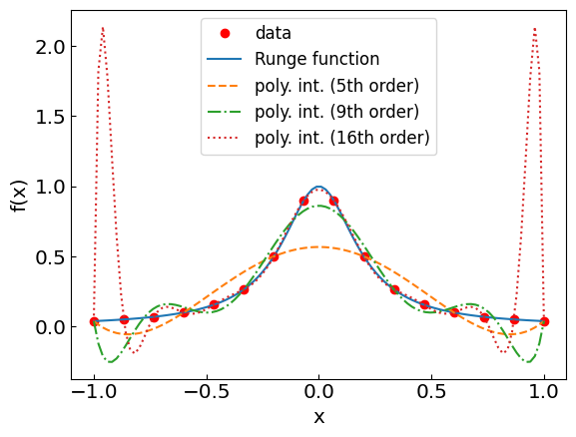
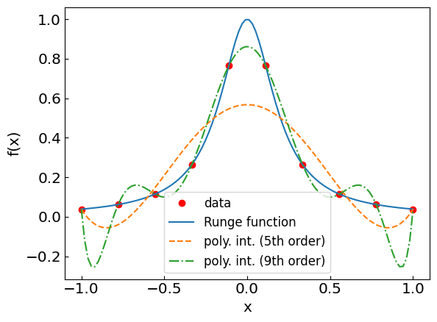
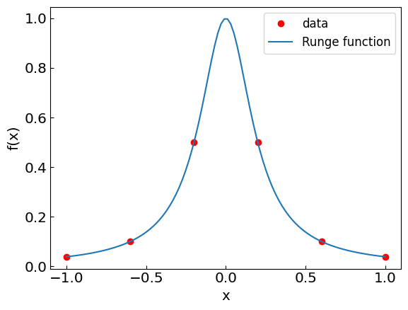
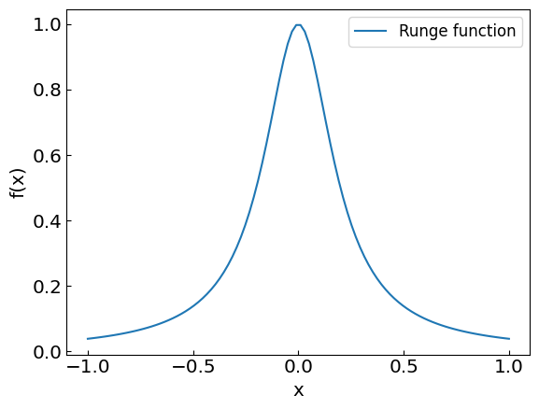
Polynomial interpolation: Runge phenomenon
Consider the Runge function:
Let us do polynomial interpolation using equidistant nodes

Slide 14
Polynomial interpolation: Runge phenomenon
Consider the Runge function:
Let us do polynomial interpolation using equidistant nodes

Slide 15
Polynomial interpolation: Runge phenomenon

Slide 16
Polynomial interpolation: Runge phenomenon

Slide 17
Polynomial interpolation: Runge phenomenon

Slide 18
Polynomial interpolation: Runge phenomenon
We have a real problem at the edges!

Slide 19
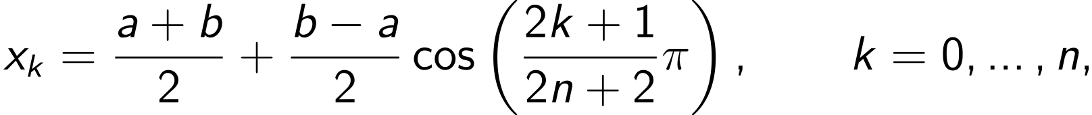
Polynomial interpolation: Chebyshev nodes
Recall the truncation error
So far, we used the equidistant nodes:
Can we choose the nodes x_{i} differently to minimize the product factor?
Yes!
Chebyshev nodes:

Slide 20
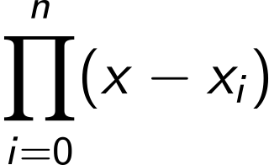
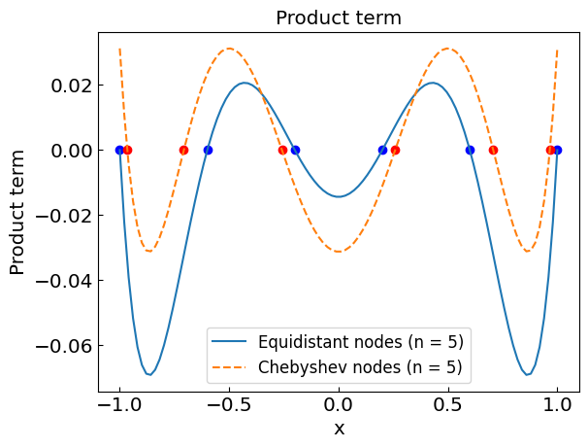
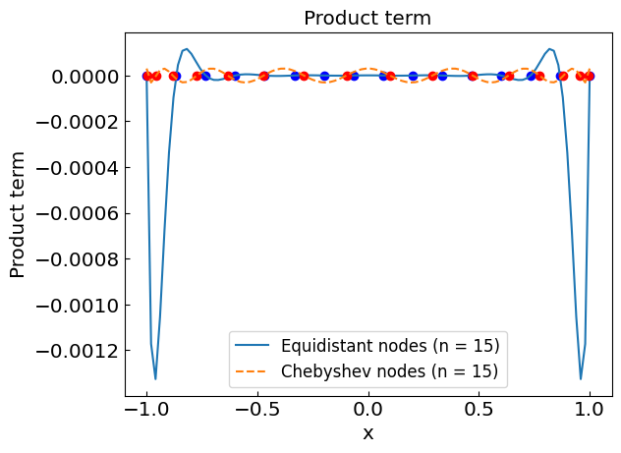
Equidistant vs Chebyshev nodes
Plot as a function of $x$ for different number of nodes $n$ on a $(−1,1)$interval

Slide 21
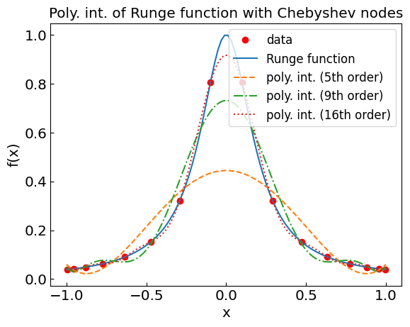
Back to the Runge function: Chebyshev nodes

Slide 22
Polynomial interpolation: Summary
Advantages:
Generally, more accurate than the linear interpolation
Derivatives are continuous
Can be used for numerical integration and differential equations
Disadvantages:
Implementation not so simple
Artefacts possible (such as large oscillations between nodes)
Polynomials of large order susceptible to round-off errors
Not easily generalized to multiple dimensions

Slide 23
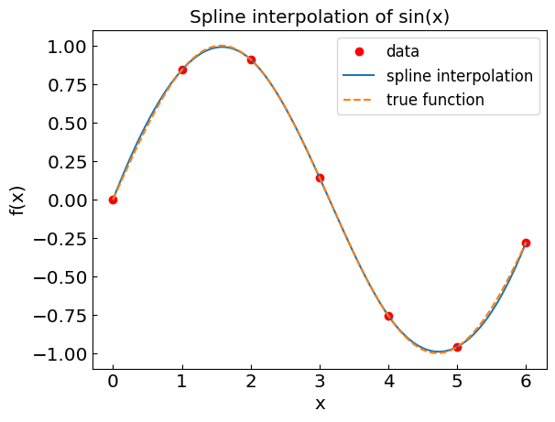
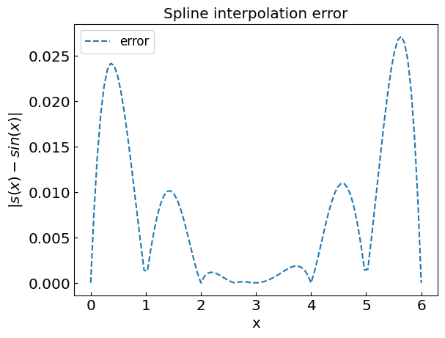
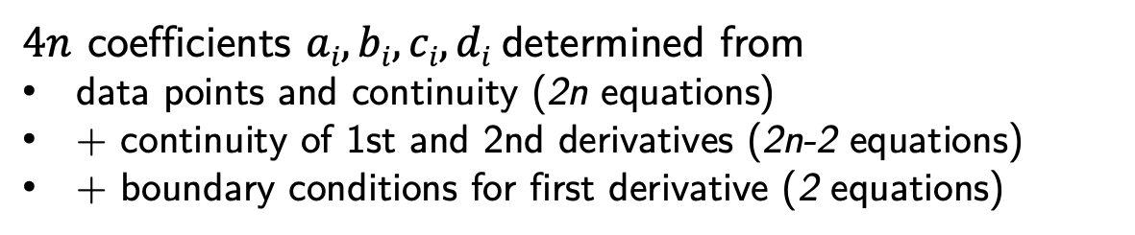
Spline interpolation
Connect each pair of nodes by a cubic polynomial
$4n$ coefficients $ai, bi, ci, di$determined from
data points and continuity (2n equations)
+ continuity of 1st and 2nd derivatives (2n-2 equations)
+ boundary conditions for first derivative (2 equations)
Advantages:
More accurate than linear interpolation
Derivatives are continuous
Avoids issues with polynomials of high degree
Disadvantages:
Implementation not so simple
Artefacts such as large oscillations between nodes are possible

Slide 24
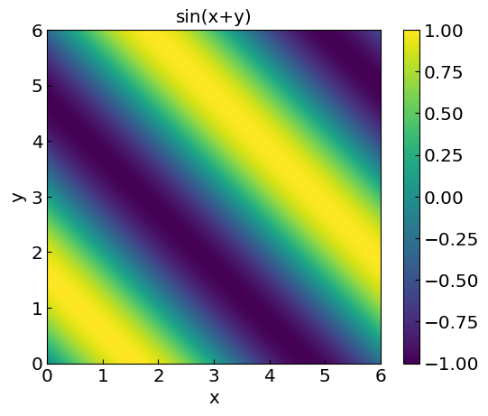
Multiple dimensions
Functions of more than one variable, e.g. $f(x,y) = sin⁡(x+y)$
Data points: $(xi,yi,fi)$
Main methods:
Nearest-neighbor
Successive 1D interpolations

Slide 25
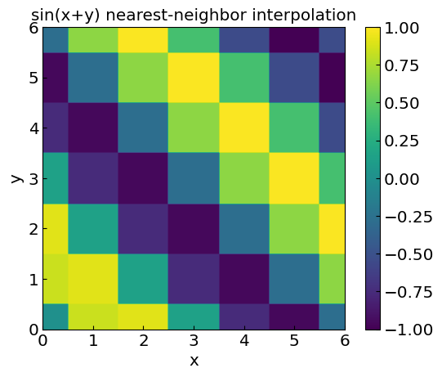
2D nearest-neighbor
2D nearest-neighbor:
Simply assign the value of the closest data point to (x,y) in the plane
Consider f(x,y) = sin(x+y)
Data points at integer values x,y=0,1,…6 (regular grid)

Slide 26
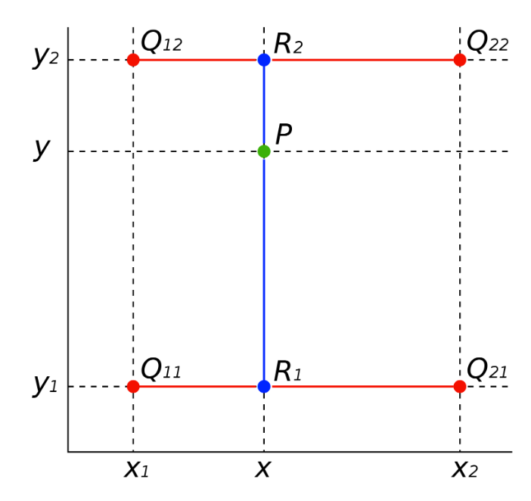
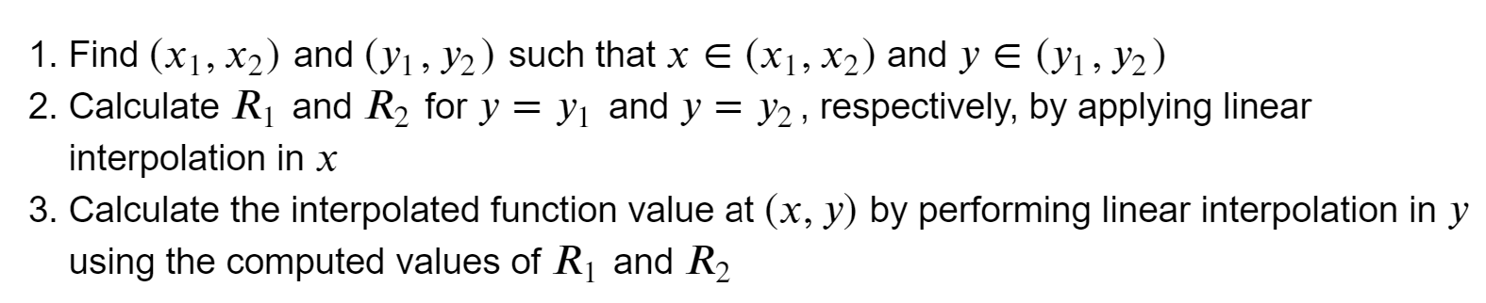
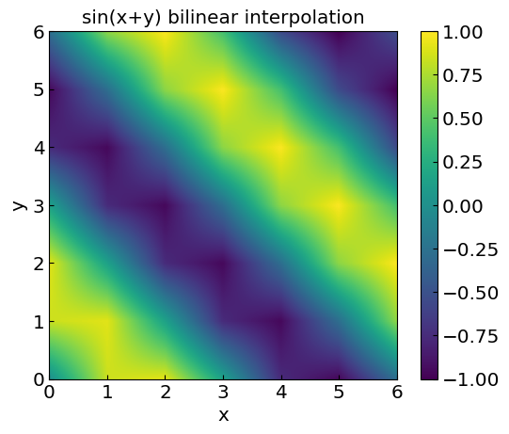
Bilinear interpolation
Bilinear interpolation: apply linear interpolation twice

Slide 27
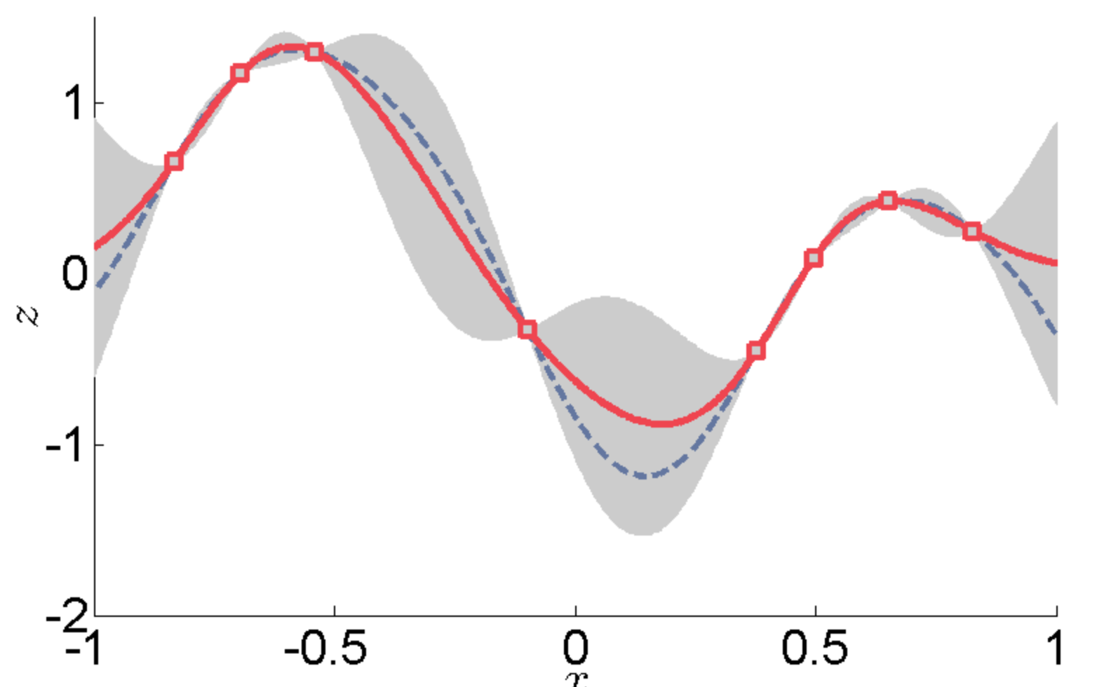
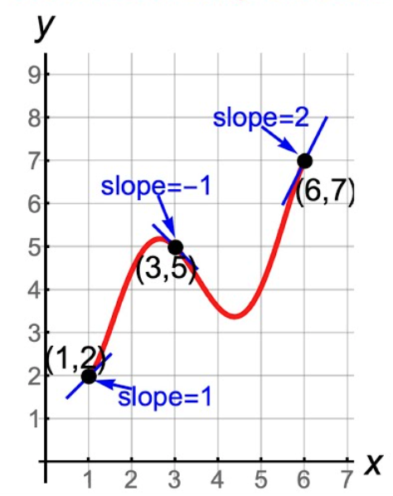
Advanced topics (further reading)
Gaussian process regression (Kriging)
Uses prior assumption on covariances
Provides a measure of uncertainty
Extendable to noisy data and multiple dimensions
Hermite interpolation
Interpolation of both the function values and derivative
Can be polynomial or splines
final project idea(?)
final project idea(?)

