Slide 1

Computational Physics (PHYS6350)
Lecture 8: Numerical Integration: Part 1
Basic methods for numerical integration (rectangle, trapezoid, Simpson)
Adaptive quadrature
Improper integrals
Instructor: Volodymyr Vovchenko (vvovchenko@uh.edu)
Course materials: https://github.com/vlvovch/PHYS6350-ComputationalPhysics
Online textbook: https://vovchenko.net/computational-physics/

Slide 2
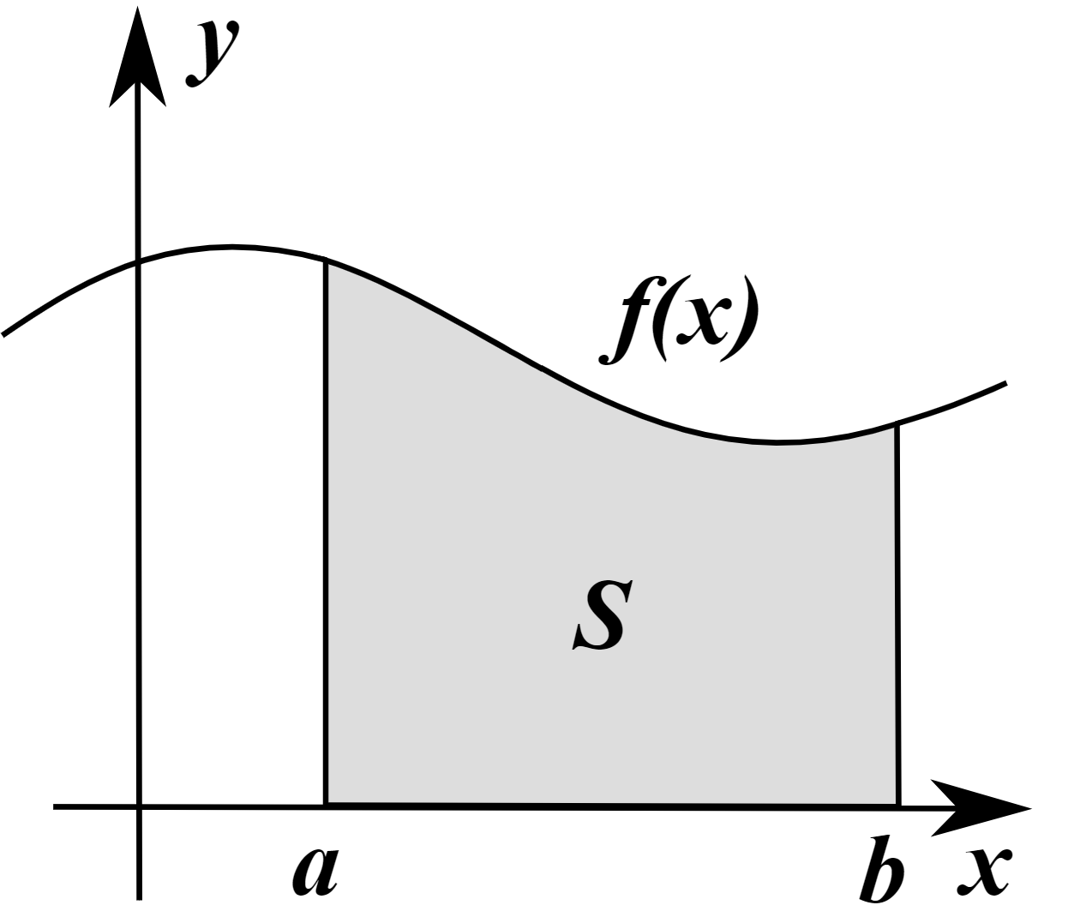
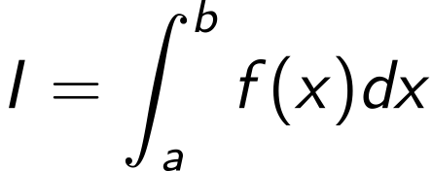
Numerical integration
Generic problem: evaluate
We need numerical integration when
Cannot/difficult integrate analytically
Only know the integrand f(x) at certain points
I
References:
Chapter 5 of Computational Physics by Mark Newman
Chapter 4 of Numerical Recipes Third Edition by W.H. Press et al.

Slide 3
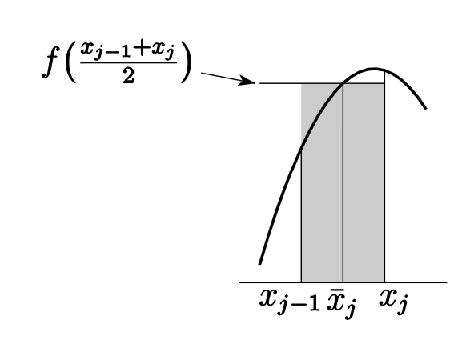
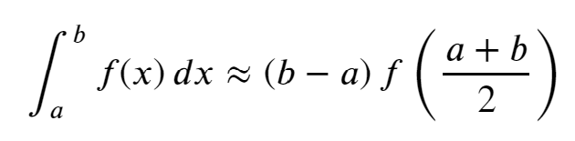
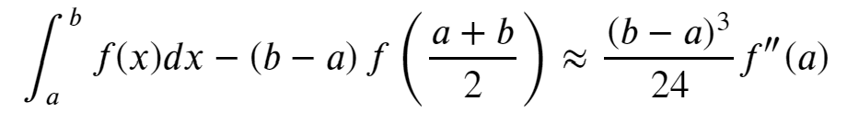
Numerical integration: rectangular (midpoint) rule
Interpret the integral as the area under the curve and approximate by a rectangle evaluated at midpoint
Error (from Euler-McLaurin formula):
The rule is exact for the integration of linear functions

Slide 4
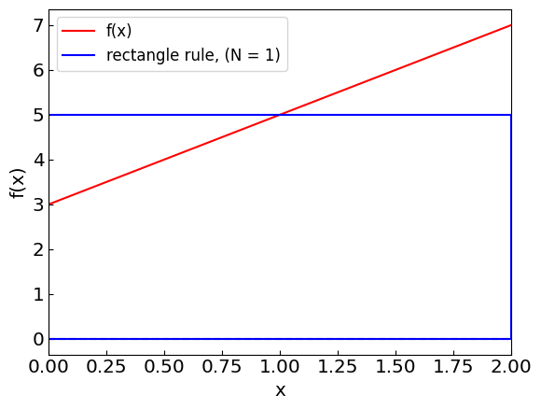
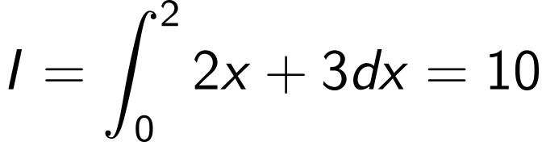
Numerical integration: rectangular (midpoint) rule
Example:
Although the rectangle is a poor approximate of the line (which is a trapezoid here), the errors cancel out

Slide 5
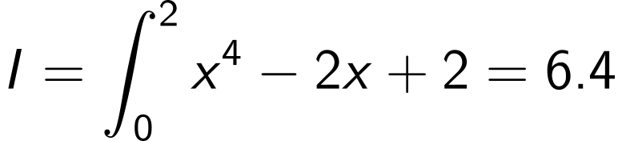
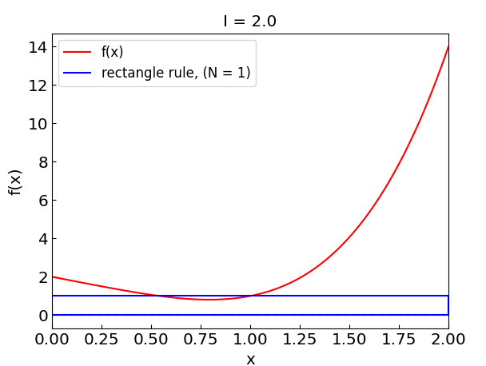
Numerical integration: rectangular (midpoint) rule
Another example:
Rectangle rule gives I_{rect} = 2 which is way off

Slide 6
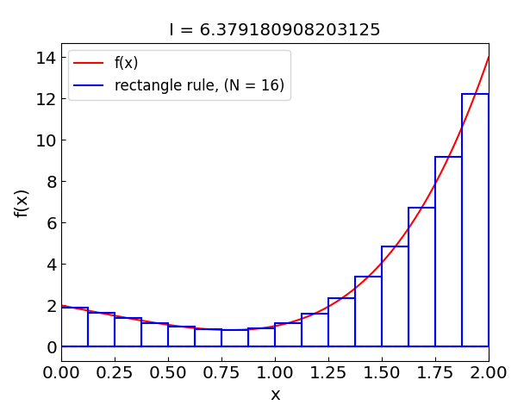
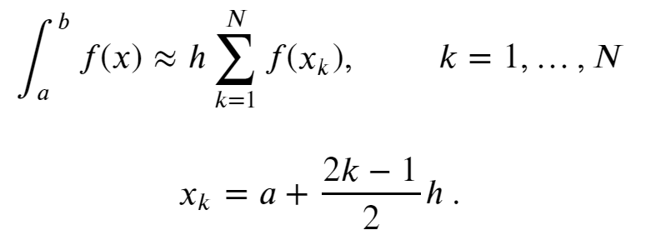

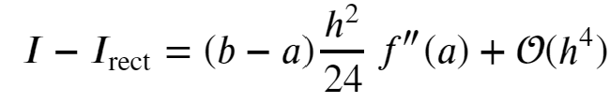
Extended (composite) rectangular rule
Split the integration interval into N sub-intervals and apply the rectangle rule separately to each one
Error estimate:

Slide 7
Extended (composite) rectangular rule

Slide 8
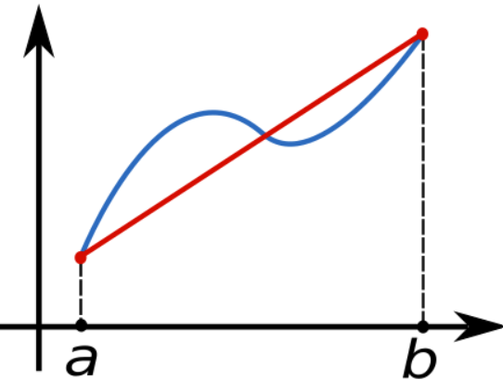
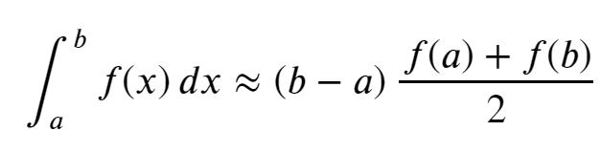
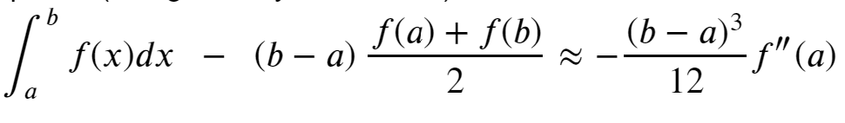
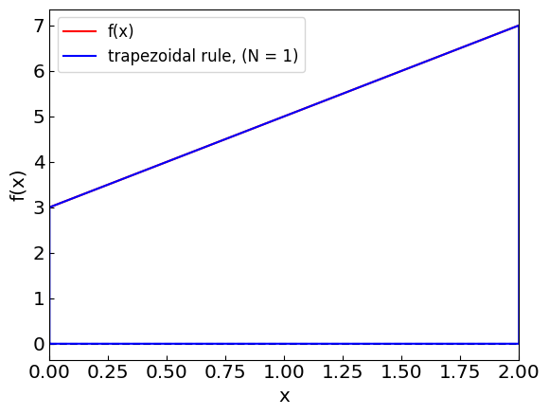
Numerical integration: trapezoidal rule
Approximate the integral by a trapezoid
Error:
The rule is exact for the integration of linear functions

Slide 9
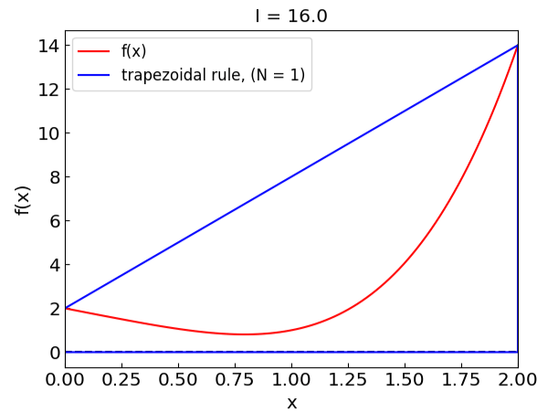
Numerical integration: trapezoidal rule
Trapezoidal rule gives I_{trap} = 16, way off and in the opposite direction relative to rectangle rule

Slide 10
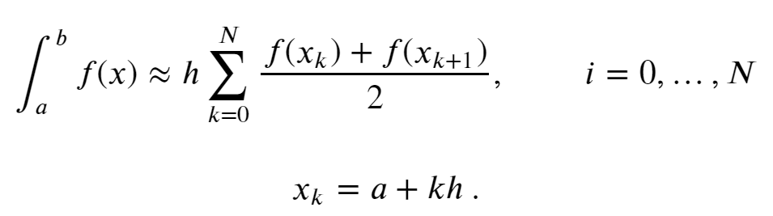
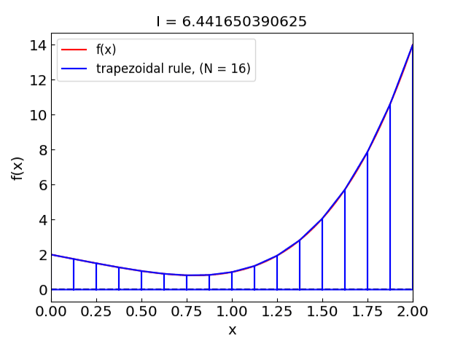
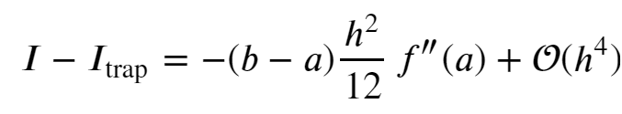
Extended trapezoidal rule
Error estimate:

Slide 11
Extended (composite) trapezoidal rule

Slide 12
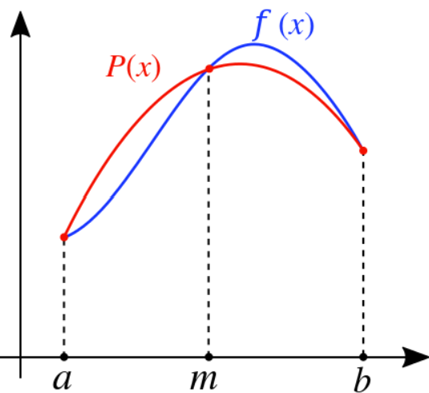
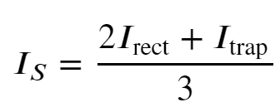
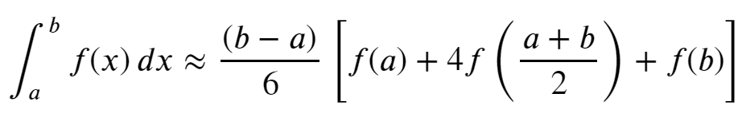
Numerical integration: Simpson’s rule
Recall the error estimates for rectangular and trapezoidal rules
Combine them to eliminate the O(h²) error term:
i.e.
Simpson’s rule
An equivalent way to obtain the rule: replace the integrand by the parabolic interpolation

Slide 13

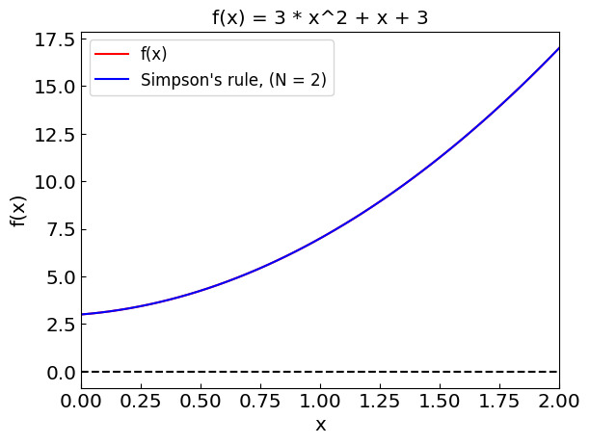
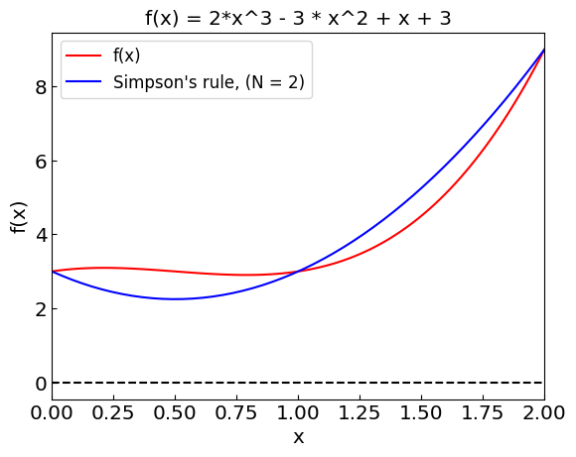
Numerical integration: Simpson’s rule
The error for the Simpson’s rule is
The method is exact for polynomials up to third order

Slide 14
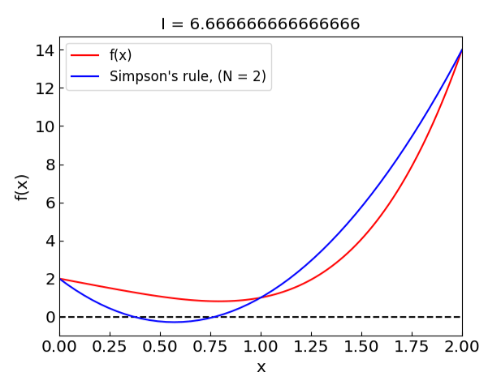
Numerical integration: Simpson’s rule
Simpson’s rule gives I_{trap} = 6.66 using three points, which is already not too bad!

Slide 15
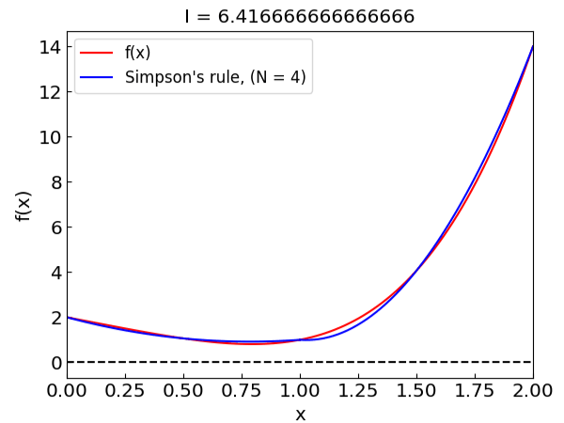
Extended Simpson’s rule
N must be even!
Error estimate:

Slide 16
Extended Simpson’s rule

Slide 17
Comparing the methods
Rectangle
Trapezoid
Simpson

Slide 18
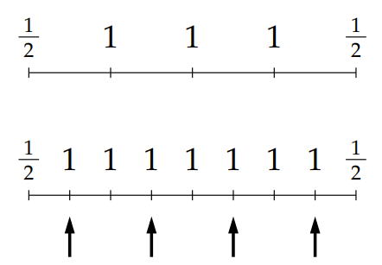


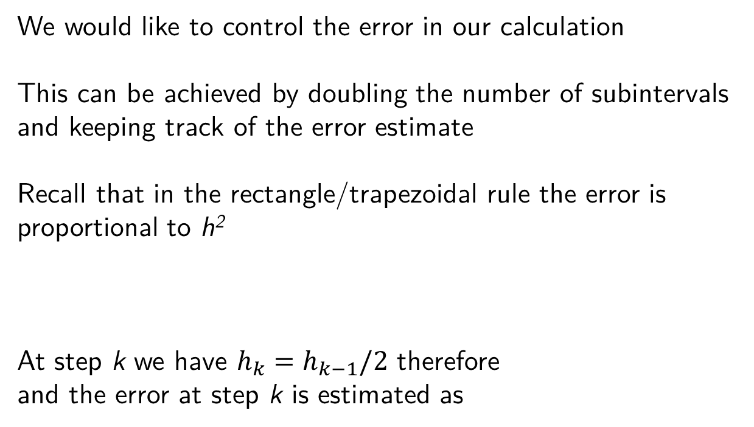
Adaptive quadrature
We would like to control the error in our calculation
This can be achieved by doubling the number of subintervals and keeping track of the error estimate
Recall that in the rectangle/trapezoidal rule the error is proportional to h²
At step k we have $h_{k}=h_{k−1}/2$ therefore
and the error at step k is estimated as

Slide 19
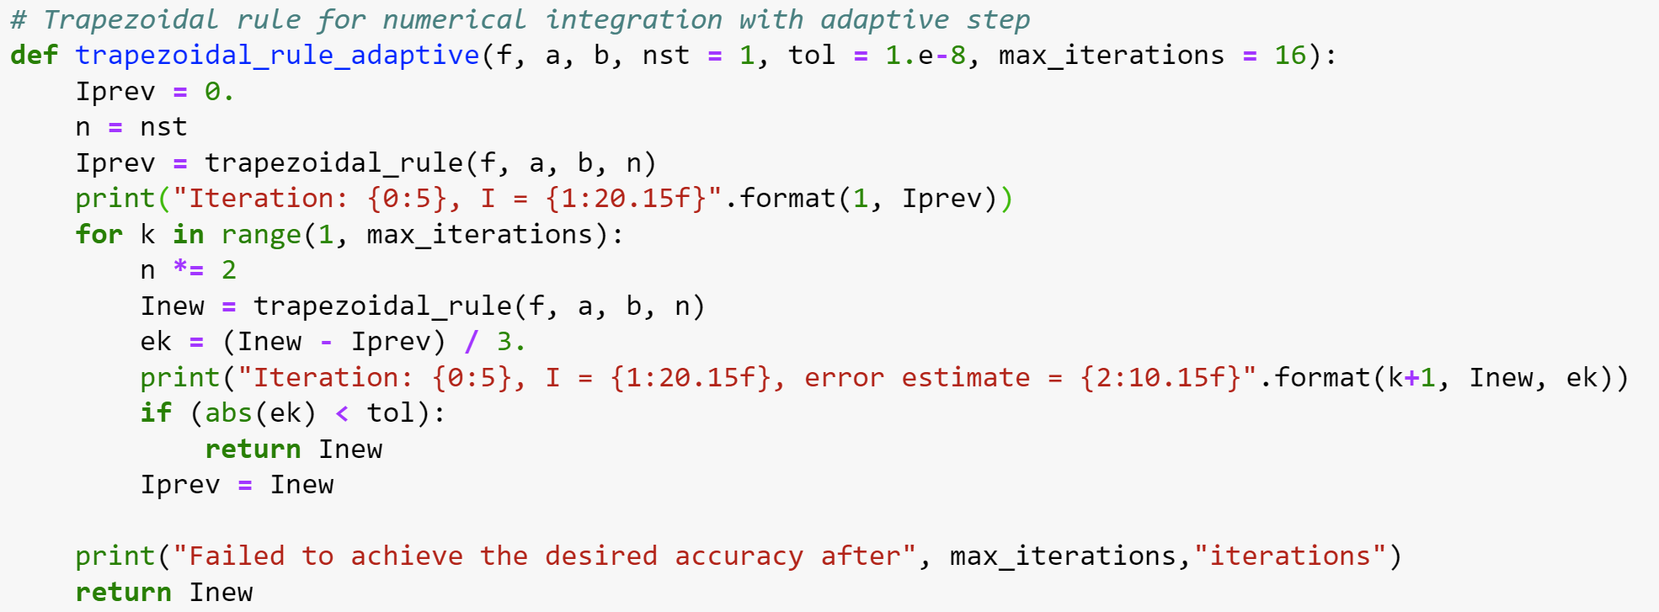
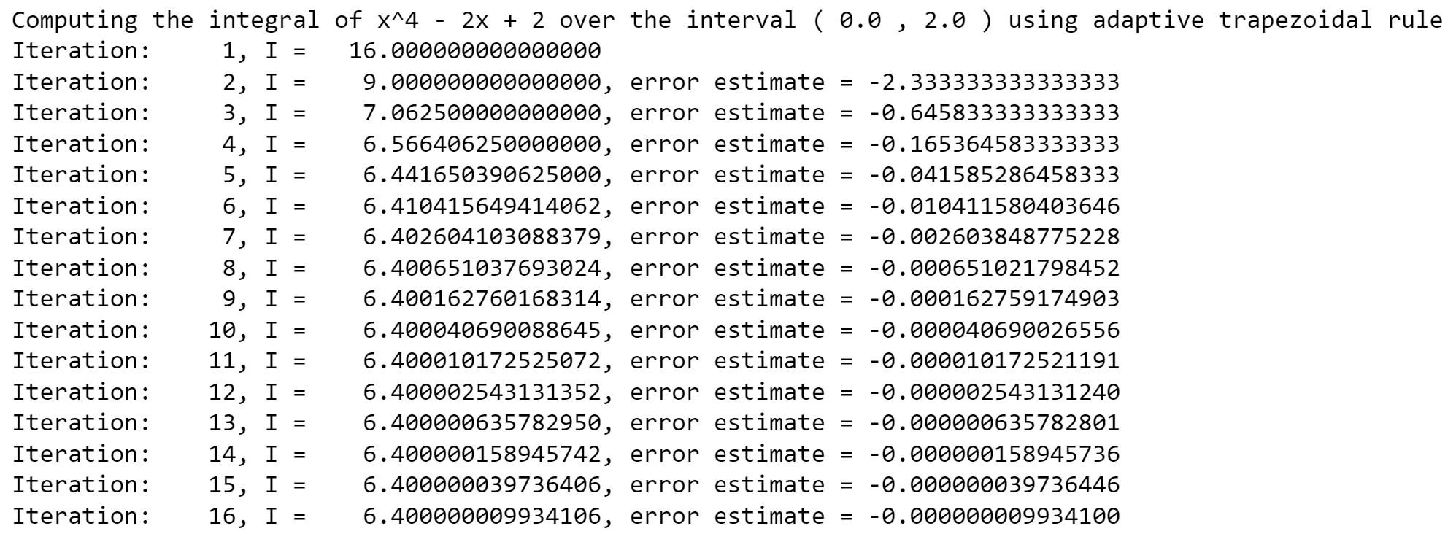
Adaptive trapezoidal rule

Slide 20

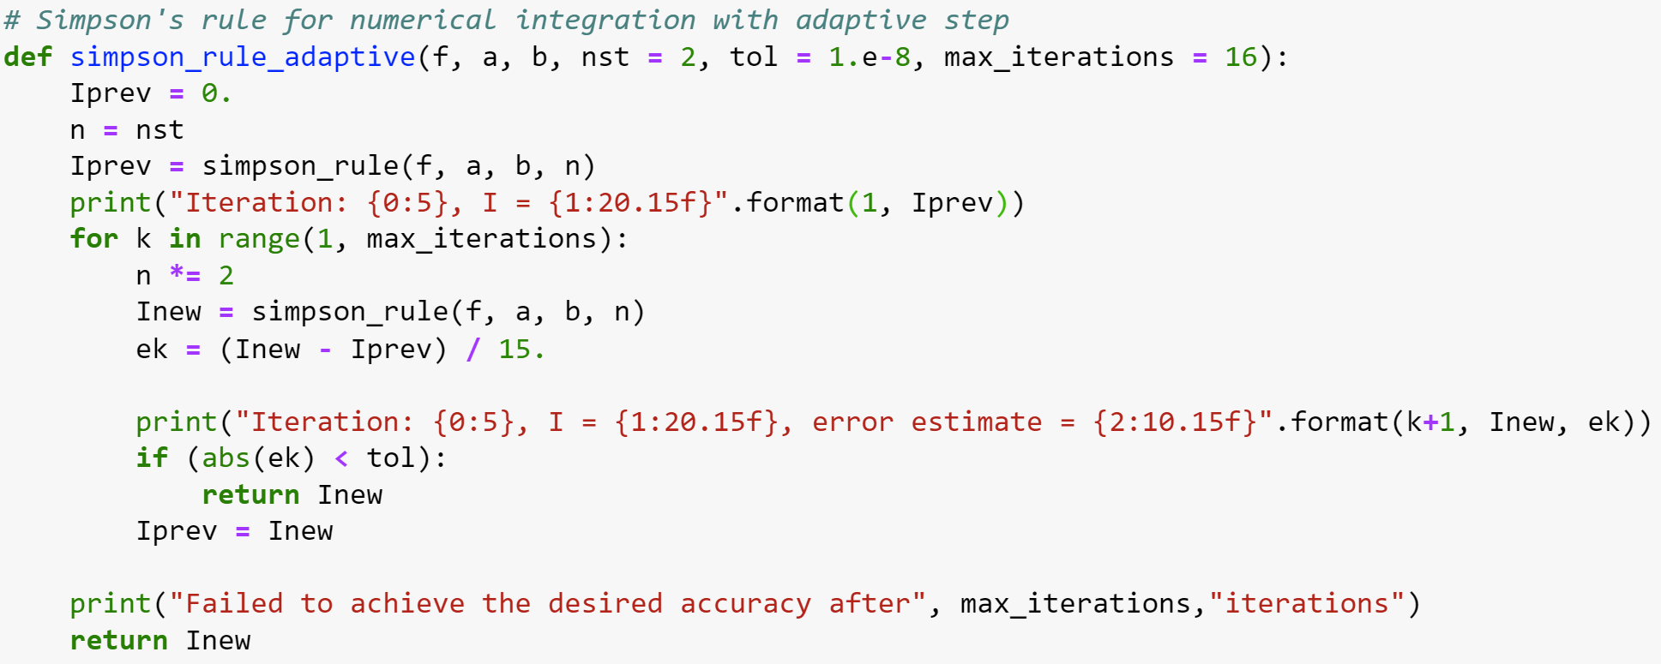
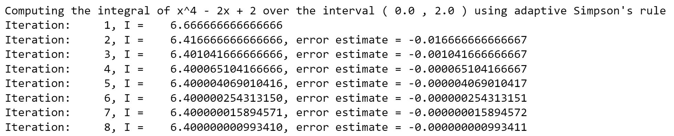
Adaptive Simpson rule
For Simpson’s rule
(understand why 15 and not 3?)

Slide 21

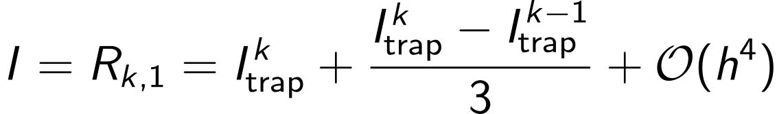
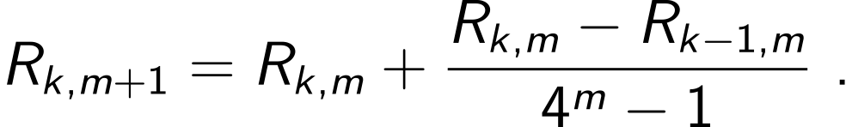
Adaptive quadratures: Romberg method
Recall that we obtained error estimate for trapezoidal method at step k
On the other hand, by definition,
Therefore, we can improve our estimate of the integral as
Romberg method: continue this procedure iteratively
until the desired accuracy is reached

Slide 22
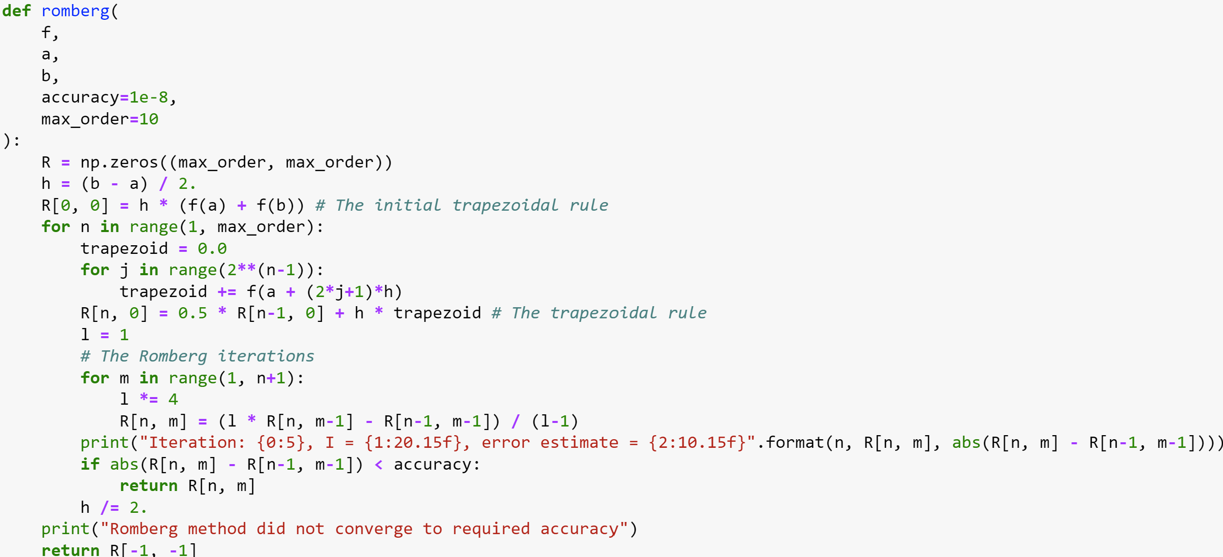
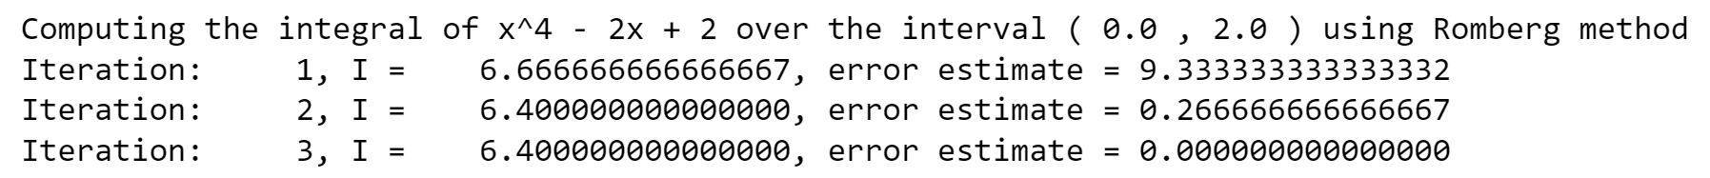
Romberg method

Slide 23
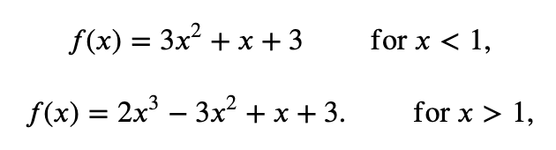
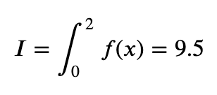
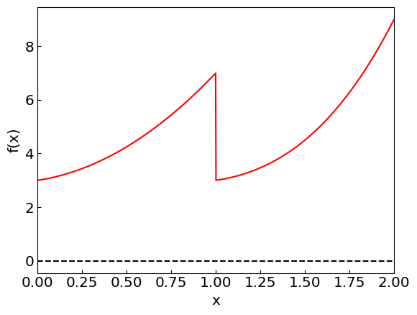
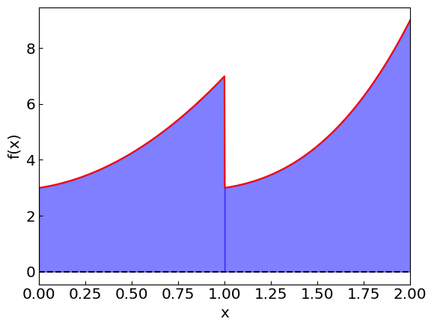
Discontinuous integrals
Nothing wrong with integrating discontinuous functions

Slide 24
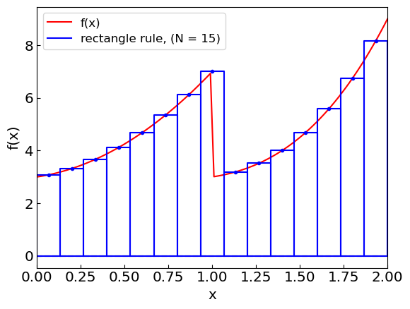
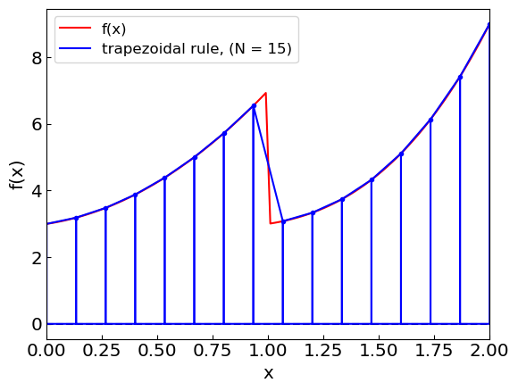
Discontinuous integrals

Slide 25
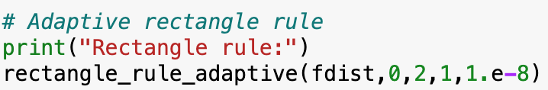
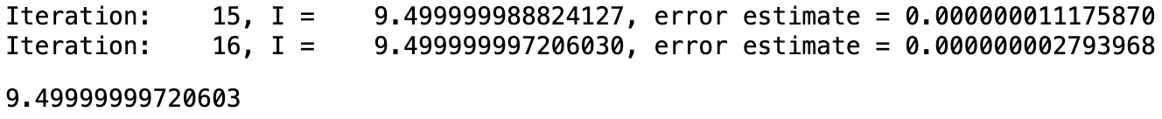
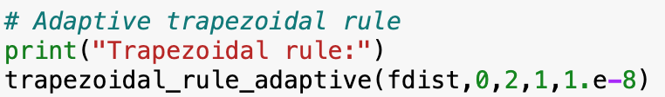
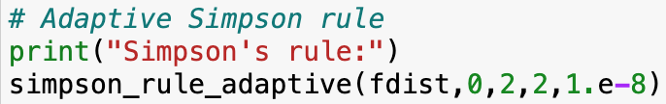
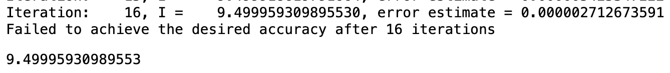
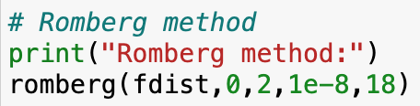
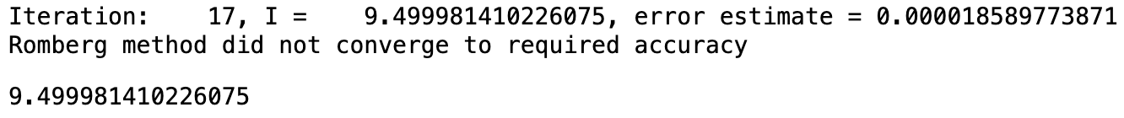
Discontinuous integrals
The methods kind of work but not quite

Slide 26







Discontinuous integrals
Better strategy: split the integral into two and integrate separately

Slide 27




Improper integrals
Contain integrable singularities (typically at the endpoints)
(Semi-)infinite integration range
Example: Momentum integration over thermal distributions (Fermi-Dirac/Bose-Einstein)

Slide 28

Improper integrals: Singularities at endpoints
Even though if the singularities at integration endpoints are integrable, the trapezoidal, Simpson, etc. methods will fail because they evaluate the integrand at the endpoints
Solution: use method that does use the endpoints (e.g. rectangle rule)

Slide 29


Improper integrals: Singularities at endpoints

Slide 30







Improper integrals: (Semi-)infinite intervals
Solution: map to a finite interval [e.g. (0,1)] by a change of variables
Semi-infinite:
$${(1−t)}^{2}$$
Infinite:
Then apply a standard method (e.g. rectangle rule to avoid endpoint singularities) to g(t)
NB: Other options for the change of variable are possible

Slide 31

Improper integrals: Semi-infinite intervals

Slide 32


Improper integrals: Infinite intervals

