Slide 1

Computational Physics (PHYS6350)
Special Lecture: Introduction to machine learning
Based on Google machine learning crash course
https://developers.google.com/machine-learning/crash-course
Instructors: Volodymyr Vovchenko (vvovchenko@uh.edu), Tripp Moss
Course materials: https://github.com/vlvovch/PHYS6350-ComputationalPhysics
Online textbook: https://vovchenko.net/computational-physics/

Slide 2
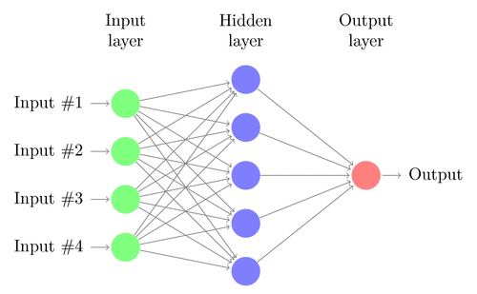
Key ML terminology
ML systems learn how to combine input to produce useful predictions on never-before-seen data
Features: input variables x
e.g. coordinates and momenta of particles
Labels: a thing we’re predicting, the y variable
e.g. the system temperature T
ML models: produce the mapping
x
y
x
y
Data:
Labeled: contains both the features and the label(s)
Unlabeled: contains only the features
Training – creating and learning the model, i.e. gradually learn the relationship between features and labels based on the labeled examples
Inference – applying the trained model to predict labels for unlabeled examples

Slide 3
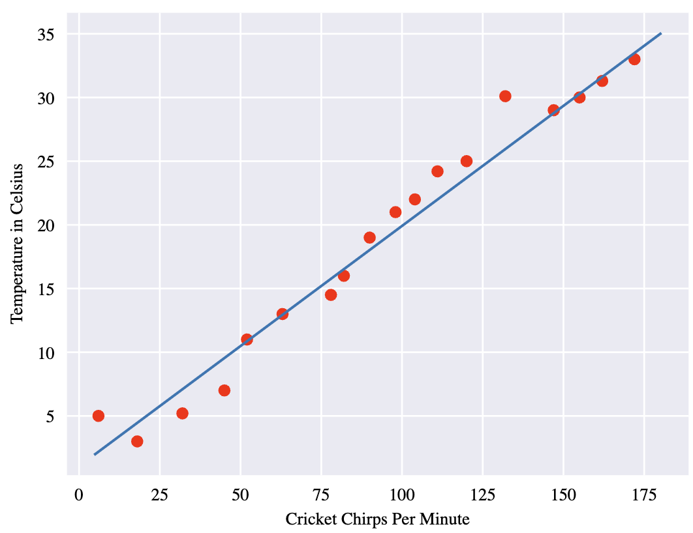


Linear regression
Regression: predict continuous values
Linear regression – linear relationship between features and labels
y’ – the predicted label
b – bias
w₁ – the weight of feature 1
x₁ – feature
If more than one feature

Slide 4
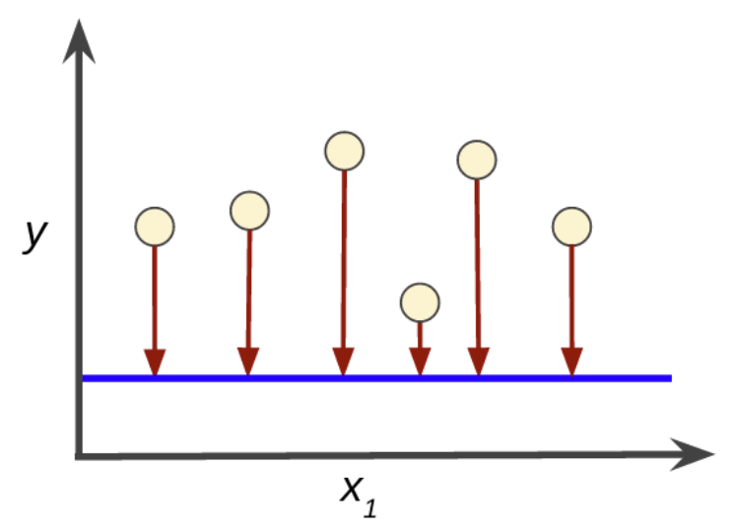
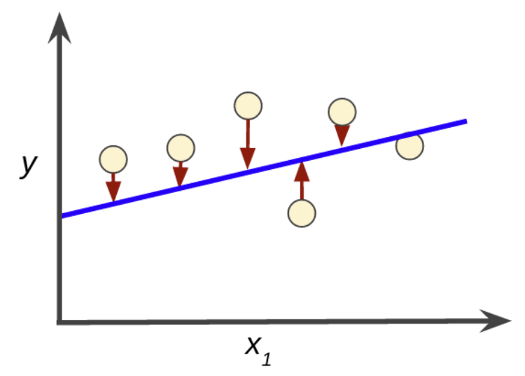
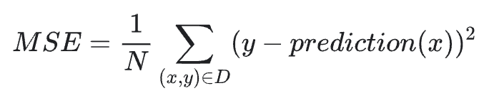
Training and loss
Training: learning good values for all the weights and bias from label examples
Training
Introduce loss function – a measure of how bad the model prediction is, and minimize it
Common choice is the mean squared loss (L₂ loss)
sum over labeled examples

Slide 5
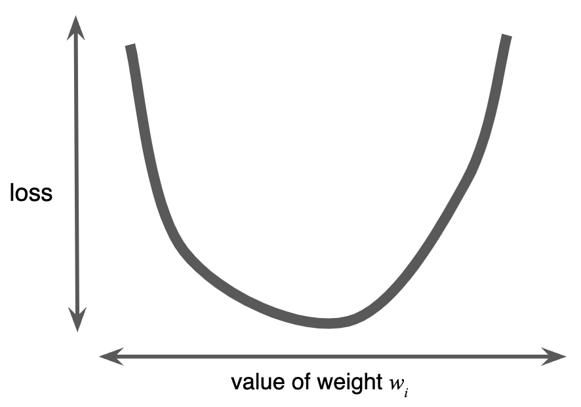
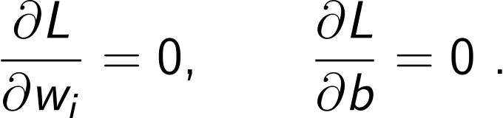
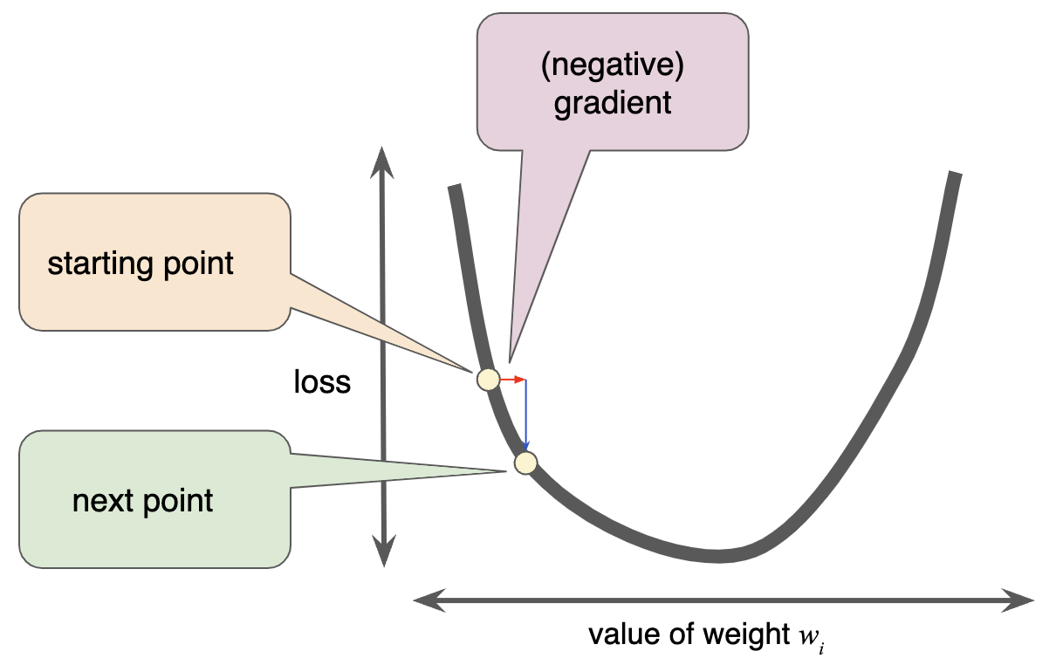
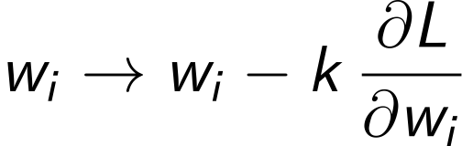
Minimizing loss
Find weights w_{i} and bias b that minimize the loss function over the dataset
In principle can be achieved by solving the equations
Issues:
Becomes challenging for non-linear problems
Does not scale well for large data sets and complex neural networks
Gradient descent: move the weights in the opposite direction of the gradient
k is learning rate

Slide 6
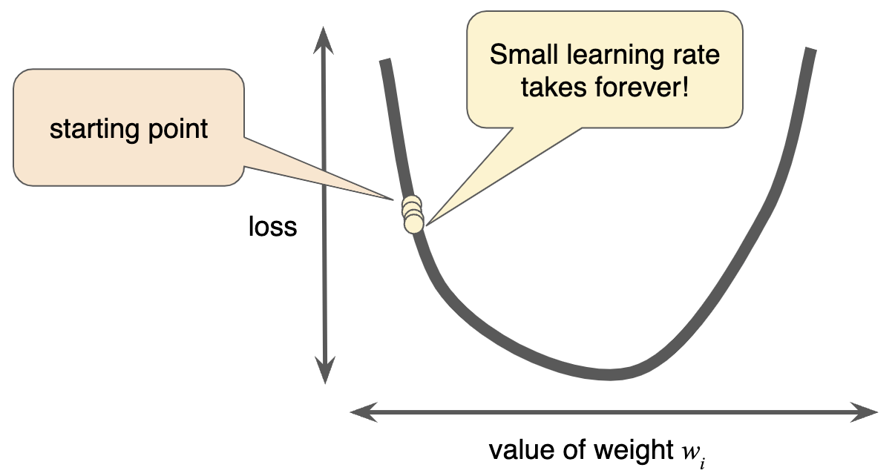
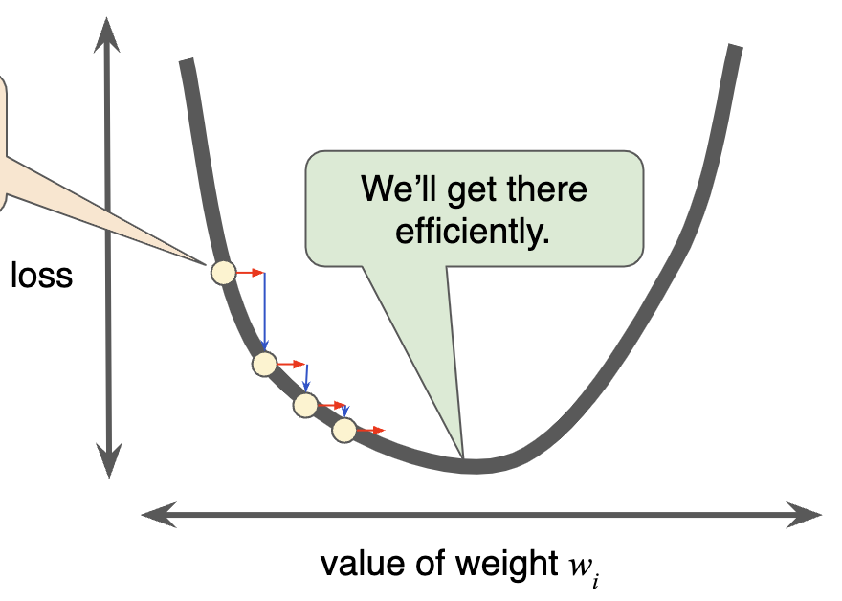
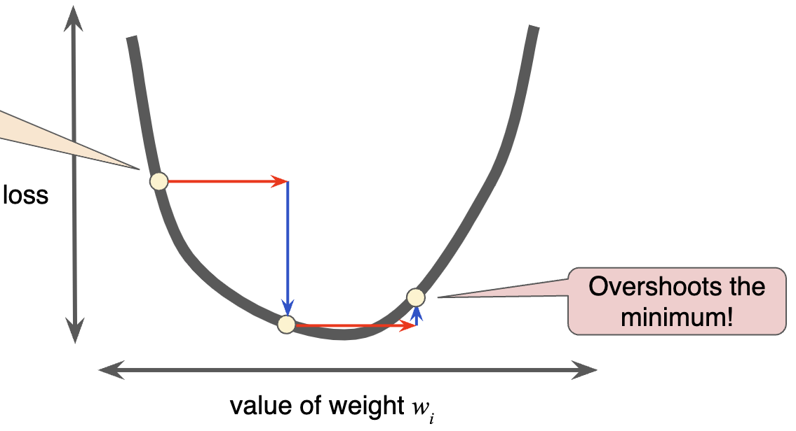
Minimizing loss: learning rate
Learning rate is a knob that should be tweaked for ML algorithm to be efficient
too small
just fine
too large
Theoretical optimal value: k = 1/(d²L/dw²) for 1d case or inverse Hessian (Jacobian) matrix for multi-dimensional
Equivalent to Newton’s method of solving the system of (non-)linear equations
Stochastic gradient descent: randomly pick a fraction (batch) of data to estimate the loss at each step

Slide 7
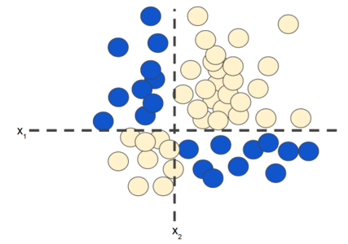
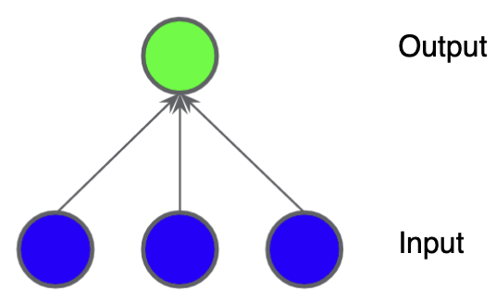
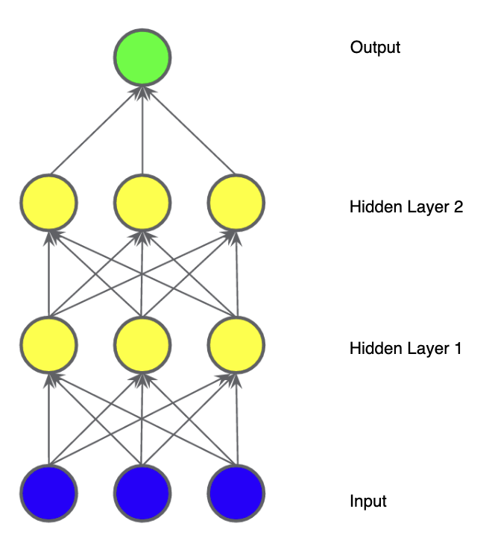
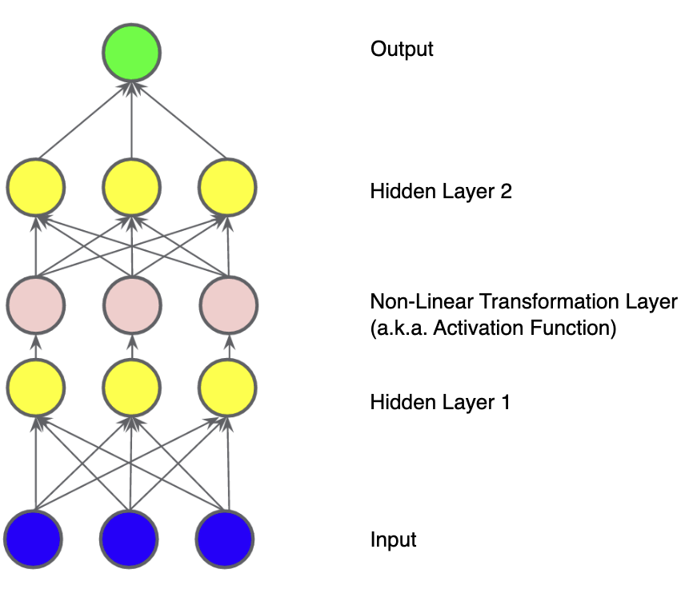
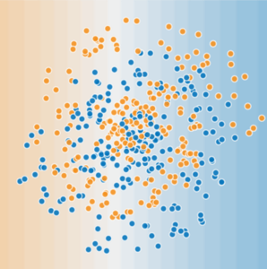
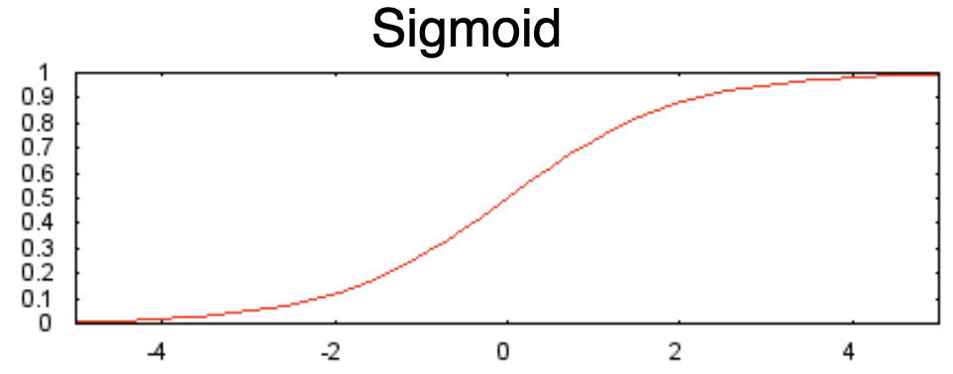
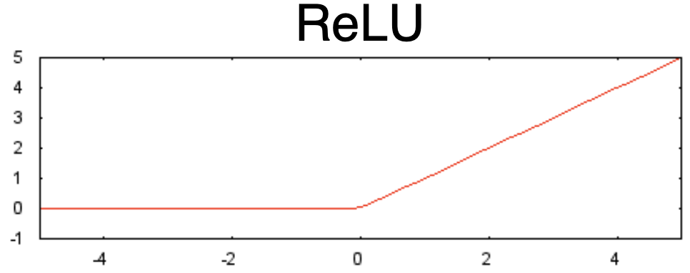
Neural networks and non-linear problems
So far we’ve dealt with linear regression problems
Non-linear problems
This can only get you so far. How to add non-linearity?
Linear
Still linear
Non-linear!
Non-linearity is achieved through adding activation functions at intermediate layers
Train weights through backpropagation (chain rule for the derivatives)

Slide 8
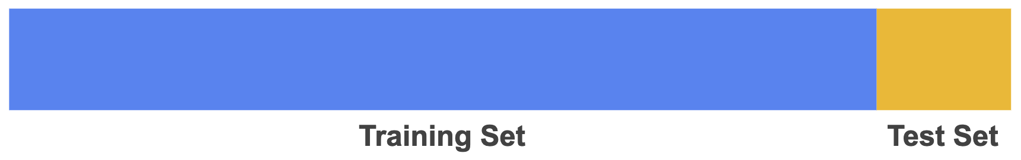
Training and Test Sets
The data (labeled examples) are typically split into training and test sets
Training set: Data used to train the model
Test set: Data not used for training but for validation of the model
Entries in training and test sets should be independent (no duplication) and statistically representative of the whole data
Some good practices:
Data sanitization (remove duplicates etc.)
Random shuffle of the order of the entries (in case they were originally sorted by some feature)
Normalization (features should all have similar scale, e.g. numbers between 0 and 1)

Slide 9
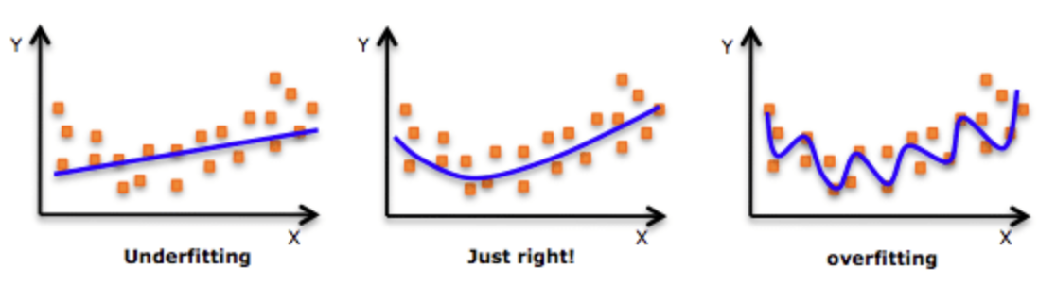
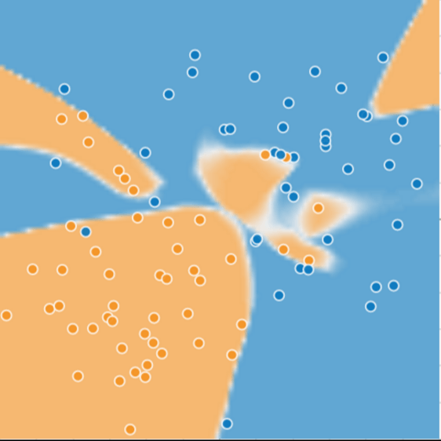
Overfitting
Overfitting is a common ML problem that occurs when a model is too complicated and overfits the peculiarities of the training set
Training set
Model is complex enough to give
a peculiar structure that models the training set well

Slide 10
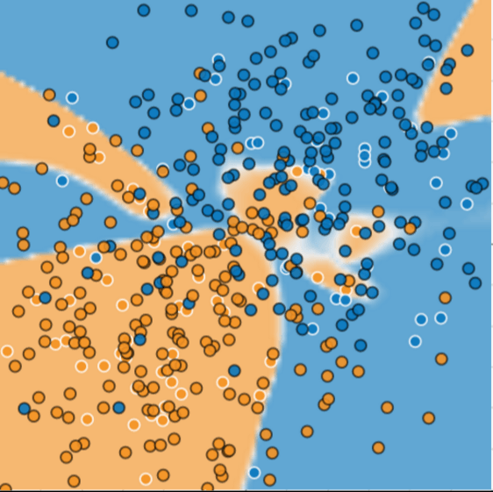
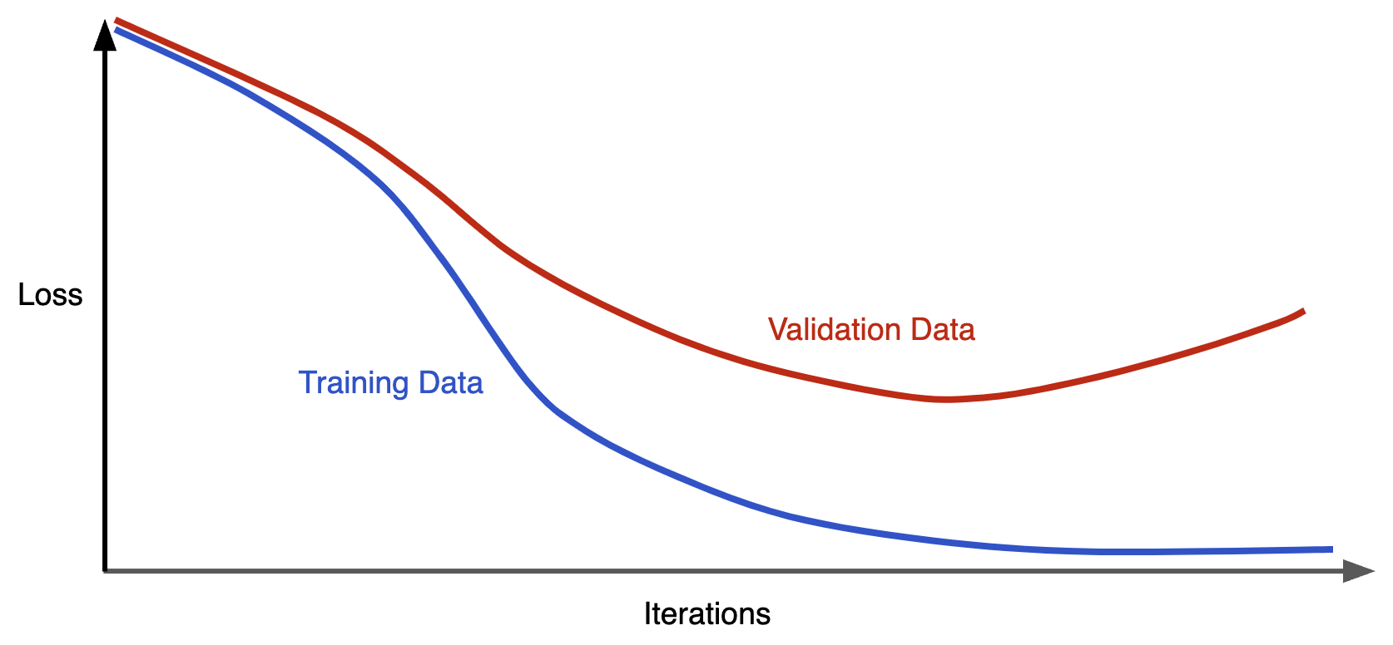
Overfitting
Overfitting is a common ML problem that occurs when a model is too complicated and overfits the peculiarities of the training set
Training set
Test set
Generalization curve
Model is complex enough to give
a peculiar structure that models the training set well
Bad performance on the test set

Slide 11


Avoid overfitting through regularization
Overfitting occurs once the model becomes too complex (too many weights)
Occam’s razor: search for the simplest possible explanation (applies here!)
Penalize complex models by introducing a complexity term
Instead of
do the minimization of the sum
$λ$ – regularization rate
One possible measure of complexity is L₂ regularization
Prefers models with smaller amount of non-zero weights: simpler models!

Slide 12
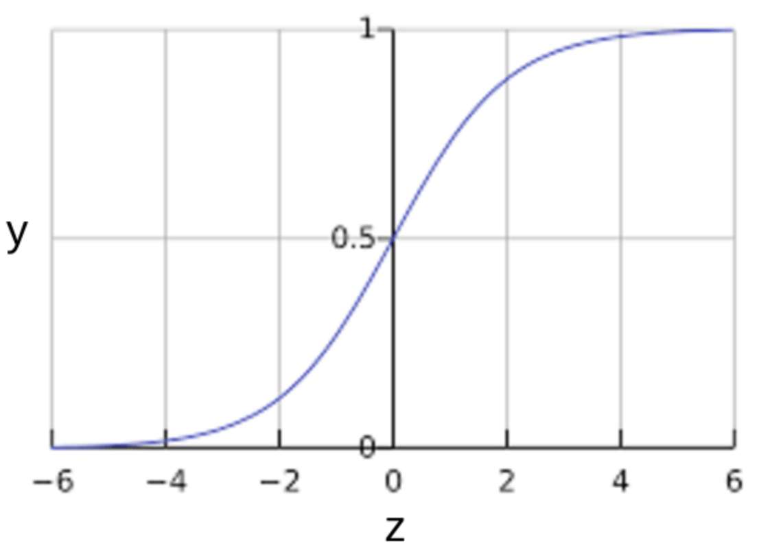
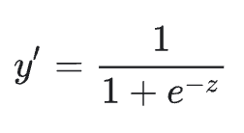
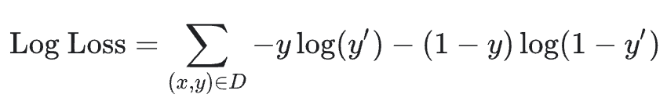
Logistic regression
Often we need the output to represent probability of some statement being true, e.g.
The given image represents a dog
The observed features of our system indicate that it is in a superconducting phase
The given proton-proton collision produced the Higgs boson
To obtain a probability output, apply the sigmoid function to the output z of the final layer
The loss function for logistic regression is log loss
y – training set label (always 0 or 1)
y’ – model prediction
Logistic regression models are prone to overfitting, thus regularization is important

Slide 13
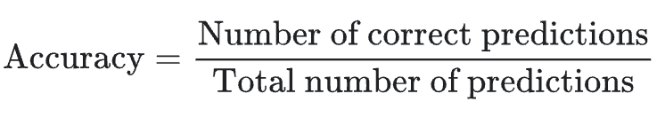
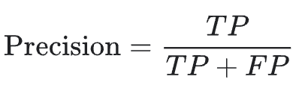
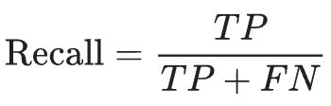
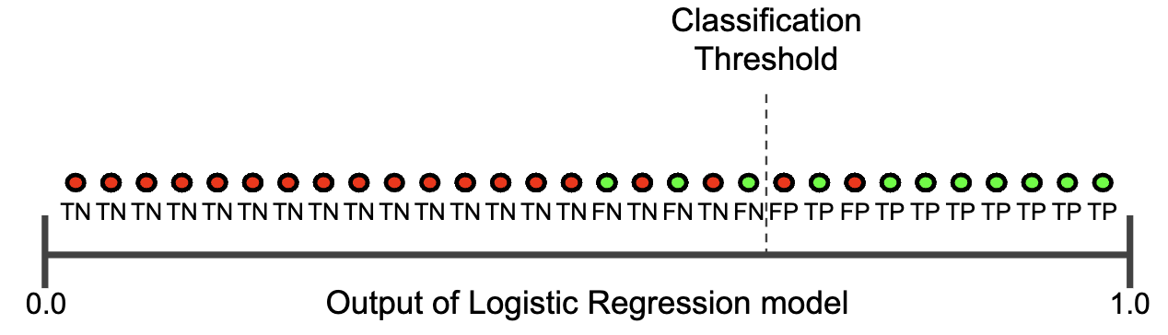
Classification
Logistic regression returns a probability.
One can use this probability to make a binary classification:
if probability is larger than classification threshold, assign 1, otherwise 0
Starting choice for classification threshold can be 0.5, but it is not necessarily the optimum one
Metrics:
High accuracy may not be enough, also precision and recall matter (e.g. in the case where true positives are very rare but important to identify)

Slide 14
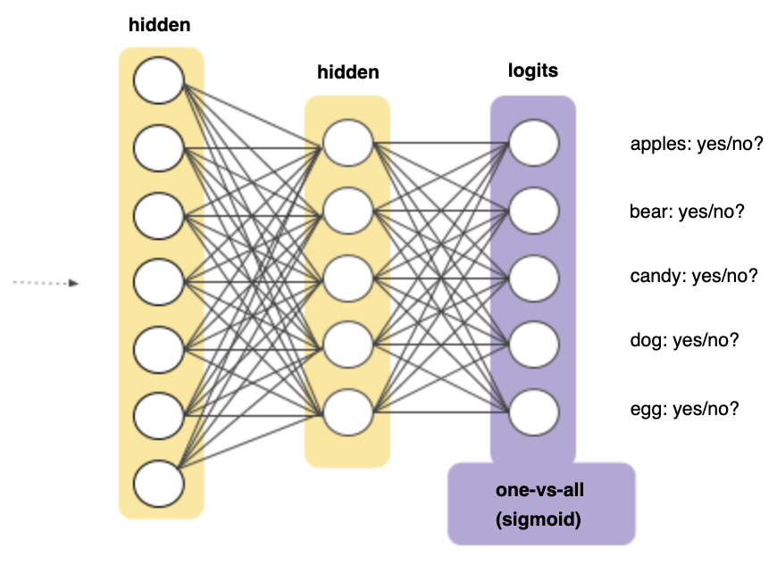
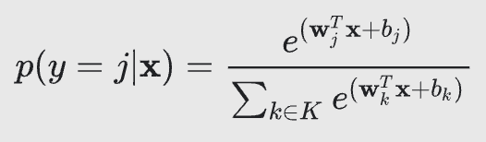
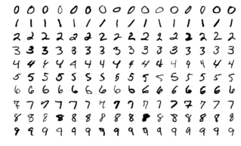
Multi-class classification
Sometimes we have to classify objects among multiple mutually exclusive classes.
Digits from 0 to 9
Animals
Etc.
Achieved through
Multiple output nodes (one per each class)
Probability through softmax equation
Classic example: MNIST problem (classification of hand-written digits)
Google Colab notebook

Slide 15
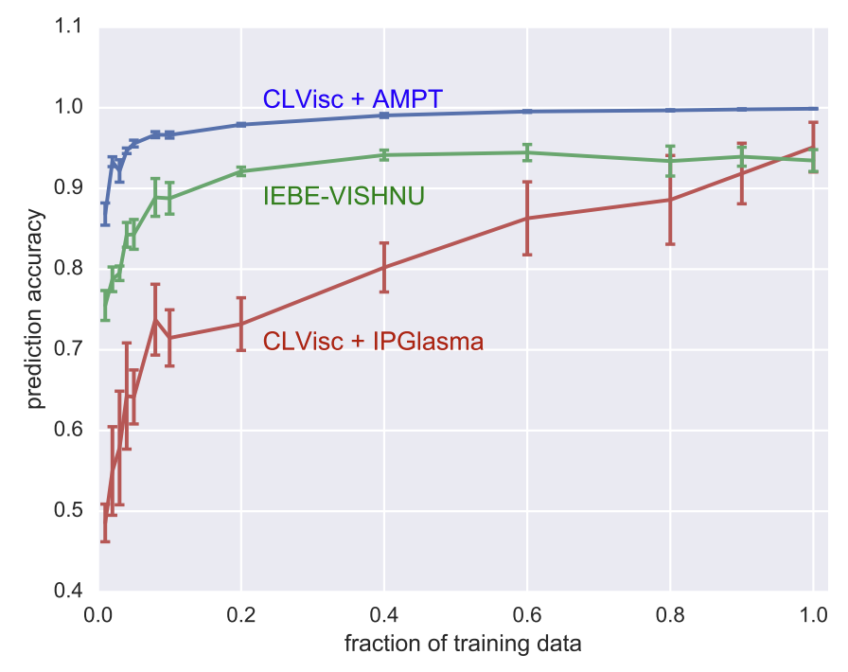
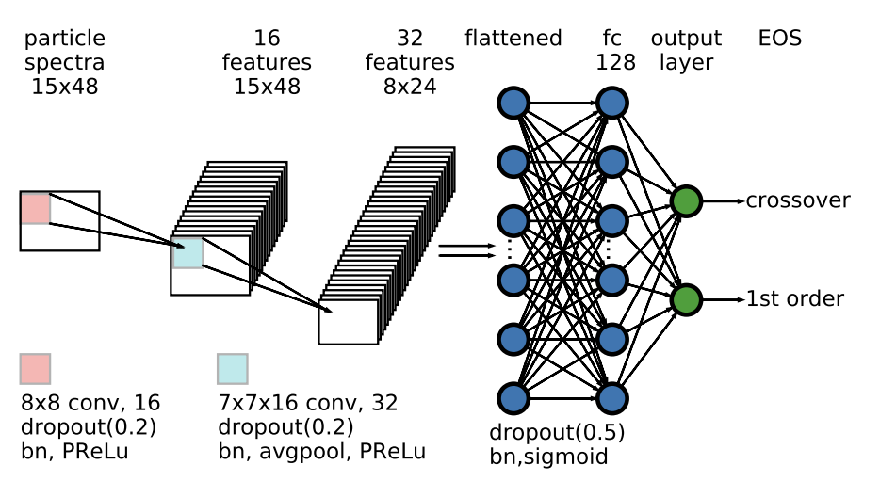
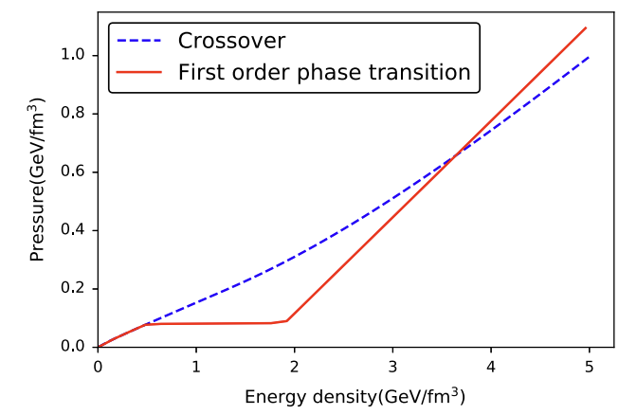
Example: Looking for the QCD phase transition
Open problem in QCD: is there a phase transition?
Models predict subtle differences in pion spectra in heavy-ion collisions
L.G. Pang, K. Zhou, N. Su, H. Petersen, H. Stoecker, X.-N. Wang, Nature Commun. 9, 210 (2018)
Neural network learns to identify the presence of phase transition in model studies
Plenty of other physics applications:
QFT properties from lattice configurations
Emulator of complex models/theories (e.g. hydrodynamics)
Multi-parameter estimation

