Slide 1

Computational Physics (PHYS6350)
Lecture 17: Random numbers
Reference: Chapter 10 of Computational Physics by Mark Newman
March 27, 2025
Instructor: Volodymyr Vovchenko (vvovchenko@uh.edu)
Course materials: https://github.com/vlvovch/PHYS6350-ComputationalPhysics/tree/spring2025

Slide 2
(Pseudo-)random numbers
Random numbers play important role, both in modelling of the physics processes (some of which are regarded as truly random, such as radioactive decay) and as a tool to tackle otherwise intractable problems.
Examples:
Numerical integration (especially in many dimensions)
Sampling microstates in statistical mechanics
Simulating quantum processes
Monte Carlo event generators
Numbers generated on a computer are usually not truly random, but a good generator produces numbers that reflect the desired properties of a random variable, hence it is called pseudo-random number generator.

Slide 3
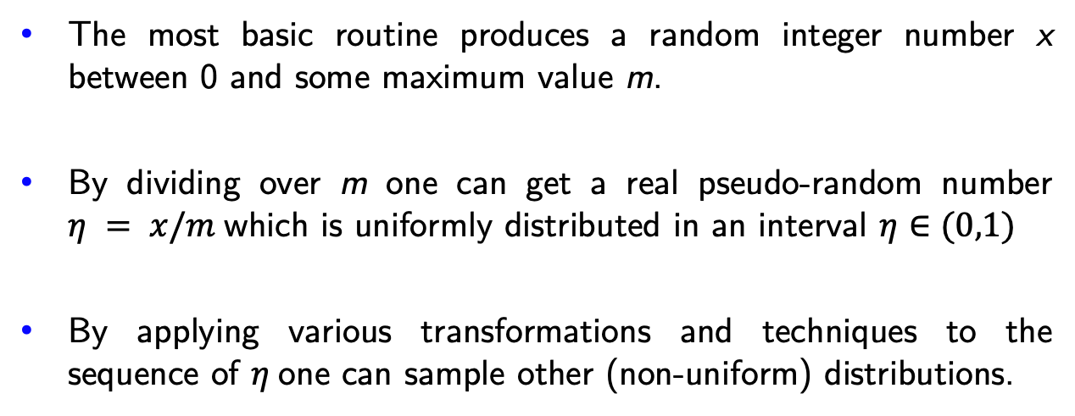
Pseudo-random numbers on a computer
The most basic routine produces a random integer number x between 0 and some maximum value m.
By dividing over m one can get a real pseudo-random number $η = x/m$which is uniformly distributed in an interval $η∈(0,1)$
By applying various transformations and techniques to the sequence of $η$one can sample other (non-uniform) distributions.
How to sample pseudo-random numbers x?

Slide 4

Linear congruential generator
Historically, one of the simplest RNG is linear congruential generator (LCG)*.
It generates a sequence of pseudo-random numbers in accordance with an iterative procedure
$$x_{n+1}=\left(ax_{n}+c\right) mod m$$
for some parameters a, m, x₀.
The next number in a sequence depends only on the present one.
The sequence is periodic with a period of at most m
*Do not use LCG in any serious calculation(!)
C++:
avoid using rand()

Slide 5
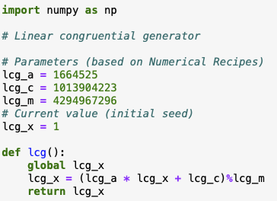
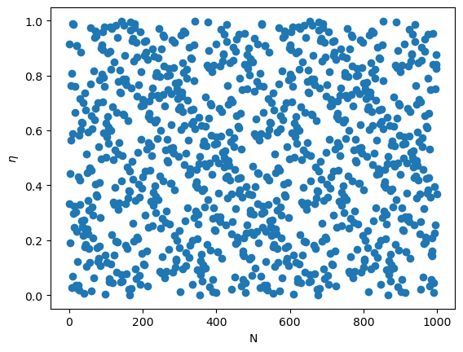
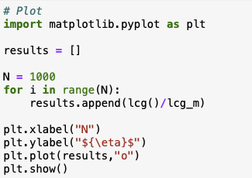
Linear congruential generator: Example

Slide 6
Linear congruential generator
LCG has some serious drawbacks:
Apart from a rather short period, it also fails many statistical randomness tests.
For instance, if one regards random numbers as components of a vector (x,y,…), the method tends to generate these points on a hyperplane (spectral test).

Slide 7
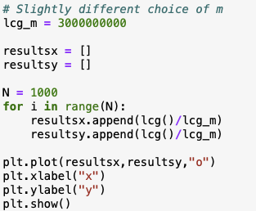
Linear congruential generator
LCG has some serious drawbacks:
Apart from a rather short period, it also fails many statistical randomness tests.
For instance, if one regards random numbers as components of a vector (x,y,…), the method tends to generate these points on a hyperplane (spectral test).

Slide 8
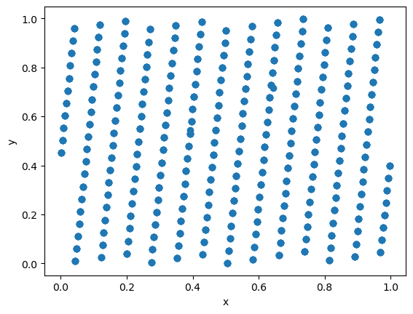
Linear congruential generator
LCG has some serious drawbacks:
Apart from a rather short period, it also fails many statistical randomness tests.
For instance, if one regards random numbers as components of a vector (x,y,…), the method tends to generate these points on a hyperplane (spectral test).

Slide 9
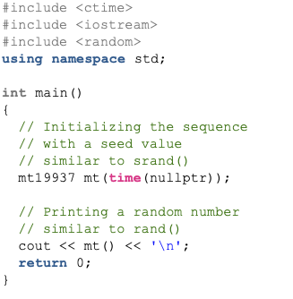

Mersenne Twister
LCG is not and should not be used in any serious calculations.
Other methods have been developed over the years and the general method of choice is Mersenne Twister random number generator which is implemented by default in many programming environments.
MT has a long period of 2¹⁹⁹³⁷ - 1, passes most statistical randomness tests, fast, and suitable for most physical applications (except cryptography).
It now implemented by default in many languages and we will take it for granted.
Python:
C++ (since C++11):

Slide 10
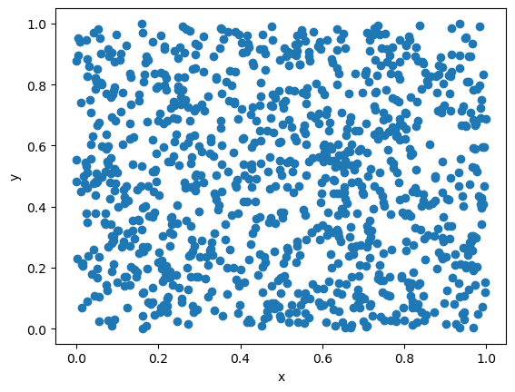
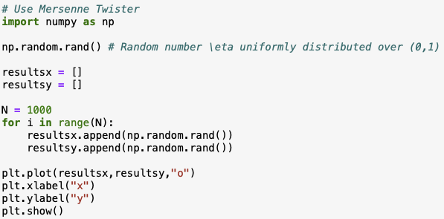
Mersenne Twister

Slide 11
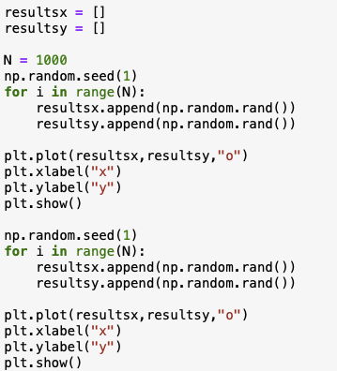
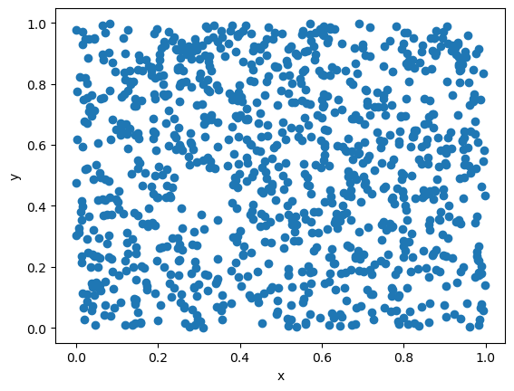

Random seed
Most RNGs (like LCG, Mersenne Twister,…) maintain state variables and
iteratively generate a pre-determined sequence of (pseudo)-random numbers
The initial state can be changed by specifying the seed
Running the program from the same seed will generate identical outcome
Using the same seed is good for debugging… but bad for parallel production runs on a cluster

Slide 12


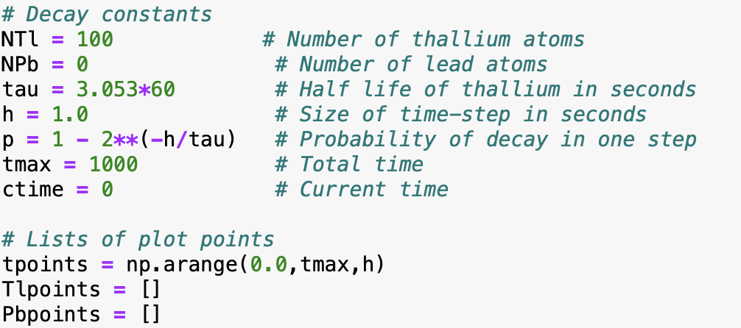
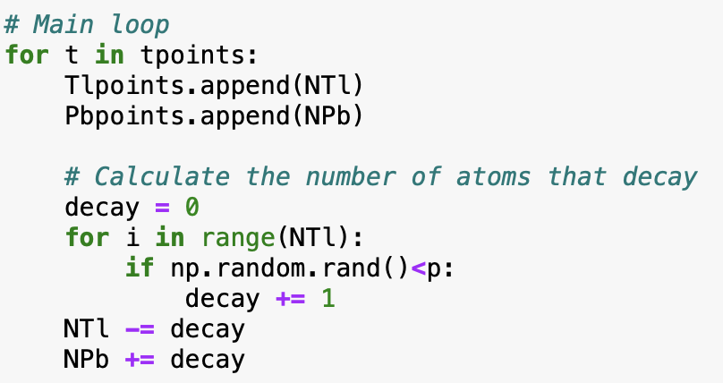
Simulation example: Radioactive decay
Example 10.1 from M. Newman, Computational Physics
Some physical processes are truly random (recall quantum mechanics), for instance radioactive decay
The number of radioactive isotopes with a half-life of $τ$ evolves as
therefore, the probability for a single atom to decay over the time interval t is
Let us simulate the time evolution for a sample of thallium atoms decaying (half-life of $τ$= 3.053 mins) into lead atoms.

Slide 13
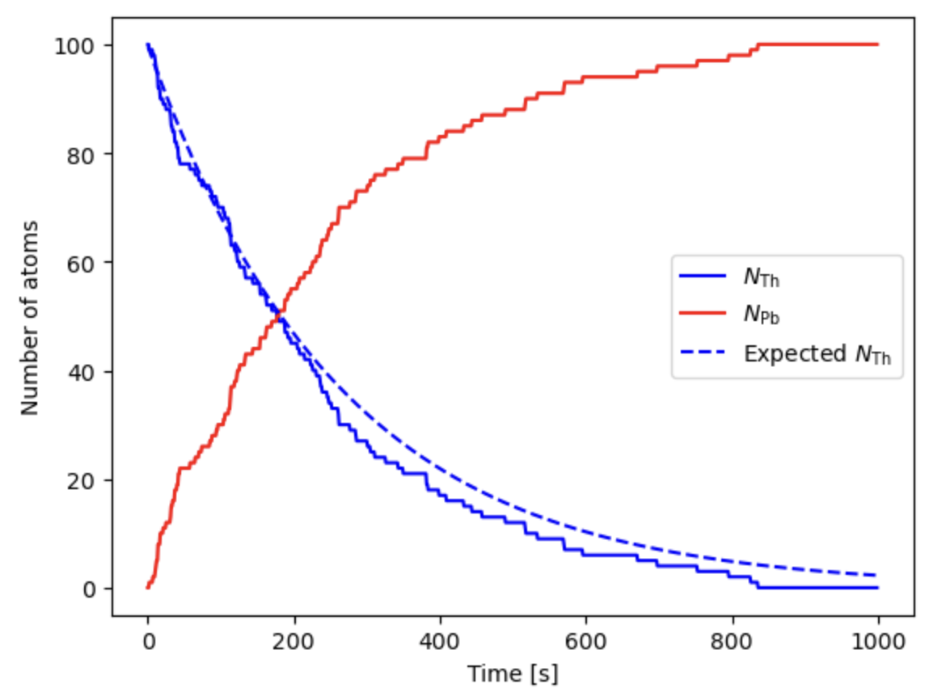
Simulation example: Radioactive decay
Expected:

Slide 14
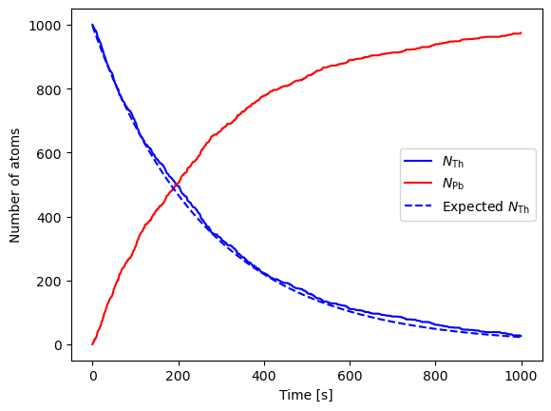
Simulation example: Radioactive decay
Expected:

Slide 15
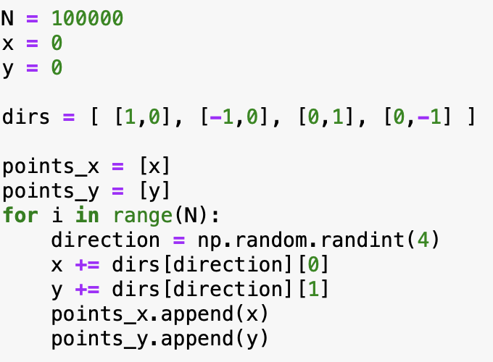
Simulation example: Brownian motion
Brownian motion is a motion of a heavy particle in a gas colliding with the lighter gas particles.
We can consider a simplified 2D motion of particle by randomly making
a small step at each iteration in one of the four directions.

Slide 16
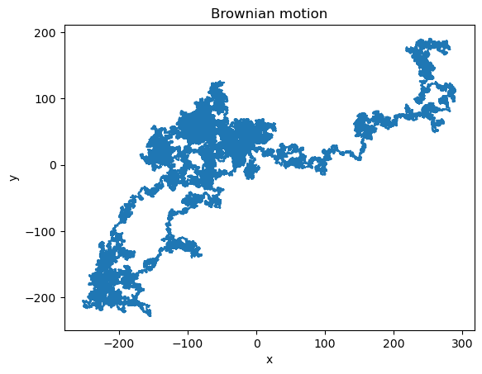
Simulation example: Brownian motion
Brownian motion is a motion of a heavy particle in a gas colliding with the lighter gas particles.
We can consider a simplified 2D motion of particle by randomly making
a small step at each iteration in one of the four directions.

Slide 17
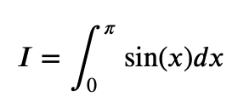
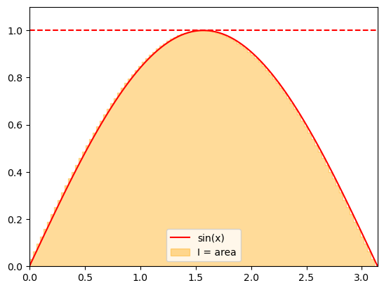
Computing integrals: Estimating the area under the curve
Recall the interpretation of a definite integral as the area under the curve.
We can use this interpretation to apply random numbers for approximating integrals.
Consider

Slide 18
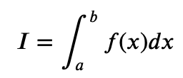

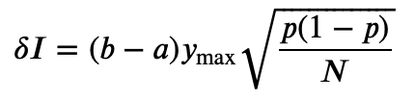
Computing integrals: Estimating the area under the curve
We can estimate the area by sampling the points uniformly from an enveloping rectangle and counting the
fraction of points under the curve given by the integrand f(x).
Assuming an integral
where f(x) > 0 and f(x) < y_{max}, the integrand can be evaluated as
where C is the number of the sampled points that fall under f(x).
The statistical error of the integrand can be estimated using the properties of the binomial distribution
with p = C/N:
The error scales with N^{-1/2}
To reduce the error by factor x2 we need to sample x4 more numbers – true for most Monte Carlo methods.

Slide 19
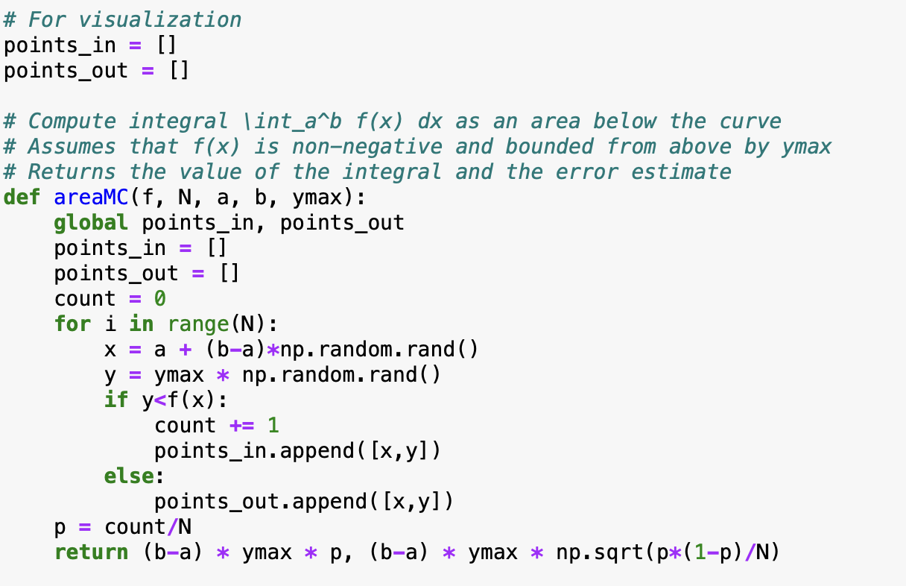
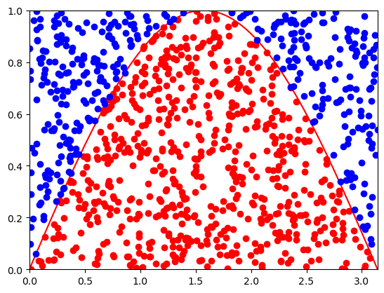
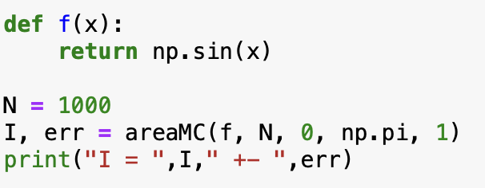
Computing integrals: Estimating the area under the curve

Slide 20
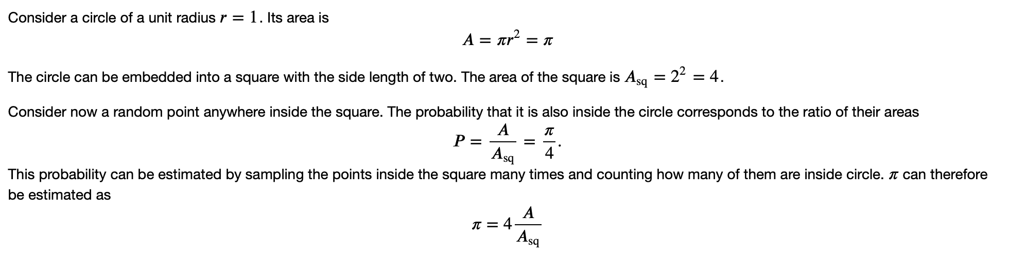
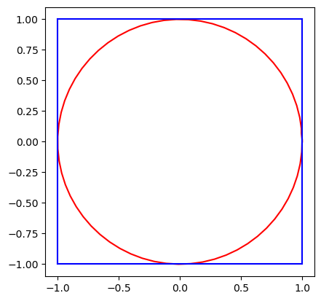
Computing pi

Slide 21


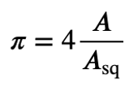

Computing $π$
Consider a circle of unit radius r = 1. Its area is:
The circle can be embedded into a square with a side length of two. The area of the square is: A_{sq} = 2² = 4
Consider now a random point anywhere inside the square. The probability that it is also inside the circle is the ratio of their areas:
This probability can be estimated by sampling points inside the square many times and counting how many fall inside the circle. $π$ can therefore be estimated as:

Slide 22
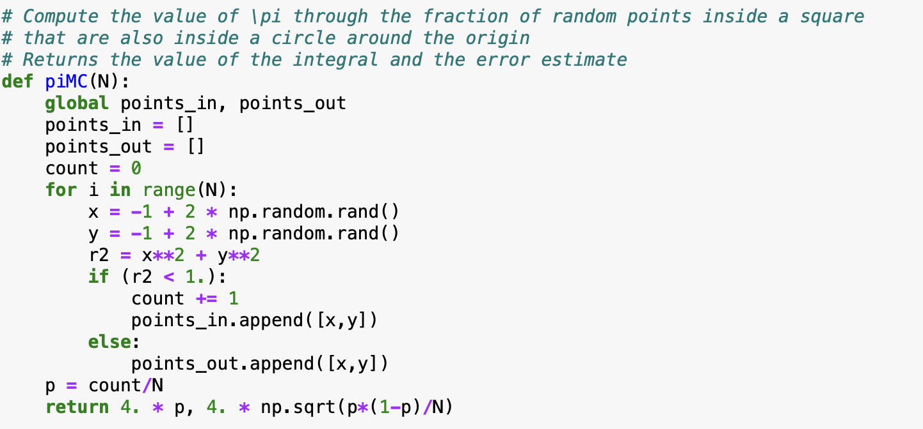
Computing $π$
Consider a circle of unit radius r = 1. Its area is:
The circle can be embedded into a square with a side length of two. The area of the square is: A_{sq} = 2² = 4
Consider now a random point anywhere inside the square. The probability that it is also inside the circle is the ratio of their areas:
This probability can be estimated by sampling points inside the square many times and counting how many fall inside the circle. $π$ can therefore be estimated as:
This method is known as the Monte Carlo estimation of π.

Slide 23
Computing pi

Slide 24
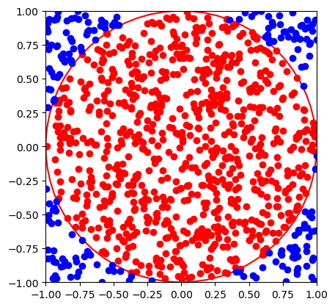
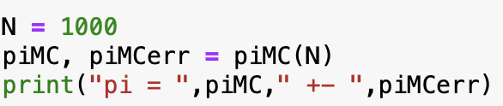
Computing pi
Try a larger number of points

Slide 25
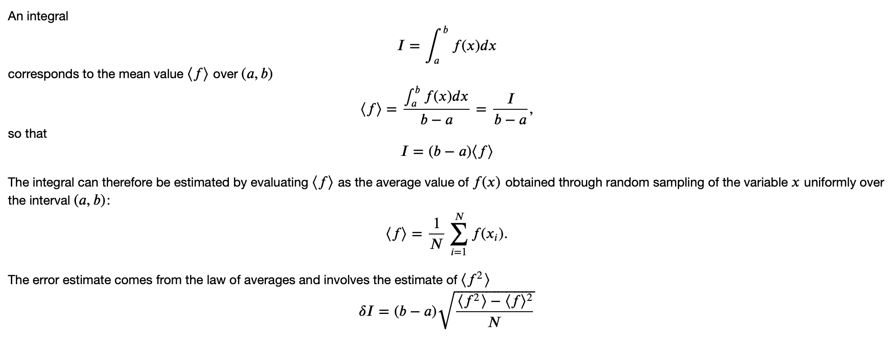
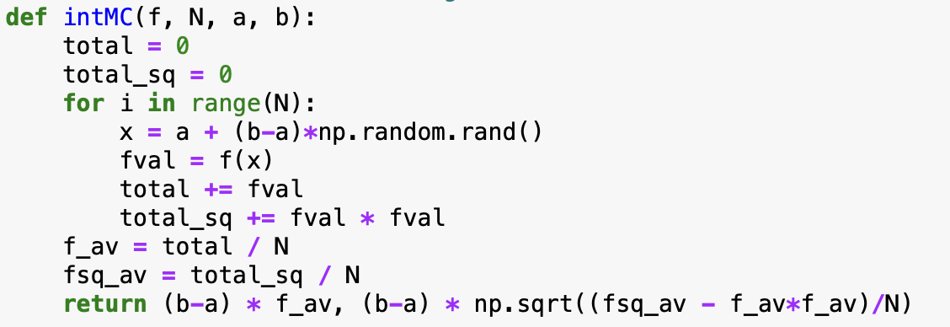
Computing integral as the average

Slide 26
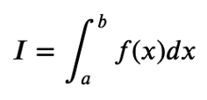
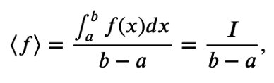

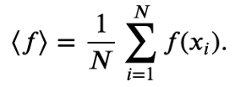

Computing integral as the average
The integral of a function over an interval (a, b) is given by:
The mean value of f(x) over (a, b) is:
which gives:
The integral can be estimated by computing the average value of f(x), where x is randomly sampled over (a, b):
Using the law of averages, the error estimate involves the variance of f(x):

Slide 27
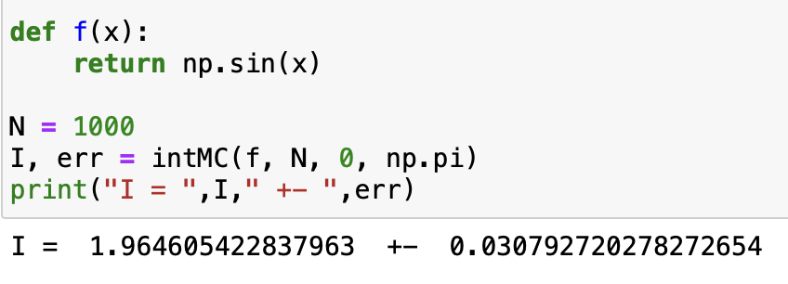
Computing integral as the average
Advantages:
the method works also if f(x) is negative
no need to know its maximum value

Slide 28
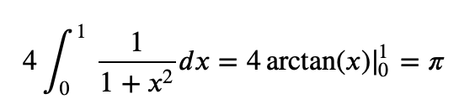
Another way to compute pi
Consider an integral

Slide 29
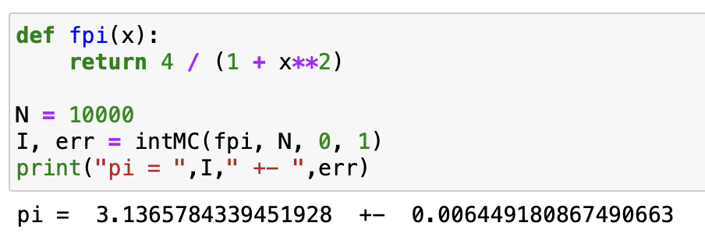
Another way to compute pi
Consider an integral

Slide 30
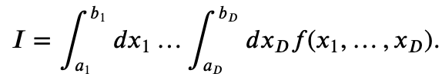
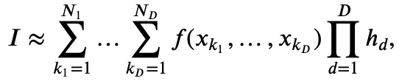

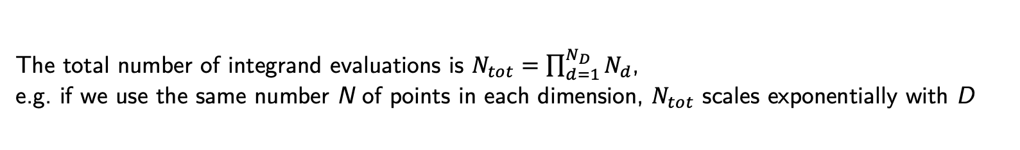
Computing multi-dimensional integrals
Monte Carlo methods really shine when it comes to numerical evaluation of integrals in multiple dimensions.
Consider the following D-dimensional integral
Computing it numerically using for instance the rectangle rule would involve the evaluation of a multi-dimensional sum
where
The total number of integrand evaluations is $N_{tot}=\prod_{d=1}^{N_{D}}{N_{d}}$,
e.g. if we use the same number N of points in each dimension, $N_{tot}$ scales exponentially with D
curse of dimensionality

Slide 31
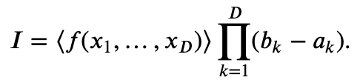
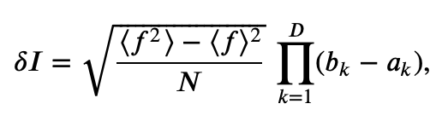
Computing multi-dimensional integrals: Monte Carlo
Similar to 1D case, replace
by the mean
Here x₁,…,x_{D} are independent random variables distributed uniformly in intervals x_{k} in [a_{k},b_{k}].
Error estimate:
Increasing the number of dimensions by one: sample one more number each iteration.
linear complexity in D

Slide 32
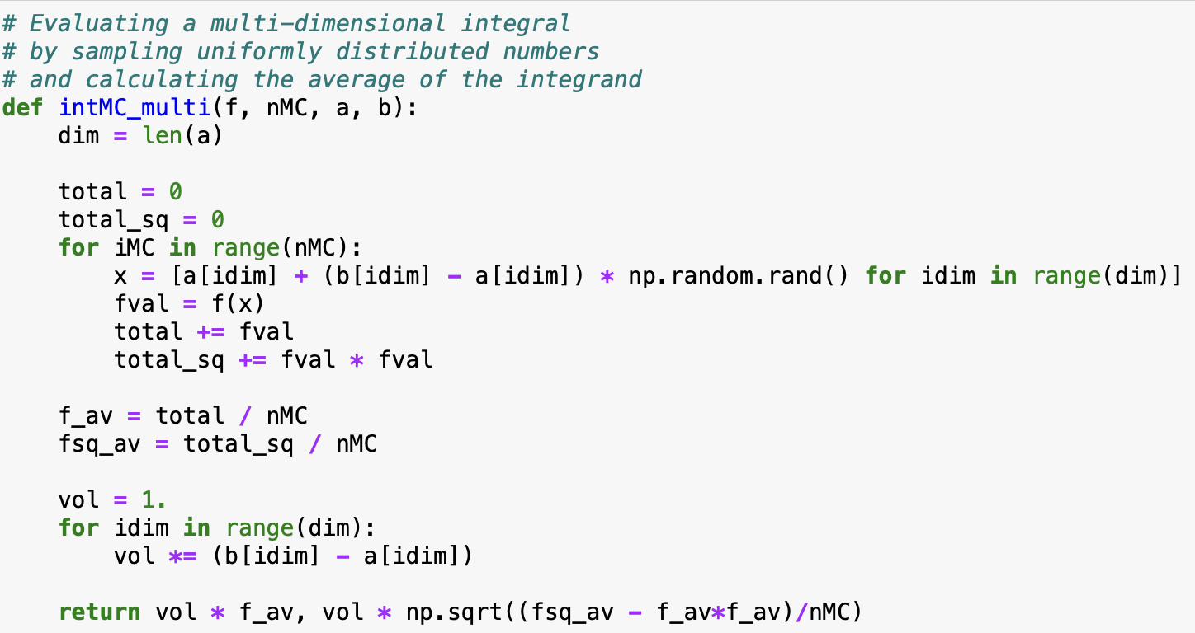
Computing multi-dimensional integrals: Monte Carlo
Implementation:

Slide 33
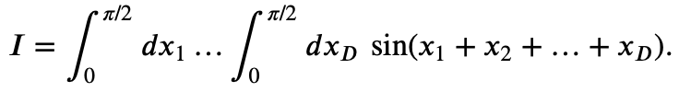
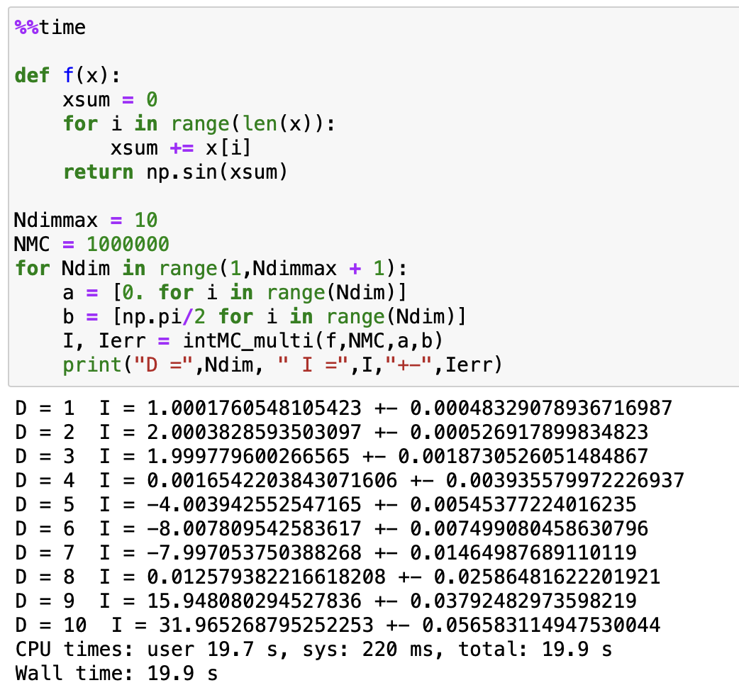
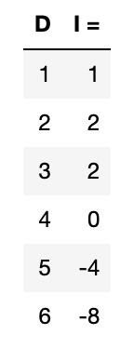
Computing multi-dimensional integrals: Monte Carlo
Our example:
Analytic result:

Slide 34
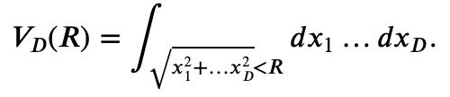
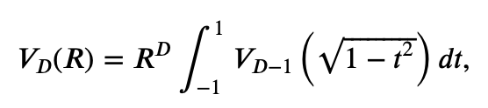
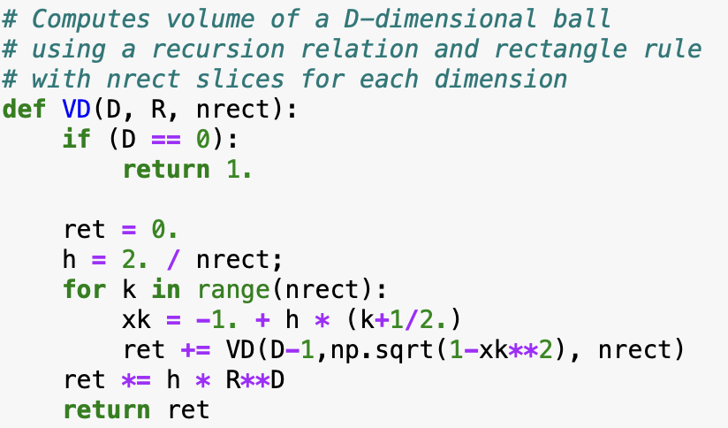


Volume of a D-dimensional ball (hypersphere)
Let us consider an D-dimensional ball of radius R.
Its volume is given by a D-dimensional integral
This can be written with the recursion formula
with $V_{0}\left(R\right)=1.$
Rectangle (non-MC) method (recursive)

Slide 35


Volume of a D-dimensional ball (hypersphere)
Monte Carlo approach:
Observe that the ball $\sqrt{x_{1}^{2}+…+x_{D}^{2}}<R$ is a subvolume of a hypercube $−R<x_{1},…,x_{D}<R.$
If we now randomly sample points that are uniformly distributed inside the hypercube,
the fraction C/N of those that are also inside the ball will reflect
the ratio of the ball and hypercube volumes $V_{D}(R)$ and $V_{cube}\left(R\right)={(2R)}^{D}$
Therefore,

Slide 36


Volume of a D-dimensional ball (hypersphere)

