Slide 1

Computational Physics (PHYS6350)
Lecture 5: Linear algebra and matrices: Part II
Matrix inversion
Tri- and band-diagonal systems
QR decomposition
Eigenvalue problem
January 30, 2025
Instructor: Volodymyr Vovchenko (vvovchenko@uh.edu)
Course materials: https://github.com/vlvovch/PHYS6350-ComputationalPhysics/tree/spring2025

Slide 2



Matrix inversion
Inverse of matrix A, if it exists, satisfies
Let us denote the columns of the inverse matrix A⁻¹ by x_{k}, i.e. A⁻¹=(x₁,…,x_{n})
The vectors x_{k} satisfy the following N systems of non-linear equations
where
Since the matrix A is always the same, these systems can be efficiently solved with LU-decomposition to find all x_{k} and thus the inverse matrix A⁻¹
Complexity: 1 LU-decomposition O(N³)
+ N backsubstitutions [each one is O(N²)]
~ O(N³) overall

Slide 3
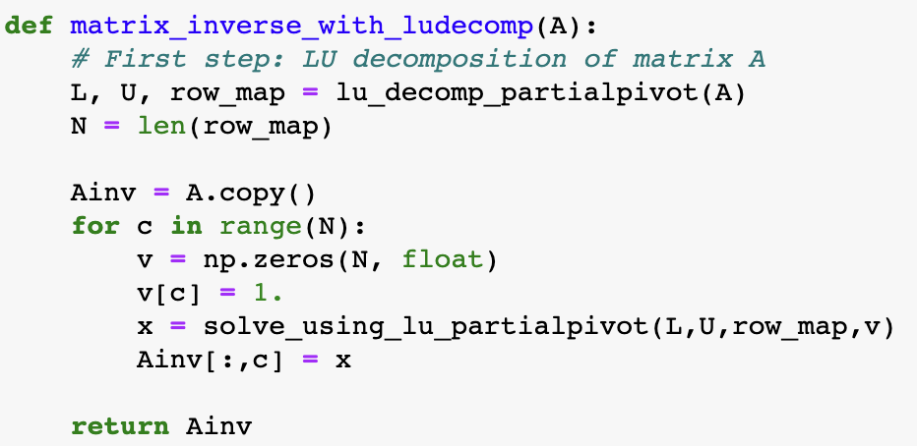
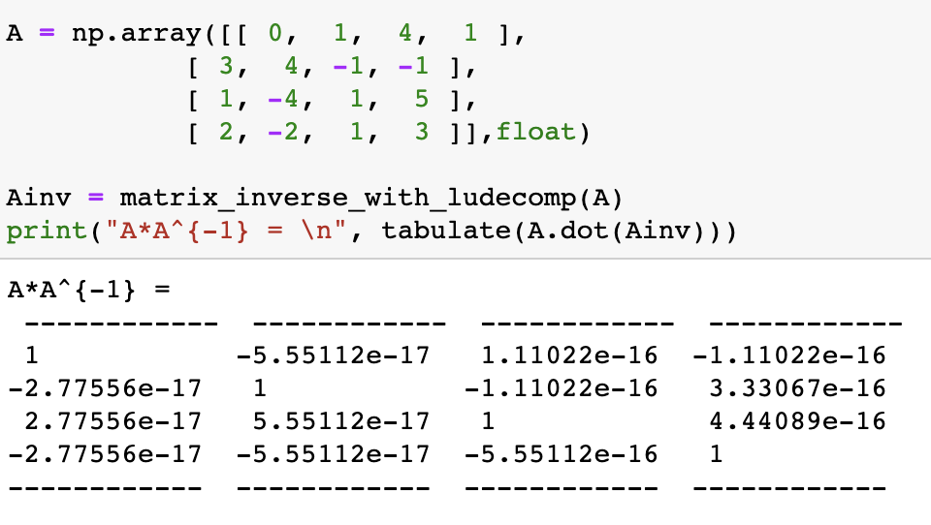
Matrix inversion

Slide 4
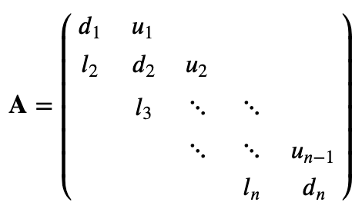
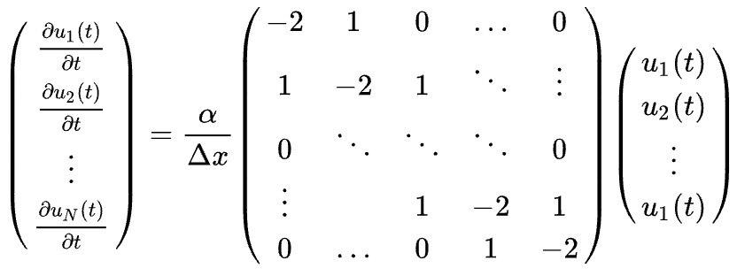
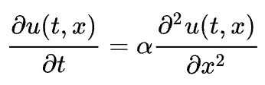
Tridiagonal systems
Tridiagonal system of equation is a special case when the matrix A is tridiagonal
0
0
Tridiagonal systems of linear equations often appear in physics, e.g.
Nearest-neighbor interaction (linear chain of springs)
Finite differences applied to partial differential equations (heat equation)

Slide 5

Solving tridiagonal systems
0
0
Tridiagonal system can be solved in linear time [O(N)] with Gaussian elimination an
Gaussian elimination: at each step need to subtract only one row below the current one, and at most two elements
Backsubstitution: subtract only single element from the upper superdiagonal

Slide 6
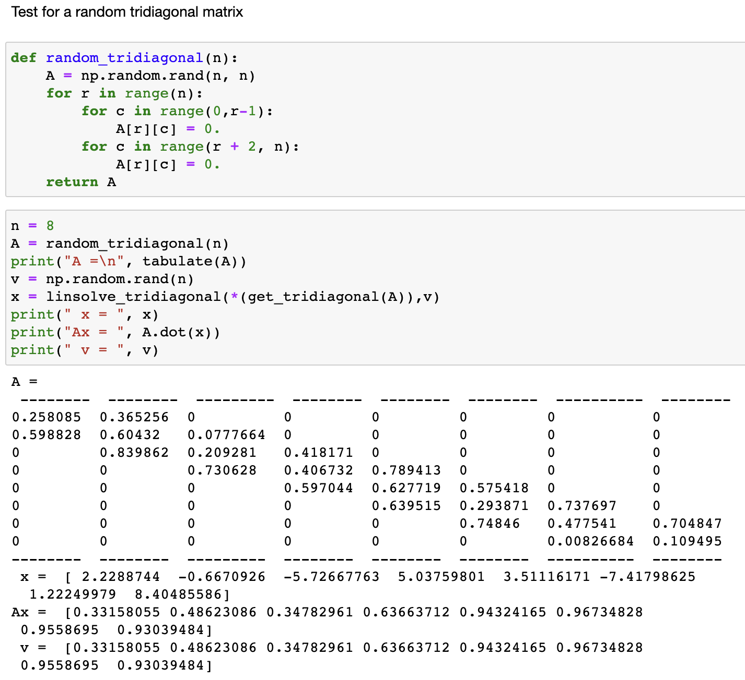
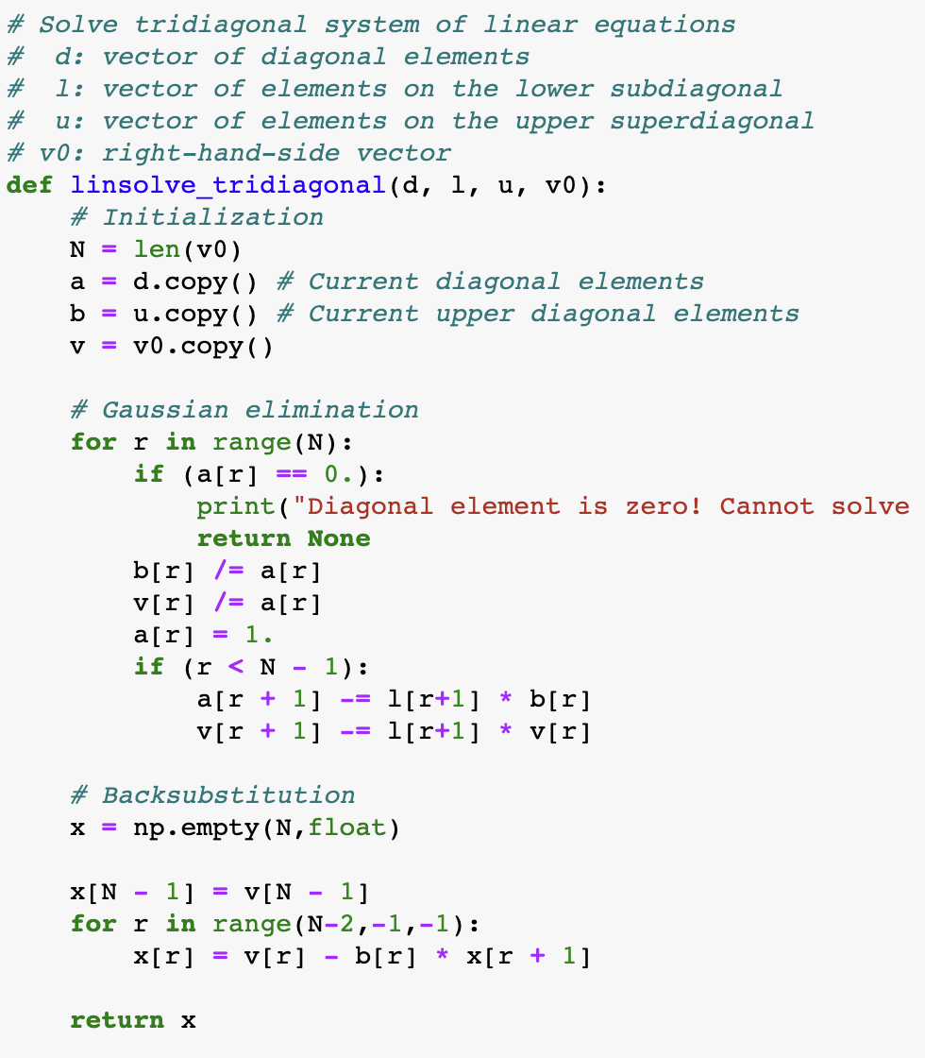
Solving tridiagonal systems

Slide 7
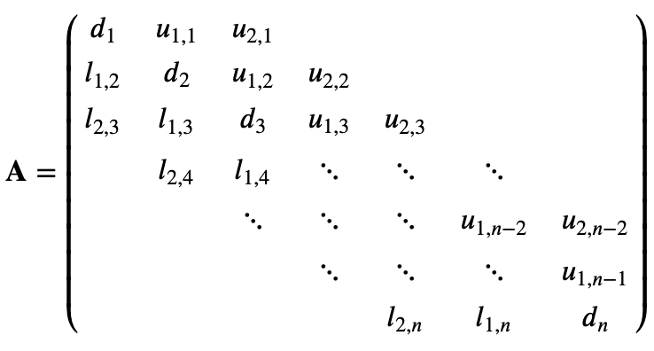
Band-diagonal systems
Band-diagonal system: in each row
at most m_{lower} non-zero elements to the left of the main diagonal
at most m_{upper} non-zero elements to the right of the main diagonal
0
0
Generalization of tridiagonal systems (m_{lower} = m_{upper} =1)
k-nearest-neighbor interaction (linear chain of springs)
High-order finite difference applied to partial differential equations (heat equation)

Slide 8
Solving band-diagonal systems
0
0
Solving band-diagonal system proceeds also through Gaussian elimination
Gaussian elimination: At each step one has to normalize m_{upper}+1 elements in the current row, then subtract the current row from at most m_{lower} rows below it. O(N x m_{upper} x m_{lower})
Backsubstitution: in each row subtract up to m_{upper} elements to the right from the main diagonal. O(N x m_{upper})
Overall complexity: O(N x m_{upper} x m_{lower})

Slide 9
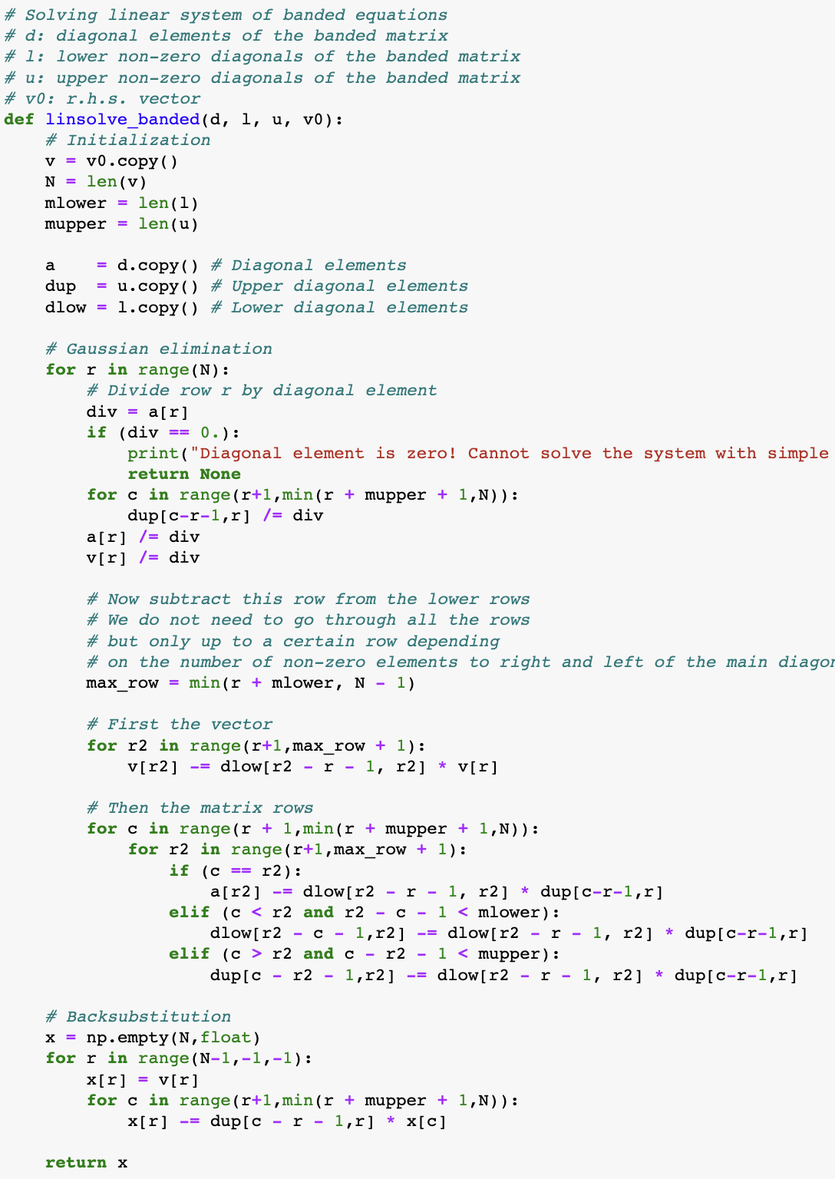
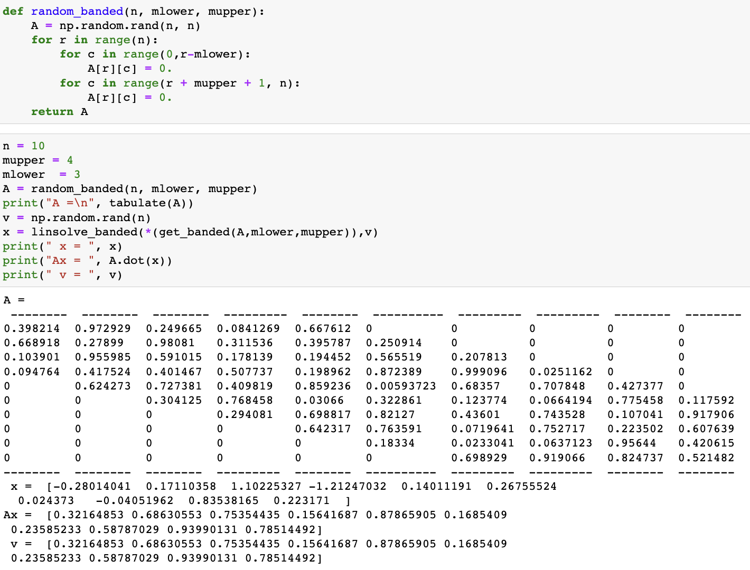
Solving band-diagonal systems

Slide 10


QR decomposition*
Any real square matrix A permits a decomposition
where
Q is orthogonal, Q⁻¹=Q^{T}, and thus, Q^{T}Q = I
R is upper diagonal
There are many algorithms for constructing the QR decomposition:
from simple Gram-Schimdt process (numerically unstable)
to more involved methods using Householder transformation or
Givens rotations.
numpy.linalg.qr
*Has nothing to do with QR codes

Slide 11



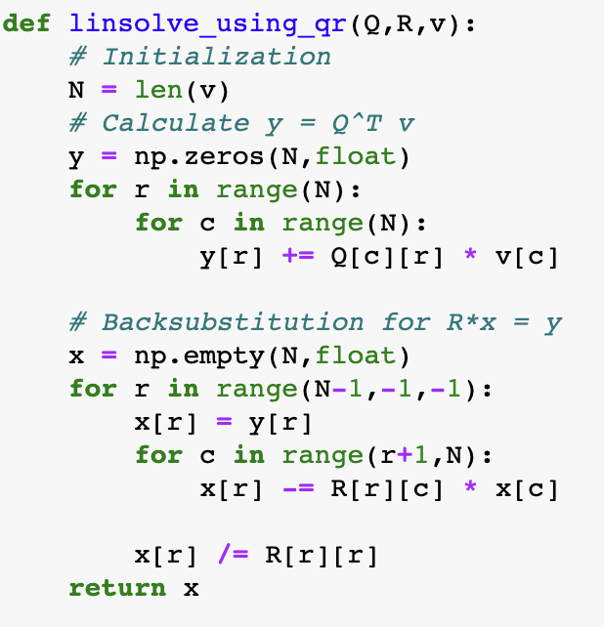
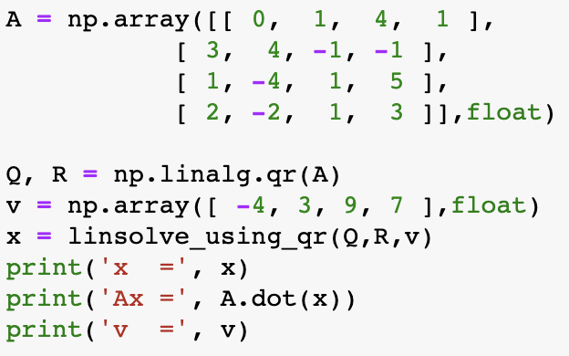
QR decomposition and systems of linear equations
System of linear equations
If A = QR we can rewrite the system as
Multiplying each side of the equation by Q^{T}, we have
The matrix R is upper triangular, thus, the system can solved using backsubstitution.

Slide 12



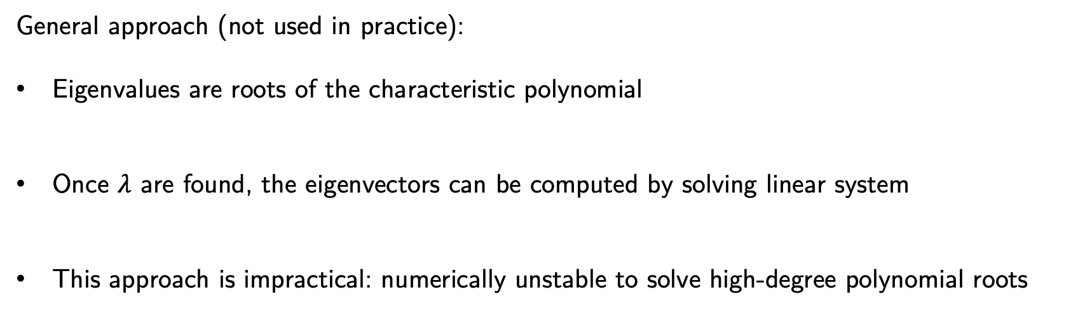

Eigenvalue problem
A common matrix problem in physics is the calculation of eigenvalues and eigenvectors of a matrix (e.g. classical and quantum mechanics).
The eigenvalue problem corresponds to the equation
Example:
$$Hψn(x)=Enψn(x)$$
Energy levels in quantum mechanics
using matrix form
Here $λ$ are the eigenvalues and v are the eigenvectors
General approach (not used in practice):
Eigenvalues are roots of the characteristic polynomial
Once $λ$ are found, the eigenvectors can be computed by solving linear system
This approach is impractical: numerically unstable to solve high-degree polynomial roots

Slide 13

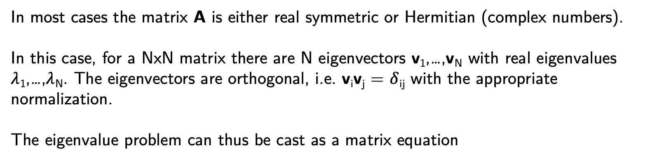
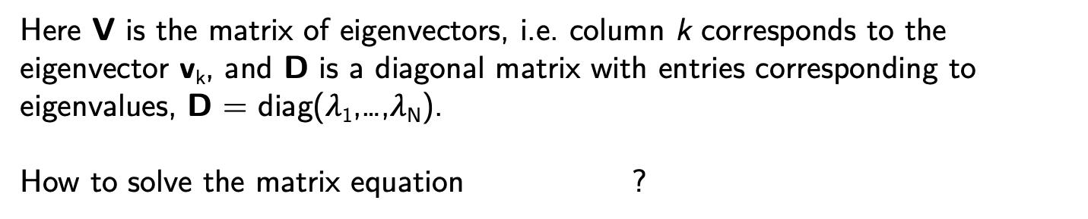
Eigenvalue problem
In most cases the matrix A is either real symmetric or Hermitian (complex numbers).
In this case, for a NxN matrix there are N eigenvectors v₁,…,v_{N} with real eigenvalues $λ$₁,…,$λ$_{N}. The eigenvectors are orthogonal, i.e. v_{i}v_{j} = $δ$_{ij} with the appropriate normalization.
The eigenvalue problem can thus be cast as a matrix equation
Here V is the matrix of eigenvectors, i.e. column k corresponds to the eigenvector v_{k}, and D is a diagonal matrix with entries corresponding to eigenvalues, D = diag($λ$₁,…,$λ$_{N}).
How to solve the matrix equation ?

Slide 14

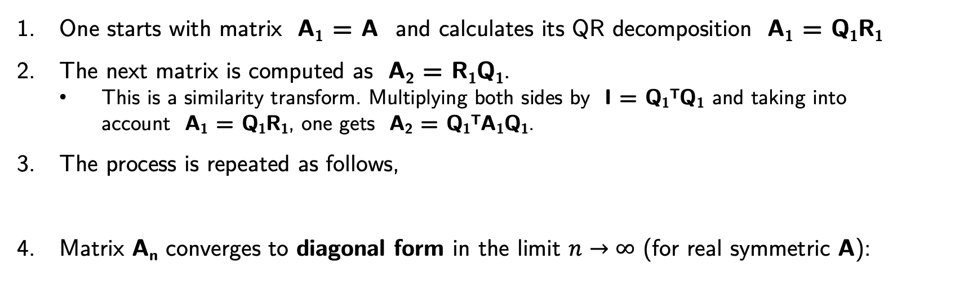



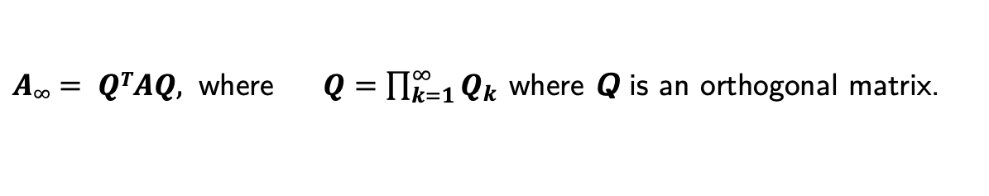
QR algorithm
QR algorithm is a method of finding eigenvalues and/or eigenvectors based on an iterative procedure.
One starts with matrix A₁ = A and calculates its QR decomposition A₁ = Q₁R₁
The next matrix is computed as A₂ = R₁Q₁.
This is a similarity transform. Multiplying both sides by I = Q₁^{T}Q₁ and taking into account A₁ = Q₁R₁, one gets A₂ = Q₁^{T}A₁Q₁.
The process is repeated as follows,
Matrix A_{n} converges to diagonal form in the limit $n→∞$ (for real symmetric A):
A_{n+1} = R_{n}Q_{n} = Q_{n}^{T}A_{n}Q_{n}.
$A∞= QTAQ,$ where $Q=\prod_{k=1}^{∞}{Q_{k}}$ where Q is an orthogonal matrix.
Multiply $A∞$ by Q from the right: $AQ=QA∞$
Compare with $AV=VD$
$$Q=V$$
$$A∞=D$$
eigenvector matrix
eigenvalue matrix
In practice, the algorithm stops once non-diagonal elements of A_{n} are below a certain threshold $ε$.

Slide 15
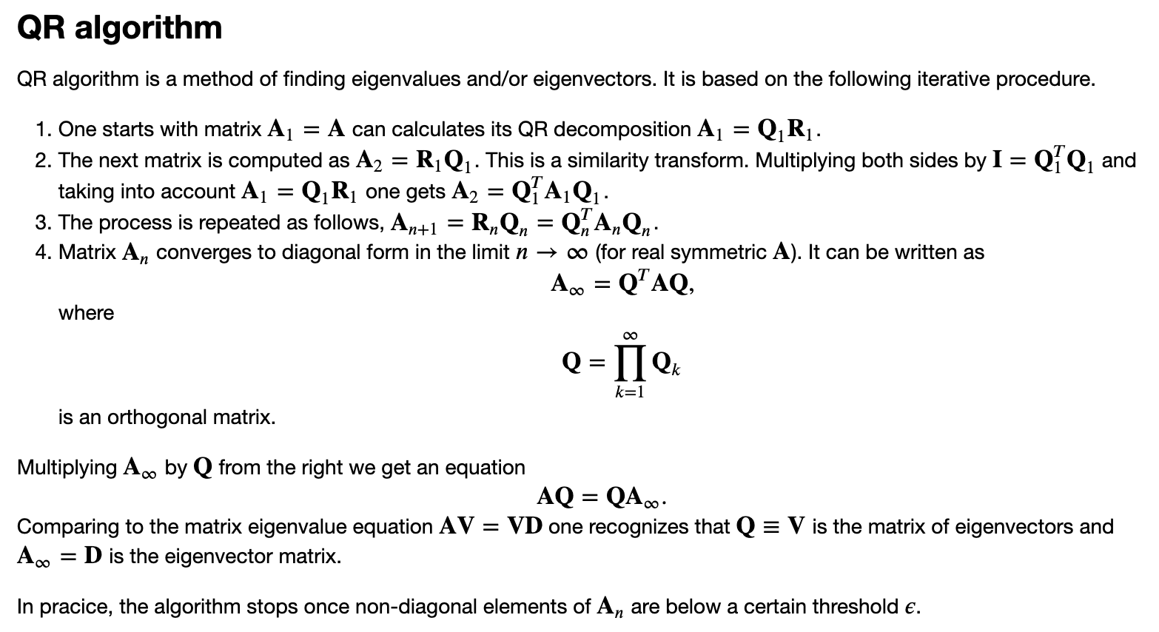
QR algorithm

Slide 16
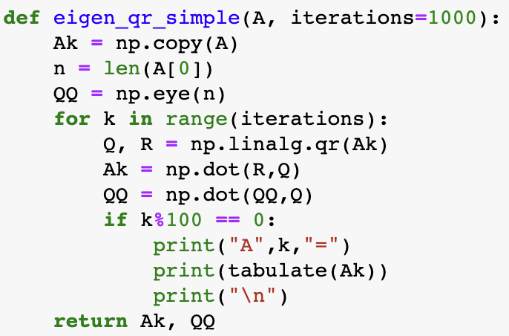
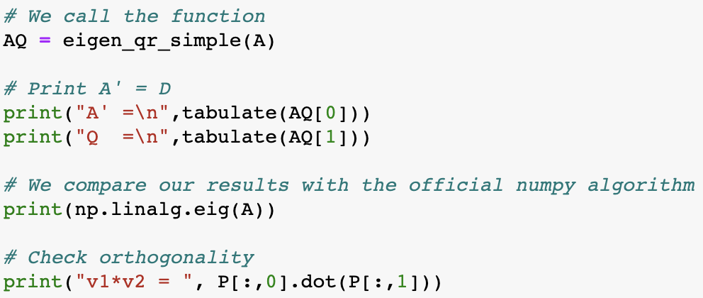
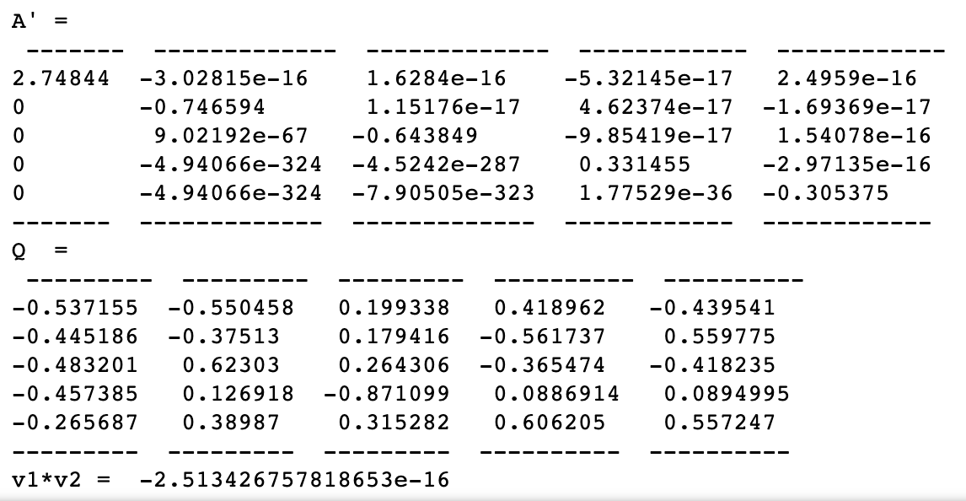
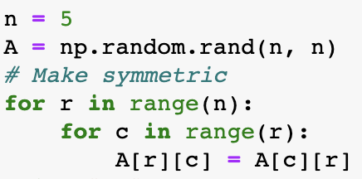
QR algorithm
v₁
v₂
v₃
v₄
v₅

Slide 17

Linear algebra: Summary
System of N linear equations
General case: use LU-decomposition [O(N³)] + forward/back-substitution [O(N²)] ~ O(N³)]
No need to repeat LU-decomposition when v (but not A) changes
Tridiagonal system: Can be solve in linear O(N) time
Band-diagonal: O(N x m_{upper} x m_{lower})
Eigenvalue problem
General case: use QR-decomposition and QR algorithm (iterative)
Specialized algorithms for sparse matrices (e.g. Lanczos algorithm)
final project idea(?)

