Slide 1

Computational Physics (PHYS6350)
Lecture 9: Numerical Integration: Part 2
High-order quadrature
Gaussian quadrature
February 13, 2025
Instructor: Volodymyr Vovchenko (vvovchenko@uh.edu)
Course materials: https://github.com/vlvovch/PHYS6350-ComputationalPhysics/tree/spring2025

Slide 2
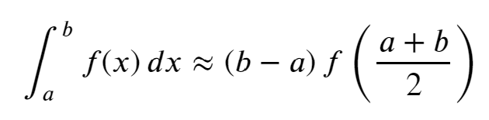
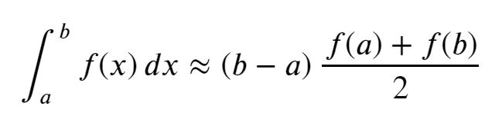
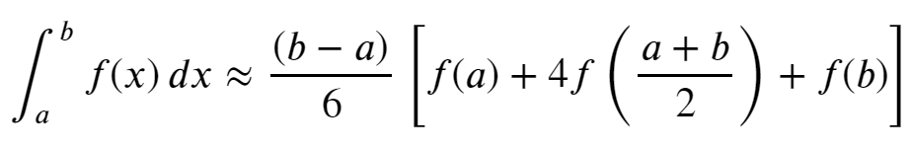
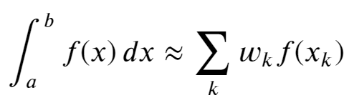
Numerical integration so far
Rectangle rule
Trapezoidal rule
Simpson’s rule
All can be written as

Slide 3
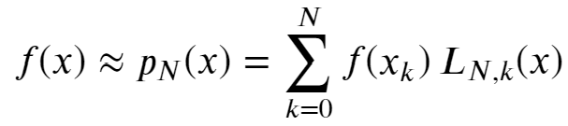
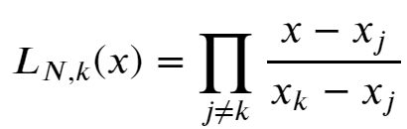
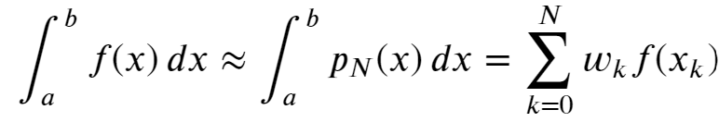
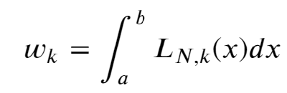
Integrating the interpolating polynomial
There is a systematic way to derive a numerical integration scheme
which will give an exact result when f(x) is a polynomial up to a certain degree.
Recall the interpolating polynomial through N+1 points where f(x) can be evaluated
Lagrange basis functions
Then, the integral reads
where
This expression is exact when f(x) is a polynomial up to degree N

Slide 4
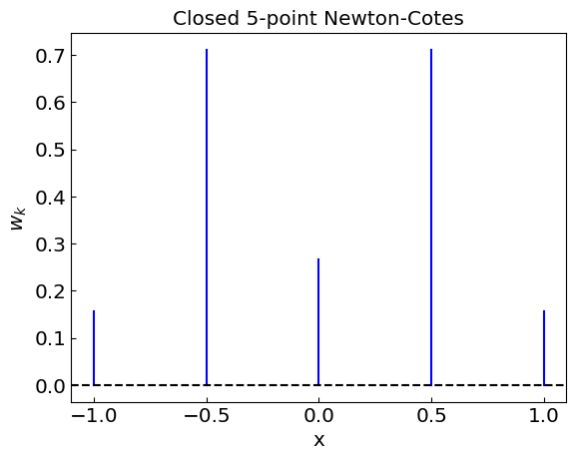
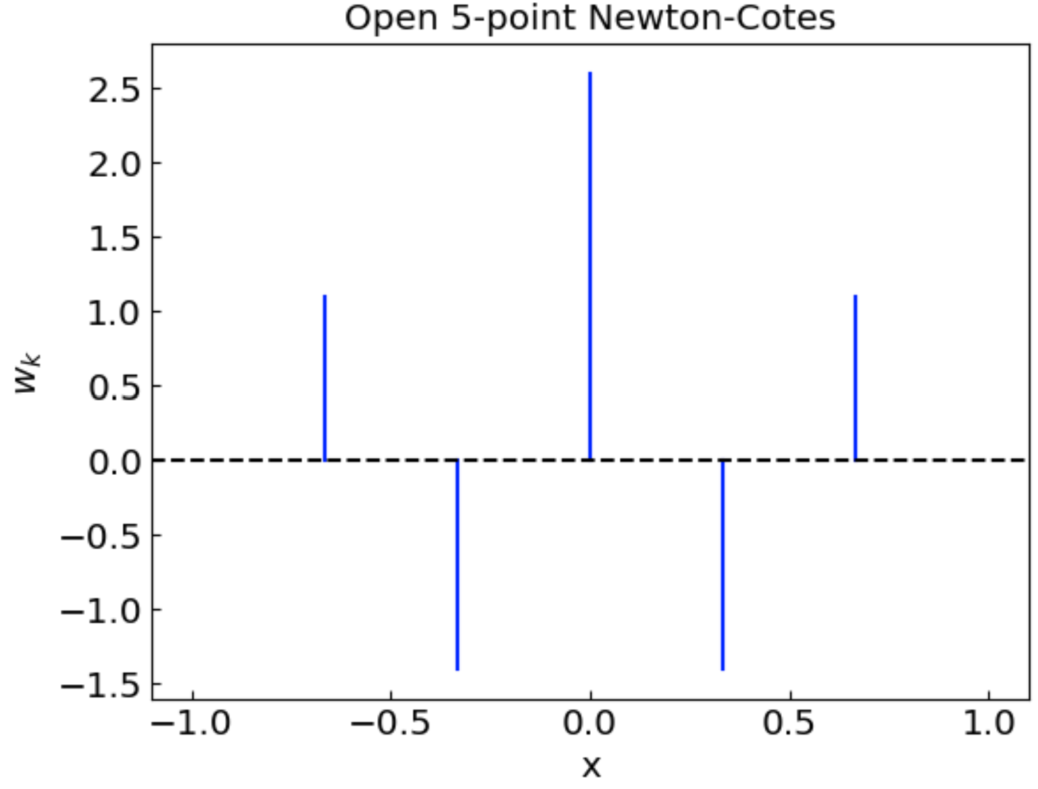
Newton-Cotes quadratures
with x_{k} distributed equidistantly
Closed Newton-Cotes (include the endpoints)
Open Newton-Cotes (exclude the endpoints)
N = 1: trapezoidal
N = 2: Simpson
N = 0: rectangle rule

Slide 5
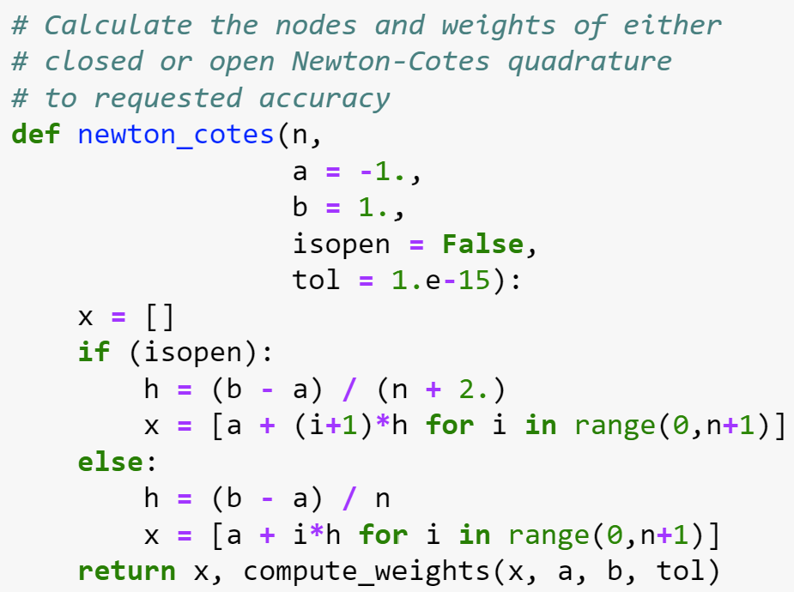
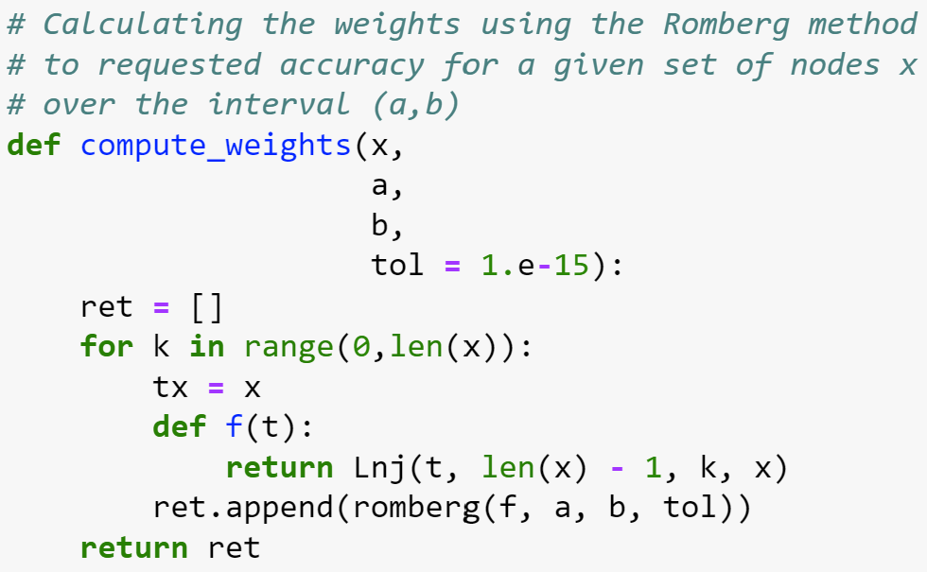
Newton-Cotes quadratures
The weights can be computed just once using one of the earlier methods (e.g. Romberg)

Slide 6
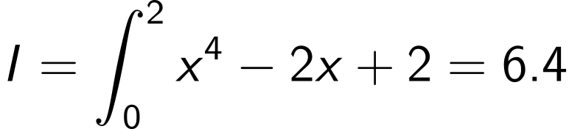
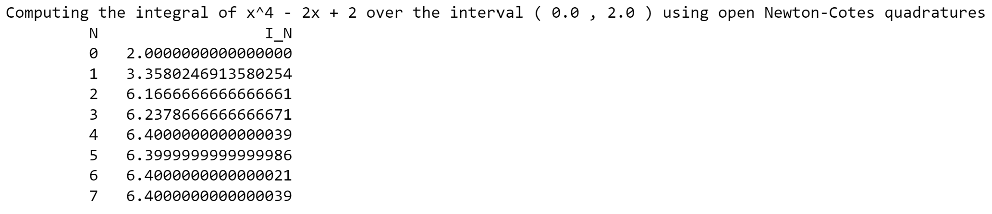
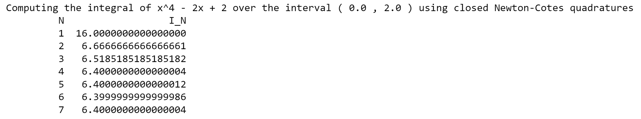
Newton-Cotes quadratures: example
Exact result (to machine precision) from N = 4

Slide 7
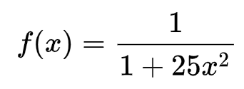
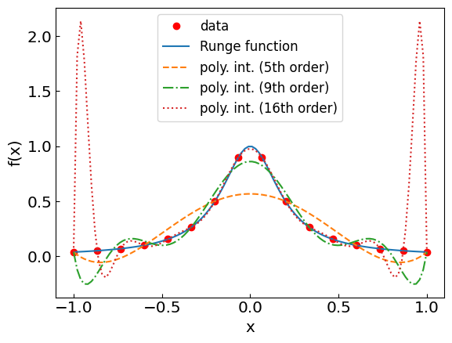
Newton-Cotes quadratures: Runge phenomenon
Recall the Runge function:

Slide 8
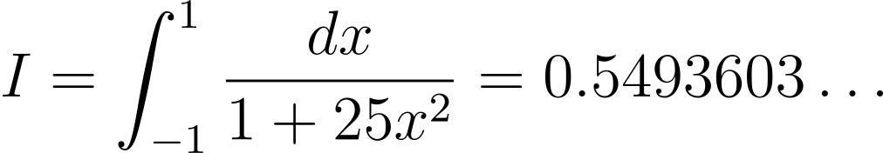
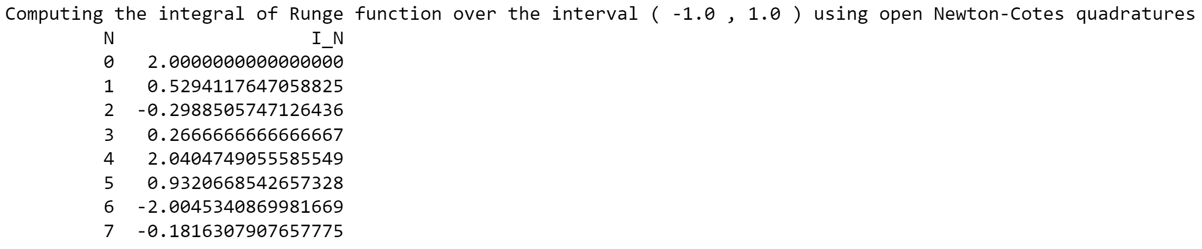
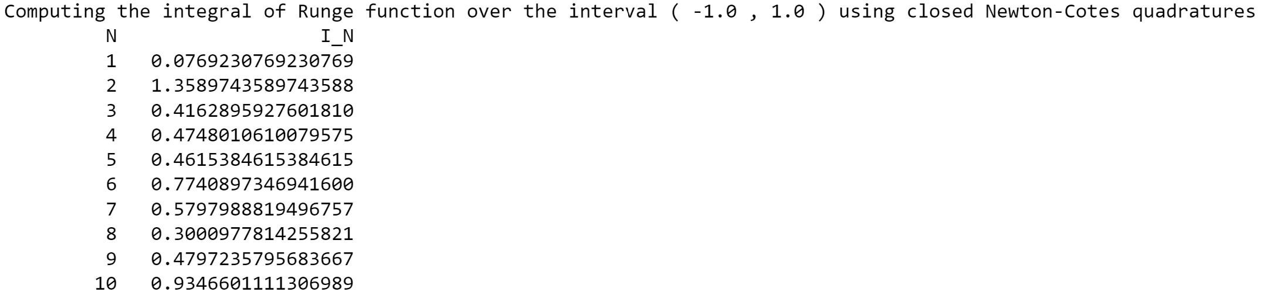
Newton-Cotes quadratures: Runge phenomenon

Slide 9
Newton-Cotes quadratures: Runge phenomenon
Romberg method

Slide 10
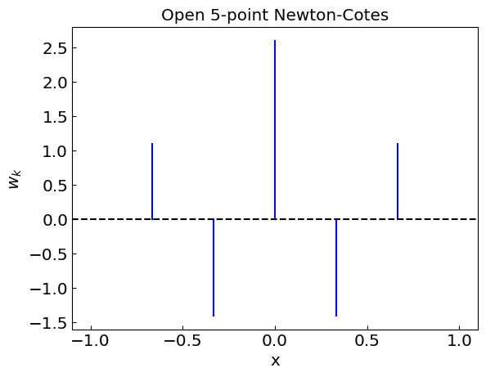
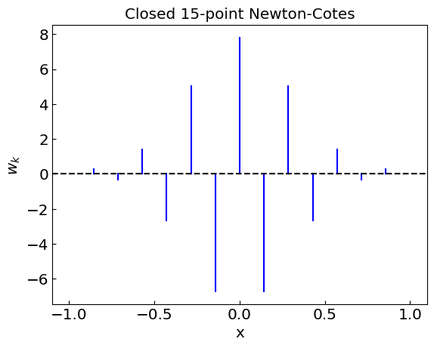
Newton-Cotes quadratures: oscillating weights
For large N one has highly oscillatory weights
Manifestation of the Runge phenomenon
Another issue: round-off error due to large cancellations

Slide 11
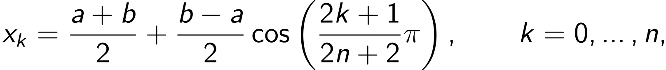
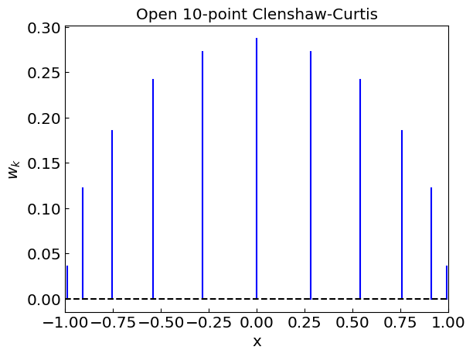
Clenshaw-Curtis quadrature
Chebyshev nodes minimize the Runge phenomenon
The corresponding quadrature is called Clenshaw-Curtis
Weights*:
*For efficient calculation use discrete cosine transform

Slide 12
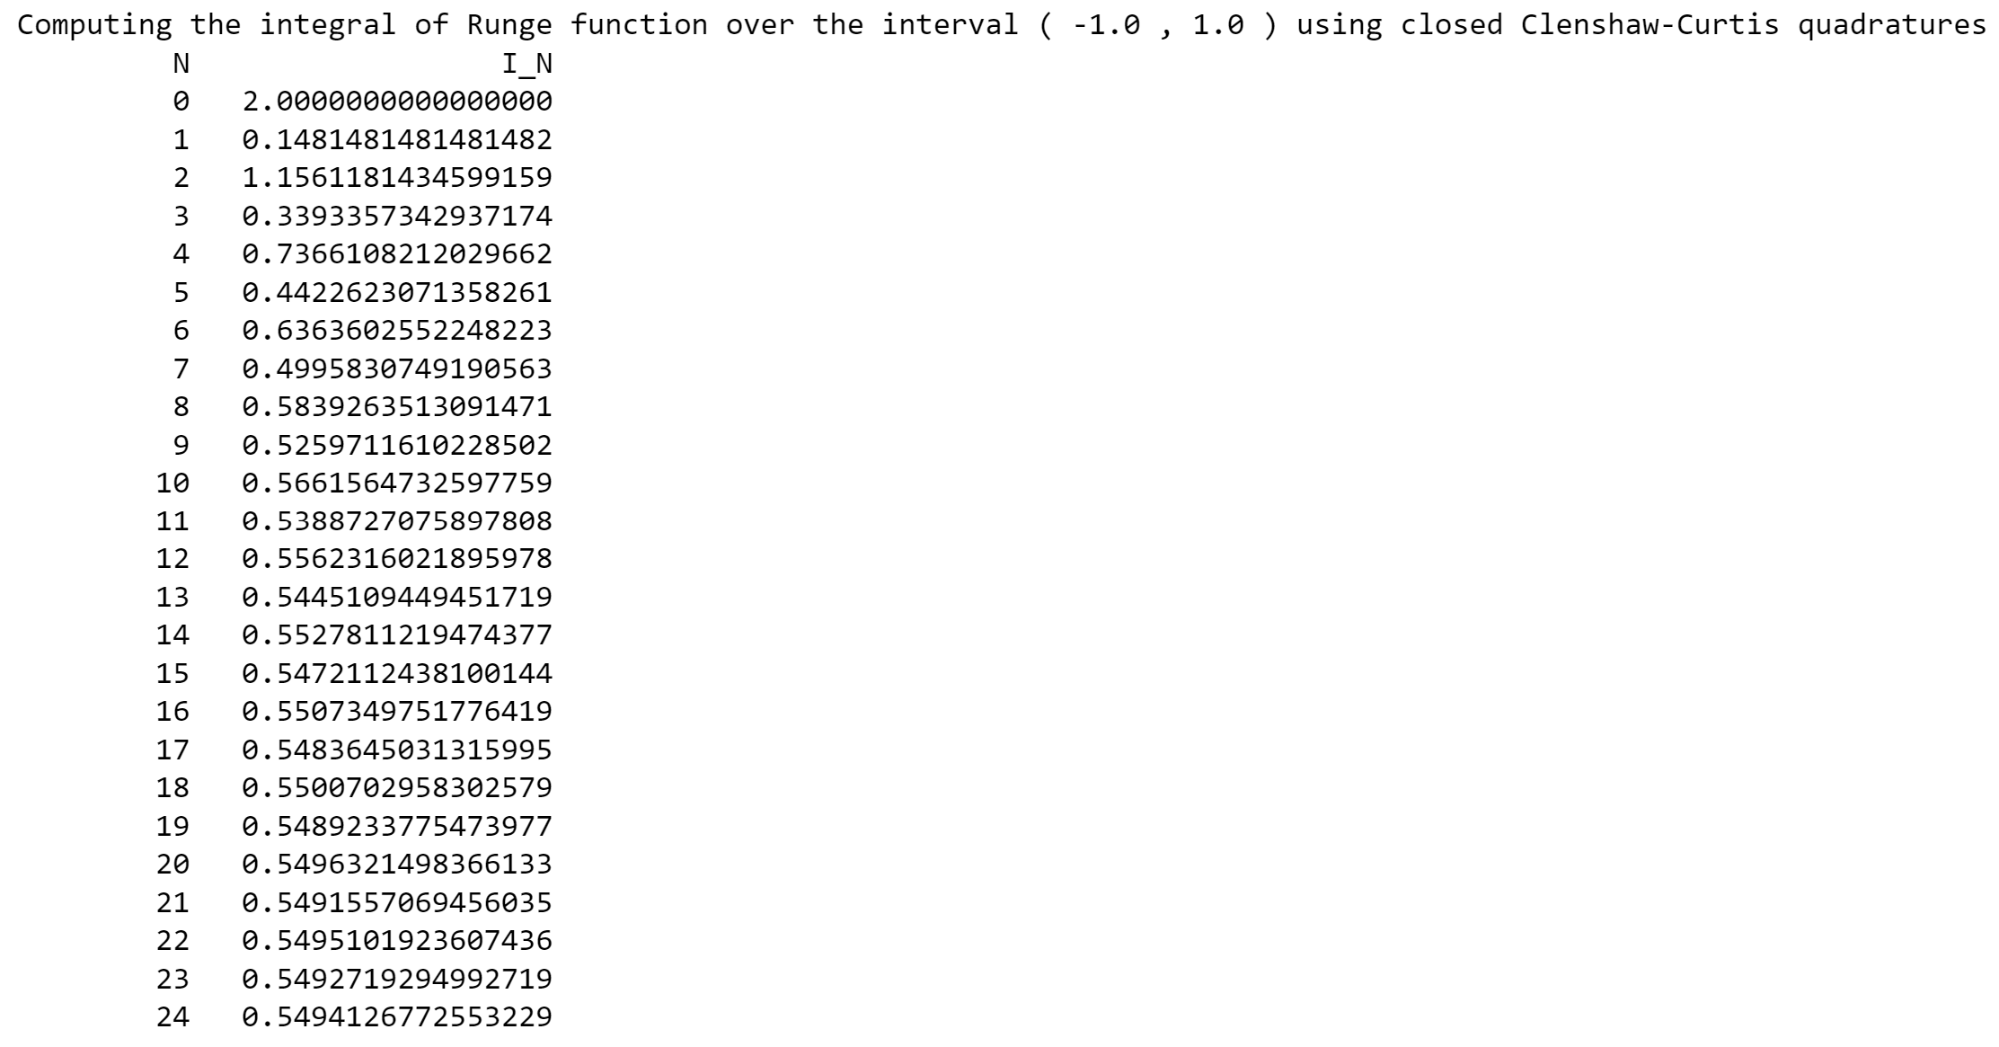
Clenshaw-Curtis quadrature

Slide 13
Gaussian quadrature
We have seen that an n-point quadrature
gives the exact result when f(x) is a polynomial of degree up to n-1.
This is true any choice of distinct nodes x_{k}.
We have the freedom to choose the locations of nodes x_{k},
which gives us additional n degrees of freedom.
It turns out this can be exploited to obtain a quadrature that is exact when f(x) is a polynomial up to degree 2n-1.
The corresponding quadrature is called Gaussian quadrature

Slide 14
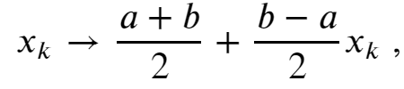
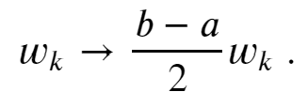
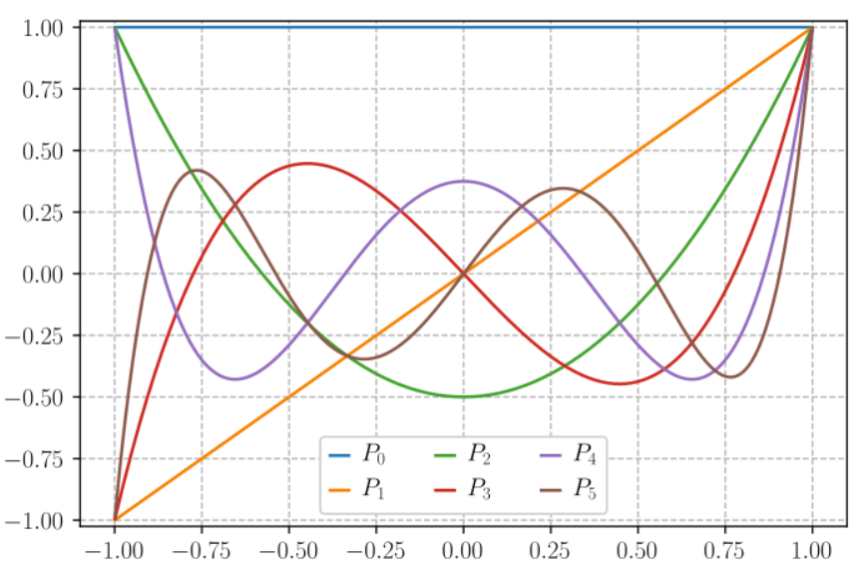
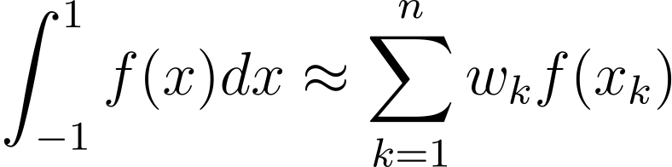
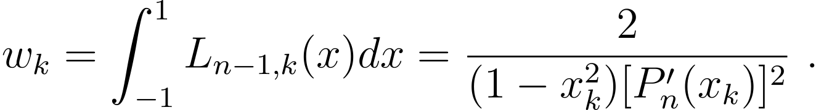
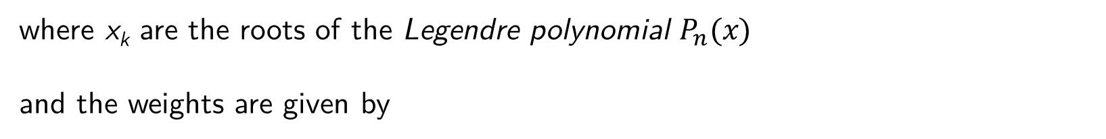
Gauss-Legendre quadrature
Let us focus on the interval (-1,1). It can always be mapped to (a,b) by a transformation
Gauss-Legendre quadrature:
where x_{k} are the roots of the Legendre polynomial $P_{n}(x)$
and the weights are given by

Slide 15
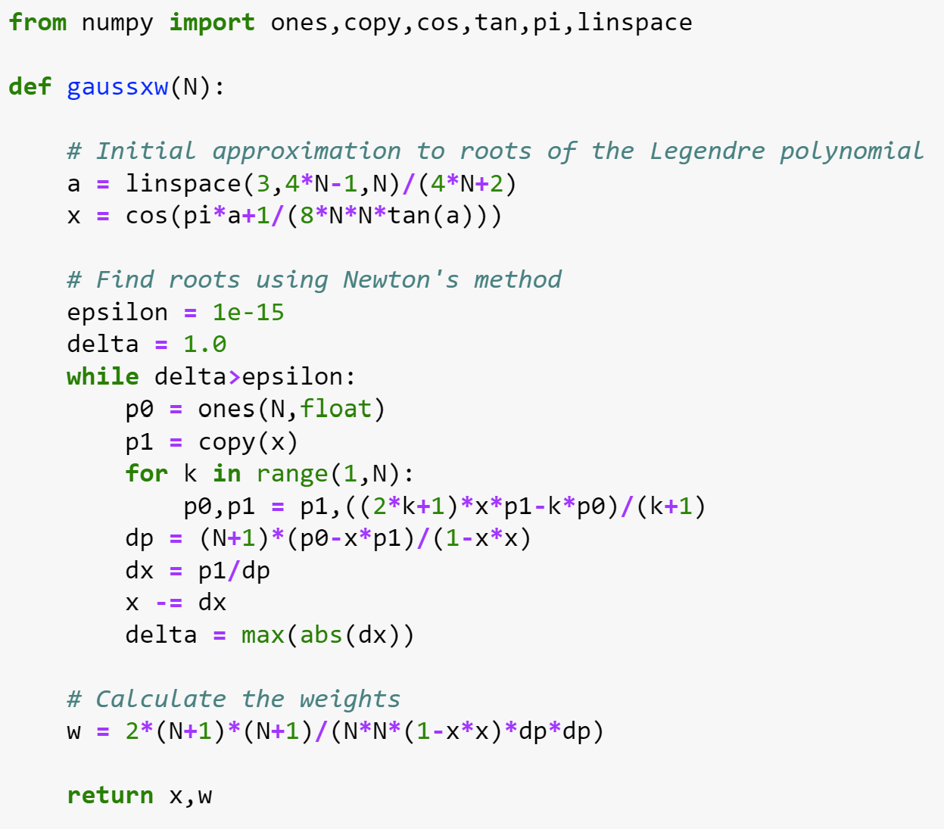
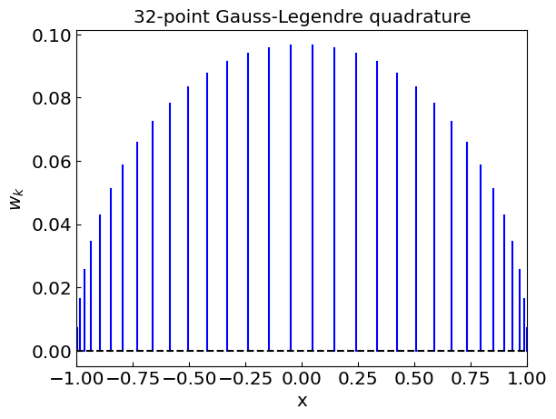
Gauss-Legendre quadrature
How to find the nodes x_{k} and weights w_{k}?
In general, we can use PolyRoots to find x_{k} and e.g. Romberg method for w_{k}
For the Gauss-Legendre quadrature a more efficient procedure exists
(see e.g. http://www-personal.umich.edu/~mejn/cp/programs/gaussxw.py)

Slide 16
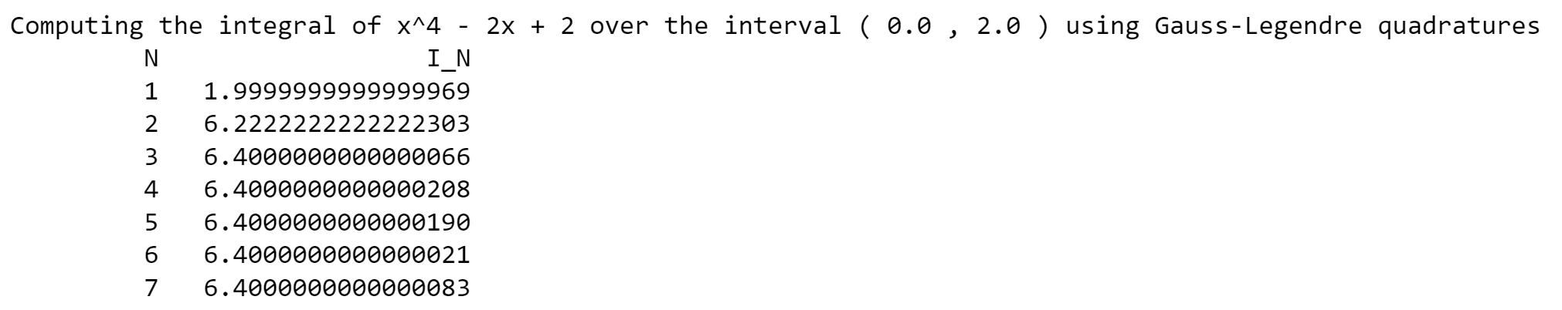
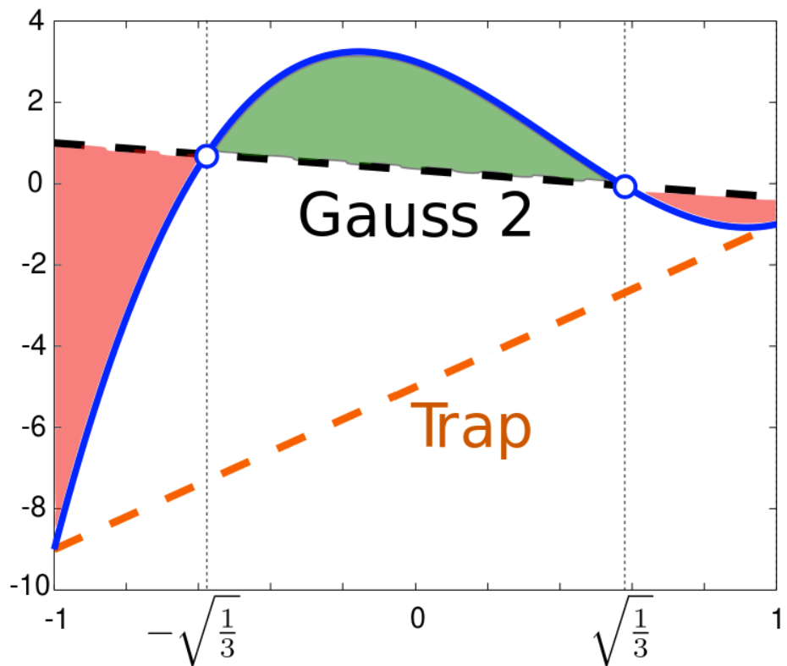
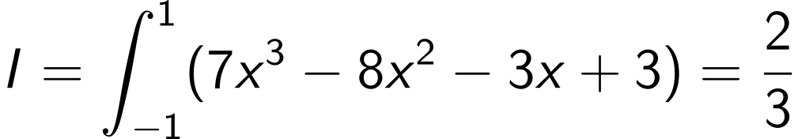
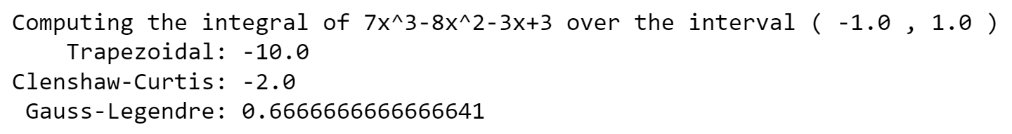
Gauss-Legendre quadrature: polynomials

Slide 17
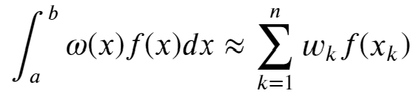
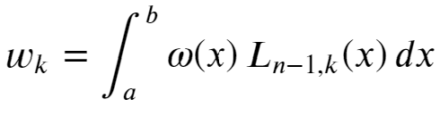
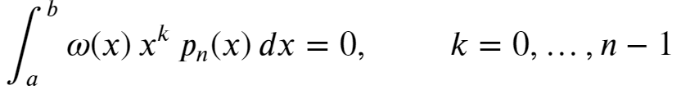

Generalized Gaussian quadratures
The method of Gaussian quadratures can be generalized to integrals of the following type
$ω(x)$ – weight function
In this case it is possible to construct an n-point quadrature that provides the exact answer when f(x) is a polynomial of degree up to 2n - 1. The weights w_{k} are given by
and the nodes x_{k} are the roots of a polynomial $p_{n}(x)$ satisfying
For a = -1, b = 1, $ω\left(x\right)=1$ we have Gauss-Legendre quadrature
For a = -1, b = 1, $ω\left(x\right)={\left(1−x\right)}^{α}{\left(1+x\right)}^{β}$ we have Gauss-Jacobi quadrature

Slide 18
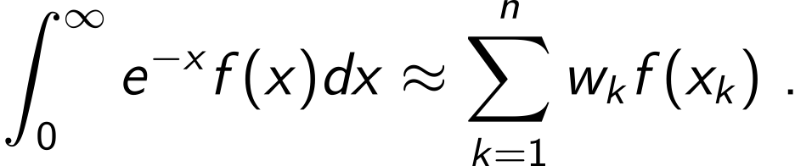
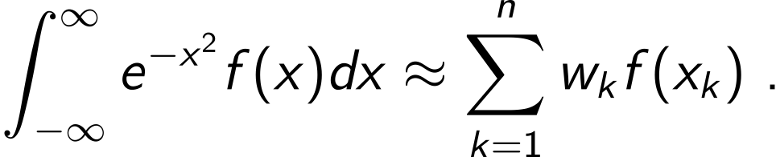


Generalized Gaussian quadratures
The interval (a,b) does not have to be finite
Gauss-Laguerre quadrature
Example: Fermi-Dirac/Bose-Einstein integrals in relativistic systems
Gauss-Hermite quadrature
Example: Expectation value of a function of a normally distributed random variable
x_{k} are the roots of Laguerre polynomial $L_{n}(x)$
x_{k} are the roots of Hermite polynomial $H_{n}(x)$
Another approach: map (semi-)infinite interval to (-1,1) and use the Gauss-Legendre quadrature

Slide 19
Summary: Choosing the integration method
Rectangle/trapezoidal rule
Good for quick calculations not requiring great accuracy
Does not rely on the integrand being smooth; a good choice for noisy/singular integrands, equally spaced points
Romberg method
Control over error
Good for relatively smooth functions evaluated at equidistant nodes
Gaussian quadrature
Theoretically most accurate if the function is relatively smooth
Good for many repeated calculations of the same type of integral
Requires unequally spaced nodes
Error can be challenging to control, especially for non-smooth functions
Gauss-Kronrod quadrature gives control over error
Bad for discontinuous integrands
final project idea(?)

