Slide 1

Computational Physics (PHYS6350)
Lecture 4: Linear algebra and matrices
Linear systems of equations
Gaussian elimination
LU decomposition
January 28, 2025
Instructor: Volodymyr Vovchenko (vvovchenko@uh.edu)
Course materials: https://github.com/vlvovch/PHYS6350-ComputationalPhysics/tree/spring2025

Slide 2
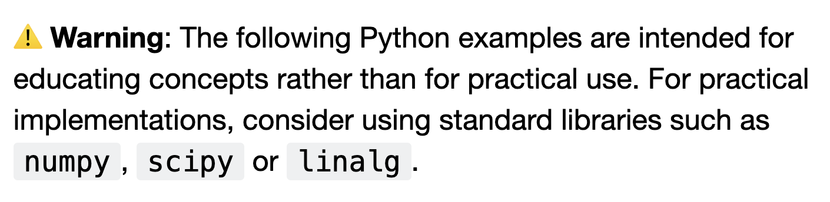
Linear system of equations

Slide 3
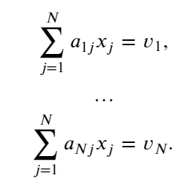

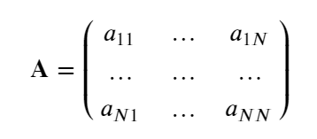
Linear system of equations
Generic problem: solve a system of linear equations
Matrix form:
A unique solution exists if all equations are linearly independent and consistent
Equivalent to condition $\det{A}≠0$

Slide 4

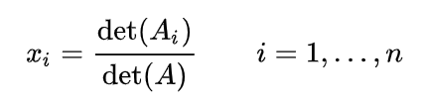
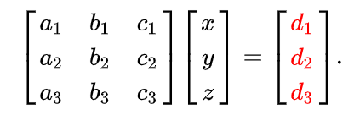
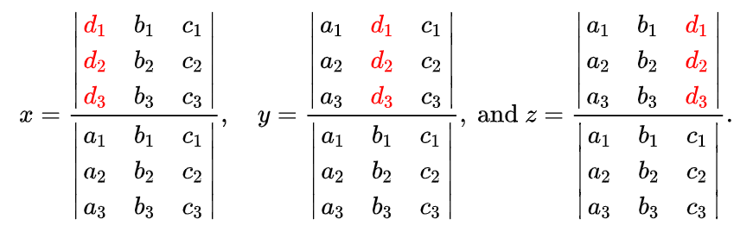
Cramer’s rule
Cramer’s rule:
Solution to reads
where A_{i} is the matrix formed by replacing the i-th column of A by the column vector b.
For example
solved as
Cramer’s rule has theoretical importance but little practical use

Slide 5
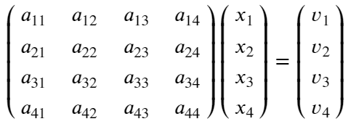
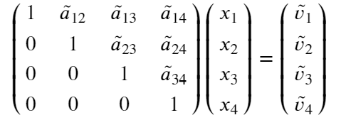
Gaussian elimination
Gaussian elimination is the base procedure for solving systems of linear equations
It is based on iterative transformation of the system of linear equations which preserve the solution (the solution stays the same)
The goal is to eliminate all entries in matrix A below the main diagonal
The following two operations preserve the solution:
One can multiply any row by a non-zero number
One can subtract from a given row any other row (with any non-zero factor)

Slide 6

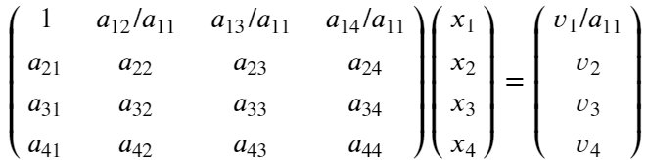
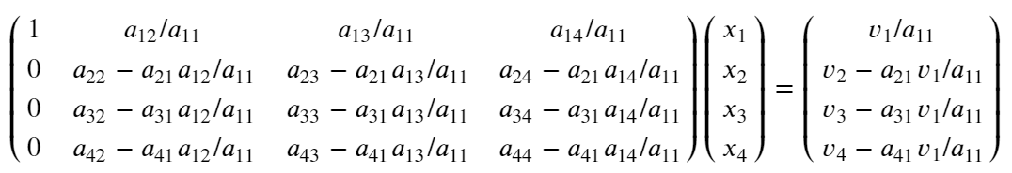
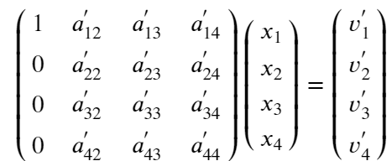
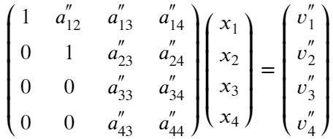
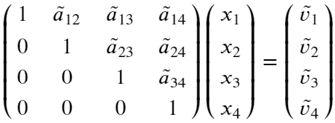
Gaussian elimination
Starting from the first row, divide the row by its diagonal element a₁₁
Make all entries in column 1 below the main diagonal equal to zero by subtracting the first equation from row j with a factor a_{j1}. We get
Repeat steps 1-2 for the 2nd row and column, and then for all others
or
Final result:

Slide 7
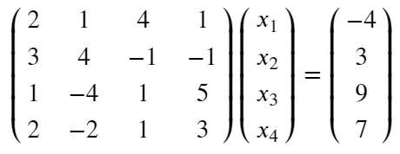
Gaussian elimination
Example: Work out Gaussian elimination for system of equations

Slide 8
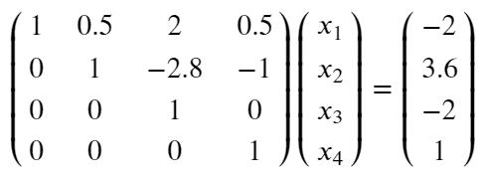
Gaussian elimination
Example: Work out Gaussian elimination for system of equations
The result should be
????

Slide 9
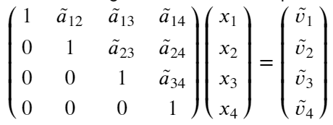
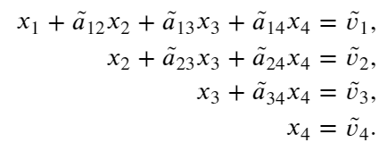
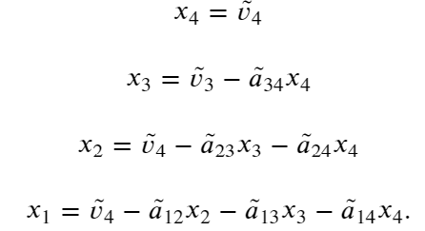
Backsubstitution
After the Gaussian elimination we have the following system of equations
or
The solution now proceeds through backsubstitution, i.e. we go from x₄ to x₁

Slide 10
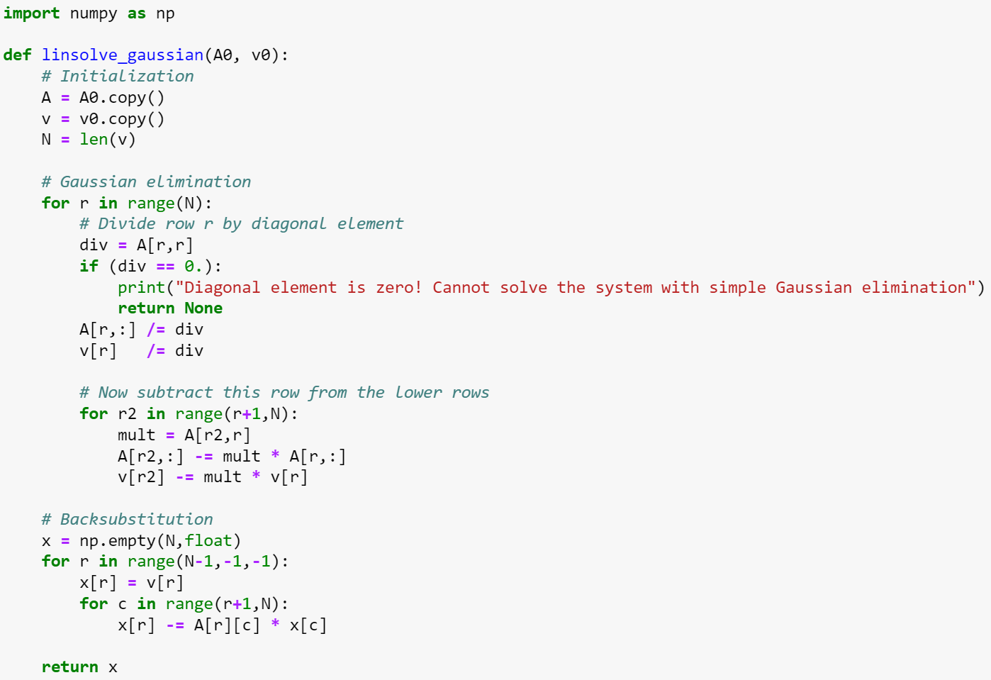
Gaussian elimination: Implementation

Slide 11
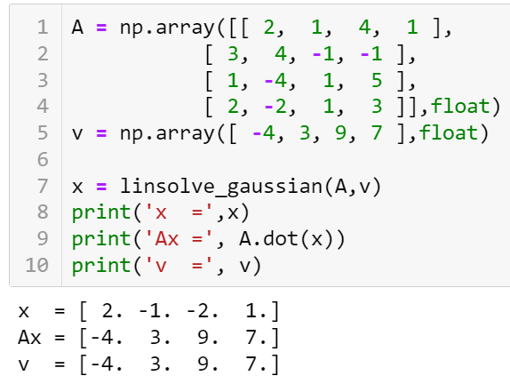
Gaussian elimination: Implementation

Slide 12
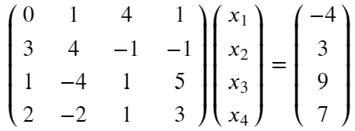
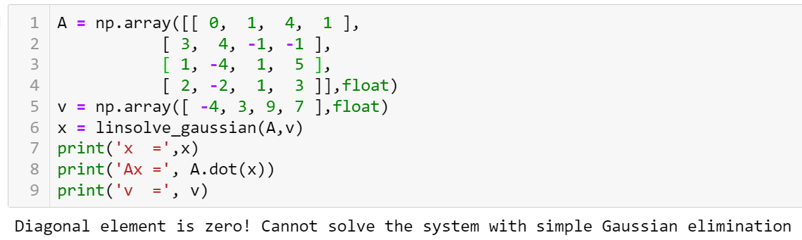
Gaussian elimination: Zero diagonal elements
The trivial implementation of Gaussian elimination will fail if any of the diagonal elements becomes equal to zero in the process of solving
For example:

Slide 13
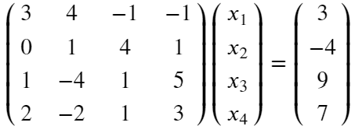
Gaussian elimination: Pivoting
We can simply exchange rows 1 & 2 and avoid the vanishing diagonal element
This is called pivoting, which does not change the solution
The optimal choice of a pivot is the largest element in magnitude (minimizes the round-off error by avoiding division by small numbers). For numerical stability, pivoting should be performed even when there are no vanishing diagonal elements
Partial pivoting: Exchange rows only
Full pivoting: Exchange both rows and columns (changes the ordering of elements in x)

Slide 14
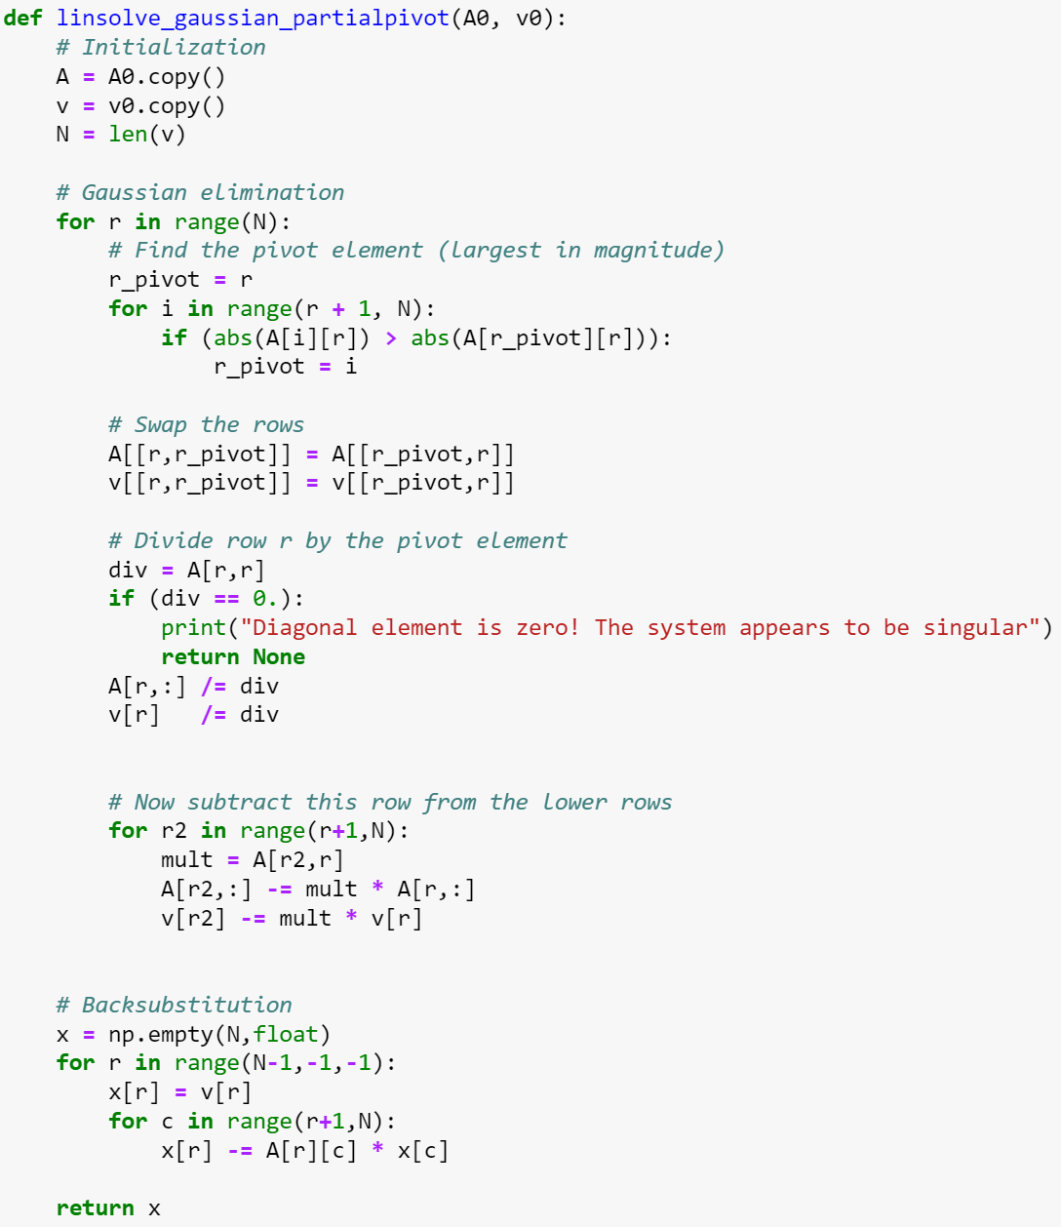
Partial pivoting implementation

Slide 15
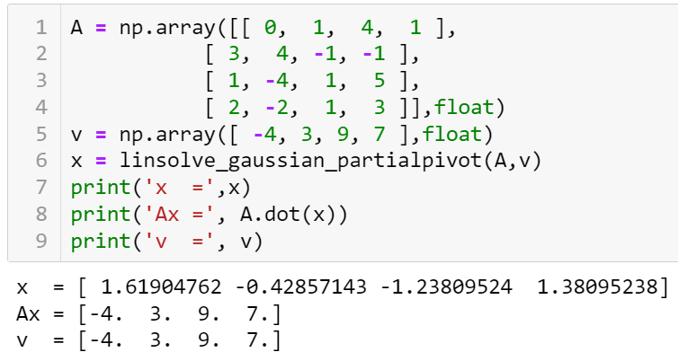
Partial pivoting implementation

Slide 16
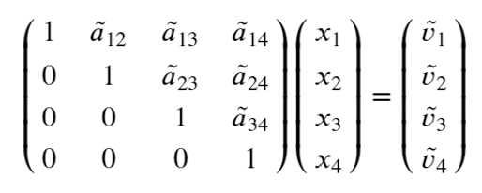


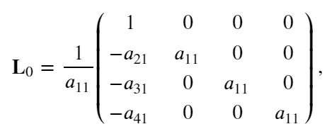
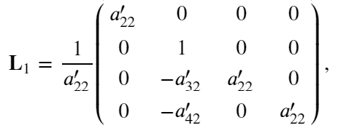
LU decomposition
At the end of Gaussian elimination we have
i.e. our matrix became upper triangular
Discarding the pivoting for a moment, all steps of the Gaussian elimination can be represented by matrix multiplication, i.e.
where e.g.

Slide 17
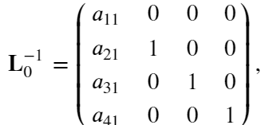
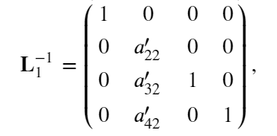
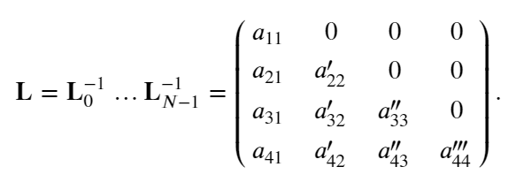

LU decomposition
The matrices L_{i} are lower triangular
Inverses are also lower triangular
Therefore,
where

Slide 18

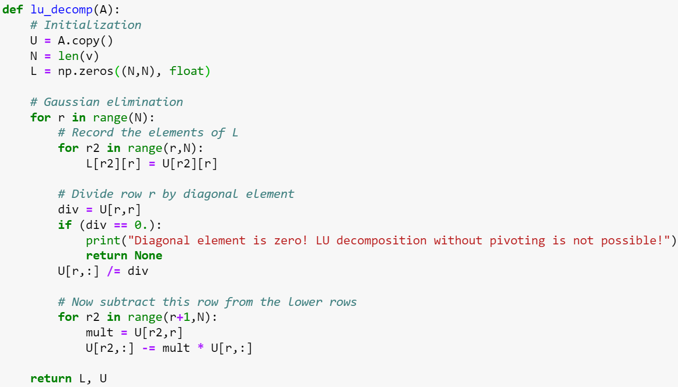
LU decomposition

Slide 19
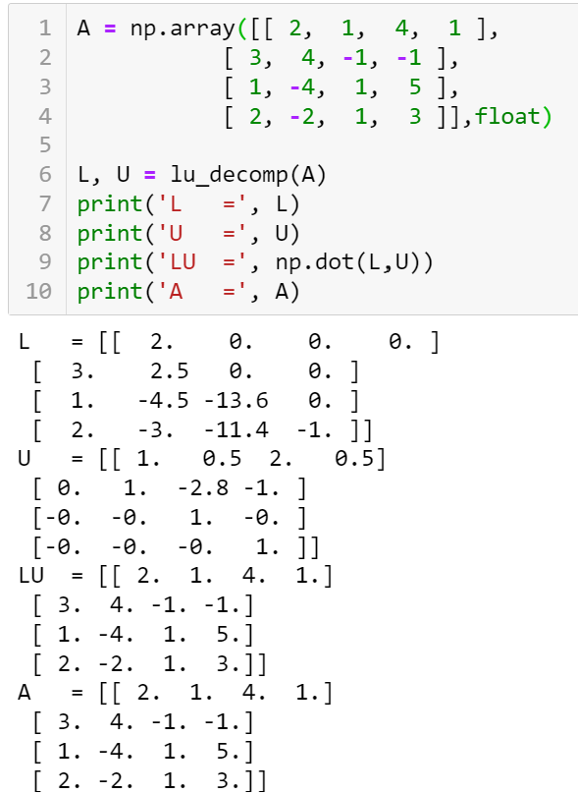
LU decomposition

Slide 20



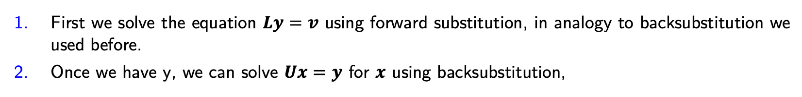
LU decomposition and systems of linear equations
LU decomposition is particularly useful for repeated solution of systems of linear equations
the matrix A stays the same but where the vector v can change.
Indeed the system of equations becomes
Let us define
then
We can solve the system for $x$ in two steps:
First we solve the equation $Ly=v$ using forward substitution, in analogy to backsubstitution we used before.
Once we have y, we can solve $Ux=y$ for $x$ using backsubstitution,

Slide 21
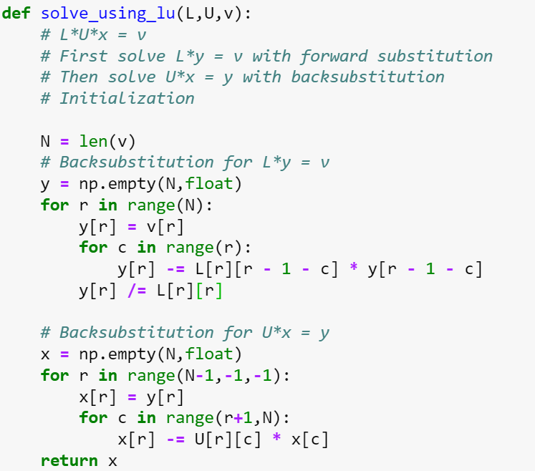
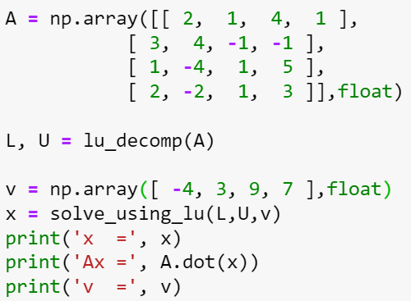
LU decomposition and systems of linear equations

Slide 22


LU decomposition with pivoting
Not every non-singular matrix allows for LU decomposition because its diagonal elements may end up being zero.
In the general case, we need to allow the possibility to perform partial pivoting by exchanging the rows of our matrix.
If we do that, what we get the LU-decomposition with pivoting, which can be written as
Here P is a row permutation operator.
Solving the system of equations
is also straightforward using forward and backsubstitution passes, except that we have to exchange the rows in the vector v to account for the row swaps that we did.

Slide 23
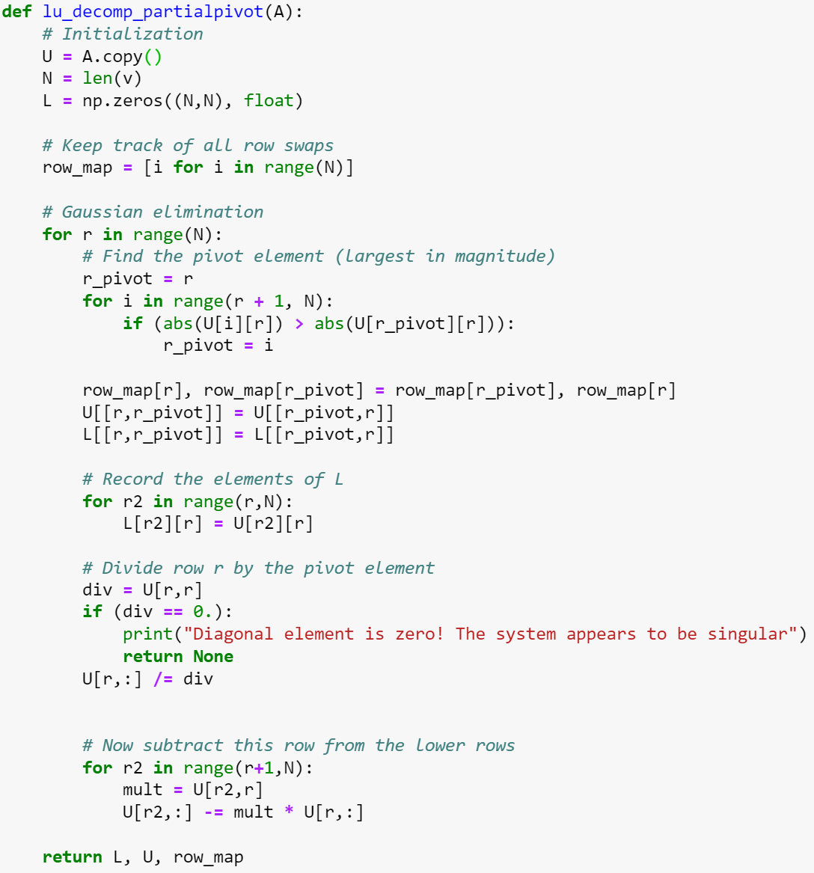
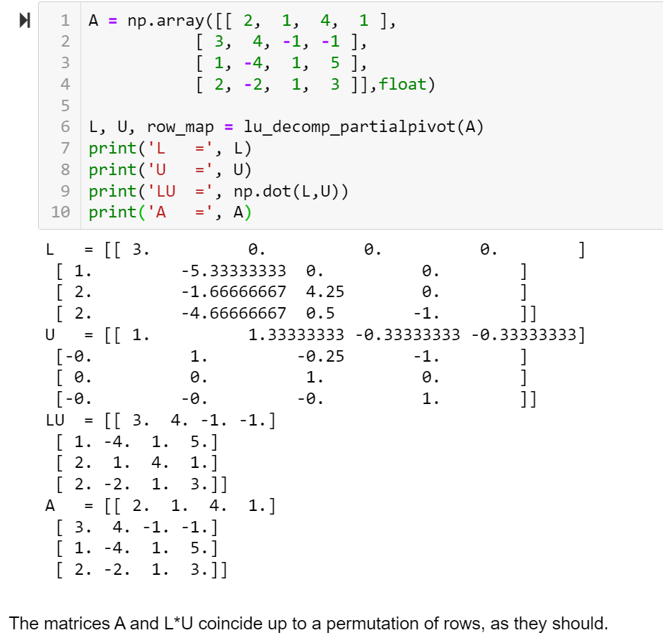
LU decomposition with pivoting

Slide 24
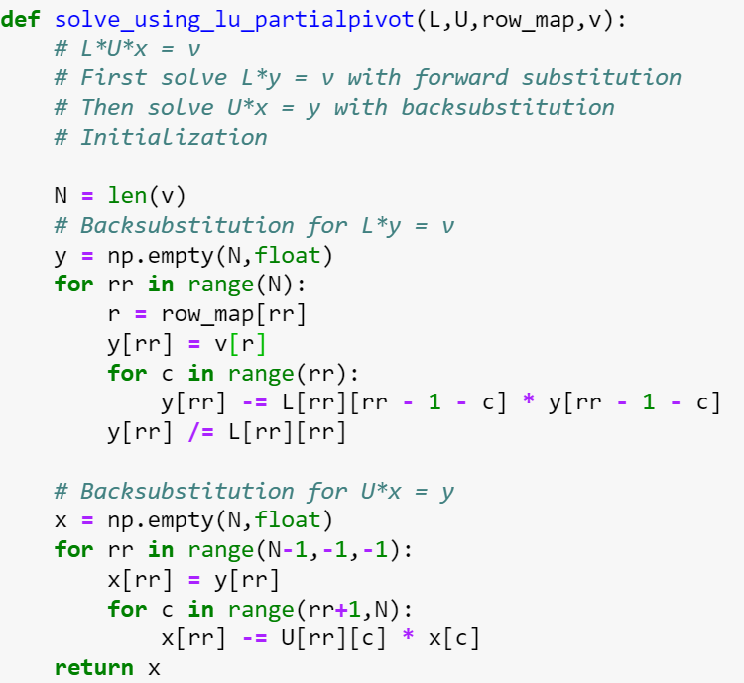
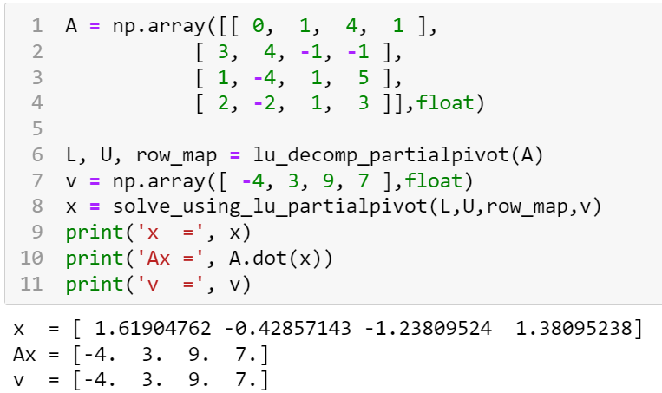
LU decomposition with pivoting

